Slide 1
CZECH ENVIRONMENTAL LAW
IN GLOBAL CONTEXT
9 December 2022
JUDr. Vojtěch Vomáčka, Ph.D., LL.M.

Slide 2
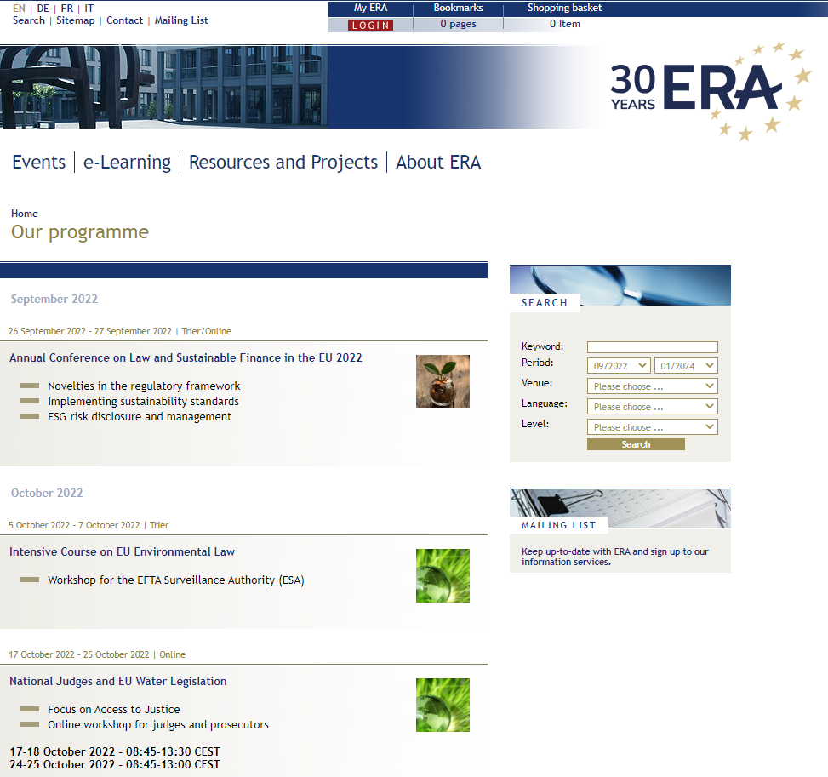
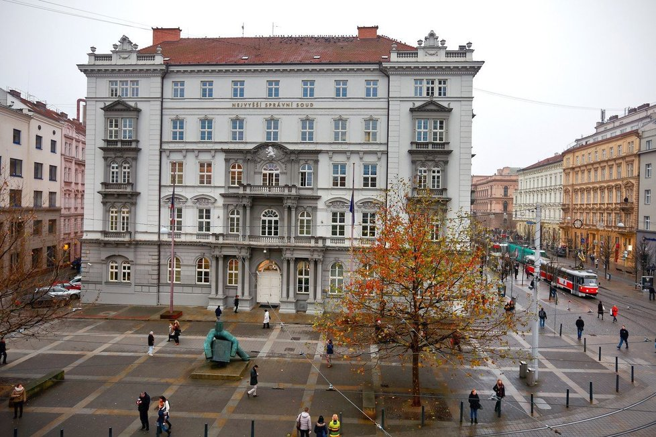
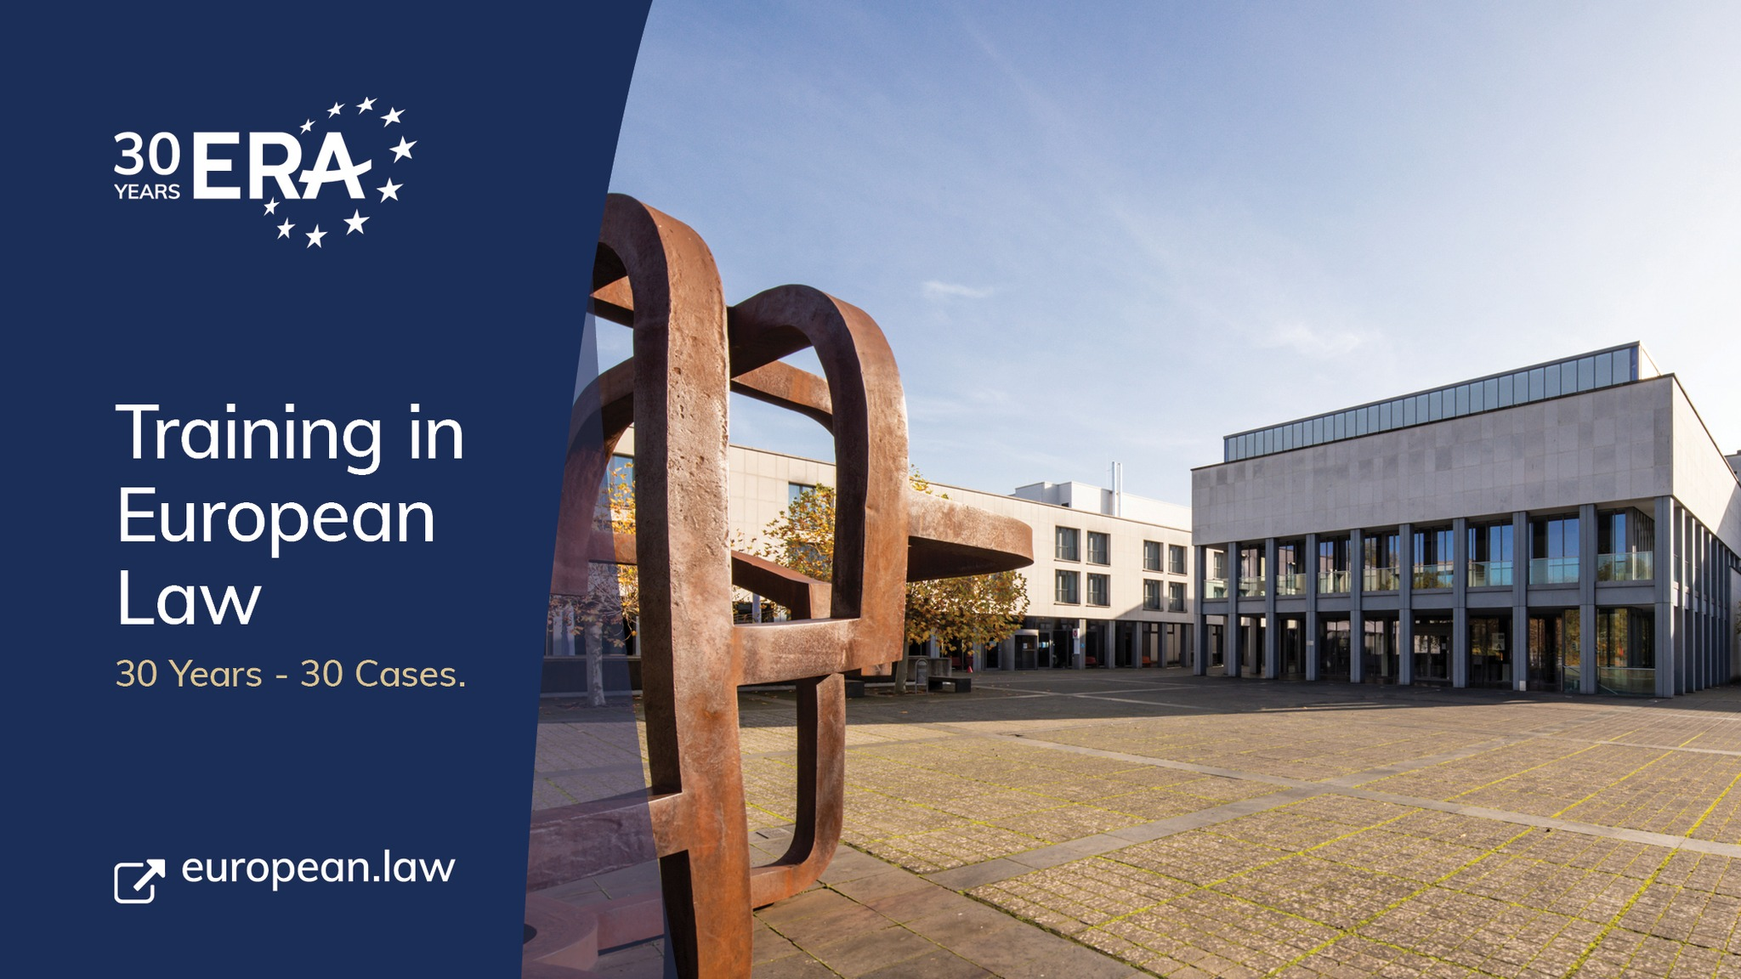

Slide 3
„Old times“?
1970 The US Environmental Protection Agency is established.
1971 The international environmental organisation Greenpeace is founded in Vancouver, Canada.
1972 The United Nations Conference on the Human Environment is held in Stockholm. This leads to the creation of government environment agencies and the UN Environment Programme.
1972 The Club of Rome publishes The Limits to Growth. It stresses, for the first time, the importance of the environment, and the essential links with population and energy.
1973 A small Environment and Consumer Protection Service is set up and attached to the European Commission department for industrial policy and a Standing Committee on the Environment is created in the European Parliament.
1973 The Arab–Israeli war of October leads to an oil price shock and economic problems in Europe, sparking action on energy efficiency. Car-free Sundays are organised throughout Europe.
1974 Scientists suggest for the first time that chlorofluorocarbons (CFCs) may be causing a thinning of the ozone layer.
1975 The Community starts building its body of environmental legislation with the adoption of — among others — the Waste Framework Directive (1975), the Bathing Water Directive (1976) and the Birds Directive (1979).

Slide 4
1976 An explosion occurs on 10 July at a chemical plant near Seveso, north of Milan in Italy. A toxic cloud containing dioxin contaminates a densely populated area. In 1982, the Seveso Directive is issued to prevent major accidents with dangerous substances.
1978 Oil tanker Amoco Cadiz spills 68 million gallons off the coast of France.
1979 A partial meltdown of the Three Mile Island nuclear plant in USA puts the future of nuclear energy in question.
1979 The first World Climate Conference takes place in February in Geneva, Switzerland. A panel on climate change set up by the National Academy of Sciences in USA advises that ‘A wait-and-see policy may mean waiting until it is too late’ to avoid significant climate changes.
1981 The European Commission creates its Environment Directorate-General.
1985 First observation of an ozone hole over Antarctica.
1986 On 25 April, an uncontrolled chain reaction in a reactor in the Chernobyl nuclear power plant, 80 miles north of Kiev, blows off the reactor's lid. More than 31 workers die instantly and around 135 000 people are evacuated from the surrounding area. A plume of radioactive fall-out drifts over western Soviet Union, eastern and western Europe, and eastern North America.
1987 The Brundtland Commission’s report, Our Common Future, defines sustainable development as ‘development that meets the needs of the present without compromising the ability of future generations to meet their own needs.’

Slide 5
European Union environmental legislation has developed over the last 50 years.
Environmental policy was not regulated at the Community level in the beginning, the Treaty of Rome does not contain regulations regarding this. Economic integration was the focus.
Awareness about environmental pollution began to develop because of:
- Intensive economic growth
- The fast growth of industrialization
- Increasing energy consumption
- on the international level + national level

Slide 6
Phase 1: 1958 - 1972
1958 EEC Treaty
No specific attention to development of environmental policy
Minor measures (common market based – dangerous chemicals, motor vehicles, detergents)
Phase 2: 1972 - 1987
European Council Summit in 1972: Heads of States and Governments decided that a Community environmental policy was necessary
The basis of the environmental policy was established in the First Environmental Action Programme (1973). Basic goals, principles of environmental law, and activities regarding certain fields of the environment.
The main goal was the efficient operation of the Community and the Common Market – but extensive interpretation of economic expansion.

Slide 7
Phase 3: 1987 - 2008
1987 Single European Act
Independent title of environment was accepted
1993 Treaty on the European Union (Maastricht)
Protection of the environment became part of the internal common policy. The scope of environmental policy was enlarged and supplemented it with new objectives.
1997 Treaty of Amsterdam
„Environmental protection requirements must be integrated into the definition and implementation of the Community policies and activities referred to in Article 3, in particular with a view to promoting sustainable development.”

Slide 8
Phase 4: Lisbon and further
2009: Treaty of Lisbon
the 3 pillars structure disappears
TUE + TFUE (former TEC) + Nice into a single Treaty
Strengthened role of the EU Parliament
Broader Union’s competences
Birth of the European External Action Service (EEAS)
EU Charter
DG Environment
DG Energy
DG Climate Action

Slide 9
Article 191
1. Union policy on the environment shall contribute to pursuit of the following objectives:
- preserving, protecting and improving the quality of the environment,
- protecting human health,
- prudent and rational utilisation of natural resources,
- promoting measures at international level to deal with regional or worldwide environmental problems, and in particular combating climate change.
2. Union policy on the environment shall aim at a high level of protection taking into account the diversity of situations in the various regions of the Union. It shall be based on the precautionary principle and on the principles that preventive action should be taken, that environmental damage should as a priority be rectified at source and that the polluter should pay.

Slide 10
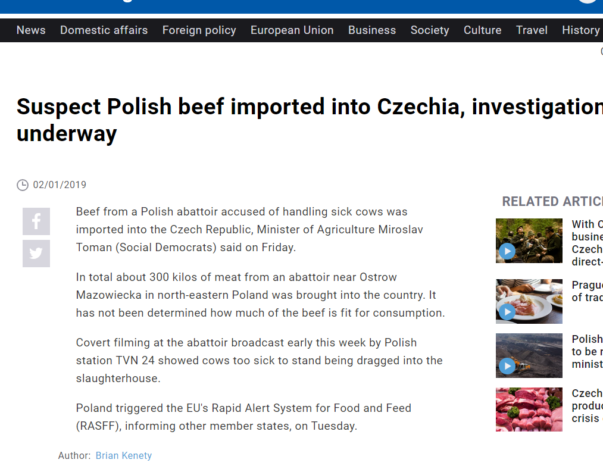
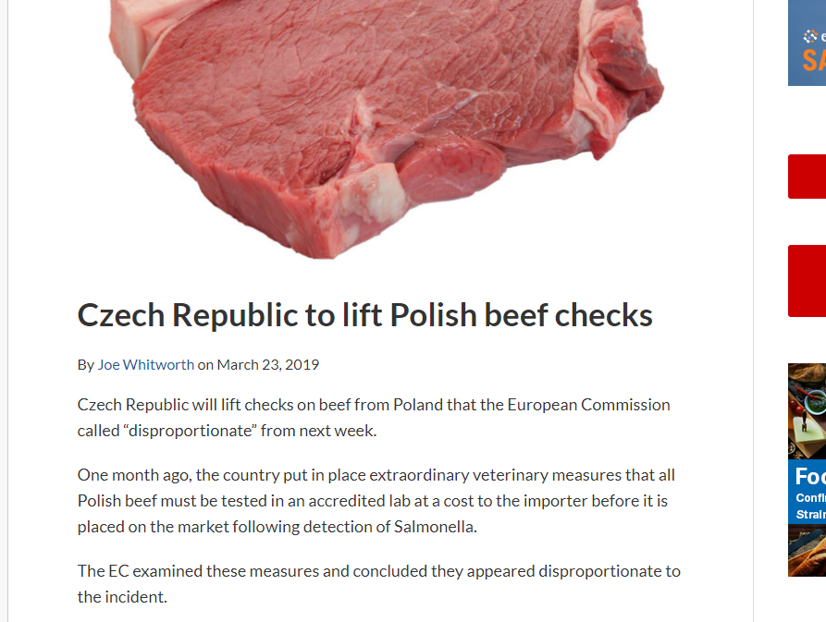

Slide 11
Precautionary principle in EU law
Where action is deemed necessary, measures based on the precautionary principle should be, inter alia:
proportional to the chosen level of protection,
non-discriminatory in their application,
consistent with similar measures already taken,
based on an examination of the potential benefits and costs of action or lack of action (including, where appropriate and feasible, an economic cost/benefit analysis),
subject to review, in the light of new scientific data, and
capable of assigning responsibility for producing the scientific evidence necessary for a more comprehensive risk assessment.

Slide 12
Secondary law:
Around 1000 pieces of legislation
Highest number of infringments, petitions, citizen initiatives
80 % of national law
Addressee – both EU and member states
Not a comperhensive system – specific EU law
Regulation x Directive
EU administration

Slide 13
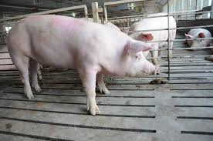
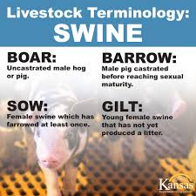
CORRECT APPLICATION = CORRECT INTERPRETATION
A sow is a female that has reproduced. A gilt is a female that has not reproduced.

Slide 14
TERMINOLOGY
A sow is a female that has reproduced. A gilt is a female that has not reproduced.
STARTING POINT: It is therefore necessary also to examine the general scheme and purposes of Directive 96/61 (C-585/10 Møller, para. 28)
The Kommune submits, before the Vestre Landsret, that it was justified in including the places for gilts in the number of places for sows. It maintains that the objective of Directive 96/61 is to protect the environment and that there is no reason to take the view that a gilt pollutes less than, or in a different manner to, a sow. It concludes that places for gilts are covered by the expression ‘places for sows’. According to the Kommune, the legislation on animal welfare is not relevant in that regard.
CONSEQUENCE:
31 As the purpose of Directive 96/61 has therefore been broadly defined, subheading 6.6(c) of Annex I to that directive cannot, as Mr Møller and Ireland suggest, be interpreted restrictively in such a way as to exclude places intended for gilts (see, by analogy, Association nationale pour la protection des eaux et rivières and OABA, paragraph 27).

Slide 15
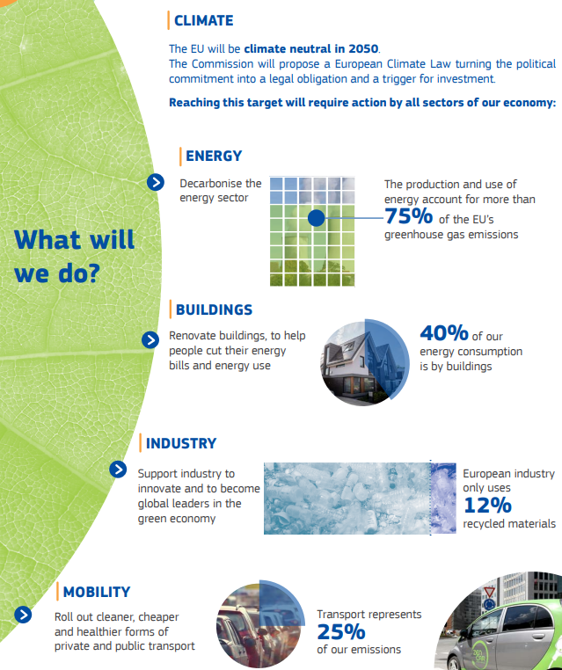
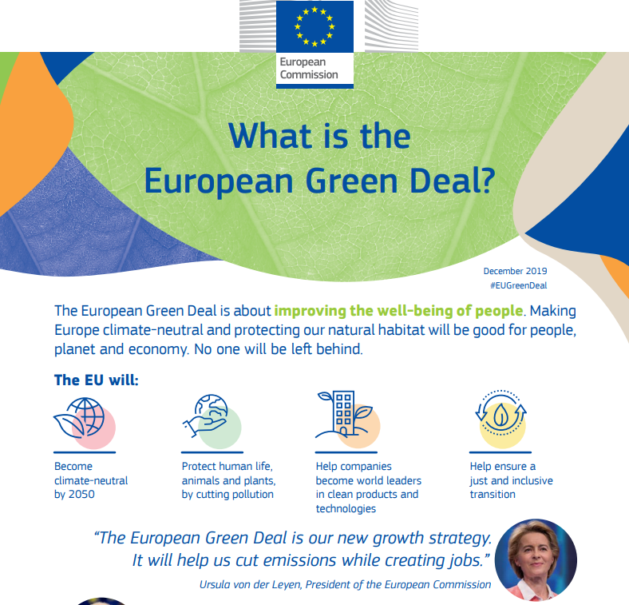
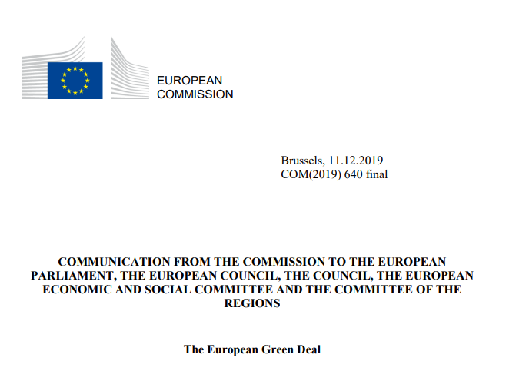

Slide 16
System and structure:
Sectoral legislation
Air pollution, Water pollution and quality, Waste, Chemicals, Nature and Biodiversity, Land and soil protection, Marine and Coast, Noise
Horizontal legislation - general environmental management issues rather than legislation regarding specific sectors, products or types of emissions.
Environmental impact assessment,
Public access to environmental information, participation in proceedings, access to justice,
Environmental liability,
Integrated pollution prevention and control,
Reports on the implementation.

Slide 17
Sanctions for violation of EU Law
Article 260 TFEU
1. If the Court of Justice of the European Union finds that a Member State has failed to fulfil an obligation under the Treaties, the State shall be required to take the necessary measures to comply with the judgment of the Court.
2. If the Commission considers that the Member State concerned has not taken the necessary measures to comply with the judgment of the Court, it may bring the case before the Court after giving that State the opportunity to submit its observations. It shall specify the amount of the lump sum or penalty payment to be paid by the Member State concerned which it considers appropriate in the circumstances. If the Court finds that the Member State concerned has not complied with its judgment it may impose a lump sum or penalty payment on it.
This procedure shall be without prejudice to Article 259.
3. When the Commission brings a case before the Court pursuant to Article 258 on the grounds that the Member State concerned has failed to fulfil its obligation to notify measures transposing a directive adopted under a legislative procedure, it may, when it deems appropriate, specify the amount of the lump sum or penalty payment to be paid by the Member State concerned which it considers appropriate in the circumstances. If the Court finds that there is an infringement it may impose a lump sum or penalty payment on the Member State concerned not exceeding the amount specified by the Commission. The payment obligation shall take effect on the date set by the Court in its judgment.

Slide 18
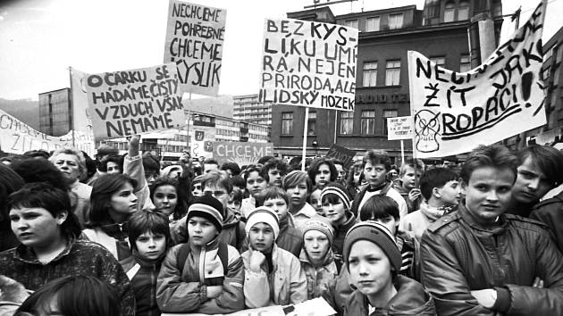
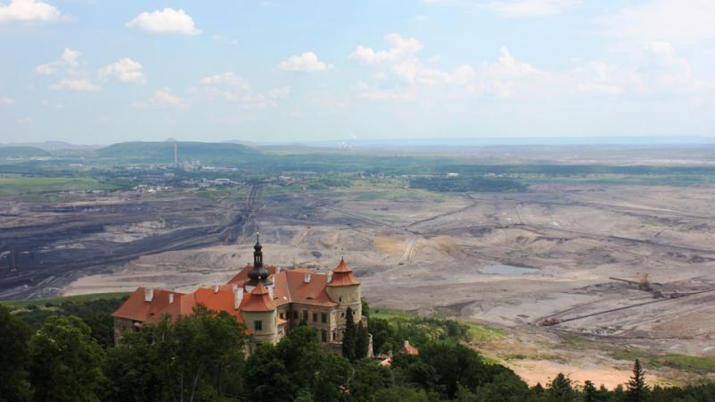
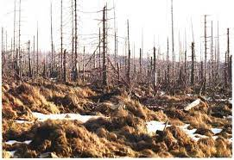
Czech Environmental Law (history):
„Old times“: Nature protection, waste management, protection of water sources
Before the WWII: Czechoslovakia among industrial superpowers
Czechoslovakia 1948–1989: Formal legal protection, environment became victim of the socialist regime

Slide 19
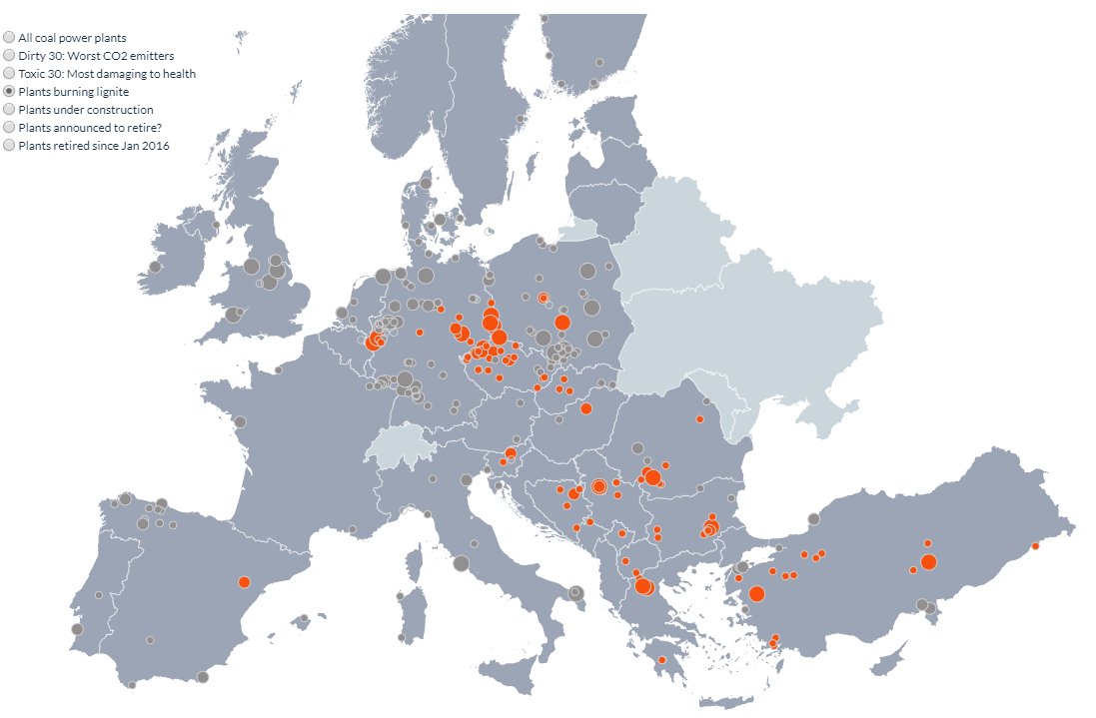
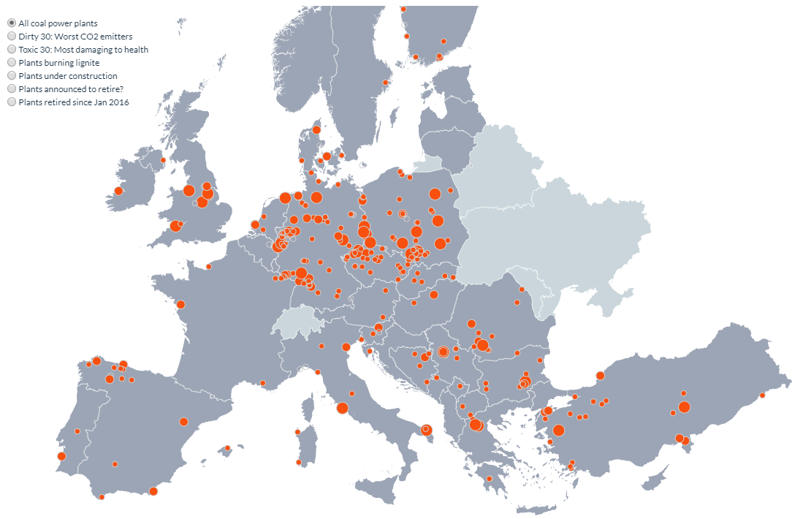
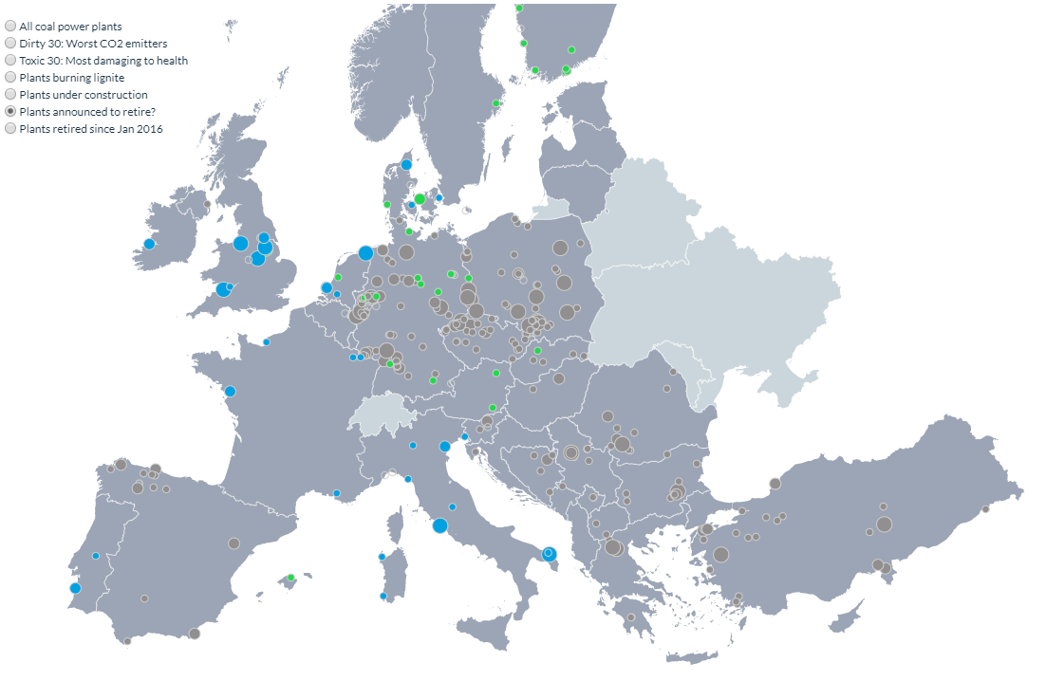
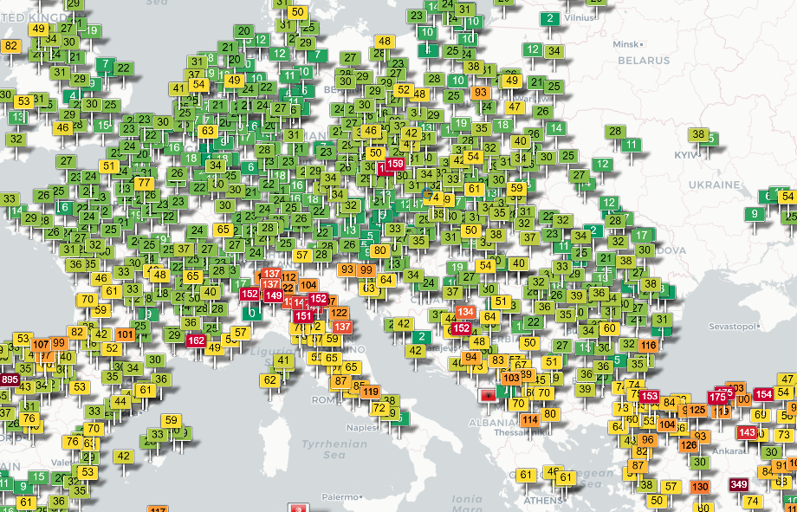

Slide 20
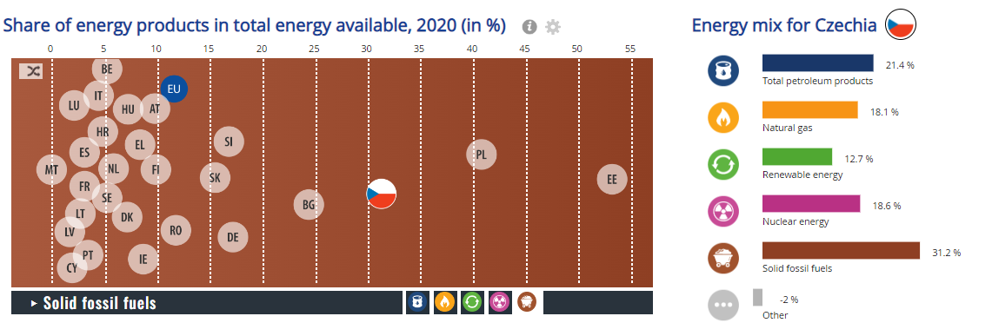

Slide 21
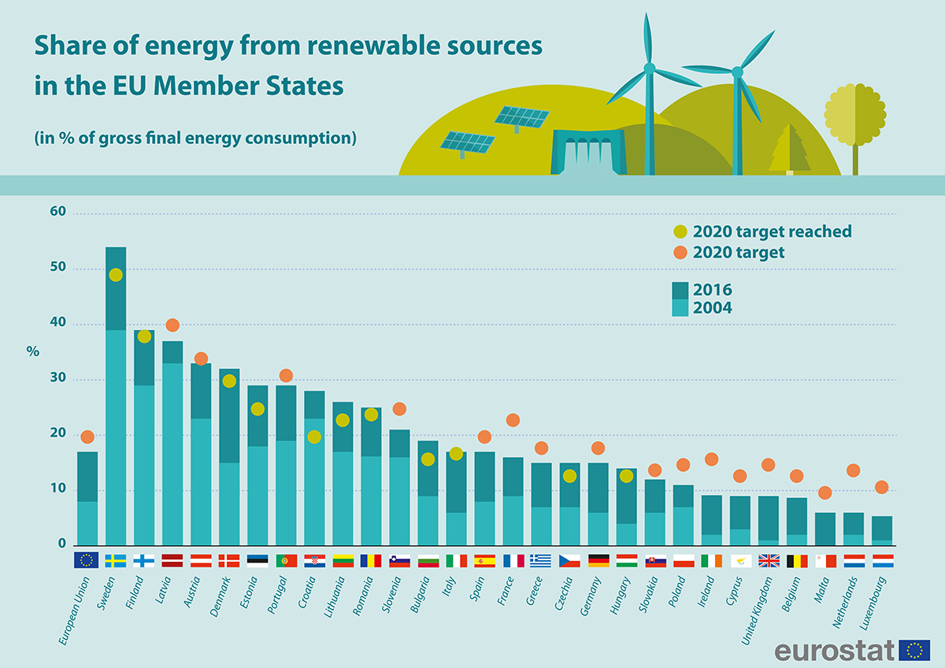

Slide 22
Czech Environmental Law (history):
After 1989: Most important legislative pieces on environmental protection (Nature and Landscape Protection Act, Forest Act, Land Use Act, EIA Act, waste management, water protection etc.
Czechoslovakia (Czechia) ratified major international treaties
Activisation of environmental NGOS
1992: Czechoslovakia split
2004: Czechia joined the EU
Practical consequences?
Case-law, guidance, experience

Slide 23
Czech Environmental Law
international treaties (multilateral/bilateral)
EU law
National Law
Constitution + Charter of Human Rights and Freedoms (Right to favourable environment)
Act on the Environment (Act 17/1992 Coll.).
Act on Nature and Landscape Protection (Act 114/1992 Coll.).
Agricultural Land Resources Protection Act (Act 334/1992 Coll.).
Forestry Act (Act 289/1995 Coll.).
Act on the Rights to Environmental Information (Act 123/1998 Coll.).
Energy Efficiency Act (Act 406/2000 Coll.).
Energy Act (Act 458/2000 Coll.).
Environmental Impact Assessment Act (Act 100/2001 Coll.).
Water Act (Act 254/2001 Coll.).
Integrated Prevention Act (Act 76/2002 Coll.).
Air Protection Act (Act 201/2012 Coll.).
Act on Emission Allowances (Act 383/2012 Coll.).
Act on Substances that Deplete the Ozone Layer and on Fluorinated Greenhouse Gases (Act 73/2012 Coll.).
Renewable Resources Act (Act 165/2012 Coll.).
Building Code (Act 183/2006 Coll.).
Mining Act (Act 44/1988 Coll.).
Act on Mining Activities, Explosives and the State Mining Administration (Act 61/1988 Coll.).
Geological activities Act (Act 62/1988 Coll.).
Act on Labour Safety (Act 309/2006 Coll.).
Act on Prevention and Remedying of Environmental Damage (Act 167/2008 Coll.).
Criminal Code (Act 40/2009 Coll.).

Slide 24
Environmental law? Specifics and overlapping systems
Policy
Framework legislation,
specific legislation, binding plans and programmes…
Administrative and judicial decisions, direct action…

Slide 25
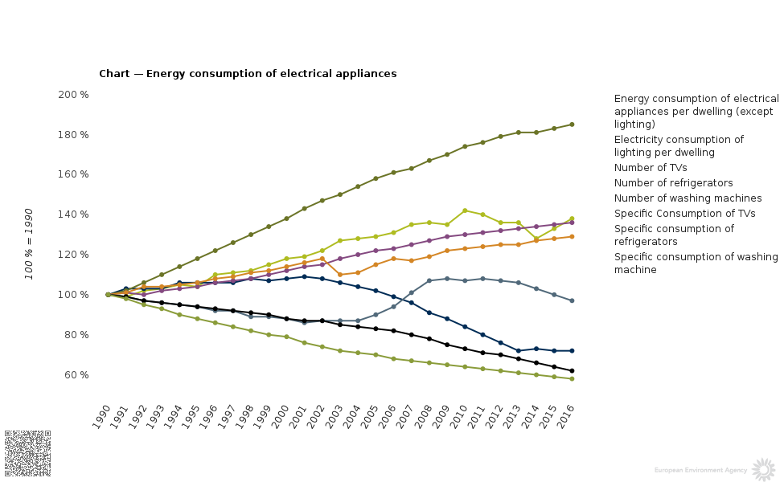

Slide 26
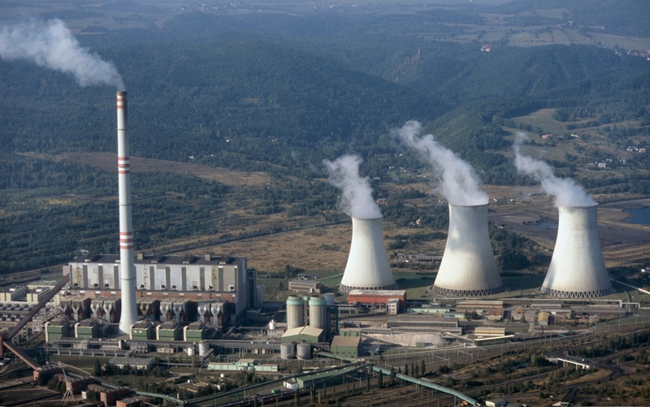
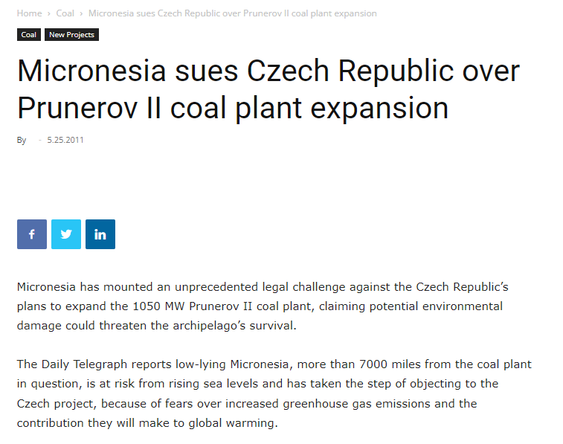
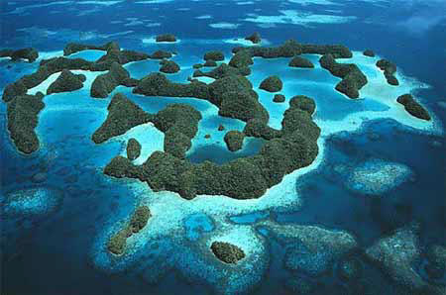
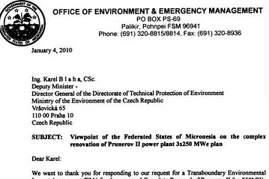

Slide 27
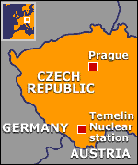
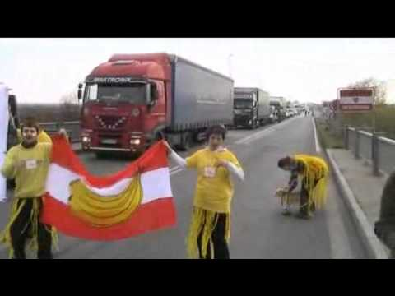
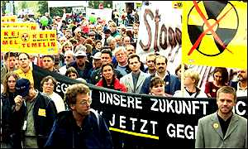
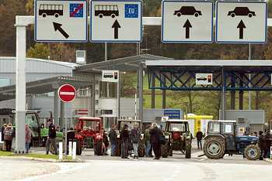
Customary international law?

Slide 28
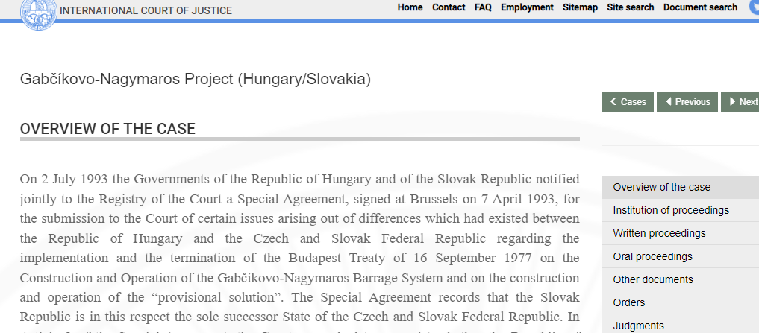
Customary international law?

Slide 29
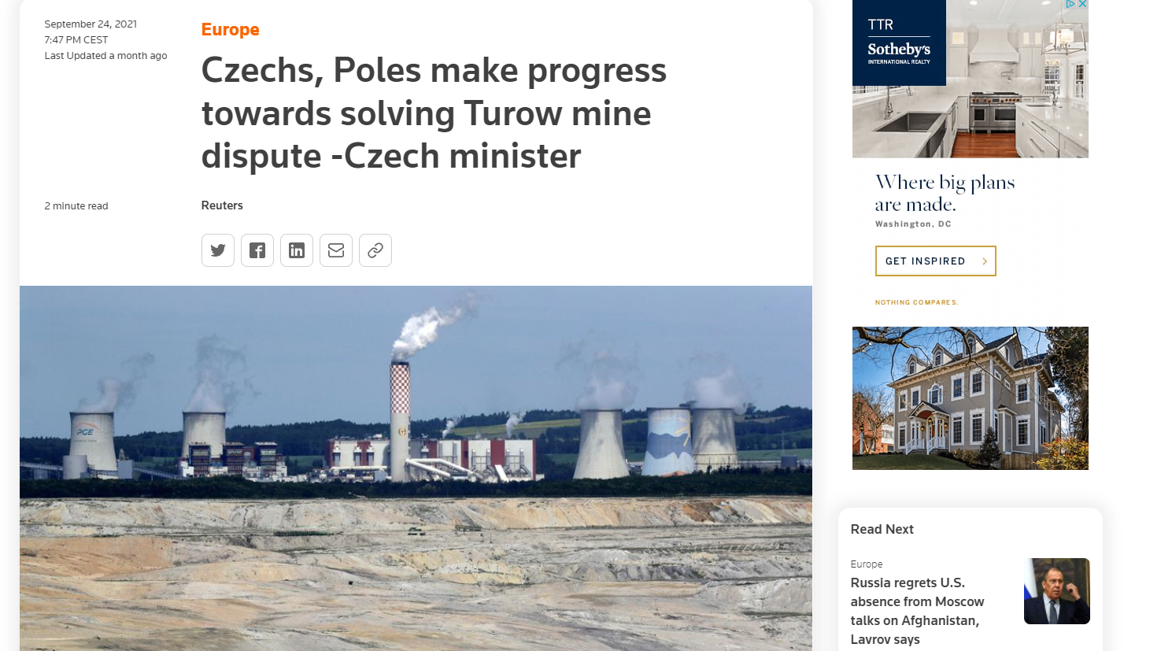
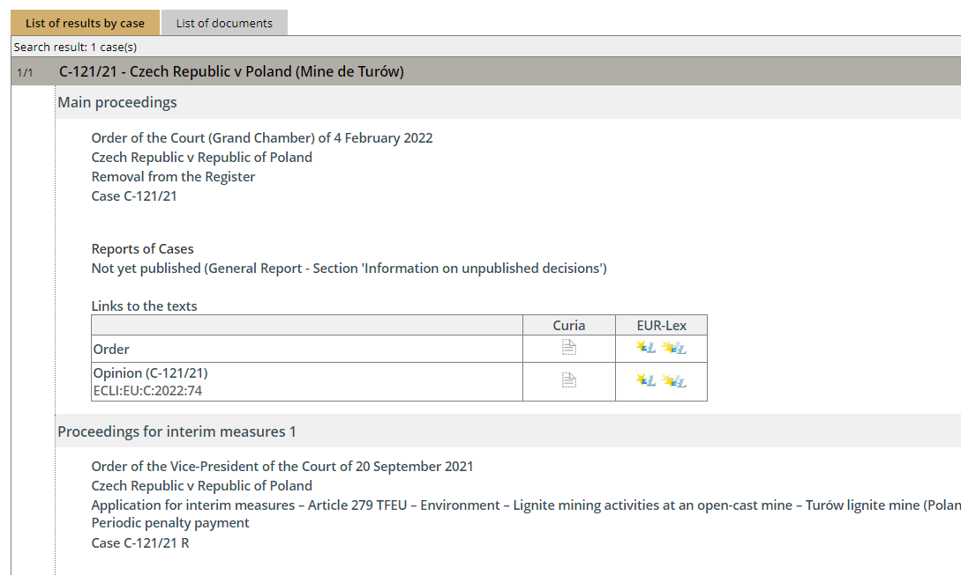

Slide 30
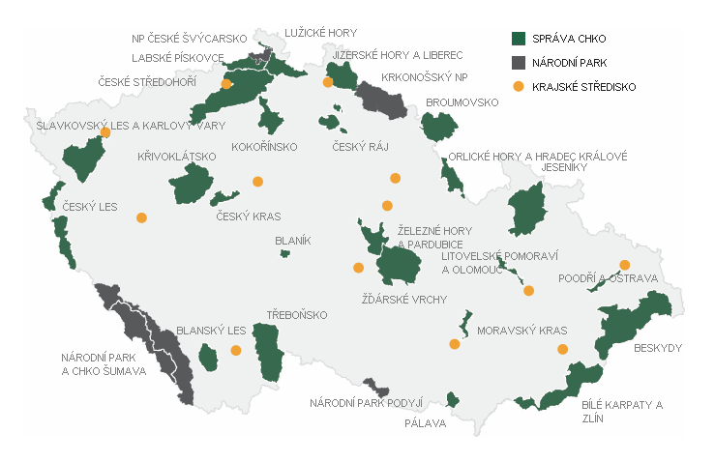

Slide 31
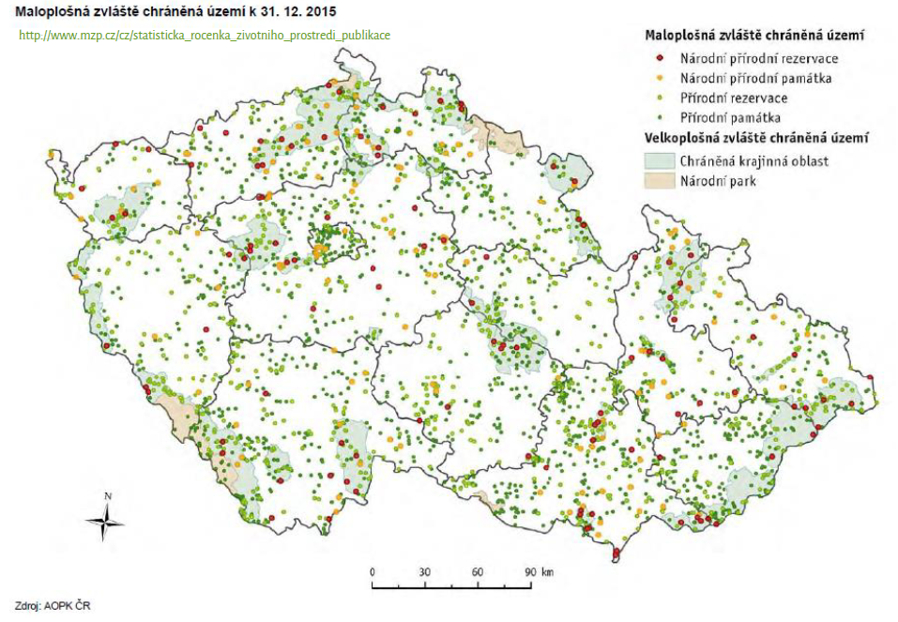
Zvláště chráněná území

Slide 32
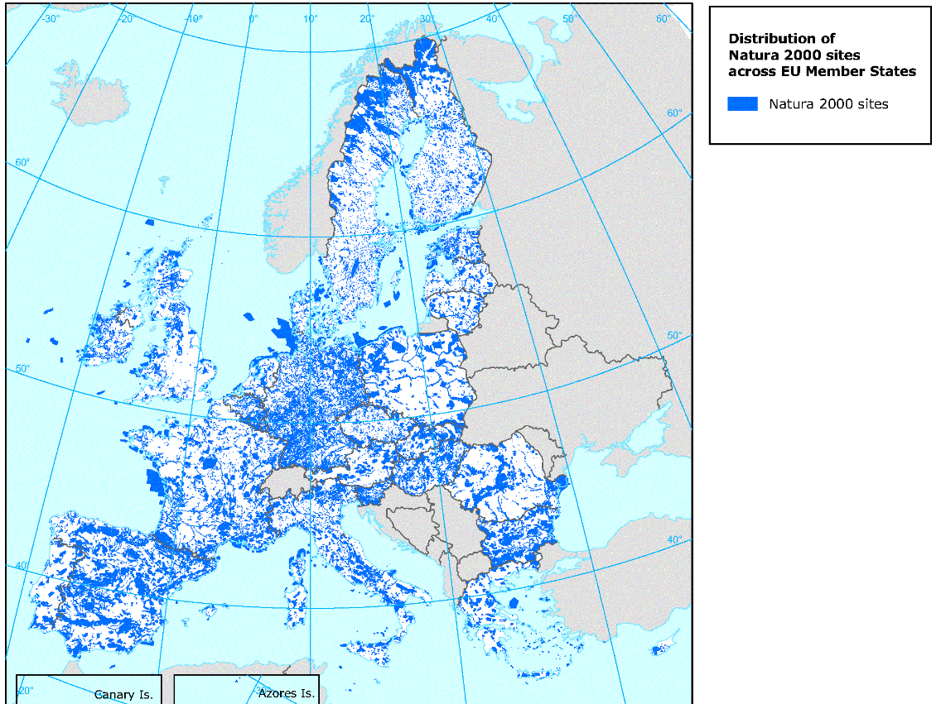

Slide 33
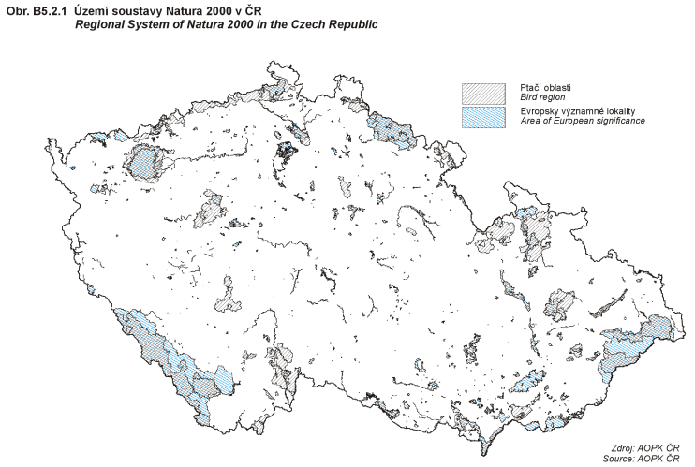

Slide 35
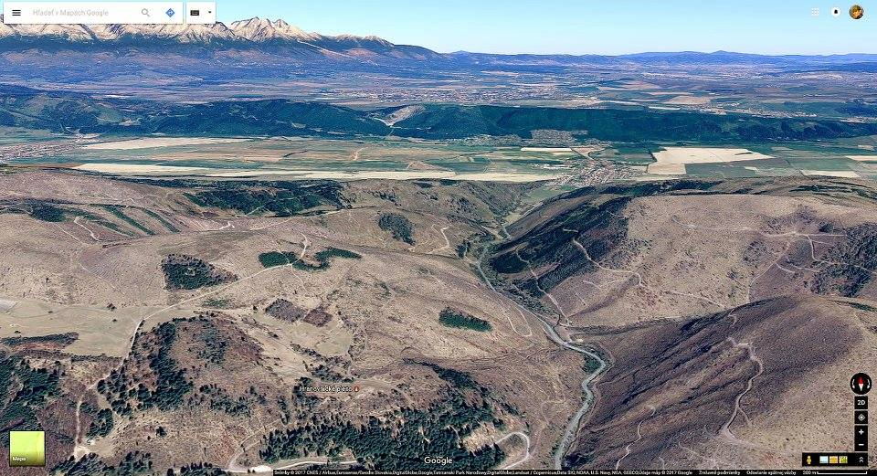
EKOPOLITIKA

Slide 36
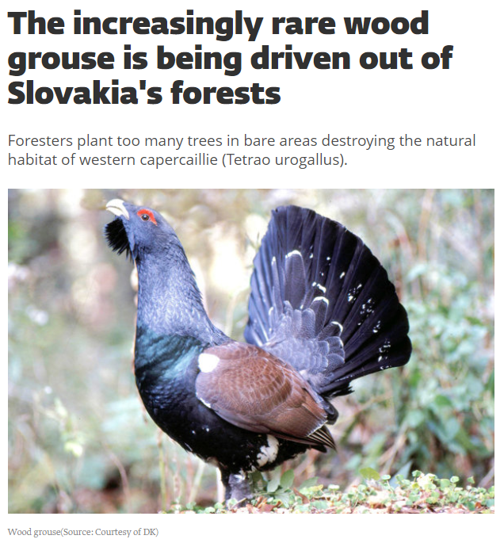
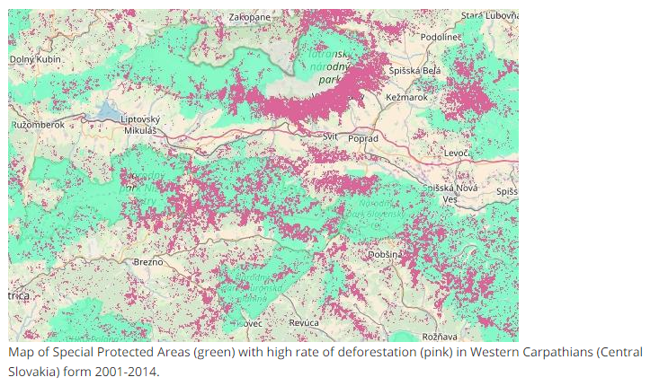
EKOPOLITIKA

Slide 37
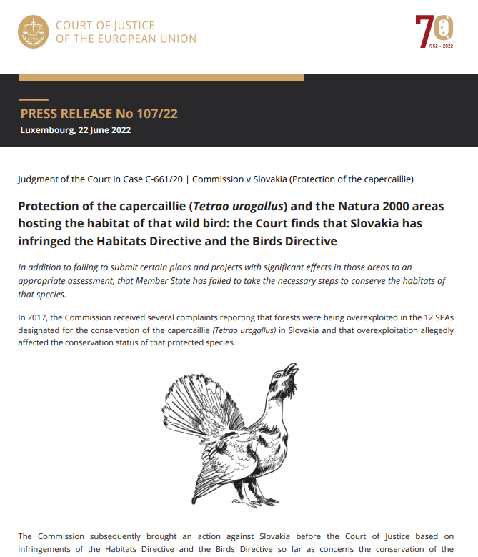
Article 6
1. For special areas of conservation, Member States shall establish the necessary conservation measures involving, if need be, appropriate management plans specifically designed for the sites or integrated into other development plans, and appropriate statutory, administrative or contractual measures which correspond to the ecological requirements of the natural habitat types in Annex I and the species in Annex II present on the sites.
2. Member States shall take appropriate steps to avoid, in the special areas of conservation, the deterioration of natural habitats and the habitats of species as well as disturbance of the species for which the areas have been designated, in so far as such disturbance could be significant in relation to the objectives of this Directive.
3. Any plan or project not directly connected with or necessary to the management of the site but likely to have a significant effect thereon, either individually or in combination with other plans or projects, shall be subject to appropriate assessment of its implications for the site in view of the site's conservation objectives. In the light of the conclusions of the assessment of the implications for the site and subject to the provisions of paragraph 4, the competent national authorities shall agree to the plan or project only after having ascertained that it will not adversely affect the integrity of the site concerned and, if appropriate, after having obtained the opinion of the general public.
4. If, in spite of a negative assessment of the implications for the site and in the absence of alternative solutions, a plan or project must nevertheless be carried out for imperative reasons of overriding public interest, including those of a social or economic nature, the Member State shall take all compensatory measures necessary to ensure that the overall coherence of Natura 2000 is protected. It shall inform the Commission of the compensatory measures adopted.
Where the site concerned hosts a priority natural habitat type and/or a priority species, the only considerations which may be raised are those relating to human health or public safety, to beneficial consequences of primary importance for the environment or, further to an opinion from the Commission, to other imperative reasons of overriding public interest.

Slide 38
Pojetí práva

Slide 39
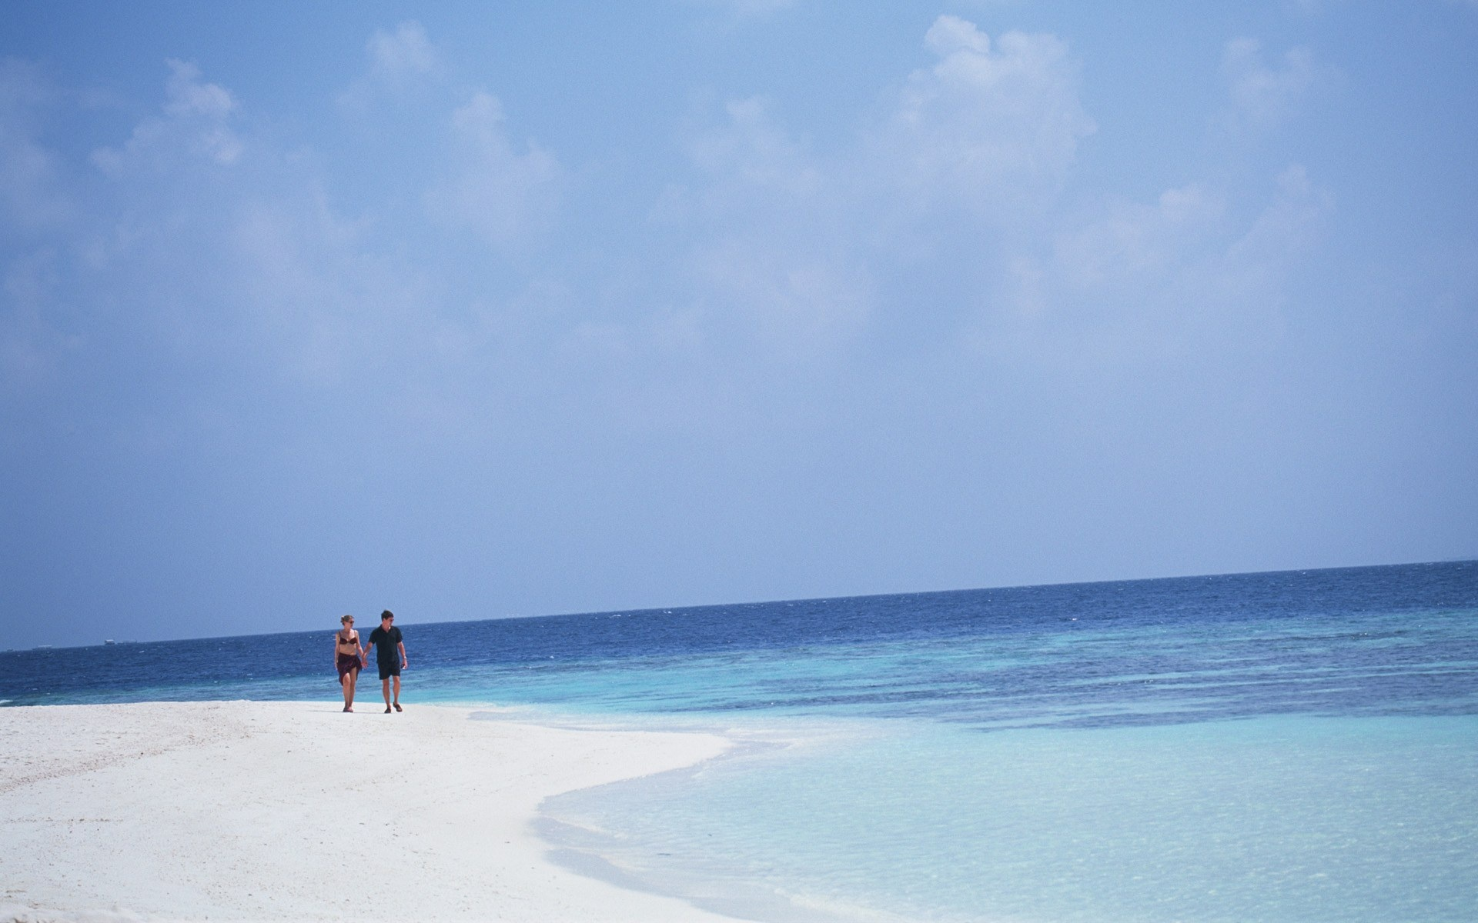
Pojetí práva

Slide 40
The Convention on Access to Information, Public Participation in Decision-making and Access to Justice in Environmental Matters (The Aarhus Convention)
Access to information Public participation in decision-making Access to justice
public concerned
Annex I and other activities with significant effects
(EIA, IED, Natura 2000, SEVESO III)
plans and programmes
general legal regulation
public (concerned)
denied information
decisions from
pillar II (EIA, IED, NATURA 2000, SEVESO III)
violation of (other) provisions of the national law relating to the environment
public
passive obligation
active obligation

Slide 41
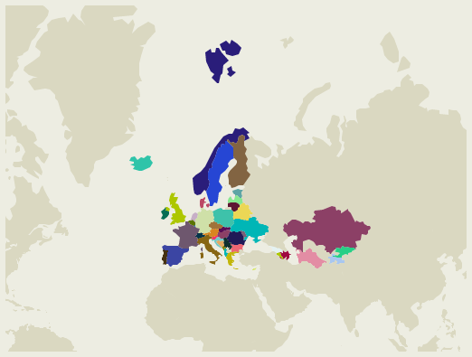
Access to justice in Environmental Matters: Sources (Layers)
National Law
Specific Acts (EIA, IED)
Constitutional Law + judicial process
Specific Directives (EIA, IED)
Art. 47 EU Charter
Everyone whose rights and freedoms guaranteed by the law of the Union are violated has the right to an effective remedy... (fair and public hearing within a reasonable time + legal aid)
EU Law
The Aarhus Convention
Pillar III: Access to justice
European Charter of Human Rights
Art. 6 (procedural – access to justice)
Art. 2 (protection of life)
Art. 8 (protection of private and family life)
Art. 1 of Protocol No. 1 (protection of property)
International Law
41

Slide 42
EU Law – EIA Directive (2011/92/EU, Art. 11)
Member States shall ensure that, in accordance with the relevant national legal system, members of the public concerned:
(a) having a sufficient interest, or alternatively;
(b) maintaining the impairment of a right, where administrative procedural law of a Member State requires this as a precondition;
have access to a review procedure before a court of law or another independent and impartial body established by law to challenge the substantive or procedural legality of decisions, acts or omissions subject to the public participation provisions of this Directive.
2. Member States shall determine at what stage the decisions, acts or omissions may be challenged.
3. What constitutes a sufficient interest and impairment of a right shall be determined by the Member States, consistently with the objective of giving the public concerned wide access to justice. To that end, the interest of any non-governmental organisation meeting the requirements referred to in Article 1(2) shall be deemed sufficient for the purpose of point (a) of paragraph 1 of this Article. Such organisations shall also be deemed to have rights capable of being impaired for the purpose of point (b) of paragraph 1 of this Article.
4. The provisions of this Article shall not exclude the possibility of a preliminary review procedure before an administrative authority and shall not affect the requirement of exhaustion of administrative review procedures prior to recourse to judicial review procedures, where such a requirement exists under national law.
Any such procedure shall be fair, equitable, timely and not prohibitively expensive.
5. In order to further the effectiveness of the provisions of this Article, Member States shall ensure that practical information is made available to the public on access to administrative and judicial review procedures.
42

Slide 43
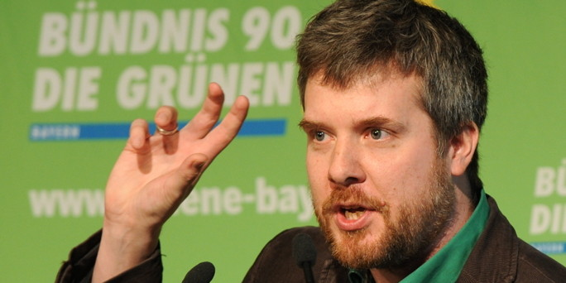
EU environmental law can be directly applicable
Directive not transposed/incorrect application
It is sufficiently precise
It grants rights to individuals
Modified rules for direct effect of the EU directives (protection of health – air quality, water management, environmental liability)
Dieter Janecek (C‑237/07)

Slide 44
Direct effect: From EIA to AIR to WATER…
Janecek (C-237/07), ClientEarth (C-404/13, ambient air quality assessment and management): The affected individuals must be able to require adoption of air-pollution action plans
Folk (C-529/15, Environmental Liability Directive): Persons with a fishing licence must be able to initiate review proceedings before a court or other competent public authority in accordance with Articles 12 and 13 of the Directive
Protect Natur-, Arten- und Landschaftschutz Umweltorganisation (C-664/15, Water Framework Directive): The NGO must be able to challenge a permit for a project of abstracting water from the river to produce snow for a ski resort under the EU law
Land Nordrhein-Westfalen (C-535/18, EIA, Water Framework Directive): Members of the public concerned by a project must be able to assert, before the competent national courts, that there has been a breach of the requirements to prevent the deterioration of bodies of water; EU law permits Member States to provide that, when a procedural defect vitiating the decision approving a project does not alter the meaning of that decision, an application for annulment of that decision is admissible only if the irregularity at issue has denied the claimant his or her right to participate in the environmental decision-making process
Wasserleitungsverband Nördliches Burgenland and Others (C-197/18, Nitrates Directive): Affected natural and legal persons, such as the applicants in the main proceedings (incl. municipality and a water distribution association), should be in a position to require the competent national authorities to amend an existing action programme or adopt additional measures or reinforced actions
if not... direct effect
44

Slide 45
Czech Administrative authorities and Judiciary
Public administration
Government
Central government bodies – Ministry of Environment, Ministry of Agriculture,
No single environmental authority
Bodies with competence in the following areas: nature, water, forests, EIA, cultural monuments...
Many special authorities
Czech Environmental Inspectorate
State Land Office
National Park Administration
State Office for Nuclear Safety
Guards (hunting, nature, water protection)
Judiciary
Two-level administrative judiciary
Damages, protection of personality rights – civil courts
45

Slide 46
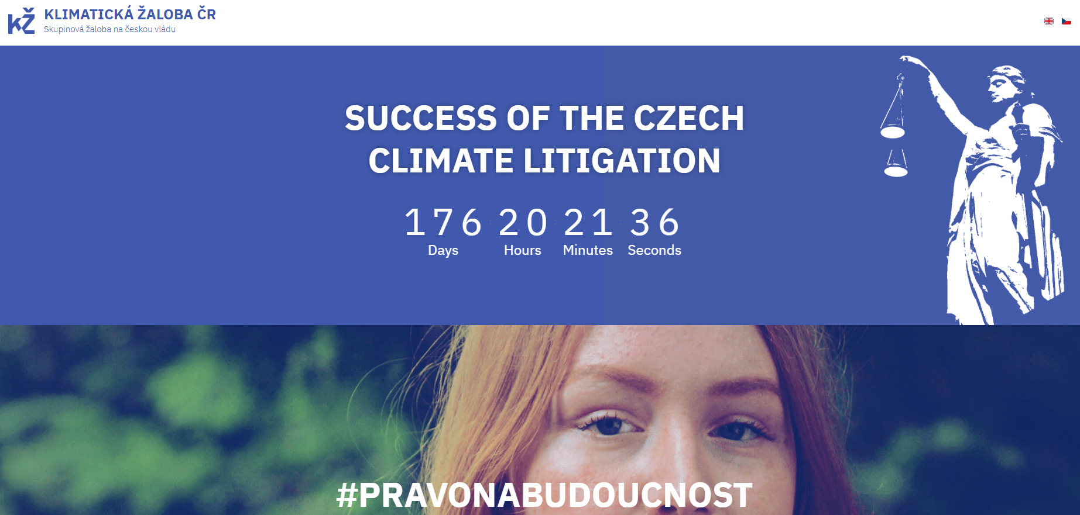
46

Slide 47
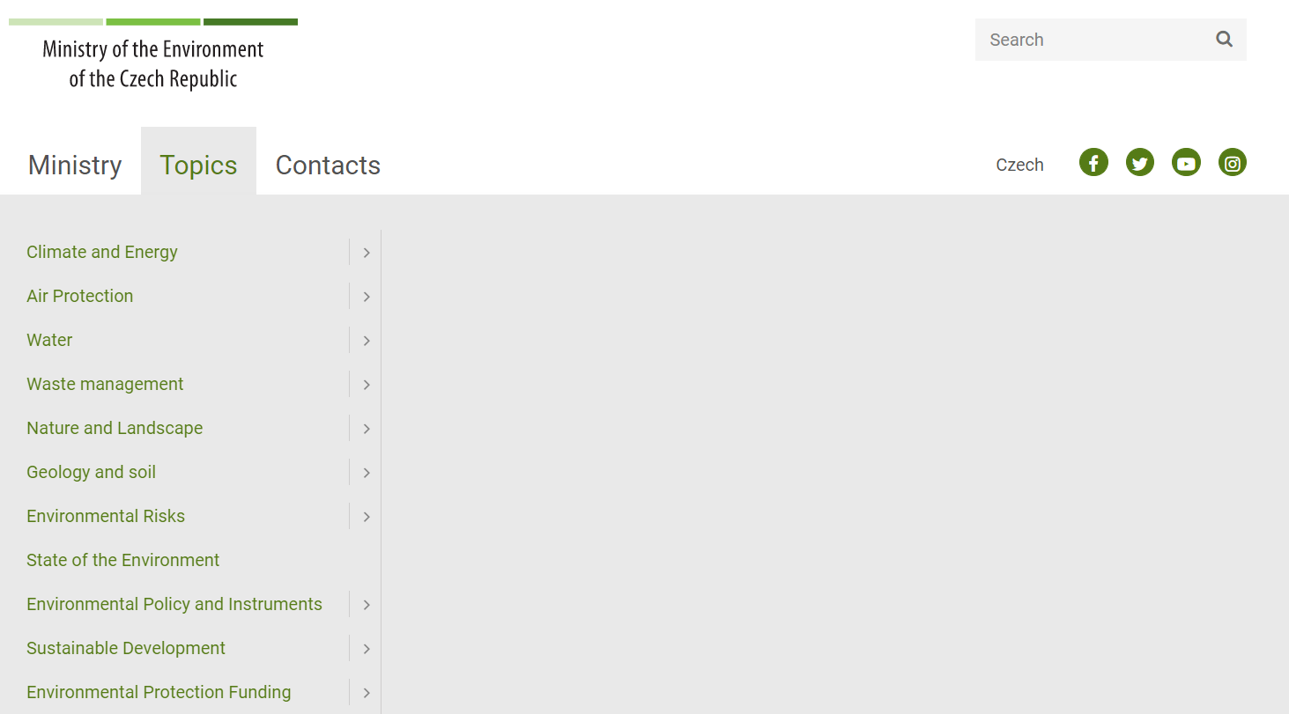
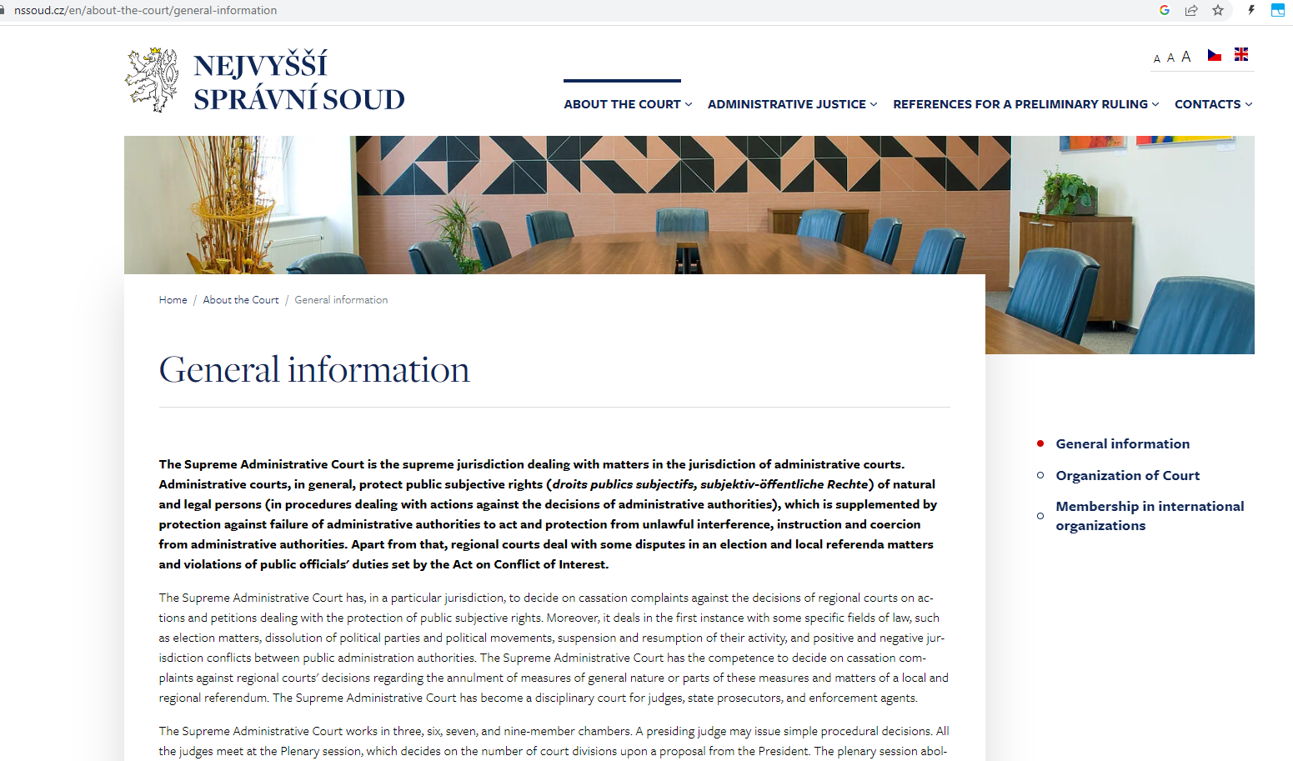
Want to know more?
47

Slide 48
THANK YOU FOR YOUR ATTENTION!
vomacka@mail.muni.cz

