Slide 1
Data, Information. Illusion of Privacy?
Jakub Míšek

Slide 2
Data and Information
Data v. Information
Many theories:
Claude Shanon: Information as a way to lower entropy
Luciano Floridi: Information consists of structured data
Michael Keeble Buckland: Information
BUCKLAND, Michael Keeble. Information as a Thing. Journal of the American Society for Information Science and Technology. 1991, Vol. 42, No. 5
Information as knowledge: Knowledge (Intangible, Entity)
Information as process: Becoming informed (Intangible, Process)
Information as thing: Data, document (Tangible, Entity)
Information processing: Data processing (Tangible, Process)
ADRIAANS, Pieter. Information. In: ZALTA, Edward N. (ed.). The Stanford Encyclopedia of Philosophy [online]. Stanford: Metaphysics Research Lab, Stanford University, 2013. Online: https://plato.stanford.edu/entries/information/

Slide 3
Data and Information
Norbert Wiener: Information as a basic premise of life
Assumption: Everything decays into entropy
Information is a way, how this decay slow or divert
The true information = information which has an organising effect
Basic notions:
Information is an opposite of entropy
Living organisms have more than critical amount of information
Living organisms (or their parts) react on a change of conditions with production of information
Examples: Ants, Justice
The Law as an Information system
The law as a way how to lower entropy in the society

Slide 4
Law and Information
Presumption: The centrality of a human
Information rights - 3 basic rights
Obtain information
To get the information from outside
To have information
Have control over information
Process information
Create, share and communicate information
Regulation of Information
Duties correlating to these rights
Regulation of the environment

Slide 5
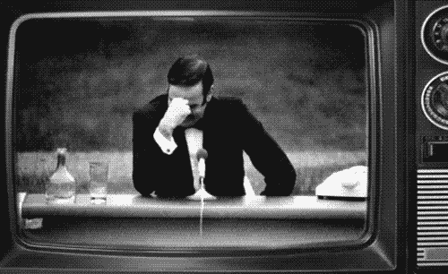

Slide 6
Privacy v. Personal Data
Why this question?
Personal data protection as an independent fundamental right
Different purposes
Protection of privacy v. Protection of rights and interests of natural persons in relation with processing of their personal data (+ purpose of enabling a fair processing)
Different means of protection
Private v. Public law
Restitutive v. Preventive
Court v. DPA
Distributive v. Non-distributive right

Slide 7
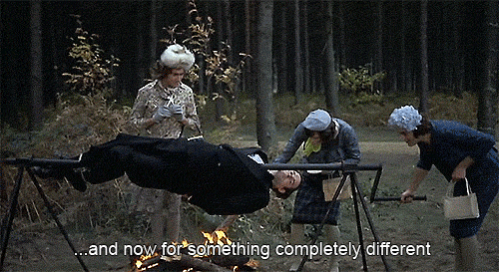

Slide 8
Is there still privacy?
Privacy is dead!
The new world paradigm
Social networks
Surveillance Capitalism
Massive surveillance
If you do not do anything bad, you do not have to be afraid!
Automated face recognition
Social credit systems
Snowden revelations
Cambridge Analytica
Data breaches

Slide 9
But!
Privacy is the essential value for free democratic liberal society.

Slide 10
Thank you for your attention.
Questions?
@jkb_misek

