Slide 1
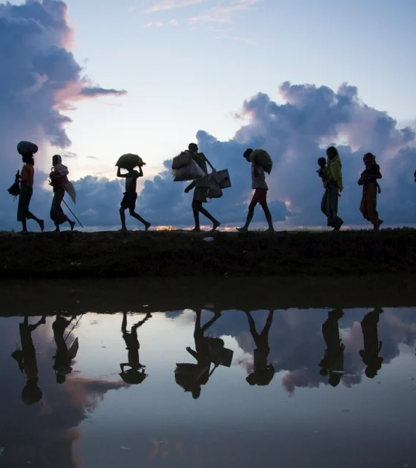
Human rights and migration
Alžbeta Králová

Slide 2
Migrant vs. refugee
migrant
no internationally recognized definition
person who moves away from his or her place of usual residence, whether within a country or across an international border, temporarily or permanently, and for a variety of reasons (IOM definition)
recognition of further categories, for example migrant workers; smuggled migrants, international students.
refugee
applies to any person owing to well founded fear of being persecuted for reasons of race, religion, nationality, membership of a particular social group or political opinion, is outside the country of his nationality and is unable or, owing to such fear, is unwilling to avail himself of the protection of that country.

Slide 3
Protocol 4/Art. 4
Prohibition of collective expulsion of aliens
Art. 3
Prohibition of torture
Art. 13
Right to an effective remedy
Art. 5
Right to liberty and security
Art. 2
Right to Life
Art. 8
Right to respect for private and family life
Protocol 7/Art. 1
Procedural safeguards relating to expulsion of aliens

Slide 4
The Convention and migration
"State is entitled, as a matter of international law and subject to its treaty obligations, to control the entry of aliens into its territory and their residence there."
(Abdulaziz, Cabales and Balkandali v. the United Kingdom, 28. 5. 1985 and many others)

Slide 5
Principle of non-refoulement
principle of customary international law prohibiting the expulsion, deportation, return or extradition of an alien to his state of origin or another state where there is a risk that his life or freedom would be threatened
Soering vs. the United Kingdom (no. 14038/88, 7. 7. 1989)
"the decision by a Contracting State to extradite a fugitive may give rise to an issue under Article 3 (art. 3), and hence engage the responsibility of that State under the Convention, where substantial grounds have been shown for believing that the person concerned, if extradited, faces a real risk of being subjected to torture or to inhuman or degrading treatment or punishment in the requesting country."

Slide 6
Principle of non-refoulement II
The Court is well aware of the immense difficulties faced by States in modern times in protecting their communities from terrorist violence. However, even in these circumstances, the Convention prohibits in absolute terms torture or inhuman or degrading treatment or punishment, irrespective of the victim's conduct (Chahal v United Kingdom, 22414/93, 15. 11. 1996)
Article 3 enshrines one of the most fundamental values of democratic societies. Even in the most difficult circumstances, such as the fight against terrorism and organised crime, the Convention prohibits in absolute terms torture and inhuman or degrading treatment or punishment (Labida v. Italy, 26772/95, 6. 4. 2000)

Slide 7
Principle of non-refoulement III
In cases concerning the expulsion of asylum-seekers, the Court does not itself examine the actual asylum applications or verify how the States honour their obligations under the Geneva Convention relating to the status of refugees. Its main concern is whether effective guarantees exist that protect the applicant against arbitrary refoulement, be it direct or indirect, to the country from which he or she has fled. By virtue of Article 1 of the Convention, the primary responsibility for implementing and enforcing the guaranteed rights and freedoms is laid on the national authorities (F. G. v Sweden [GC], 43611/11, 23. 3. 2016)

Slide 8
Entry to the territory
protection from refoulement by issuing a visa?
M. N. and others v. Belgium [GC], 3599/18, 5. 5. 2020
the applicants had not been within Belgium’s jurisdiction with regard to the circumstances in respect of which they complained under Article 3 of the Convention
the mere fact that decisions taken at national level had had an impact on the situation of persons resident abroad was not such as to establish the jurisdiction of the State concerned over those persons outside its territory
there were no exceptional circumstances capable of creating and extraterritorial jurisdictional link

Slide 9
Entry to the territory
entry of citizens?
H. F. and others v France [GC], 24384/19 and 44234/02, 14. 9. 2022 (prohibition of expulsion of nationals)
refusal to grant the applicants’ requests for the repatriation by the French authorities of their daughters and grandchildren, who are being held in camps in north-eastern Syria
not within France’s jurisdiction for the purposes of the Article 3, but a jurisdictional link between them and France as regards the complaint under Article 3 § 2 of Protocol No. 4.
positive obligation to enable the effective exercise of the right to enter its territory the State had to afford appropriate safeguards against the risk of arbitrariness in the relevant process.

Slide 10
Pushbacks
set of state measures by which refugees and migrants are forced back over a border – generally immediately after they crossed it –without consideration of their individual circumstances and without any possibility to apply for asylum
Hirsi Jamaa and Others v Italy [GC], 27765/09, 23. 2. 2012
Somali and Eritrean migrants travelling from Libya who had been intercepted at sea by the Italian authorities and sent back to Libya. Returning them to Libya without examining their case exposed them to a risk of ill-treatment and amounted to a collective expulsion.

Slide 11
Pushbacks
N. D. and N. T. v Spain [GC], 8675/15 and 8697/15, 13. 2. 2020
The migrants attempted to cross the border fences in Melilla (Marocco) into Spain, along with 600 other migrants. They managed to escape the Moroccan police but got stuck on top of the inner fence and were helped down with ladders by the Spanish Guardia Civil. They were then immediately escorted back to Morocco by those same officers without any procedure, and transferred to the Nador police station before being taken to Fez and left there on their own.
where there are enough arrangements for legal entry to secure the right to request protection under the Convention in a genuine and effective manner, states can require applications to be submitted at existing border points. As such, they may refuse entry to aliens, including potential asylum seekers, who have crossed the border at a different location without cogent reasons
.

Slide 12
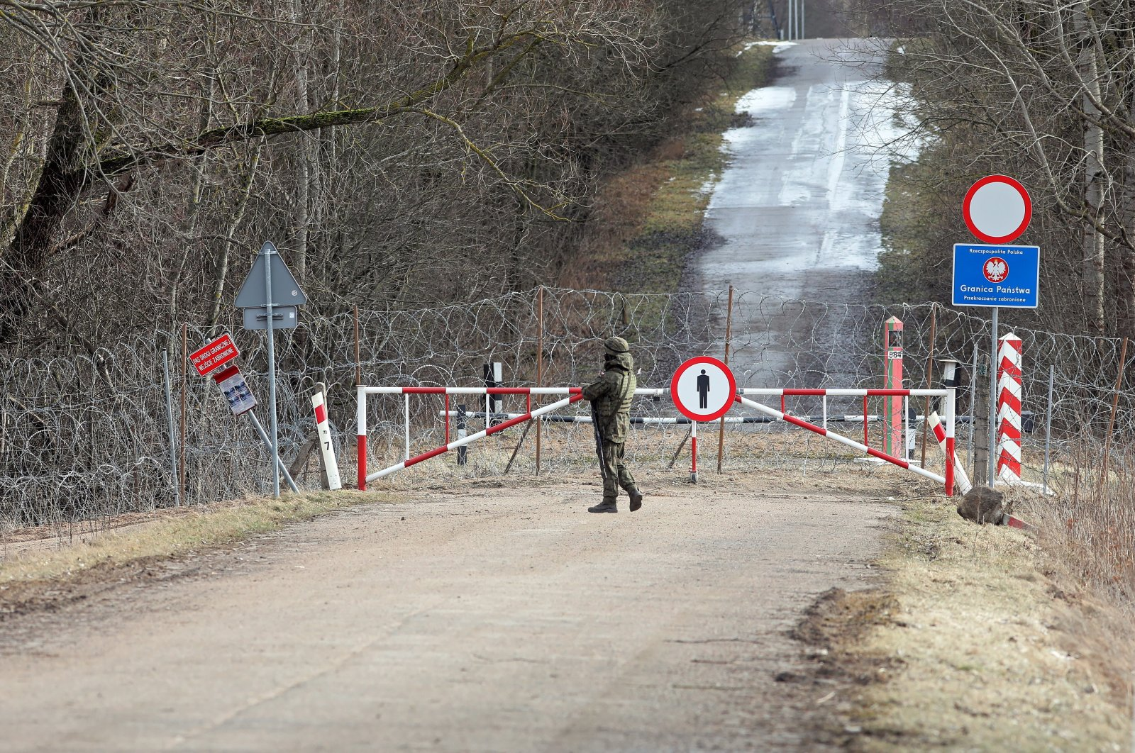
Pushbacks Poland
M. K. and others (2020)
D. A. and others v. Poland (2021)
recent communicated cases:
H. K. and others (12752/22)
A A. and others and M. M and others
(15182/22 and 40833/22) - family from Iraq and
Kurd from Iraq

Slide 13
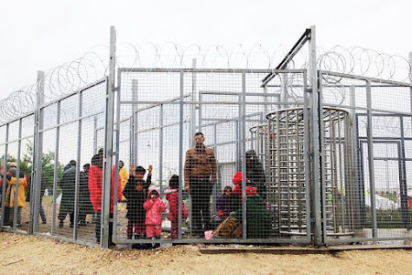
Detention of migrants – transit zones?
The criminalisation of migration?
Article 5, article 3
Ilias and Ahmed v. Hungary [GC], no. 47287/15, 21. 11. 2019
"in drawing the distinction between a restriction on liberty of movement and deprivation of liberty in the context of the situation of asylum seekers, its approach should be practical and realistic, having regard to the present-day conditions and challenges" (par. 2013)
the sum of all other relevant factors did not point to a situation of de facto deprivation of liberty and it was possible for the asylum seekers, without a direct threat for their life or health, known by or brought to the attention of the authorities at the relevant time, to return to the third intermediary country they had come from, Article 5 could not be seen as applicable

Slide 14
Transit zones – act II
CJEU, C‑924/19 PPU and C‑925/19 PPU, 14. 5. 2020
"the obligation imposed on a third-country national to remain permanently in a transit zone the perimeter of which is restricted and closed, within which that national’s movements are limited and monitored, and which he or she cannot legally leave voluntarily, in any direction whatsoever, appears to be a deprivation of liberty, characterised by ‘detention’ within the meaning of those directives."
R. R. and others v Hungary, 36037/17, 2. 3. 2021
family that spent almost four months awaiting the outcome of proceeding in transit zone, their freedom of movement had been severely restricted while living in the transit zone, it had become even more restrictive after moving to the isolation section, the living conditions had been found to be in violation of Article 3.
In those circumstances, the applicants’ stay in the transit zone had amounted to a de facto deprivation of liberty. Article 5 § 1 was therefore applicable + violation

Slide 15
Expulsion and article 8
Unjustified inteference with private and family life?
expulsion of settled migrants (negative obligations)
is there any private or/and family life?
Üner criteria (Üner v. the Netherlands [GC], 46410/99, 18. 10. 2006):
the nature and seriousness of the offence committed by the applicant
the length of the applicant’s stay in the country from which he or she is to be expelled
the time elapsed since the offence was committed and the applicant’s conduct during that period
the nationalities of the various persons concerned
the applicant’s family situation, such as the length of a marriage, and other factors expressing the effectiveness of a couple’s family life
whether the spouse knew about the offence at the time when he or she entered into a family relationship
whether there are children from the marriage and, if so, their age
the seriousness of the difficulties which the spouse is likely to encounter in the country to which the applicant is to be expelled
the best interests and well-being of the children, in particular the seriousness of the difficulties which any children of the applicant are likely to encounter in the country to which the applicant is to be expelled
the solidity of social, cultural and family ties with the host country and with the country of destination.

Slide 16
Article 8 and irregular migration?
positive obligations to allow to maintain and develop family life in the territory of Member States
no general obligation for a State to respect immigrants' choice of the country of their residence and to authorise family reunion in its territory
if the family life was created at a time when the persons involved were aware of the irregularity of stay, the removal of the non-national family member will constitute a violation of Article 8 only in the most exceptional circumstances (see for example Rodrigues da Silva and Hoogkamer v. the Netherlands, 50435/99, 31. 1. 2006)

