Slide 1
Global Climate Change in EU Environmental Policy
Jiri Vodicka, Ph.D. 18. 10. 2023

Slide 2
Brainstorming session
Discussion points
Is climate change real? How do you perceive climate change?
How is climate change affecting you personally (or your family)?
Is your state/local authority (municipality) active in combating climate change?
Do you think all people are affected the same way? Are there any vulnerable groups? Is climate change discriminating any groups?
What should we do? Are there any viable solutions?

Slide 3
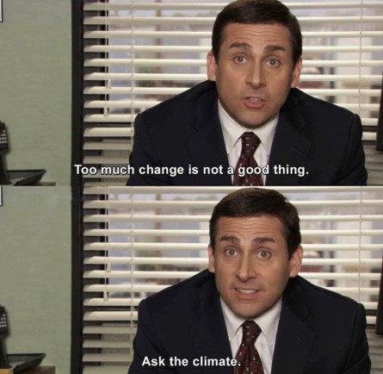
Structure
Introduction
Current Issues
Sources of Law
International
EU
Green Deal

Slide 4
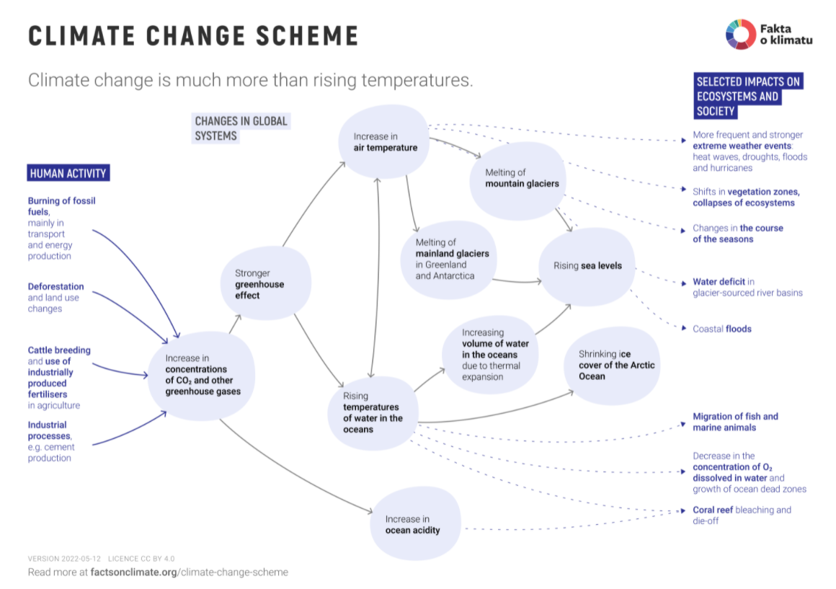
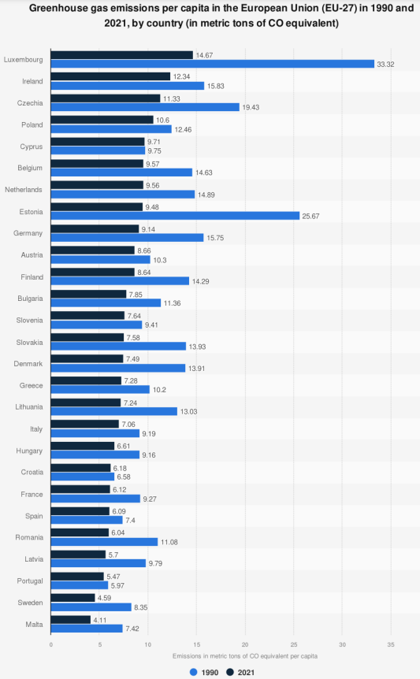
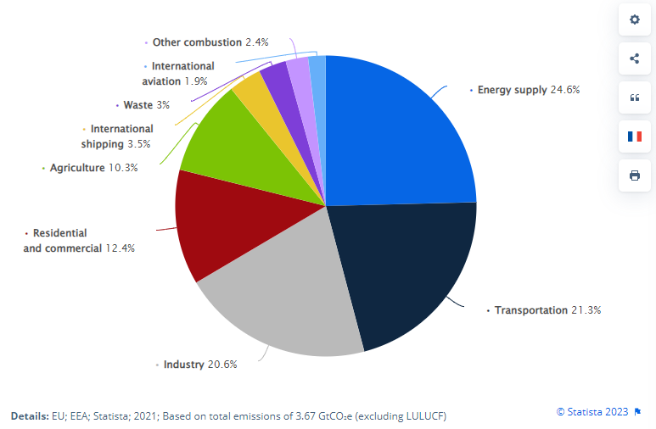
Introductory thoughts
Global x National (systemic) x Individual emissions
International x EU x Local level
How to force states into actions?
Notes:
https://www.statista.com/statistics/986392/co2-emissions-per-cap-by-country-eu/
https://factsonclimate.org/infographics/climate-change-scheme

Slide 5
Climate Change Debate: Last Week Tonight with John Oliver (HBO) Released 9 years ago
Notes:
https://www.youtube.com/watch?v=cjuGCJJUGsg

Slide 6
Paris Agreement: Last Week Tonight with John Oliver (HBO) Released 6 years ago

Slide 7
Current issues
International Consensus
Money
Renewables
Circular economy
Greenwashing
Non-GHGs
Technology
GHGs
Migration

Slide 8
Solutions?
Regulatory mechanisms
Technological progress (Innovation)
Change in consumer behaviour
Focus on specific sector
Carbon pricing

Slide 9
Bill Gates on Climate: “Are We Science People or Are We the Idiots?”
Notes:
https://www.youtube.com/watch?v=wmBj-5owOLA

Slide 10
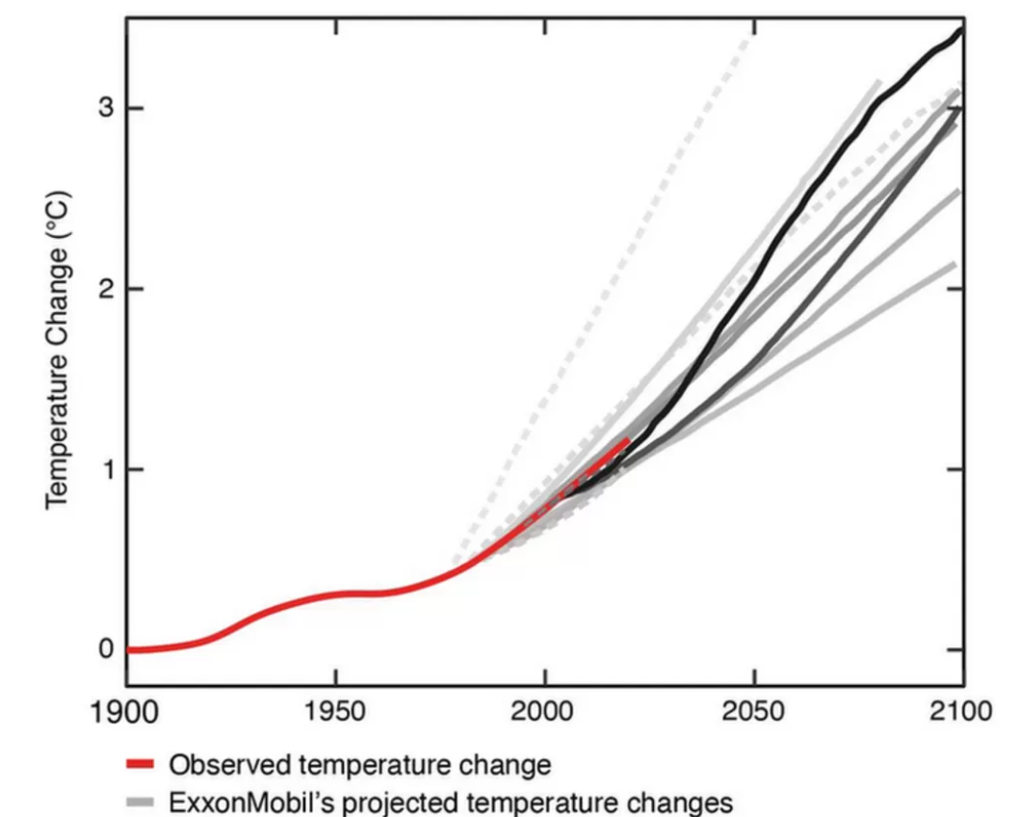
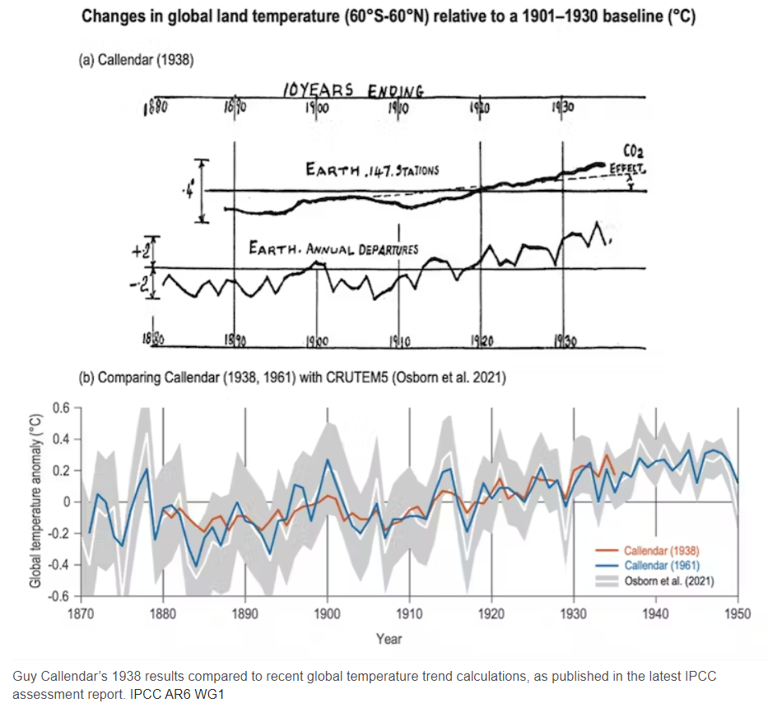
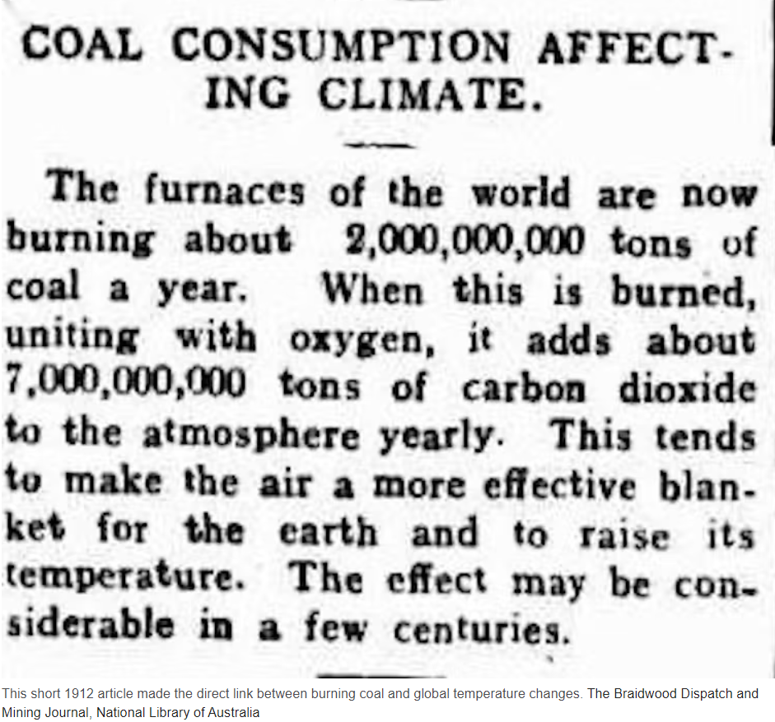
History of climate change
First mention 110 years ago (1912)
1938 Guy Callendar
1970s ExxonMobil‘s projected changes
1988 James Hansen (NASA)
1992 Rio Earth Summit
The United Nations Conference on Environment and Development
UNFCCC
1979 First Climate
Conference (Geneva)
1988 IPCC founded
Notes:
Pics. https://theconversation.com/for-110-years-climate-change-has-been-in-the-news-are-we-finally-ready-to-listen-188646
https://www.bbc.com/news/science-environment-64241994
https://www.ucsusa.org/climate/accountability

Slide 11
6th Synthesis Report
IPCC (Intergovernmental Panel on Climate Change)
AR 6 Synthesis Report
Notes:
Summary of 6 Synthesis report: https://www.wri.org/insights/2023-ipcc-ar6-synthesis-report-climate-change-findings

Slide 12
Sources of Law - International
International customs
General widely recognised principles of law
United Nations Framework Convention on Climate Change (Rio 1992)
International consensus on combating climate change
Obligation for parties to monitor and report emissions
Kyoto Protocol
5,2 % reduction of GHG (2008-2012)
Doha Amendment (2012-2020), 18 % reduction
Notes:
http://lawdefine.blogspot.com/2017/04/unced-or-earth-summit-or-rio-declaration.html

Slide 13
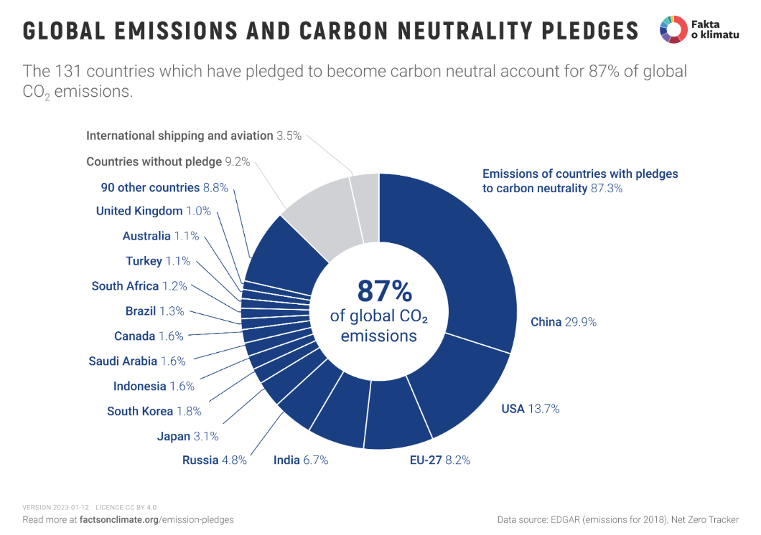
Sources of Law - International
Paris Agreement (COP 21, Paris, 2015)
196 parties
Nationally Determined Contributions (NDCs)
Updated every 5 years
EU 55% reduction by 2030 compared to 1990
Its overarching goal is to hold “the increase in the global
average temperature to well below 2°C above pre-industrial
levels” and pursue efforts “to limit the temperature increase
to 1.5°C above pre-industrial levels.”
Notes:
https://unfccc.int/process-and-meetings/the-paris-agreement
https://unfccc.int/process-and-meetings/the-paris-agreement/nationally-determined-contributions-ndcs#NDC-registry--

Slide 14
Paris Agreement – a short introductory video

Slide 15
EU and Climate Change
EU Party to UNFCC, Kyoto and Paris joint obligation with MS to reduce GHGs
Commitments:
20 % 40 % (2030) 55 % (2030) 100 % (2050)
Legal instruments: policies, strategies, laws (regulations and directives), economic
pre-Green Deal Era x post-Green Deal Era
RePower EU
ReFuel EU

Slide 16
EU and Climate Change
Art. 11 + art. 191 TFEU
Art. 3(3) TEU
European Commission:
DG Climate Action
DG Environment
DG Agri
DG Energy
DG Grow
DG Move
DG Regio
Basis for EU environmental policies and legislation
Executive Agency: CINEA (European Climate, Infrastructure and Environment Executive Agency)
European Environment Agency

Slide 17
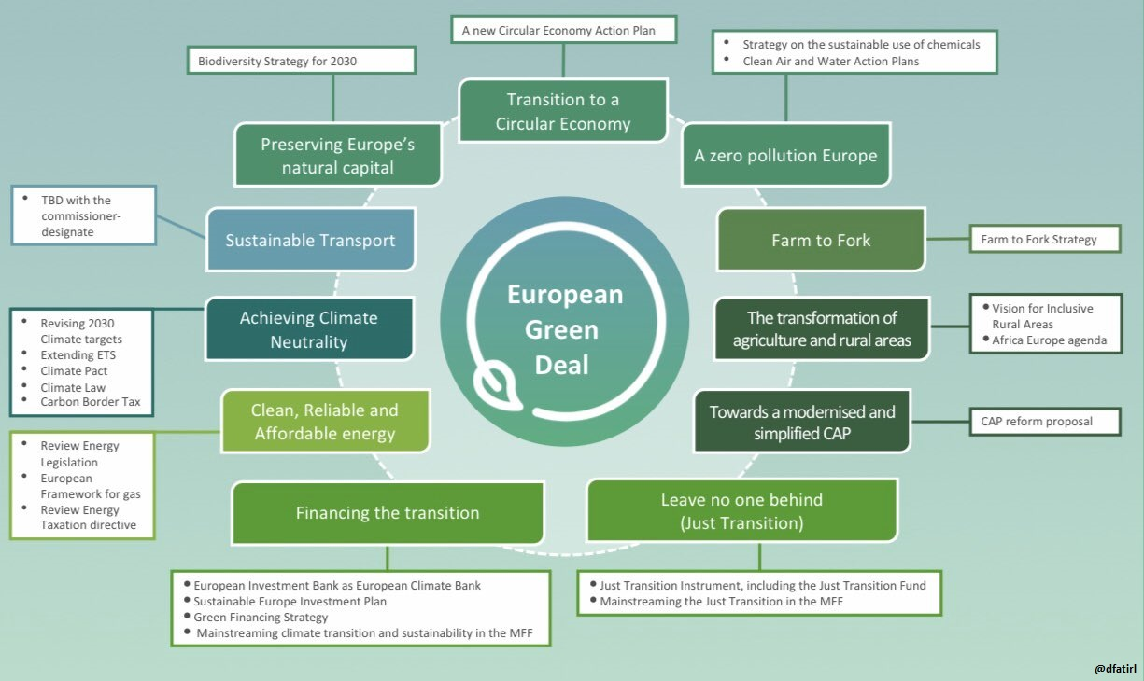
EU and Climate Change: post-Green Deal Era
Game changer
Fit-for-55 package
Holistic approach to climate change (mostly) through sectoral legislation
Setting an international example
Notes:
https://www.euractiv.com/section/energy-environment/news/macron-calls-for-regulatory-break-in-eu-green-laws-to-help-industry/

Slide 18
EU and Climate Change: post-Green Deal Era
Affected sectors:
Industry, transport, electricity generation, agriculture + forestry, financial, waste management etc.
Affected environmental sectors:
Air protection, nature (biodiversity), noise pollution etc.

Slide 19
EU and Climate Change: post-Green Deal Era
Regulation (EU) 2021/1119 establishing the framework for achieving climate neutrality and amending Regulations (EC) No 401/2009 and (EU) 2018/1999 (‘European Climate Law’)
Art. 2(1) Net zero target by 2050
Art. 4(1) intermediate target of 55 % reduction by 2030
Art. 4(3) 2040 target? (tba)
Art. 7(2-3) insufficient national measures
Possible grounds for infringement procedure art. 258 TFEU?
Principle of solidarity art. 3 TEU

Slide 20
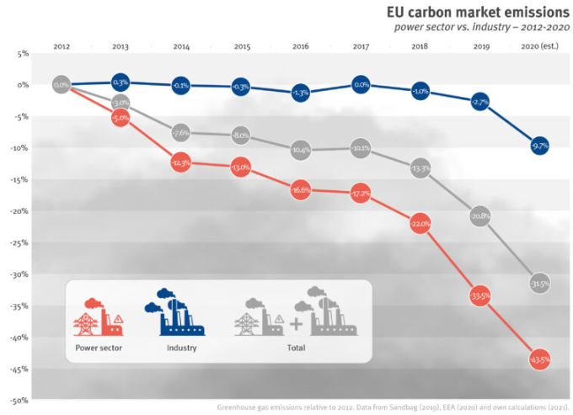
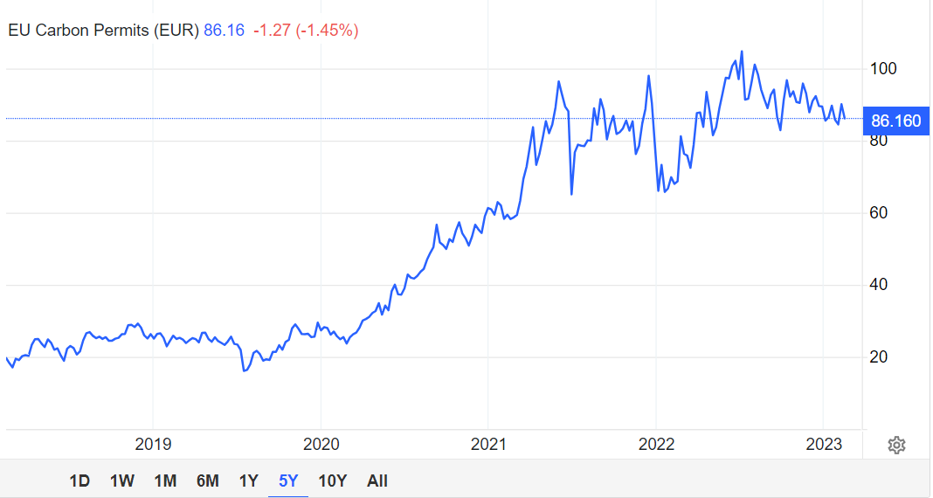
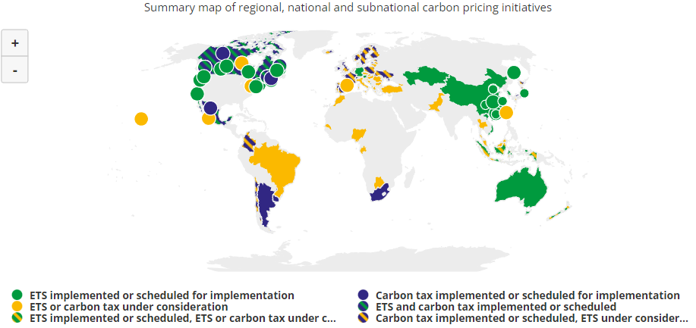
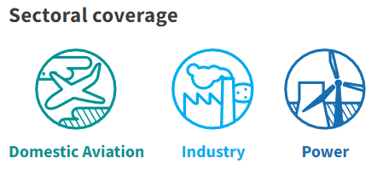
EU and Climate Change: post-Green Deal Era
Sectoral legislation
Emission Trading Scheme (ETS) – Directive 2003/87
Polluter pays principle
CO2, N2O, PFC
A certain number of free allowances, but the number is being reduced
Covers only selcted sectors (+ maritime)
Covers cca 38 % of EU GHGs
ETS 2 – buildings + road transport + small industry
Notes:
https://climate.ec.europa.eu/eu-action/eu-emissions-trading-system-eu-ets_en
https://carbonpricingdashboard.worldbank.org/
https://carbonmarketwatch.org/publications/a-new-hope-recommendations-for-the-eu-emissions-trading-system-review/

Slide 21
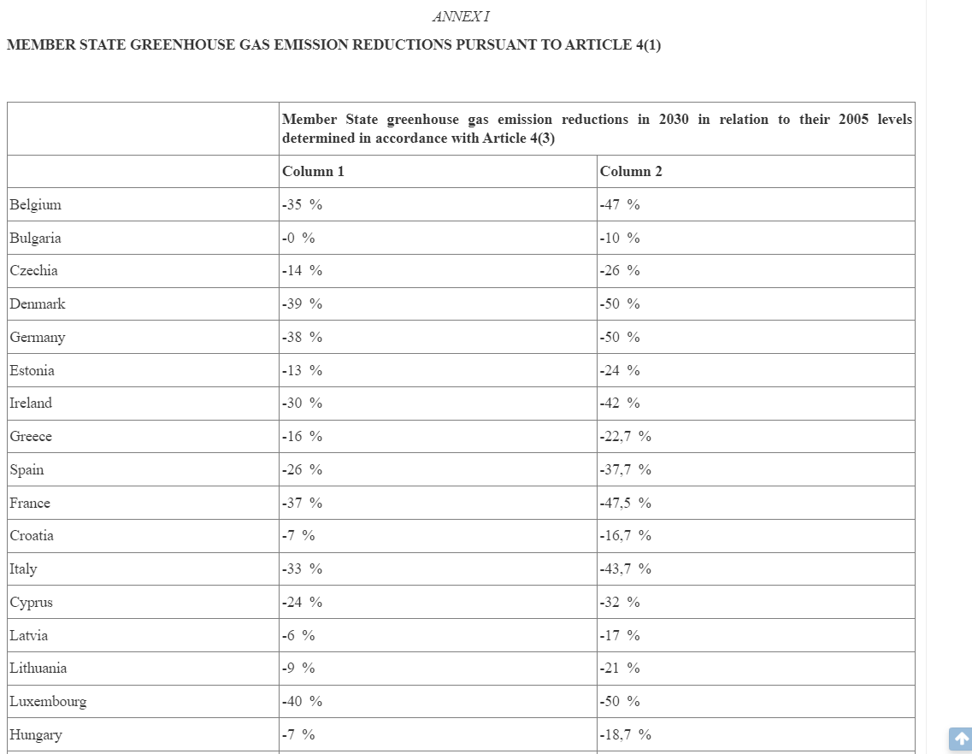
EU and Climate Change: post-Green Deal Era
Sectoral legislation: Non-ETS
Effort Sharing Regulation – Regulation 2018/842
Covers non-ETS sectors
domestic transport (excluding aviation a maritime from 2024),
buildings,
agriculture,
small industry and
waste
Art. 1(1) 40 % reduction as opposed to 2005 levels (2021-2030)
EU collective target

Slide 22
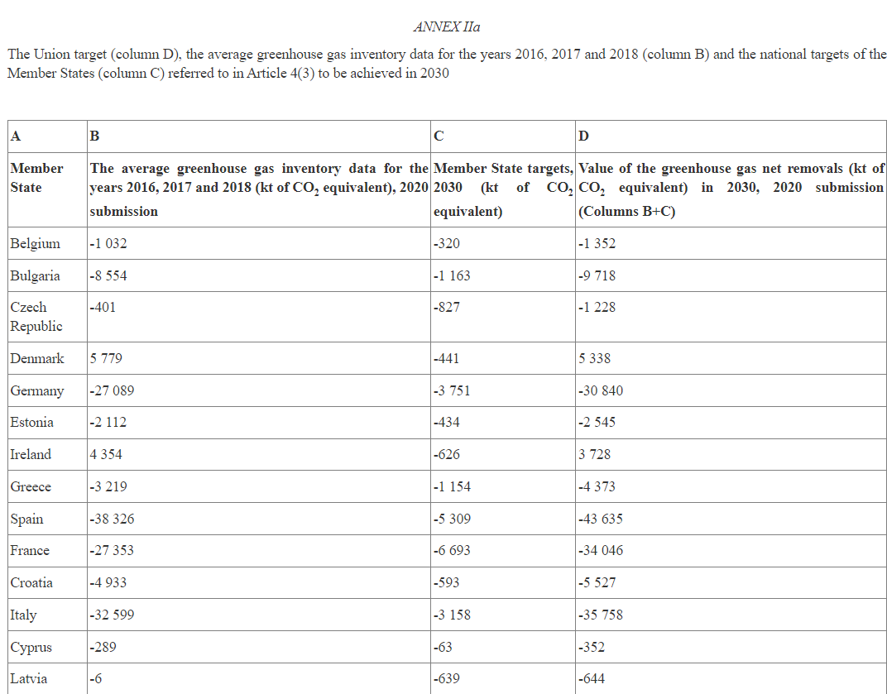
EU and Climate Change: post-Green Deal Era
Sectoral legislation: Agriculture and forestry
LULUCF (Land Use Land Use Change and Forestry) – regulation 2018/841
EU 2030 target EU target for carbon removal (310 mil tones of GHG)
Specific 2030 MS targets
GHGs net removals

Slide 23
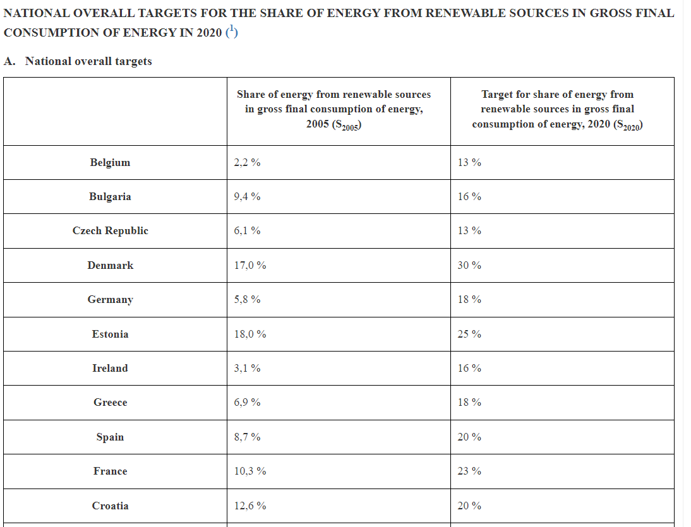
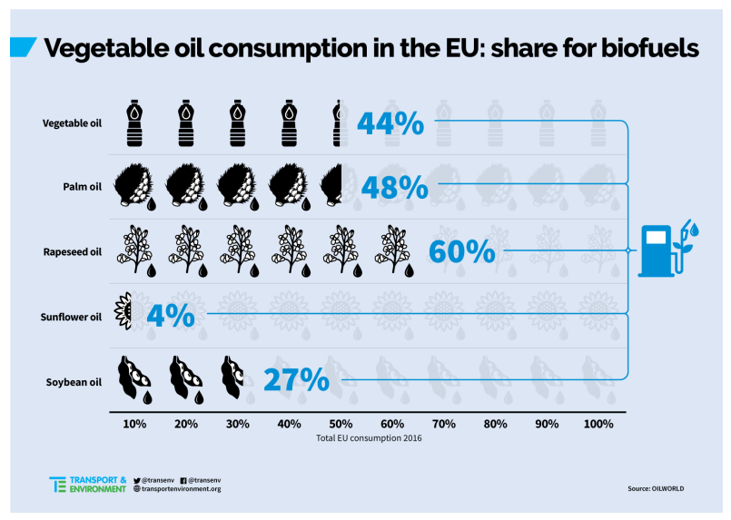
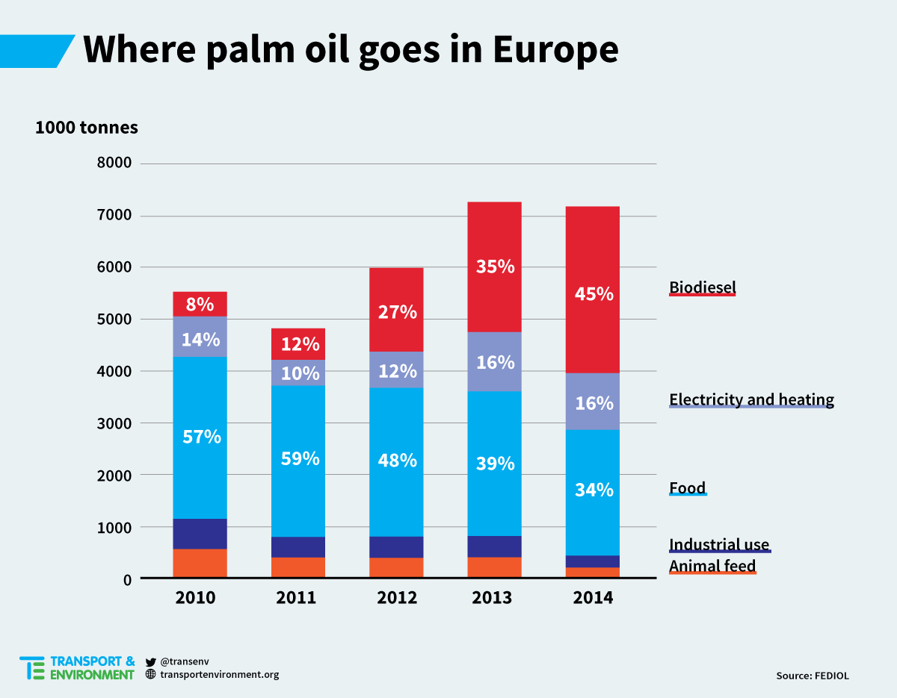
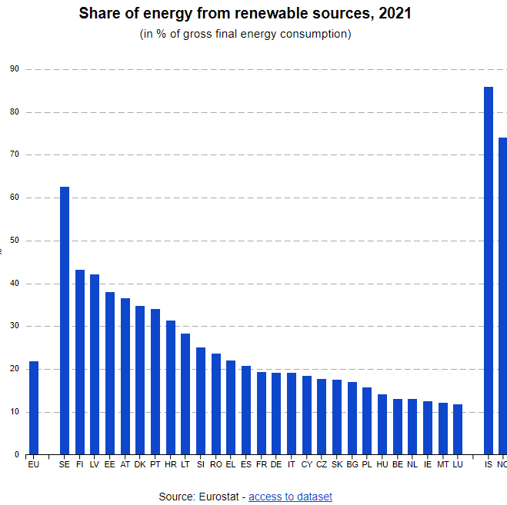
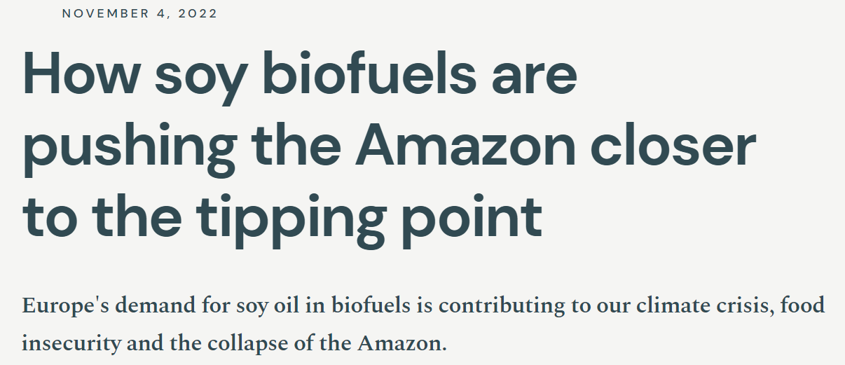
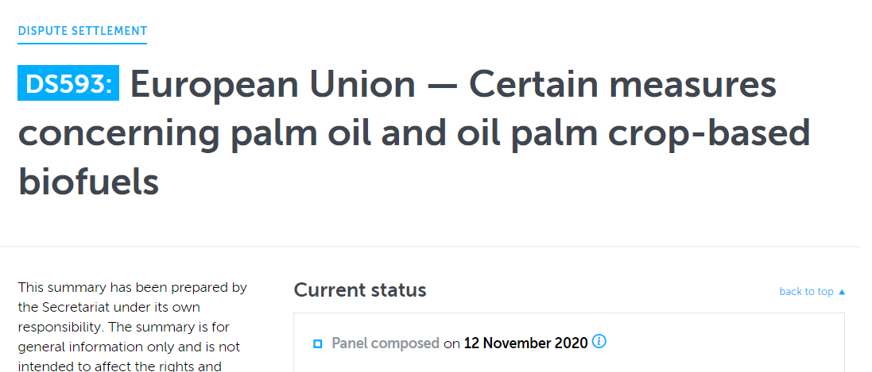
EU and Climate Change: post-Green Deal Era
Sectoral legislation: Renewable Energy
Directive 2018/2001 (RES II)
Binding overall Union target for 2030 32 % in art. 3
Renewable energy communities
RES in transport sector at least 14 % in art. 25
Gradual phase-out of I. generation biofuels
MS target!
Palm Oil -> Global Trade! -> Breach of WTO rules?
Notes:
https://www.transportenvironment.org/discover/reality-check-10-things-you-didnt-know-about-eu-biofuels-policy/

Slide 24
EU and Climate Change: post-Green Deal Era
Overarching sectoral legislation
Regulation 2018/1999 on the Governance of the Energy Union and Climate Action
5 dimensions:
energy security;
internal energy market;
energy efficiency;
decarbonisation; and
research, innovation and competitiveness
Art. 4 national targets/objectives/contributions
ESR
LULUCF
RES II – indicative trajectory of 18 % by 2022 43 % by 2025 65 % by 2027

Slide 25
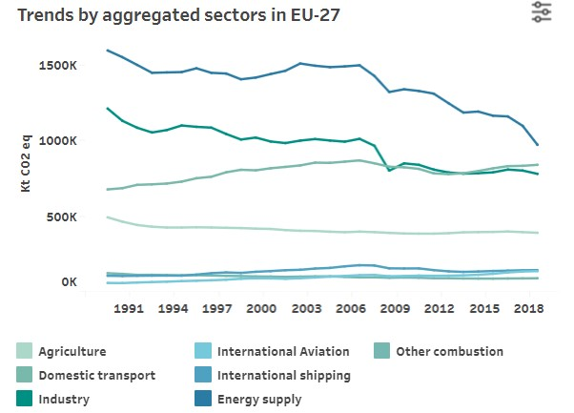
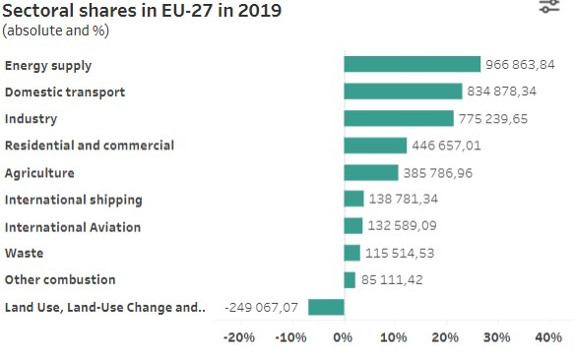
EU and Climate Change: post-Green Deal Era
Sectoral legislation: Transport
The fastest and most growing sector
Cca 23,04 % GHGs intra-EU transport
+ 3,83 % international maritime
+ 3,66 % international aviation
Road transport forms cca 72 % of GHGs from Transport Secotr
More than industry or agriculture!
Light vehicles (cars)
57,5 % GHG!!
Notes:
https://www.eea.europa.eu/ims/greenhouse-gas-emissions-from-transport
https://www.eea.europa.eu/data-and-maps/data/data-viewers/greenhouse-gases-viewer

Slide 26
EU and Climate Change: post-Green Deal Era
Production
Use
End of life-cycle
Fuel
Where to reduce GHGs

Slide 27
EU and Climate Change: post-Green Deal Era
Sectoral legislation: Transport – fuels
Directive 2009/30 as regards the specification of petrol, diesel and gas-oil and introducing a mechanism to monitor and reduce greenhouse gas emissions
Regulation 2023/1804 on the deployment of alternative fuels infrastructure
National targets + mandatory national targets for alternative infrastructure
Electricity (road, shore-side elektricity supply in ports, electriciuty for aircrafts)
Hydrogen
Liquefied methane
RES II Directive (biofuels + MS targets)
Aviation: ReFuel Aviation Proposal for a Regulation on ensuring a level playing field for sustainable air transport
SAF (Austainable Aviation Fuel)
+ ETS 2 – fuel
suppliers
Notes:
https://www.europarl.europa.eu/thinktank/en/document/EPRS_BRI(2022)698900

Slide 28
EU and Climate Change: post-Green Deal Era
Sectoral legislation: Transport – production of vehicles
Regulation 2019/631 – CO2 emissions from new vehicles
„ban“ on combustion engine vehicles from 2035
Gradual phase-out of combustion engines (passanger cars and ligt commercial vehicles)
15 % 55 % (50 %)
Only new cars!
ETS: aviation + maritime

Slide 29
EU and Climate Change: post-Green Deal Era
Other sectoral legislation:
Directive 2009/31 2009 on the geological storage of carbon dioxide
Energy Efficiency Directive 2012/27 (target of 32,5 % by 2030)
Regulation No. 517/2014 on fluorinated greenhouse gases (Fgases)

Slide 30
EU and Climate Change: post-Green Deal Era
Sectoral legislation: Finance
Taxonomy – Regulation (EU) 2020/852 on the establishment of a framework to facilitate sustainable investment
What it is?
Sustainable economic activity classification
Aiming at private sphere
Guidance for banks and other financial entities
6 objectives and 3 types of activities (low carbon, transitional and supportive)

Slide 31
EU and Climate Change: post-Green Deal Era
Sectoral legislation: Finance – ESG framework
Regulation 2019/2088 on sustainability‐related disclosures in the financial services sector
Regulation 2019/2089 as regards EU Climate Transition Benchmarks, EU Paris-aligned Benchmarks and sustainability-related disclosures for benchmarks
Directive 2022/2464 as regards corporate sustainability reporting

Slide 32
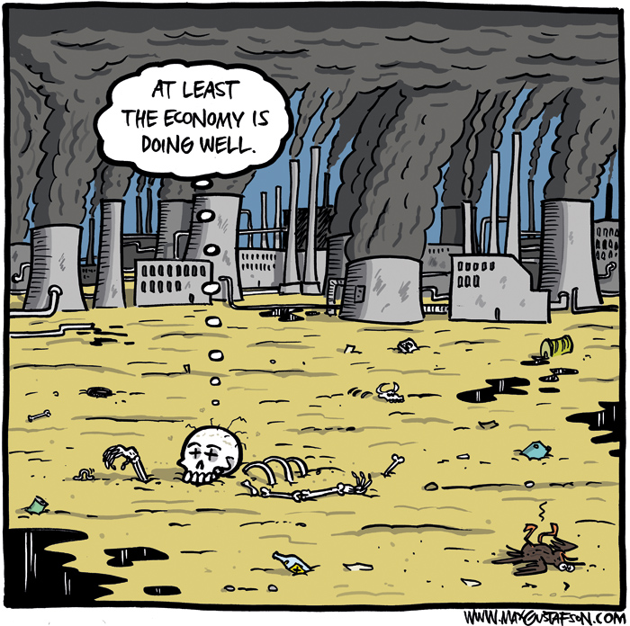
Questions?

Slide 33
Thank you for your attention!
Jiri.Vodicka@law.muni.cz

Slide 34
Sources
Gates Bill. How to Avoid a Climate Disaster: The Solutions We Have and the Breakthroughs We Need. 2021.
Thunberg Greta. The Climate Book. 2022.
Jancarova, I. Climate Change In Eu Policy. Masaryk University:Faculty of Law. Spring 2022.
European Commission
European Environment Agency
Podcasts: https://unfccc.int/blog/5-climate-action-podcasts-you-should-be-listening-to

