Slide 1



PUBLIC PROCUREMENT and environment
JUDr. Vojtěch Vomáčka, Ph.D., LL.M.
Basics of EU Environmental Law
25 October 2023

Slide 2
GPP in the context of the European Green Deal
EU policy developements and possible mandatory measures in sectorial legislation
European Commission GPP support tools

Slide 3
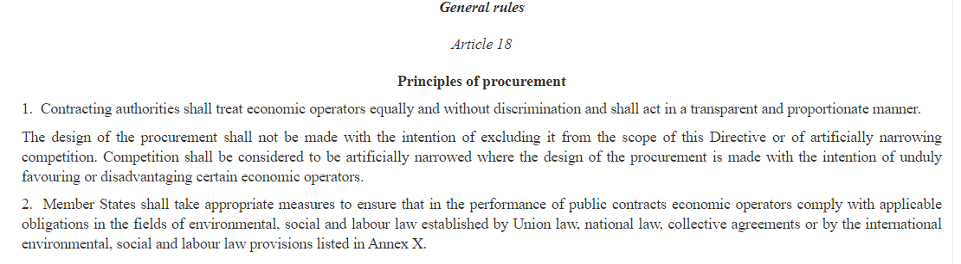
What is public procurement?
Directive 2014/24/EU on public procurement
Directive 2014/25/EU on procurement by entities operating in the water, energy, transport and postal services sectors
Directive 2014/23/EU on the award of concession contracts
EU law sets minimum harmonised rules for tenders whose monetary value exceeds a certain amount and which are presumed to be of cross-border interest. The European rules ensure that the award of contracts of higher value for the provision of public goods and services must be fair, equitable, transparent and non-discriminatory. For tenders of lower value however, national rules apply, which nevertheless must respect general principles of EU law.

Slide 4
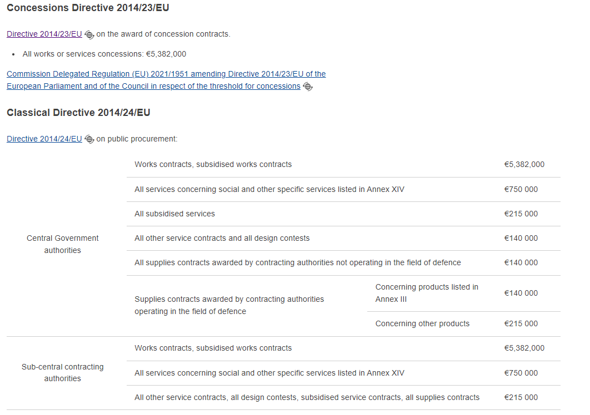

Slide 5
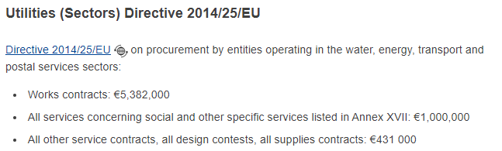

Slide 6
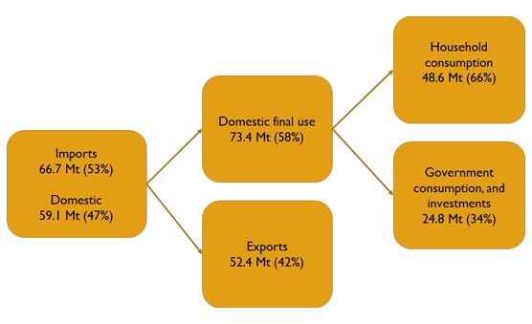
Why GPP?
Carbon footprint of public procurement – Finland – 2015
Carbon footprint of public procurement – Denmark – 2019

Slide 7
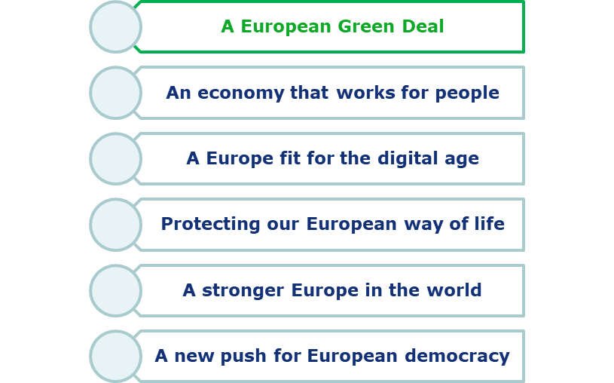
Priorities of the European Commission 2019-2024

Slide 8
European Green Deal and GPP
COM (2019) 640 final of 11.12.2019
2.1.3. Mobilising industry for a clean and circular economy
Public authorities, including the EU institutions, should lead by example and ensure that their procurement is green.
The Commission will propose further legislation and guidance on green public purchasing.

Slide 9
2020 Circular Economy Action Plan and GPP
COM (2020) 98 final of 11.03.2020
A Sustainable Product Policy Framework
  2.2 Empowering consumers and public buyers
the Commission will propose minimum mandatory green public procurement (GPP) criteria and targets in sectoral legislation and phase in compulsory reporting to monitor the uptake of Green Public Procurement (GPP) without creating unjustified administrative burden for public buyers.
Furthermore, the Commission will continue to support capacity building with guidance, training and dissemination of good practices and encouraging public buyers to take part in a “Public Buyers for Climate and Environment” initiative, which will facilitate exchanges among buyers committed to GPP implementation.

Slide 10
2020 Circular economy action plan
Designing sustainable products
Sustainable products initiative: revision of the Ecodesign Directive to go beyond energy-related products
Empowering consumers and public buyers
  Revision of the consumer law: consumers to receive trustworthy and relevant information on products at the point of sale
  Establishing a new “Right to repair”
  Legislative proposal to ensure companies substantiate their green claims using Product and Organisation Environmental Footprint methods

Slide 11
Minimum mandatory GPP criteria in sectoral legislation – new Batteries regulation
Commission proposal for a regulation adopted on 10 December 2020
COM/2020/798 final
https://eur-lex.europa.eu/legal-content/EN/TXT/?uri=CELEX%3A52020PC0798
Chapter X - Art. 70 Green public procurement
The proposal presented by the European Commission is designed to modernise the EU's regulatory framework for batteries in order to secure the sustainability and competitiveness of battery value chains.
It would introduce mandatory requirements on sustainability (such as carbon footprint rules, minimum recycled content, performance and durability criteria), safety and labelling for the marketing and putting into service of batteries, and requirements for end-of-life management.
The proposal also includes due diligence obligations for economic operators as regards the sourcing of raw materials.
Adopted July 2023 (Article 85)

Slide 12
Minimum mandatory GPP criteria in sectoral legislation – new Batteries regulation (2)
Art 85, point 3
The Commission shall, 12 months after the adoption of the latest of the delegated acts
referred to in Article 7(2), fourth subparagraph, point (a), Article 8(1), Article 9(2) and
Article 10(5), adopt delegated acts in accordance with Article 89 supplementing this
Regulation by establishing award criteria for procurement procedures for batteries, or
products containing batteries, based on the sustainability requirements laid down in
Articles 7 to 10

Slide 13
Minimum mandatory GPP criteria in sectoral legislation – EU energy efficiency directive (1)
Commission proposal for a Directive (recast) adopted on 14 July 2021
COM/2021/558 final
https://eur-lex.europa.eu/legal-content/EN/TXT/?uri=CELEX%3A52021PC0558
Under the European Green Deal, the Commission has committed to stronger action on climate change. It aims to assess how the EU’s greenhouse gas emissions could responsibly be reduced by at least 50% to 55% by 2030
As the efficient use of energy is key to achieving such a target, the review aims to provide insights into how the EED could be revised to:
achieve a higher level of greenhouse gas reduction by 2030
contribute to other European Green Deal initiatives
Adopted July 2023
https://data.consilium.europa.eu/doc/document/PE-15-2023-INIT/en/pdf

Slide 14
Minimum mandatory GPP criteria in sectoral legislation – EU energy efficiency directive (2)
Chapter II – Exemplary role of public sector
Art. 6 – exemplary role of public bodies buildings
at least 3 % of the total floor area of heated and/or cooled buildings owned by public bodies is renovated each year to at least be transformed into nearly zero-energy buildings
Art. 7 – Public procurement
contracting authorities to buy only products, services, buildings and works with high energy efficiency in accordance to requirements referred to in Annex IV (which makes reference, among others documents, to EU GPP criteria-set)

Slide 15


Sustainable Products Initiative (SPI) (1)
  Widening the scope of the Ecodesign Directive to the broadest possible range of products
  Establishing sustainability principles and setting product requirements on:
  Improving product durability, reusability, upgradability and reparability
  Increasing recycled content in products and facilitating remanufacturing, including possible measures on production processes
  Restricting single-use, countering premature obsolescence, banning the destruction of unsold durable goods
  Incentivising product-as-a-service
  Mandatory labelling a/o provision of information in the form of a digital product passport
  Rewarding sustainable products by linking incentives to sustainability performance levels; minimum sustainability requirements on public procurement of products
  Addressing social aspects throughout the lifecycle of products where feasible
Priority to CEAP key value chains and intermediate products such as steel, cement, chemicals

Slide 16
Sustainable Products Initiative (SPI) (2)
Commission proposal adopted on 30 March 2022
COM(2022) 142 final
Art. 58
Reference to mandatory GPP criteria that will be adopted as part of the delegated act setting requirements for specific product groups
Priority product categories:
electronics & ICT equipment
Textiles
furniture
steel, cement & chemicals.
https://ec.europa.eu/info/law/better-regulation/have-your-say/initiatives/12567-Sustainable-products-initiative_en

Slide 17
Construction Products Regulation
Commission proposal adopted on 30 March 2022
COM(2022) 144 final
The Construction Products Regulation lays down EU-wide rules for marketing construction products.
This initiative will review these rules. It includes:
addressing the issues identified in the 2019 evaluation
improving how the single market for construction products functions.
The aim is to unlock the sector’s growth and jobs potential, promote environmental goals as part of the Green Deal and Circular Economy Action Plan, and possibly promote product safety.
Art. 84
Reference to mandatory GPP criteria that will be adopted as part of mandatory standards and implementing acts setting requirements for specific products

Slide 18
Reducing packaging waste – review of rules
In a ‘circular economy’, waste is reduced and goods are re-used and recycled as much as possible. This means that packaging waste should also be reduced, and packaging should be made easier to recycle.
The Commission will review the requirements on packaging and packaging waste in the EU. This will include assessing how to:
improve packaging design to promote reuse and recycling
increase recycled content in packaging
tackle excessive packaging
reduce packaging waste
Commission proposal: November 2022
Chapter IX (Article 57) concerns green public procurement and, more specifically, the possibility for the Commission to adopt delegated acts to establish requirements applicable to public contracts (e.g. technical specifications, selection criteria, award criteria, etc.), based on the sustainability requirements laid down in this Regulation.

Slide 19
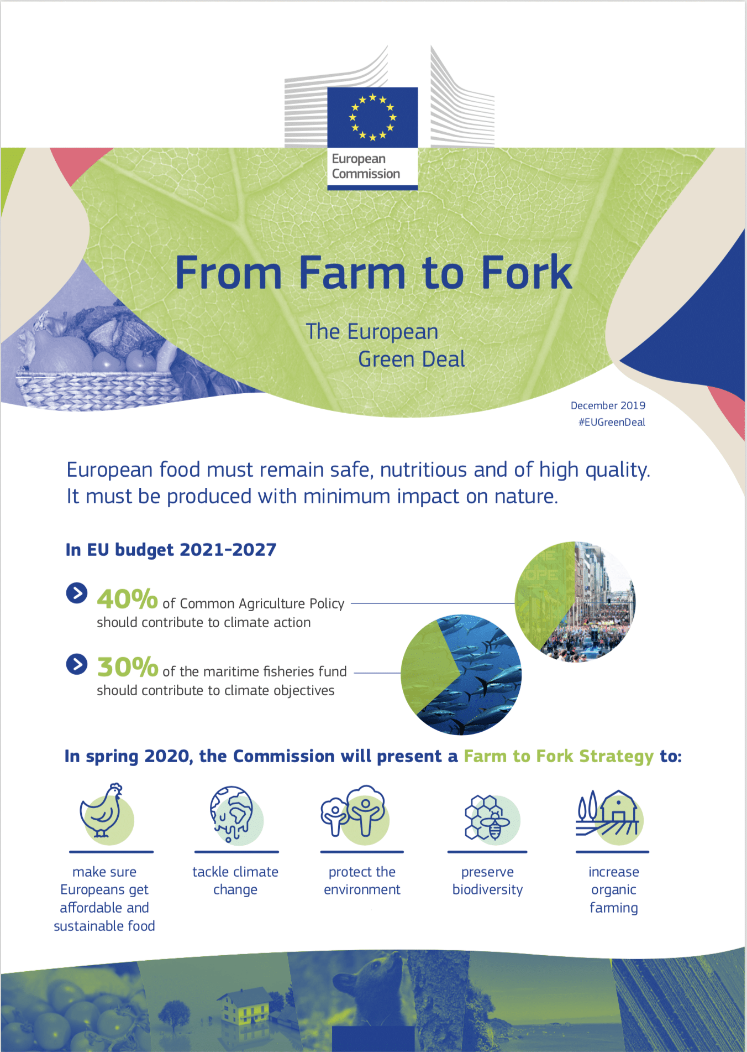
Legislative framework for sustainable food systems
  This initiative aims to make the EU food system sustainable and to integrate sustainability into all food-related policies.
  It will lay down general principles and objectives, together with the requirements and responsibilities of all actors in the EU food system.
  More specifically, it will lay down rules on:
  sustainability labelling of food products
  minimum criteria for sustainable public procurement of food
  governance and monitoring.
  Topic: Food safety
  Type of act: Proposal for a regulation
  Open Public consultation: 2nd quarter 2022
  Commission adoption: 4th quarter 2023
https://ec.europa.eu/info/law/better-regulation/have-your-say/initiatives/13174-Sustainable-EU-food-system-new-initiative_en

Slide 20
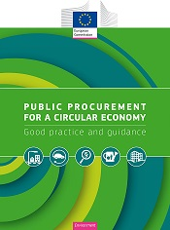
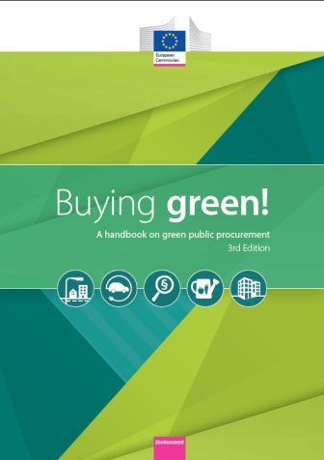
GPP support tools
GPP website of the European Commission:
Full sets of EU GPP criteria and background
reports in 20+ languages
Buying Green Handbook
Updated GPP Training Toolkit
Circular Procurement brochure
More than 180 GPP Examples
News and upcoming events
General GPP Help desk: gpp-helpdesk@iclei.org
GPP Newsletter
Exchange Platform - https://procurement-forum.eu/
Notes:
20
This is an overview of the main tools developed by the European Commission to support to uptake of GPP. They are available through the EU GPP webpage (https://ec.europa.eu/environment/gpp/index_en.htm).

Slide 21
Common EU GPP Criteria
Clear, verifiable, justifiable and ambitious environmental criteria
Scientific evidence base, life-cycle approach
Having common criteria reduces considerably the administrative burden for economic operators and for public administrations implementing GPP
~ 20 product groups covered (e.g. food and catering services, cleaning services, public space maintenance, computers, vehicles, data centres, etc.)
Voluntary (unless differently defined by Member States)
Section on LCC is always inlcuded
Notes:
21

Slide 22



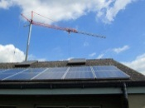
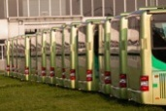





EU GPP Criteria
Copying and graphic paper
Cleaning products and services
Computer, monitors, tablets
and smartphones
Office Buildings
Road transport
Furniture
Electricity
Food & Catering services
Public space maintenance
Textiles
→ Feedback on EU GPP criteria are welcome!
Notes:
22
The basic concept of GPP relies on having clear, verifiable, justifiable and ambitious environmental criteria for products and services, based on a life-cycle approach and scientific evidence base. In the Communication “Public procurement for a better environment” (COM (2008) 400) the Commission recommended the creation of a process for setting common GPP criteria.
The criteria used by Member States should be similar to avoid a distortion of the single market and a reduction of EU-wide competition. Having common criteria reduces considerably the administrative burden for economic operators and for public administrations implementing GPP. Common GPP criteria are of a particular benefit to companies operating in more than one Member State as well as SMEs (whose capacity to master differing procurement procedures is limited).
Since 2008, the Commission has developed more than 20 common GPP criteria. The priority sectors for implementing GPP were selected through a multi-criteria analysis including: scope for environmental improvement; public expenditure; potential impact on suppliers; potential for setting an example to private or corporate consumers; political sensitivity; existence of relevant and easy-to-use criteria; market availability and economic efficiency. The criteria are regularly updated.
The GPP criteria are based on data from an evidence base, on existing ecolabel criteria and on information collected from stakeholders of industry, civil society and Member States. The evidence base uses available scientific information and data, adopts a life-cycle approach and engages stakeholders who meet to discuss issues and develop consensus.
For certain product group, where the market is global (e.g. computers, data centres, imaging equipment, vehicles, … the criteria could also be applied in countries outside the EU.

Slide 23
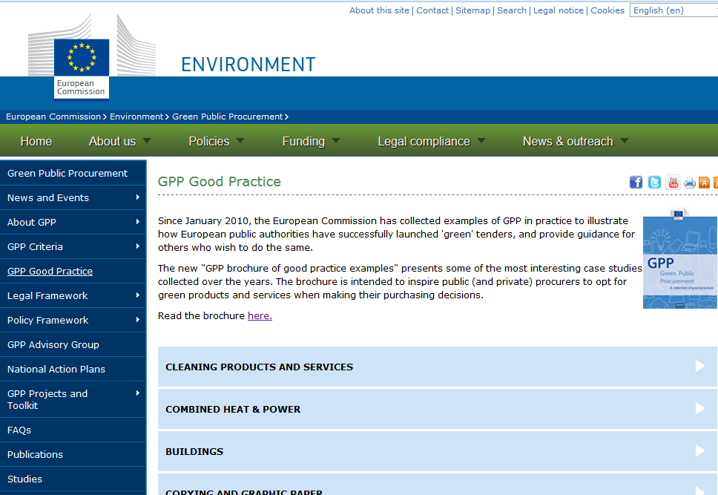
GPP Good practice
Notes:
23
According to the feedback received from Member States and contracting authorities, the exchange of good procurement practices is one of the most effective ways to help them increase the use of GPP.
Therefore, since January 2010, the European Commission has been promoting good practice experiences on GPP to illustrate how public authorities in Europe have successfully 'greened' a public tender or procurement process.
These include the use of life-cycle costing (LCC), circular economy principles, approaches fostering sustainable innovation, among others.
These good practice cases also provide some tips for replicating experiences under the ‘lessons learned’ sections.

Slide 24
GPP Life Cycle Costing Tools
Computers and monitors
Indoor lighting
Outdoor lighting
Imaging equipment
Vending machines
Life cycle costing - GPP - Environment - European Commission (europa.eu)
Notes:
24

Slide 25
THANK YOU FOR YOUR ATTENTION!
vomacka@mail.muni.cz

