Slide 1
Basics of EU Environmental Law
NATURE PROTECTION
22 November 2023
JUDr. Vojtěch Vomáčka, Ph.D., LL.M.

Slide 2
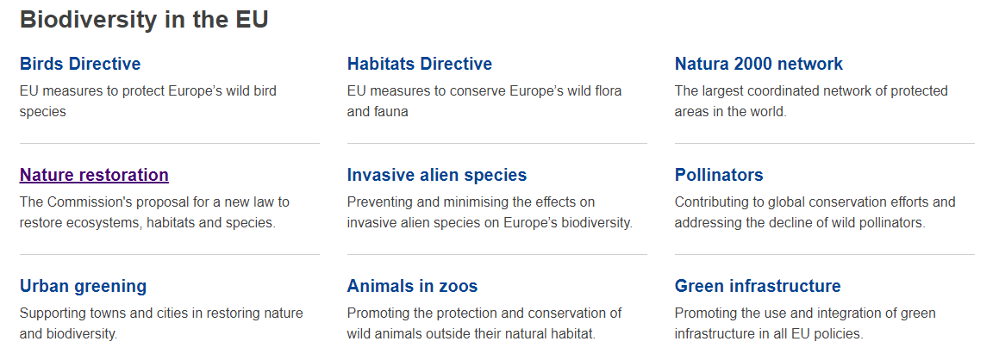

Slide 3
EU Law on Nature Protection
Birds Directive, Habitats Directive
Protection of sites – Natura 2000
Protection of species
Other Directives: Environmental Crime Directive, Environmental Liability Directive

Slide 4
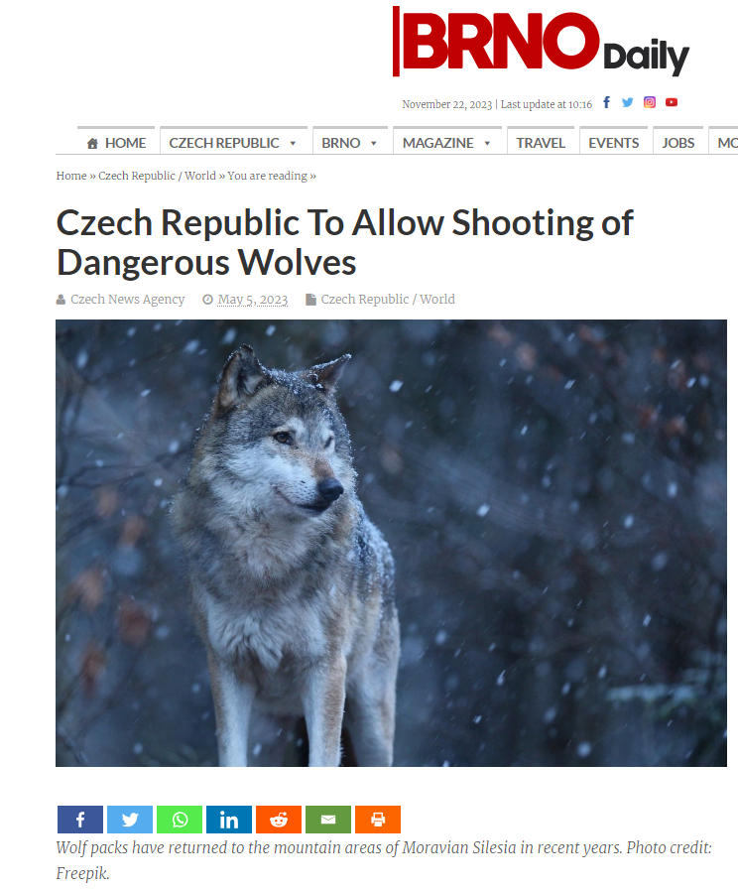

Slide 5
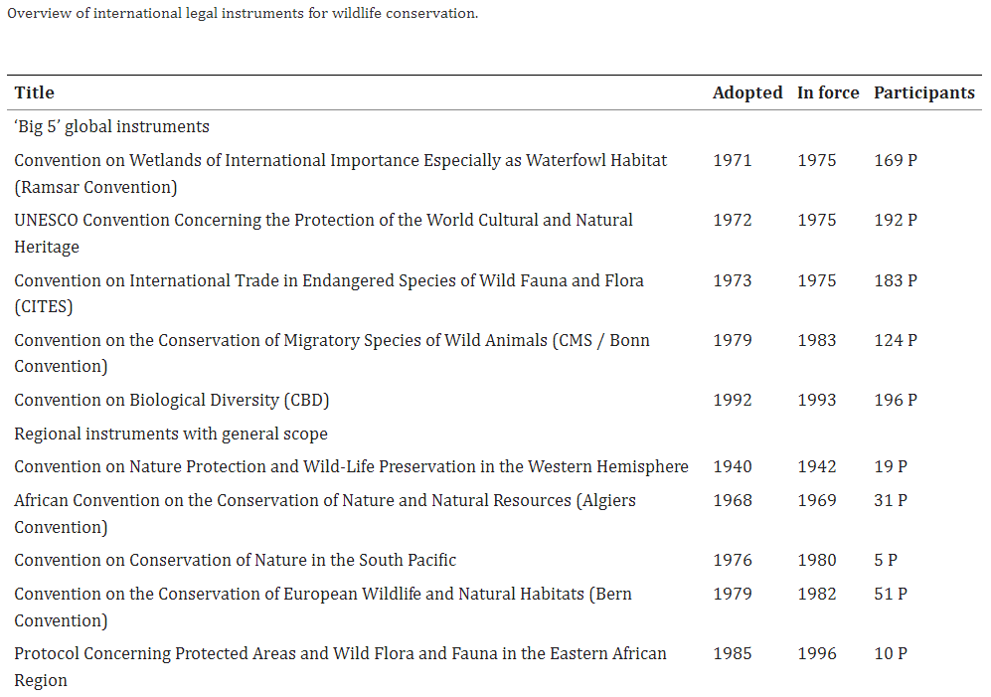

Slide 6
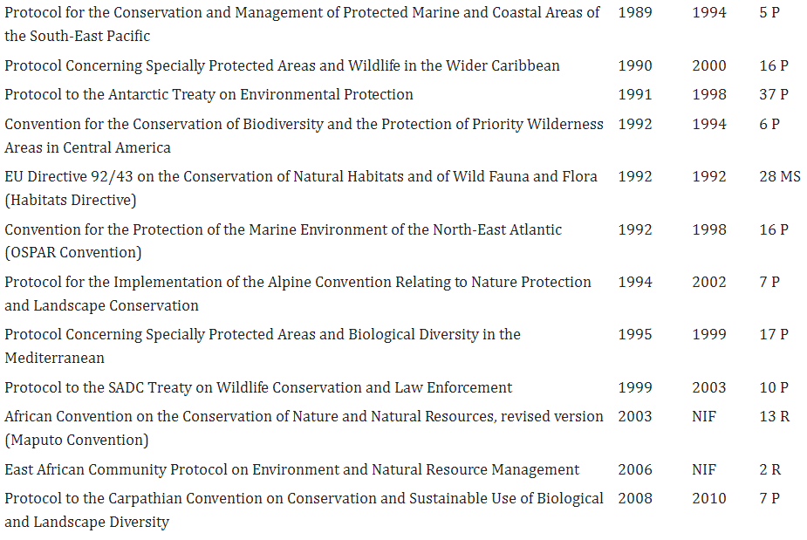

Slide 7
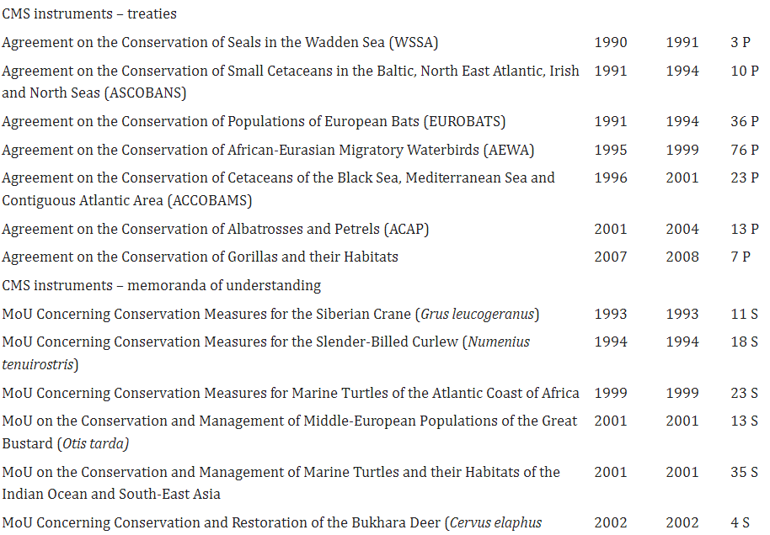

Slide 8
EU Law on Nature Protection
The EU has played and continues to play an important role at international level in nature protection and conservation. It is party to several conventions including:
the Convention on the Conservation of Wetlands, adopted in Ramsar (1971);
the Convention on International Trade in Endangered Species of Wild Fauna and Flora, known as CITES, adopted in Washington (1973);
the Convention on the Conservation of Migratory Species of Wild Animals, adopted in Bonn (1979);
the Convention on the Protection of European Wildlife and Natural Habitats, adopted in Bern (1982);
the Convention on Biological Diversity, adopted in Rio de Janeiro (1992).
The EU is also bound by the Aarhus Convention (1998), which concerns public access to environmental information, public participation in decision-making and access to justice.
The EU’s first legislation to protect nature was the original Birds Directive, adopted in 1979 and codified and replaced, in 2009, by Directive 2009/147/EC. The Directive provides comprehensive protection to all wild bird species naturally occurring in the EU.
In 1992, the Habitats Directive (Directive 92/43/EEC) was adopted to help maintain biodiversity by protecting over 1,000 animal and plant species and over 200 types of habitats, and introducing the Natura 2000 network of protected areas across Europe. The Natura 2000 network’s Special Areas of Conservation and Special Protection Areas currently (2021) account for around 18% of EU’s land and 9% of EU seas.

Slide 9
The Habitats Directive (92/43/EEC)
Article 6(3) Any plan or project not directly connected with or necessary to the management of the site but likely to have a significant effect thereon, either individually or in combination with other plans or projects, shall be subject to appropriate assessment of its implications for the site in view of the site's conservation objectives. In the light of the conclusions of the assessment of the implications for the site and subject to the provisions of paragraph 4, the competent national authorities shall agree to the plan or project only after having ascertained that it will not adversely affect the integrity of the site concerned and, if appropriate, after having obtained the opinion of the general public.
Art. 6(4): If, in spite of a negative assessment of the implications for the site and in the absence of alternative solutions, a plan or project must nevertheless be carried out for imperative reasons of overriding public interest, including those of a social or economic nature, the Member State shall take all compensatory measures necessary to ensure that the overall coherence of Natura 2000 is protected. It shall inform the Commission of the compensatory measures adopted.
Where the site concerned hosts a priority natural habitat type and/or a priority species, the only considerations which may be raised are those relating to human health or public safety, to beneficial consequences of primary importance for the environment or, further to an opinion from the Commission, to other imperative reasons of overriding public interest.

Slide 10
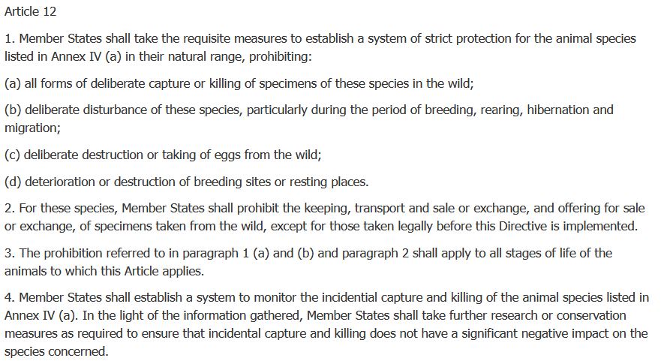
The Habitats Directive (92/43/EEC)

Slide 11
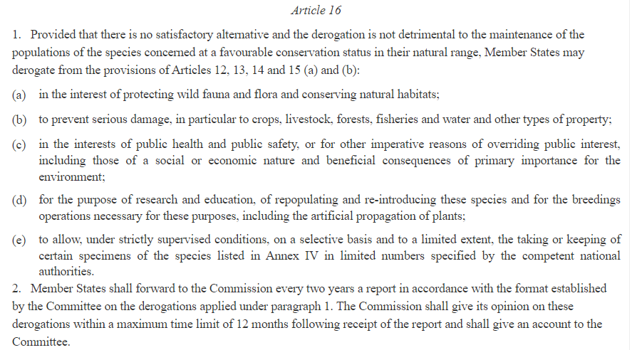
The Habitats Directive (92/43/EEC)

Slide 12
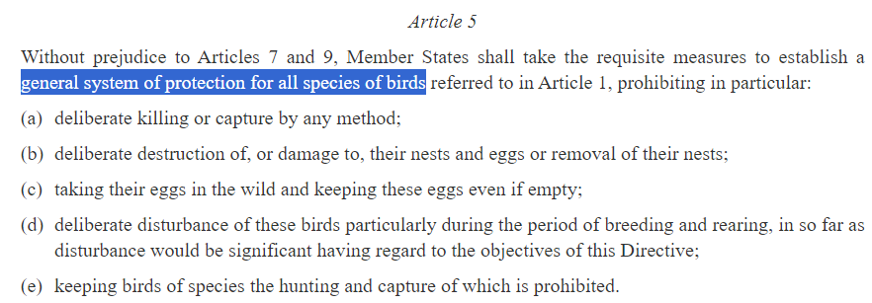
The Birds Directive (2009/147/EC)

Slide 13
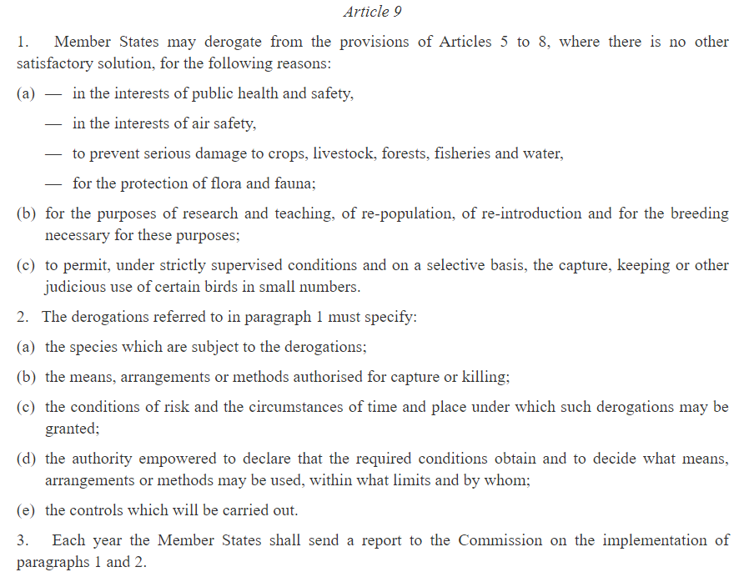
The Birds Directive (2009/147/EC)

Slide 14
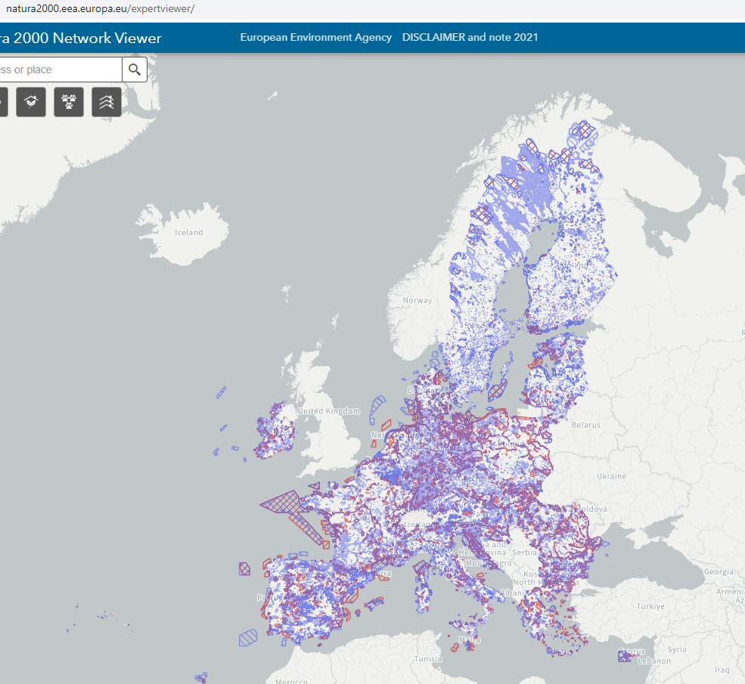

Slide 15
EU Law on Nature Protection
The EU’s nature-related legislation also deals with:
invasive alien species (animals and plants introduced accidentally or deliberately into a natural environment where they are not normally present, with serious negative consequences for their new environment);
wildlife trade (rules implementing CITES, which go beyond the convention’s requirements, trade in seal products, and humane trapping standards);
the role of zoos in the conservation of biodiversity.
Since the mid-2000s, the EU has adopted a series of biodiversity action plans and strategies. The latest one, the 2030 Biodiversity Strategy, aims to protect nature and reverse the degradation of ecosystems. The strategy aims to put Europe’s biodiversity on a path to recovery by 2030, and contains over 100 specific actions and commitments. It is the proposal for the EU’s contribution to the international negotiations on the global post-2020 biodiversity framework. A core part of the European Green Deal, it will also support a green recovery following the COVID-19 pandemic.

Slide 16
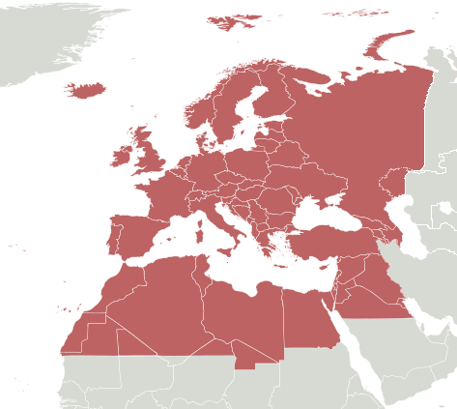
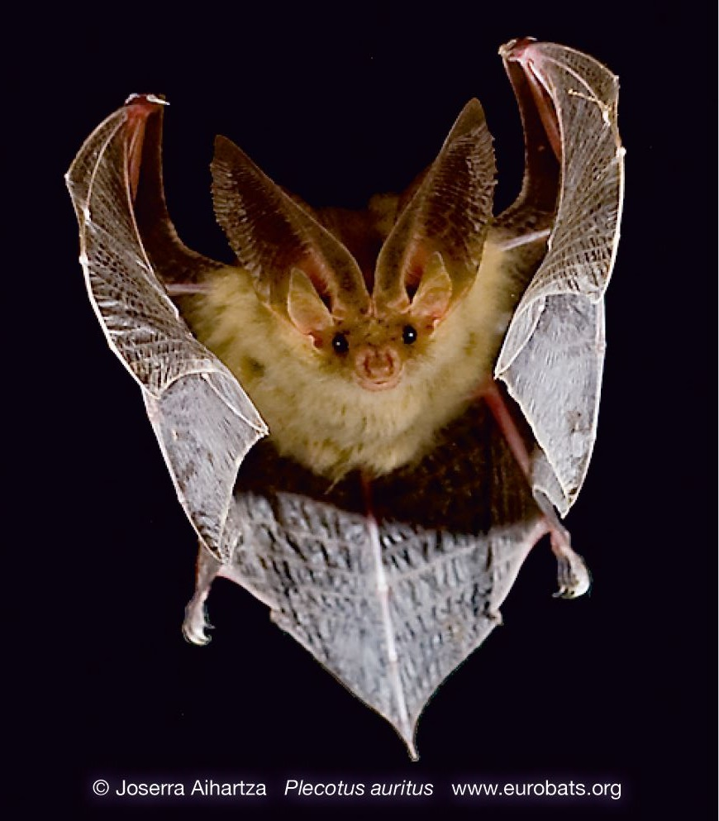
Example: Protection of bats
(a) International law: EUROBATS
51 species
38 parties
States prohibit the deliberate capture, keeping or killing of bats except for research purposes for which a special permit is required. Furthermore, the Parties identify important sites for bat conservation, survey the status and trends of bat populations and study their migratory patterns.

Slide 17
Example: Protection of bats
EU law
The Habitats Directive
Bats are a European Protected Species, included in Annex 4 of the Habitats Directive - referred to as “Microchiroptera”.
Article 12 sets out legal protection for bats and their roosts.
Under Annex 2 it also sets out which bat species should have Special Areas of Conservation designated for them- Greater horseshoe, Lesser horseshoe, Barbastelle and Bechstein’s.

Slide 18
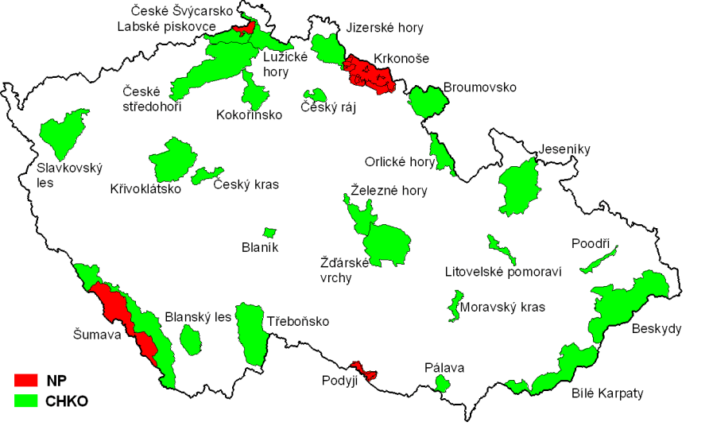
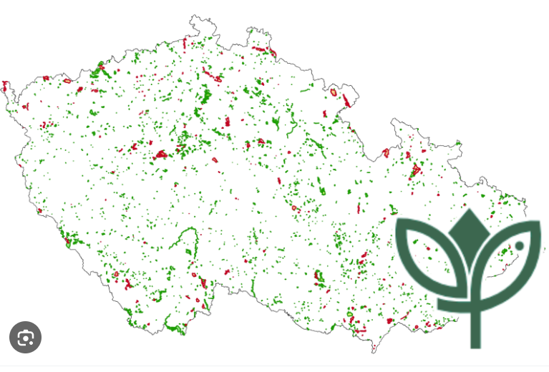
Czech Law on Nature Protection - Act No. 114/1992, on Protection of Nature and Landscape
There are 26 Protected Landscape Areas (IUCN Category V) and 4 National Parks (Category II) in the Czech Republic, and hundreds of small scale protected areas of different categories.

Slide 19
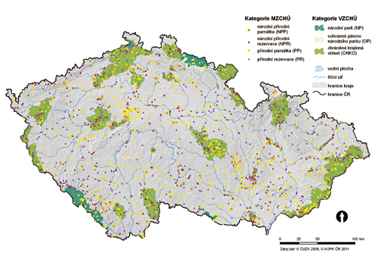
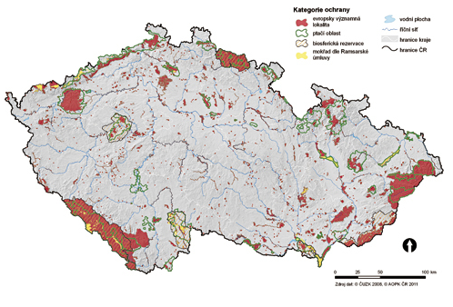
Czech Law on Nature Protection - Act No. 114/1992, on Protection of Nature and Landscape
The traditional system is combined with Natura 2000 EU network.

Slide 20
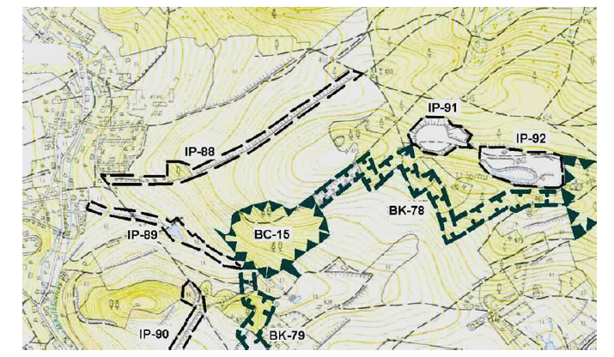
Czech Law on Nature Protection
Protection of landscape character is defined as general protection and, as such, it is valid on the whole territory of the Czech Republic.
More attention is paid to it in Protected Landscape Areas in order to protect the harmonious character of the cultural landscape and to regulate various investment projects.
The authority is competent to grant approval of constructions (or too not approve) and does so in the case of other activities that could harm or change landscape character.
Territorial system of ecological stability
The Territorial System of Ecological Stability (TSES) is a mutually interconnected complex of both natural and near-natural, altered ecosystems that maintain natural balance.
Its main purpose is to reinforce ecological stability of the landscape by conservation or restoration of ecosystems and their mutual interconnection.
In other words, TSES forms green infrastructure in the landscape. It is formed by biocentres and biocorridors. TSES plans are developed for the entire territory of the country.
They serve as documentation for TSES projects, land consolidations and land replotting, processing of territorial planning documentation, forest management plans, water management documents, and other documents regarding protection and restoration of the landscape.

Slide 21
Practical task
Does your country set a network of (traditional) protected sites?
What is the hierarchy of the protective system?
Which protective measures are used?

Slide 22
Protection of Species (CZE)
General protection (§ 5):
All species of plants and animals are protected from destruction, damage, collection or capture that could lead to the extinction of a population or the destruction of an ekosystem + protection of vertebrates against cruelty by Act. 246/1992 Coll.
Protection of birds (§ 5a):
All bird species protected from killing, trapping, scaring, egg collecting, disturbing, keeping
Derogatory regime (§ 5b):Due to various public interests
Specially protected species (including birds)
Categorisation:(a) Critically Endangered (b) Severely Endangered(c) endangered
Protection: in all underground and above-ground parts in all developmental stages, even 'dead' - prohibition to collect, tear, dig, damage, destroy or otherwise disturb in development
- prohibition to possess, cultivate, transport, sell, barter or offer for sale or exchange
Exception: various overriding public interests
Obligation to prove origin!

Slide 23
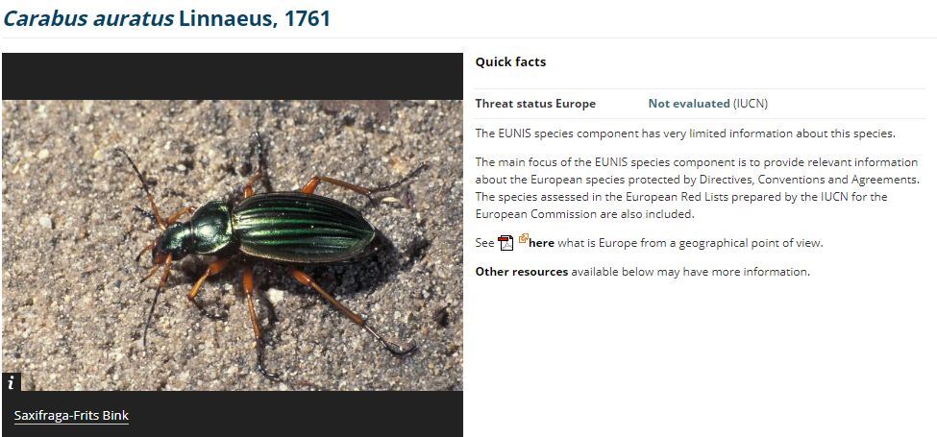
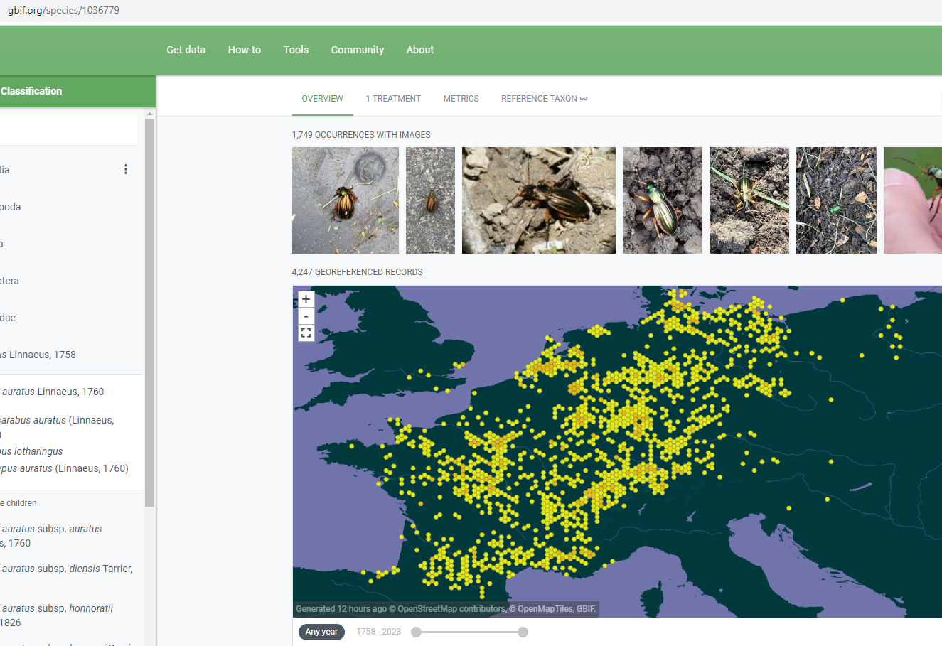
Example: The Golden Beetle

Slide 24
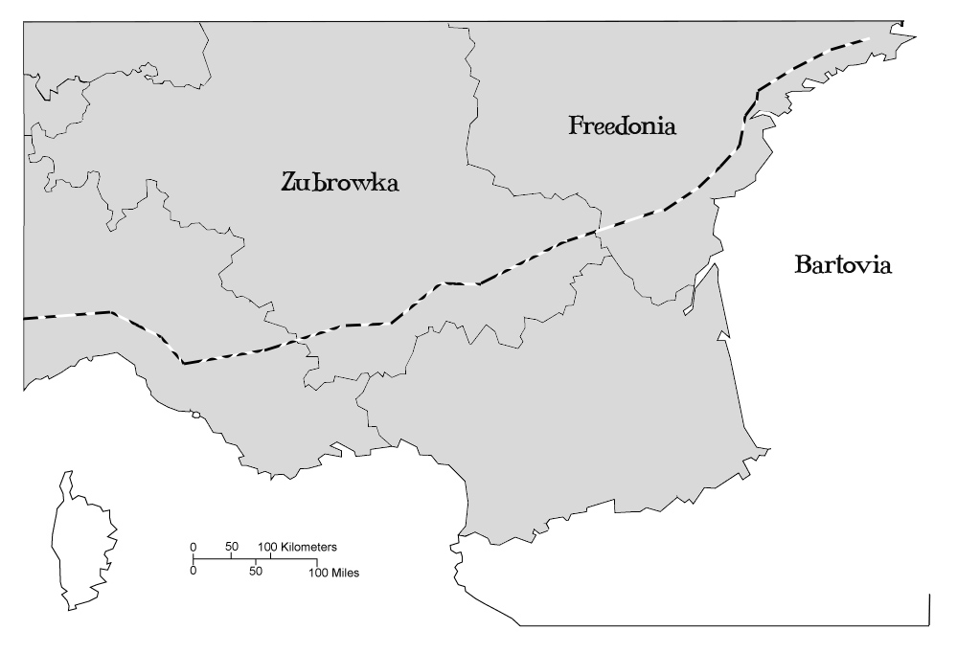

Slide 25
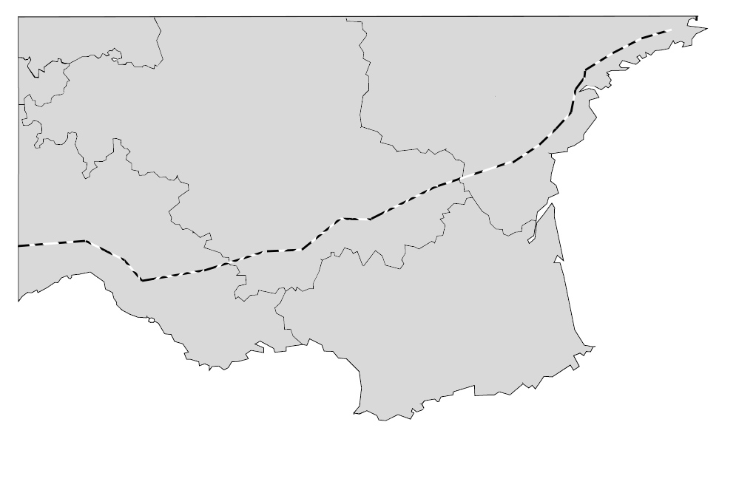

Slide 26
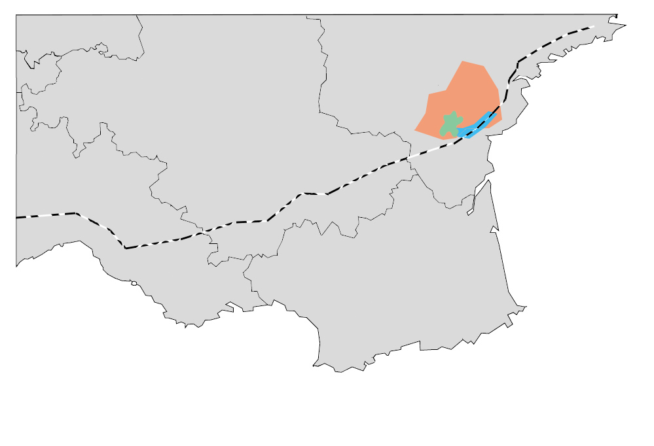

Slide 27
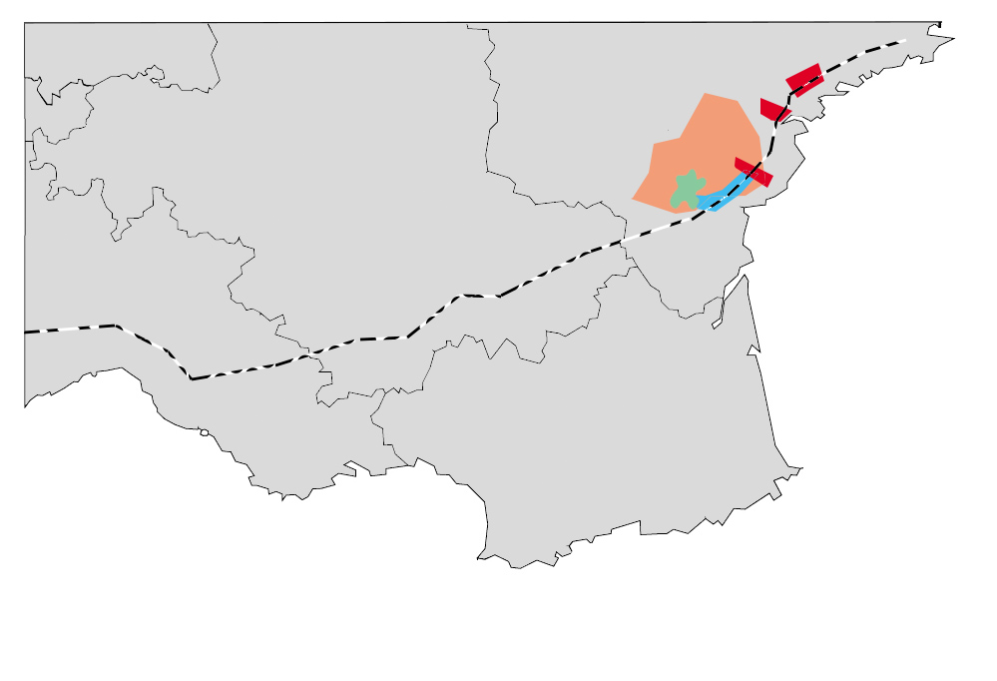

Slide 28
EU ENVIRONMENTAL LAW
Environmental Impact Assessment (EIA Directive, SEA Directive)
(assessment of projects and plans)
EIA Directive, Annex I: 15. Dams and other installations designed for the holding back or permanent storage of water, where a new or additional amount of water held back or stored exceeds 10 million cubic metres
Annex II: 10. (f) Inland-waterway construction not included in Annex I, canalisation and flood-relief works; (g) Dams and other installations designed to hold water or store it on a long-term basis (projects not included in Annex I);
Protection of the site in the NATURA 2000 network (the Habitats Directive)
(protection of the site, assessment of the plans and projects, monitoring)
Protection of the species (the Habitats Directive, the Birds Directive)
(protection against interference, ilegal capture or killing)

Slide 31
THE CASE STUDY
Requirements of the Habitats Directive – easy interpretation
Requirements of the Habitats Directive – difficult interpretation (CJEU case law)
A gray zone – legal questions upon consideration of the official authorities and ultimately of the national judges.

Slide 32
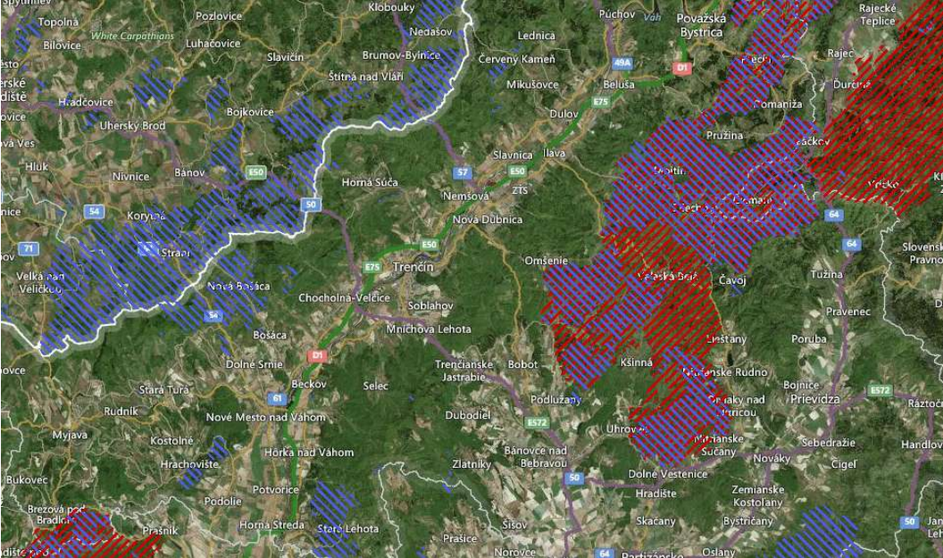
How many NATURA 2000 networks?
http://natura2000.eea.europa.eu/

Slide 33
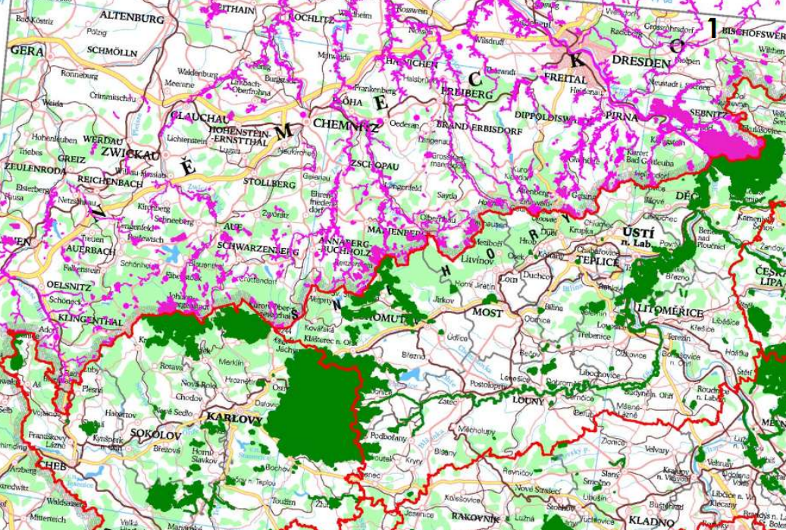
How many NATURA 2000 networks?
http://natura2000.eea.europa.eu/

Slide 35
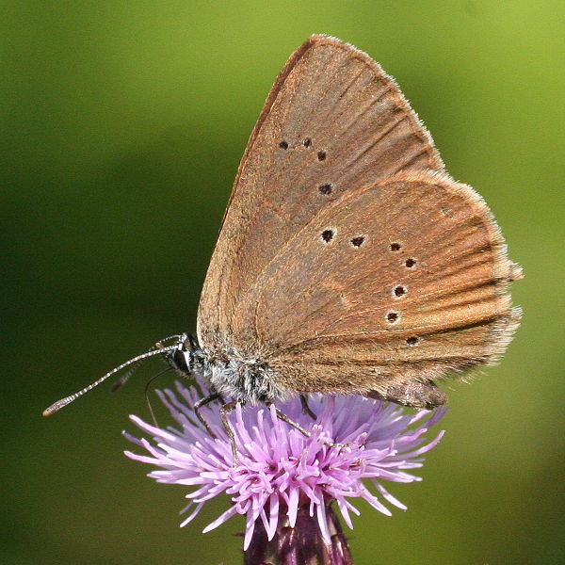
Dusky large blue
(Phengaris nausithous)
The life cycle of this species is strongly related to the herbaceous plant Sanguisorba officinalis (great burnet).
Egg like that of euphemus laid on Sanguisorba. The young larva pale, later on purple-brown and finally probably yellowish-brown, at first at the flowers, later on at the leaves of Sanguisorba.

Slide 36
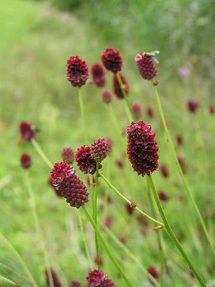
Dusky large blue
(Phengaris nausithous)
The life cycle of this species is strongly related to the herbaceous plant Sanguisorba officinalis (great burnet).
Egg like that of euphemus laid on Sanguisorba. The young larva pale, later on purple-brown and finally probably yellowish-brown, at first at the flowers, later on at the leaves of Sanguisorba.

Slide 37
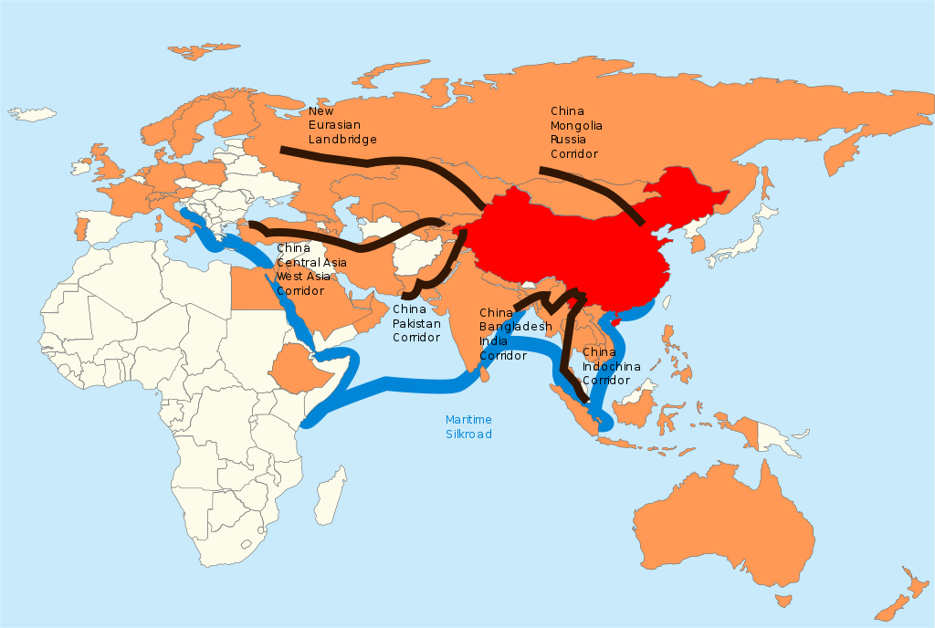
Belt and Road Initiative
The immense project will have environmental effects, generating a substantial carbon footprint, and construction will directly affect environmentally sensitive areas.
The BRI will use more concrete (a major source of greenhouse gas emissions ) than all pre-existing infrastructure projects on the planet.
Notes:
Number of recorded transactions

Slide 38
THE CASE STUDY
Definition of plans and projects
Temporary scope of the Habitats Directive
Requirements of the Art. 6(3) of the Habitats Directive
Existence of alternative solutions
Imperative reasons of overriding public interest

Slide 39
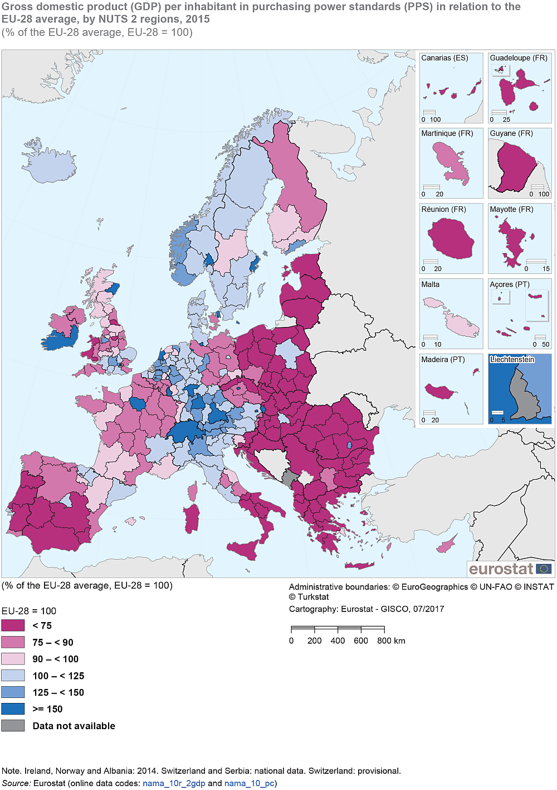
SOLUTION

Slide 40
Thank you for your attention!

