Slide 1

Waste Management
Jiri Vodicka, Ph.D. 13. 12. 2023

Slide 2
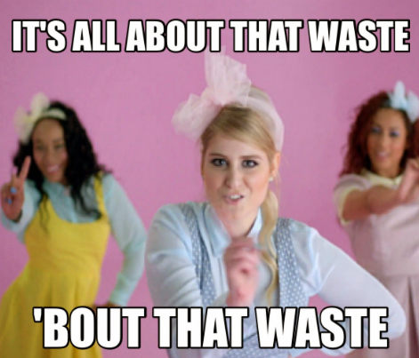
Structure
Introduction
Current Issues
Sources of Law
Waste Framework Directive
Green Deal

Slide 3
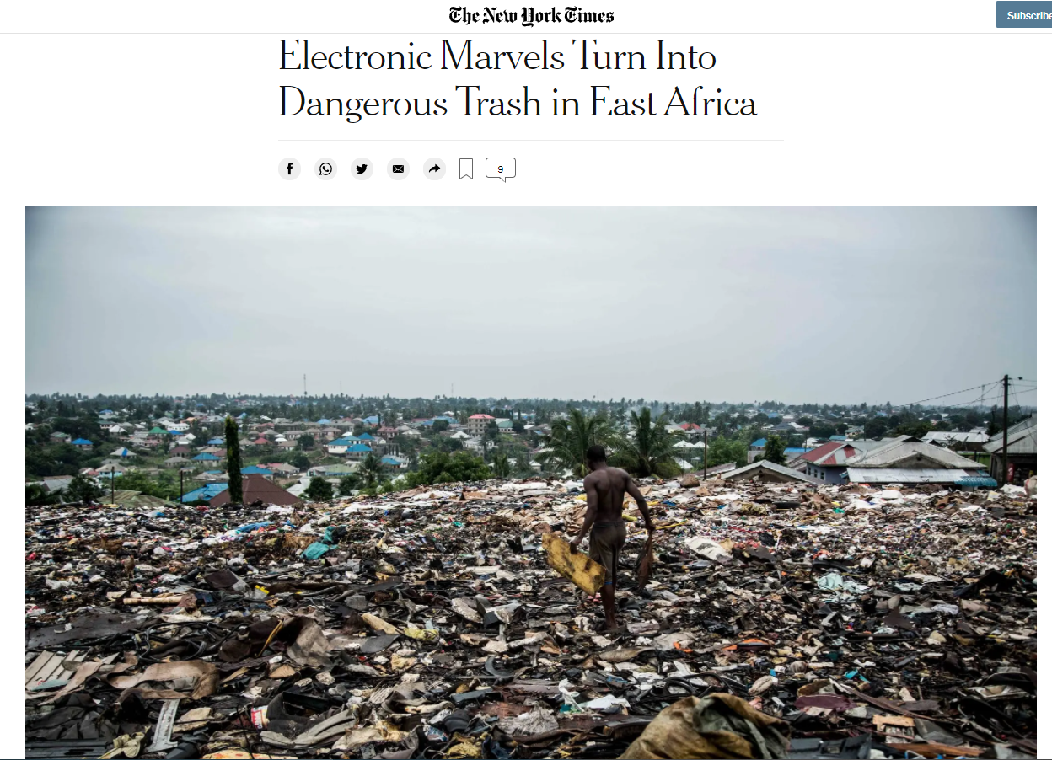
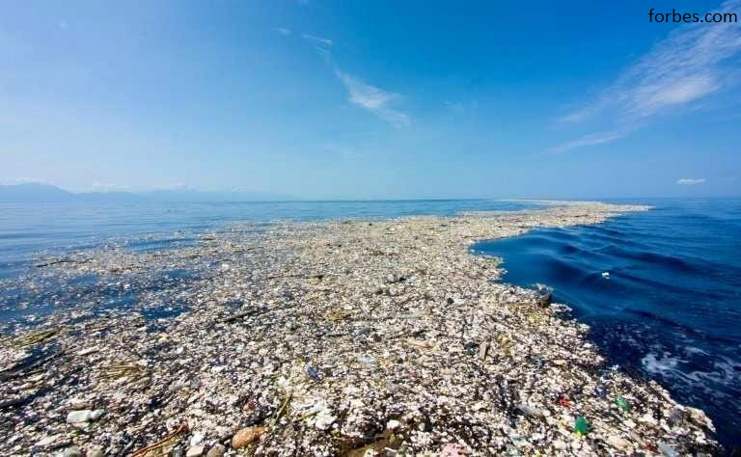
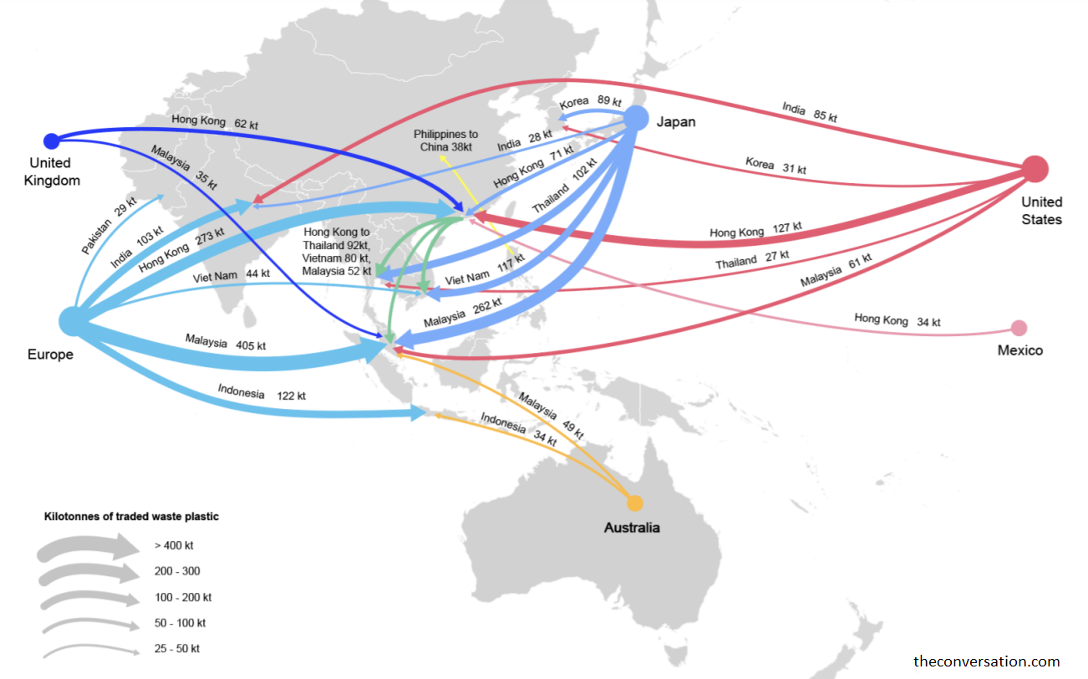
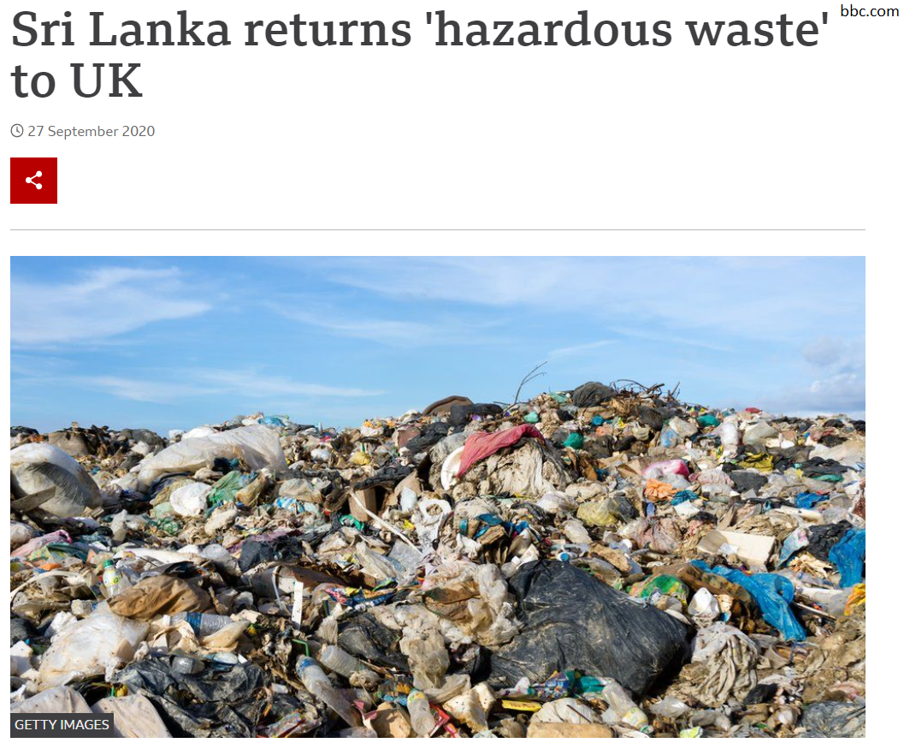
Is there a need to regulate?
YES!
Consumer behaviour x manufacturers (producers) x products
Local x International level x EU
Dangerous (toxic) x E-waste x other
Where to store it?
Notes:
Electronic Marvels Turn Into Dangerous Trash in East Africa https://www.nytimes.com/2019/05/12/climate/electronic-marvels-turn-into-dangerous-trash-in-east-africa.html
https://theconversation.com/think-all-your-plastic-is-being-recycled-new-research-shows-it-can-end-up-in-the-ocean-155208
Where Does Plastic Come From? - The $79 Billion Industry https://howmuch.net/articles/plastic-trade-around-the-world
Circular Economy - https://www.europarl.europa.eu/thinktank/infographics/circulareconomy/public/index.html

Slide 4
Current issues
Microplastics
Landfilling
Consumerism
Circular economy
Toxic waste
Outdated technology
Food waste
GHG
Notes:
Food Waste: Last Week Tonight with John Oliver (HBO) https://www.youtube.com/watch?v=i8xwLWb0lLY
The Great Pacific Garbage Patch Is Not What You Think It Is | The Swim https://www.youtube.com/watch?v=6HBtl4sHTqU

Slide 5
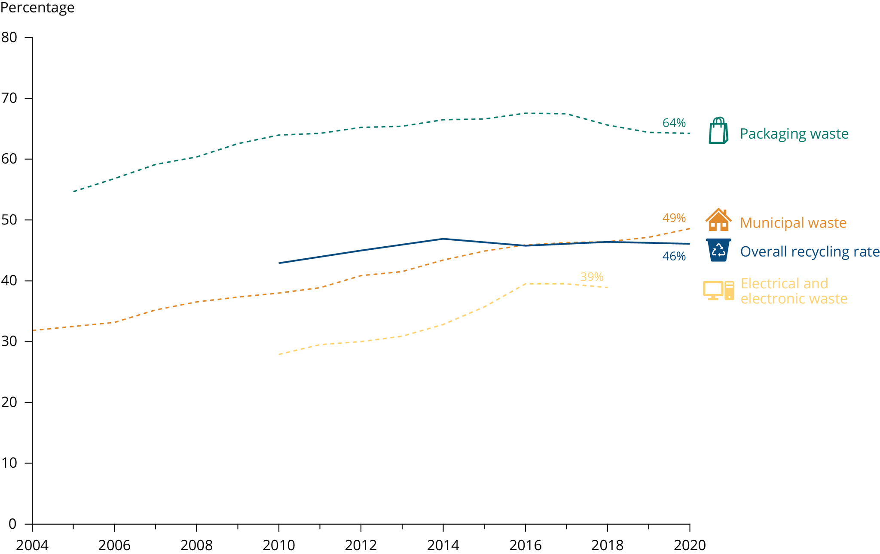
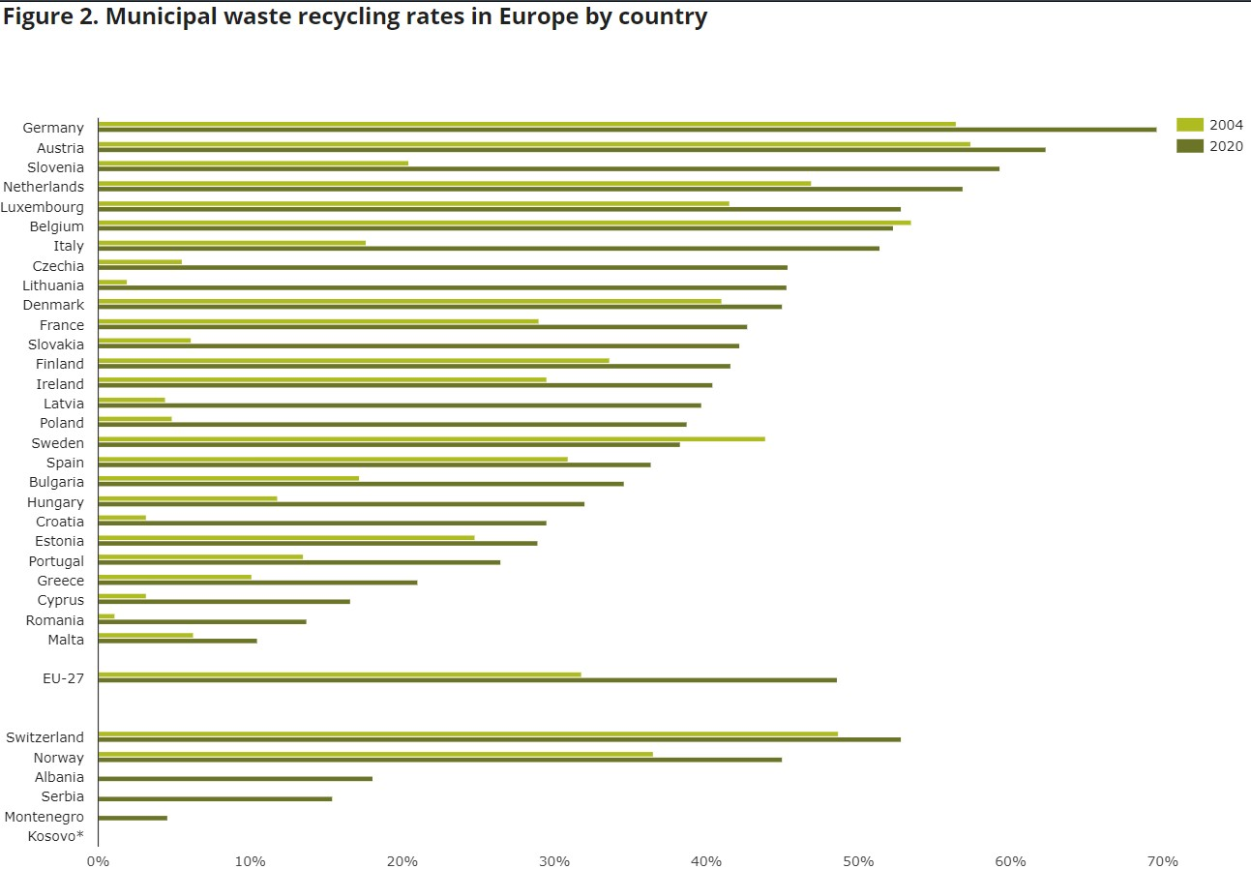
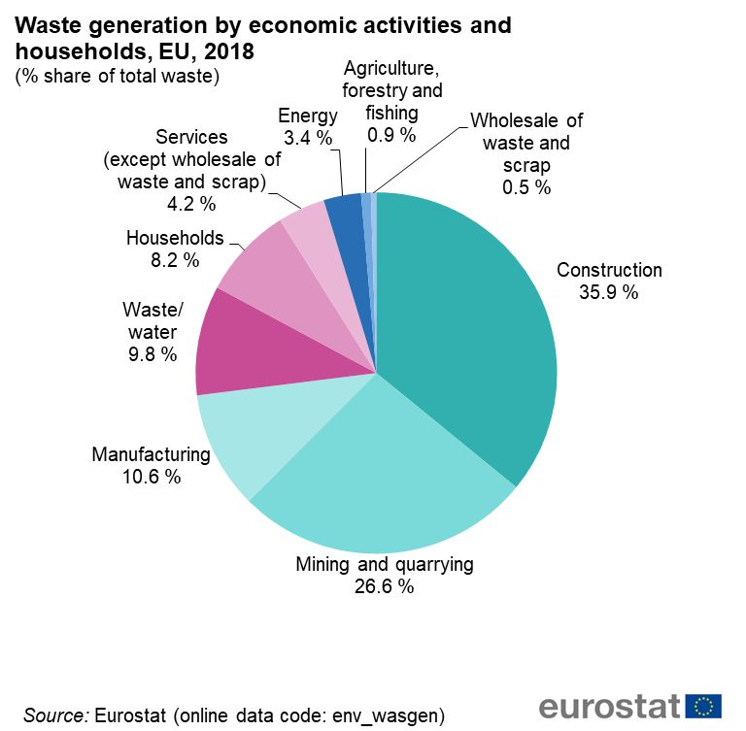
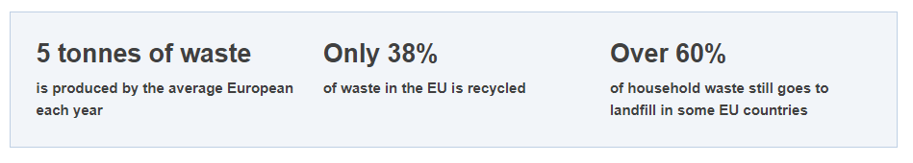
Sources of waste
Recycling rate in EU
Notes:
Pictures: eea.eu, eurostat.eu

Slide 6
Sources of Law - International
International customs
General widely recognised principles of law
Bilateral Agreements
  Bilateral Preferential Trade Agreement between Japan & China (2008)
Basel Convention on the Control of Transboundary Movements of Hazardous Wastes and Their Disposal (1989)
Convention to Ban the Importation into Forum Island Countries of Hazardous and Radioactive Wastes and to Control the Transboundary Movement and Management of Hazardous Wastes within the South Pacific Region (Waigani Convention)

Slide 7
Sources of Law - EU
General framework
CJEU case-law
Regulation No. 1013/2006 on shipment of waste
Directive 2008/98/EC on waste (FWD)
Directive 1999/31 on the landfill waste
Directive 2010/75 Industrial emissions directive
Specific waste
management
Notes:
List of legislation: https://www.municipalwasteeurope.eu/summary-current-eu-waste-legislation

Slide 8
Sources of Law - EU
Specific waste streams
Directive 2000/53 End-of-life Vehicles directive
Directive 2006/66 Batteries directice (new regulation is coming)
Directive 2009/125 Ecodesign directive
Directive 2012/19 Waste Electrical and Electronic Equipment (WEEE)
Directive 2015/720 Plastic Bags directive
Directive 2018/852 Packaging and Packaging Waste directive
Directive 2019/904 on the reduction of the impact of certain plastic products on the environment (single use plastic) etc..

Slide 9
EU waste management framework
Precautionary principle
Prevention principle
Polluter pays principle
Integrated protection
Disposal at source
Since 1975
3 governing principles
  Prevention principle
  Self-sufficiency
  High level of protection
Reduce generation of waste
Limit hazardous substances in waste
Waste as a resource
Aims

Slide 10
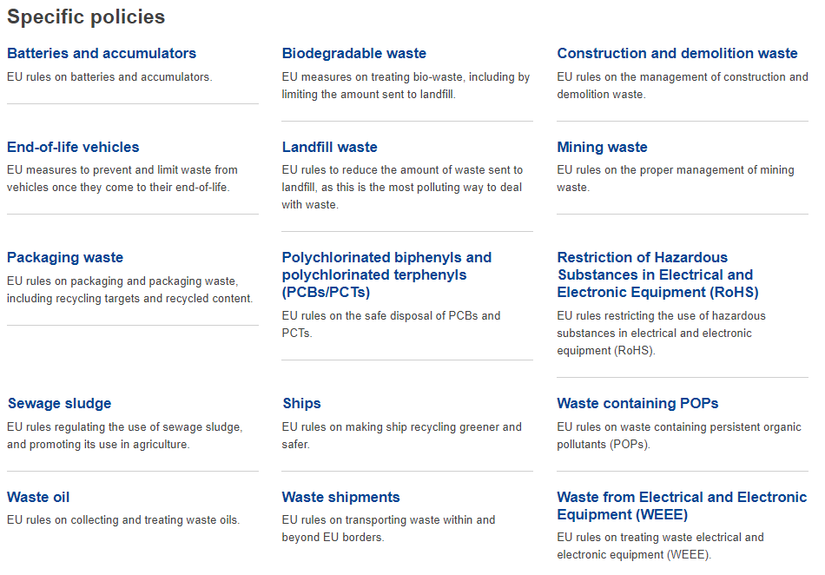
EU waste management framework
EU waste policy objectives
  Improve waste management
  Stimulate innovation in recycling
  Limit landfilling
General framework + Specific policies

Slide 11
Framework Directive on Waste 2008/98 (FWD)
General Directive
Key concepts
Major principles
Allocation of responsibilities
x specific streams of waste
x specific waste management

Slide 12
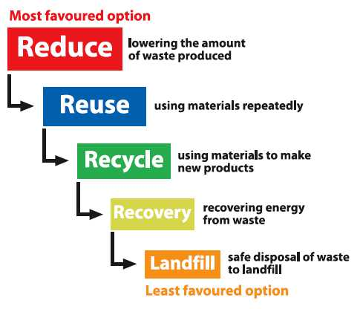
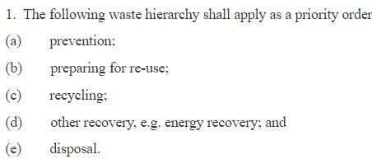
FWD - Waste management hierarchy

Slide 13
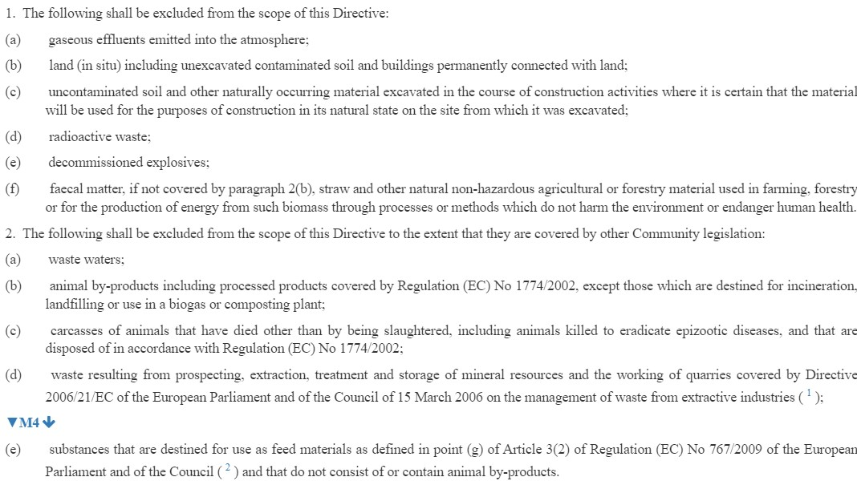
FWD - waste
What is a waste?
Waste
Hazardous waste
Non-hazardous waste
Municipal waste
Bio-waste
Waste oils
Construction and demolition waste
Food waste

Slide 14
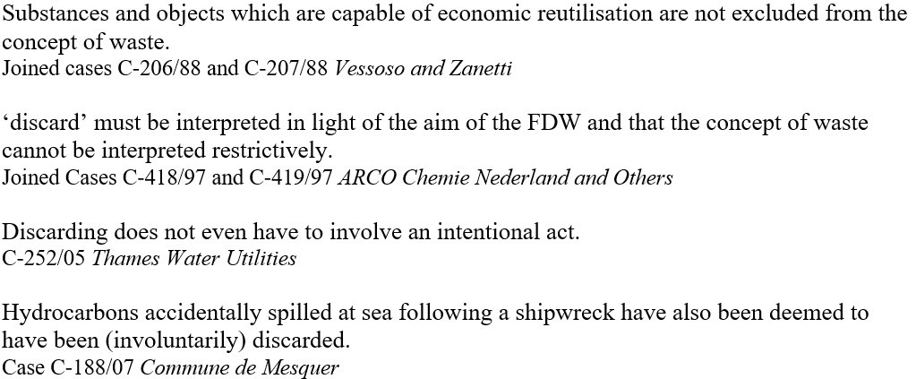
FWD
Waste means any substance or object which the holder discards or intends or is required to discard
Problematic interpretation of „discard“
Excavation material as waste or by-product
C-238/21 Porr Bau

Slide 15
FWD - Waste or not?
Important is perspective of producer (holder) of product/waste
  Only the holder of the products can prove that he intends not to discard those products (C-113/12)
  Waste needs to be interpreted widely not restrictively!
Criteria based on case law
Waste
Waste
By-product
Waste recovery & recycling

Slide 16
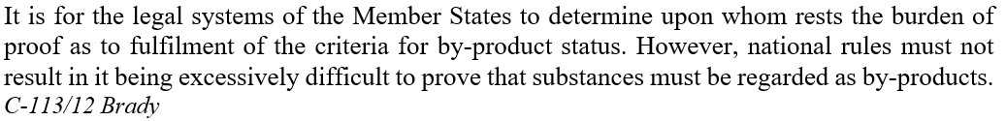

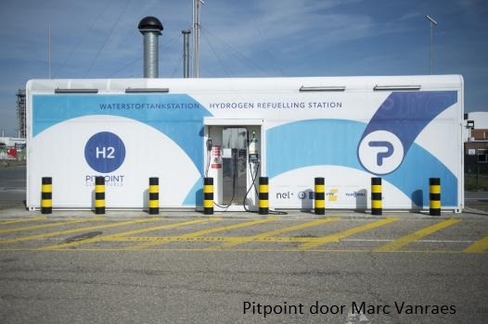
FWD - Waste or not?
By-product needs to fulfill criteria:
  Further use is certain
  The substance can be used directly without any further processing other than normal industrial practice
  Not primary production intention but is an integral part of production process
  Further use is legal
Toxic x non-toxic

Slide 17
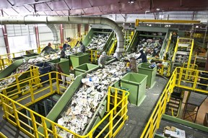
FWD - Waste or not?
Recovery of waste (end-of-waste criteria):
  The substance or object is commonly used for specific purposes
  A market or demand exists for such a substance or object
  It fulfils the technical requirements for the specific purposes and meets the existing legislation and standards applicable to products
  Its use will not lead to overall adverse environmental or human health impacts

Slide 18
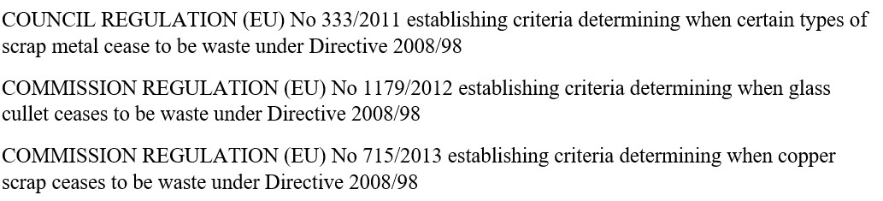
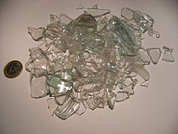
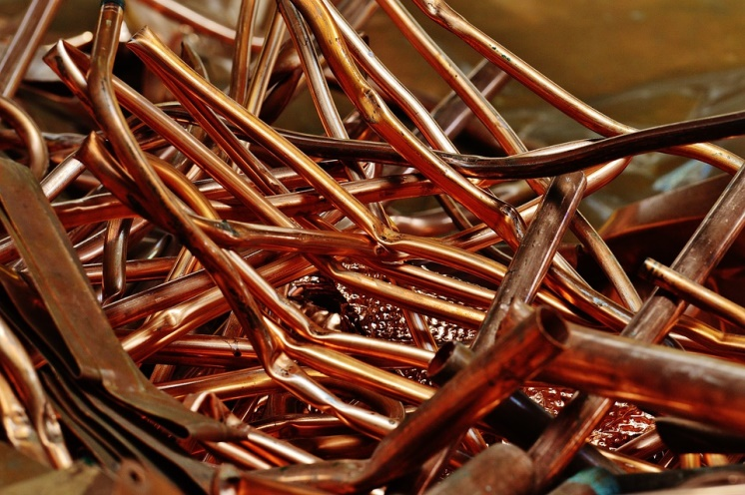
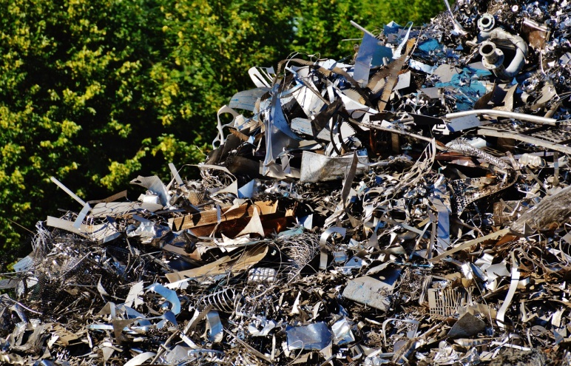
FWD - Waste or not?
EU End-of-waste criteria only for certain materials
x
Case by case at national level
Glass cullet
Copper scrap
Scrap metal

Slide 19
FWD - Waste recovery & recycling
Recycling: any recovery operation by which waste materials are reprocessed into products, materials or substances whether for the original or other purposes
Recovery: any operation the principal result of which is waste serving a useful purpose by replacing other materials which would otherwise have been used to fulfil a particular function, or waste being prepared to fulfil that function, in the plant or in the wider economy
  Material recovery

Slide 20
Types of waste
Waste
Hazardous
Other
Municipal

Slide 21
FWD - Hazardous waste
Exceptions
for MS
Properties: explosive, corrosive, carcinogenic, and ecotoxic
  Annex III of FWD + Commission decision 2000/532 (only ⃰ )
Ban on the mixing of hazardous waste with other waste or substances
Traceability from production to final destination
Packaging and labelling requirements
Hazardous waste may cease to be waste (recovery)
Case C-358/11 Lapin luonnonsuojelupiiri

Slide 22
FWD - Waste management
treatment means recovery
or disposal operations,
including preparation prior
to recovery or disposal
Treatement of waste
  Waste producer
  Licensed person
  Public x private collector
Responsibility problem
  Does the producer retain responsibility (for the whole chain) or can the responsibility be shared among actors of chain?
Obligation of MS is to make sure that the permit system set up is in fact applied and complied with, in particular by conducting appropriate checks for that purpose and ensuring that operations carried out without a permit are brought to an end and punished. Case C-196/13 Commission v Italy

Slide 23
FWD - Waste management
Broad discretion
by MS
Polluter-pays principle
  Costs of waste management to be born by original waste producer
  MS can decide that distributors share the costs
MS can limit incoming/outgoing shipments
  Environmental grounds

Slide 24
General Targets
Member States shall take the necessary measures to ensure that by 2035 the amount of municipal waste landfilled is reduced to 10 % or less of the total amount of municipal waste generated (by weight). Landfill directive
Recycling target for municipal waste to 55 % by 2025; 60 % by 2030; 65 % by 2035 FWD
Sustainable Development Goal: to reduce food waste to 50 % by 2030

Slide 25
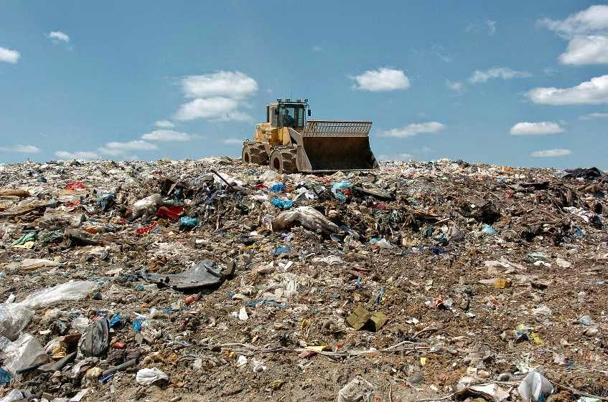
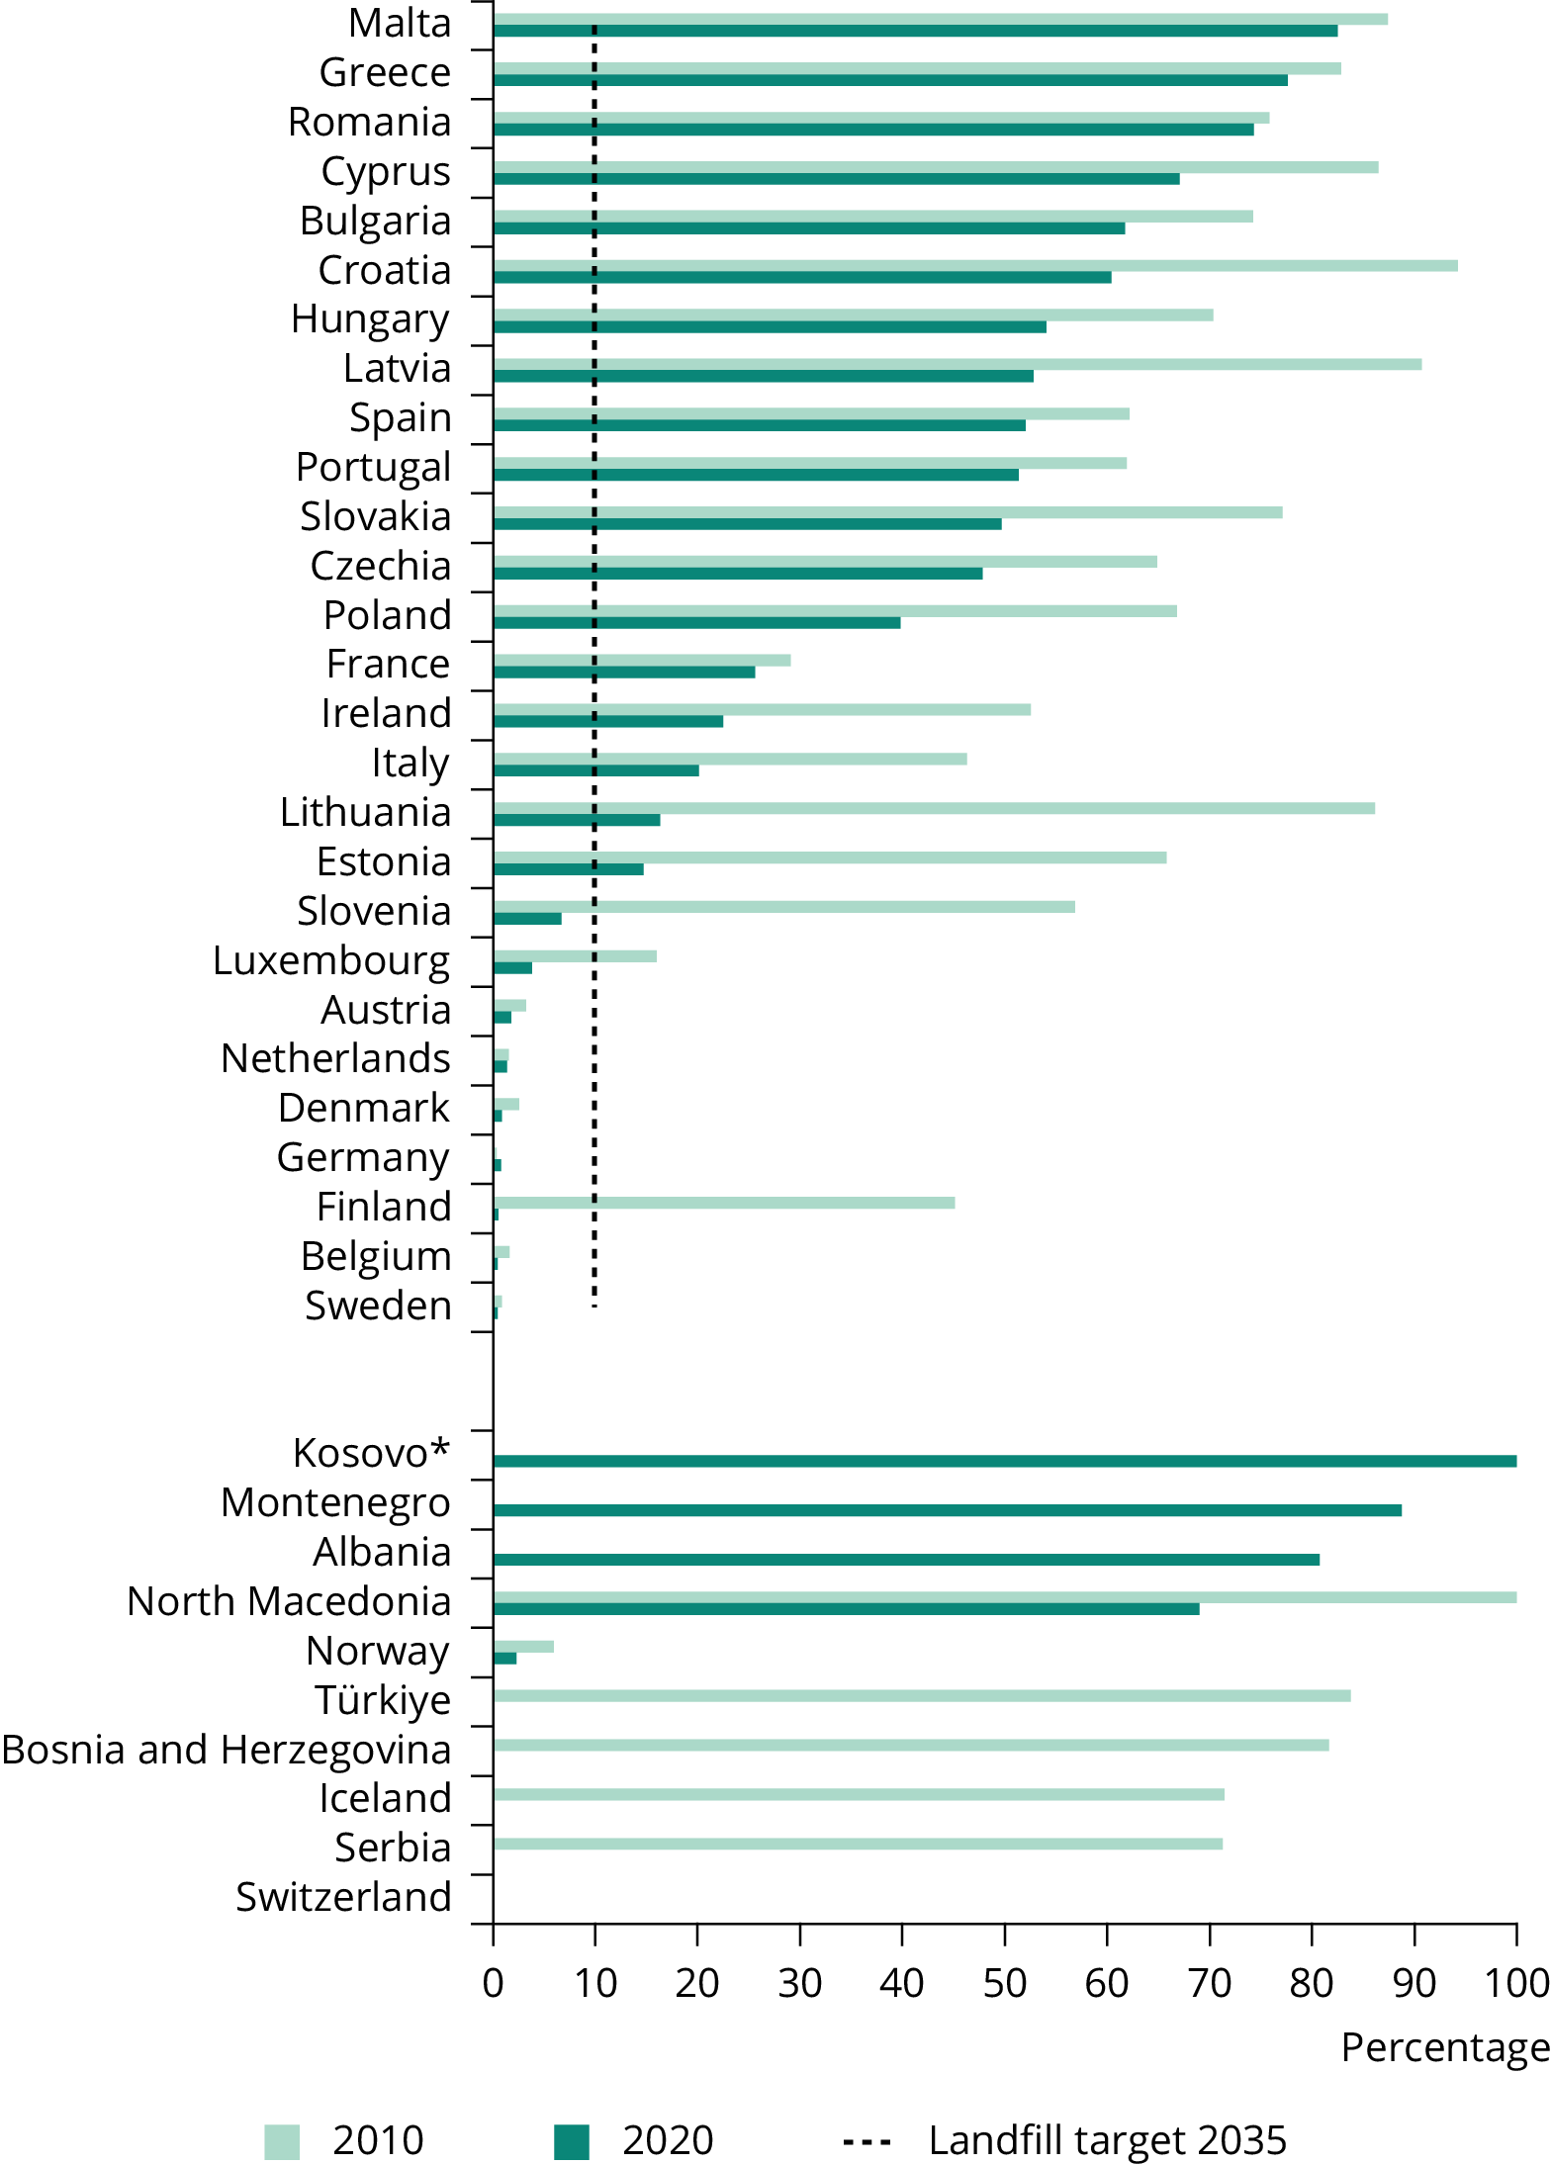
Landfill Directive
„Waste disposal site for the deposit of the waste onto or into land (i.e. underground)“
The worst and extreme end of waste
Types: hazardous – other – inert
3 phases (using, closing & recultivation, after care)
  closed after final on site inspection carried out by competent authority
  operator remains responsible for maintenance and control of the site
Tato fotka od autora Neznámý autor s licencí CC BY-SA-NC

Slide 26
FWD - Extended producer responsibility
Duties of producers of products from which the waste came
Obligation to accept returned product
Subsequent management of the waste and financial responsibility for such activities
  Who bears the cost? Producer/distributor
e.g. packaging waste, end of life vehicles, batteries, electric and electronic equipment

Slide 27
Packaging waste
packaging: „all products made of any materials of any nature to be used for the containment, protection, handling, delivery and presentation of goods“
recycling targets for materials contained in packaging waste
  collection systems - producer responsibility organisations
  now: separate collection shall be set up for at least the following: paper, metal, plastic and glass (art. 11 WFD)
  future: mandatory separate collection of bio-waste by 2024, textiles by 2025
  obligation to offer re-usable packaging

Slide 28
Plans, programmes, policies
Waste management plans
Obligation of MS
WMP shall cover the whole territory of the MS
Evaluation at least every sixth year -> review
Targets & measures
Waste prevention programmes
Separate document, integral part of WMP or other environmental policy programme
Description and evaluation of prevention measures
  Annex IV WFD

Slide 29
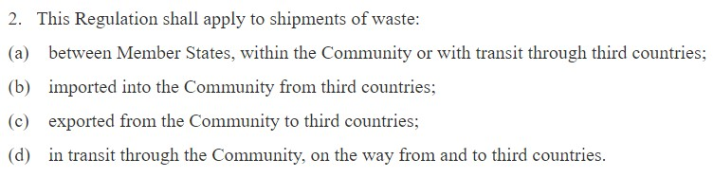
Shipment of waste
Commission v Czech Republic
C-399/17
Regulation No. 1013/2006
  Waste (definition WFD)
  Establishes procedures and control regimes for the shipment of waste
  Prior consent of the authority of destination
  Notifications through competent authorities
  Financial guarantee
Basel Convention
  Hazardous waste
  OECD x non-OECD countries (ban)
Notes:
https://ec.europa.eu/commission/presscorner/detail/IT/IP_16_2492

Slide 30
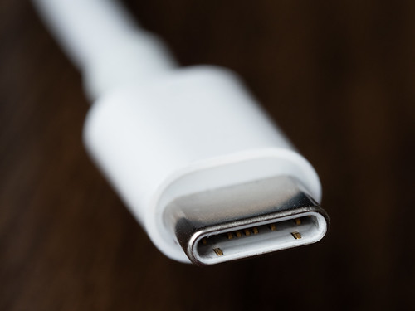
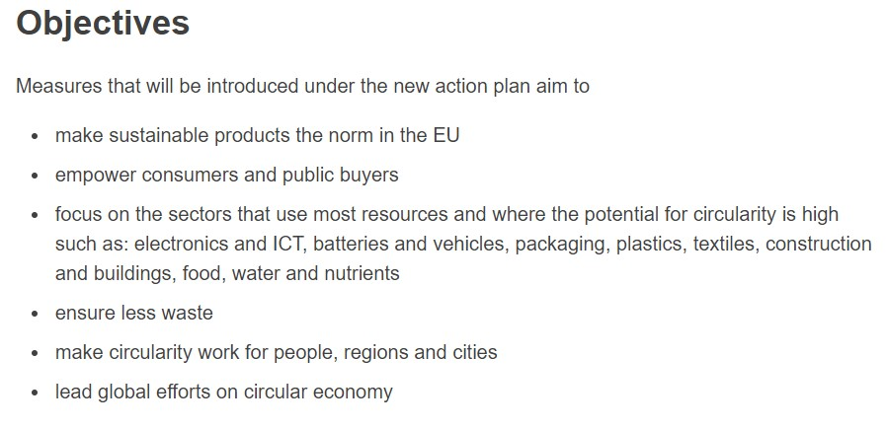
Waste and Green Deal
Transition to circular economy
  Sustainable growth
  Natural resources
  Creation of jobs
Sustainable and circular textiles
Proposal for ecodesign of sustainable products
Microplastics reduction
Revision of packaging
Right to „repair“
Radio Equipment Directive
Notes:
https://environment.ec.europa.eu/strategy/circular-economy-action-plan_en
https://www.europarl.europa.eu/RegData/etudes/BRIE/2022/698869/EPRS_BRI(2022)698869_EN.pdf
https://environment.ec.europa.eu/strategy/textiles-strategy_en

Slide 31
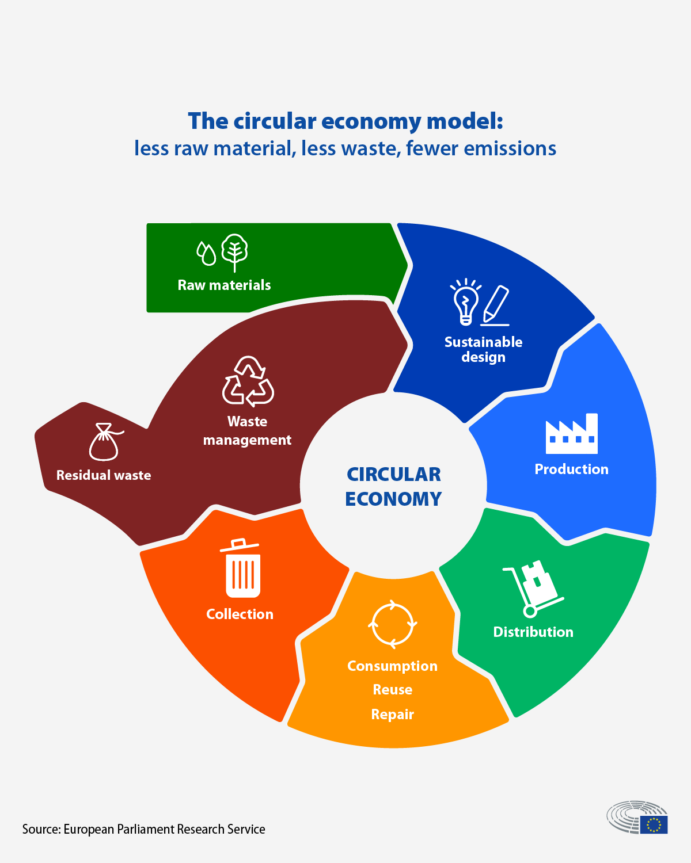
Circular Economy
Notes:
https://www.europarl.europa.eu/news/en/headlines/economy/20151201STO05603/circular-economy-definition-importance-and-benefits

Slide 32


Slide 33
Thank you for your attention!
Jiri.Vodicka@law.muni.cz

Slide 34
Sources
Hanak J., Waste management, MU, 2021.
Langlet D., Mahmoudi S., EU Environmental Law and Policy, Oxford University Press, 2016.
European Commission
European Environment Agency

