Slide 1
Czech Administrative Law
MVE009Zk Czech Law in Global Context
29. 11. 2024
JUDr. Anna Chamráthová Richterová, Ph.D.
Department of Administrative Studies and Administrative Law, Faculty of Law, Masaryk university

Slide 2
Qustions and possible answers:
How does Czech legal theory views public administration?
What is the relation between administrative law and public administration?
Why do we have (in a legal order) administrative law?
What is the purpose of administrative law?
Which examples/issues are under legal regulation by administrative law?

Slide 3
Public Administration in point of view of its organization + activity + control
Public Administration and Administrative Law - relationship
System of Administrative Law (according to the Czech theory/doctrine)
System of Public Administration in the Czech Republic – its organization („who conducts administrative law“)
System of Public Administration activity; public administration as an activity and its forms („what different procedural types do we have“)
Control system of Public Administration

Slide 4
Administration and Public Administration
Administration – deliberate/intentional activity aimed at a certain goal, consists of management and organisation, not identical with the term "management„
Private administration - private entities, private interest, private goals, private affairs, private measures, all that is permitted that is not prohibited
Public administration – public law entities (public administration bodies/administrative bodies), duty, public goals and tasks, public law measures (forms), public interest, public affairs (public tasks), allowed is only that that is allowed by law
Public administration/state is not a "business" - the necessity to implement public tasks (regardless of profit and popularity) and to fulfill and protect/promote the public interest

Slide 5
Possible Views on Public Administration
Organisation – WHO, system of bodies conductiong public administration
Activity – WHAT (also HOW), scope of actions within public administration, system of good governance may be included
  Reason of existence of public administration

Slide 6
System of Czech Public Administration
State administration
Self government
Public administration
State administration belongs to the state; important part of public adminstration, different task of the state are perfomed by the state and its bodies („direct state administration“), but also „indirectly“ by other bodies that are not part of the state administration („indirect/transfered state administration“) – there are bodies of territorial unites entitled (and also obliged) by law to perform state administration instead of the state and its bodies („mixed model of state administration“) – specific „representation“ – they perform the state administration, but in origin, are not part of this body
Self government includes local, regional and also „university/interest and professional“ self-government (advocates, tax advisors, doctors, dentists, pharmacists, …)

Slide 7
University self-administration/government
Representative body („akademický senát“): is elected by all students and academic staff, elects (rector/dean), approves university statutes
Existence of disciplinary body („disciplinární komise“) to punish students https://is.muni.cz/auth/do/mu/Uredni_deska/Predpisy_MU/Masarykova_univerzita/Vnitrni_predpisy_MU/Disciplinarni_rad_pro_studenty_masarykovy_univerzity/Disciplinarni_rad_pro_studenty_Masarykovy_univerzity__ucinny_od_1.9.2022_.pdf
Existence of university statutes/norms (Study and Examination Regulation, fees, …) https://is.muni.cz/auth/do/mu/Uredni_deska/Predpisy_MU/Masarykova_univerzita/Vnitrni_predpisy_MU/Studijni_a_zkusebni_rad/124377837/II._Consolidated_text_of_the_Masaryk_University_Study_and_Examination_Regulations__1._3._2022_.pdf

Slide 8
System of (Czech) Administrative Law
Administrative Law („Správní právo“)
is the biggest branch/part of law/legal system; part of public law
regulates relations in Public Administration
its organization (at different levels) and
its functions/activities; public administration is based on (intentional) activity
its funcion in the society;
to gain public goals and
to protect public interest
represents a possibility of using public power; protects public interest; examples of superiority

Slide 9
(Mighty) Administrative Law - why?
Public Administration surrounds us in everyday life: public media and press, healthcare, public transport, traffic regulation, education, hygiene and consumer protection, fines, ...
Public Administration follows us, it goes step by step with us in our life (from birth to death): health care, birth - register, kindergarten and compulsory school attendance, identity card, driver's license, travel document (passport), unemployment, university admission, studies, dealings with the authorities (purchase of real estate, registration vehicles), wrongdoing, marriage/partnership, business, pension insurance, death, …

Slide 10
System of (Czech) Administrative Law
One possible division:
Administrative Law
General part
What is common: general rules, institutes, organization, sources of legal regulation, forms of activity, liability, control of public administration, etc., also different procedural aspects of conducting public administration
Special part
Legal regulation of different „branches“ of public administration and administrative law – „construction law“, „health care law“, „school law“, „cultural law“, „police law“, „refugee law“, „ius gentium“, law of electronic communication, expropriation, etc (about houndreds of laws and other norms, also law of the EU)

Slide 11
System of (Czech) Administrative Law
Second possible division:
Administrative Law
Organizational Administrative Law
Procedural Administrative Law
Substantive Administrative Law
Administrative Punishment Law/Criminal Administrative Law
„Who“ – legal regulation of organization of public administration – state administration (central, regional, local), self government, …
„How“ – different procedural aspects of administrative law, procedural forms of activity, also (subsequent) judicial control – administrative justice
„What“ – rights and duties at different branches of public administration
„What will happen if the regulation is violated“; it contains features of organization, procedural and substantive administrative law

Slide 12
Organizational Administrative Law
Act no 2/1969 Coll. On the establishment of ministries and other central state administration bodies
Act no 128/2000 Coll. Municipalities Act
Act no 129/2000 Coll. Regions Act
Act no 131/2000 Coll. On the capital city of Prague
Act no 51/2020 Coll. On territorial state administration division
Act no 349/1999 Coll. On the Public Rights Defensor/ombudsman

Slide 13
Administrative Procedural Law
Procedural part of Administrative Law (different procedures that can be found in public administration) – protection of rights
Code of Administrative Procedure (act no 500/2004 Coll.)
Code of Administrative Justice (act no 150/2002 Coll.)

Slide 14
How we can know if the state is democratic and legal?
Adolf Merkl (Austrian scientist) wrote in the 30´s that such state recognizes:
Principle of legality, rule of law
Existence of self – government and
Judicial control of public administration – administrative justice
Example: In the Czechoslovakia these roots were destroyed from 1948 to 1989
So, thanks to this heritage, we should be aware and be carefull, if someone will try to limit it (due also „economic“ reasons)

Slide 15
Substantive Administrative Law (for example)
Acts on: IDs (269/2021 Coll.), passports (329/1999 Coll.), foreigneres (326/1999 Coll.), asylum (international protection) act (325/1999 Coll.), interim protection (221/2003 Coll.) building act (183/2006 Coll.), expropriation act (186/2006 Coll.), state monument care (20/1987 Coll.), education (561/2004 Coll.), universities (111/1998 Coll.), Police of the Czech Republic (273/2008 Coll.), state citizenship (183/2013 Coll.), health service (372/2011 Coll.), special helath service (373/2011 Coll.), guns (119/2002 Coll.), name and surname (301/2000 Coll.), protection of public health (258/2000 Coll.), sea cruise (61/2000 Coll.), domestic cruise (114/1995 Coll.), civil aviation (49/1997 Coll.), railways (266/1994 Coll.), digital service (12/2020 Coll.), nuclear energy (263/2016 Coll.), fireman service (320/2015 Coll.), libraries (257/2001 Coll.), spas (164/2001 Coll.),

Slide 16
Administrative Punishment Law/Criminal Administrative Law
Act no 250/2016 Coll. Code of Administrative Offenses
Act no 251/2016 Coll. On some administrative offenses

Slide 17
System of Czech Public Administration
Local/regional self government (based in Constitution, European Charter of Local Government) – is protected, „prepares the politicians for the national/state level“
14 regions (all perform also state administration)
+/- 6254 municipalites (cca 30 cities with specific regime – division between part of such cities and the city itself); all of them perform (of course) self government and the state administration (but in different scope – three cathegories of the municipalites, only for the tasks of STATE administration)

Slide 18
System of Czech Public Administration

Slide 19
System of Czech Public Administration

Slide 20
System of Czech Public Administration
Government and ministries (14) (and other central administrative bodies – 17: 1. Czech Statistical Office, 2. Czech Office for Surveying, Mapping and Cadastre, 3. Czech Mining Authority, 4. Industrial Property Office, 5. Office for the Protection of Competition, 6. Administration of State Material Reserves, 7. State Office for Nuclear Safety, 8. National Security Authority, 9. Energy Regulatory Office, 10. Office of the Government of the Czech Republic, 11. Czech Telecommunication Office, 12. Office for Personal Data Protection, 13. The Council for Radio and Television Broadcasting, 14. Office for the Supervision of the Management of Political Parties and Political Movements; 15. National Office for Cyber and Information Security, 16. National Sports Agency, 17. Digital and Information Agency and „independent“ bodies as Czech National Bank or Supreme Control Office
State administrative bodies with the whole state/national scope: National Heritage Institute, Czech Social Security Administration, Labor Office, State Labor Inspection Office, Civil Aviation Office, General Financial Directorate, Specialized Tax Office, Railway Authority, Office for International Legal Protection of Children, State Institute for Drug Control, National Accreditation Office
Local Specialized bodies: Tax offices (14), regional sanitary stations (14), regional military headquarters (14), district social security administration (84), district mining offices (8), cadastral offices, inspectorates (84)
Indirect state administration perfomed by the bodies of regions and municipalites

Slide 21
System of Czech Public Administration
Art. 1 section 1 of law nr. 500/2004 Coll., Code of Administrative Procedure
„This Act regulates the procedure of executive bodies, bodies of territorial self-governing units and other bodies, legal and natural persons, if they exercise competence in the field of public administration (hereinafter referred to as "administrative body").“
Executive body – ministries and central administrative bodies - act no 2/1969 Coll.
Bodies of territorial self-government units – 14 regional offices and about 6254 municipalities offices
Other bodies
Legal and natural persons – universities (disciplinary committee), chamber of attorneys, chamber of „doctors“, etc. (about 10 chambers with the right to self government)

Slide 22
Activity of Public Administration
Public administration as activity of administrative bodies is represented by the system of forms („formy činnosti“, „formy działania“, „Handlungsformen“)
Variety of forms – a lot of tasks and duties of public adminstration in the 21st century
In general, they are mostly regulated (their the procedural aspects) by the act nr. 500/2004 Coll. – Code of Administrative Procedure (CAP) – the principle of legality

Slide 23
Activity of Public Administration
Necessity of division of forms of activities of public administration:
Who can issue?
Who can change?
Who can abolish?
Who is bound by them?

Slide 24
Activity of Public Administration
Forms of public administration activity
Administrative act | normative administrative act
 | individual administrative act
 | mixed administrative act
Public law contract
Factual act and immediate intervention
24

Slide 25
Activity of Public Administration
Form(s) of activity:
Outcome/result of public administration activity; several forms (due to complexity of public tasks and goals)
Shows in which ways/forms is the public administration realized and applicated
Presents scope of administrative and (later) judicial protection.
Normative approach to the forms: which forms has the public administration permited/allowed and „prescribed“ to fulfill its tasks (principle of legality), helps the public administration
Instrumental approach: the system of forms protects the individual rights, another than prescribed form can´t be applied/used

Slide 26
General rules/principles of public administration activity
In Constitution (act no 1/1993 Coll. – principle of legality, legal basis for the establishment of authorities, order of the government – government regulation), Charter of Fundamental Rights and Freedoms (no 2/1993 Coll.) – right for a fair trial (art. 36 sec. 1) and judicial protecion (art. 36 sec. 2)
Art. 6 European Convention on Protection of Rights and Freedoms – is applicable also to the administrative procedure? – existence of judicial protection
Art. 2 – 8 CAP (principles of good administration): legality, proportionality, protection of good will, legitimate expectations, public service, alternative solutions, speed and economy, minimalization of interventions, equality, cooperation – binding for the administrative bodies
Soft law: Rec (2007) 7 on good governance

Slide 27
Legal regulation of administrative procedure
In general is in the CAP (art. 1 sec. 2) „This Act or its individual provisions shall apply unless a special Act provides otherwise.“, so CAP:
as lex generalis (about 300 laws in position of lex specialis), we can find bigger or lower „deviations“,
about 180 provisions, in effect since 2006

Slide 28
Legal regulation of administrative procedure
CAP in the Czech history:
8/1928 Coll. – 137 provisions, „only“ administrative procedure
20/1955 Coll. – 53 provisions, „only“ administrative procedure
91/1960 Coll. – just 36 provisions, „only“ administrative procedure
Act no 71/1967 Coll. – 86 provisions, mostly administrative procedure, still in effect in Slovakia (common CAP for the CZ and SK)
Act no 500/2004 Coll. – 184 provisions, mostly administrative procedure (art. 9 – 153),

Slide 29
Legal Guarantess in Public Administration
Principle of legality (Constitution, Charter of Fundamental Rights and Freedoms, Code of Administrative Procedure, …)
Legal guarantees: different measures that enables and ensures legality in public administration
Control (in public administration – internal and external), Code of Control (act no 255/2012 Coll.), external control by: courts, ombudsman, people (petition, individual complaint), independent administrative bodies, Parliament
Right to information (FOIA – act no 106/1999 Coll.)
Control of administrative acts
Responsibility (act no 82/1998 Coll. for damages), administrative offences (act no 250/2016 Coll.)

Slide 30
Administrative Justice in the Czech Republic
1867 and 1876 in Austrian Empire – Code of Administrative Justice (Act no 36/1876 Coll.) – this act was in effect (with some changes) till 1952!
Act no 3/1918 Coll. – Code of Administrative Justice; „only“ Supreme Administrative Court with the the cassation action/complaint (against administrative decision), but continuing Austrian procedural regulation
Adoption of the Code of Administrative Procedure (in 1928) was strongly influenced by the case law of the Austrian/Czeschoslovakian (Supreme) Administrative Court
Destroyed in 1952
Restoration in 1992 (to 2003)

Slide 31
Administrative Justice in the Czech Republic
New system (since 1. 1. 2003, Act Nr. 150/2002 Coll., Code of Administrative Justice)
Regional courts and Supreme Administrative Court
Possibility to take an action againt: decision, inactivity, factual acts, act of general measure, … wide scope of judicial protection

Slide 32
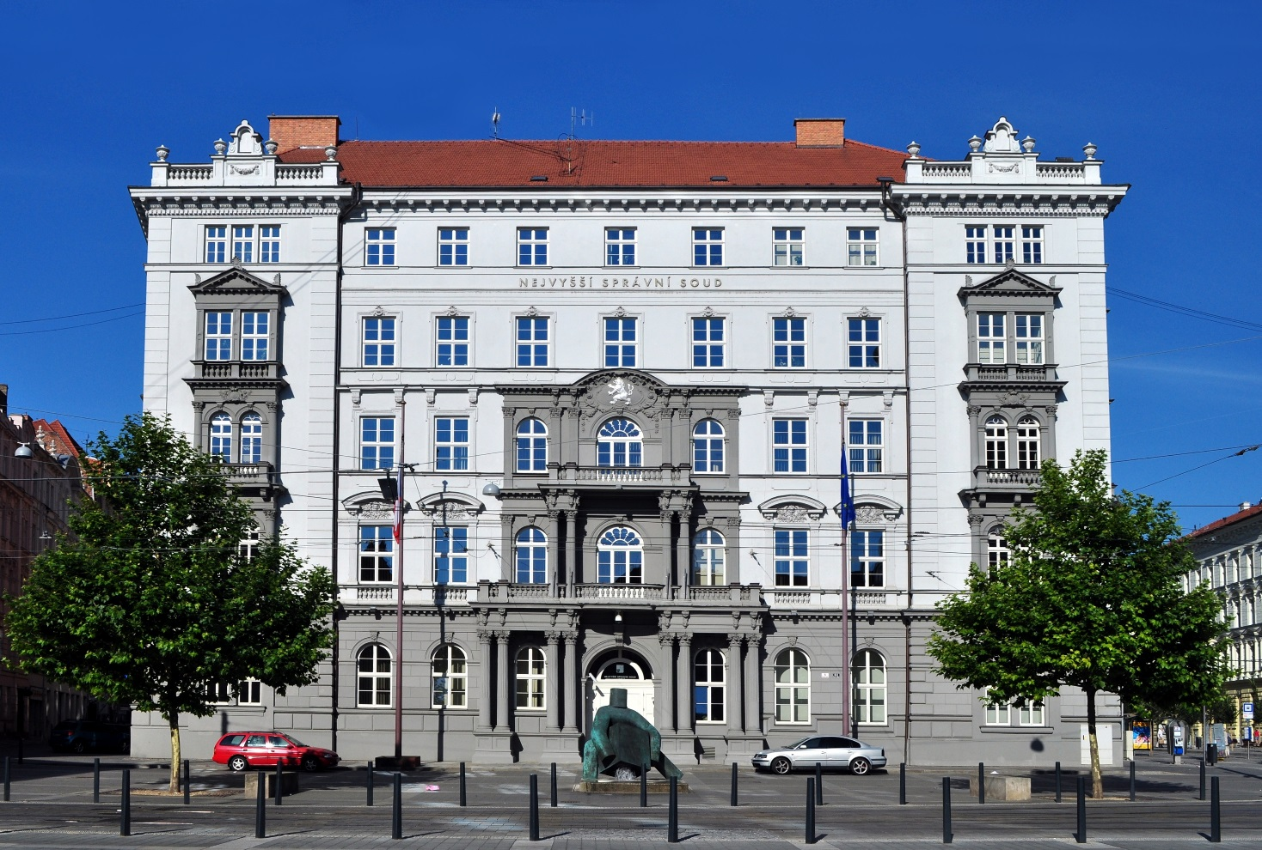
Administrative Justice in the Czech Republic

Slide 33
Ombudsman
Established in 2000, Act no 349/1999 Coll., seat in Brno
„Public Defender of Rights“
https://www.ochrance.cz/en/

Slide 34
Ombudsman
Protects people against the conduct of authorities and other institutions if the conduct is against the law, does not correspond to the principles of a democratic legal state and the principles of good administration, or the authorities are inactive.
He/she also carries out preventive systematic visits to places where people are restricted in their freedom and seeks to ensure that their rights are respected. The Defender also contributes to promotion of the right to equal treatment and protection against discrimination and also systematically deals with the rights of the people with disabilities.

Slide 35
Conclusion
Prepare your answer to the following questions:
Why do we have public administration? Is it good/bad thing, helps/is harmful, …
What is (is there any) a connection between public administration and administrative law?
Why is important to control public administration?

Slide 36
If you are interested …
https://www.mvcr.cz/clanek/vyrocni-zpravy-o-stavu-verejne-spravy.aspx
https://www.vlada.cz
https://www.mvcr.cz
https://www.nssoud.cz
https://www.ochrance.cz
https://portal.gov.cz/

