Slide 1
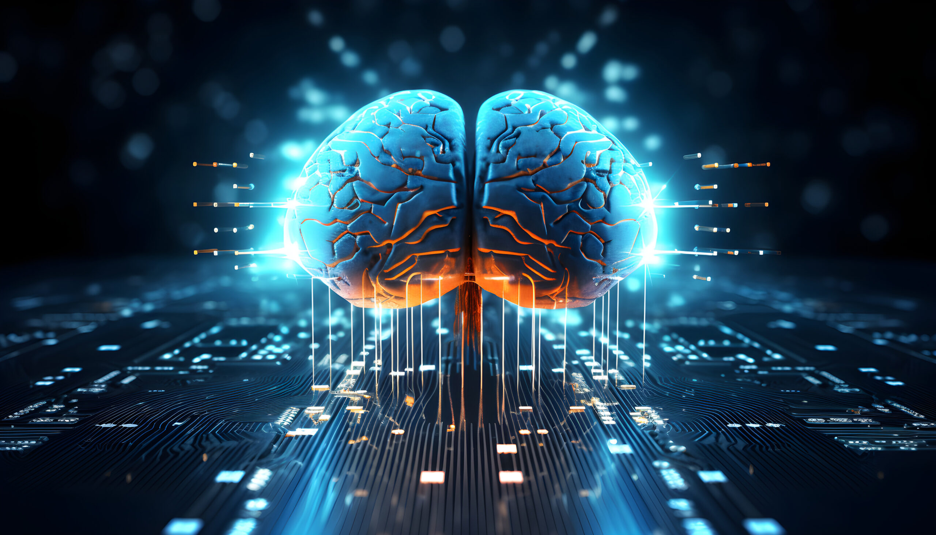
Copyright exceptions for Artificial Intelligence

Slide 2
In Groups – 30 mins
Group 1: How does the CDSM Directive (Directive (EU) 790/2019) address Text and Data Mining? What is the provision’s relevant for AI Training?
Group 2: How would AI Training be addressed under the US fair use defense? Discuss potential outcomes.

Slide 3
Copyright and AI - EU
Different treatment for commercial and non-commercial (scientific research) TDM → opt-out (LG Hamburg - Kneschke v. LAION)
EU rules are silent on output
AI Act → compliance with Union law and respect for opt-outs (art. 53(1)(c)

Slide 4
Copyright and AI - US
+30 cases pending before various US courts
At what stage must ‘transformativeness’ be assessed
How/when do other factors come into play?

Slide 5
Copyright and AI
What practical solutions could help to strike a fair balance between the necessity to develop AI application and copyright?

Slide 6
In preparation for next session…
What reforms to copyright exceptions – or copyright in general - would be necessary to incentivize/enable innovation and creativity?

