Slide 1
ENVIRONMENTAL ASSESSMENT (SEA & EIA)
JUDr. Vojtěch Vomáčka, Ph.D., LL.M.
Basics of EU Environmental Law
Autumn 2024

Slide 2
EIA/SEA
EIA is “the process of identifying, predicting, evaluating and mitigating the biophysical, social, and other relevant effects of development proposals or projects prior to major decisions being taken and commitments made.”
(www.unesco.org)
”SEA is a systematic process for evaluating the environmental consequences of proposed policy, plan or programme initiative in order to ensure they are fully included and appropriately addressed at the earliest appropriate stage of decision making on par with economic and social consideration”
(Sadler,Verheem 1996)

Slide 3
Historical/international perspective
US National Environmental Protection Act (1969)
EIA Directive (1985)
UNEP Guidelines Goals and Principles of EIA (1987)
Espoo Convention (adopted in 1991 – into force in 1997)
Rio Declaration on Environment and Development (1992)
1st amendment to the EIA Directive (1997)
Gabčíkovo -Nagymaros Project (ICJ ruling in 1997)
Aarhus Convention (adopted in 1998 – into force in 2001)
SEA Directive (2001)
SEA Protocol to Espoo (adopted in 2003 – into force in 2010)
Pulp Mills case (ICJ ruling in 2010): EIA attains customary international law
2nd and 3^{d} amendments to the EIA Directive (2003 and 2009)
EIA codified (2011)
Revised EIA Directive (2014)
Evaluation of the SEA Directive (ongoing)

Slide 4
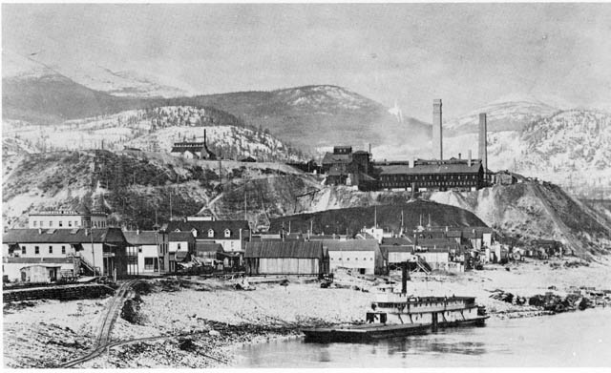
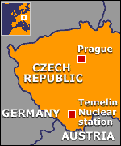
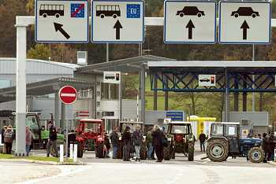
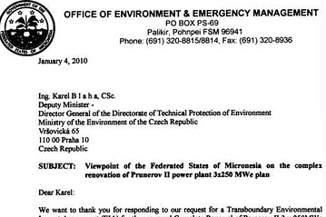
Impact assessment?
International law – Customary law, Espoo convention (transboundary assessment)…
EU law – EIA Directive (2011/92/EU), SEA Directive (2001/42/EC), the Habitats Directive
National law

Slide 5
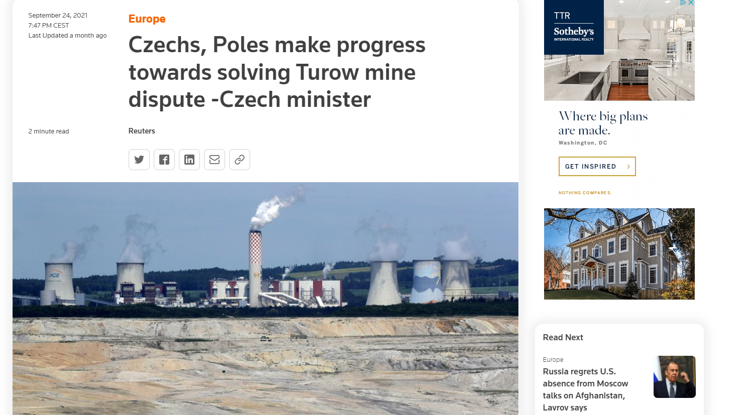
SEA
ZÚR
OOP
SEA
ÚP
OOP
EIA
ZS
IPPC
(povolení, závazná stanoviska a stanoviska podle některých zvl. Předpisů - , OvzdZ, OdpZ, Vodz, VeřZd)
Územní řízení
R
R
R
Stavební řízení
Řízení o zkušebním provozu
Kolaudační rozhodnutí
R
Povolení, závazná stanoviska a stanoviska podle zvláštních předpisů (ZOPK, ZPF, LesZ)
R

Slide 6
Impact assessment?
https://www.youtube.com/watch?v=RCg800TYf4k

Slide 7
Environmental Assessments at EU level
Water Framework Directive
Policies,
Strategies,
Legislation
Impact Assessment (COM legislative proposals)
Waste Framework Directive
Habitats and Birds Directives
Plans & Programmes
SEA Directive (2001/42/EC)
Projects (public - private)
EIA Directive (2011/92/EU, as amended by 2014/52/EU)
Landfill
Directive
Industrial Emissions
& Seveso Directive
Other Directives: Carbon Capture Storage, Offshore Safety…

Slide 8
EIA/SEA
Plans - Programmes
Projects
How
Where
If
Why
SEA
EIA

Slide 9
EIA - General objective
What does the EIA Directive apply to?
projects likely to have significant effects on the environment (by virtue, inter alia, of their characteristics, size and location)
What are these projects subject to?
a requirement for development consent
an assessment of their effects
When?
before consent is given
EIA must identify, describe, assess
likely direct and indirect environmental effects of activities on
human beings,
fauna, flora, soil, water, air, climate, landscape,
material assets, cultural heritage
the interaction between those factors

Slide 10
EIA - General objective
Cumulative effects & "whole" project – case law
It is necessary to consider projects jointly in particular where they are connected, follow on from one another, or their environmental effects overlap (Case C-147/07, Ecologistas en Acción-CODA; Case C-205/08, Alpe Adria).
It is necessary to take into account the cumulative effect of such projects which have an objective and chronological link between them (Case C-244/12, Salzburger Flughafen).
Works to modify an airport with a runway length of 2 100 metres or more thus comprise not only works to extend the runway, but all works relating to the buildings, installations or equipment of that airport where they may be regarded, in particular because of their nature, extent and characteristics, as a modification of the airport itself. That is the case in particular for works aimed at significantly increasing the activity of the airport and air traffic. (Case C-2/07, Abraham and Others).

Slide 11
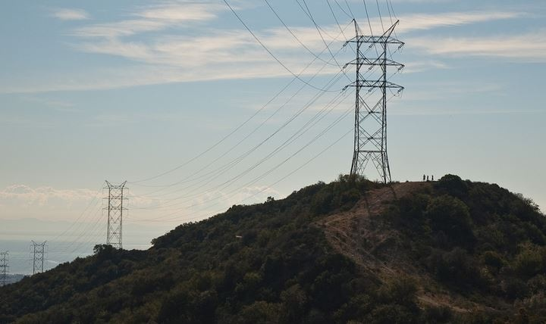
Salami slicing

Slide 12
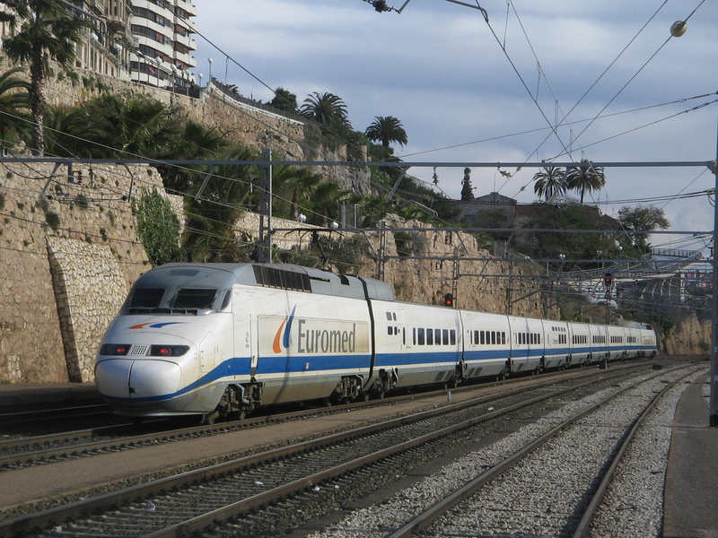
Spain C-227/01 - Valencia-Tarragona railway line, Las Palmas-Oropesa section

Slide 13
Spain C-227/01 - Valencia-Tarragona railway line, Las Palmas-Oropesa section
Annex I point 7 must be understood to include the doubling of an existing track, and not a mere modification.
That the case concerned a short section of a long distance route is not relevant: If the argument of the Spanish Government were upheld, the effectiveness of Directive 85/337 could be seriously compromised, since the national authorities concerned would need only to split up a long-distance project into successive shorter sections in order to exclude from the requirements of the Directive both the project as a whole and the sections resulting from that division.
The new track would obviously create significant new nuisances, so no need to prove the existence of concrete negative effects – likelihood is sufficient.
Note: this case pre-dates amendments by Directive 97/11.

Slide 14
EIA - Which projects?
Annex I projects
Annex II projects
Mandatory
EIA
Screening
by Competent authorities to decide if
EIA needed or not

Slide 15
EIA - examples
ANNEX I
Long-distance railway lines
Motorways, express roads, roads of four lanes or more (of at least 10Km)
Waste disposal installations
for hazardous waste
for non hazardous waste (above 100 tonnes/day)
Waste water treatment plants (above 150000 p.e.)
[+ changes or extensions of Annex I projects meeting Annex I thresholds]
….
ANNEX II
Construction of railways and roads not included in Annex I
Waste disposal installations and waste water treatment plants not included in Annex I
Urban development projects
Changes or extensions of Annex I and II projects that may have adverse environmental effects
[+ modifications not included in Annex I]
….

Slide 16
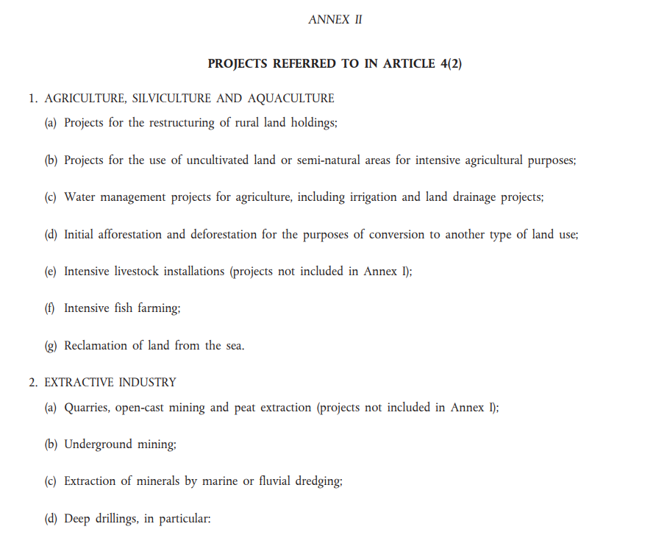

Slide 17
Level of thresholds - case law
Member States have a level of discretion to establish thresholds or criteria, BUT limited by the obligation (Art 2(1)) to make projects likely, by virtue inter alia of their nature, size or location, to have significant effects on the environment subject to an impact assessment (C-244/12, Salzburger Flughafen, C-531/13, Kornhuber and Others, paragraph 40-41);
Thresholds/criteria are to help in screening, not exempt classes of projects, UNLESS, when viewed as a whole, they would not be likely to have significant environmental effects – (e.g. C-392/96, Commission v. Ireland, C-66/06, Commission v. Ireland)
Member States are obliged to take account of all the relevant selection criteria listed in Annex III when establishing criteria or thresholds for Annex II projects (C-66/06, Commission v. Ireland, C-255/08, Commission v. Netherlands, C-435/09 Commission v. Belgium, C-531/13, Kornhuber and Others).

Slide 18
Impact assessment?
https://www.youtube.com/watch?v=0uReVJYe0qw

Slide 19
The EIA Procedure after the 2014 amendment
Annex II.A information & updated screening criteria listed in Annex III +
content of the screening decision
For projects screened out
90 days + extension
Screening (for Annex II projects)
Scoping
Scope and level of detail (optional)
Updated Annex IV & quality control
EIA Report
Public, environmental authorities, local and regional authorities, other MS & reinforced modalities
Information and Consultation
Decision (& reasoned conclusion)
Takes account of env. report and consultations => content of the decision & reasoned conclusion
Information on decision
End of EIA process
Monitoring
For projects with significant and adverse environmental effects

Slide 20
Screening
New elements in the information of the EIA Report – Annex IV
Resource and energy efficiency elements (IV.1 and IV.5).
Reasonable alternatives include baseline scenario (IV.2 and IV.3).
Consideration of new environmental issues, such as climate change and biodiversity (IV.4 and IV.5).
Cumulative impacts (IV.5.e).
Risk assessment related to accidents/disasters (IV.8).
More thorough description of mitigation/compensation measures, as well as introduction of monitoring (IV.7).
Methods/evidence and list of sources used (IV.6 and IV.10).
Scoping
EIA report
Consultation
Decision
Information on decision
Monitoring

Slide 21
Screening
NEW elements in Articles 6 and 7
Broadened scope: local and regional authorities clearly spelled out as bodies to be consulted.
Reinforced modalities:
Public to be informed electronically and by public notices (Art.6 (5))
Relevant information electronically accessible to the public, through at least a central portal or easily accessible points of access, at the appropriate administrative level (Art. 6 (5))
Reasonable time-frames for the different phases of the decision-making (Art. 6(6)).
Time-frame for consulting the public concerned on the EIA report - at least 30 days (Art. 6(7)).
Transboundary consultations:
Consultations may be conducted through an appropriate joint body (Art.7(4)).
Time-frames for public consultation to be set (Art. 7(5)).
Scoping
EIA report
Consultation
Decision
Information on decision
Monitoring

Slide 22
Case law as a result of:
Art 258 TFEU (Commission v MS) actions
Art 267 TFEU preliminary references
EIA Directive
rich case law, both Art 258 and Art 267 TFEU cases
on objectives and basic principles, definitions (e.g. 'project', 'development consent'), screening (criteria/thresholds, cumulative effects), public participation and A2J, project categories of Annexes I and II)
The meaning of the EIA Directive is not static
Affected by technical development
The EIA Directive has “a wide scope and a broad purpose” (Kraaijeveld).
Member States’ discretion is limited.
Consistent emphasis on the likely environmental effects of proposed projects.
Exemptions to be interpreted narrowly.
SEA Directive
~ 20 rulings so far, almost exclusively Art 267 TFEU
mostly on the scope of the Directive

Slide 23
Commission support towards a better implementation
Guidance document on streamlining environmental assessments conducted under Article 2(3) of the EIA (Commission Notice 2016/4701, OJ C 273, 27.7.2016, p.1)
Compilation of the CJEU case-law
Interpretation of definitions of project categories of annex I and II of the EIA Directive
Guidance on the three key steps of the EIA:
Screening
Scoping
EIA report
Guidance on the Application of the EIA Procedure for Large-scale Transboundary Projects
Guidance on Integrating Climate Change and Biodiversity into Environmental Impact Assessment

Slide 24
SEA: WHICH plans and programmes?
prepared and/or adopted by an authority at national, regional or local level AND
required by legislative, regulatory or administrative provisions.
=> Normative acts adopted by law or regulation are covered (C-290/15)!
Exemptions:
Plans & programmes the sole purpose of which is to serve national defence or civil emergency;
Financial or budget plans/programmes.

Slide 25
SEA: WHICH plans and programmes?
1. Plans and programmes (P/Ps) that always undergo an SEA are those:
prepared for agriculture, forestry, fisheries, energy, industry, transport, waste/ water management, telecommunications, tourism, town & country planning or land use AND which set the framework for future development consent of projects listed in the EIA Directive;
which have been determined to require an assessment under Articles 6 or 7 of the Habitats Directive.
Including
P/Ps co-financed by the EU (e.g. OPs).
Modifications of P/Ps.
2. Plans and programmes that must be screened:
P/Ps using small areas at local level.
minor modifications to P/Ps.
P/Ps setting the framework for future “non-EIA projects” and “non-sector” P/Ps.

Slide 26
Scope of Article 3(1)-(2) – case-law D’Oultremont, case C‑290/15, Inter-Environnement Bruxelles, case C-671/16, Thybaut C-160/17
The notion of ‘plans and programmes’ relates to any measure which establishes, by defining rules and procedures for scrutiny applicable to the sector concerned, a significant body of criteria and detailed rules for the grant and implementation of one or more projects likely to have significant effects on the environment.
That interpretation of the concept of ‘plans and programmes’ is intended to ensure that provisions which are likely to have significant effects on the environment are subject to an environmental assessment.
The concept of ‘a significant body of criteria and detailed rules’ must be construed qualitatively and not quantitatively. It is necessary to avoid strategies which may be designed to circumvent the obligations laid down in the SEA Directive by splitting measures.

Slide 27
Screening
Using screening criteria
Scoping
Scope and level of detail (obligatory)
The “Report” (including a non-technical summary)
Environmental Report/Study
Information and Consultation
Public, environmental authorities, transboundary procedure (Art.7, and if applicable)
Decision
Takes account of environmental report and consultations
End of SEA process
Information on decision
Significant environmental effects
Monitoring

Slide 28
SEA can address a wide range of issues
Climate change mitigation | Climate change adaptation | Biodiversity
energy demand (industry) energy demand (housing & construction) GHG emissions in agriculture GHG emissions (waste management) travel patterns and GHG emissions (transport) GHG emissions from energy production land use, land-use change, forestry and biodiversity … | heat waves droughts flood management and extreme rainfall events storms and high wind landslides sea level rise, extreme storms, coastal erosion and saline intrusion cold spells freeze-thaw damage … | degradation of ecosystem services loss of habitats, fragmentation loss of species diversity loss of genetic diversity …

Slide 29
Key elements of SEA
The Environmental Report
Outline of the plan/programme and relationship with other plans/programmes
Environmental characteristics of the area.
Environmental protection objectives, how they were taken into account.
Mitigation measures (envisaged to prevent, reduce and as fully as possible compensate any significant adverse effects on the environment of implementing the plan or programme).
Monitoring measures.
Non-technical summary (important).
Consultation
Environmental authorities
- in screening
- in scoping
- on the draft plan/programme and the environmental report
The public
- on the draft plan/programme and the environmental report
Transboundary consultations
- on the draft plan/programme and the environmental report

Slide 30
SEA Guidance
Commission's Guidance on the implementation of Directive 2001/42/EC on the assessment of the effects of certain plans and programmes on the environment;
Guidance on Integrating Climate Change and Biodiversity into Strategic Environmental Assessment (March 2013);
Report from the Commission on the application and effectiveness of the SEA Directive, COM/2009/469;
GRDP Handbook on SEA for Cohesion Policy 2007-2013 (Interreg IIIC, GRDP greening regional development programmes).
* * *

Slide 31
THANK YOU FOR YOUR ATTENTION!
vomacka@mail.muni.cz

