Slide 1
Basics of EU Environmental Law
NATURE PROTECTION/BIODIVERSITY/CITES
Autumn 2024
JUDr. Vojtěch Vomáčka, Ph.D., LL.M.

Slide 2
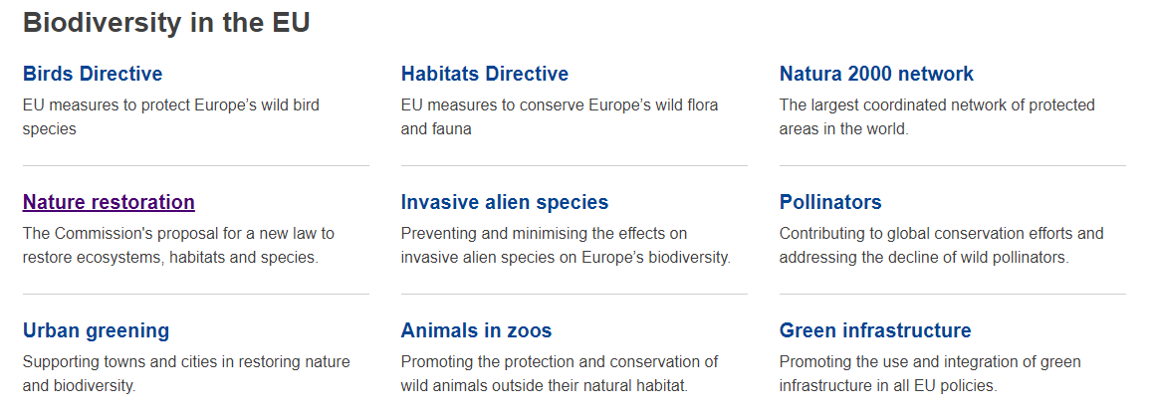

Slide 3
EU Law on Nature Protection and Biodiversity
1) Birds Directive, Habitats Directive
Protection of sites – Natura 2000
Protection of wild birds + species (animals/plants)
2) Nature Restoration Law
3) CITES Regulation: Trade with endangered species
4) EU Deforestation Regulation
invasive alien species (animals and plants introduced accidentally or deliberately into a natural environment where they are not normally present, with serious negative consequences for their new environment);
Protection of marine ecosystems
Other Directives: Environmental Crime Directive, Environmental Liability Directive

Slide 4
EU Law on Nature Protection
The EU has played and continues to play an important role at international level in nature protection and conservation. It is party to several conventions including:
the Convention on the Conservation of Wetlands, adopted in Ramsar (1971);
the Convention on International Trade in Endangered Species of Wild Fauna and Flora, known as CITES, adopted in Washington (1973);
the Convention on the Conservation of Migratory Species of Wild Animals, adopted in Bonn (1979);
the Convention on the Protection of European Wildlife and Natural Habitats, adopted in Bern (1982);
the Convention on Biological Diversity, adopted in Rio de Janeiro (1992).
The EU’s first legislation to protect nature was the original Birds Directive, adopted in 1979 and codified and replaced, in 2009, by Directive 2009/147/EC. The Directive provides comprehensive protection to all wild bird species naturally occurring in the EU.
In 1992, the Habitats Directive (Directive 92/43/EEC) was adopted to help maintain biodiversity by protecting over 1,000 animal and plant species and over 200 types of habitats, and introducing the Natura 2000 network of protected areas across Europe. The Natura 2000 network’s Special Areas of Conservation and Special Protection Areas currently account for around 18% of EU’s land and 9% of EU seas.

Slide 5
EU Law on Nature Protection
Since the mid-2000s, the EU has adopted a series of biodiversity action plans and strategies.
The latest one, the 2030 Biodiversity Strategy, aims to protect nature and reverse the degradation of ecosystems.
The strategy aims to put Europe’s biodiversity on a path to recovery by 2030, and contains over 100 specific actions and commitments.
It is the proposal for the EU’s contribution to the international negotiations on the global post-2020 biodiversity framework.

Slide 6
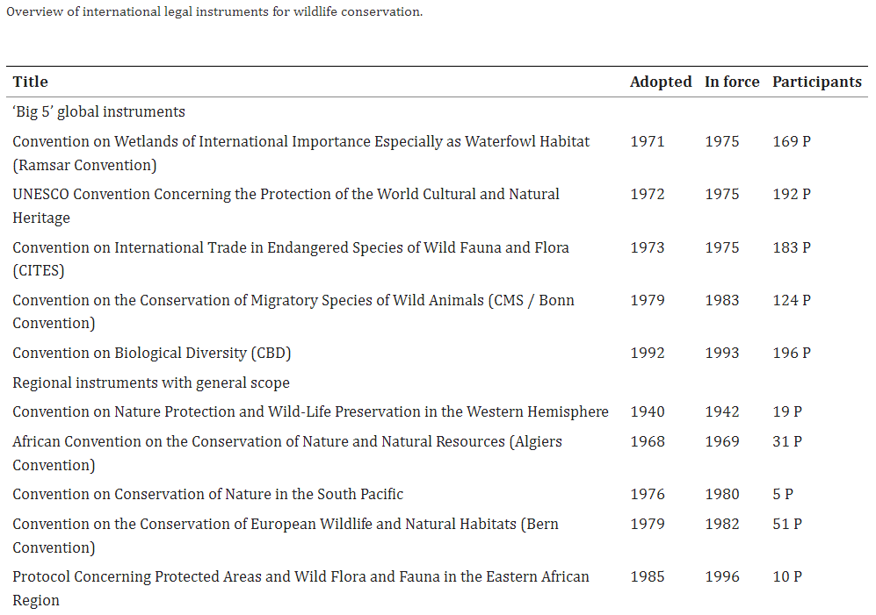

Slide 7
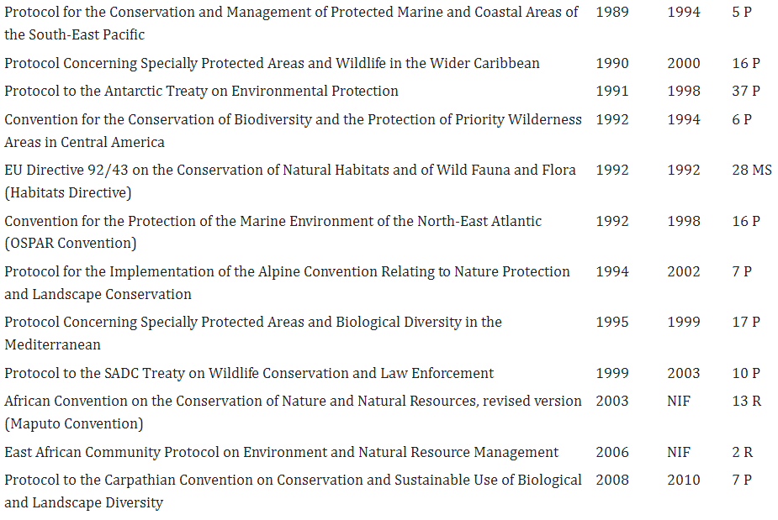

Slide 8
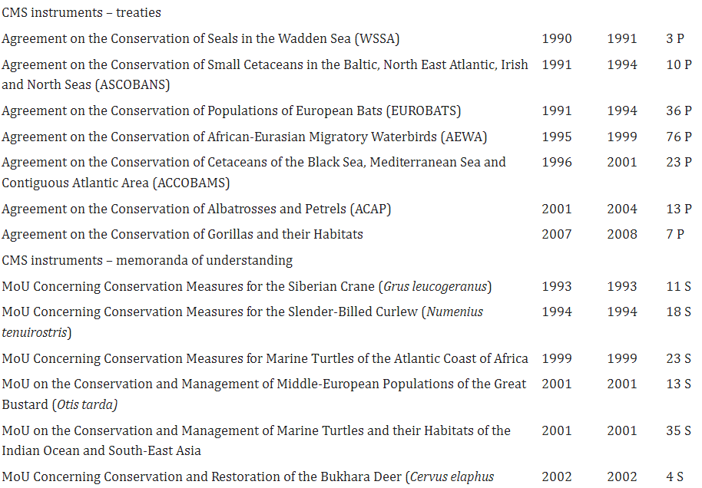

Slide 9
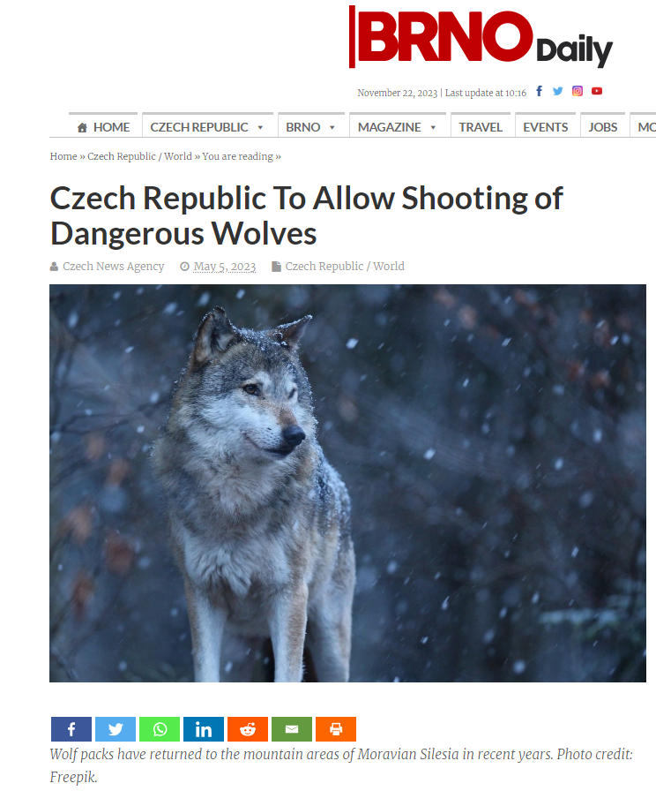
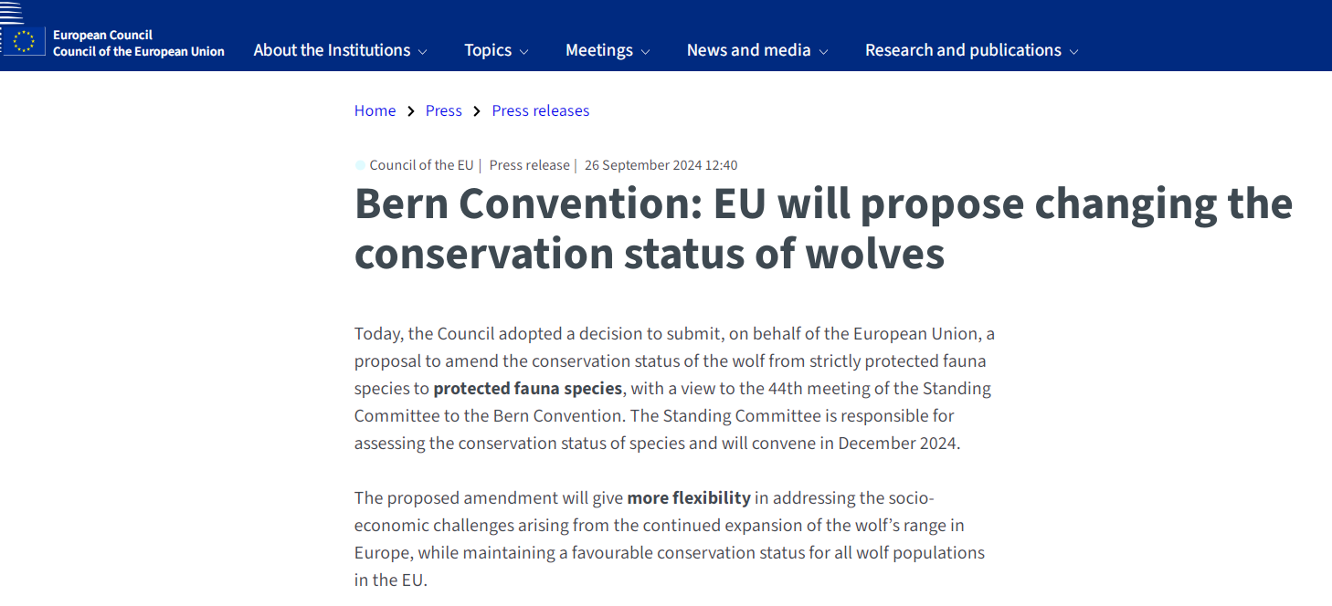

Slide 10
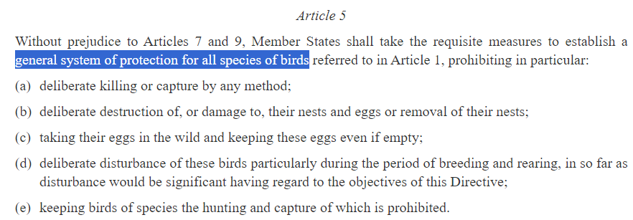
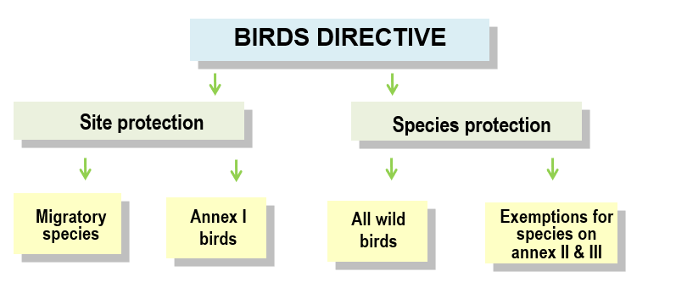
The Birds Directive (2009/147/EC)

Slide 11
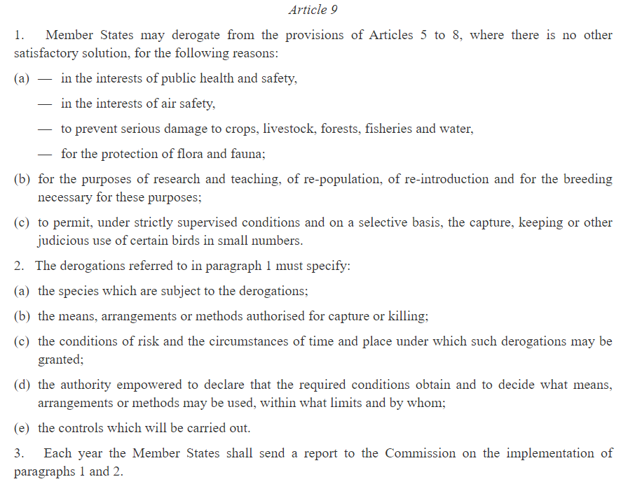
The Birds Directive (2009/147/EC)

Slide 12
The Birds Directive (2009/147/EC)
Recent Case Law
C-900/19 (One Voice a Ligue pour la protection des oiseaux): traditional method of the bird trapping is not sufficient to demonstrate that it cannot be replaced by another satisfactory solution;
C-473/19 and C-474/19 (Föreningen Skydda Skogen): requirements of Art. 5 of the Birds Directive and Art. 12 of the Habitats Directive also apply to species for which favourable conservation status has been achieved;
C-217/19 (Commission v Finland): Improper granting of exemptions from bird protection;
C-161/19 (Commission v Austria): Improper granting of exemptions from bird protection.

Slide 13
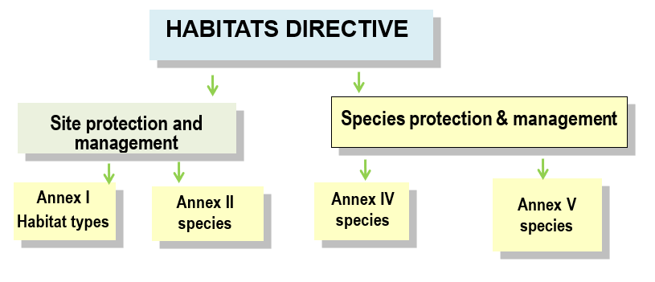
The Habitats Directive (92/43/EEC)

Slide 14
The Habitats Directive (92/43/EEC)
Article 6(3) Any plan or project not directly connected with or necessary to the management of the site but likely to have a significant effect thereon, either individually or in combination with other plans or projects, shall be subject to appropriate assessment of its implications for the site in view of the site's conservation objectives. In the light of the conclusions of the assessment of the implications for the site and subject to the provisions of paragraph 4, the competent national authorities shall agree to the plan or project only after having ascertained that it will not adversely affect the integrity of the site concerned and, if appropriate, after having obtained the opinion of the general public.
Art. 6(4): If, in spite of a negative assessment of the implications for the site and in the absence of alternative solutions, a plan or project must nevertheless be carried out for imperative reasons of overriding public interest, including those of a social or economic nature, the Member State shall take all compensatory measures necessary to ensure that the overall coherence of Natura 2000 is protected. It shall inform the Commission of the compensatory measures adopted.
Where the site concerned hosts a priority natural habitat type and/or a priority species, the only considerations which may be raised are those relating to human health or public safety, to beneficial consequences of primary importance for the environment or, further to an opinion from the Commission, to other imperative reasons of overriding public interest.

Slide 15
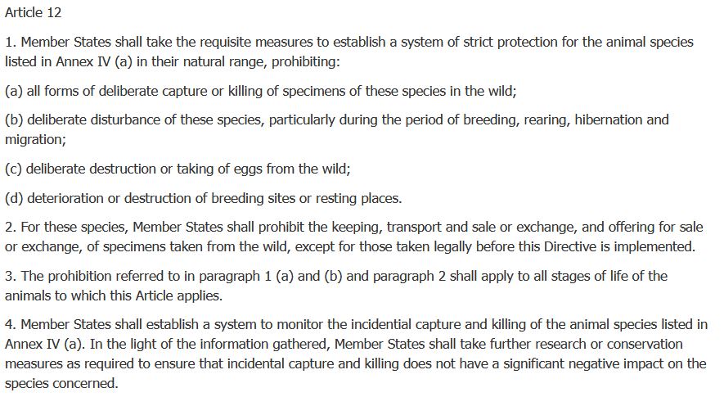
The Habitats Directive (92/43/EEC)

Slide 16
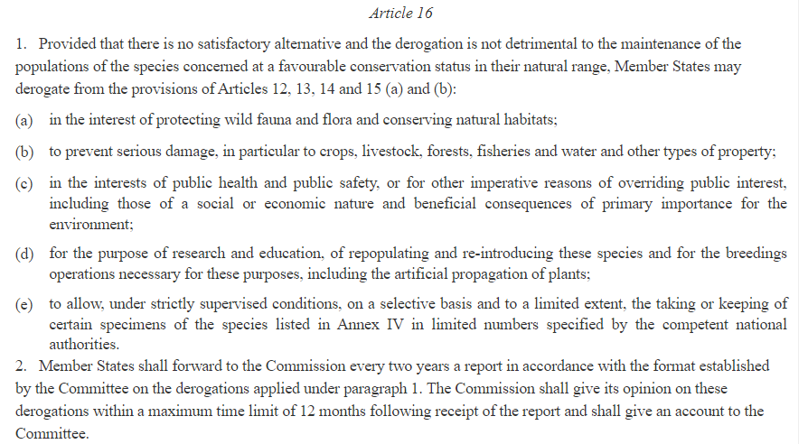
The Habitats Directive (92/43/EEC)

Slide 17
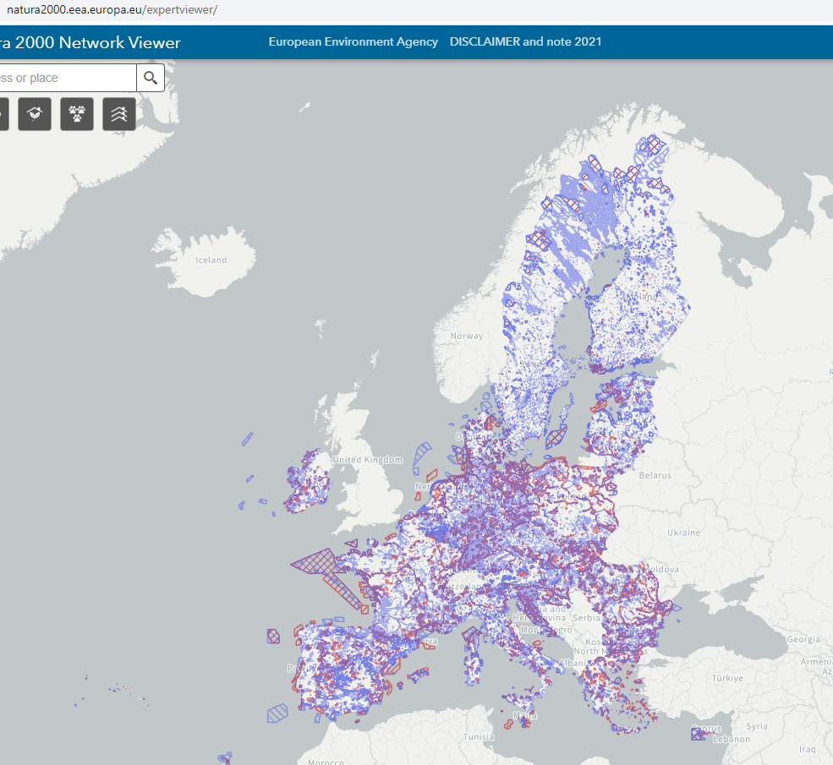

Slide 18
The Habitats Directive (92/43/EEC)
recent cases concerning habitats protection:
C-434/22 (Latvijas valsts meži): Assessment of maintenance of fire infrastructure in the protected area according to the Habitats Directive if changes the physical condition of the site
C-238/20 (Sātiņi-S): Member States may compensate owners of land affected by conservation measures, but there is no obligation under EU law to provide such compensation
C-254/19 (Friends of the Irish Environment): Extension of a permit for the construction of a liquefied natural gas regasification terminal in principle requires an assessment if the original permit has lapsed and ceased to produce legal effects after the expiry of the period it set for the works that have not started
C-116/22 (Commission v Germany): Germany has not declared 88 sites as Special Areas of Conservation and has not established conservation measures for 737 sites within the prescribed timeframe
C-432/21 (Commission v Poland): Polish law allowing forest management in accordance with the requirements of good practice without complying with the protective provisions of the Habitats Directive and the Birds Directive constitutes an unlawful exception; violation of the Aarhus Convention by not allowing the review of management plans by ENGOs
C-661/20 (Commission v Slovakia): Failure to assess the effects of forest maintenance and logging on Natura 2000 sites, and to protect the capercaillie
C-559/19 (Commission v Spain): Spain failed to take measures to prevent the disturbance of protected locations caused by the abstraction of groundwater
C-849/19 (Commission v Greece): Failed to set appropriate conservation objectives and adopt appropriate conservation measures for 239 sites that should have been designated as protected under the 2006 Commission Decision
C-411/19 (WWF Italia Onlus): Impossibility of ex post assessment of impacts on the Natura 2000 site
C-297/19 (Naturschutzbund Deutschland – Landesverband Schleswig Holstein): Interpretation of the concept of site management and the liability of legal persons for environmental damage
Other recent cases concerning species protection:
C-166/22 (Hellfire Massy Residents Association): Participation in the proceedings to grant exception under Art. 16 of the Habitats Directive (not necessary)
C-357/20 [Magistrat der Stadt Wien (Grand hamster – I)]: Interpretation of breeding sites, concepts of ‘deterioration’ and ‘destruction
C-477/19 (Magistrat der Stadt Wien): Interpretation of resting places and breeding sites, areas which have been abandoned (by hamster)
C-88/19 (Alianța pentru combaterea abuzurilor): Conservation of wolves in human settlements
C-601/22 (Umweltverband WWF Österreich and Others v Amt der Tiroler Landesregierung): Wolf Conservation status; strict protection

Slide 19
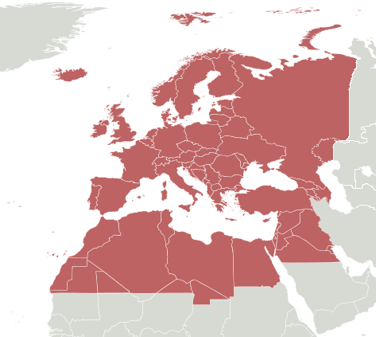
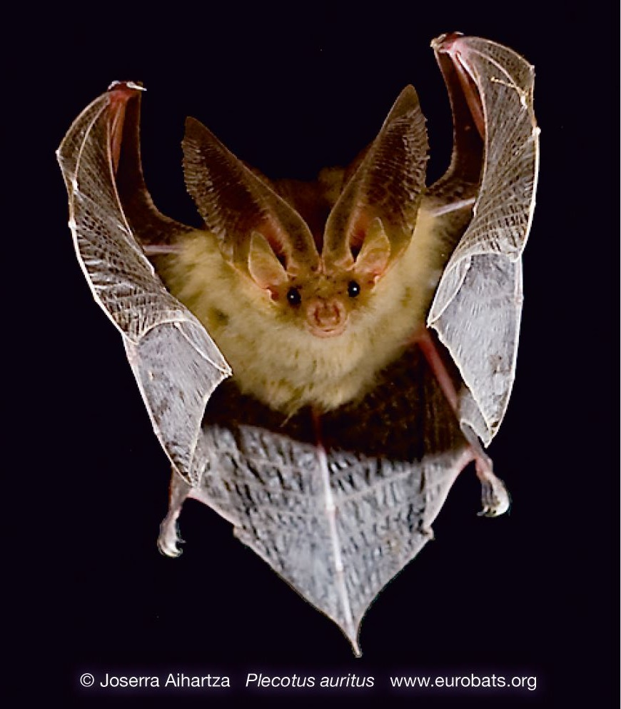
Example: Protection of bats
(a) International law: EUROBATS
51 species
38 parties
States prohibit the deliberate capture, keeping or killing of bats except for research purposes for which a special permit is required. Furthermore, the Parties identify important sites for bat conservation, survey the status and trends of bat populations and study their migratory patterns.

Slide 20
Example: Protection of bats
EU law
The Habitats Directive
Bats are a European Protected Species, included in Annex 4 of the Habitats Directive - referred to as “Microchiroptera”.
Article 12 sets out legal protection for bats and their roosts.
Under Annex 2 it also sets out which bat species should have Special Areas of Conservation designated for them- Greater horseshoe, Lesser horseshoe, Barbastelle and Bechstein’s.

Slide 21
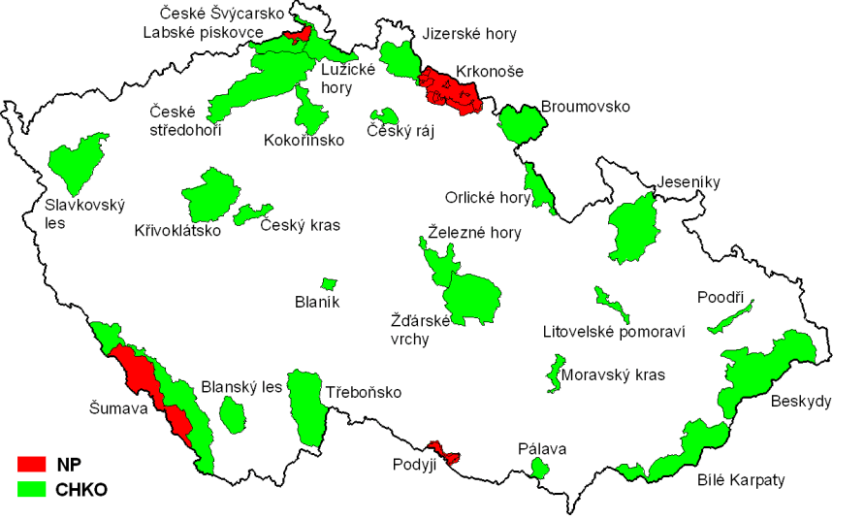
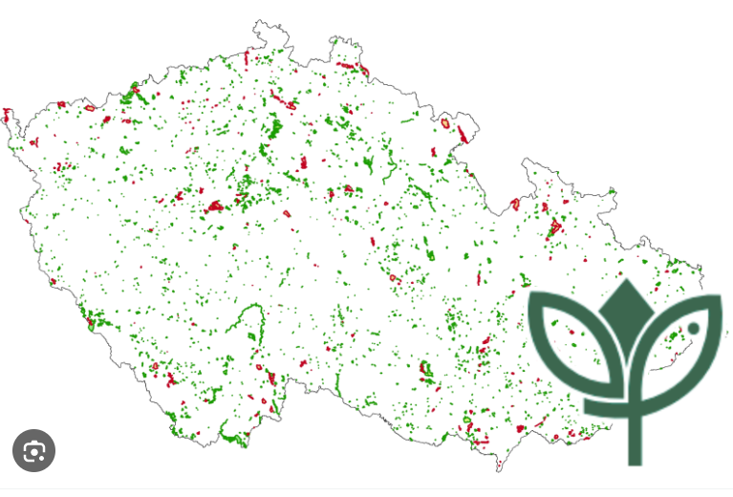
Czech Law on Nature Protection - Act No. 114/1992, on Protection of Nature and Landscape
There are 26 Protected Landscape Areas (IUCN Category V) and 4 National Parks (Category II) in the Czech Republic, and hundreds of small scale protected areas of different categories.

Slide 22
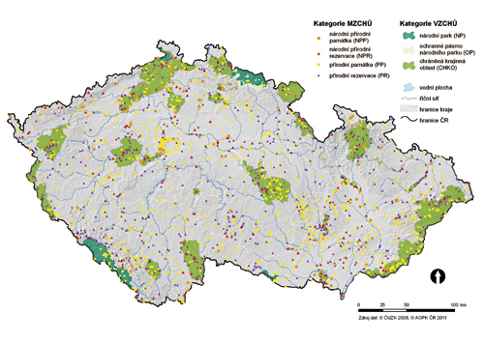
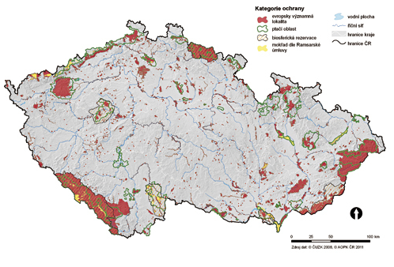
Czech Law on Nature Protection - Act No. 114/1992, on Protection of Nature and Landscape
The traditional system is combined with Natura 2000 EU network.

Slide 23
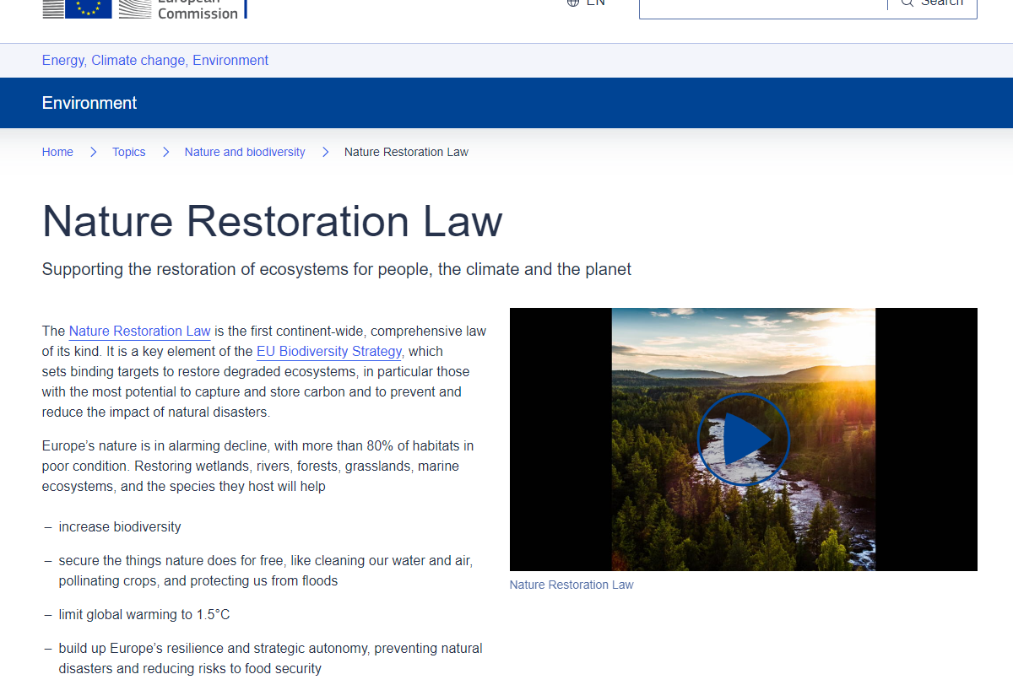

Slide 24
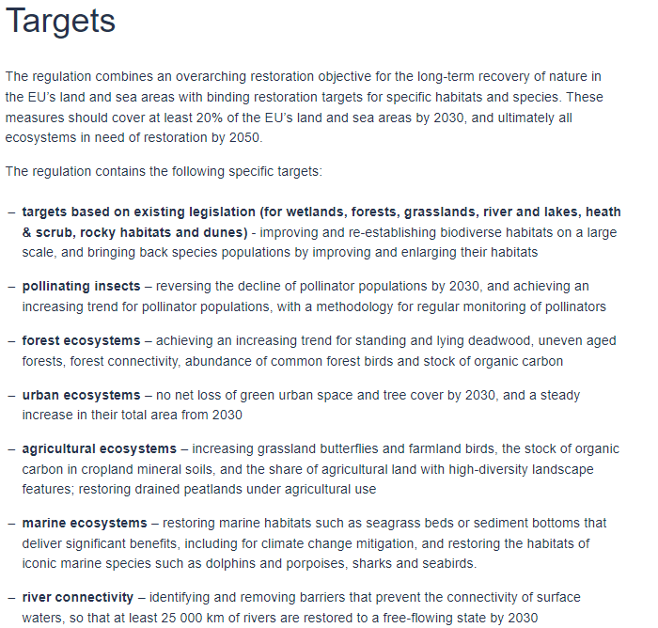
NATURE RESTORATION LAW - Regulation (EU) 2024/1991 of the European Parliament and of the Council of 24 June 2024 on nature restoration and amending Regulation (EU) 2022/869

Slide 25
EU DEFORESTATION REGULATION - Regulation on deforestation-free products (Regulation (EU) No 2023/1115)
Under the EUDR, any operator or trader who places commodities like soy, beef, palm oil, wood, cocoa, coffee, or rubber commodities on the EU market, or exports from it, must be able to prove that the products do not originate from recently deforested land or have contributed to forest degradation. Relevant goods must also be covered by a due diligence statement and be produced in accordance with applicable local laws. The EUDR does not include ‘compound feed’ in the Annex I of relevant commodities or products, meaning the placement of compound feed on the EU market is excluded from the scope of the EUDR requirements. Compound feed containing relevant commodities and products, such as soy and palm oil products, is not subject to the EUDR, except certain traceability requirements linked to feed containing soy and/or palm products destined for cattle.
Products produced inside the EU are subject to the same requirements as those produced outside the EU. The EUDR applies to products listed in Annex I, whether they are produced in the EU or imported.
For instance, if an EU company produces chocolate (code 1806, which is included in Annex I), then it will be considered an operator subject to the obligations of the EUDR, even if the cocoa powder used in the chocolate has already been placed on the market and fulfilled the due diligence requirements. In contrast, if an EU company produces soap – which is not included in Annex I –, it will not be subject to the requirements of the Regulation, even if the soap contains palm oil.

Slide 26
Practical task
Does your country set a network of (traditional) protected sites?
What is the hierarchy of the protective system?
Which protective measures are used?

Slide 27
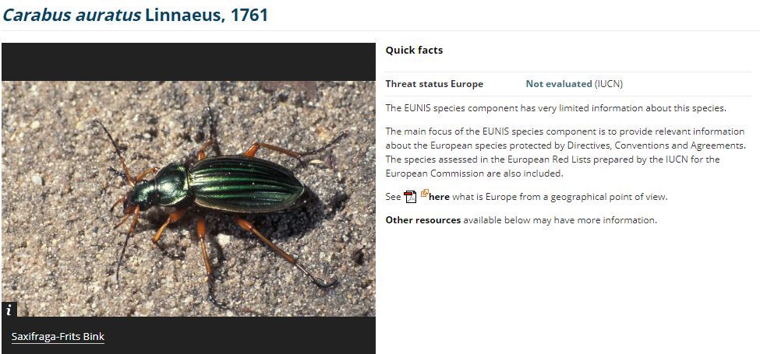
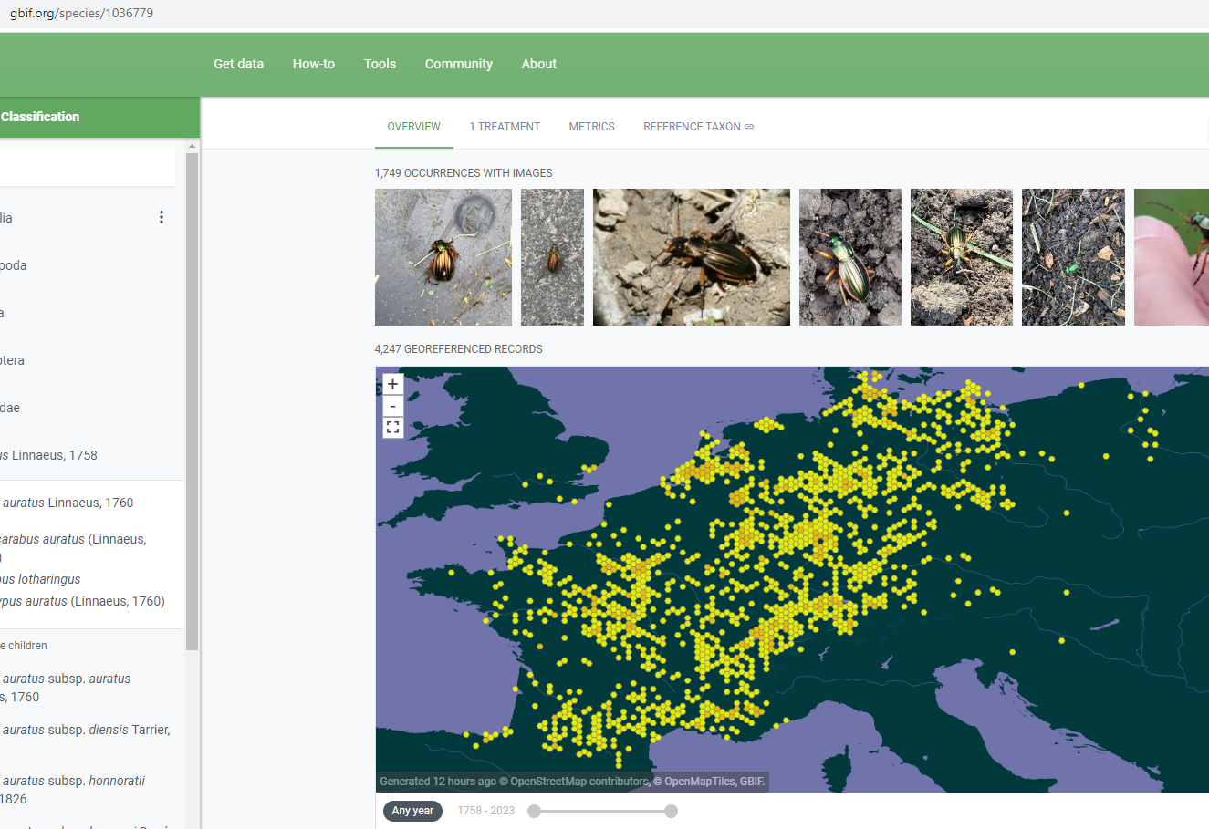
Example: The Golden Beetle

Slide 28
TRADE IN ENDANGERED SPECIES
International Law:
Convention on International Trade in Endangered Species of Wild Fauna and Flora (CITES - 1975)
Difficult nature - binding international convention, but instruments contained therein are not binding until they become part of national law
Large number of Parties lack regulations prohibiting illegal trade or imposing sanctions or allowing seizure of specimens or defining professional conservation authorities
Possibility of bilateral "sanctions" (e.g. certification)
Does not protect habitats, does not address causes of illegal trade
Within biodiversity conservation, the focus of CITES is paradoxically narrow
EU Law:
Council Regulation (EC) No 338/97 of 9 December 1996 on the protection of species of wild fauna and flora by regulating trade therein + amendments and implementing regulations
Regulation (EC) No 1007/2009 of the European Parliament and of the Council on trade in seal products

Slide 29
TRADE IN ENDANGERED SPECIES
‘Specimen’
shall mean any animal or plant, whether alive or dead, of the species listed in Annexes A to D, any part or derivative thereof, whether or not contained
in other goods, as well as any other goods which appear from an accompanying document, the packaging or a mark or label, or from any other circumstances, to be or to contain parts or derivatives of animals or plants of those species, unless such parts or derivatives are specifically exempted from the provisions of this
Regulation or from the provisions relating to the Annex in which the species concerned is listed by means of an indication to that effect in the Annexes concerned.

Slide 30
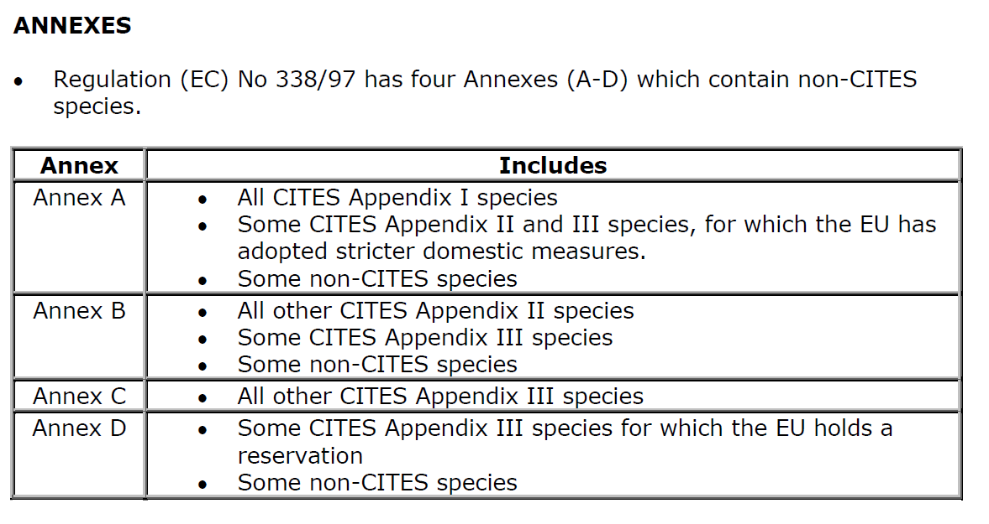
TRADE IN ENDANGERED SPECIES

Slide 31
TRADE IN ENDANGERED SPECIES
ART. 8 OF REGULATION 338/97
(1) The purchase, offer to purchase, acquisition for commercial purposes, display to the public for commercial purposes, use for commercial gain and sale,
keeping for sale, offering for sale or transporting for sale of specimens of the species listed in Annex A shall be prohibited.
(2) This prohibition shall also apply to specimens of species listed in Annex B except where it can be proved that such specimens were acquired in accordance with the legislation in force.

Slide 32
TRADE IN ENDANGERED SPECIES
ART. 8 OF REGULATION 338/97
(3) Exemption from the prohibitions referred to in paragraph 1 may be
granted by issuance of a certificate to that effect by a management
authority of the Member State in which the specimens are located, on
a case-by-case basis where the specimens:
(a) were acquired in, or were introduced into, the Community before the
provisions relating to species listed in Appendix I to the Convention or in
Annex C1 to Regulation (EEC) No 3626/82 or in Annex A became applicable to
the specimens; or
(b) are worked specimens that were acquired more than 50 years
previously; or
(c) were introduced into the Community in compliance with the provisions of
this Regulation and are to be used for purposes which are not detrimental to
the survival of the species concerned; or
(d) are captive-born and bred specimens of an animal species or artificially
propagated specimens of a plant species or are parts or derivatives of such
specimens; or

Slide 33
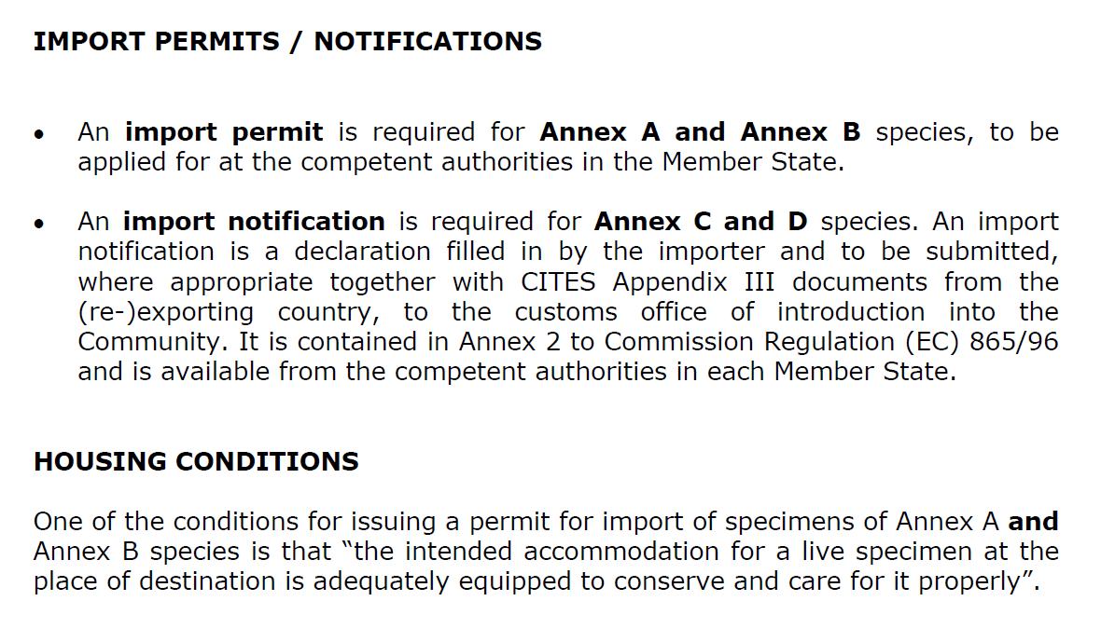
TRADE IN ENDANGERED SPECIES

Slide 34
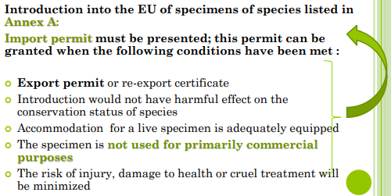
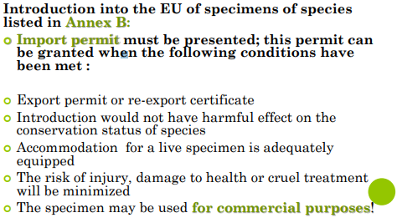
TRADE IN ENDANGERED SPECIES
A bred in captivity = B
Introduction into the EU of specimens of species listed in Annex C: At the border customs office at the point of introduction the importer must present
○ Import notification
○ Export permit / re-export certificate / certificate of
Origin
species listed in Annex C: notification

Slide 35
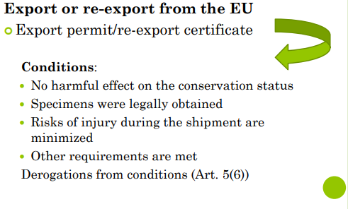
TRADE IN ENDANGERED SPECIES
Intra EU trade: notifications, documents…

Slide 36
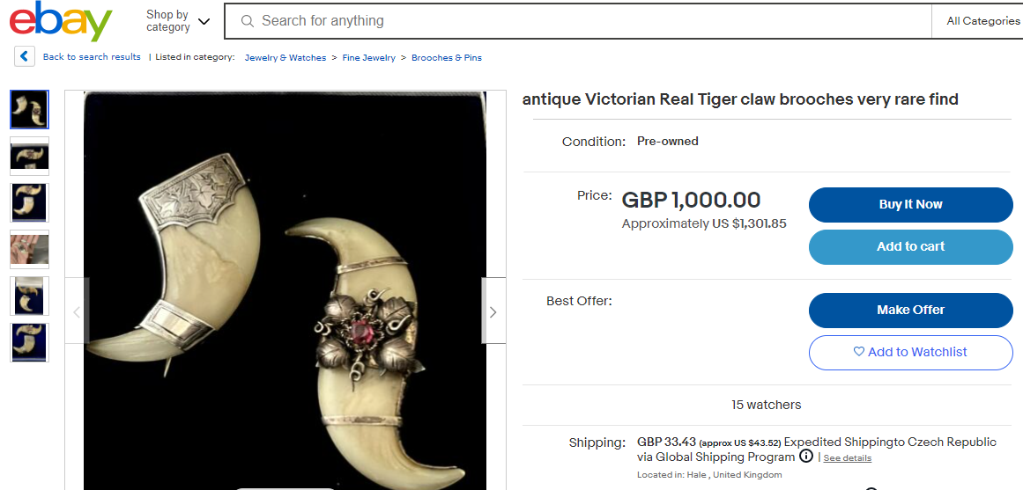
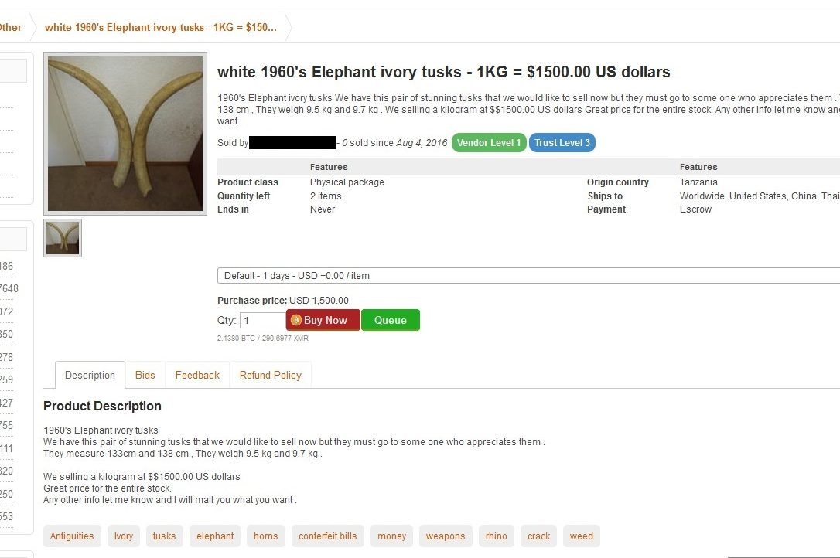
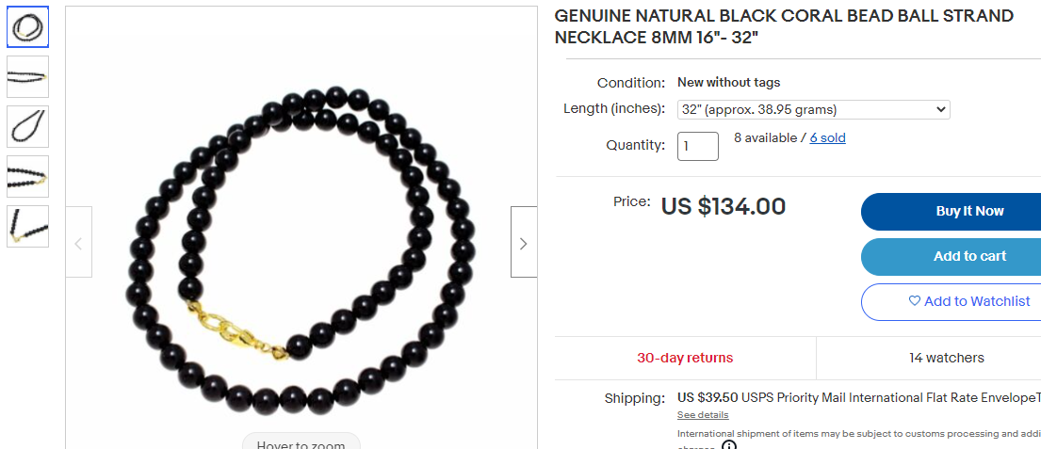
36

Slide 37
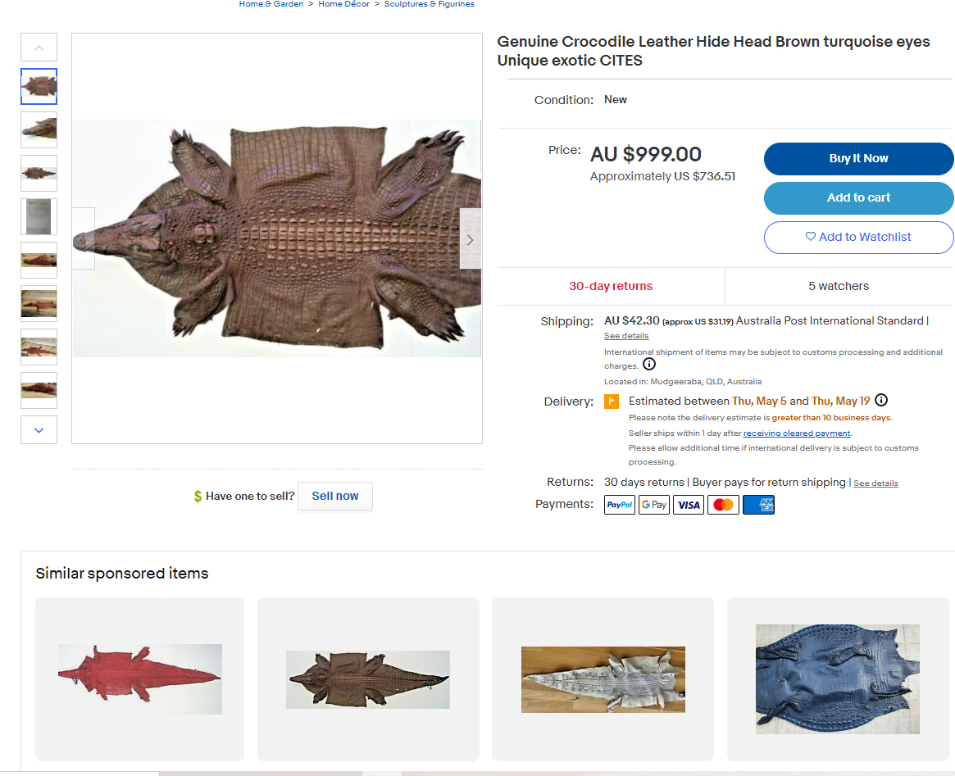
37

Slide 38
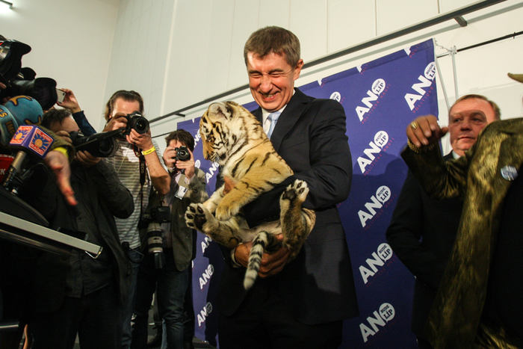
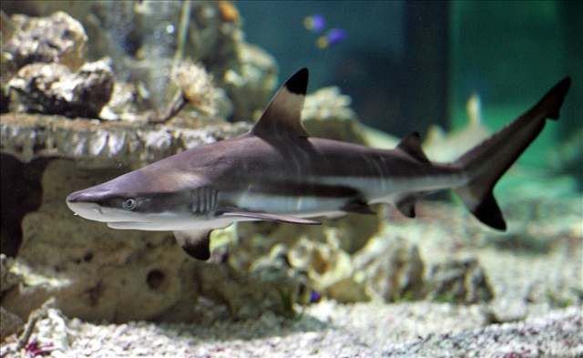
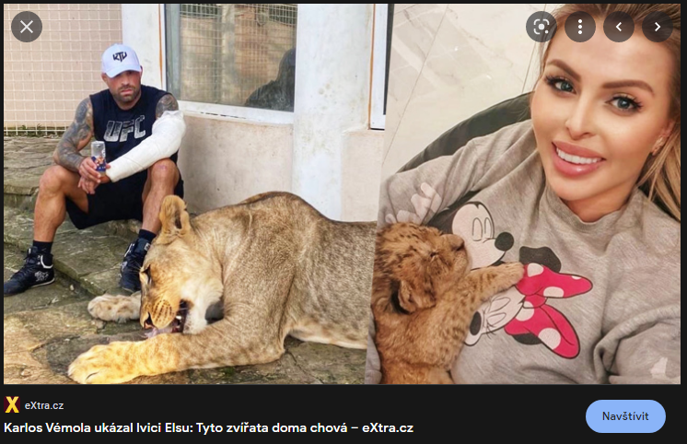
???

Slide 39
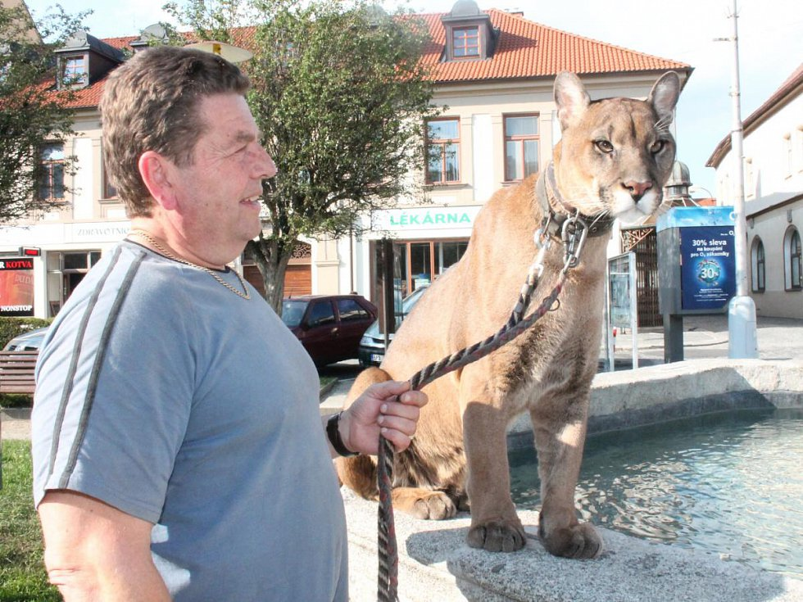
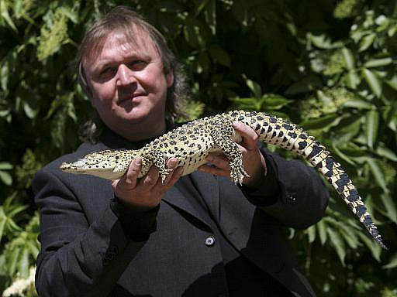
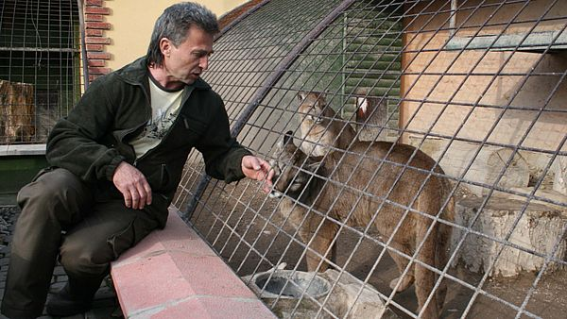
???

Slide 40
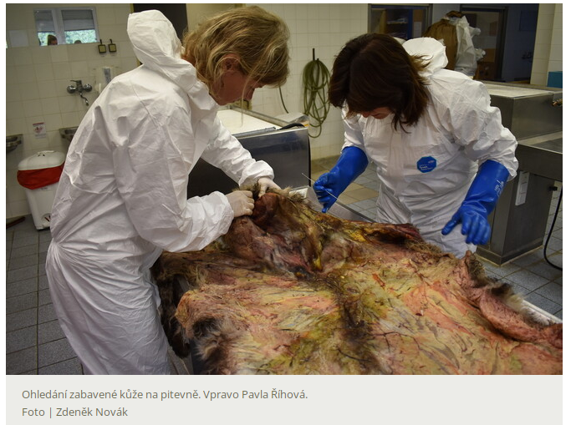
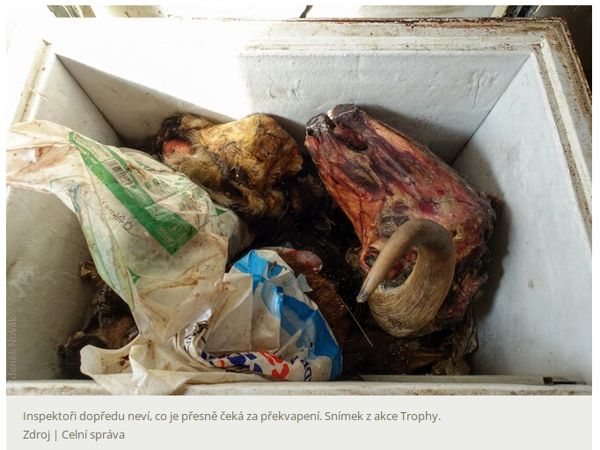
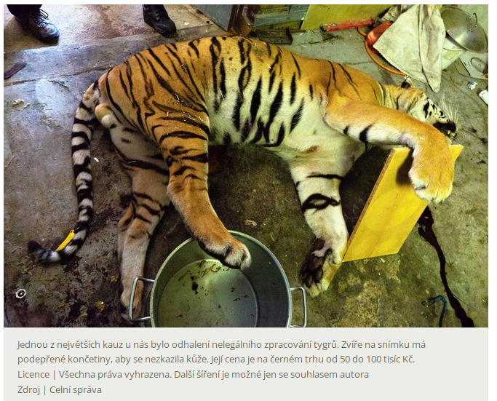
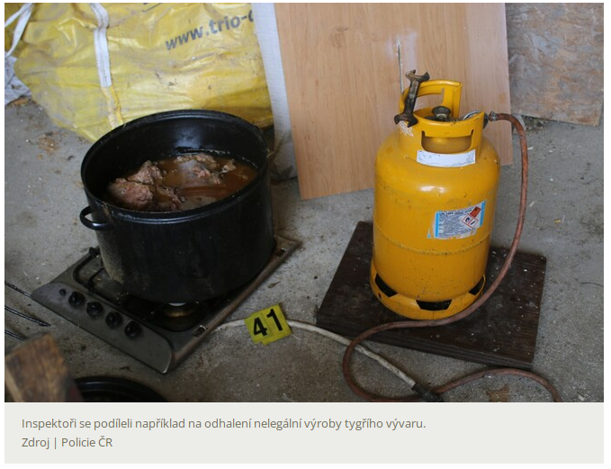

Slide 41
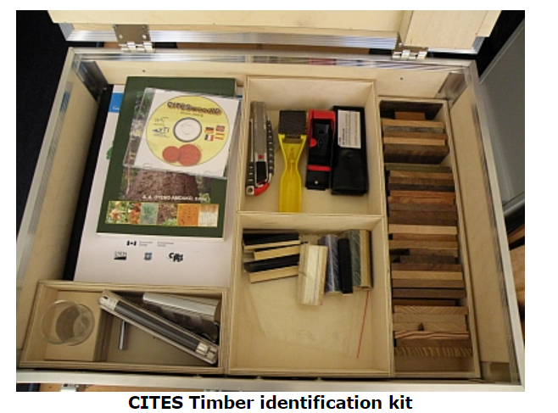

Slide 42
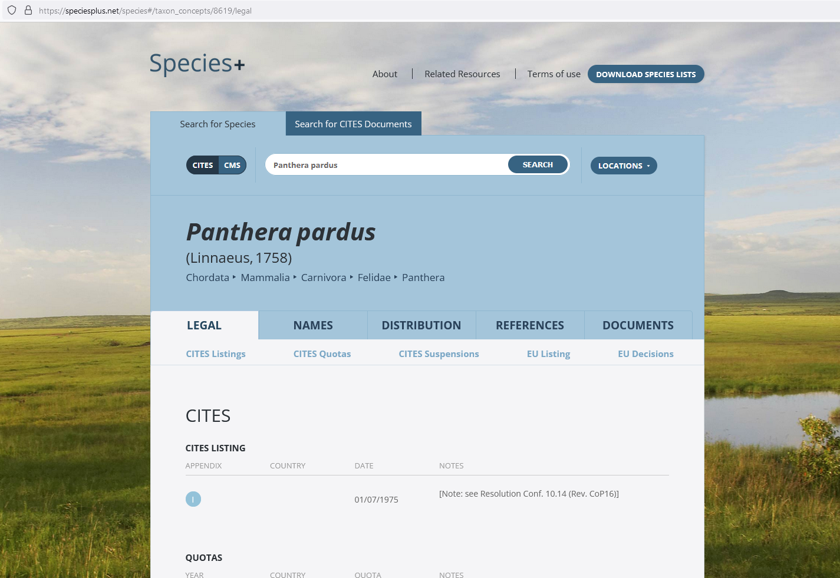
42

Slide 43
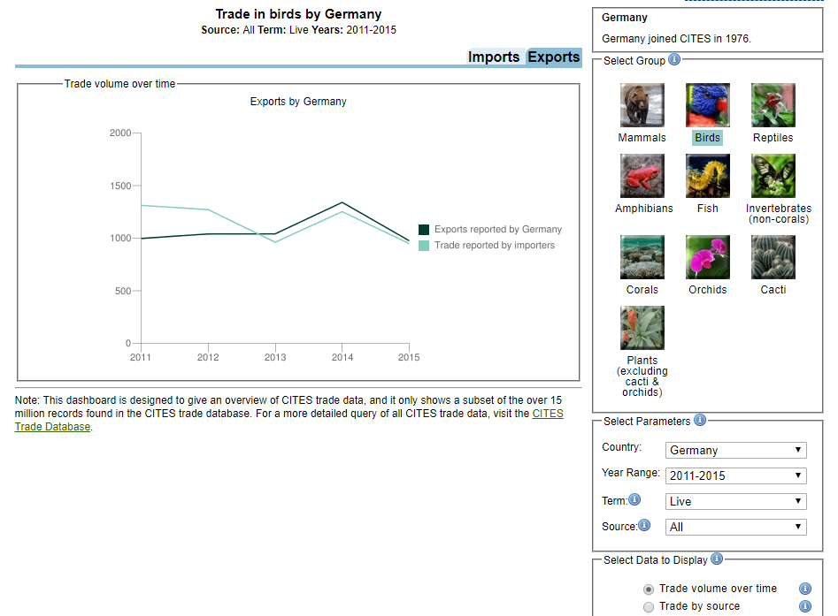

Slide 44
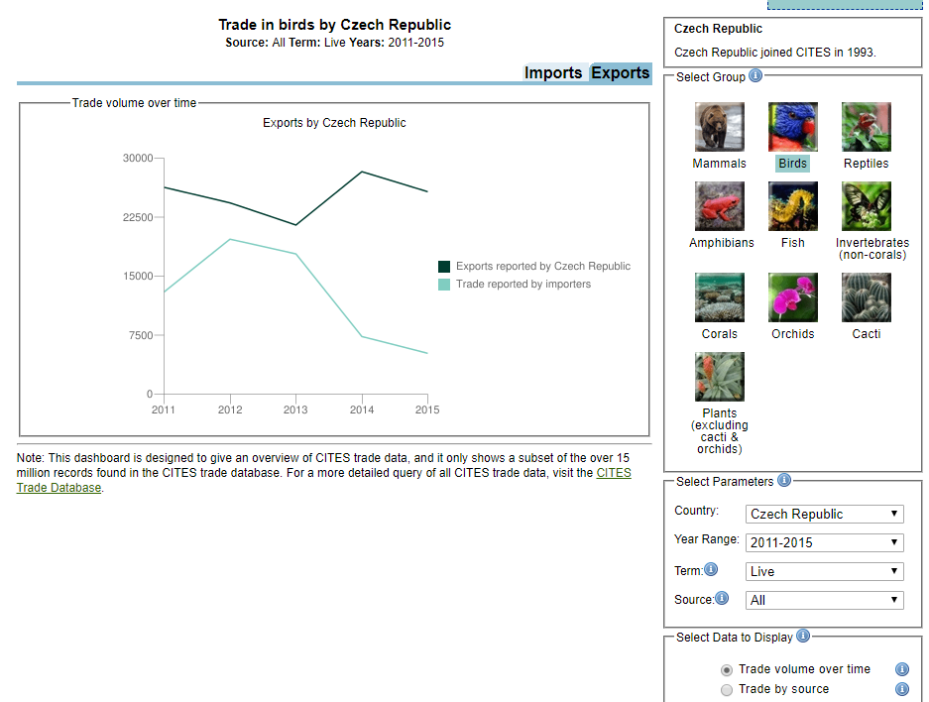

Slide 45
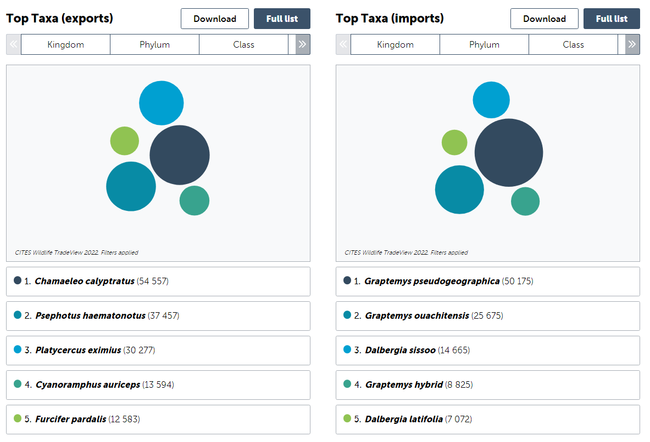
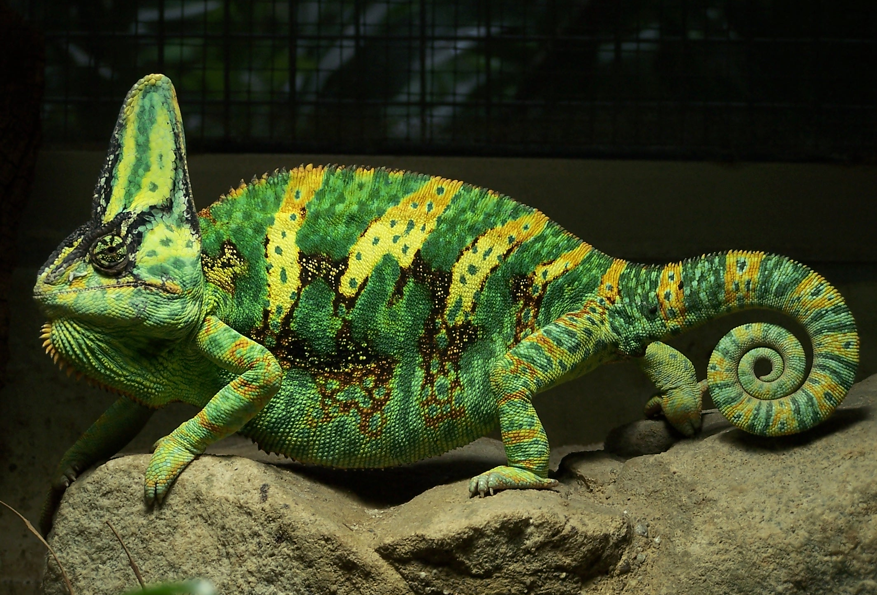
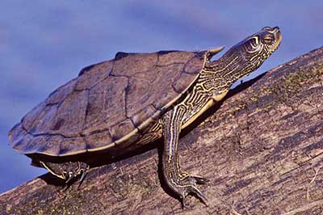

Slide 46
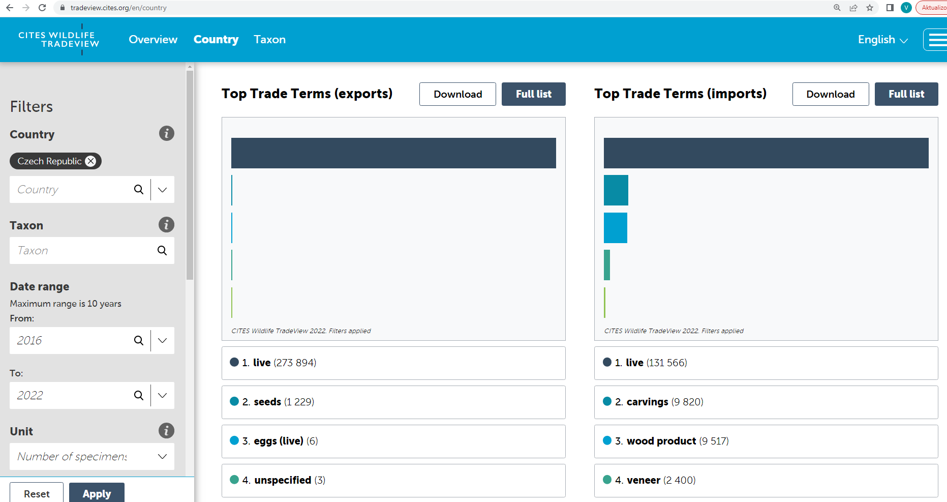
https://tradeview.cites.org/

Slide 47
Practical task
Which species are most frequently imported to your country?
Which species are most frequently exported from your country?
In which quantity)condition are these species transported?

Slide 48
Thank you for your attention!

