Slide 1
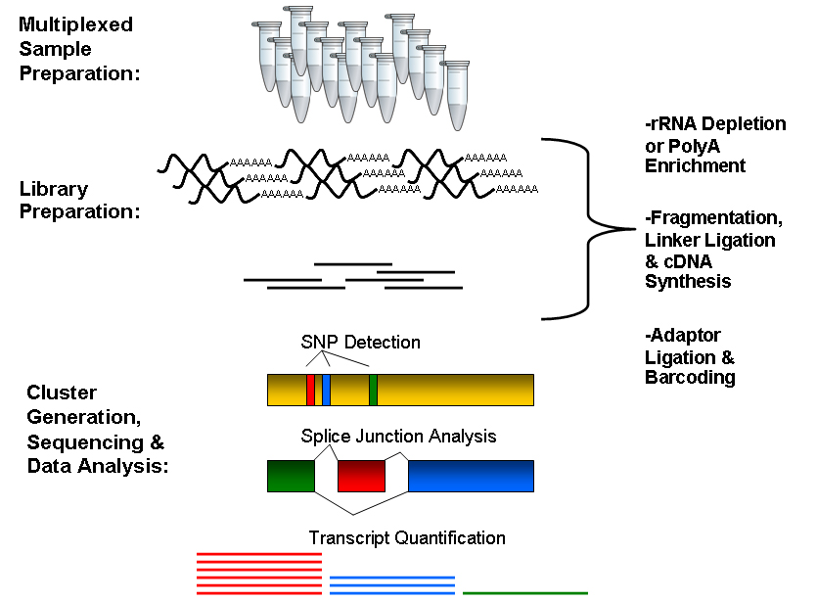
Brief workflow
RNA is isolated from cells, fragmented at random positions, and copied into complementary DNA (cDNA).
Fragments meeting a certain size specification (e.g., 200–300 bases long) are retained for amplification using PCR.
After amplification, the cDNA is sequenced using NGS; the resulting reads are aligned to a reference genome, and the number of sequencing reads mapped to each gene in the reference is tabulated.
These gene counts, or digital gene expression (DGE) measures, can be transformed and used to test differential expression

Slide 2
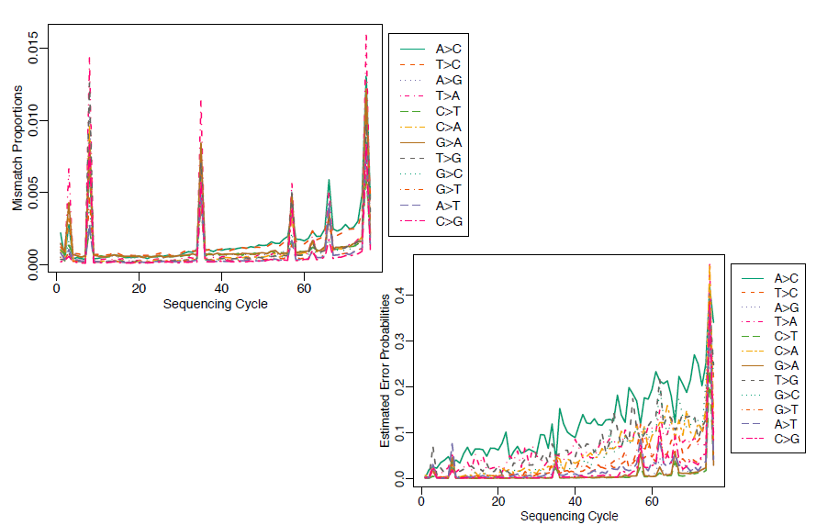
But…
many steps in experimental process may introduce errors and biases

Slide 3
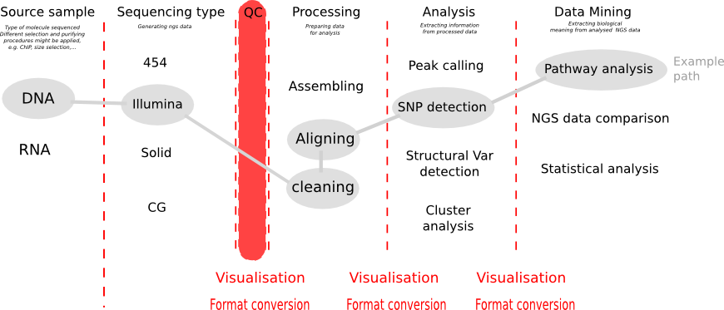
QC in Galaxy

Slide 4
FASTQ format
The first line starts with '@', followed by the label
The third line starts with '+'. In some variants, the '+' line contains a second copy of the label
The fourth line contains the Q scores represented as ASCII characters

Slide 5
Q scores of FASTQ

Slide 6
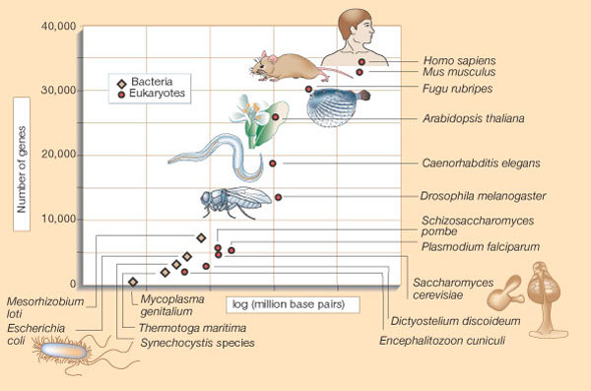
Scales of genome size
Russell F. Doolittle
Nature 419, 493-494(3 October 2002)

Slide 7
Exploratory analyses
1.PCA

Slide 8
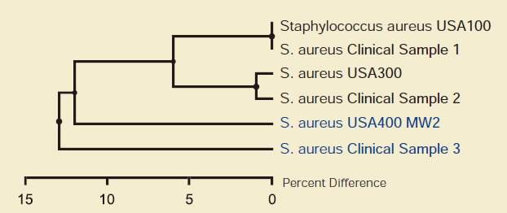
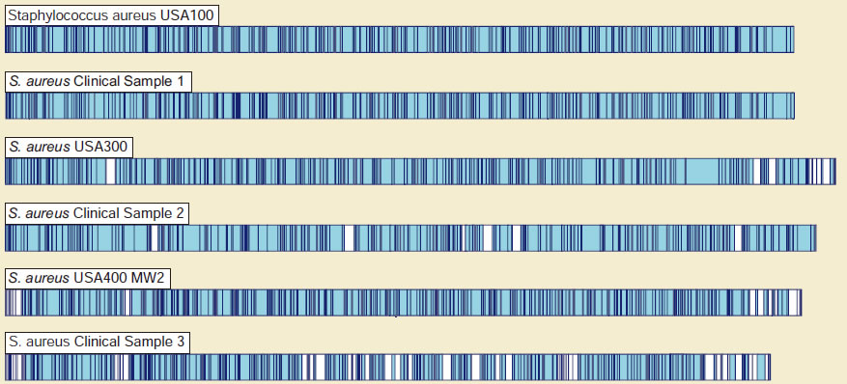
Exploratory analyses
2.Unsupervised clustering

Slide 9
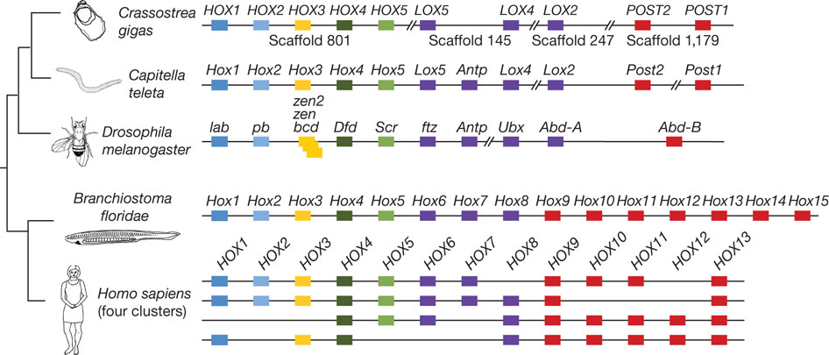
Exploratory analyses
2b.Unsupervised clustering on gene subset
GF Zhang et al. Nature 000, 1-6 (2012) doi:10.1038/nature11413

Slide 10
From microarrays to NGS data
As research transitions from microarrays to sequencing-based approaches, it is essential that we revisit many of the same concerns that the statistical community had at the beginning of the microarray era
series of articles was published elucidating the need for proper experimental design

Slide 11
Experimental design
All of these articles rely on the three fundamental aspects of sound experimental design formalized by R. A. Fisher 70 years (!!!) ago, namely replication, randomization, and blocking:
the experimental design would include many different subjects (i.e., replication) recruited from multiple weight loss centers (i.e., blocking). Each center would randomly assign its subjects to one of the two diets (i.e., randomization).

Slide 12
In case of bad experimental design
it is essentially impossible to partition biological variation from technical variation
No amount of statistical sophistication can separate confounded factors after data have been collected.

Slide 13
Good news for NGS
certain properties of the platforms can be leveraged to ensure proper design
Capacity to bar code

Slide 14
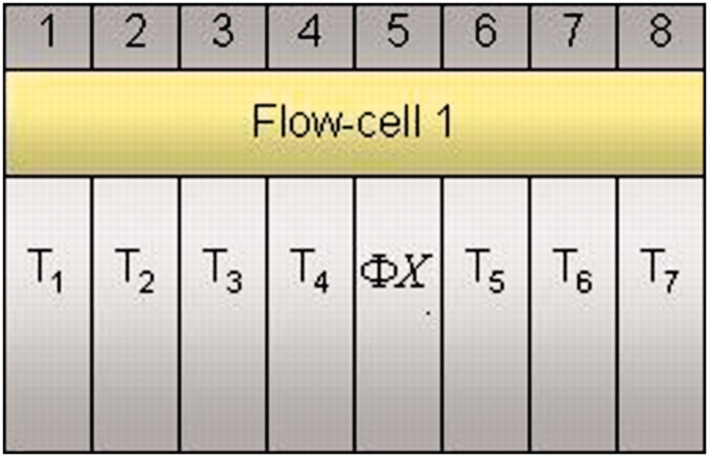
Replication 1. no biological replication
Unreplicated data consider only a single subject per treatment group
it is not possible to estimate variability within treatment group, and the analysis must proceed without any information regarding within-group biological variation
Auer P L , and Doerge R W Genetics 2010;185:405-416
Notes:
Hypothetical Illumina GA flow cell with mRNA isolated from subjects within seven different treatment groups and loaded into individual lanes (e.g., the mRNA from the subject within treatment group 1 is sequenced in lane 1). As a control, a genomic sample is often loaded into lane 5 (can be used to recalibrate the quality scoring of sequencing reads from other lanes).

Slide 15
Fisher's exact test
 | Treatment 1 | Treatment 2 | Total
Gene A | n11 | n12 | N1.
Remaining genes | n21 | n22 | N2.
Total | N.1 | N.2 | N
The cell counts represent the DGE count for gene A or the remaining genes, for Treatment 1, and 2.
Several methods for p-value computation

Slide 16
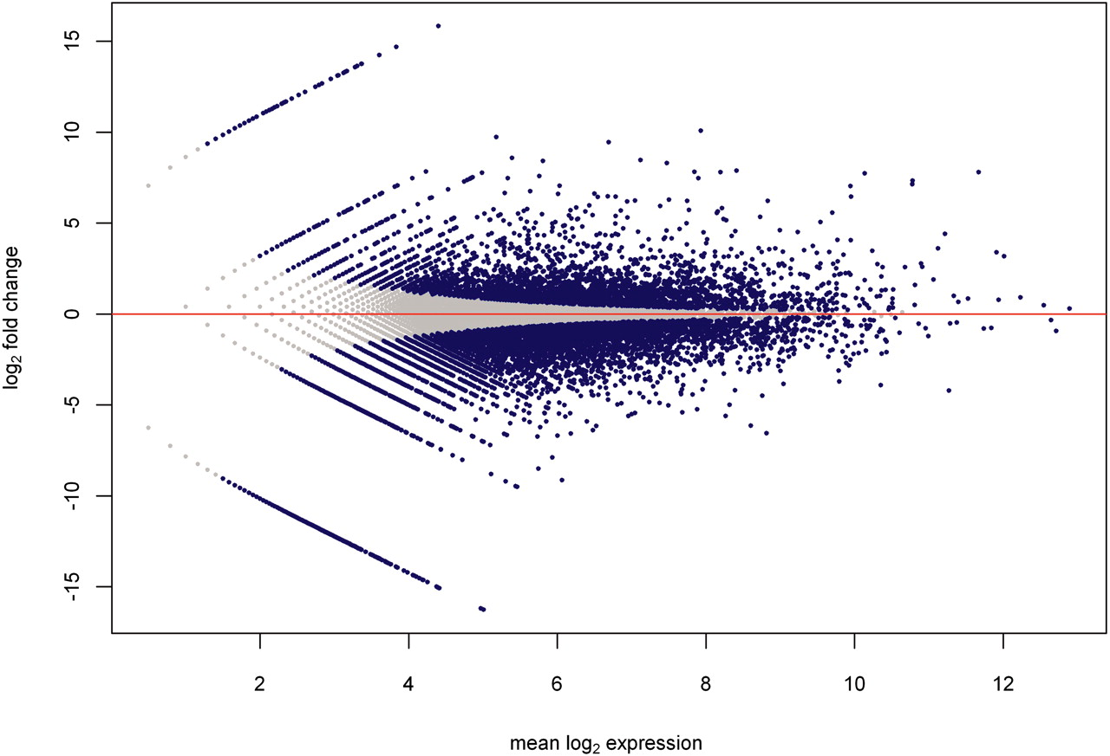
Log2 FC
Gene expression counts were normalized by the column totals of the corresponding 2 × 2 table. Blue dots represent significantly differentially expressed genes (by Fisher's exact test); gray dots represent genes with similar expression.
Auer P L , and Doerge R W Genetics 2010;185:405-416

Slide 17
Limitations of unreplicated data
complete lack of knowledge about biological variation
without an estimate of variability (i.e., within treatment group), there is no basis for inference (between treatment groups)
the results of the analysis only apply to the specific subjects included in the study

Slide 18
Replication 2. replicated data
Auer P L , and Doerge R W Genetics 2010;185:405-416
A multiple flow-cell design based on three biological replicates within seven treatment groups. There are three flow cells with eight lanes per flow cell. The control sample is in lane 5 of each flow cell. T_{ij} refers to the j-th replicate in the i-th treatment group .

Slide 19
DGE
methods for testing differential expression that incorporates within-group (or within-treatment) variability relies on a generalized linear model
(Poisson GLM, logistic regression models, Bayessian approach, beta binomial model, negative binomial model)

Slide 20
Blocking
if the treatment effects are not separable from possible confounding factors, then for any given gene, there is no way of knowing whether the observed difference in abundance between treatment groups is due to the biology or the technology (e.g., amplification or sequencing bias).

Slide 21
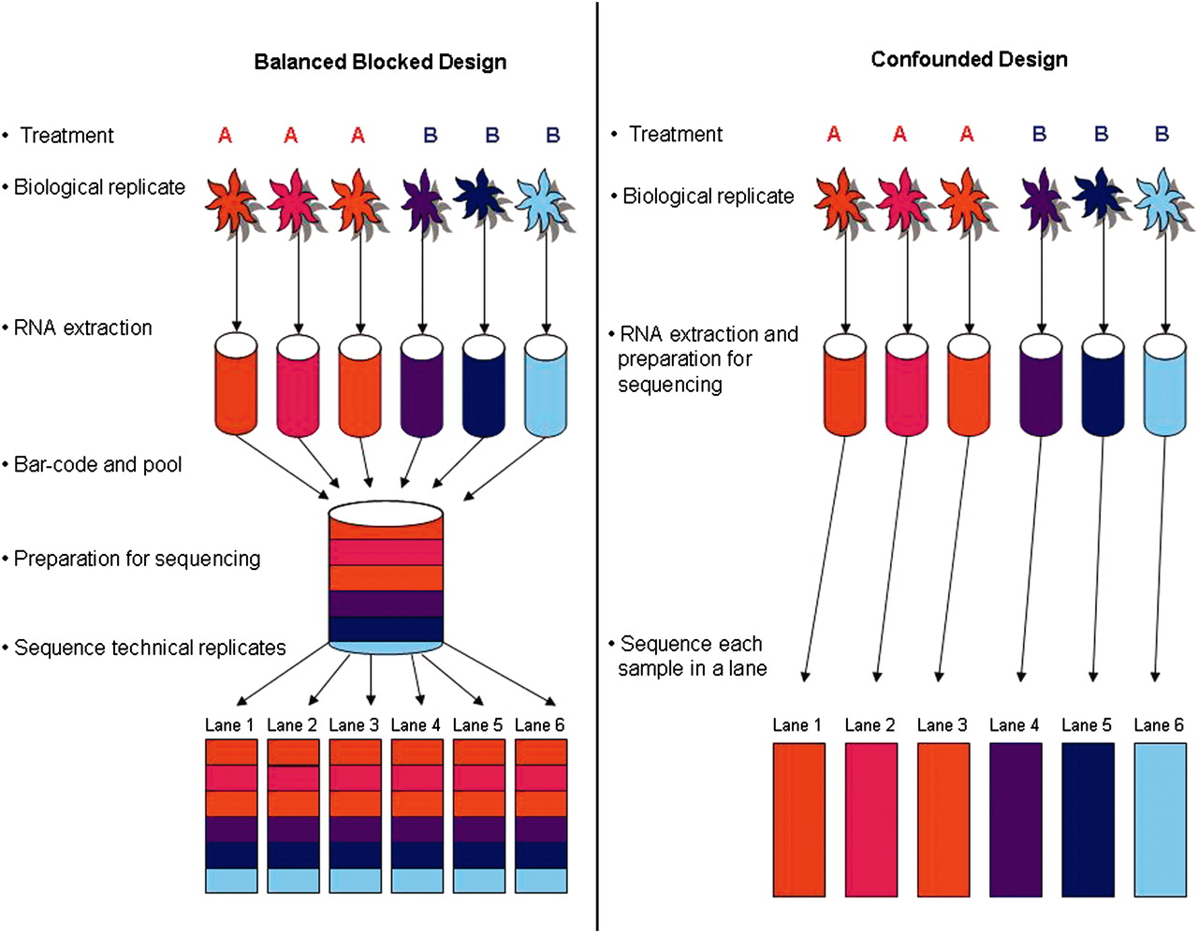
Comparison of two designs
Auer P L , and Doerge R W Genetics 2010;185:405-416
Notes:
Treatment A is denoted by red tones and treatment B by blue tones. In the ideal balanced block design (left), six samples are bar coded, pooled, and processed together. The pool is then divided into six equal portions that are input to six lanes

Slide 22
0. Cofounded design
typical RNA-Seq experiment
consists of the same six samples, with no bar coding, and does not permit partitioning of batch and lane effects from the estimate of within-group biological variability.

Slide 23
1. Balanced block design
Bar coding results in six technical replicates of each sample, while balancing batch and lane effects and blocking on lane.
Allows partitioning of batch and lane effects from the within-group biological variability.

Slide 24
2. Balanced incomplete block designs and blocking without multiplexing
Mostly reliable
in reality:
the number of treatments (I),
the number of biol. replicates per treatment (J),
the number of unique bar codes (s) that can be
included in a single lane,
the number of lanes available for sequencing (L).

Slide 25
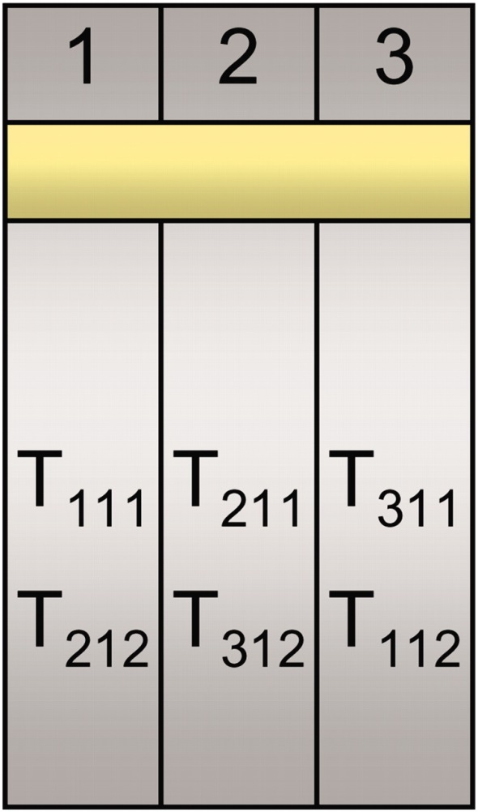
A balanced incomplete block design (BIBD) for three treatment groups (T₁, T₂, T₃) with one subject per treatment group (T_{11,} T₂₁, T₃₁) and two technical replicates of each (T₁₁₁, T_{112,} T₂₁₁, T_{212,} T₃₁₁, T₃₁₂).
each of the three samples is bar coded and divided in two (e.g., T₁₁ would be split into T₁₁₁ and T₁₁₂) and then pooled and sequenced as illustrated (e.g., T₁₁₁ is pooled with T₂₁₂ as input to lane 1).
Auer P L , and Doerge R W Genetics 2010;185:405-416

Slide 26
Auer P L , and Doerge R W Genetics 2010;185:405-416
A design based on three biological replicates within seven treatment groups. For each of the three flow cells there are eight lanes per flow cell and a control sample in lane 5. T_{ij} refers to the j-th replicate in the i-th treatment group

Slide 27
Overview
http://www.nature.com/nprot/journal/v8/n9/full/nprot.2013.099.html

Slide 28
Expression level in RNA-seq
= The number of reads (counts) mapping to the biological feature of interest (gene, transcript, exon, etc.) is considered to be linearly related to the abundance of the target feature

Slide 29
What is differential expression?
A gene is declared differentially expressed if an observed difference or change in read counts between two experimental conditions is statistically significant, i.e. whether it is greater than what would be expected just due to natural random variation.
Statistical tools are needed to make such a decision by studying counts probability distributions.

Slide 30
Definitions
Sequencing depth: Total number of reads mapped to the genome. Library size.
Gene length: Number of bases.
Gene counts: Number of reads mapping to that gene (expression measurement)

Slide 31
Experimental design
Pairwise comparisons: Only two experimental conditions or groups are compared.
Multiple comparisons: More than 2 conditions or groups.
Replicates
Biological replicates. To draw general conclusions: from samples to population.
Technical replicates. Conclusions are only valid for compared samples.

Slide 32
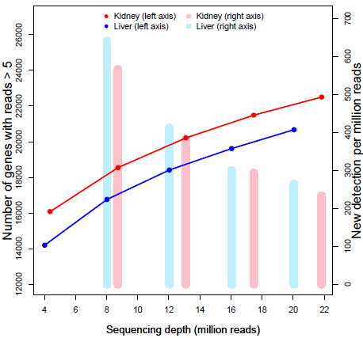
RNA-seq biases
Influence of sequencing depth: The higher sequencing depth, the higher counts

Slide 33
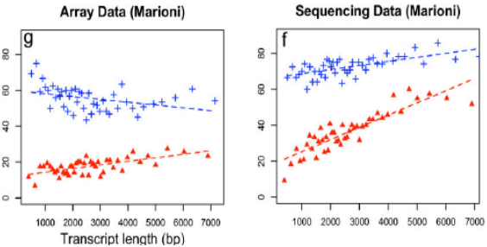
RNA-seq biases
Dependence on gene length: Counts are proportional to the transcript length times the mRNA expression level
%DE genes
Oshlack and Wakefield. 2009

Slide 34
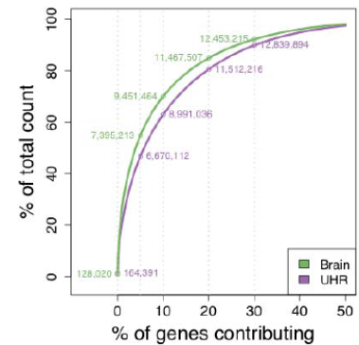
RNA-seq biases
Differences on the counts distribution among samples

Slide 35
RNA-seq biases
Influence of sequencing depth: The higher sequencing depth, the higher counts.
Dependence on gene length: Counts are proportional to the transcript length times the mRNA expression level.
Differences on the counts distribution among samples.

Slide 36
Options
1. Normalization: Counts should be previously corrected in order to minimize these biases.
2. Statistical model should take them into account.

Slide 37
Normalization methods
RPKM (Mortazavi et al., 2008) = Reads per kilo base per million: Counts are divided by the transcript length (kb) times the total number of millions of mapped reads
Upper-quartile (Bullard et al., 2010): Counts are divided by upper-quartile of counts for transcripts with at least one read.
TMM (Robinson and Oshlack, 2010): Trimmed Mean of M values.
Quantiles, as in microarray normalization (Irizarry et al., 2003).
FPKM (Trapnell et al., 2010): Instead of counts, Cufflinks software generates FPKM values (Fragments Per Kilobase of exon per Million fragments mapped) to estimate gene expression, which are analogous to RPKM.

Slide 38
Differential expression
Parametric assumptions: Are they fulfilled?
Need of replicates.
Problems to detect differential expression in genes with low counts.

Slide 39
Goal
Based on a count table, we want to detect differentially expressed genes between conditions of interest.
We will assign to each gene a p-value (0-1), which shows us 'how surprised we should be' to see this difference, when we assume there is no difference.

Slide 40
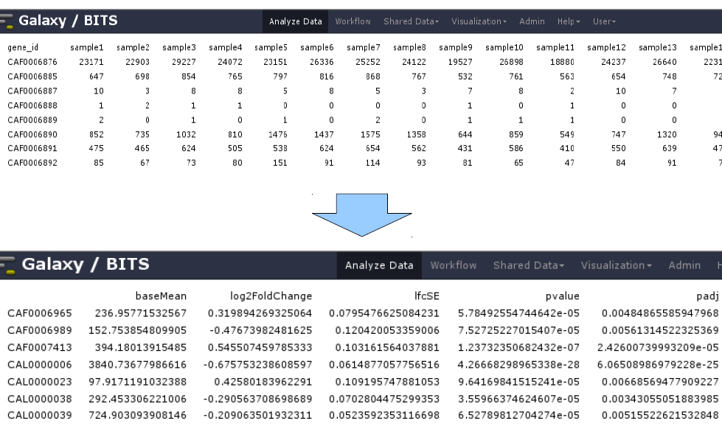
Goal

Slide 41
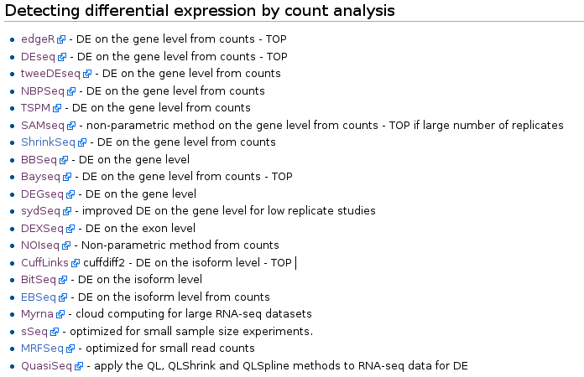
Algorithms under active development
http://wiki.bits.vib.be/index.php/RNAseq_toolbox#Detecting_differential_expression_by_count_analysis

Slide 42
Intuition - gene
Condition A | sample1 | sample2 | sample3 | sample4 | sample5 | sample6 | sample7 | sample8
 | 23171 | 22903 | 29227 | 24072 | 23151 | 26336 | 25252 | 24122
Condition B | Sample9 | sample10 | sample11 | sample12 | sample13 | sample14 | sample15 | sample16
 | 19527 | 26898 | 18880 | 24237 | 26640 | 22315 | 20952 | 25629
}
Variability A
Variability B
Compare and conclude given a Mean level: similar or not?

Slide 43
Intuition

Slide 44
Intuition
NB model is estimated: 2 parameters needed
(mean and dispersion)

Slide 45
Intuition
Difference is quantified and used for
p-value computation

Slide 46
Dispersion estimation
For every gene, a NB is fitted based on the counts. The most important factor in that model to be estimated is the dispersion.
DESeq2 estimates dispersion by 3 steps:
1. Estimates dispersion parameter for each gene
2. Plots and fits a curve
3. Adjusts the dispersion parameter towards the
curve ('shrinking')

Slide 47
Dispersion estimation
Black dots = estimates from the data
Red line = curve fitted
Blue dots = final assigned dispersion parameter for that gene
Model is fitted

Slide 48
Test runs between 2 conditions
for each gene 2 NB models (one for each condition) are made, and a Wald test decides whether the difference is significant (red in plot).

Slide 49
Test runs between 2 conditions
for each gene 2 NB models (one for each condition) are made, and a Wald test decides whether the difference is significant (red in plot).
i.e. we are going to perform thousands of tests…
(if we set set a cut-off on the p-value of 0,05 and we have performed 20000 tests, 1000 genes will appear significant by chance)

Slide 50
Check the distribution of p-values
If the histogram of the p-values does not match a profile as shown here, the test is not reliable. Perhaps the NB fitting step did not succeed, or confounding variables are present.

Slide 51
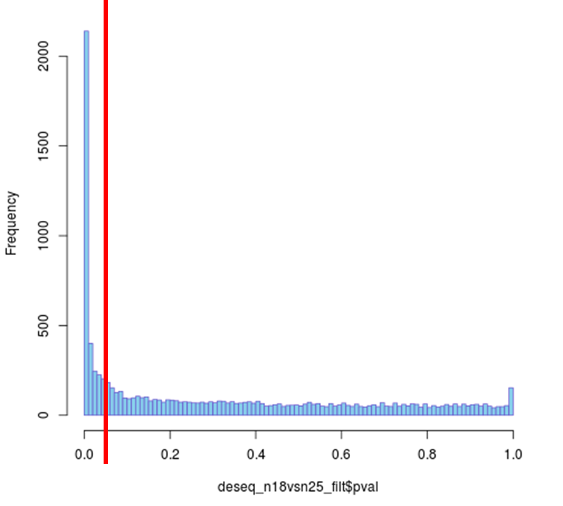
Improve test results
Correctly identified
as DE
False positive
fraction
0.05
Cut-off

Slide 52
Improve test results
Avoid testing = apply a filter before testing, an independent filtering
Apply multiple testing correction

Slide 53
Independent filtering
If we filter out increasingly bigger portions of genes based on their mean counts, the number of significant genes increase

Slide 54
Multiple testing corrections
Bonferroni or Benjamini-Hochberg correction, to control false discovery rate (FDR).
FDR is the fraction of false positives in the genes that are classified as DE.
If we set a threshold α of 0,05, 20% of the DE genes will be false positives.

Slide 55
Why to apply multiple testing correction?
Consider a case where you have 20 hypotheses to test, and a significance level of 0.05.
??? What's the probability of observing at least one significant result just due to chance???
P(at least one significant result) = 1 - P(no signif. results)
= 1 - (1 – 0.05)²⁰ ≈ 0.64
So, with 20 tests being considered, we have a 64% chance of observing at least one significant result, even if all of the tests are actually not significant.

Slide 56
Including different factors
Treatment G
Treatment AG
WT
Mutant (UPC)
Day 1
Day 2
Day 1
Day 2
Additional metadata (batch factor)

Slide 57
Including different factors
Treatment G
Treatment AG
WT
Mutant (UPC)
Day 1
Day 2
Day 1
Day 2
Additional metadata (batch factor)
Which genes are DE between UPC and WT?
Which genes are DE between G and AG?
Which genes are DE in WT between G and AG?

Slide 58
Statistical model
Gene = strain + treatment + day
export results for unique comparisons

Slide 59
Goal

