Slide 1
Moderní metody analýzy genomu
Mgr. Lenka Radová, Ph.D.
Brno, 6.5.2015

Slide 2
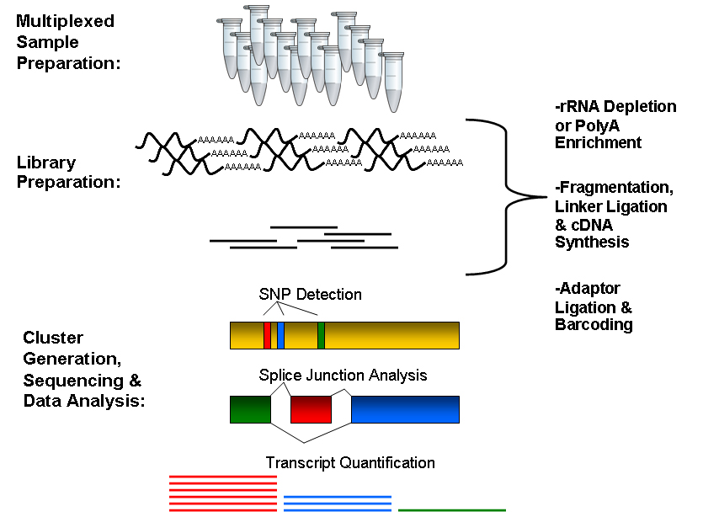
Brief workflow
RNA is isolated from cells, fragmented at random positions, and copied into complementary DNA (cDNA).
Fragments meeting a certain size specification (e.g., 200–300 bases long) are retained for amplification using PCR.
After amplification, the cDNA is sequenced using NGS; the resulting reads are aligned to a reference genome, and the number of sequencing reads mapped to each gene in the reference is tabulated.
These gene counts, or digital gene expression (DGE) measures, can be transformed and used to test differential expression

Slide 3
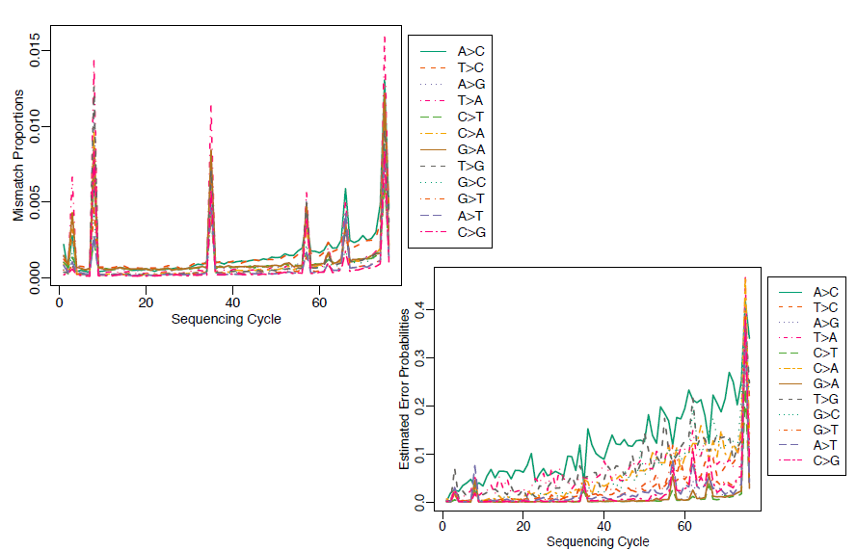
But…
many steps in experimental process may introduce errors and biases

Slide 4
Scales of genome size

Slide 5
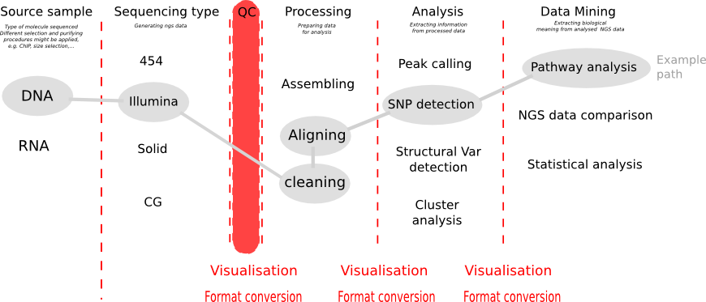
QC in Galaxy

Slide 6
FASTQ format
The first line starts with '@', followed by the label
The third line starts with '+'. In some variants, the '+' line contains a second copy of the label
The fourth line contains the Q scores represented as ASCII characters

Slide 7
Q scores of FASTQ

Slide 8
Quality control tools for NGS data
fastQC in Galaxy
QC report in CLCbio

Slide 9
From microarrays to NGS data
As research transitions from microarrays to sequencing-based approaches, it is essential that we revisit many of the same concerns that the statistical community had at the beginning of the microarray era
series of articles was published elucidating the need for proper experimental design

Slide 10
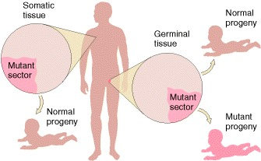
Basic biological problems
Identification of mutations
- somatic
- germinal
Expression analyses - genes, miRNAs, etc.
An Introduction to Genetic Analysis. 7th edition. Griffiths AJF, Miller JH, Suzuki DT, et al. New York: W. H. Freeman; 2000

Slide 11
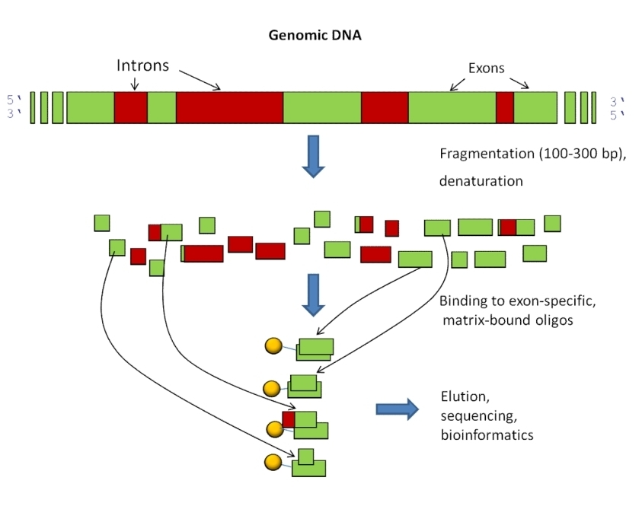
Mutation identification
Whole exome or whole genome data, ultra-deep sequencing
Output: VCF-format

Slide 12
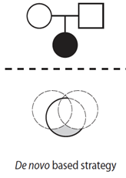
Mutation identification
Aim: identification of point mutations
Application: diagnostic of diseases
- inherited (germinal, de-novo mutations)
e.g. familiar hypercholesterolemia, hemophylia, cystic fibrosis…
- gained (somatic mutations)
e.g. cancer, leukemia, …

Slide 13
Germinal mutations
Comparison with reference genome
Expected allele frequency: 30-100%
Softwares: GATK, VarScan, …
Usage: e.g. prenatal diagnostic

Slide 14
Somatic mutations
Comparison tumor-normal (matched, unmatched)
Expected allele frequency:
>0,2%
Softwares: MuTect, FreeBayes, deepSNV, …
Usage: translational research, cancer diagnostic, personalized medicine,…

Slide 15
Expression analyses – RNA-seq
characterization of gene expression in cells via measurement of mRNA levels
Output: expression level table

Slide 16
RNA-seq
Aim: identification of genes differentially expressed in tissues with different conditions (tumor vs normal, treated vs untreated, different stages of illness, …)
Application: translational research, diagnostic of diseases

Slide 17
Expression level in RNA-seq
= The number of reads (counts) mapping to the biological feature of interest (gene, transcript, exon, etc.) is considered to be linearly related to the abundance of the target feature

Slide 18
What is differential expression?
A gene is declared differentially expressed if an observed difference or change in read counts between two experimental conditions is statistically significant, i.e. whether it is greater than what would be expected just due to natural random variation.
Statistical tools are needed to make such a decision by studying counts probability distributions.

Slide 19
Definitions
Sequencing depth: Total number of reads mapped to the genome. Library size.
Gene length: Number of bases.
Gene counts: Number of reads mapping to that gene (expression measurement)

Slide 20
Experimental design
Pairwise comparisons: Only two experimental conditions or groups are compared.
Multiple comparisons: More than 2 conditions or groups.
Replicates
Biological replicates. To draw general conclusions: from samples to population.
Technical replicates. Conclusions are only valid for compared samples.

Slide 21
RNA-seq biases
Influence of sequencing depth: The higher sequencing depth, the higher counts.
Dependence on gene length: Counts are proportional to the transcript length times the mRNA expression level.
Differences on the counts distribution among samples.

Slide 22
Options
1. Normalization: Counts should be previously corrected in order to minimize these biases.
2. Statistical model should take them into account.

Slide 23
Normalization methods
RPKM (Mortazavi et al., 2008) = Reads per kilo base per million: Counts are divided by the transcript length (kb) times the total number of millions of mapped reads
Upper-quartile (Bullard et al., 2010): Counts are divided by upper-quartile of counts for transcripts with at least one read.
TMM (Robinson and Oshlack, 2010): Trimmed Mean of M values.
Quantiles, as in microarray normalization (Irizarry et al., 2003).
FPKM (Trapnell et al., 2010): Instead of counts, Cufflinks software generates FPKM values (Fragments Per Kilobase of exon per Million fragments mapped) to estimate gene expression, which are analogous to RPKM.

Slide 24
Differential expression
Parametric assumptions: Are they fulfilled?
Need of replicates.
Problems to detect differential expression in genes with low counts.

Slide 25
Goal
Based on a count table, we want to detect differentially expressed genes between conditions of interest.
We will assign to each gene a p-value (0-1), which shows us 'how surprised we should be' to see this difference, when we assume there is no difference.

Slide 26
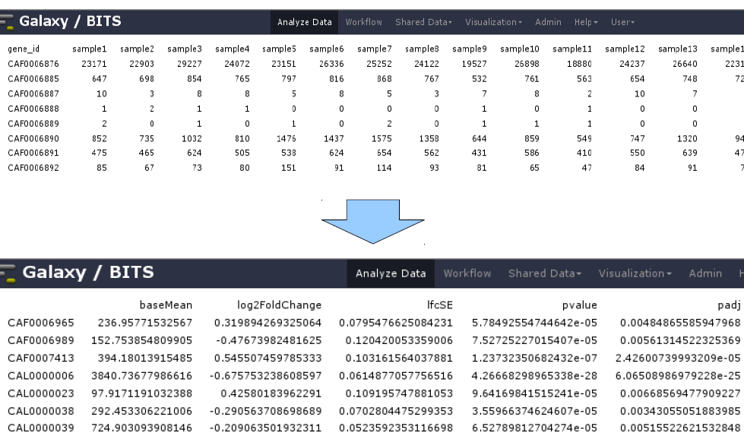
Goal

Slide 27
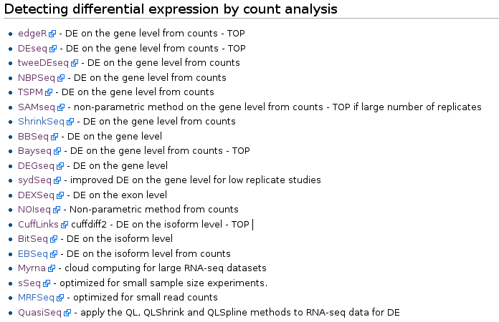
Algorithms under active development
http://wiki.bits.vib.be/index.php/RNAseq_toolbox#Detecting_differential_expression_by_count_analysis

Slide 28
Intuition - gene
Condition A | sample1 | sample2 | sample3 | sample4 | sample5 | sample6 | sample7 | sample8
 | 23171 | 22903 | 29227 | 24072 | 23151 | 26336 | 25252 | 24122
Condition B | Sample9 | sample10 | sample11 | sample12 | sample13 | sample14 | sample15 | sample16
 | 19527 | 26898 | 18880 | 24237 | 26640 | 22315 | 20952 | 25629
}
Variability A
Variability B
Compare and conclude given a Mean level: similar or not?

Slide 29
Intuition
Difference is quantified and used for
p-value computation

Slide 30
Dispersion estimation
For every gene, a NB is fitted based on the counts. The most important factor in that model to be estimated is the dispersion.
DESeq2 estimates dispersion by 3 steps:
1. Estimates dispersion parameter for each gene
2. Plots and fits a curve
3. Adjusts the dispersion parameter towards the
curve ('shrinking')

Slide 31
Dispersion estimation
Black dots = estimates from the data
Red line = curve fitted
Blue dots = final assigned dispersion parameter for that gene
Model is fitted

Slide 32
Test runs between 2 conditions
for each gene 2 NB models (one for each condition) are made, and a Wald test decides whether the difference is significant (red in plot).

Slide 33
Test runs between 2 conditions
for each gene 2 NB models (one for each condition) are made, and a Wald test decides whether the difference is significant (red in plot).
i.e. we are going to perform thousands of tests…
(if we set set a cut-off on the p-value of 0,05 and we have performed 20000 tests, 1000 genes will appear significant by chance)

Slide 34
Check the distribution of p-values
If the histogram of the p-values does not match a profile as shown here, the test is not reliable. Perhaps the NB fitting step did not succeed, or confounding variables are present.

Slide 35
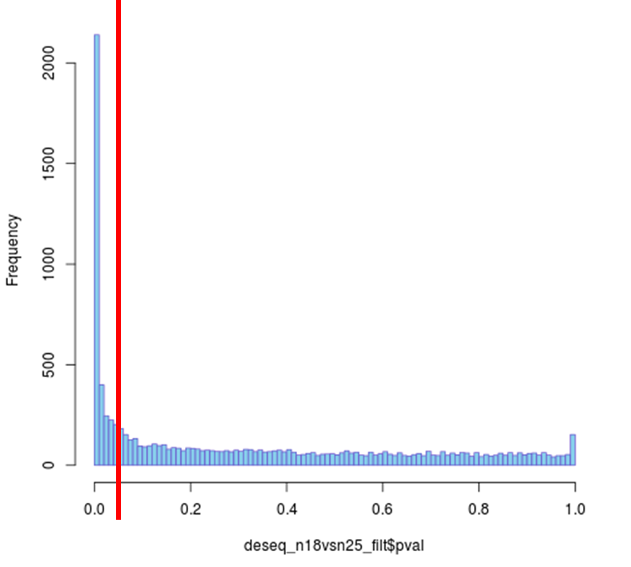
Improve test results
Correctly identified
as DE
False positive
fraction
0.05
Cut-off

Slide 36
Improve test results
Avoid testing = apply a filter before testing, an independent filtering
Apply multiple testing correction

Slide 37
Multiple testing corrections
Bonferroni or Benjamini-Hochberg correction, to control false discovery rate (FDR).
FDR is the fraction of false positives in the genes that are classified as DE.
If we set a threshold α of 0,05, 20% of the DE genes will be false positives.

Slide 38
Why to apply multiple testing correction?
Consider a case where you have 20 hypotheses to test, and a significance level of 0.05.
??? What's the probability of observing at least one significant result just due to chance???
P(at least one significant result) = 1 - P(no signif. results)
= 1 - (1 – 0.05)²⁰ ≈ 0.64
So, with 20 tests being considered, we have a 64% chance of observing at least one significant result, even if all of the tests are actually not significant.

Slide 39
Including different factors
Treatment G
Treatment AG
WT
Mutant (UPC)
Day 1
Day 2
Day 1
Day 2
Additional metadata (batch factor)

Slide 40
Including different factors
Treatment G
Treatment AG
WT
Mutant (UPC)
Day 1
Day 2
Day 1
Day 2
Additional metadata (batch factor)
Which genes are DE between UPC and WT?
Which genes are DE between G and AG?
Which genes are DE in WT between G and AG?

Slide 41
Statistical model
Gene = strain + treatment + day
export results for unique comparisons

Slide 42
Goal

Slide 43
Visualization of results - heatmap
Differentially expressed miRNAs with adjusted p<0,01
samples

