Slide 1
LARYNX

Slide 2
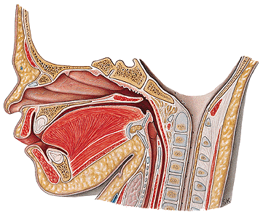
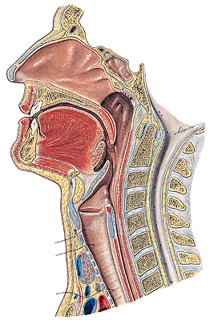
LARYNX
NEONATE
ADULT

Slide 3
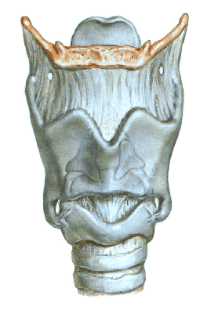
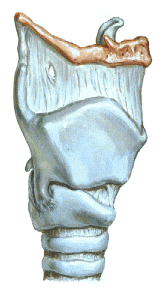
CARTILAGINES LARYNGIS
Cartilago thyroidea
Cartilago cricoidea
Cartilago arytenoidea
Cartilago epiglotica
Cartilago corniculata
Cartilago cuneiformis
Cartilago triticea

Slide 4
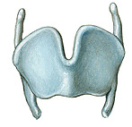

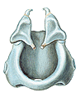

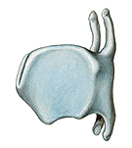

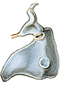
CARTILAGO ARYTENOIDEA
- apex
- basis
- facies art. cricoidea
- processus vocalis
- processus
muscularis
- facies anterolateralis
- colliculus
- crista arcuata
- fossa triangularis
- fovea oblonga
- facies medialis
- facies posterior
CARTILAGO EPIGLOTTICA
petiolus epiglottidis
lamina
CARTILAGO CORNICULATA
CARTILAGO CUNEIFORMIS
CARTILAGO TRITICEA
CARTILAGO CRICOIDEA
-arcus
-lamina
-facies articularis
arytenoidea
-facies articularis
thyroidea
CARTILAGO THYROIDEA
lamina dextra
lamina sinistra
incisura thyroidea sup.
incisura thyroidea inf.
cornua superiora
ligg. thyroidea lateralia
cornua inferiora
facies art. cricoidea
linea obliqua
foramen thyroideum

Slide 5
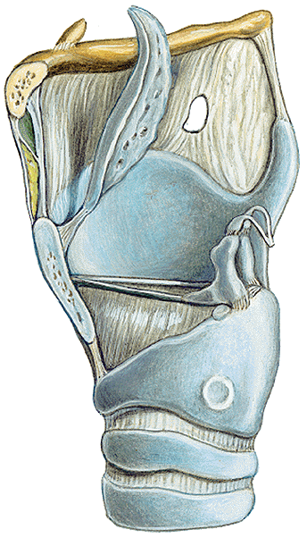
Connections-ligaments
Membrana thyrohyoidea
Lig. cricothyroideum (coniotomy)
Membrana quadrangularis
(epiglottis - arytenoid c., ligg. vestibularia)
Conus elasticus
(ligg.vocalia and arcus cartilaginis cricoideae)
Membrana fibrocartilaginea laryngis
conus elasticus + membrana quadrangularis
Ligg. vestibularia (thickened margine of membrana quandrangularis)
Ligg. vocalia (thickened margin of conus elasticus)
stratified squamous epithelium – due to strain during phonation
Lig. cricotracheale

Slide 6
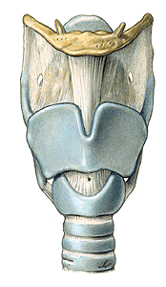
MEMBRANA THYROIDEA
lig. thyroideum laterale
lig. thyroideum medianum

Slide 7
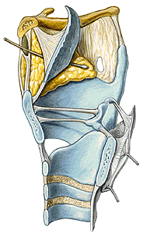
Lig thyroepiglotticum
Lig. hyoepiglotticum
Spatium praeepiglotticum

Slide 8
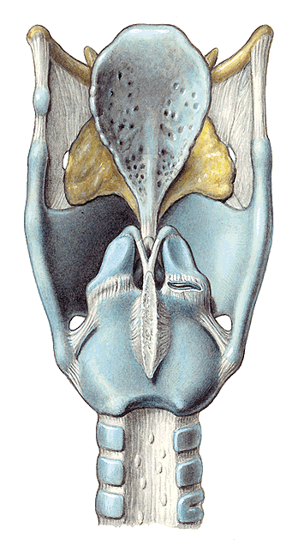
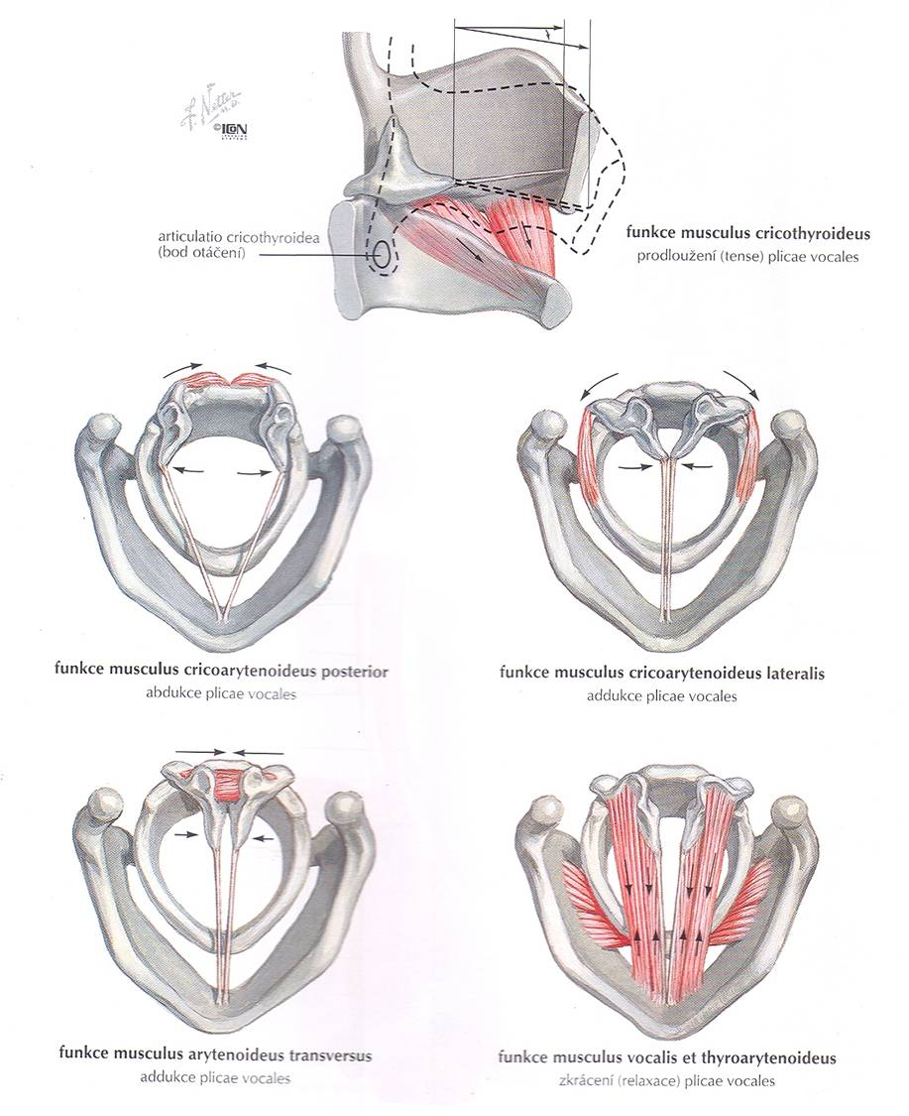
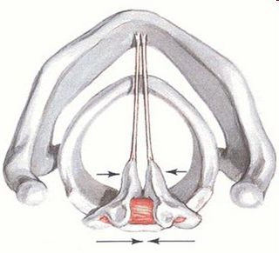
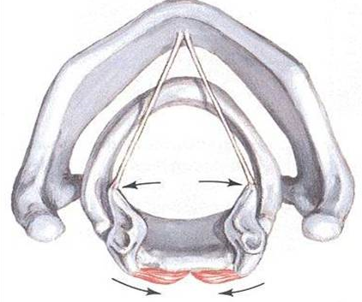
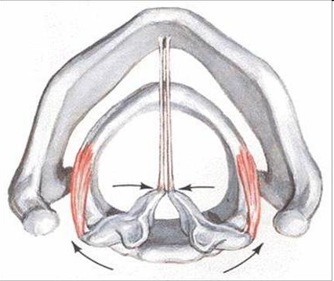
Joints
Art. cricothyroidea (oscilating movements)
Lig. cricoaerytaenoideumpost.
Art. cricoarytaenoidea (rotation and sliding movements – result in abduction and adduction of vocal cords)

Slide 9
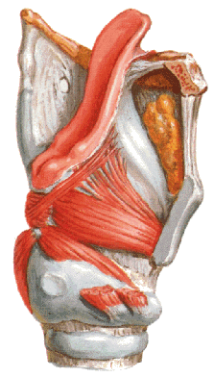
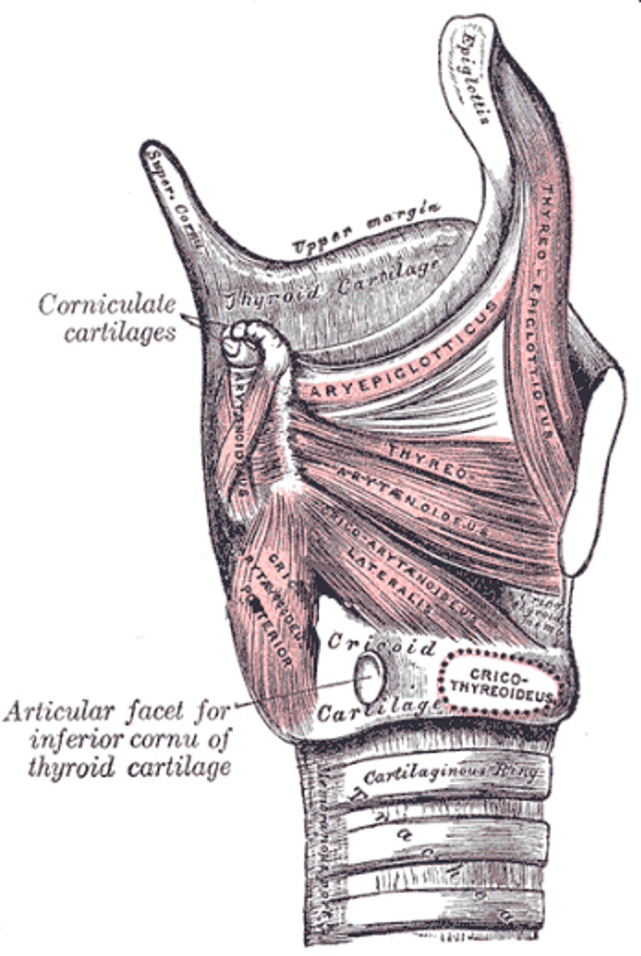
MUSCLES
according to their function
1) Muscles moving with epiglotis:
a) Musculus thyroepiglotticus
opens aditus laryngis
b) Musculus aryepiglotticus
closes aditus laryngis

Slide 10
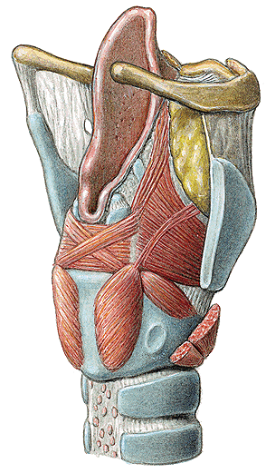
2) Muscles responsible for respiration and phonation position of vocal cords:
Musculus cricoarytaenoideus lateralis
narrows the rima glottidis (adduktion of vocal cords) - phonation
b) Musculus cricoarytaenoideus posterior (musculus posticus) opens rima glottidis – abduktion of vocal cords (ligg. vocalia) – respiration position
c) Musculus arytaenoideus
Strongest adduktor - phonation
L
P
m. cricoarytaenoideus lateralis
m. cricoarytaenoideus posterior
m. arytaenoideus

Slide 11
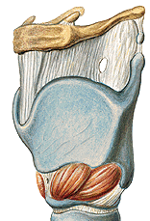
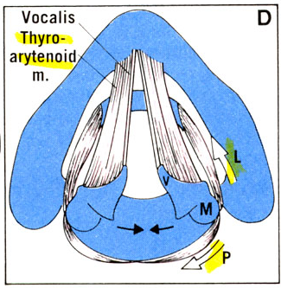
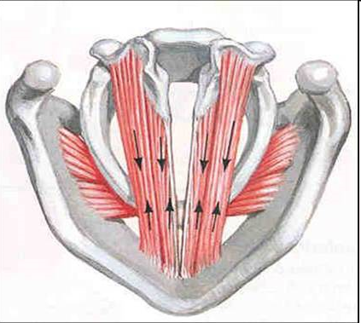
3) Muscles responsible for the tension of the vocal cords:
Musculus cricothyroideus
tenses the vocal cords
b) Musculus thyroarytaenoideus relaxes the tension of vocal cords
c) Musculus vocalis
fine regulation of the vocal cord tension
TA

Slide 12
m. cricoarytaenoideus posterior
m. cricoarytaenoideus lateralis
Respiration position
Vocal cords in abduktion
Phonation position
Vocal cords in adduktion
Relaxation of vocal cords m. thyroarytenoideus and vocalis
Tension of v.c. m. cricothyroideus
m. arytaenoideus
m. thyroarytaenoideus
m. cricothyroideus

Slide 13
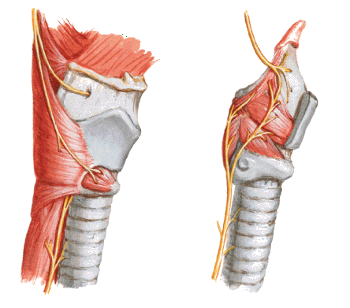
Inervation of laryngeal muscles nervus vagus via:
nervus laryngeus superior
(musculus cricothyroideus)
nervus laryngeus inferior
(n. laryngeus recurrens)
(all others)

Slide 14
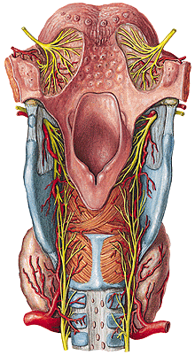
laryngea sup. - A. thyroidea sup.
A. laryngea inf. – A. thyroidea inf.
Subcutaneous tissue– oedema
Folliculi lymph. laryngei
Tonsilla laryngea
Posterior side of epiglotis-
taste buds

Slide 15
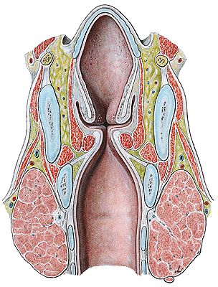
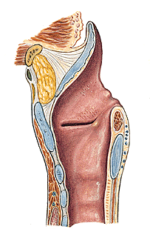
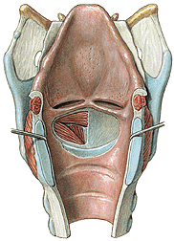
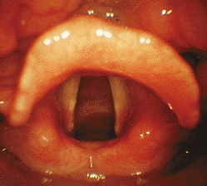
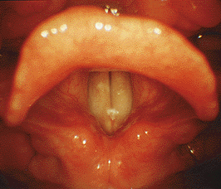
1) Vestibulum laryngis
epiglottis (aditus laryngis) - plicae vestibulares
2) Glottis
plicae vestibulares - plicae vocales
rima glottidis – saggital slit
between vocal cords
3) Cavitas infraglottica
False cords(ligg. ventricularia)
True cords (ligg. vocalia)
False vocal cords
respirační postavení fonační postavení
True vocal cords
(ligg. vocalia)
laryngoskopie
Aerytaenoid cartilage
False vocal cords
(ligg. ventricularia)
True vocal cords

Slide 16
CAVITAS LARYNGIS
vestibulum laryngis
plicae vestibulares
rima vestibuli
plicae vocales
rima glottidis
-glottis
-ventriculus laryngis
sacculus laryngis
cavum infraglotticum

Slide 17
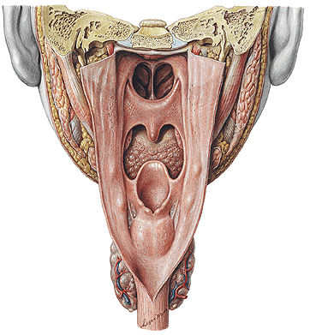
CAVITAS LARYNGIS
aditus laryngis-plicae aryepiglotticae (tuberculum cuneiforme
et corniculatum), plica interarytenoidea,incisura interarytenoidea
plicae vestibulares
plicae vocales

Slide 18
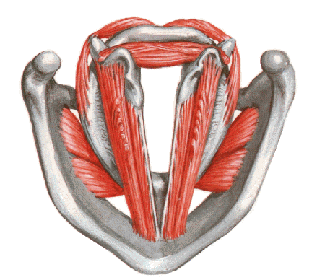
Rima glottidis
pars inter-
membranacea
pars inter-
cartilaginea

Slide 19
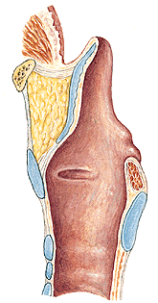
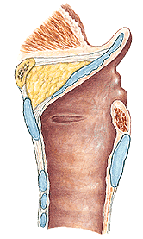

Slide 20
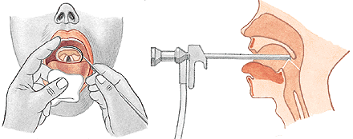
LARYNGOSCOPY
indirect
direct

Slide 21
RESPIRATION
PHONATION

Slide 22
Vocal Cords up close while singing
http://www.youtube.com/watch?v=-XGds2GAvGQ

Slide 23
Illustrations and photographs were copied from:
Atlas der Anatomie des Menschen/Sobotta.
Putz,R., und Pabst,R. 20. Auflage. München:
Urban & Schwarzenberg, 1993
Netter: Interactive Atlas of Human Anatomy.
Windows Version 2.0

