Slide 1
1
2
DEPARTMENT OF HISTOLOGY AND EMBRYOLOGY
FACULTY OF MEDICINE, MASARYK UNIVERSITY
1
3
Notes:
Larynx
1 – cartilage
2 – muscle
3 – connective tissue

Slide 2
2
3
4
2
DEPARTMENT OF HISTOLOGY AND EMBRYOLOGY
FACULTY OF MEDICINE, MASARYK UNIVERSITY
1
Notes:
Trachea
1 – hyaline cartilage
2 – perichondrium
3 – adipose tissue
4 – muscle

Slide 3
3
3
2
1
DEPARTMENT OF HISTOLOGY AND EMBRYOLOGY
FACULTY OF MEDICINE, MASARYK UNIVERSITY
Notes:
1 - elastic cartilage (aldehyde fuchsin)
2 – glands
3 – connective tissue proper

Slide 4
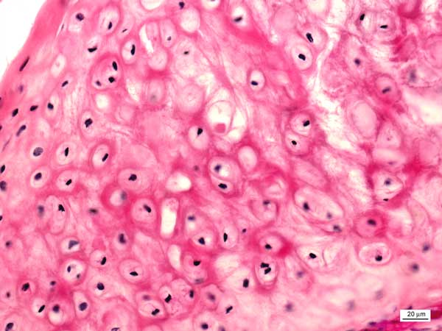
4
DEPARTMENT OF HISTOLOGY AND EMBRYOLOGY
FACULTY OF MEDICINE, MASARYK UNIVERSITY
Notes:
Elastic cartilage

Slide 5
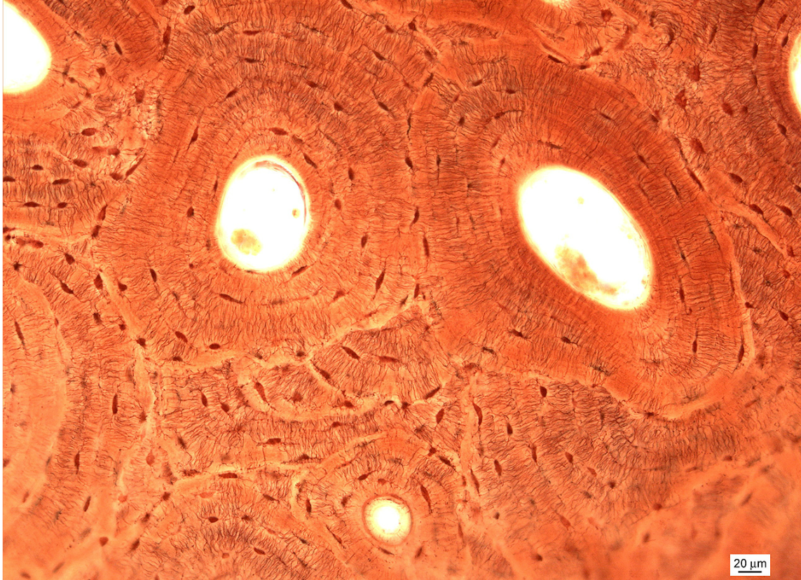
3
5
1
2
DEPARTMENT OF HISTOLOGY AND EMBRYOLOGY
FACULTY OF MEDICINE, MASARYK UNIVERSITY
Notes:
Lamellar bone
1 – osteocyte
2 – Haversian canal
3 – Haversian system (osteon)

Slide 6
6
1
DEPARTMENT OF HISTOLOGY AND EMBRYOLOGY
FACULTY OF MEDICINE, MASARYK UNIVERSITY
2
Notes:
1 - lamellar bone
2 – bone marrow

Slide 7
7
1
2
DEPARTMENT OF HISTOLOGY AND EMBRYOLOGY
FACULTY OF MEDICINE, MASARYK UNIVERSITY
Notes:
Lamellar bone
1 – Haversian system (osteon)
2 – Haversian canal with vessels and nerves

Slide 8
8
2
DEPARTMENT OF HISTOLOGY AND EMBRYOLOGY
FACULTY OF MEDICINE, MASARYK UNIVERSITY
1
3
Notes:
Intracartilaginous (enchondral) ossification
1 – zone of proliferation
2 – zone of calcification
3 – zone of ossification

Slide 9
9
2
4
3
DEPARTMENT OF HISTOLOGY AND EMBRYOLOGY
FACULTY OF MEDICINE, MASARYK UNIVERSITY
1
Notes:
Concha nasi
1 – lamellar bone
2 - pseudostratified epithelium
3 – glands
4 - loose connective tissue

