Slide 1
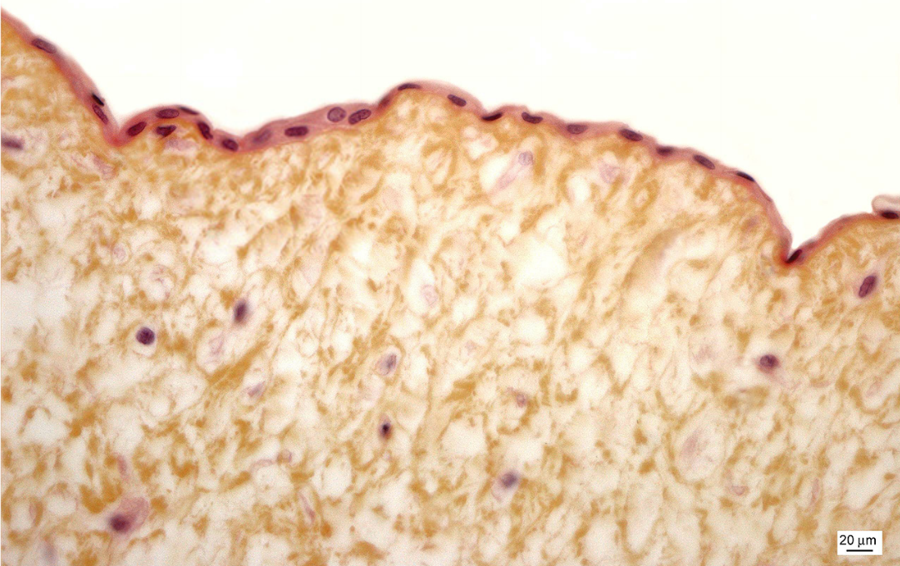
Notes:
Simple squamous epithelium

Slide 2
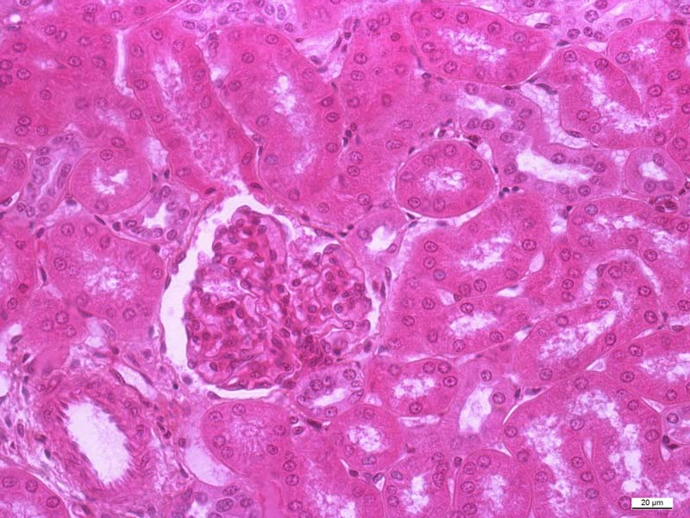
2
1
Notes:
1 - Simple squamous epithelium – Bowman's capsule
2 – simple cuboidal epithelium – distal tubule

Slide 3
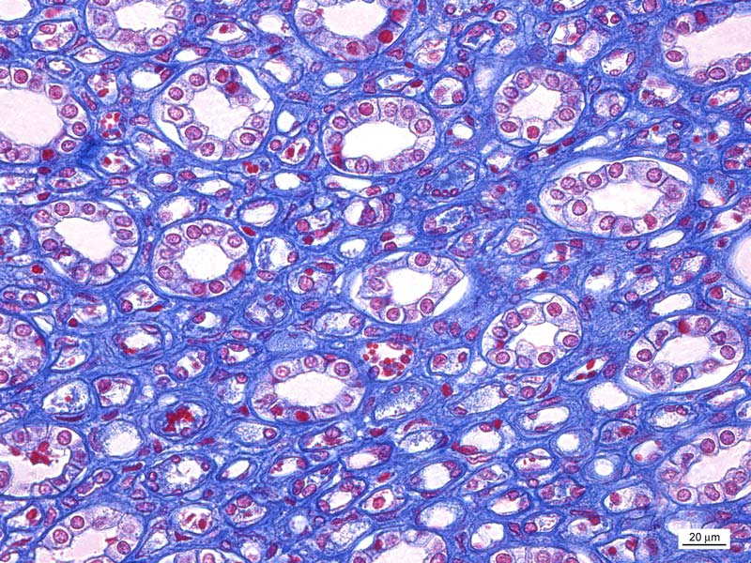
1
Notes:
1 - Simple cuboidal epithelium - Henle's loop (asc.)

Slide 4
1
Notes:
1 - Simple columnar epithelium – fundus ventriculi

Slide 5
Notes:
Simple columnar epithelium – vesica fellea

Slide 6
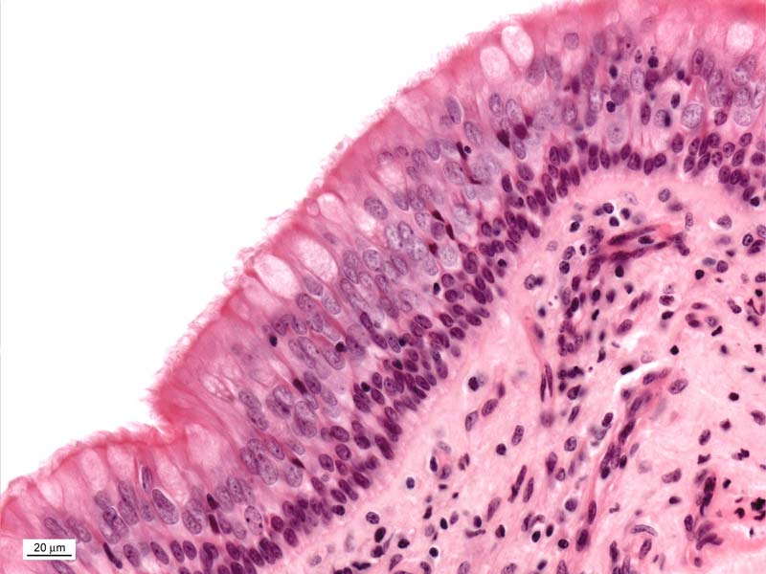
Notes:
Pseudostratified columnar epithelium with goblet cells and cilia

Slide 7
Notes:
Stratified squamous epithelium

Slide 8
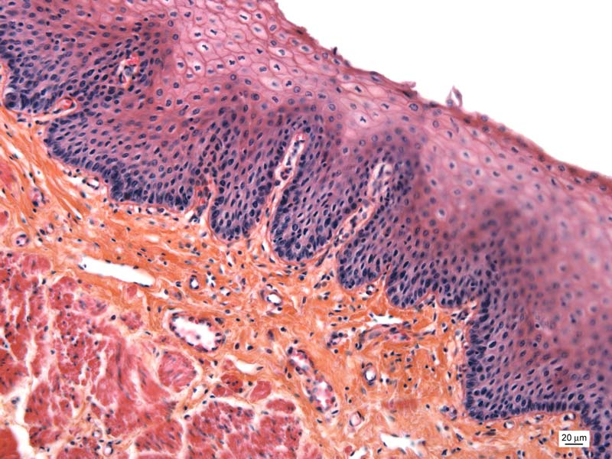
Notes:
Stratified squamous epithelium

Slide 9
Notes:
Stratified squamous epithelium

Slide 10
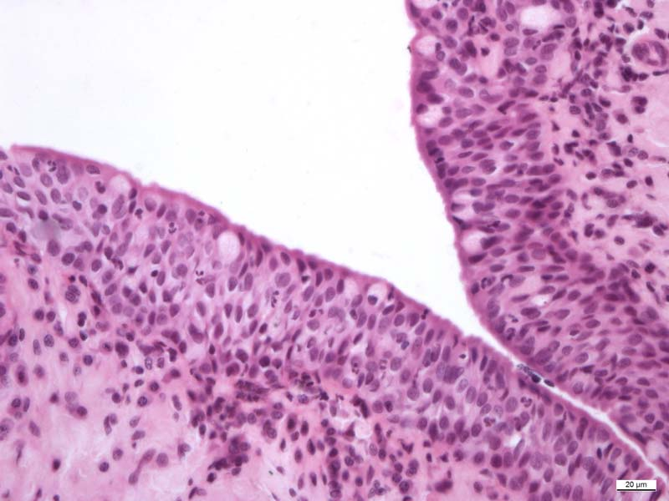
Notes:
Stratified columnar epithelium - palpebra - conjunctiva

Slide 11
Notes:
Transitional epithelium – calyx renalis

Slide 12
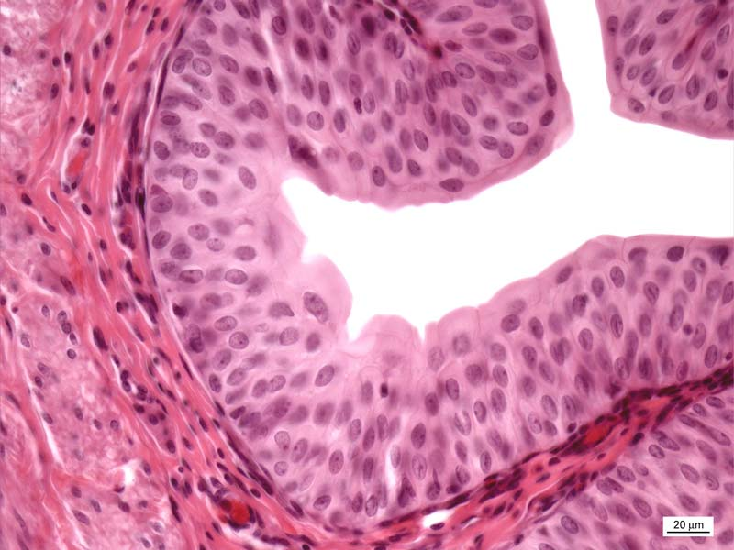
Notes:
Transitional epithelium - ureter

