Slide 1
BIOCHEMISTRY
USMLE step 1

Slide 2
Question 1
A 6-year-old presents to his pediatrician with skin lesions all over his body. For several years he has been very sensitive to sunlight. Neither the boy’s parents nor his siblings have the same skin lesions or sun sensitivity. Biopsies of several of the boy’s lesions reveal squamous cell carcinoma. Which mutation would one expect to see in this patient’s DNA?
A, Methylation of the gene
B, Missense mutation in the gene
C, Nonsense mutation in the middle of the gene
D, Point mutation within the enhancer region
E, Point mutation within the operator region
F, Point mutation within the promoter region
G, Thymidine dimers

Slide 3
Question 1
A 6-year-old presents to his pediatrician with skin lesions all over his body. For several years he has been very sensitive to sunlight. Neither the boy’s parents nor his siblings have the same skin lesions or sun sensitivity. Biopsies of several of the boy’s lesions reveal squamous cell carcinoma. Which mutation would one expect to see in this patient’s DNA?
A, Methylation of the gene
B, Missense mutation in the gene
C, Nonsense mutation in the middle of the gene
D, Point mutation within the enhancer region
E, Point mutation within the operator region
F, Point mutation within the promoter region
G, Thymidine dimers

Slide 4
Question 1
Patients with inherited disorder, … , are at increased risk for the development of cancers (basal cell carcinoma, squamous cell carcinoma, malignant melanoma) of sun-exposed skin. The basis for this disorder is defective DNA repair. UV rays in sunlight cause cross-linking of pyrimidine residues, preventing normal DNA replication. Such DNA damage is repaired by the nucleotide excision repair system. Several proteins are involved in nucleotide excision repair, and an inherited loss of any of these can give rise to … .
Notes:
BP 197

Slide 5
Question 1
Patients with inherited disorder, xeroderma pigmentosum, are at increased risk for the development of cancers (basal cell carcinoma, squamous cell carcinoma, malignant melanoma) of sun-exposed skin. The basis for this disorder is defective DNA repair. UV rays in sunlight cause cross-linking of pyrimidine residues, preventing normal DNA replication. Such DNA damage is repaired by the nucleotide excision repair system. Several proteins are involved in nucleotide excision repair, and an inherited loss of any of these can give rise to xeroderma pigmentosum.
Notes:
BP 197

Slide 6
Nucleobases
PURines
PYrimidines
Adenine
Guanine
PURe As Gold
Cytosine
Uracil
Thymine
CUT the PY (pie)
Notes:
FA 66

Slide 7
Question 1
A 6-year-old presents to his pediatrician with skin lesions all over his body. For several years he has been very sensitive to sunlight. Neither the boy’s parents nor his siblings have the same skin lesions or sun sensitivity. Biopsies of several of the boy’s lesions reveal squamous cell carcinoma. Which mutation would one expect to see in this patient’s DNA?
A, Methylation of the gene
B, Missense mutation in the gene
C, Nonsense mutation in the middle of the gene
D, Point mutation within the enhancer region
E, Point mutation within the operator region
F, Point mutation within the promoter region
G, Thymidine dimers

Slide 8
Question 1
A 6-year-old presents to his pediatrician with skin lesions all over his body. For several years he has been very sensitive to sunlight. Neither the boy’s parents nor his siblings have the same skin lesions or sun sensitivity. Biopsies of several of the boy’s lesions reveal squamous cell carcinoma. Which mutation would one expect to see in this patient’s DNA?
A, Methylation of the gene
B, Missense mutation in the gene
C, Nonsense mutation in the middle of the gene
D, Point mutation within the enhancer region
E, Point mutation within the operator region
F, Point mutation within the promoter region
G, Thymidine dimers

Slide 9
Question 1 - Thinking outside the box
Autosomal recessive/dominant
X-linked recessive/dominant
What is the zygosity of the boy’s parents with respect to the gene in question?

Slide 10
Question 1 - Thinking outside the box
What if DNA analysis shows that only one of the parents is a carrier?
  Sequencing error
  One of the parents is not an actual biological parent
  Something else

Slide 11
Question 1 - Thinking outside the box
Something else
  Uniparental disomy
    Offspring receives 2 copies of a chromosome from 1 parent and no copies from the other parent
    Heterodisomy
      Nondisjunction at meiosis 1
    Isodisomy
      Nondisjunction at meiosis 2
      Postzygotic chromosomal duplication of one of a pair of chromosomes, and loss of the other of the original pair
Notes:
FA 85

Slide 12
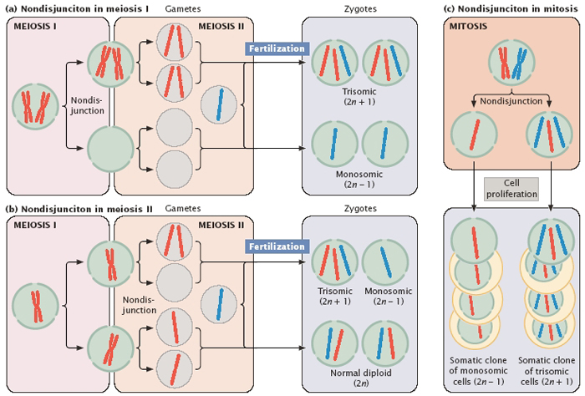
Nondisjunction

Slide 13
Question 2
A 32-year-old develops polyuria. Her nephrologist monitors her closely on a water deprivation test, and she continues to have increased urine output. A diagnosis of diabetes insipidus is made. The nephrologist orders an antidiuretic hormone level and determines that it is slightly increased. Which of the following is the site of pathology in this patient?
A, Adenoypophysis
B, D₁
C, Pituitary function
D, V₁
E, V₂

Slide 14
Question 2
A 32-year-old develops polyuria. Her nephrologist monitors her closely on a water deprivation test, and she continues to have increased urine output. A diagnosis of diabetes insipidus is made. The nephrologist orders an antidiuretic hormone level and determines that it is slightly increased. Which of the following is the site of pathology in this patient?
A, Adenoypophysis
B, D₁
C, Pituitary function
D, V₁
E, V₂

Slide 15
Diabetes insipidus
ADH (vasopressin) issue
Clinical findings
  Intense thirst
  Polyuria
Lab
  Urine specific gravity <1.006
  Serum osmolarity >290 mOsm/L
Notes:
Specific gravity – density of a substance/density of a reference substance
BP 721

Slide 16
Diabetes insipidus
Central
Nephrogenic
ADH deficiency
Causes
  Head trauma
  Neoplasms
  Inflammatory disorders
  Surgical procedures
Renal tubular unresponsivness
Vasopressin receptors
  V₁ on vascular smooth muscles → vasoconstriction
  V₂ on late distal tubules, collecting tubules and collecting ducts → water reabsorption
  V₃ in pituitary

Slide 17
Diabetes insipidus
Central
Nephrogenic
Notes:
Supraoptic – ADH
Paraventricular – oxytocin (contraction of smooth muscles in the pregnant uterus, and muscles surrounding the lactiferous ducts of the mammary glands)

Slide 18
Question 2
A 32-year-old develops polyuria. Her nephrologist monitors her closely on a water deprivation test, and she continues to have increased urine output. A diagnosis of diabetes insipidus is made. The nephrologist orders an antidiuretic hormone level and determines that it is slightly increased. Which of the following is the site of pathology in this patient?
A, Adenohypophysis
B, D₁
C, Pituitary function
D, V₁
E, V₂
Notes:
D1 – dopamine 1 receptor (G protein coupled receptor)

Slide 19
Bibliography
Robbins Basic Pathology, Kumar, Abbas, Aster
Rapid Review Pathology, Goljan et al.
First Aid for the USMLE step 1 2014, Le, Bhushan, Sochat
First Aid Q&A for the USMLE step 1 2nd edition, Le, Bechis
Guyton and Hall Textbook of Medical Physiology, Hall

Slide 20
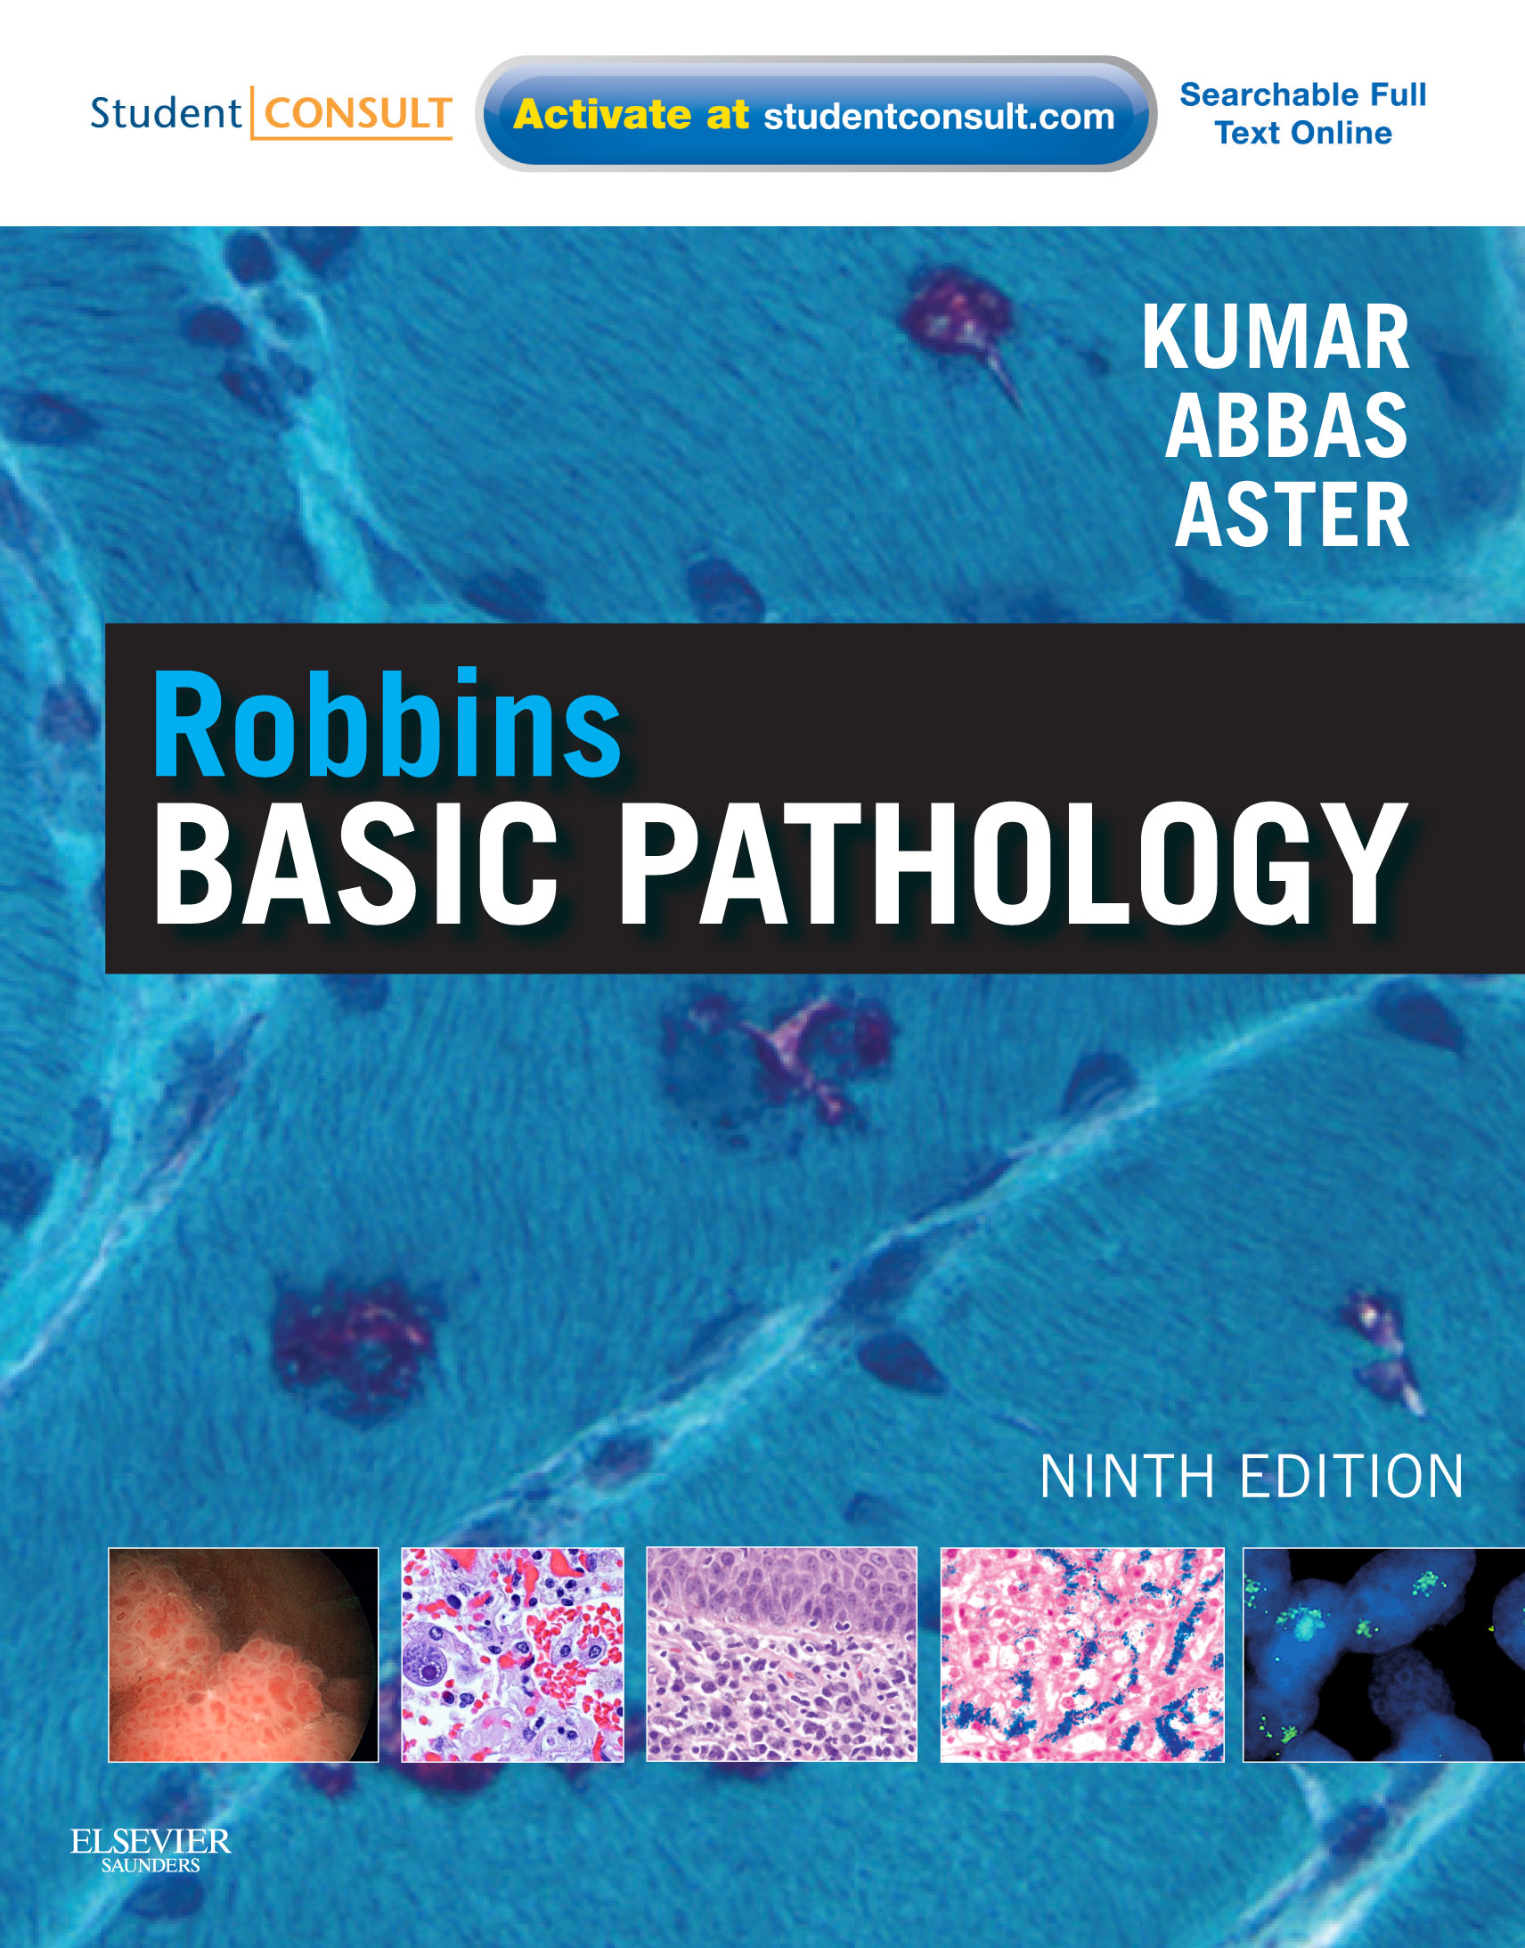

www.lekarskeknihy.cz, www.ilc.cz, www.megabooks.cz

