Slide 1
USMLE STEP 1

Slide 2

Ref: clipartpanda.com

Slide 3

Ref: cclscorp.com

Slide 4
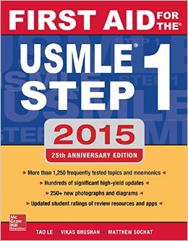

Ref: amazon.com
clipartpanda.com

Slide 5


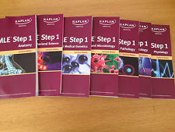
Ref: amazon.com

Slide 6

Ref: amazon.com

Slide 7

Behavioral Sciences
Immune System
Musculoskeletal System
Ref: turnov.cz

Slide 8
A 6-year-old boy with glioblastoma has recurrence of the tumor despite aggressive treatment. The physician discusses the patient´s prognosis with his parents and recommends palliative care. The parents ask how they should talk with their son about his prognosis and possible death. The physician advises that the parents should be honest and follow the patient´s lead during conversation. This patient most likely has which of following concepts of death?
Being asleep
Being final
Being a long journey
Being a temporary separation from his parents
No understanding of death

Slide 9

A 6-year-old boy with glioblastoma has recurrence of the tumor despite aggressive treatment. The physician discusses the patient´s prognosis with his parents and recommends palliative care. The parents ask how they should talk with their son about his prognosis and possible death. The physician advises that the parents should be honest and follow the patient´s lead during conversation. This patient most likely has which of following concepts of death?
Being asleep
Being final
Being a long journey
Being a temporary separation from his parents
No understanding of death

Slide 10
The patient You were taking care of for last 4 weeks comes to you when leaving the hospital to thank you. He says he is really grateful for everything you have done for him and gives you a homemade thank you card and two tickets for a basketball game. He explains that he works in a sport center as a janitor and gets these tickets for free. What do you do?
You refuse to accept anything, explaining your patient, that you are not allowed to accept any material gifts.
Thankfully accept both gifts and enjoy the game with your friend.
Gratefully accept the card as it is a homemade gift of no value but refuse the tickets as a valuable gift, that you are not allowed to accept.
Accept both the card and the tickets and give it to your office staff, because you are not allowed to keep it.

Slide 11
The patient You were taking care of for last 4 weeks comes to you when leaving the hospital to thank you. He says he is really grateful for everything you have done for him and gives you a homemade thank you card and two tickets for a basketball game. He explains that he works in a sport center as a janitor and gets these tickets for free. What do you do?
You refuse to accept anything, explaining your patient, that you are not allowed to accept any material gifts.
Thankfully accept both gifts and enjoy the game with your friend.
Gratefully accept the card as it is a homemade gift of no value but refuse the tickets as a valuable gift, that you are not allowed to accept.
Accept both the card and the tickets and give it to your office staff, because you are not allowed to keep it.

Slide 12
A 30-year-old Caucasian male comes to your office for a routine check-up. He is found to have BMI=30 and blood pressure of 135/90. He admits, that he works in IT company, he lives with two friends, consumes red meat and deep fried meals approximately three times a week and doesn´t have any time left for going to the gym. What do You tell him?
Suggest him to write down everything he eats and drinks during one week and than come again.
Explain to him, why is it so important to cut down on meat and deep fried meals and start on vegetables in order to avoid health problems.
Ask him to tell you how he understands healthy diet and what are risks of long term consuming of unhealthy food.
Send him directly to a dietitian.
Tell him, that he is going to die soon, because of so much fat he consumes.

Slide 13
A 30-year-old Caucasian male comes to your office for a routine check-up. He is found to have BMI=30 and blood pressure of 135/90. He admits, that he works in IT company, he lives with two friends, consumes red meat and deep fried meals approximately three times a week and doesn´t have any time left for going to the gym. What do You tell him?
Suggest him to write down everything he eats and drinks during one week and than come again.
Explain to him, why is it so important to cut down on meat and deep fried meals and start on vegetables in order to avoid health problems.
Ask him to tell you how he understands healthy diet and what are risks of long term consuming of unhealthy food.
Send him directly to a dietitian.
Tell him, that he is going to die soon, because of so much fat he consumes.

Slide 14
A 45-year-old man comes to the physician because of right shoulder pain that began after he chopped wood 2 days ago. Examination of the right upper extremity shows no obvious bone deformities or point tenderness. The pain is reproduced when the patient is asked to externally rotate the shoulder against resistance, there is no weakness. In addition to the teres minor, inflammation of which of the following tendons is most likely in this patient?
A. Infraspinatus
B. Pectoralis
C. Subscapularis
D. Supraspinatus
E. Trapezius

Slide 15
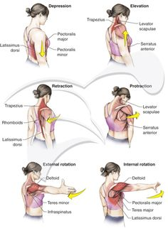
Ref: pinterest.com

Slide 16
A 45-year-old man comes to the physician because of right shoulder pain that began after he chopped wood 2 days ago. Examination of the right upper extremity shows no obvious bone deformities or point tenderness. The pain is reproduced when the patient is asked to externally rotate the shoulder against resistance, there is no weakness. In addition to the teres minor, inflammation of which of the following tendons is most likely in this patient?
A. Infraspinatus
B. Pectoralis
C. Subscapularis
D. Supraspinatus
E. Trapezius

Slide 17
A 29-year-old man is brought to the physician for removal of a cast from his leg. He sustained a fracture of the left lower extremity 6 weeks ago and was immobilized in a cast that extended from just below the knee to the foot. At the time of injury there was severe pain but normal strength in the extremity. When the cast is removed today, physical examination shows a pronounced left footdrop with paresthesia and sensory loss over the dorsum of the left foot and lateral leg. Injury to which of the following nerves is the most likely to cause this patient´s condition?
Common fibular (peroneal)
Femoral
Obturator
Sciatic
Tibial

Slide 18
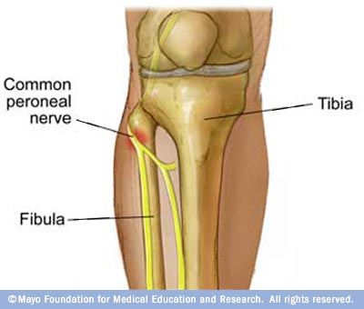
PED = Peroneal Everts and Dorsiflexes, if injured foot dropPED
TIP = Tibial Inverts and Plantarflexes, if injured, can´t stand on TIPtoes
Ref: pinterest.com

Slide 19
A 29-year-old man is brought to the physician for removal of a cast from his leg. He sustained a fracture of the left lower extremity 6 weeks ago and was immobilized in a cast that extended from just below the knee to the foot. At the time of injury there was severe pain but normal strength in the extremity. When the cast is removed today, physical examination shows a pronounced left footdrop with paresthesia and sensory loss over the dorsum of the left foot and lateral leg. Injury to which of the following nerves is the most likely to cause this patient´s condition?
Common fibular (peroneal)
Femoral
Obturator
Sciatic
Tibial

