Slide 1
CHANGES AFTER DEATH
MUDr. Kateřina Stoklásková
Changes after death | early | late
physical | body cooling- algor mortis hypostasis- livor mortis desiccation diffusion of liquids and gases | mummification
chemical | autolysis stiffness- rigor mortis | putrefaction (decomposition) adipocere

Slide 2
Cessation of heartbeat and respiration
traditionally, both the legal and medical communities determined death through the end of respiration and heartbeat
but with the increasing ability of medicine to resuscitate patients, a need for better definition of death became obvious
life support equipment can manintain body functions for a long time
a demand for organ transplantation is rising

Slide 3
Patophysiology of death
It is conventional to describe two types of death:
Somatic death – the person is unconscious, unable to be aware of the environment, to communicate, unable to initiate any voluntary movement
reflex nervous activity may persist, circulatory and respiratory functions continue either spontaneously or with artificial support
Cellular death – cells no longer function and have no metabolic activity
it is a process- not an event- different tissues die at different rates, the cerebral cortex being vulnerable to only few minutes’ anoxia, connective tissues surviving for many hours

Slide 4
Brain death
equals somatic death
the number of minutes for which total anoxia will cause cortical damage is estimated 8 minutes
hypothermia (e.g. immersion under water) reduces the oxygen needs of the tissues – even 40 minutes of hypoxia has been claimed as not leading to brain damage
when the higher levels of cerebral activity are selectively lost (hypoxia, trauma, toxic insult), the victim will exist in vegetative state (coma vigile, apalic syndrome)
  the vicitim can remain in deep coma certainly for years, is able to sustain circulation and respiration, control body temperature, excerete waists, heal wounds, gestate featus

Slide 5
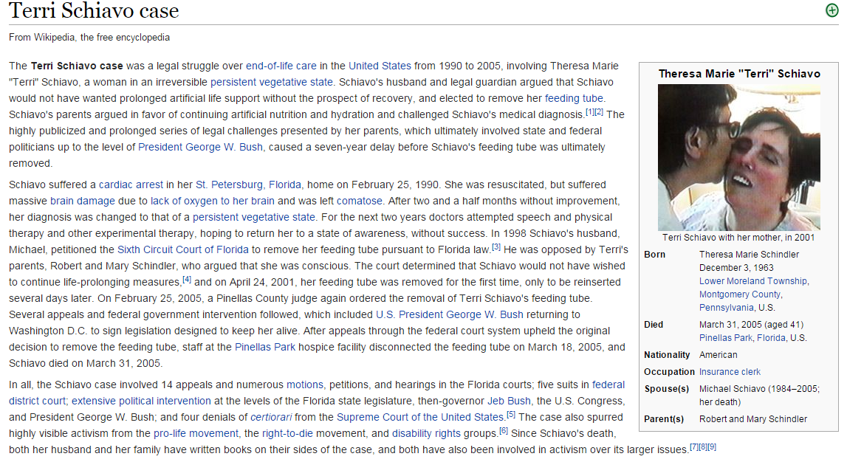
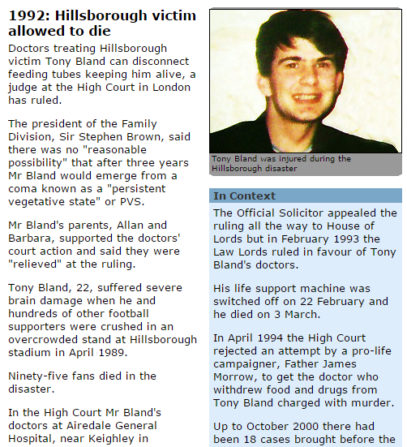
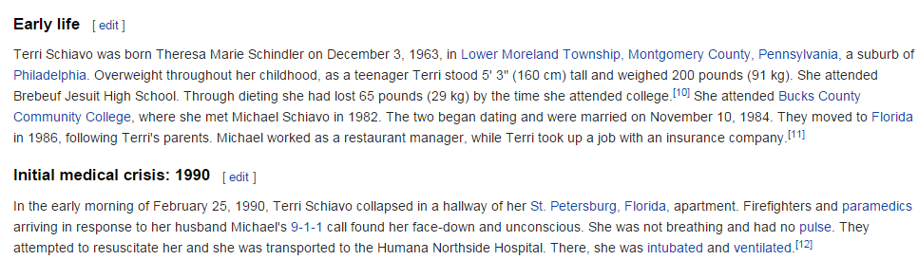
http://news.bbc.co.uk/onthisday/hi/dates/stories/november/19/newsid_2520000/2520581.stm
https://en.wikipedia.org/wiki/Terri_Schiavo_case

Slide 6
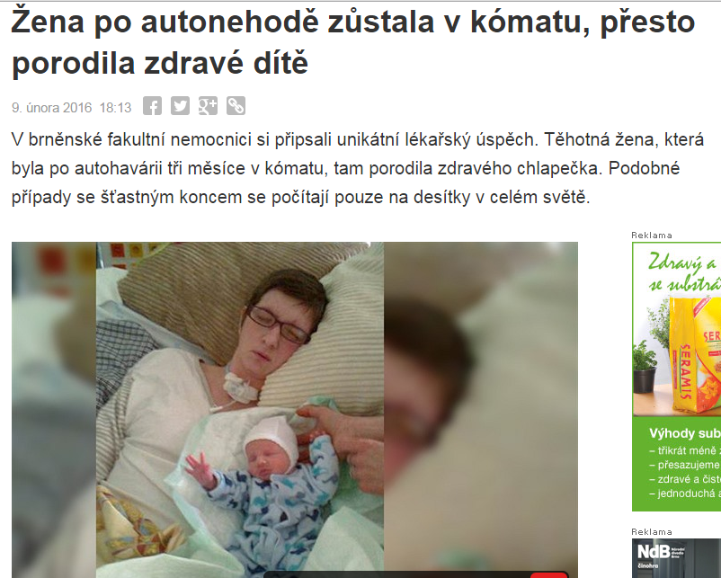
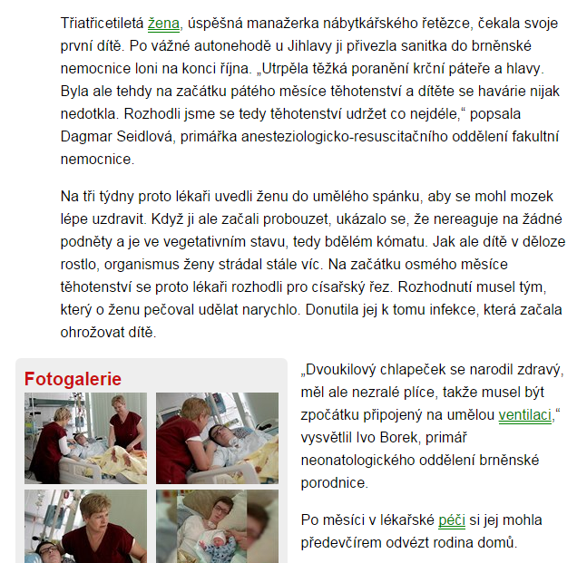
http://brno.idnes.cz/zena-porodila-v-komatu-0be-/brno-zpravy.aspx?c=A160209_164845_brno-zpravy_zde

Slide 7
Brainstem death
it is another matter when the brain death spreads below the tentorium (midbrain, pons, upper medulla) – the victim is not only irreversibly comatose, but also incapable of spontaneous breathing
without medical intervention, hypoxic cardiac arrest inevitably follows within minutes and then the usual progression of cellular death ensues
Diagnosis of brain death
panagiography, cerebral blood flow and echo-doppler- can prove the death of “higher brain”, but not the brain stem
irreversible brain stem dysfunction is diagnosed using ABR (auditory brain stem responses) and SEP (short latency somatosensory potentials)
EEG- in the United States a flat EEG test is not required to certify death, it is considered to have confirmatory value. In the UK it is not considered to be of value.

Slide 8
dead…or not?
vita minima- apparent death- hypnotics overdose, electricity injury, lightning strike, coma, drowning
agony- vita reducta- the struggle that precedes death

Slide 9
Uncertain signs of death- paleness, no pulse, no blood pressure, areflexia
Certain signs of death- livores mortis, rigor mortis, putrefaction, …

Slide 10
Body Cooling – Algor Mortis
the rate of cooling is proportional to the difference in temperature between the body surface and its surroundings
the ideal cooling curve would be exponential, but it is not in the real human body
estimation of the time of death is complicated, there are many factors affecting cooling of the body:
  initial body temperature (fever, hypotermia, diurnal variation, physical activity, …)
  body size (obesity, children)
  body posture
  clothing and coverings
  ambient temperature
  air movement and humidity
  air x water

Slide 11
Body Cooling
roughly the decrease in temperature is 1°C/hour, but without considering all the factors affecting cooling, this is highly inaccurate

Slide 12
Hypostasis
hypostasis occurs when the circulation ceases and the gravity acts upon the stagnant blood and pulls it down to the lowest accessible areas
bluish red discoloration begins as blotchy patches which soon coalesce, the color depending on the state of oxygenation at death
darker tint is a result of reduced haemoglobin in skin vessels – asphyxia
pink or dark red in hypothermia
cherry pink color of carboxyhaemoglobin in carbon monoxide poisoning
pattern of hypostasis depends on the posture of the body after death
pale areas are the result of pressure against a hard supporting surface
hypostasis may start forming after 30 minutes, reaches maximum within 8-12 hours
does not have much value for estimation of the time since death – in some cases may not be visible at all (infants, old people, anaemia, bleeding out…), in some cases it can be observed in the living if the heart action is failing

Slide 13
Hypostasis
Once hypostastis is established, it can undergo subsequent gravitational shift –
if the body is moved into a different posture, the primary hypostasis may either:
move completely to the newly lowest areas – can be examined by thumb pressure
be partly relocated and partly fixed
remain fixed due to staining of the tissues by haemolysis

Slide 14
Hypostasis
blood also settles in the internal tissues and organs
differentiation between hypostasis and bruising – the classic test is to incise the suspect area to see if the underlying blood is intravascular (hypostasis) or infiltrating the tissues outside the vessels (contusion), histological examination may be necessary

Slide 15
Desiccation
caused by evaporation of fluids from the body’s naturally wet regions (eyes, lips, genitals) or wounds
Autolysis
cellular lysozomes disintegrate and hydrolases are released, which break down cells and cellular membranes
starts in pancreas, stomach mucosa
Diffusion of liquids and gases
result of autolysis
natural barriers do not function anymore and liquids and gases spread freely though the tissues

Slide 16
Rigor mortis
immediately after death there is general muscular flaccidity, usually followed by a period of partial or total rigidity, which in turn passes off as the signs of decomposition appear
rigor is initiated when the ATP concentration falls to 85 % of normal
stiffness may start developing within 30 minutes or may be postponed almost indefinitely (physical activity before death, electrocution X freezing)
  reaches maximum within 6-12 hours
  duration of full rigor may be 18-36 hours
rigor is first apparent in the smaller muscle groups – jaw, facial muscles, neck
fades in the same order of muscle groups as it appeared
rigor can be “broken” during manipulation with the body
rigor mortis in other tissues – iris, heart, dartos muscle, seminal vesicles, prostate, erector pili muscles
poorly developed in infants, elderly, cachectic
cadaveric spasm – a rare form of virtually instantaneous rigor that develops at the time of death with no period of post-mortem flaccidity (soldiers, falling from height)

Slide 17
A rough estimation of the post-mortem interval in average condition (18°C):
the body is:
  warm and flaccid – less than 3 hours
  warm and stiff – 3-8 hours
  cold and stiff – 8-36 hours
  cold and flaccid – more than 36 hours

Slide 18
death
cremation
putrefaction
adipocere
mummification
skeletization
complete dissolution
(unless fossilized)

Slide 19
Putrefaction (decomposition)
onset depends on the environment, but in average conditions the putrefaction starts after approximately 3 days
first external naked-eye sign is discoloration of the lower abdominal wall (caecum)
1 week
the color of the skin is green/ black/ reddish
putrefactive bacteria spread through the venous system, hemolyze the blood and stain the vessels and adjacent tissues greenish-black
the face and other soft tissues become swolen and pervaded by fluid and gas
2-3 weeks
skin blisters appear, filled with clear, pink or red fluid
later the skin starts peeling off, the hair and nails detach
the scrotum and breasts are swolen
bloody fluid (tissue liquefaction stained by haemolysis) leaks from body orifices
several months
soft tissues disintegrate, leaving ligamentous and tendineous tissues attached to skeleton

Slide 20
Forensic Enthomology
animal, especially insect infestation depends on the ambient temperature and environment

Slide 21
Decomposition in immersed bodies
the rate of decomposition is slower- approximately twice compared to decopmosition in air
water slows down putrefaction mainly because of the lower ambient temperature and protection from insect
the epidermis becomes macerated and eventually detached
gas formation is the reason for flotation of an unweighted body
the usual posture of a freely floating body is face down

Slide 22
Decomposition in buried bodies
the rate of decay of bodies buried in earth is much slower than those in either air (approximately eight times) or water- due to lower temperature, exclusion of animal and insect predators and lack of oxygen
after 10 years only bones should be found in the grave
…unless…

Slide 23
Adipocere
the body tissues transform into a waxy substance derived from the body fat
caused by hydrolysis and hydrogenation of adipose tissue by anaerobic bacteria (fatty acids + K, Na, Ca, Mg ions)
the tissues are greasy or waxy, later brittle and chalky, white, pinkish, greenish or grey
requires MOISTURE (usually wet soil or water), usually warmth and alcalic pH
adipocere starts forming after approximately 3 months

Slide 24
Mummification
dried out body, usually only some body parts (fingers, toes, ears, nose)
the skin is dry, hard, brown
secondary colonization by moulds causes white, green or black patches on the skin
can only occur in a DRY environment, preferably with moving air current, which is usually also warm
mummification can take weeks or months, depending on the environment

Slide 25
Damage caused by animals after death
there is no bleeding, oedema or reddening of the edges of the wound, no other vital signs of injuries

Slide 26
References: Knight´s Forensic Pathology, 2004

