Slide 1
TRANSPORTATION INJURIES
MUDr. Kateřina Stoklásková
pedestrians
bicycles
motorcycles
cars
light vans under 1.5 tons
trucks
buses
trains
airplanes
…
frontal (60-80 %)
rear
lateral
roll-overs
…

Slide 2
transportation injuries are the most common cause of death below the age of 50 years in developed countries
tissue injuries are caused by a change of rate of movement – acceleration or deceleration (measured in ‘G forces’)

Slide 3
Injuries to pedestrians
injuries are caused by acceleration (as opposed to injuries to vehicle occupants, which are caused by deceleration)
primary injuries are caused by the first impact of the vehicle on the victim- usually legs and hips
secondary injuries are caused by subsequent contact with the ground

Slide 4
Injuries to pedestrians
depending on the profile of the front of the car, the struck pedestrian is either thrown forwards in the direction of travel if the bonnet-front is high and blunt, or scooped up onto the bonnet top, as with many slope-fronted modern vehicles
  if thrown forward, secondary injuries will be suffered as a result of striking the ground, the body can be run over by the vehicle
  if the impact is on the front corner of the car, the pedestrian may be knocked diagonally out of the path of the car and can be run over by a different vehicle overtaking in another lane or coming in the opposite direction
  if scooped up, the victim will land on either the bonnet or against the windscreen or corner-supporting pillar (the A-frame)
  scooping-up can occur at speeds as low as 23 km/hour, pedestrian may then fall off sideways or when the speed is higher may be thrown over the roof, if the driver applies the brakes violently the body may slide off in front of the car
  in a high-speed impact (over 50 km/hour) the body can be flung high in the air

Slide 5
Injuries to pedestrians
child victims
  the primary contact is higher up their body, so they tend to be hit forwards rather than rotated upwards
  they tend to be projected further by impact and may be hurled in the air at lower speeds compared to adults
  they are more prone to be run over by reversing vehicles
larger vehicles (van, truck, bus)
  the initial point of impact is higher
  because of the flat profile there is no scooping-up effect and the victim is usually projected forwards

Slide 6
Injuries to pedal cyclists
less severe counterpart of motorcycle lesions, as the pedal cycle has the same instability but far lower speeds
injuries from primary impact
secondary injuries from passive falls- head injuries,…

Slide 7
Injuries to motorcyclists
because the rider inevitably falls to the ground, head injuries cause majority of deaths
crash helmets are mandatory in the Czech Republic, but the severity of impact often defeats the protective effect of the helmet
typical skull fractures:
  temporal-parietal
  hinge fracture, motorcyclist´s fracture- transverse crack across the floor of the skull, crossing the petrous base or behind the greater wing of the sphenoid bones through the pituitary fossa to the opposite side
  ring fracture around the foramen magnum in the posterior fossa caused by an impact on the crown of the head
‘tail-gating’ accident- rider drives into the back of a truck so that the machine passes underneath, but the head of the motorcyclist impacts upon the tail-board

Slide 8
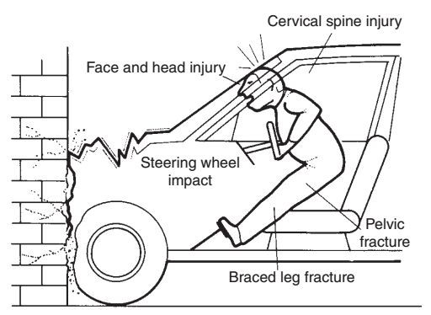
Injuries to vehicle occupants- unrestrained driver
the body is moving forward and upwards
head strikes the upper windscreen rim or the side pillar
flexion of the cervical and thoracic spine
chest and abdomen colide with the steering whell
legs strike the parcel-shelf area
any protruding parts of the interior can cause injuries
the body can be ejected through the broken windscreen
in a rear impact the head is moving forward and than backwards – whiplash injury (hyperflexion-hyperextension sequence)

Slide 9
Injuries to vehicle occupants- front-seat passenger
no steering wheel- nothing to brace against to reduce the the collision with the windscreen
does not pay as much attention to the road as the driver
Injuries to vehicle occupants- rear-seat occupants
unrestrained occupants are projected forward towards the soft back surface of the front seats, may cause an injury to other occupants or be ejected from the vehicle

Slide 10
Seatbelts
reduce deaths and serious injuries by 20-25 %
in the Czech Republic compulsory for all vehicle occupants
usually „three point attachement“- lap-strap and shoulder
with the area of 500 cm² they decrease the force applied per unit area during deceleration

Slide 11
References: Knight´s Forensic Pathology, 2004

