Slide 1
Respiratory system

Slide 2
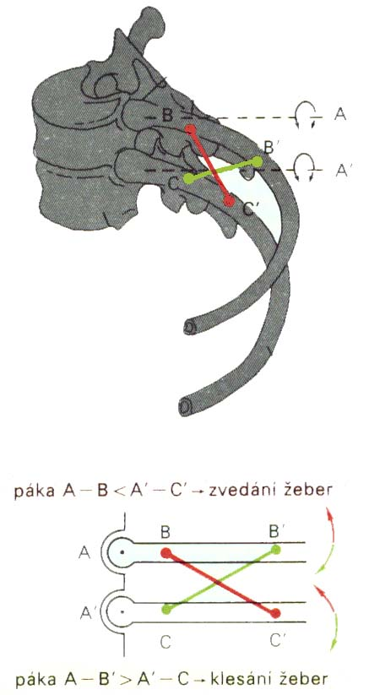
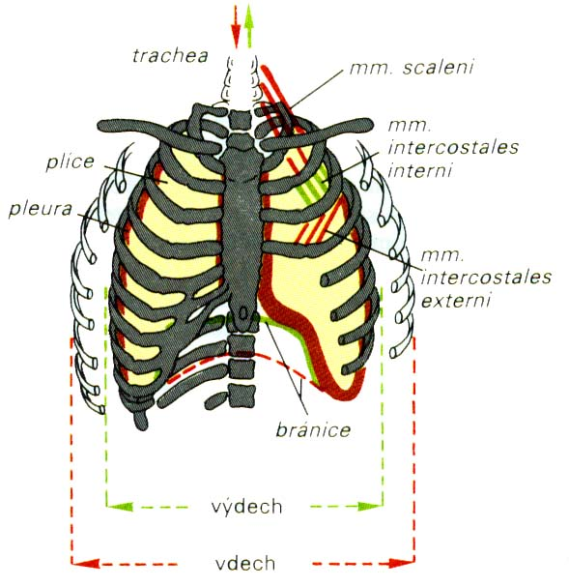
Bucket-handle and water-pump handle effects
Silbernagl, Despopoulos: Color atlas of physiology, 2006.

Slide 3
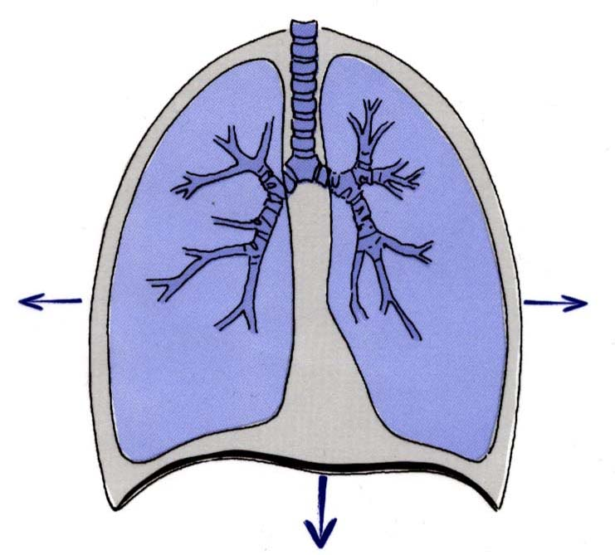
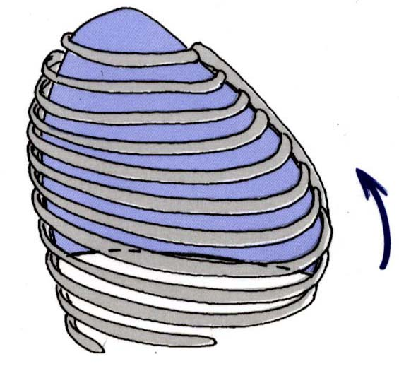
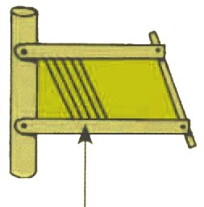
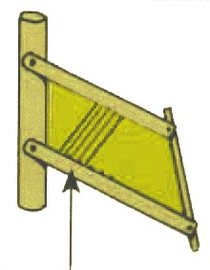
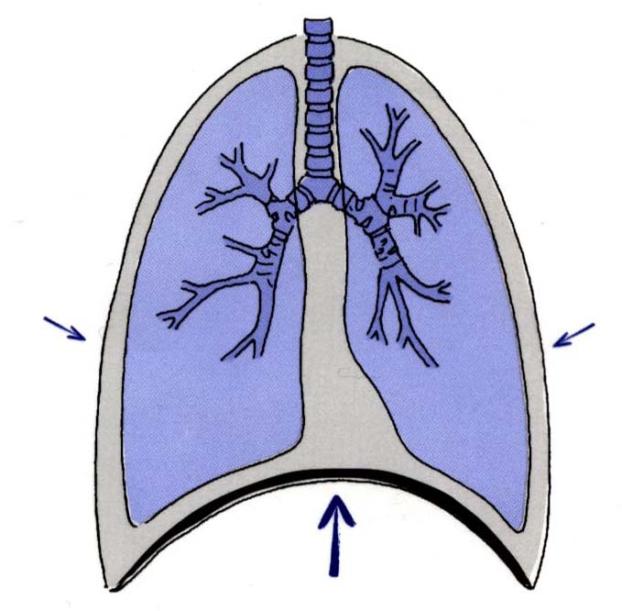
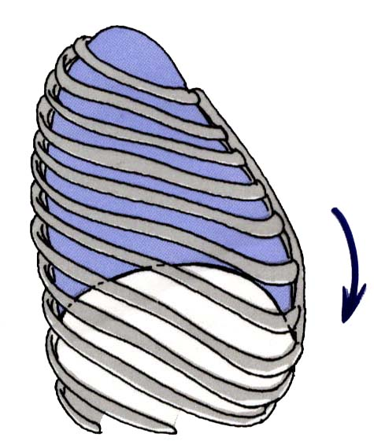
Bucket-handle and water-pump handle effects
Silbernagl, Despopoulos: Color atlas of physiology, 2006.

Slide 4
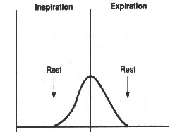
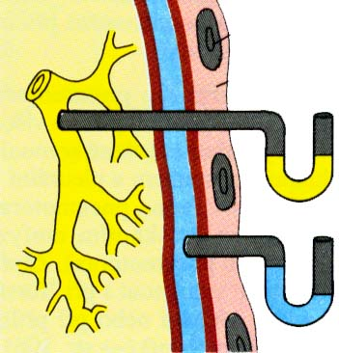
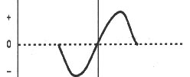
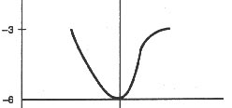
PLEURA
pulmonalis
parietalis
Silbernagl, Despopoulos: Color atlas of physiology, 2006.

Slide 5
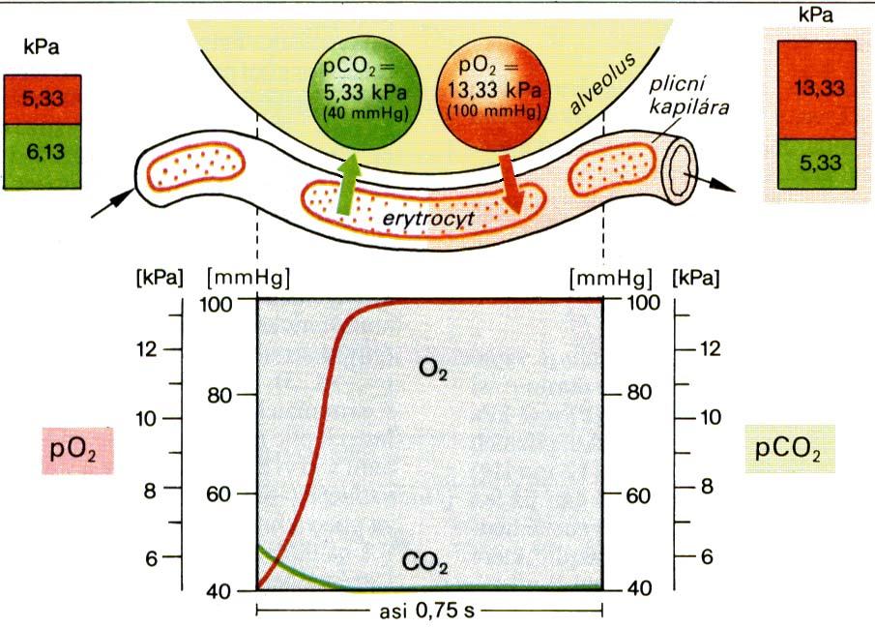
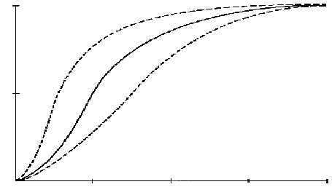
TRANSPORT of O₂
↓ temperature
↑ pH
pCO₂
↓ DPG
100%
↑ temperature
↓ pH
↑ pCO₂
↑ DPG
50%
pO₂
25
50
75
100
Silbernagl, Despopoulos: Color atlas of physiology, 2006.

Slide 6
Control of ventilation

Slide 7
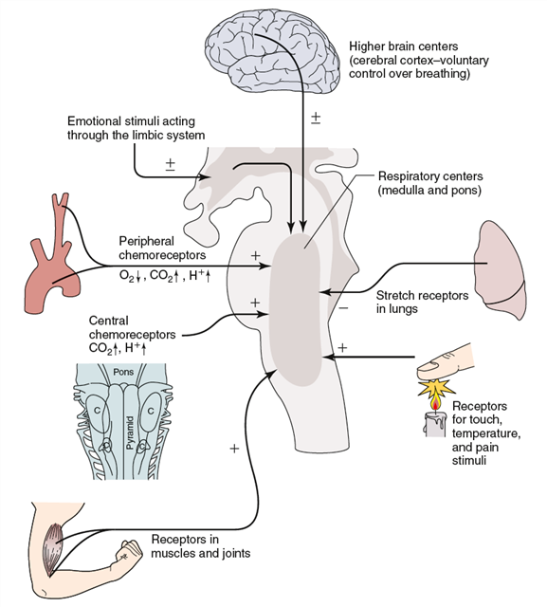
https://sleep.sharepoint.com/siteimages/Chapter%203.png

Slide 8
Boron, Boulpaep, Medical Physiology, 2003.

Slide 9
Boron, Boulpaep, Medical Physiology, 2003.

Slide 10
Breathing is an automatic process that takes place unconsciously.
Automaticity of breathing comes from regular (rhythmic) activity of groups of neurons anatomically localized in the medulla and its vicinity. They can be divided into three main groups:
dorsal respiratory group – placed bilaterally on the dorsal side of the medulla oblongata, only inspiratory neurons, sending axons to motoneurons of inspiratory muscles (diaphragm, external intercostal muscles; their activation=inspiration, their relaxation=expiration; participates on inspiration at rest and forced inspiration
ventral respiratory group - located on the ventrolateral part of the medulla oblongata, the upper part: neurons whose axons of motor neurons activate the main and auxiliary inspiratory muscles; the lower part: expiratory neurons which innervate expiratory muscles (internal intercostal muscles). Neurons in this group operate only during forced inspiration and forced expiration.
Pontine respiratory group - pneumotaxic center - dorsally placed on top of the pont, contributes to the frequency and depth of breathing; affects the activity of respiratory neurons in the medulla oblongata.

Slide 11
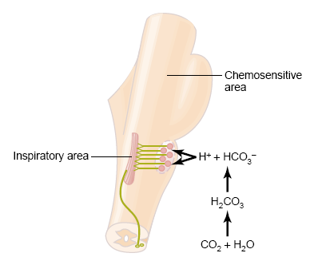
Chemical factors affecting the respiratory center:
Central chemoreceptors
on the front side of the medulla
sensitive only to increase of arterial pCO₂ (by increasing H⁺ )
central chemoreceptor are stimulated by other types of acidosis (lactate acidosis, ketoacidosis)
http://www.medicine.mcgill.ca/physio/resp-web/sect8.htm

Slide 12
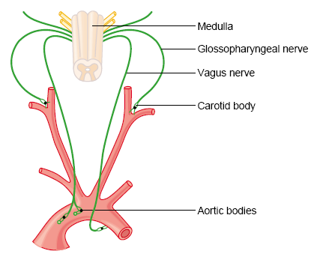
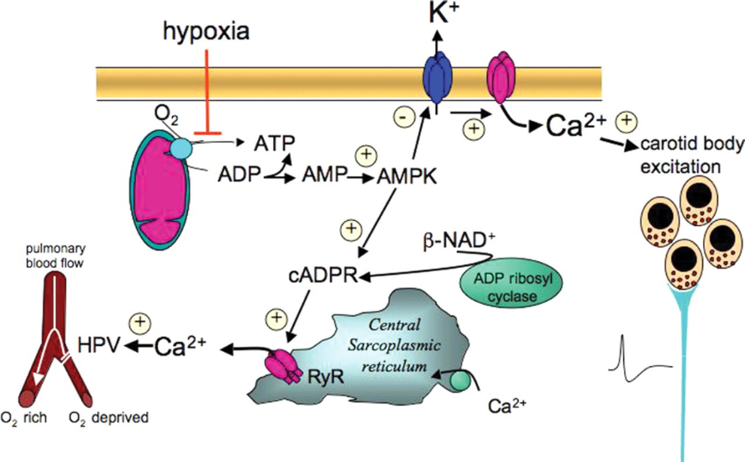
Peripheral chemoreceptors
– located in the aortic and carotid bodies
-primarily sensitive to decrease in arterial pO₂, particularly to decrease of O₂ under 10-13 kPa in the arterial blood.
They convey their sensory information to the medulla via the vagus nerve and glossopharyngeal nerve.
Mechanism of action: Decreased ATP production in mitochondria leads to depolarization of receptors membrane and to excitation of chemoreceptor
http://www.medicine.mcgill.ca/physio/resp-web/sect8.htm,

Slide 13
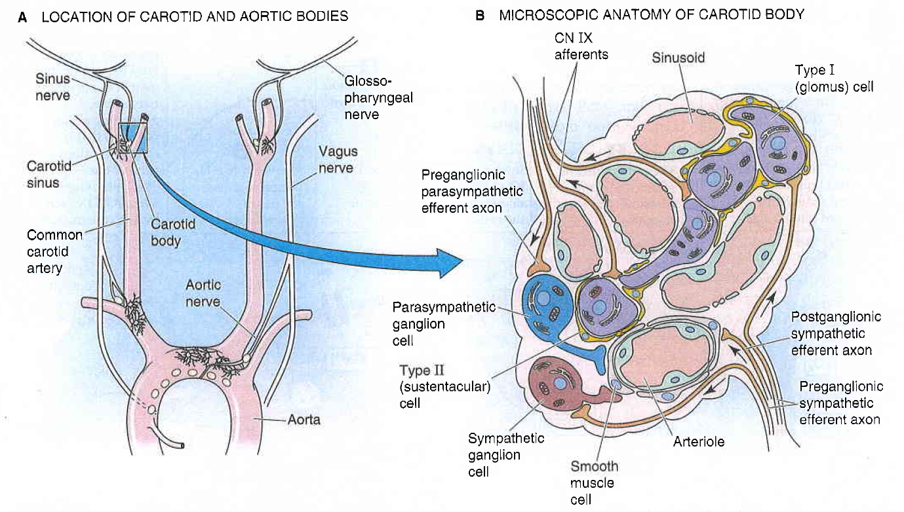
Boron, Boulpaep, Medical Physiology, 2003.

Slide 14
Boron, Boulpaep, Medical Physiology, 2003.

Slide 15
Modulation of respiratory output
Major parameters for feedback control – classical gases:pO2, pCO2, pH
In additin to these, the respiratory system receives input from two other major sources:
1. variety of stretch and chemical/irritant receptors that monitor the size of airways and the presence of noxious agentsreceptors in respiratory systém
2. Higher CNS centers that modulate respiratory activity for the sake of nonrespiratory activities
Irritants receptors on mucose of respiratory system – rapidly adapting
Stimulus: agens - chemical substances (histamin, serotonin, prostaglandins, ammonia, cigarette smoke).
Respons: increase mucus secretion, constriction of larynx and brochus
C-fibre receptors (juxtacapillary=J receptors)– free nerve ending of n.vagus (unmyelinated axon) in intersticium of bronchus and alveolus;
Stimulus: Mechanical irritans (pulmonary hypertension, pulmonary oedema)+chemical
Response: hypopnoe, rapid shallow breathing, bronchoconstriction, cough
Stretch receptors slowly adapting (mechanoreceptors in tracheobronchial tree that detect the changes in lung volume by sensing the stretch receptors of the airway wall), inform to brain about the lung volume to optimize respiratory; its irritants triggered decrese activity of respiratory centre – Hering-Breuer´s reflexes. (protecting the lungs from overinflation/deflation)

Slide 16
Baroreceptors – suppresses activity of respiratory centre (only slight effect)
Irritants of proprioreceptors of muscles, tendons during active and pasive movements of limbs
Influenced activity of respiratory neurons (increase minute ventilation during work load)
The Limbic system and affective states – fear, horror, rage – can be associated with major and highly characteristic changes of the respiratory pattern
- descending pathways from the limbic structure of the forebrain may mediate these emotional effects on breathing
Various behaviors
Playing on musical wind instruments
strong pain
Tractus corticospinalis =cortex – activated RC during work load
temperature

