Slide 1
Comparison of adjectives comparatives

Slide 2
a) Choose the correct form of the comparative: b) Use words in the oval to form complete anatomical terms: c) Give opposites:
Ala + major/majus
Foramen + major/majus
Canalis + major/majus
Cornu + major/majus
ischiadicum
ossis hyoidei
palatinus
ossis sphenoidalis

Slide 3
Caput + superior/superius
Arcus + superior/superius
Vena + superior/superius
Labium + superior/superius
oris
musculi pterygoidei lateralis
cava
dentalis

Slide 4
Facies + anterior/anterius
Foramen + anterior/anterius
Regio + anterior/anterius
Ligamentum + anterior/anterius
cruciatum
ethmoidale
palpebrae
antebrachii

Slide 5
a) Fill in missing adjectives : b) Connect the terms with distensio:
Musculus pectoralis ____________, minor
Musculi intercostales externi, interni, ____________
Musculus scalenus ____________, medius, posterior
Musculus serratus anterior, ____________ inferior et ____________

Slide 6
Fill in comparatives in the correct form:
Major, majus
Nervus petrosus ___________
Hiatus canalis nervi petrosi ___________
Sub (position) nervo petroso ___________
In (direction) nervum petrosum ___________
Minor, minus
Abruptio cornus ___________ ossis hyoidei
Prope cornu ___________ ossis hyoidei
Cornua ___________ ossis hyoidei
Abruptio cornuum ___________ ossis hyoidei

Slide 7
Superior, superius
Ligamentum transversum scapulae ___________
Ligamenta transversa scapularum ___________
Ruptura ligamenti transversi scapulae ___________
Ruptura ligamentorum transversorum scapularum ___________
Anterior, anterius
Musculus rectus capitis ___________
Sub (position) musculo recto capitis ___________
Laesio musculi recti capitis ___________
Ad musculum rectum capitis ___________

Slide 8
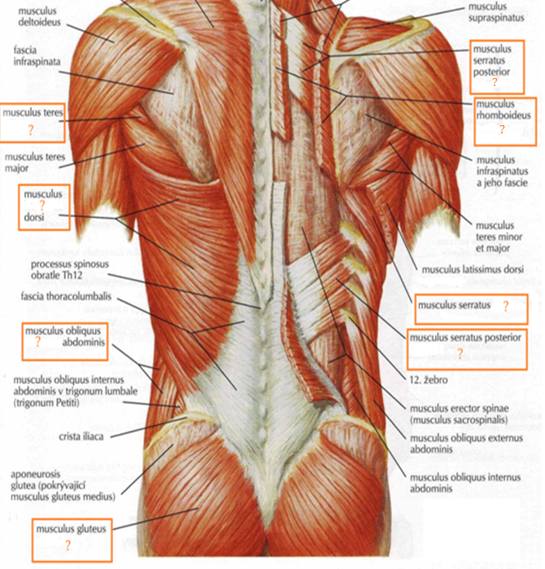
inferior, ius
minor, minus
anterior, ius
latissimus, a, um
major, majus
externus, a, um
superior, ius
maximus, a, um

Slide 9
