Slide 1
Final revision

Slide 2
FIND FEMININES AND NEUTRALS:
parietem calcium empyema
symphysibus cuspidibus focos
eupnoen anni decocta
metritide cicatrices diabetes
selectione fronte praecordii
lacrimis foramina
Notes:
Fem: symphysis, eupnoe, selectio, lacrima, cicatrix
Neutr: calcium, foramen, empyema, decoctum, praecordium

Slide 3
CONNECT
Epithelium + | lens => | Epithelium lentis
Sanatio + | decubitus
Diphtheria + | fauces
Axis + | oculus
Cirrhosis + | hepar
Calcar + | avis
Diameter + | pelvis
Melanosis + | colon
Symptomata + | synarthrosis
Articulatio + | genu
Collapsus + | systema
Calculosis + | vesica
Stenosis + | ostium
Therapia + | scabies
decubitus
faucium
oculi
hepatis
avis
pelvis
coli
synarthrosis/eos
genus
systematis
vesicae
ostii
scabiei

Slide 4
CONNECT
partes
processus
nervus
ruptura
carcinoma
sanatio
caries
bursa
inflammatio
lamina
fractura
therapia
operatio
remedium
columna vertebralis
vertebrae lumbales
brachium laterale
ligamentum teres
colon descendens
herpes simplex
dentes permanentes
musculus biceps brachii
appendix vermiformis
os ethmoidale
ossa nasalia
morbus exacerbans
trauma grave
febris recurrens
columnae vertebralis
vertebrarum lumbalium
brachii lateralis
ligamenti teretis
coli descendentis
herpetis simplicis
dentium permanentium
musculi bicipitis brachii
appendicis vermiformis
ossis ethmoidalis
ossium nasalium
morbi exacerbantis
traumatis gravis
febris recurrentis
Notes:
Ktoré spojenia sú v pluráli

Slide 5
CREATE COMPARATIVES AND SUPERLATIVES
Musculus longus – longior - longissimus
Pelvis lata
Os fragile
Icterus gravis
Pars mollis
Pulsus frequens
Dolor acer
Infarctus recens
Appendicitis acuta
Incisura parva
Foramen magnus
Ossa brevia
Operationes breves
latior – latissima
fragilius – fragilissimum
gravior – gravissimus
mollior – mollissima
frequentior – frequentissimus
acrior – acerrimus
recentior – recentissimus
acutior – acutissima
minor – minima
majus – maximum
breviora – brevissima
breviores – brevissimae

Slide 6
ADD COMPARATIVES IN PROPER FORM
Major, majus
Nervus petrosus ___________
Hiatus canalis nervi petrosi ___________
Sub nervo petroso ___________
In nervum petrosum ___________
Minor, minus
Abruptio cornus ___________ ossis hyoidei
Prope cornu ___________ ossis hyoidei
Cornua ___________ ossis hyoidei
Abruptio cornuum ___________ ossis hyoidei
major
majoris
majore
majorem
minoris
minus
minora
minorum

Slide 7
CREATE CLINICAL DIAGNOSES (DO NOT CHANGE THE WORD ORDER)
vulnus – lacer – pars – distalis – femur – latus – dexter
suspicio – commotio – cerebrum – post – trauma – gravis
post – resectio – pulmo (pl.) – subtotalis – propter tuberculosis
sinusitis – paranasalis – subacutus – siccus
e – hyperemesis – in – graviditas
pseudoneoplasma (pl.) – duodenum – suspectus
Notes:
Vulnus lacerum partis distalis femoris lateris dextri – suspicio commotionis cerebri post trauma grave – post resectionem pulmonum subtotalem propter tuberculosim – sinusitis paranasalis subacuta sicca – e hyperemesi in graviditate – pseudoneoplasmata duodeni suspecta

Slide 8
FIND MISTAKE
vagina tendonis musculi extensoris digiti minimis
bursa ischiadicus musculi gluteae maximalis
arteriae (pl.) lumbalis ima
musculi intercostali internes
trauma grava membrorum superiorium
amputatio phalangum indexis
propter necrosem heparis acutam
status post abortum in statu febrile
Notes:
Tendinis, minimi – ischiadica, glutei, maximi – lumbales, imae – intercostales, interni – grave, superiorum – indicis – necrosim, hepatis - febrili

Slide 9
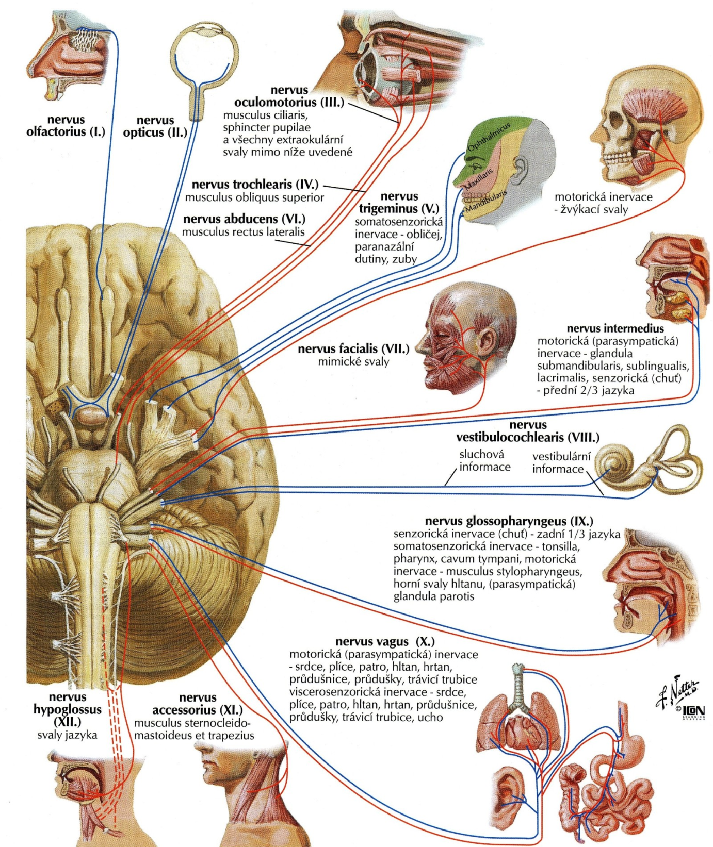
TRANSLATE THE ORDINAL NUMBERS PERTAINING TO THE NERVES OF HEAD

Slide 10
READ AND TRANSLATE
Insufficientia renalis chronica gr. IV.
Decubitus regionis ossis sacri et calcanei l. sin. gr. II.
St. p. amputationem pollicis et digiti III. manus l. dx. traumaticam
Gangraena digiti IV. et V. pedis l. Sin.
St. p. fracturam vertebrae Th12 compressivam
St. p. fracturam costae l. sin. IV., V., VI. et VII. ante dies XII
St. p. hysterectomiam abdominalem simplicem anno 2012/05
Pelvis renis l. dx. et ureter l. dx duplex
Tumor lobi superioris pulmonis l. sin. Triplex
Metastases hepatis multiplices susp.
Funiculus umbilicalis circum collum fetus 1x/2x/3x in grav. hebd. 40+4
Notes:
Abbreviations: gr. = gradus; l. sin/dx = lateris sinistri/dextri; Th
= vertebra thoracica duodecima; St.p. = status post; in grav. Hebd. = in graviditatis hebdomade

Slide 11
FILL IN THE GAPS
SPECIALITAS
ANTIDEPRESSIVUM
________
Asentra 50 tbl. p. o. 28 x 50 mg
________ orig. _______ IV (quattuor)
D. ________ 2 tablety denně.
Notes:
Rp. – Exp. Orig. No. IV – D. S.

Slide 12
FILL IN THE GAPS
MAGISTRALITER
HYPNOTICUM
Rp.
Amobarbitali 0,15
Codeinii dihydrogenphosphorici 0,03
Aminophenazoni 0,25
Olei cacao q. _______ ut _______ supp.
D. ________ d. _________ VI (sex)
S. Na noc zavést 1 čípek.
Notes:
q. s. ut f. supp. – D. t. d.

Slide 13
CREATE COMPOUNDS AND TRANSLATE THEM
hystera – salpinx – graphia
hysterosalpingographia
pan – hystera – salpinx – oophoron – ectome
panhysterosalpingooophorectomia
oligos – erythros – kytos – haima
oligoerythrocytaemia
erythros – leukos – thrombos – kytos – haima
ethythroleucothrombocytaemia
pneumon – haima – pericardium
pneumohaemopericardium
kystis – ureter – pyelos – nephritis
cystoureteropyelonephritis
hepaticus – duodenum – anastomosis
hepaticoduodenoanastomosis

Slide 14
DERIVE TERMS FROM THE GREEK ROOT ODOÚS, ODONTOS
toothache
originating from teeth
inflammation of the tissues surrounding teeth
hypersensitivity of teeth
the field of medicine dealing with the anatomy, development, and diseases of teeth
benign tumour of tooth-tissue origin
tooth development
pathological fear of dental care, dentistry
visual examination of oral cavity
field of medicine dealing with the prevention and correction of malpositioned teeth
surgical removal of tooth
Notes:
Odontalgia; odontogenes; periodontitis; odntohyperaesthesia; odontologia; odontoma; odontogenesis; odontophobia; odontoscopia; ortodontia; odontectomia

