Slide 1
STRUCTURAL ARRANGEMENT OF THE NERVOUS SYSTEM
IVANA HRADILOVÁ SVÍŽENSKÁ

Slide 2
Homeostasis
maintains the stability of the human
body's internal environment
in response to changes in external
conditions

Slide 3
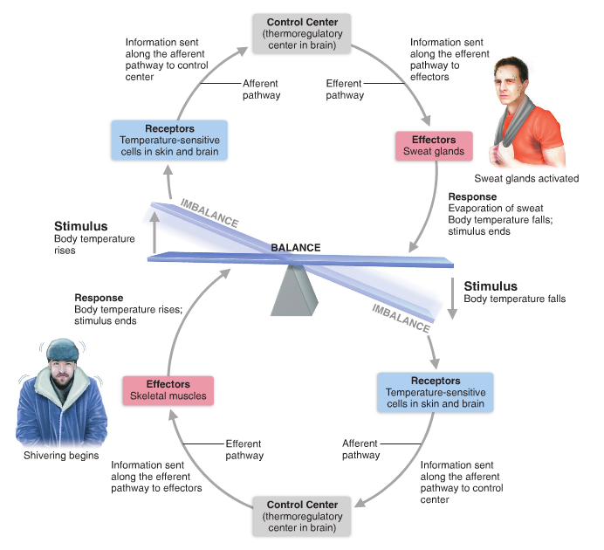

Slide 4
Nervous system
organ system containing a network of specialized cells (neurons and glia)that coordinate the actions of an organism and transmit signals between different parts of its body

Slide 5
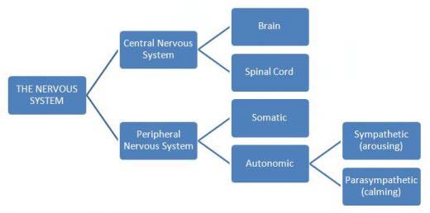

Slide 6
Nervous tissue
one of four major classes of vertebrate tissue
composed of
  neurons - transmit impulses
  glial cells - assist propagation of the nerve impulse as well as provide nutrients to the neuron

Slide 7
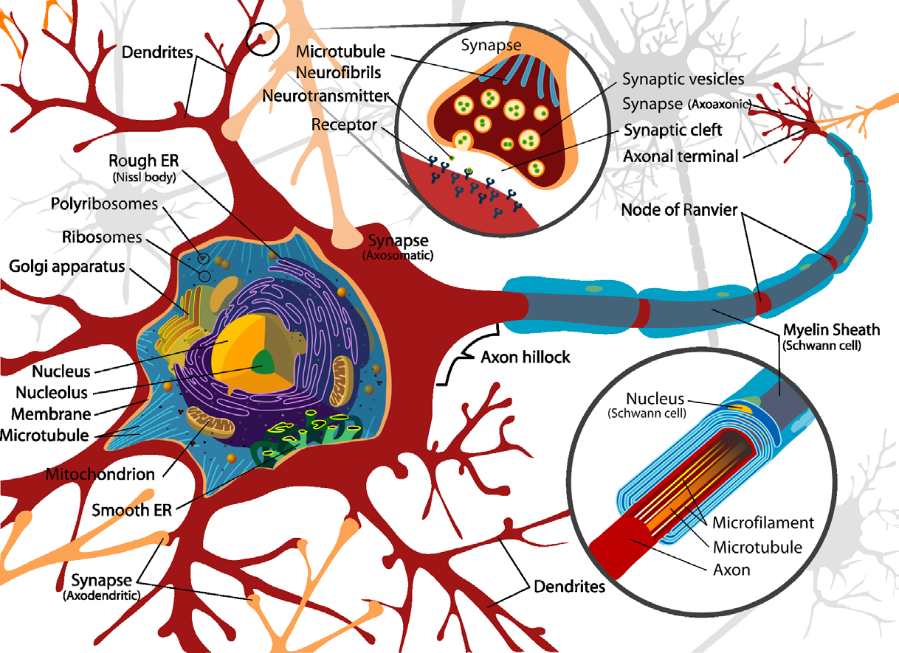
Neuron

Slide 8
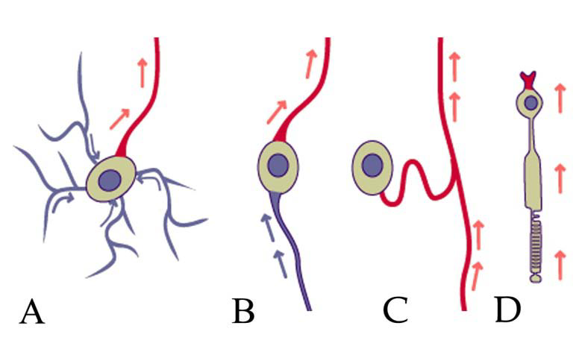
Structural classification of neurons:
multipolar neurons
bipolar neurons
pseudounipolar neurons
unipolar neurons

Slide 9
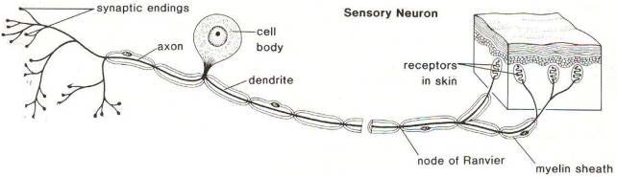
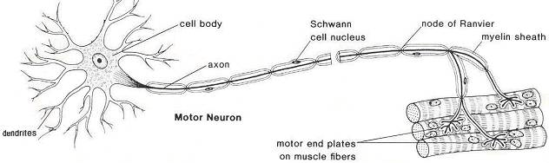
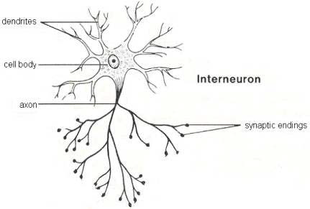

Slide 10
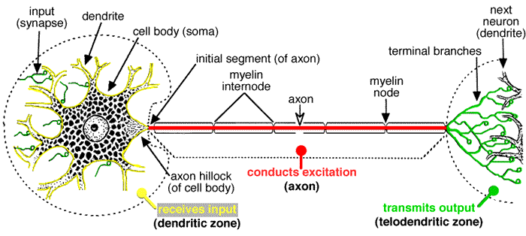
Zones of a neuron

Slide 11
- a distribution of many substances and
organelles through the cytoplasm
to and from the neuronal body
axoplasm = cytoplasm of the axon
Axoplasmic transport

Slide 12
Axoplasmic transport
  Speed
    fast rate >100 mm/day (i.e., hundreds of mm/day)
    slow rate < 10 mm/day
  Direction
    anterograde movement from the cell body to the terminals
  fast+ slow
    retrograde movement toward the cell body
  fast

Slide 13
Anterograde transport
  Rapid (at a speed of 300-400 mm/day)
    Synaptic vesicles, transmitters, mitochondria, lipids and proteins of the plasma membrane
  Slow (at 5-10 mm/day)
    skeletal elements, proteins and other substances to renew and maintain the axoplasm, soluble enzymes

Slide 14
Retrograde transport
  Rapid (at a speed of 150-200 mm/day)
transport of exhausted organelles and old membrane constituents(e.g. receptors, …)
transport of trophic and other signalling molecules from the periphery to the neuronal body
some neurotropic viruses such as poliomyelitis, herpes, and rabies and neurotoxins enter peripheral nerve endings and ascend to infect the cell body via retrograde transport

Slide 15
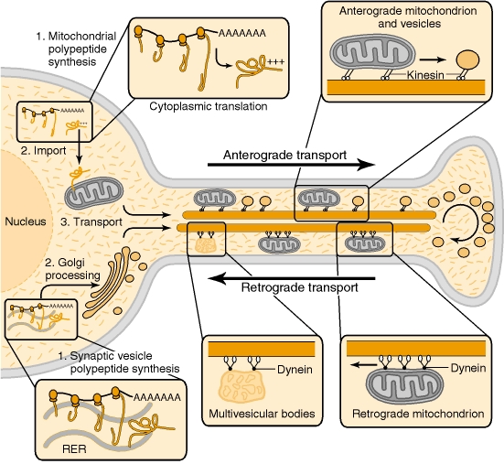
Fast axonal transport

Slide 16
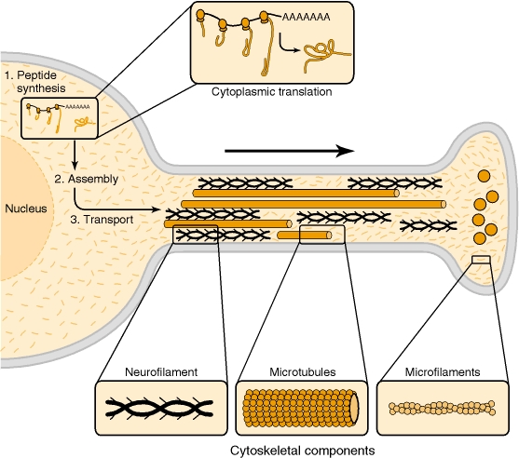
Slow axonal transport

Slide 17
Glial cells
  PNS (neural crest)
  Schwann cells
  satellite glial cells
  enteric glial cells
CNS
Microglia (mesoderm)
specialized macrophages capable of phagocytosis
that protect neurons of the central nervous system
  Macroglia (ectoderm)
  Astrocytes
  Oligodendrocytes
  Ependymal cells
  Radial glia

Slide 18
Glia of PNS
  Schwann cells
  myelinating Schwann cells form myelin sheaths
  around peripheral axons
non-myelinating Schwann cells
terminal Schwann cells

Slide 19
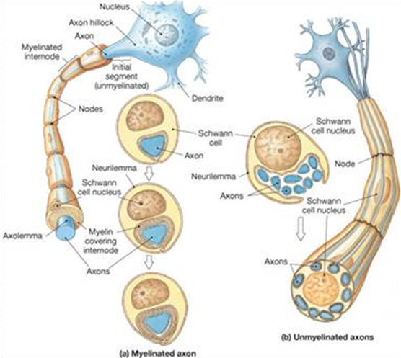
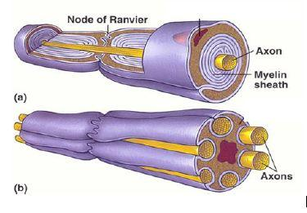
Saltatory conduction

Slide 20
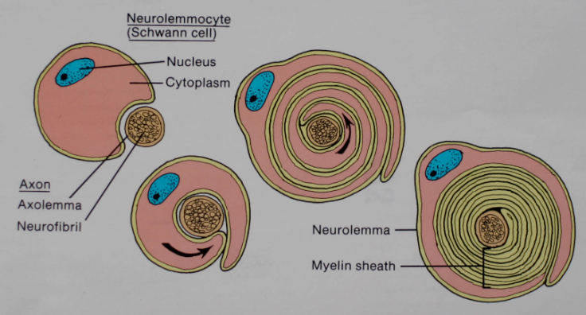
Myelination in the PNS

Slide 21
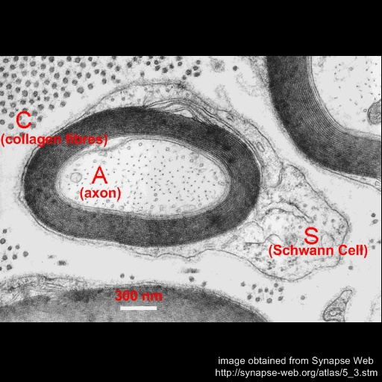
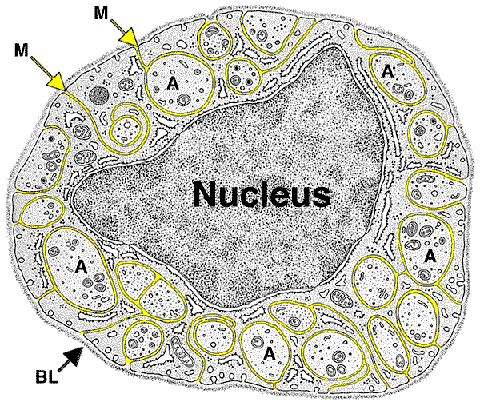

Slide 22
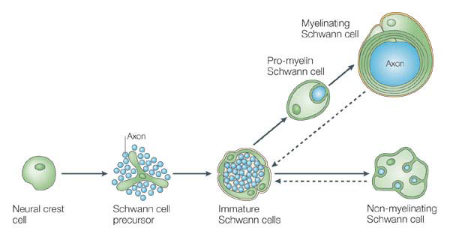
Schwann cell development

Slide 23
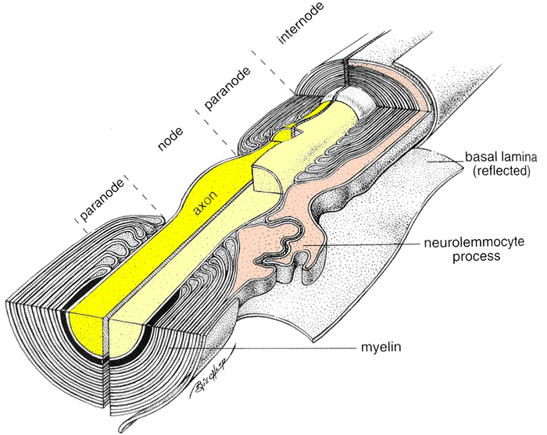
Node of Ranvier

Slide 24
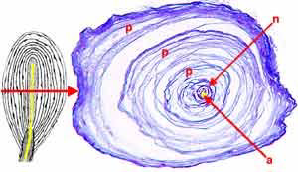
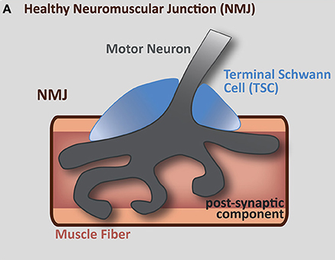
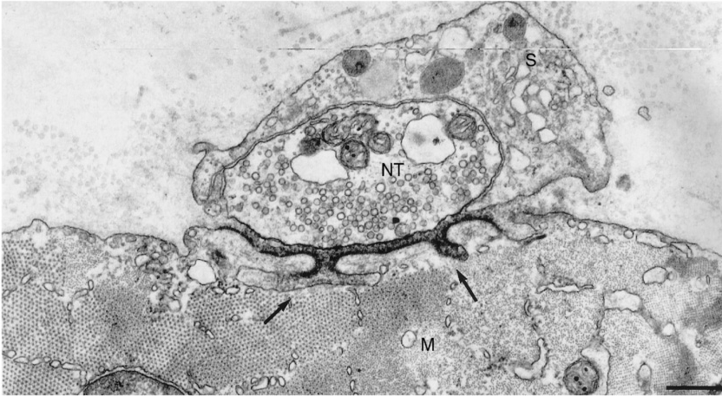
Terminal Schwann cells
Pacinian corpuscle

Slide 25
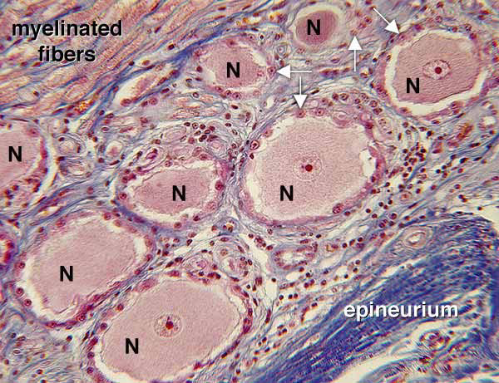
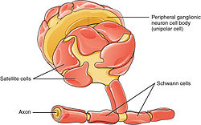
Glia of PNS
satellite glial cells - support neurons in the PNS ganglia

Slide 26
Glia of CNS
Astrocytes - provide a link between the vasculature and neurons
Oligodendrocytes - form the myelin sheath around axons of the CNS
Microglia - phagocyte cells that migrate through the CNS removing foreign matter and degenerated brain tissue
Ependymal cells - line the ventricular system of the CNS, are involved in the secretion of the cerebrospinal fluid and aid in its circulation

Slide 27
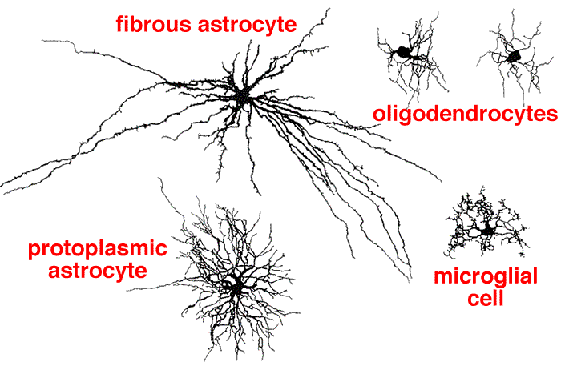

Slide 28
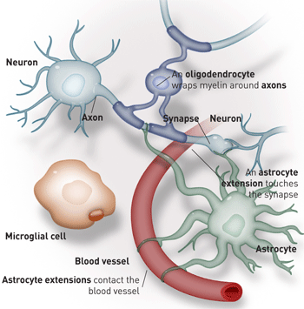

Slide 29
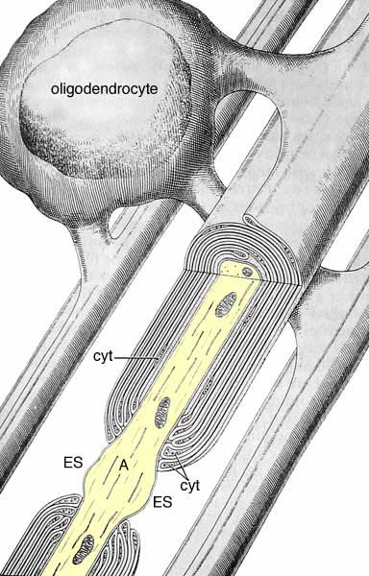
Myelin sheath in the CNS

Slide 30
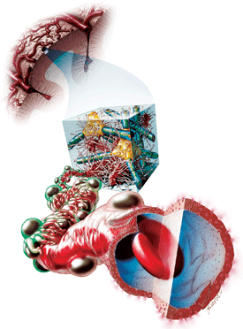
BLOOD – BRAIN BARRIER

Slide 31
BARRIERS OF THE CNS
Intracellular compartment
Extracellular compartment
Compartment of CSF
Intravascular compartment
Meningeal barrier
Blood – CSF barrier
Blood – brain barrier

Slide 32
BLOOD – BRAIN BARRIER
A barrier separating the circulating blood from the
extracellular space of the CNS
Functions
protects the brain from "foreign substances" in the
blood that may injure the brain
protects the brain from hormones and neurotransmitters
in the rest of the body
maintains a constant environment for the brain

Slide 33
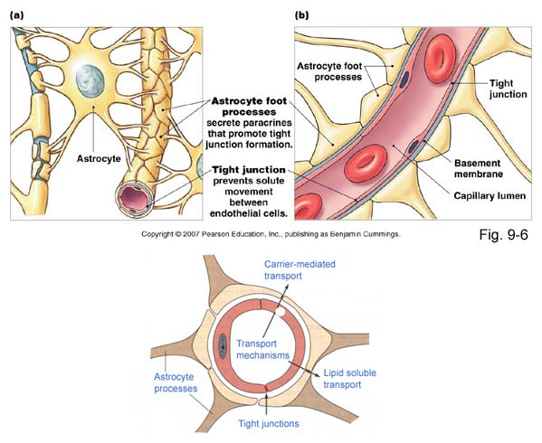
Structural
components
of BBB
Endothelial cells connected by tight junctions
Foot processes of astrocytes
Basement membrane

Slide 34
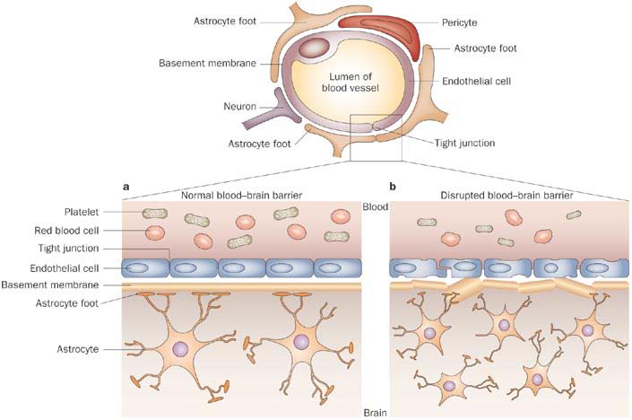

Slide 35
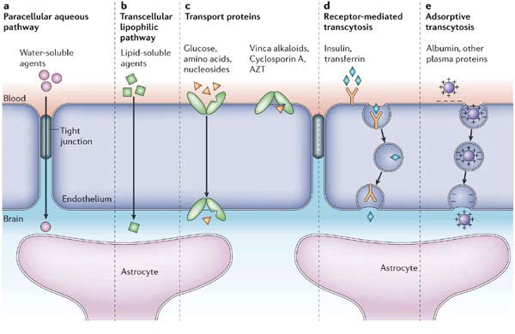

Slide 36
Transport through the BBB
simple diffusion (lipofillic substances)
facilitated diffusion through a protein carrier
energy independent
simple diffusion through an aqueous channel
active transport – energy dependent

Slide 37
Circumventricular organs
areas of the human brain without the BBB:
Pineal body (epiphysis)
Neurohypophysis (posterior pituitary) - releases
neurohormones (oxytocin and vasopressin) into blood
Area postrema: "vomiting center"
Subfornical organ: important for the regulation
of body fluids
Vascular organ of lamina terminalis: a chemosensory
area that detects peptides and other molecules
Median eminence: regulates anterior pituitary through
release of neurohormones

Slide 38
