Slide 1
ONTOGENETIC DEVELOPMENT OF THE NERVOUS SYSTEM

Slide 2
Ontogenetic development
= individual development of
the organism from the fertilized egg
to its mature form and finally death

Slide 3
Development of a neuron:
genetic level
a) transciption (DNA → RNA)
b) translation (RNA → polypeptides)
epigenetic level
neurotropic and neurotrophic molecules

Slide 4
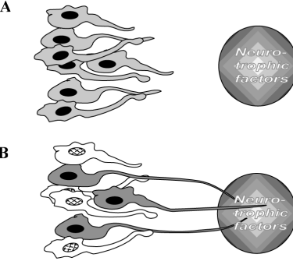
Target field theory
anatomy
Notes:
4

Slide 5
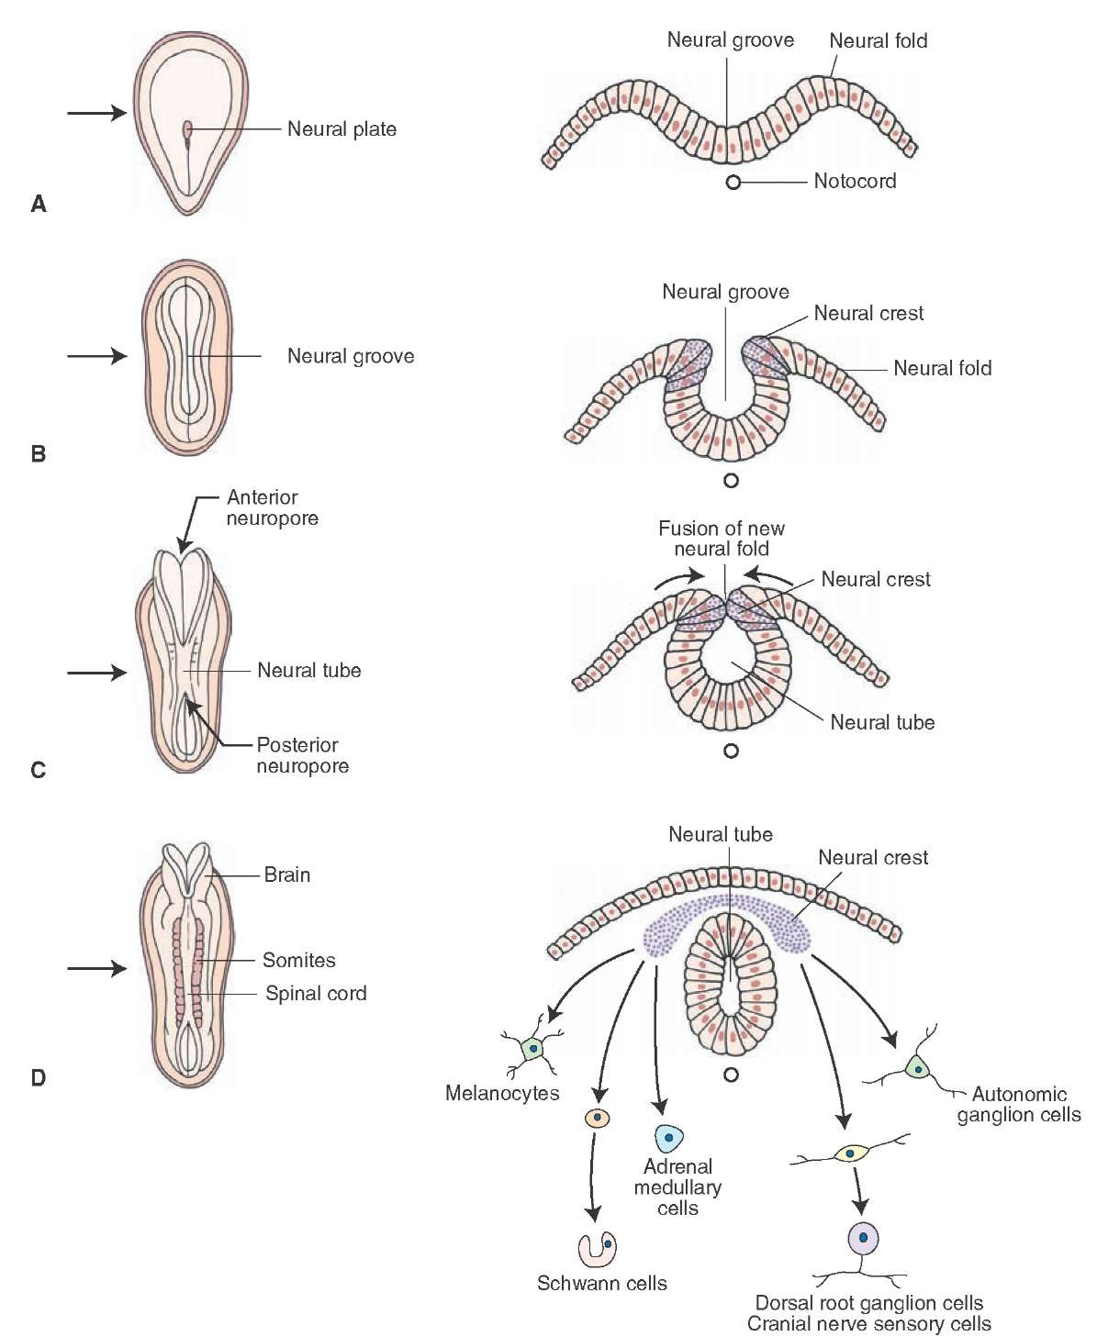
Development of
the NS

Slide 6
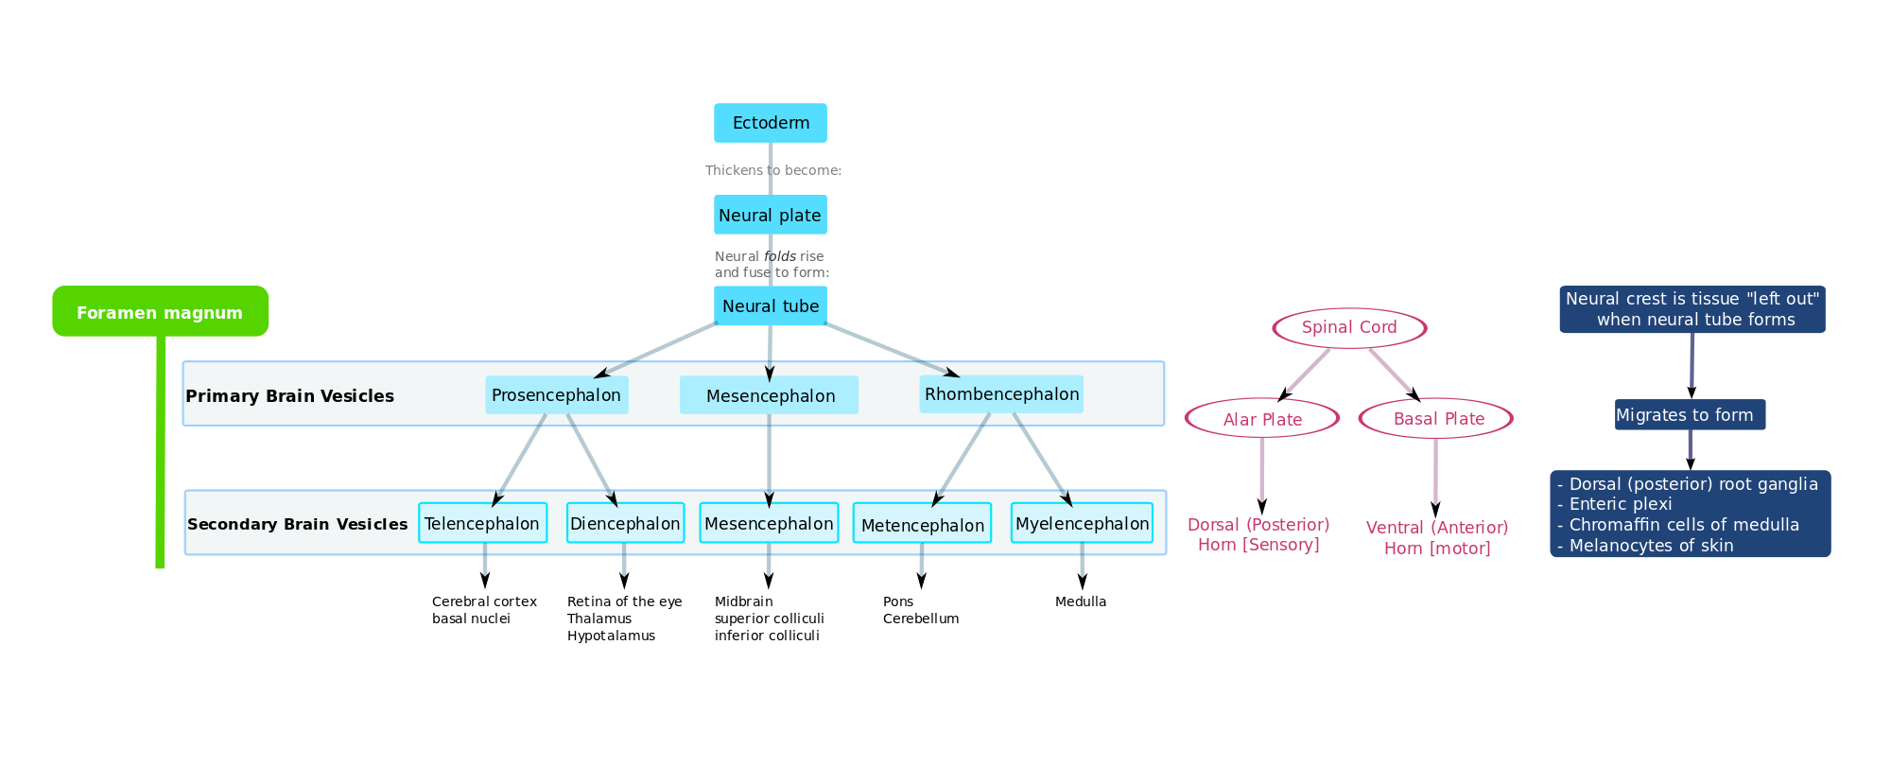
Development of the NS

Slide 7
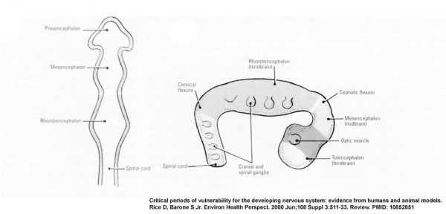
Primary brain vesicles

Slide 8
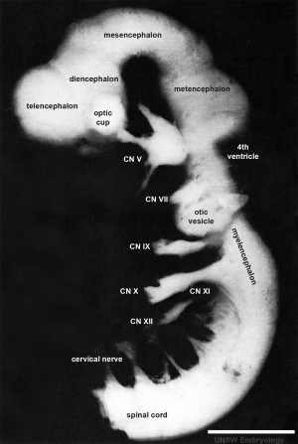
Secondary vesicles
and cranial nerves
1 mm

Slide 9
General principles of the ontogenetic
development of the CNS
segmentation of NS (somitogenesis)
control by genes
fate of neurons (death or survival) based on epigenetic
factors, migration and interaction of neurons –
neurotrophic molecules
neuronal differentiation and survival molecules
navigation of neurons towards the target structures –
neurotropism
end-differentiation of neurons

Slide 10
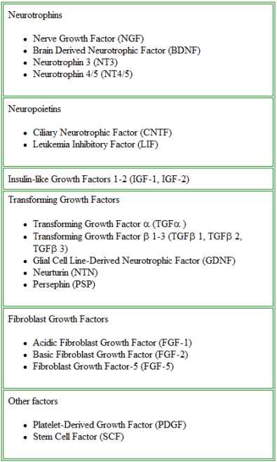
Neurotrophic factor
families

Slide 11
Trophic relationships in the NS
Neurons have trophic effect on periferal tissues
Periferal tissues have trophic effect on neurons

Slide 12
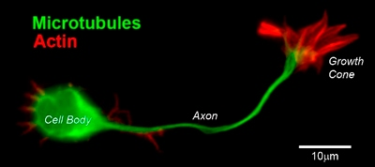
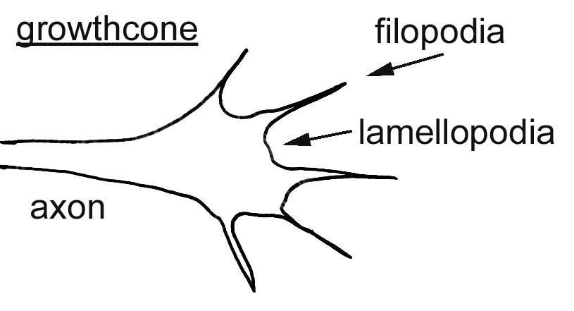
Growth cone

Slide 13
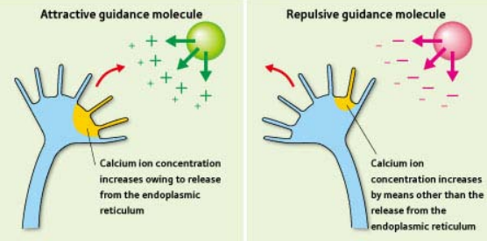
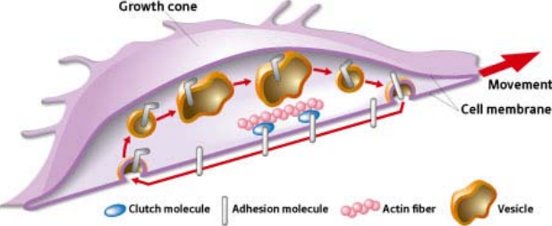
Axon guidance

Slide 14
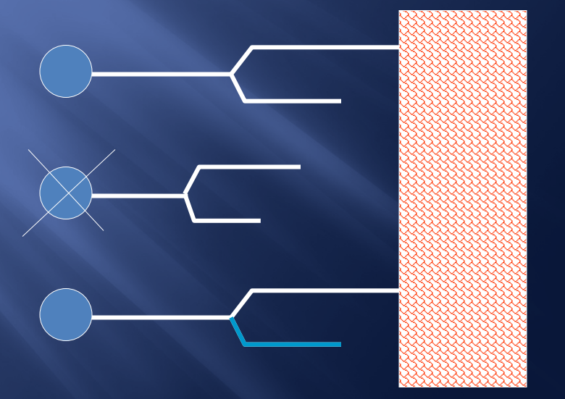
Reduction of redundant axons

Slide 15
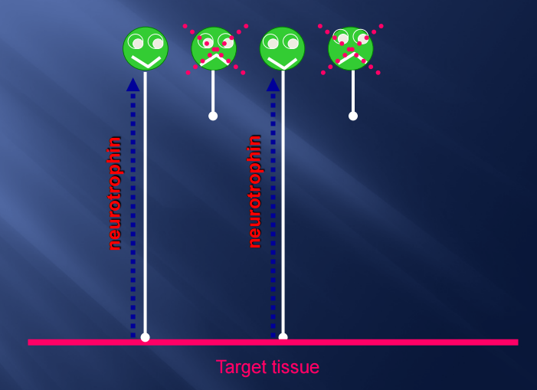
Neurotrophism
Neurotrophic factors

Slide 16
Molecular mechanisms of axonal guidance
contact adhesion
permissive surface
contact inhibition
non-permissive surface
fasciculation
chemotropism – attractive molecules

Slide 17
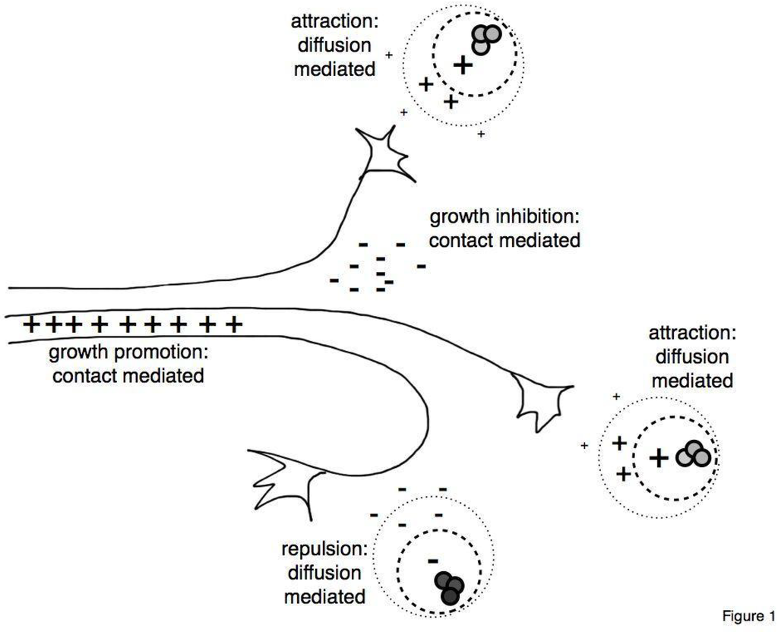
Axon guidance

Slide 18
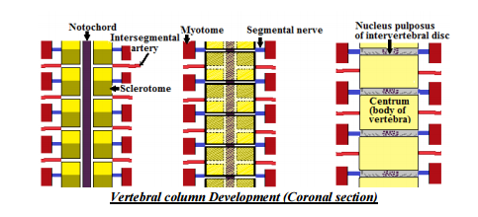
Contact adhesion and inhibition

Slide 19
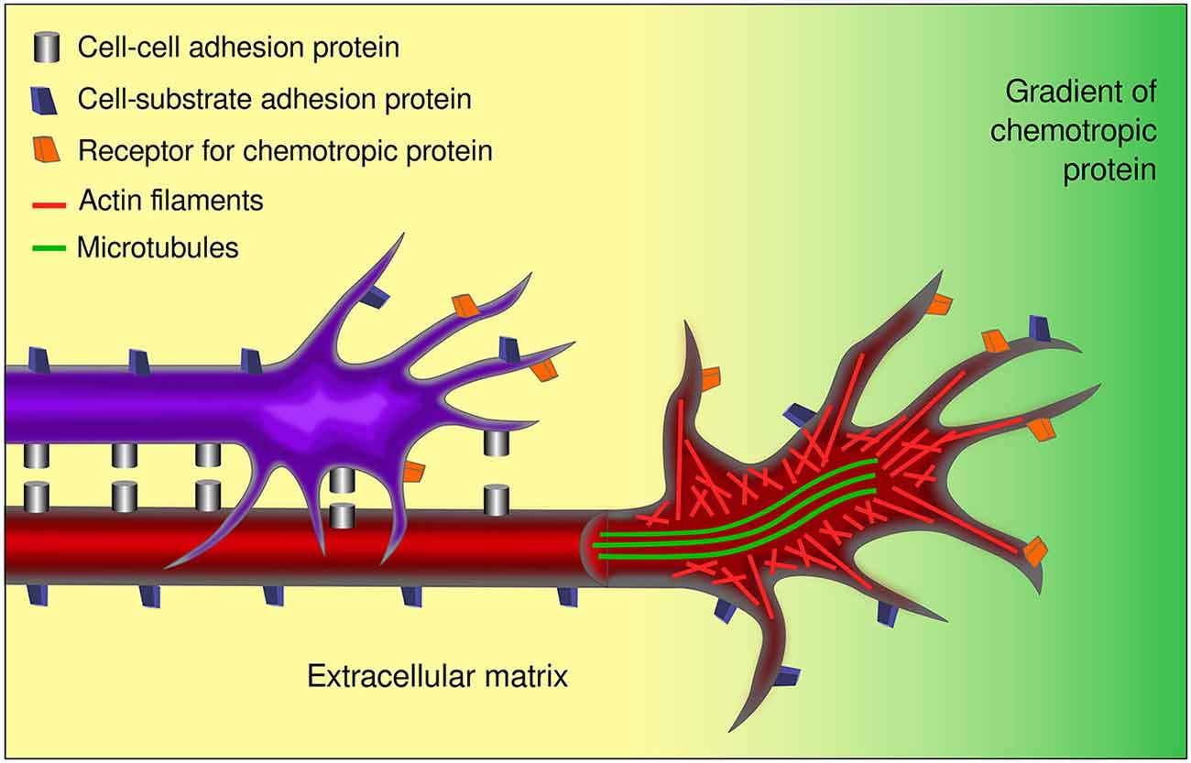
Fasciculation

Slide 20
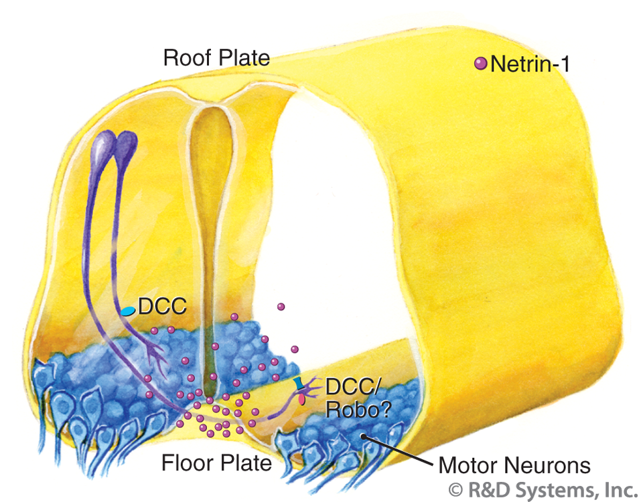
Chemotropism

Slide 21
Neural plasticity
developmental plasticity
neuroanatomical and neurophysiological changes
chemical plasticity
fast or slow turnover
neurotrophic-derived plasticity
neurons are not irrevocably genetically programmed
to produce one transmitter
neuronal plasticity
capability of generating new branches and synapses
synaptic plasticity
strenthening or weakening of synapses

Slide 22
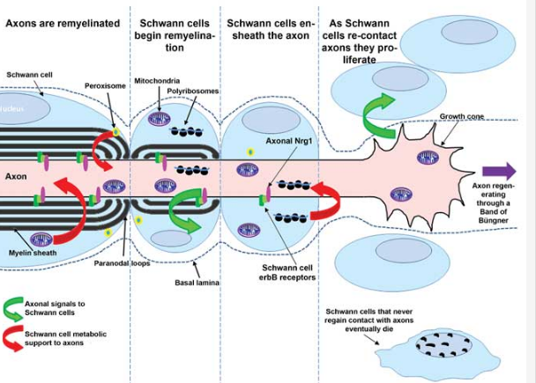
Reciprocal Schwann cell-axon interactions

Slide 23
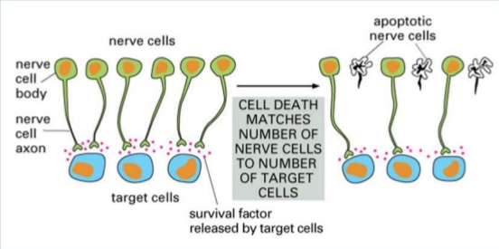
Apoptosis

Slide 24
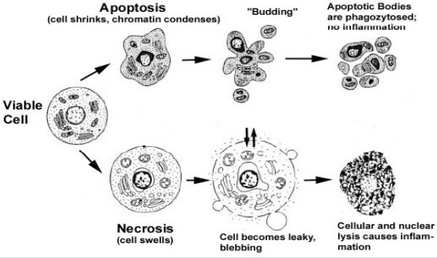

Slide 25
Critical factors and periods in
development of the CNS
critical period in development of the CNS
influence of the developmental factors is necessary
for the next development of the structure
genetic factors (initial period of development)
nutritive factors
critical period – the 3rd trimester – reduction in amount of
neurons
hormonal factors
factors of afferent pathways

Slide 26
Reaction of neurons to injury
loss of function
influence of duration of the damaging agent
reaction of processes differs in neurons of CNS and PNS
CNS neurons - atrophy and death due to great decline
of RNA synthesis
PNS neurons – anabolic processes depending on
type of injury
distance of the injury site from the body
age of the organism
localization and function of neurons

Slide 28
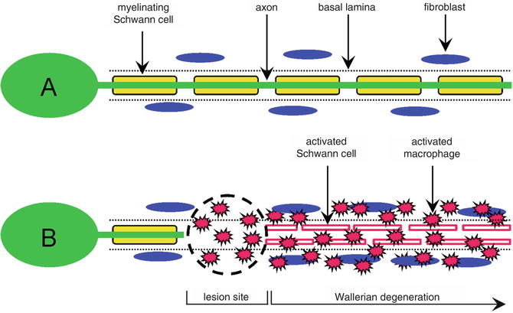
Wallerian degeneration

Slide 29
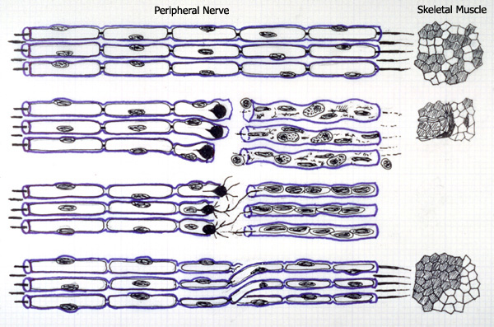
Peripheral nerve transection

Slide 30
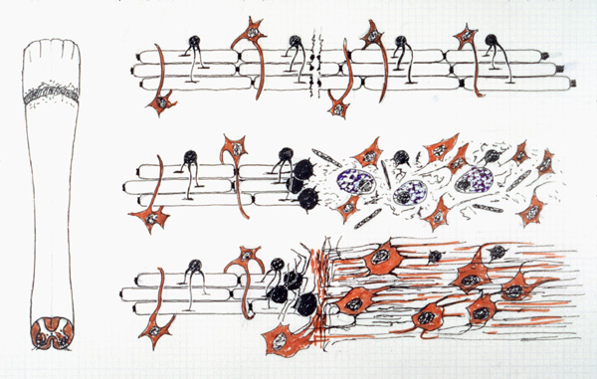
Spinal cord trauma

Slide 31
Illustrations were copied from:
Neuroscience Online, the Open-Access Neuroscience
Electronic Textbook
Department of Neurobiology and Anatomy
University of Texas Medical School at Houston

