Slide 1
Revision

Slide 2
Declensions
How many declensions are in Latin?
How do you decide on the declension of the noun?
What are the example words for the nouns of Ist declension?
vena, systole, diabetes
What are the example words for the nouns of IInd declension?
nervus, septum, nephros, colon
What are the example words for the nouns of IIIrd declension?
dolor, corpus, pelvis, rete, dosis (febris)
What are the example words for the nouns of IVth declension?
ductus, genu
What are the example words for the nouns of Vth declension?
facies

Slide 3
Adjectives
Latin adjective has to match the noun in...?
gender, case, number
thus the endings do NOT have to look similarly
diabetes mellitus, gen.: diabetae melliti
rete venosum, gen.: retis venosi
vulnus lacerum, gen.: vulneris laceri
manus dextra, gen.: manus dextrae
etc...

Slide 4
Spot and correct the mistakes
mors in tabulam
solutio ad injectione intravenosa
vulna scissa
oedema cum thrombosim venarum
cervices dentum caninorum
sub ossia
musculi sphinctes
species ad gargarismam
vulnus mors faciei

Slide 5
Confusing words
Tell the difference between the words and make up illustrative phrases:
fractura, ae, f. X fractus, fracta, fractum
fractura costae verae aperta
costa vera fracta
ruptura, ae, f. X ruptus, rupta, ruptum
ruptura tendinis
tendo rupta
periculum, i, n, X periculosus, a, um
periculum mortis in tabula
morbus periculosus
thorax, thoracis, m. X thoracicus, a, um
vulnus punctum thoracis
vertebra thoracica

Slide 6
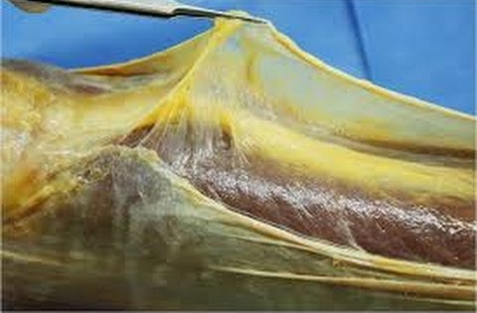
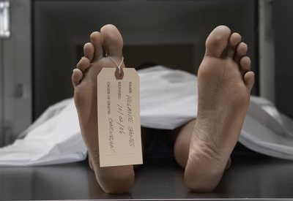
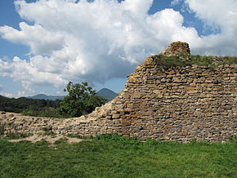
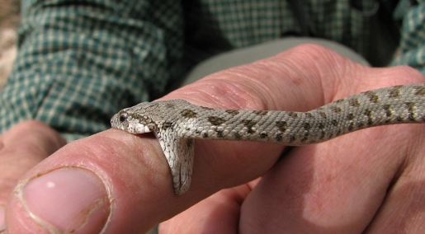
Confusing words II Match the nouns with the pictures
morsus
paries
pars
mors
facies
morbus
fascia

Slide 7
Confusing words II Match the nouns with the pictures
fascia, ae, f.
mors, tis, f.
paries, etis, m.
morsus, us, m.
facies, ei, f.
pars, tis, f.
morbus, i, m.
Notes:
ať studenti teď zkusí vytvořit nějaké fráze

Slide 8
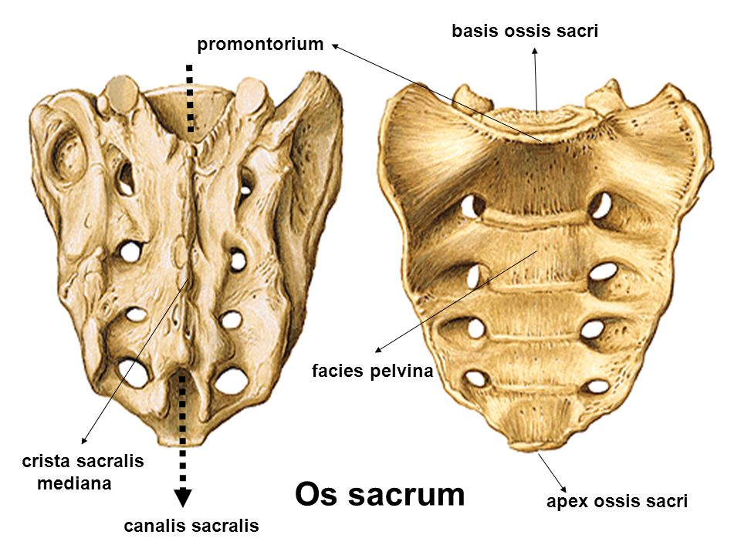
Translate
rupture of the wide fascia
ruptura fasciae latae
death after an animal bite
mors post morsum animalis
parts of a gall bladder
partes vesicae felleae
pelvic surface of sacral bone
facies pelvina ossis sacri
infectious diseases
morbi infectiosi
perforation of the wall of the stomach
perforatio parietis gastris

Slide 9
Form phrases from words in boxes and translate them into English
medicamenta contagiosum
morbum
contra
medicamenta contra morbum contagiosum
medicaments against contagious disease
acutus
pulmonis
dolor
dextri
dolor acutus pulmonis dextri
acute pain of right lung
symptomata
hepatitidis
acutae
symptomata hepatitidis acutae
symptoms of acute inflammation of the liver
collapsus
periculum
digestorii
systematis
periculum collapsus systematis digestorii
danger of a collapse of the digestive system

Slide 10
What are the correct LATIN terms?
paries perforatus
wallum perforatum
neonatus malignus
cancer testiculi
traumata bruisa
vulni sub tempibus
inflammatio cerebri
tea urologica
tumor malignus
cancer testis
vulnera contusa
vulnera sub temporibus
encephalitis
species urologicae

