Slide 1
Adjectives of 3rd Declension

Slide 2
ADJECTIVES of 3RD DECLENSION /DICTIONARY ENTRY
ADJECTIVES OF 1st and 2nd DECLENSION
albus, a, um// niger, a, um
ADJECTIVES OF 3rd DECLENSION
acer, is, e// brevis, e// simplex, cis
3 : –ER (M), -IS (F), -E (N): very rare in med. terminology
2 : -IS (M+F), -E (N): extremely frequent
1 : -X, -NS (M+F+N): some types are frequent
!genitive sg.!

Slide 3
FORM CLOSE ATTRIBUTE
musculus+ biventer, is, e
!fossa + biventer, is, e
!ganglion + biventer, is, e
musculus + communis, e
arteria + communis, e
crus + communis, e
lobulus + simplex, cis
articulatio + simplex, cis
crus + simplex, cis
3-forms
2-forms
1-form
Number of forms in nom. sg.

Slide 4
ADJECTIVES of 3RD DECLENSION
3 terminations in nominative sg. which are always:
-ER (M), -IS (F), -E (N)
e. g.:
biventer, is, e having two bellies
acer, is, e sharp, violent, drastic
celer, is, e fast, quick

Slide 5
ADJECTIVES of 3RD DECLENSION
2 terminations in nominative sg. which are always:
-IS (M+F), -E (N) :
e. g.:
Underived adjectives like: brevis, e short; gravis, e heavy, difficult
levis, e light; tenuis, e thin, slender
Derived adjectives ending on -alis, e/-aris, e cranialis, e; muscularis, e
(means relation, pertaining to or belonging to)
Derived adjectives ending on -bilis, e operabilis, e; sanabilis, e
(means capable or susceptible of a specified action)
Derived adjectives ending on -formis, e pisiformis, e; vermiformis, e
(means shaped like, looking like, latin equivalent to ending -oideus, a, um)

Slide 6
ADJECTIVES of 3RD DECLENSION
1 termination in nominative sg. which usually is:
-X, -NS (M+F+N) and is always accompanied with the genitive ending
e. g.:
Underived adjectives like: recens, recentis recent, new;
latens, latentis latent, not manifested
Derived adjectives ending -plex, plicis simplex, cis; duplex, cis
(refers to number, multiplicity)
Derived adjectives ending on -ceps, cipitis biceps, bicipitis
(refers to head-like strucutres)
Originally participles having meaning of action ending on
-ans, antis and -ens, entis migrans, antis; ascendens, entis

Slide 7
INFLECTION
ADJECTIVES of 1st and 2nd declension depending on their gender inflect like paradigms:
nervus (M), vena (F), septum (N)
ADJECTIVES of 3rd declension depending on their gender inflect like paradigms:
1. pelvis (M+(F) BUT!!! abl. sg. is always on -i
2. rete (N)

Slide 8
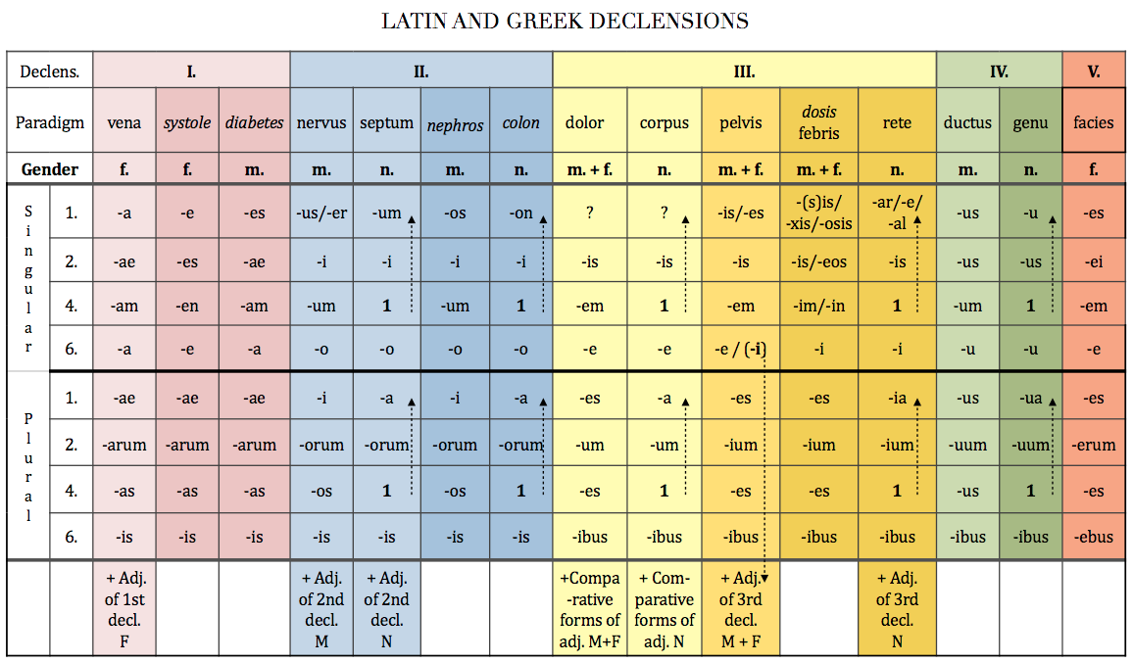

Slide 9
Adjectives of 3rd declension
 | two forms: m+f/n | one form for all genders
1. singular | brevis breve | simplex
2. | brev-is | simplic-is
4. | brev-em breve | simplic-em simplex
6. | brev-i | simplic-i
1. plural | brev-es brev-ia | simplic-es simplic-ia
2. | brev-ium | simplic-ium
4. | brev-es brev-ia | simplic-es simplic-ia
6. | brev-ibus | simplic-ibus

Slide 10
Form required cases from these expressions:
dolor acer acc. sg. and nom. pl.
nervus cranialis abl. sg. and gen. pl.
vertebra cervicalis nom. pl. and gen. pl.
caput breve gen. sg. and abl. sg.
musculus biceps gen. sg. and acc. pl.
margo occipitalis acc. sg. and abl. sg.

Slide 11
Examples of authentic diagnoses
code | diagnosis
K928 | Corpus alienum intestini tenuis perforans
C259 | Carcinoma capitis pancreatis inoperabile, metastases hepatis multiplices
S019 | Vulnera lacera regionis frontalis, dorsi nasi, labii superioris oris et vestibuli oris
C348 | Tumor lobi medii pulmonis l. dx. ad pericardium, diaphragma et nervum phrenicum increscens
C186 | St. p. colectomiam subtotalem propter carcinoma coli descendentis
M4795 | Vulnus punctum cubiti sin., corpus alienum vitreum loci vulneris
S5250 | Fractura intraarticularis partis distalis radii sin. dislocata comminutiva
S9220 | Fractura ossis cuboidei et navicularis pedis l. dx. sine dislocatione
S863 | Ruptura musculi tricipitis surae l. dx. suspecta
K928 | Corpora aliena vitrea multiplicia antebrachii l. dx.
S300 | Contusio dorsi regionis lumbalis gravis

Slide 12
Examples of authentic diagnoses
code | diagnosis
K928 | Corpus alienum intestini tenuis perforans
C259 | Carcinoma capitis pancreatis inoperabile, metastases hepatis multiplices
S019 | Vulnera lacera regionis frontalis, dorsi nasi, labii superioris oris et vestibuli oris
C348 | Tumor lobi medii pulmonis l. dx. ad pericardium, diaphragma et nervum phrenicum increscens
C186 | St. p. colectomiam subtotalem propter carcinoma coli descendentis
M4795 | Vulnus punctum cubiti sin., corpus alienum vitreum loci vulneris
S5250 | Fractura intraarticularis partis distalis radii sin. dislocata comminutiva
S9220 | Fractura ossis cuboidei et navicularis pedis l. dx. sine dislocatione
S863 | Ruptura musculi tricipitis surae l. dx. suspecta
K928 | Corpora aliena vitrea multiplicia antebrachii l. dx.
S300 | Contusio dorsi regionis lumbalis gravis
Notes:
os cuboideum - kost krychlová. Jedna z kostí zánártí. Proximálně je spojena s kostí patní.
os naviculare – lat. 1. kost člunkovitá loďkovitá. Jedna z kůstek zánártí. Proximálně má kloubní spojení s kostí hlezenní

