Slide 1
ADJECTIVES OF THE 3rd DECLENSION COMPARISON OF ADJECTIVES NUMERALS

Slide 2
COMBINE WORDS IN LINES TO FORM ANATOMICAL TERMS, DO NOT CHANGE ORDER
linea  gluteus, a, um  inferior, ius
foramen (pl.)  sacralis, e  anterior, ius
arteria  iliacus, a, um  communis, e
musculus (pl.)  regio  urogenitalis, e
glandula (pl.)  vestibularis, e  minor, minus
pars  proximalis, e  urethra
arteria (pl.)  perforans, ntis  anterior, ius
paries  posterior, ius  orbita
arteria (pl.)  sacralis, e  lateralis, e
ligamentum  teres, etis  uterus
nervus (pl.)  analis, e  superior, ius

Slide 3
COMBINE WORDS IN LINES TO FORM ANATOMICAL TERMS, DO NOT CHANGE ORDER
linea glutea inferior
foramina sacralia anteriora
arteria iliaca communis
musculi regionis urogenitalis
glandulae vestibulares minores
pars proximalis urethrae
arteriae perforantes anteriores
paries posterior orbitae
arteriae sacrales laterales
ligamenta teretis uteri
nervi anales superiores

Slide 4
GIVE THE OPPOSITE TO THE UNDERLINED TERM
musculi membrorum inferiorum
foramen palatinum majus
pollex lateris dextri
musculus gluteus minimus
palatum molle
tunica externa arteriae
articulatio composita
arteria temporalis anterior
m. transversus perinei profundus
organa genitalia feminina
fascia superior diaphragmatis pelvis
commissura labiorum anterior
incisura ischiadica minor
spina iliaca posterior superior
pelvis major
pars proximalis urethrae masculinae
superiorum
minus
sinistri
maximus
durum
intima
simplex
posterior
superficialis
masculina
inferior
posterior
major
anterior
minor
distalis

Slide 5
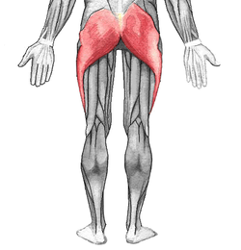
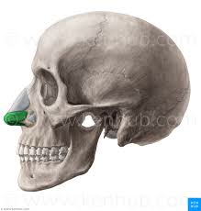
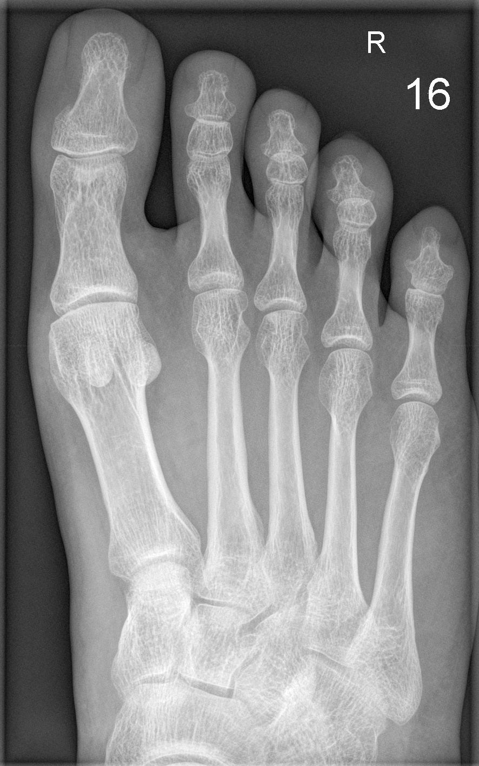
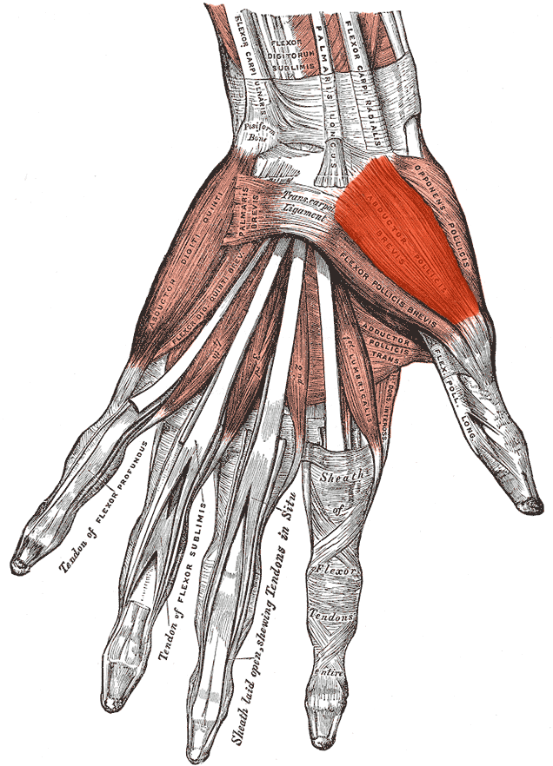
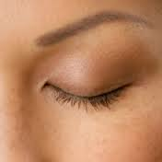
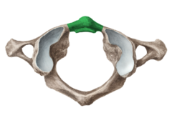
NAME COLORED/HIGHLIGHTED STRUCTURES
Notes:
Musculus gluteus maximus // Cartilago alaris major // Digitus minimus pedis // palpebra superior // musculus abductor pollicis brevis // Arcus anterior atlantis

Slide 6
READ MEDICAL RECORDS CONTAINING NUMERALS
ICD code | DIAGNOSIS
S2230 | Fractura traumatica costae VI.- IX. l. dx
S2200 | Fractura pathologica vertebrae Th7, Th9, Th10 et processus transversi L3
S2200 | Fractura compressiva corporis vertebrae Th 5, Th9, Th11 et Th12
S6261 | Fractura phalangis proximalis digiti III. manus l. sin. comminutiva aperta
S6230 | Fractura ossis metacarpalis V. manus l. dx.
S9230 | Fractura ossis metatarsalis II. et III. pedis l. dx. sine dislocatione
L030 | Defectus chronicus cum phlegmone digiti IV. pedis l. sin.
D6919 | Gangraena diabetica hallucis et digiti II. pedis l. dx.
Phlegmone, es, f. : phlegmon (purulent inflammation of the cellular
or areolar tissue)

Slide 7
CHANGE THE WORD ORDER TO GET THE AUTHENTIC RECORD
pedis excoriationes dx. et ablatio digiti II. multiplices unguis pedis l.
seu manus quinti luxatio digiti l. sin. minimi
Excoriationes pedis l. dx. multiplices et ablatio unguis digiti II. pedis
Luxatio digiti quinti seu minimi manus l. sin.
digiti vulnus III. manus contusolacerum l. sin.
digiti pollicis status II. post traumaticam et manus l. dx. amputationem
Vulnus contusolacerum digiti III. manus l. sin.
Status post amputationem traumaticam pollicis et digiti II. manus l. dx.

Slide 8
FILL IN THE MISSING ENDINGS,
TRANSLATE AUTHENTIC RECORDS
1: Distorsio gen_ _ l. dx. cum excoriation_ _ _ _ multiplic_ _ _ _ et laesion_ muscul_ _ _ _ l. dx. suspect_
2: Laceratio lob_ superior_ _ pulmon_ _ l. sin et contusio pulmon_ _ l. dx lev_ _
3: Fractura oss_ _ _ nasal_ _ _ sine dislocation_. Contusio faci_ _ cum haematomat_ region_ _ orbital_ _ l. sin.
4: Contusio cox_ _ l. sin. cum distension_ muscul_ _ _ _ region_ _ glute_ _ l. sin.

Slide 9
FILL IN THE MISSING ENDINGS,
TRANSLATE AUTHENTIC RECORDS
1: Distorsio genus l. dx. cum excoriationibus multiplicibus et laesione musculorum l. dx. suspecta
2: Laceratio lobi superioris pulmonis l. sin et contusio pulmonis l. dx levis
3: Fractura ossium nasalium sine dislocatione. Contusio faciei cum haematomate regionis orbitalis l. sin.
4: Contusio coxae l. sin. cum distensione musculorum regionis gluteae l. sin.

Slide 10
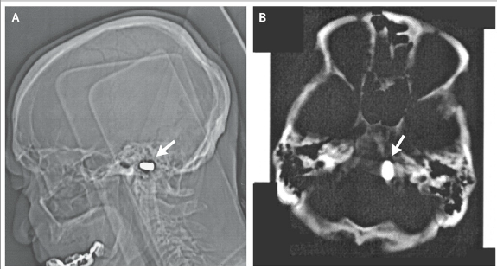
Cranial computed tomographic imaging revealed a metal foreign
body, 1.2×0.7 cm, at the left edge of the foramen magnum
in this 85-year-old man. There was no clinical or radiographic
evidence of neural damage. The patient revealed that at the age
of 3 he had been accidentally shot with a pistol by his older brother.
The bullet had struck him just inferior to the nose, and he had lost
consciousness for several hours, recovering completely without
specific therapy.
Notes:
corpus alienum in margine sinistro foraminis magni sine laesione

Slide 11
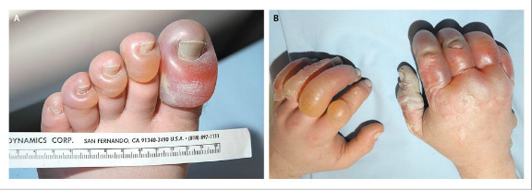
A 39-year-old man was found in a snowbank, with the ambient
Temperature 34°C. He had been reported missing the previous
evening, after and argument with his girlfriend. The emergency
services crew noticed the odor of alcohol in his breath. Large, clear blisters characteristic of severe frostbite were noted on the hands and feet. Of particular note were the left great toe and right thumb with frostbite of the third grade. Subsequently, the patient’s left great toe was amputated.
blister = bulla, ae, f.
Notes:
bulla

Slide 12
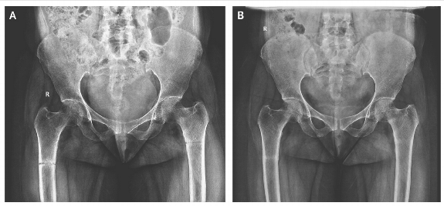
A 45-year-old woman presented with a 3-month history of
generalized body pains nonresponsive to analgesic agents.
Along with low back pain, she had progressive difficulty in getting
up from sitting and supine positions and in walking. There was
no history of trauma or any medication intake.
An anteroposterior radiograph of the pelvis showed an
undisplaced transverse fracture of the shaft of both femurs.
Notes:
fractura diaphyseos femoris lateris utriusque (l. utrq.) sine dislocatione

Slide 13
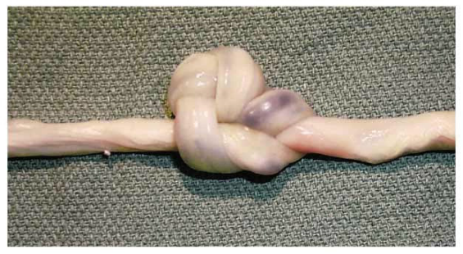
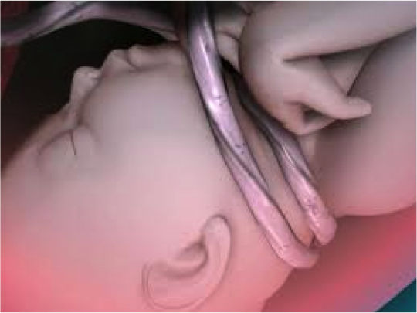
23 years old woman (gravida 1, para 0) was admitted at 40+1 weeks gestation and underwent an emergency caesarian section due to imminent hypoxia of the fetus. As revealed during the section the umbilical cord was twisted twice around the neck of the neonate, furthermore the umbilical cord was noted to have a compound knot. Compound knots, as in this case, are rare.
hypoxia, ae, f. =a diminished availability of oxygen to the body tissues
Notes:
sectio caesarea propter hypoxiam fetus imminentem, funiculus umbilicalis circum collum fetus bis, nodus compositus funiculi umbilicalis

Slide 14
HOW MANY PREGNANCIES, HOW MANY CHILDBIRTHS?
GRAVIDA - number of pregnancies, regardles of result
PARA - number of births after 20 weeks of pregnancy,
regardless of result,
stillbirth counted as 1,
multiple births /twins et. al./ counted as 1
ABORTION - miscarriage before 20 weeks of pregnancy
G₈P₅A₃
G₂P₂
G₄P₃A₁

Slide 15
-PARA AND -GRAVIDA
0
1
2
3
4
5
6
7
8
9
10
MANY
NULLI-PARA
UNI/PRIMI-PARA
SECUNDI-PARA
TERTI-PARA
QUARTI/QUADRI-PARA
QUINTI-PARA
SEXTI-PARA
SEPTI-PARA
OCTI-PARA
NONI-PARA
DECI-PARA
MULTI/PLURI-PARA
NULLI-GRAVIDA
PRIMI-GRAVIDA
SECUNDI-GRAVIDA
TERTI-GRAVIDA
QUARTI-GRAVIDA
QUINTI-GRAVIDA
SEXTI-GRAVIDA
SEPTI-GRAVIDA
OCTI-GRAVIDA
NONI-GRAVIDA
DECI-GRAVIDA
MULTI/PLURI-GRAVIDA

Slide 16
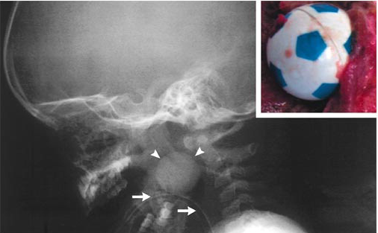
A three-year-old boy was playing with a plastic ball while in the
backseat of a car. The father heard a gasp, saw that the child was
unconscious, and suspected the child to aspirate the toy ball.
Emergency personnel intubated the child, no foreign body was
visualized then. The child was dead on arrival at the hospital.
During the postmortem examination, a radiograph of the head and
neck showed a spherical foreign body located in the oropharynx.
The oropharynx contained a toy soccer ball 2.5 cm in diameter.
spherical = spheroideus, a, um
Notes:
Corpus alienum sphaeroideum oropharyngis
Oropharynx, gis, m. (os, oris, n. + pharynx, gis, m.)

Slide 17
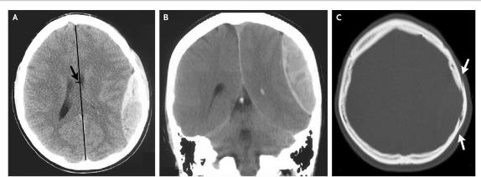
An 18-year-old intoxicated man was assaulted with a glass bottle on the left parietal region of his head and had a 5-minute loss of consciousness. Two hours after the injury he presented to a local emergency with severe headache, nausea, and vomiting. Computed tomography of the head revealed a 2.5-cm epidural hematoma in the left parietal region (Panels A and B) underlying a linear, nondisplaced skull fracture (Panel C, arrows).
Notes:
Haematoma epidurale regionis parietalis l. dx.
Fractura cranii sine dislocatione

Slide 18
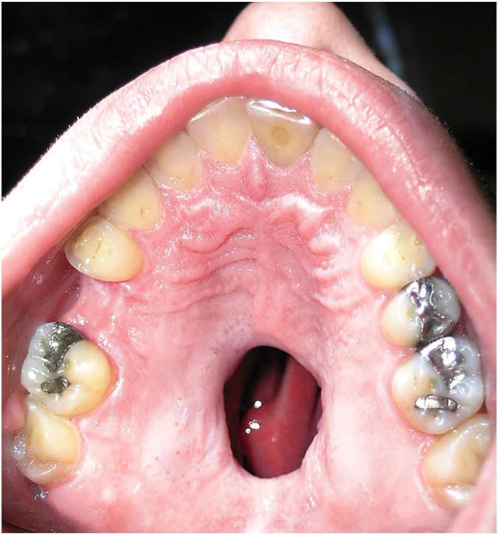
A healthy 25-year-old man presented to the surgical clinic with a hole in the roof of his mouth, present for a year, and he requested surgical correction. The patient reported a 5-year history of nasal cocaine use from which he had recently abstained. Examination revealed a large perforation of the nasal septum and midline palate. Local complications of intranasal cocaine abuse include chronic rhinitis, sinusitis, epistaxis, ossification or necrosis of the nasal septum, and in rare cases, palatal perforation.
epistaxis = nosebleed
Notes:
Perforatio (per)magna septi nasi et partis medialis palati duri
Cocainismus/Abusus cocaini in anamnesi
Praesenti tempore abstinentia cocaini

Slide 19
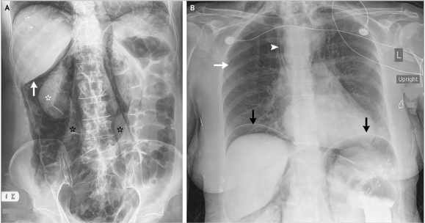
A 74-year-old woman was undergoing a screening colonoscopy when it became apparent that the rectosigmoid junction might have become perforated. Radiographs obtained revealed revealed retroperitoneal free air outlining the right kidney (white asterisk) and psoas muscles (black asterisks). A 1-cm perforation in the distal sigmoid, near the rectosigmoid junction, allowed air to track into the intraperitoneal and retroperitoneal spaces.
Notes:
Perforatio partis distalis (junctio rectosigmoidea) coli sigmoidei
Junctio rectosigmoidea is not official anatomical term,sometimes substtantive rectosigmoideum, i, n. is used

