Slide 1
BASIC VERBAL FORMS
MEDICAL PRESCRIPTIONS

Slide 2
FIVE BASIC FORMS
Medical terminology uses only selected number of verbal forms:
1. Dictionary entry -
  a) 1st person singular of present active indicative
  I heal, I mix, I divide, I dispatch
  b) Infinitive
  to heal, to mix, to divide, to dispatch
  2. Imperative
  Heal! Mix! Divide! Dispatch!
  3. Subjunctive : 3rd person singular (present passive)
  It is to be /should be healed, mixed, divided, dispatched
  4. Subjunctive : 3rd person plural (present passive)
  they are to be/ should be healed, mixed, divided, dispatched

Slide 3
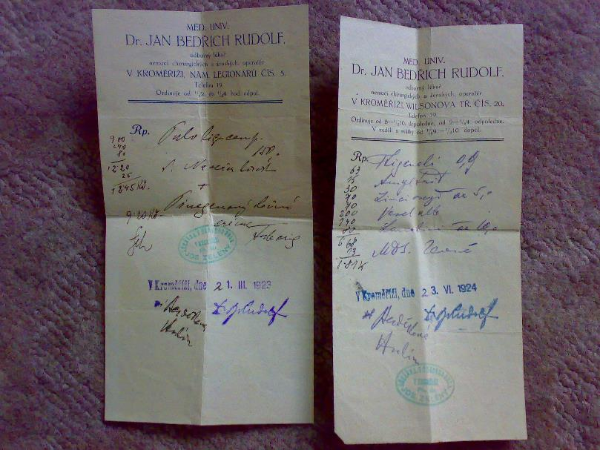
CZECH, 1920

Slide 4
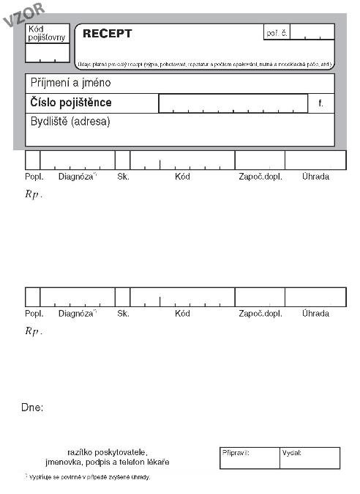
CZECH

Slide 5
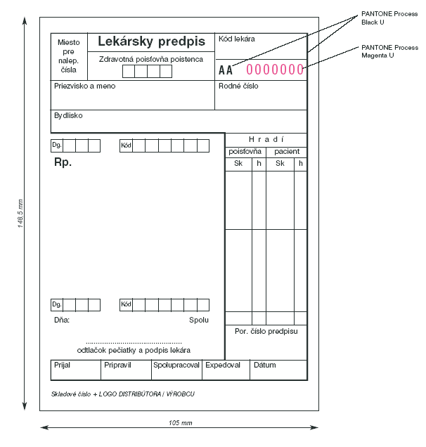
SLOVAK

Slide 6
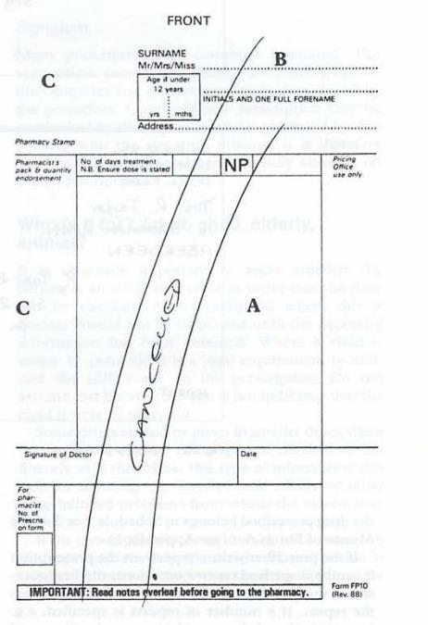
BRITISH

Slide 7
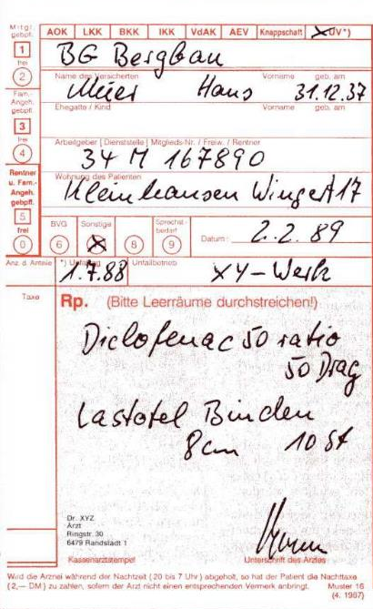
GERMAN

Slide 8
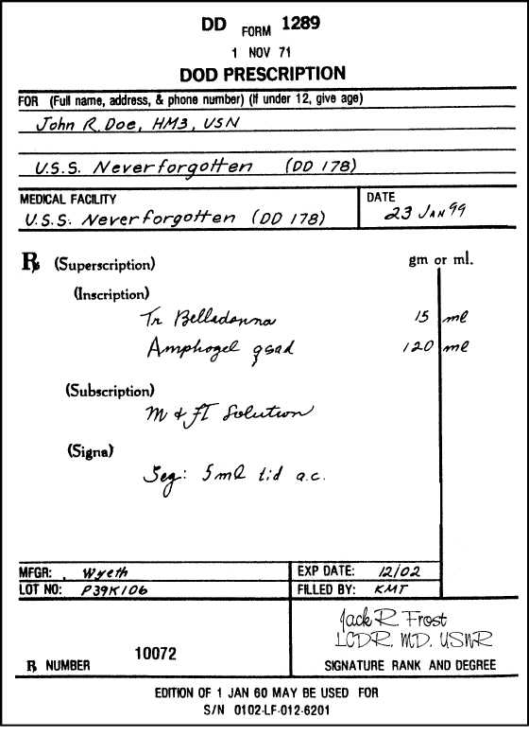
AMERICAN

Slide 9
CZECH, currently used

Slide 10
Rp.
Acidi acetylsalicylici
Paracetamoli aa 0,3
Codeinii dihydrogenphosphorici 0,02
Coffeini cum natrio benzoico 0,1
Magnesii oxydati 0,05
M. f. pulv.
D. t. d. No. XX (viginti) ad caps.
S. 3krát denně 1 prášek.
Analgeticum +
antipyreticum
Rp.
Aminophyllini 1,8
Olei cacao q. s. ut f. supp.
D. t. d. No. VI (sex)
S. 2krát denně zavést 1 čípek do konečníku.
Diureticum

Slide 11
Rp.
Ureae 40,0
Acidi lactici 1,0
Ung. lanalcoli 20,0
Cerae albae 5,0
Vaselini albi ad 100,0
M. f. ung. Týden používat v okluzním obvazu na nehty před aplikací antimykotik.
Antimycoticum
Rp.
Framykoin plv. ads. 1 x 20 gm
Exp. orig. No. II (duas)
D. S. Aplikovat 2krát denně na postižená místa po dobu 10 dnů.
Antibioticum

