Slide 1
Injuries

Slide 2
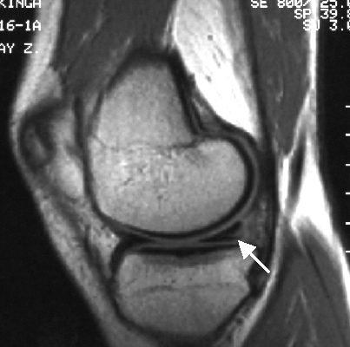
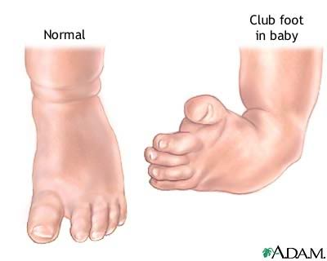
Laesio Deformitas
Any damage of an organ or tissue that leads to its damaged function
Permanent bodily malformation of the shape of and organ or part of the body
Torn meniscus

Slide 3
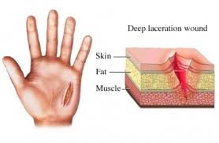
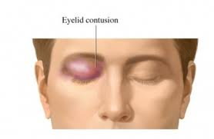
Laceratio = vulnus lacerum
Contusio = vulnus contusum
a torn ragged wound
bruise

Slide 4
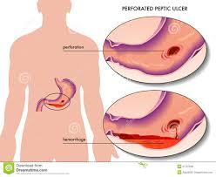
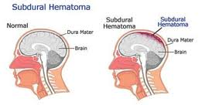
Haematoma Perforatio
Localized swelling filled with blood
Hole through the whole thickness of a tissue or membrane

Slide 5
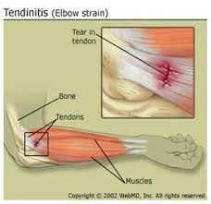
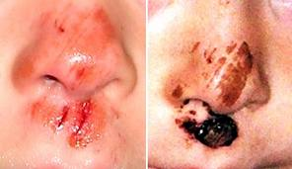
Distensio Excoriatio
Strain
scrape on top of the skin

Slide 6
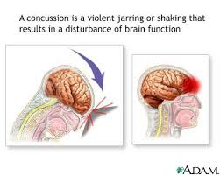
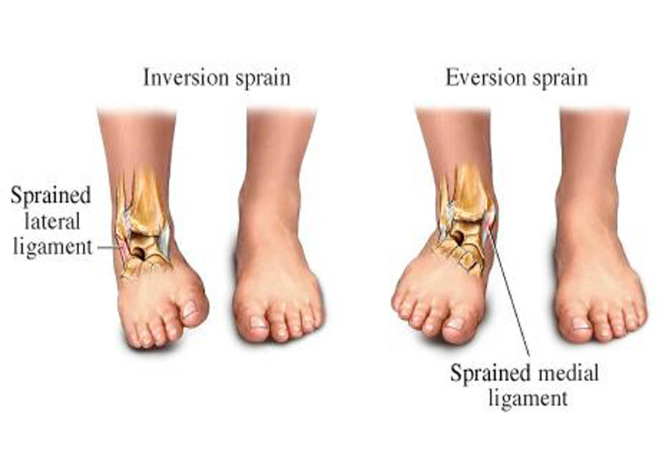
Commotio Distorsio
Concussion
a joint injury in which some of the fibers of a supporting ligament are ruptured but the continuity of the ligament remains intact

Slide 7
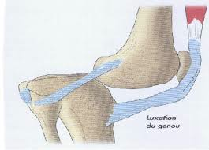
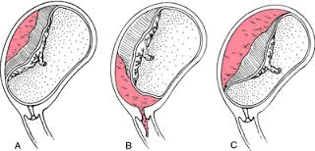
Luxatio Abruptio
Luxation, displacement of a bone from a joint
A tearing away, separation, or detachment
Placental abruption

Slide 8
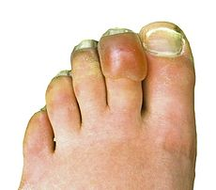
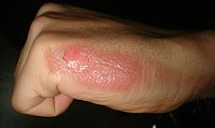
Combustio Congelatio
burn
Frostbite
2nd degree/grade burn

Slide 9
Decubitus

