Slide 1
PREFIXES + SUFFIXES

Slide 2
DERIVE ADJECTIVE USE –ARIS, E OR –ALIS, E
ACROMION
OS (mouth)
OCCIPUT
DIGITUS
MAXILLA
STERNUM
DENS
CAPUT
INTESTINUM
CELLULA
FEMUR
PATELLA
TIBIA
FIBULA
PALMA
CAPUT
SCAPULA
CLAVICULA
TRACHEA
DUODENUM
MANUS
DORSUM

Slide 3
EXPLAIN THE MEANING OF WORDS DERIVES BY PREFIXES AND SUFFIXES
digitatus
stimulus
digitatio
DIGITUS
digitalis
stimulator
STIMULARE
stimulans
digitiformis
stimulatio
deformans
formula
FORMA
deformitas
deformatio
mammarius
sterilisatio
mammalia
MAMMA
mamilla
sterilisare
STERILIS
sterilitas
mamillaris
sterilisatus

Slide 4
IDENTIFY THE SUFFIX, EXPLAIN ITS MEANING
strictura
caudatus
circulatio
aciditas
lacteus
hepaticus
foramen
lobulus
ligamentum
latitudo
adductor
obesitas
cerebellum
tuberculum
arteriola
ventralis

Slide 5
FORM FIVE TERMS BY COMBINING THE FOLLOWING PREFIXES/ROOTS/SUFFIXES:
IM-
NAT-
DYS-
-MOBIL-
-CAPIT-
-IA
-CELL-
-AL-
-ITAS
INTRA-
-ALIS
-PEPS-
-ARIS
-ITAS
-UL-
SUB-
Notes:
Dys-peps-ia
Im-mobil-itas
Intra-celull-aris
Nat-al-itas
Sub-capit-alis

Slide 6
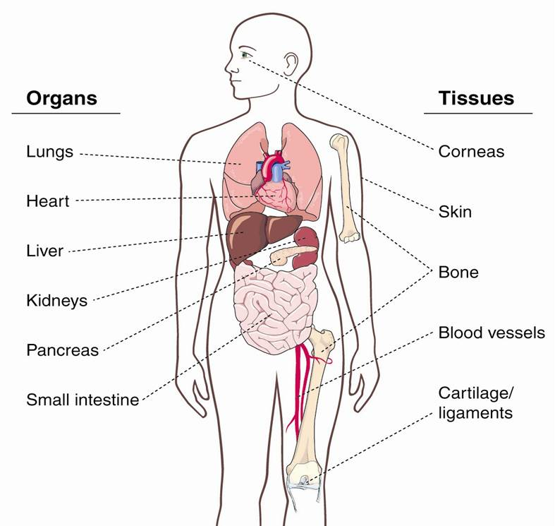
1: LABEL FOLLOWING STRUCTURES/ORGANS IN LATIN
2: DERIVE ADJECTIVES USING THE FOLLOWING ENDINGS:
a) -eus, a, um (3x) b) -aris, e (1x) c) -icus, a, um (2x) d) -alis, e (5x)
Palpebra
Ventriculus
Artery
Intestine
Tendon

Slide 7
1: LABEL FOLLOWING STRUCTURES/ORGANS IN LATIN
2: DERIVE ADJECTIVES USING THE FOLLOWING ENDINGS:
a) -eus, a, um (3x) b) -aris, e (1x) c) -icus, a, um (2x) d) -alis, e (5x)
Pulmonalis, e
Palpebra
Palpebralis, e
Ventricularis, e
Ventriculus
Cutaneus, a, um
Hepaticus, a, um
Osseus, a, um
Renalis, e
Pancreaticus, a, um
Artery
Arterialis, e
Intestinalis, e
Intestine
Tendon
Tendineus, a, um

Slide 8
TO DESIGNATE DIFFERENT MUSCLES USE PREFIXES AND SUFFIXES:
SUB-
AB-
-ILIS
-OR
-ATUS
-OIDEUS
It is a flat, quadrilateral skeletal muscle located on the posterior side of the hip joint, besides other functions it also acts to stabilize the femoral head in the acetabulum, it is called musculus ____________________
In English this muscle is called slender muscle of the thigh, what should be its name in Latin? Musculus ____________________
A long, heavy triangular muscle of the medial aspect of the thigh which acts to pull a thigh away from the body is: musculus ___________________ magnus
A large triangular muscle that covers the shoulder joint and serves to abduct, flex, extend and rotate the arm is: musculus ____________________
This muscle is of triangular shape and it is placed under the collar bone, it is: musculus ____________________
Notes:
, musculus quadratus femoris, musculu gracilis, Musculus abductor magnus, musculus deltoideus brachii, Musculus subclavius

Slide 9
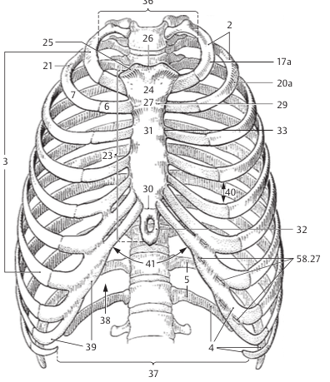
NAME ANATOMICAL STRUCTURES ON THE BASE OF DEFINITIONS AND/OR IMAGES:
The angle between the right and left costal arch which is measured under the sternum is called angulus _____________________
Small branches of aorta thoracica that supply the posterior wall of the pericardium are named rami_____________________
Rough bony area between external lip of the iliac crest (labium externum ossis ilii) and internal lip of the iliac crest (labium internum ossis ilii) is labeled as linea _____________________
The Latin name for ligaments which are lying outside a joint capsule is ligamenta_____________________
The delicate moveable layer of loose connective tissue between
the external surface of the sclera and the fascial sheath of the eyeball should be called lamina _____________________
Autonomic nerve plexus around the subclavian artery is labelled as plexus _____________________
Notes:
Angulus infrasternalis, rami pericardiaci, linea intermedia, ligamenta extracapsularia, lamina episcleralis, plexus subclavius

