Slide 1
USMLE session #5 Psychoactive drug intoxication and withdrawal SRY gene
Šimon Hajda
(395098@mail.muni.cz)

Slide 2
1. Psychoactive drug intoxication and withdrawal

Slide 3
What kind of psychoactive drugs are there?
Depressants (e.g., alcohol)
intoxication: mood elevation, anxiety, sedation
withdrawal: anxiety, tremor, seizures
Stimulants (e.g., cocaine)
intoxication: mood elevation, insomnia, tachycardia
withdrawal: depression, lethargy, weight gain
Hallucinogens (eg. LSD)

Slide 4
1. Depressants
 | intoxication | withdrawal
Alcohol¹ | slurred speech, ataxia, coma | severe: autonomic hyperactivity and delirium tremens
Opioids (e.g., morphine, heroin, methadone) | euphoria, respiratory and CNS depression, gag reflex, pinpoint pupils, seizures (overdose) Treatment: naloxone, naltrexone | dilated pupils, piloerection („cold turkey“), rhinorrhea, yawning, diarrhea Treatment: methadone, buprenorphine
Barbiturates | respiratory depression | Delirium, life-threatening cardiovascular collapse, psychotic symtpoms (e.g., the belief that someone’s going to kill him)
Benzodiazepines | Ataxia, minor respiratory depression Treatment: flumezenil | Rebound anxiety, tachycardia
¹ GGT – sensitive indicator of alcohol use. AST value is twice ALT value.

Slide 5
Delirium tremens
life threatening alcohol withdrawal sy that peaks 2-4 days after last drink (typically after surgery in hospital)
clinical findings:
autonomic hyperactivity (e.g., tachycardia, tremor, anxiety, seizures)
treatment:
benzodiazepins

Slide 6
2. Stimulants
 | intoxication | withdrawal
amphetamines | Euphoria, pupillary dilatation, prolonged wakefulness and attention | Anhedonia, appetite, hypersomnolence
cocaine | Hallucinations (including tactile – „cocaine bugs“), angina, sudden cardiac death Treatment: α-blockers, benzodiazepines | Hypersomnolence, malaise, severe psychological craving
Caffeine | Restlessness, diuresis, muscle twitching | Lack of concentration, headache
Nicotine | Restlessness | Irritability, anxiety, craving Treatment: nicotine patch, bupropion/varenicline

Slide 7
3. Hallucinogens
 | Intoxication | Withdrawal (generally few)
PCP (phencyclidine, „angel dust“) | Aggressivity, vertical and horizontal nystagmus
LSD | Perceptual distortion (visual, auditory), depersonalization, possible flashbacks
Marijuana (cannabinoid) | Euphoria, perception of slowed time, appetite, conjuctival injection, amotivational syndrome in chronic useres

Slide 8
Source
Tao Le, Vikas Bhushan: First Aid for the USMLE Step 1 2014, McGraw Hill Professional, 2014, ISBN 0071831436.

Slide 9
2. SRY gene

Slide 10
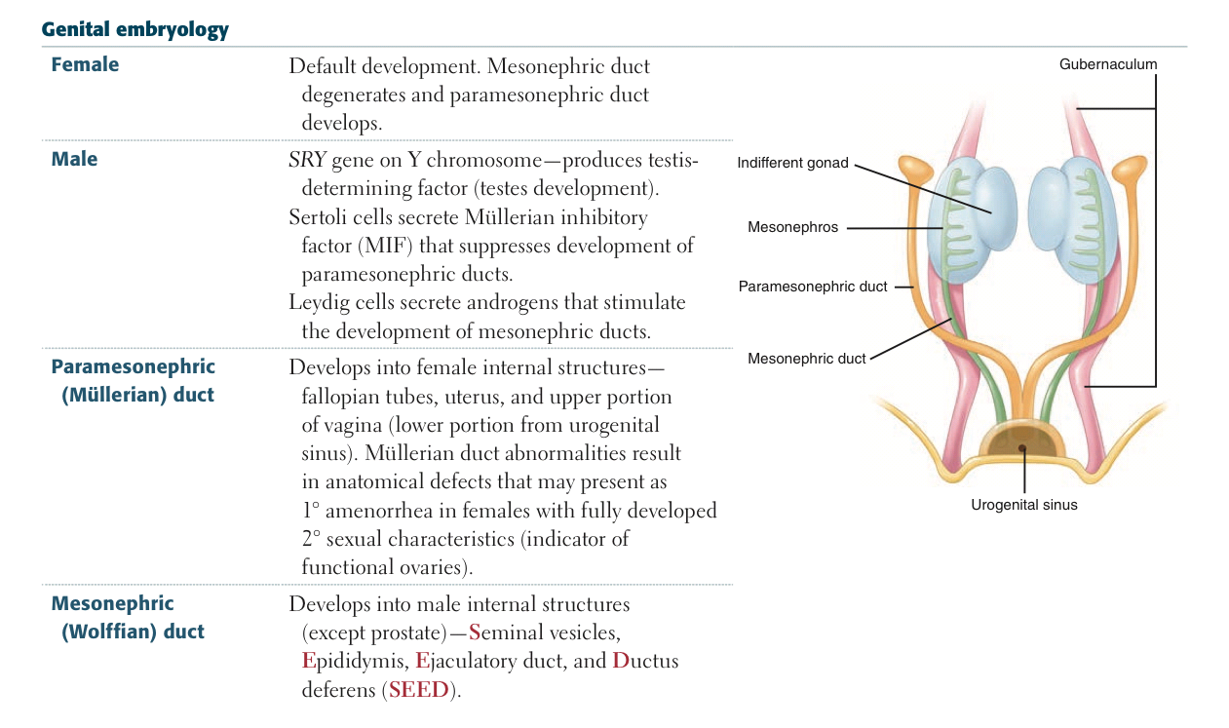
Tao Le, Vikas Bhushan: First Aid for the USMLE Step 1 2014, McGraw Hill Professional, 2014, ISBN 0071831436.

Slide 11
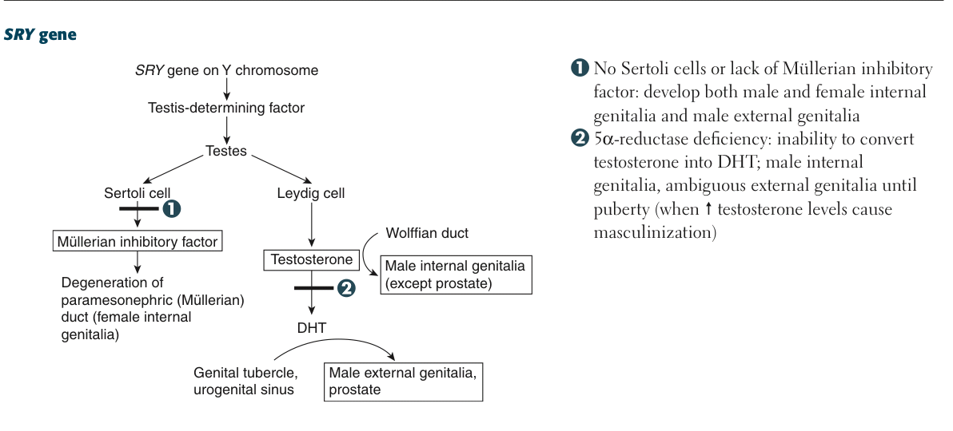
Tao Le, Vikas Bhushan: First Aid for the USMLE Step 1 2014, McGraw Hill Professional, 2014, ISBN 0071831436.

Slide 12
3. Questions

Slide 13
Q1 A 60-year-old man is brought to the hospital after a fall outside of a neighborhood bar. Radiologic studies indicate that the patient has a fractured hip and surgery is performed immediately. Two days later, the patient begins to show an intense hand tremor and tachycardia. He tells the doctor that he has been “shaky” ever since his admission and that the shakiness is getting worse. The patient states that while he feels frightened, he is comforted by the fact that the nurse is an old friend (he has never met the nurse before). He also reports that he has started to see spiders crawling on the walls and can feel them crawling on his arms. The doctor notes that the patient’s speech seems to be drifting from one subject to another. Of the following, what is the most likely cause of this picture?
(A) Alcohol use (B) Alcohol withdrawal (C) Heroin use (D) Heroin withdrawal (E) Amphetamine withdrawal
FADEM, Barbara. BRS Behavioral science. 5th Edition. Lippincott Williams & Wilkins, c2009. ISBN 978-0-7817-8257-9

Slide 14
Q1 A 60-year-old man is brought to the hospital after a fall outside of a neighborhood bar. Radiologic studies indicate that the patient has a fractured hip and surgery is performed immediately. Two days later, the patient begins to show an intense hand tremor and tachycardia. He tells the doctor that he has been “shaky” ever since his admission and that the shakiness is getting worse. The patient states that while he feels frightened, he is comforted by the fact that the nurse is an old friend (he has never met the nurse before). He also reports that he has started to see spiders crawling on the walls and can feel them crawling on his arms. The doctor notes that the patient’s speech seems to be drifting from one subject to another. Of the following, what is the most likely cause of this picture?
(A) Alcohol use (B) Alcohol withdrawal (C) Heroin use (D) Heroin withdrawal (E) Amphetamine withdrawal
FADEM, Barbara. BRS Behavioral science. 5th Edition. Lippincott Williams & Wilkins, c2009. ISBN 978-0-7817-8257-9

Slide 15
The answer is B. The most likely cause of tremor, tachycardia, illusions (e.g., believing the nurse is an old friend), and visual and tactile hallucinations (e.g., formication—the feeling of insects crawling on the skin) in this patient is alcohol withdrawal, since use of alcohol during the past few days of hospitalization is unlikely. His fractured hip may have been sustained in the fall while he was intoxicated. Heroin use and heroin and amphetamine withdrawal generally are not associated with psychotic symptoms.
FADEM, Barbara. BRS Behavioral science. 5th Edition. Lippincott Williams & Wilkins, c2009. ISBN 978-0-7817-8257-9

Slide 16
Q2 A 43-year-old man with a 5-year history of HIV tells his physician that he has been smoking marijuana a few times a day to treat his symptoms of nausea and lack of appetite. To obtain the marijuana, the patient notes that he grows it in his backyard. The doctor’s best response to this patient’s revelation is
(A) I am sorry but growing or using marijuana is illegal and I must notify the police
(B) I have read about other patients growing marijuana
(C) Are you aware that marijuana can cause respiratory problems?
(D) There are a number of medications that I can prescribe to help alleviate your nausea and lack of appetite in place of marijuana
(E) Do you think that using marijuana has negative long-term effects?
FADEM, Barbara. BRS Behavioral science. 5th Edition. Lippincott Williams & Wilkins, c2009. ISBN 978-0-7817-8257-9

Slide 17
The answer is D. The best response to this patient’s revelation about growing and using marijuana is to recommend effective but safer substitutes, e.g., prescription medications to treat his nausea and lack of appetite. It is neither appropriate nor necessary for a physician to report the patient’s actions to the police. Also, this HIV-positive patient is likely to be more concerned about feeling ill in the short term than long-term consequences of marijuana use such as respiratory problems.
FADEM, Barbara. BRS Behavioral science. 5th Edition. Lippincott Williams & Wilkins, c2009. ISBN 978-0-7817-8257-9

Slide 18
Q3 A 35-year-old man is brought to the emergency department confused and anxious. The man reports that someone is trying to kill him but he does not know who the person is. Initial physical examination reveals elevated heart and respiration rates. While in the emergency room the patient has a seizure and then develops life-threatening cardiovascular symptoms. The drug that this patient is most likely to be withdrawing from is
(A) phencyclidine (PCP) (B) lysergic acid diethylamide (LSD)
(C) heroin (D) secobarbital (E) marijuana
FADEM, Barbara. BRS Behavioral science. 5th Edition. Lippincott Williams & Wilkins, c2009. ISBN 978-0-7817-8257-9

Slide 19
The answer is D. This 35-year-old patient is most likely to be withdrawing from secobarbital, a barbiturate. Barbiturate withdrawal symptoms appear about 12–20 hours after the last dose and include anxiety, elevated heart and respiration rates, psychotic symptoms (e.g., the belief that someone is trying to kill him), confusion, and seizures, and can be associated with life-threatening cardiovascular symptoms. There are few physical withdrawal symptoms associated with marijuana, phencyclidine (PCP), or lysergic acid diethylamide (LSD), and those associated with heroin are uncomfortable but rarely physically dangerous.
FADEM, Barbara. BRS Behavioral science. 5th Edition. Lippincott Williams & Wilkins, c2009. ISBN 978-0-7817-8257-9

Slide 20
Q4 A 56-year-old woman presents to her physician because of recent onset of chest pain and dyspnea. Six weeks earlier the patient suffered an MI. Her physical examination is remarkable for a friction rub over the fifth intercostal space in the midclavicular line together with an elevated jugular venous pressure. Which of the following myocardial complications is this individual most likely suffering from?
Cardiac arrhythmia
(B) Dressler’s syndrome
(C) Left ventricular failure
(D) Thromboembolism
(E) Ventricular rupture
LE, Tao, Karen A ADLER a Seth K BECHIS (eds.). First aid Q&A for the USMLE Step 1. 2nd ed. New York: McGraw-Hill Medical, c2009. ISBN 978-0-07-159794-4

Slide 21
The correct answer is B. Dressler’s syndrome is an autoimmune phenomenon that results in fibrinous pericarditis. This delayed pericarditis typically develops 2–10 weeks post-MI and presents clinically as chest pain and a pericardial friction rub. It is generally treated with nonsteroidal antiinflammatory agentes or corticosteroids.
Answer A is incorrect. Cardiac arrhythmia is a common cause of post-MI death and typically occurs 2 days post-MI. It does not typically present with a friction rub.
Answer C is incorrect. Left ventricular failure occurs in 60% of people who suffer from MI and can present as CHF or cardiogenic shock.
Answer D is incorrect. Thromboemboli are typically systemic emboli that originate from mural thrombi and can lead to cerebrovascular accidents, transient ischemic attacks, and renal artery thrombosis.
Answer E is incorrect. Ventricular rupture is a cause of post-MI death that typically occurs 4–10 days post-MI. It often presents with persistent chest pain, syncope, and distended jugular veins.
LE, Tao, Karen A ADLER a Seth K BECHIS (eds.). First aid Q&A for the USMLE Step 1. 2nd ed. New York: McGraw-Hill Medical, c2009. ISBN 978-0-07-159794-4

Slide 22
MI complications
cardiac arrythmia (most commonly ventricular fibrillation), important cause of death, common in first few days
LV failure and pulmonary edema
cardiogenic shock
ventricular free wall rupture -> cardiac tamponade; papillary muscle rupture -> severe mitral regurgitation; interventricular septum rupture -> VSD
greatest risk 6-14 days postinfarct
ventricular pseudoaneurysm formation -> CO, risk of arrhythmia, embolus from mural thrombus
greatest risk approximately 1 week post-MI
postinfarction fibrinous pericarditis - friction rub (1-3 days post MI)
Dressler syndrome

Slide 23
Q5 A newborn girl is diagnosed as dysmorphic by a pediatrician in the newborn nursery. On physical examination the girl has a broad neck, wide-spaced nipples, and a systolic ejection murmur. An echocardiogram is performed and demonstrates coarctation of the aorta. The echocardiography technologist also runs his transducer across the patient’s abdomen and notices a renal abnormality associated with this patient’s syndrome. The most likely observed renal abnormality increases this patient’s risk for developing which disease?
Neuroblastoma
Ovarian cancer
Transitional cell carcinoma
Uterine cancer
Wilms’ tumor
LE, Tao, Karen A ADLER a Seth K BECHIS (eds.). First aid Q&A for the USMLE Step 1. 2nd ed. New York: McGraw-Hill Medical, c2009. ISBN 978-0-07-159794-4

Slide 24
The correct answer is E. This patient has classic findings associated with Turner’s syndrome, a genetic disorder resulting from a 45,XO complement of chromosomes. Approximately 25%–30% of patients will have associated renal anomalies, including horseshoe kidney, pelvic kidney, or duplicated collecting systems. Patients with horseshoe kidneys are approximately four times more likely to develop Wilms’ tumor when compared to the general population.
Answer A is incorrect. Although it has been suggested that patients with Turner’s syndrome are at increased risk of developing malignancy, they do not have a specific increased risk of developing neuroblastoma.
Answer B is incorrect. Although it has been suggested that patients with Turner’s syndrome are at increased risk of developing malignancy, they do not have a specific increased risk of developing ovarian cancer. Familial BRCA gene mutations or no history of childbirth each increases the risk of ovarian cancer.
Answer C is incorrect. Although it has been suggested that patients with Turner’s syndrome are at increased risk of developing malignancy, they do not have a specific increased risk of developing transitional cell carcinoma. Smoking greatly increases the risk of transitional cell carcinoma.
Answer D is incorrect. Although it has been suggested that patients with Turner’s syndrome are at increased risk of developing malignancy, they do not have a specific increased risk of developing uterine cancer. Unopposed estrogen secretion (eg., hormone replacement therapy without progesterone) increases the risk of uterine cancer.
LE, Tao, Karen A ADLER a Seth K BECHIS (eds.). First aid Q&A for the USMLE Step 1. 2nd ed. New York: McGraw-Hill Medical, c2009. ISBN 978-0-07-159794-4

