Slide 1
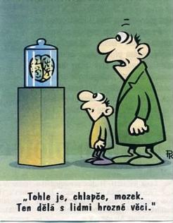

Slide 2
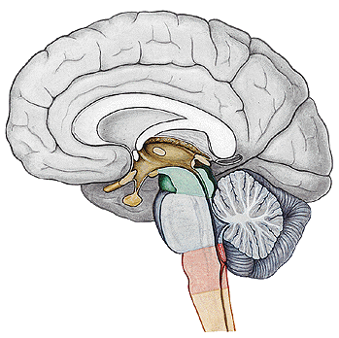
MOZKOVÝ KMEN
Mesencephalon
Pons
Medulla oblongata
Medulla spinalis

Slide 3
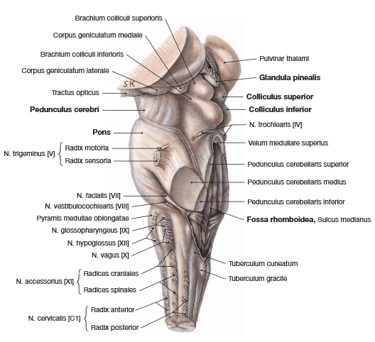

Slide 4
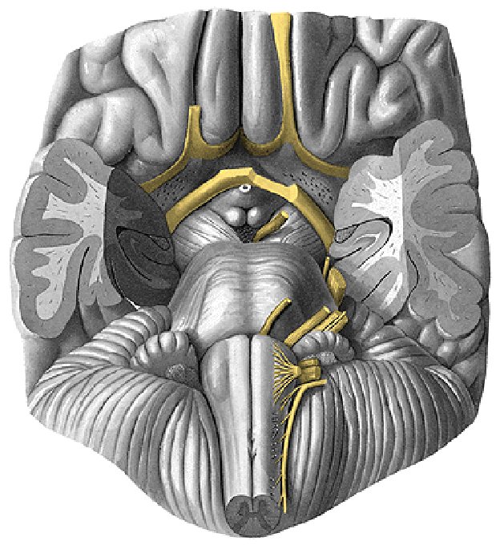
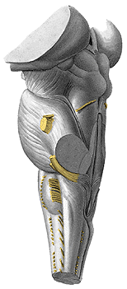
MOZKOVÝ KMEN – Odstupy hlavových nervů

Slide 5
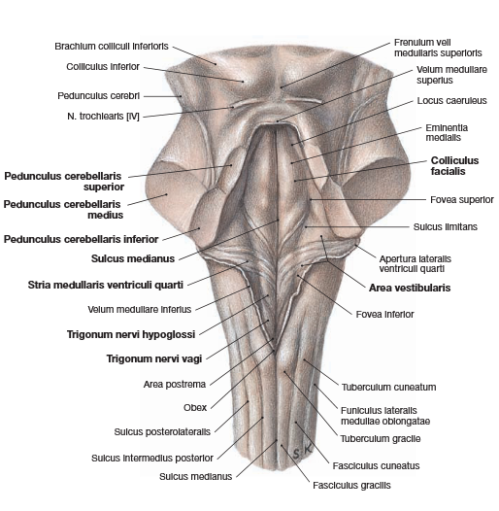
Ncl. coliculi inferioris
Ncl. m. n. VI.
Ncll. vestibulares
Ncl. cuneatus
Ncl. gracilis

Slide 6
Cortex
Thalamus
Tr. cortico-spinalis
Tr. cortico-nuclearis
Tr. spino-thalamicus
Ncl. m. n. III.
Ncl. m. n. IV.
Ncl. m. n. VI.
Ncl. m. n. V.
Ncl. gracilis
Tr. spino-bulbaris
Medulla spinalis
Ganglion spinale

Slide 7
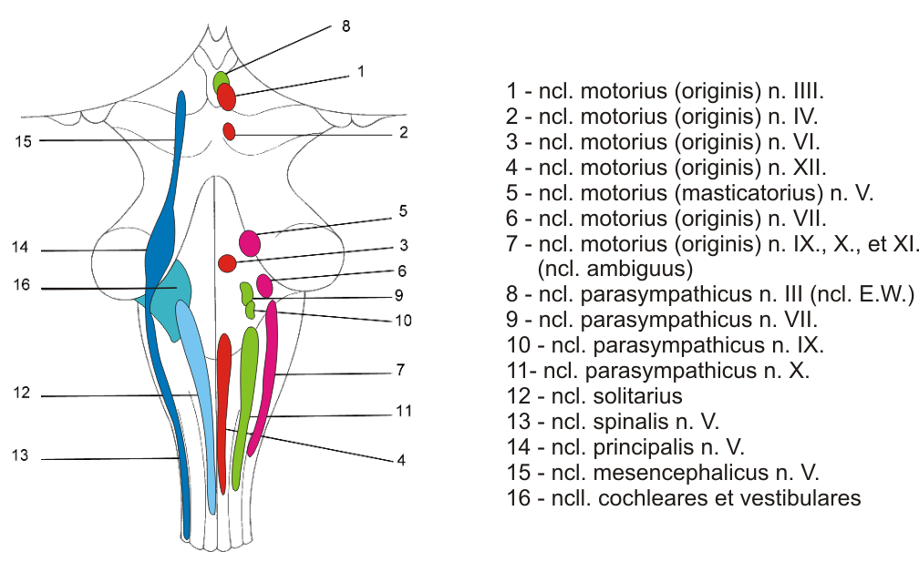
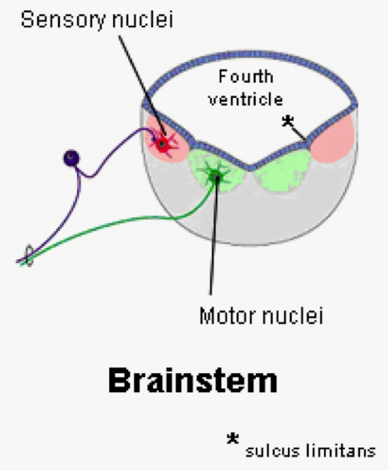

Slide 8
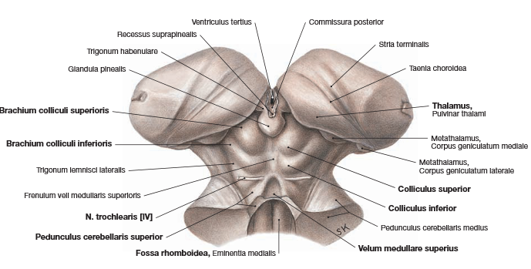
Ncl. colliculi superioris
Ncl. colliculi inferioris

Slide 9
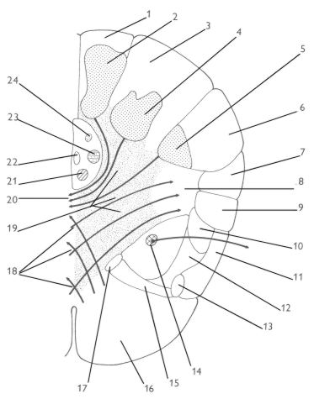
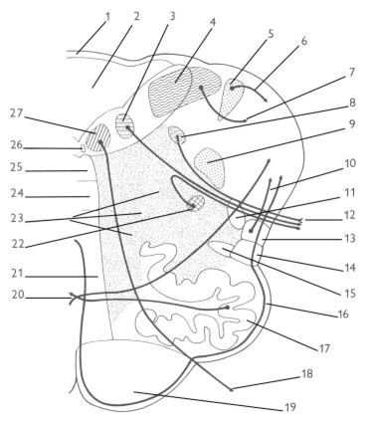
Medulla oblongata – representativní řezy
R
C

Slide 10
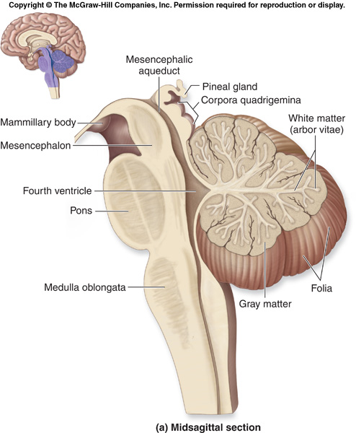
SS
VS
ncl. et tr. solitarius
VM
ncl. parasymp. n. X
SM
BM
tr. spino-c.post.
ncl. originis n. XII
tr.cortico-
spinalis lat.
tr. spino-c.ant.
FR
tr.rubro-
spinalis
tr.spino-th.
tr.ret.-spinalis
tr.vest.-spinalis
ncl. originis n. XI
FLM
tr.tecto-spinalis

Slide 11
ncl.p.n.X
ncll.vest.
ncl.cun.lat.
S
SS
tr.cuneo-cer.
VS
VM
ncl. originis n. XII
ncl.+tr.sol.
SM
BM
fld
FLM
tr.tecto-spinalis
tr.rubro-
spinalis
ncl.o. n. X et XI
LM
tr.vest.-spinalis

Slide 12
MOZKOVÝ KMEN - Pons

Slide 13
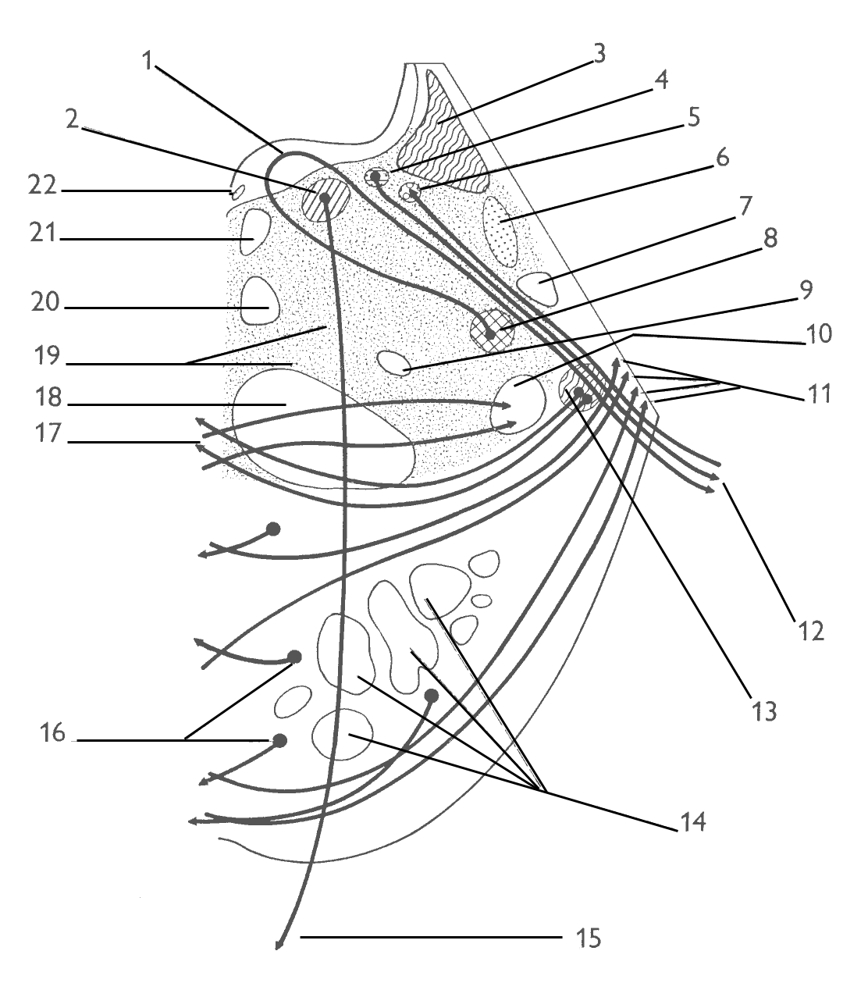
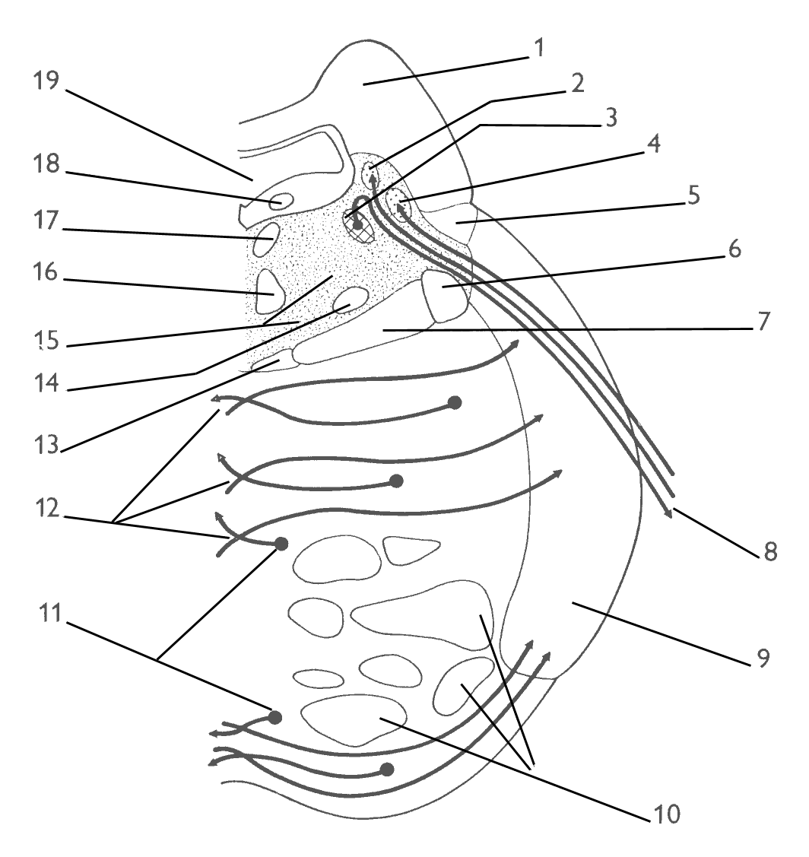
Pons – representativní řezy
R
C

Slide 14
S
ncl. p. n. VII
SS
ncl. o. n. VI
ncl. solitarius
V
fld
ncl.+tr.spinalis n.V.
VS
FLM
tr. spino-cereb. ant.
VM
ncl. o. n. VII
SM
tr. tecto-spinalis
tr. rubro-spinalis
BM
ttc
FR
C
LL
LM
tr. ponto-cerebellaris
n. VII.
Ncll. pontis
tr. cortico-spinalis
n. VI.

Slide 15
pedunculus sup.
ncl.tr.mes.n.V.
SS
ncl. motor. n.V.
fld
ncl. principalis n.V.
tr. spino-cereb. ant.
FLM
tr. tecto-spinalis
ttc
BM
LL
LM
FR
tr. rubro-spinalis
tr.cortico-bulbaris
Ncll. pontis
pedunculus med.
tr. cortico-spinalis
Notes:
The central tegmental tract is a structure in the midbrain and pons.
The central tegmental tract includes ascending axonal fibers that arise from the rostral nucleus solitarius and terminate in the ventral posteromedial nucleus (VPM) of thalamus. Information from the thalamus will go to cortical taste area, namely the insula and frontal operculum.
It also contains descending axonal fibers from the parvocellular red nucleus. The descending axons will project to the inferior olivary nucleus. This latter pathway (the rubro-olivary tract) will be used to connect the contralateral cerebellum.
Lesion of the tract can cause palatal myoclonus, e.g. in myoclonic syndrome, itself a symptom of medial superior pontine syndrome: a form of stroke affecting the paramedian branches of the upper basilar artery.
Palatal myoclonus

Slide 17
MOZKOVÝ KMEN – Mesencephalon

Slide 18
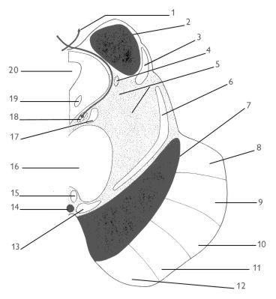
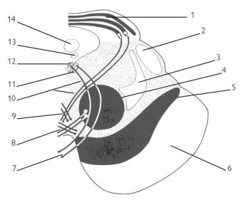
Mesencephalon – representativní řezy
R
C

Slide 19
n.IV.
S
ncl. colliculi inf.
SS
LL
ncl. mes. n.V.
aqued. cerebri
FR
PAG
LM
SM
fld
ncl. orig. n. IV.
FLM
tr. o.,p.,t.pontinus
decussatio ped. cereb.sup.
tr.tecto-spinalis
substantia nigra
tr.c.-nucl.
ncl. interpeduncularis
tr. rubro-spinalis
tr.c.-spin.
tr.c.-nucl.
tr. f.pontinus

Slide 20
S
aqued. cerebri
ncl. colliculi sup.
LM
LL
PAG
fld
VM
ncl. E.W.
LM
SM
BM
ncl. orig. n. III.
FR
tr.tecto-spinalis
tr. rubro-spinalis
n. III.

