Slide 1
Practical training
in Histology
Physiotherapy (bc.)

Slide 2
Organization issues
Beginning - strictly
Change your shoes - you cannot enter the hall with outdoor shoes (slippers)
Locker room – shoes, jackets, coats, bags etc. (use padlock)
Cell phone – switched off or in silent mode
Microscopic hall = laboratory
– eating, drinking, smoking not allowed
– students have to follow the instructions
– academic misconducts or inappropriate behavior result in excluding
from the lesson or course
Follow safety rules
You have dedicated working place
You are responsible for microscope, slide set, EM atlas

Slide 3
Practical lesson
Introduction, presentation (demonstrated topic)
Your individual work = study of the slides, schematic but precise drawing of tissue structure, careful description. The result of your work is PROTOCOL in each practice.
Students come prepared for practices - programmes on pin-boards or dpt. webpage
Attendance
100% attendance
Substitution only in exceptional cases, after permissions from both the teacher of your group and the lesson where you plan to substitute
Make a protocol during substitution, let it check and sign by the chief teacher

Slide 4
Registration of substitution:
Datum Jméno Ročník Skupina Č. praktika Č. místa Vyučující - podpis
Date Name Year Group Nr. of practice Nr. of place Teacher- signature
Each absence must be excused via study department and in IS (medical report from doctor,
Official invitation, etc. Is necessary).

Slide 5
Protocols
you have to make paper protocols (no tablets, laptops)
A4 size, blank, without lines, according to the template
pencil handdrawings (no pen)
complete set of your protocols is required for getting the credits
the quality of the protocol is approved by your teacher’s signature at the end of practical lesson
Low-quality protocols cannot be approved and you have to substitute the respective practical lesson
Testing your knowledge
Credit test in the last practice of semester (20 questions – max. 20 points, result 12 – 20 points = P (passed), 0 – 11 N (not passed), one resit is possible.
Exam in exam period: 2 questions from histology topics of lectures and practices (marks A – F).
3 terms: 1 regular and 2 resits.

Slide 6
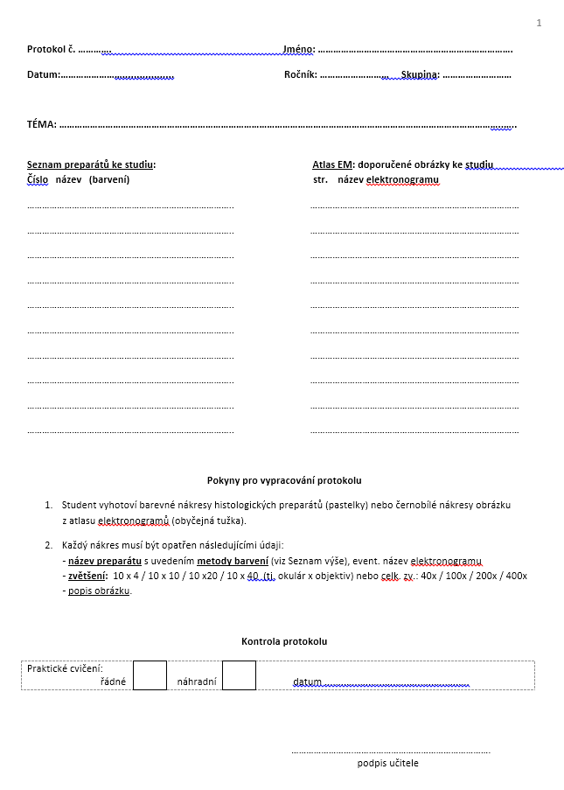
The english form of protocol:
on www of department

Slide 7
Credits
- 100% attendance
- complete set of signed protocols from all lessons
- Passed credit test (written in practice before the last)
End of practice:
- The practice is closed by teacher

Slide 8
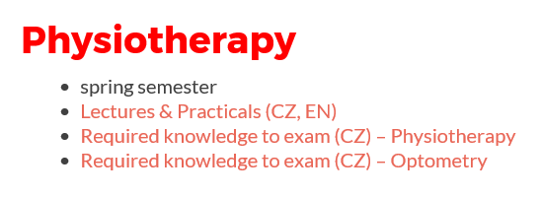
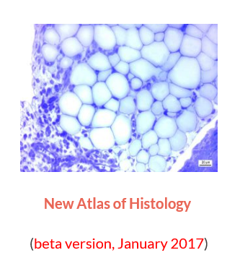
http://www.med.muni.cz/histology
✓
✓
✓
protocol

Slide 9
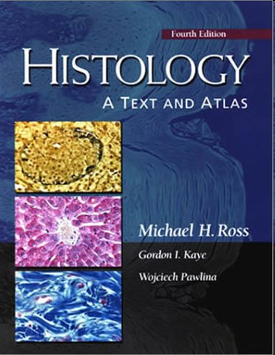
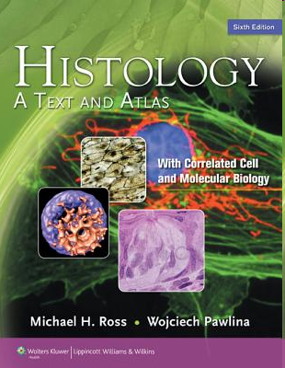
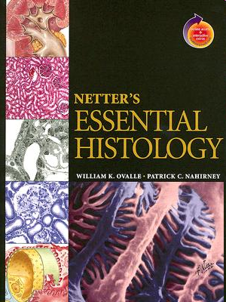
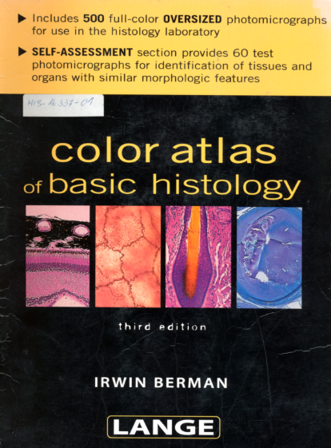
Recommended literature
+ Lectures
Protocols

Slide 10
HISTOLOGY
structure and ultrastructure of normal cells and tissues,
cytology and general histology
special histology = microscopic anatomy of individual organs
relevance: oncology, surgery, hematology, pathology, forensic,…

Slide 11
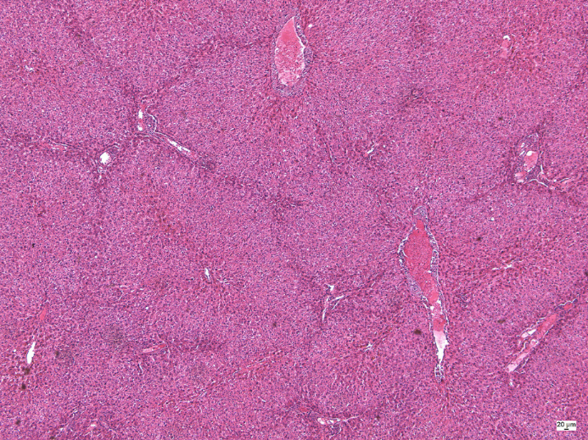
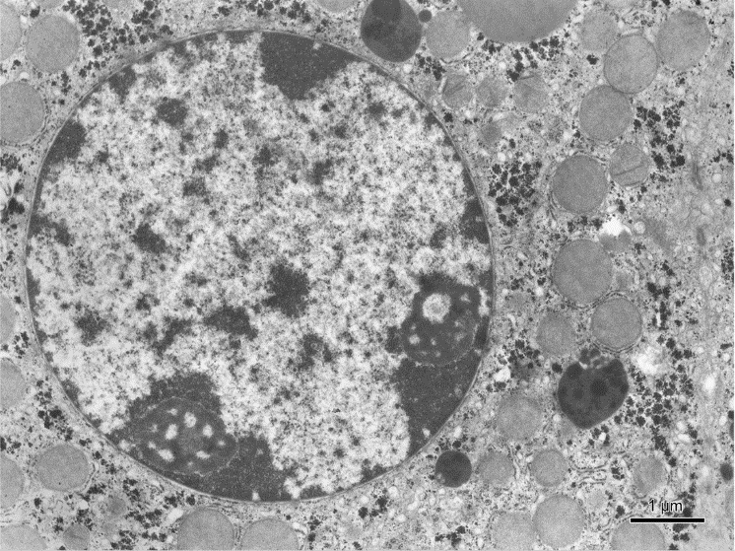
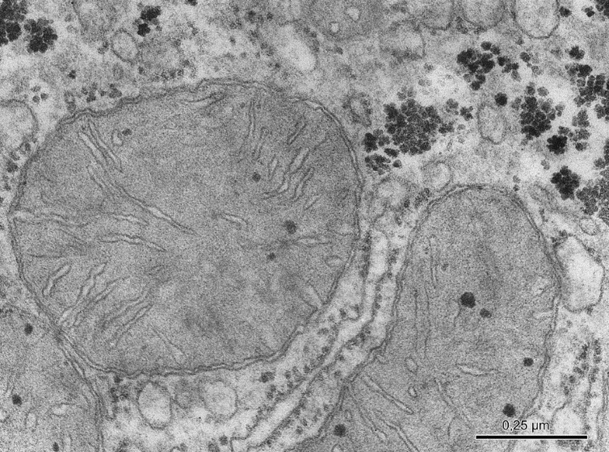
Histology
Resolution of naked eye – 0,1 mm
Resolution of light microscopy – 10 nm
Resolution of electron microscopy – 0,1 nm

Slide 12
Tissue processing for the light microscopy (LM) (making of permanent preparations – slides)
SAMPLING (obtaining of material – cells, tissue pieces)
FIXATION of samples (tissue blocks)
RINSING (washing) of samples
EMBEDDING of samples - embedded blocks
CUTTING of blocks - sections
AFFIXING of sections
STAINING of sections
MOUNTING of sections

Slide 13
SAMPLING
A small piece of organ (tissue) is sampled and quickly put into the fixative medium.
Biopsy during surgical dissection of organs in living organism
= excision
= puncture (liver or kidney parenchyma, bone marrow)
= curettage (uterine endometrium, adenoid vegetation)
Necropsy from dead individual (sections); in experiments laboratory animals are used and tissue have to be sampled as soon as possible after the break of blood circulation
The specimens shouldn't be more than 5 – 10 mm³ thick and fixation should follow immediately.

Slide 14
FIXATION
Definition: denaturation and stabilization of cell proteins with minimum artifacts)
The reason of fixation: freshly removed tissues are chemically unstable – dry, shrink, undergo hypoxia, autolysis and bacteriological changes
To stop or prevent these changes and preserve the structure tissue samples have to be fixed. During the fixation, all tissue proteins are converted into inactive denaturized (stable) form.
3 main requirements on fixatives:
- good preservation of structure
- quick penetration into tissue block
- no negative effects on tissue staining

Slide 15
Fixatives: solutions of different chemicals
- organic fixatives – ALDEHYDES – formaldehyde (most frequently used for LM)
– glutaraldehyde (used for EM)
– ALCOHOLS – 96 – 100 % (absolute) ethylalcohol
– ORGANIC ACIDS – glacial acetic acid, picric acid,
trichloracetic acid
- inorganic fixatives – INORGANIC ACIDS – chromic acid, osmium tetraoxide (OsO4)
– SALTS OF HEAVY METALS – mercuric chloride HgC_{l2}
- compound fixatives – mixtures (two or more chemical components to offset
undesirable effects fo indiviual (simple) fixatives.
FLEMMING´s fluid – with OsO₄
ZENKER´s and HELLY´s fluid, SUSA fluid – with HgCl₂
BOUIN´s fluid – with picric acid
CARNOY´s fluid – with alcohol
Performance: fixatives are carried out at room temperature, the duration varies
between 12 – 24 hours, specimen must be covered by 20 – 50 times fixative volume:
Ratio of tissue block volume to fixative volume 1 cm³ : 20 – 50 cm3

Slide 16
RINSING and EMBEDDING
All samples should be washed to remove the excess of fixative; the choice of rinsing medium is determined by type of fixative: running tap-water or 70-80% ethanol
Relevance of embedding: tissues and organs are brittle and unequal in density, they must be hardened before cutting

Slide 17
Embedding media
water soluble – gelatine, celodal, water soluble waxes
anhydrous – paraffin, celoidin

Slide 18
EMBEDDING into PARAFFIN
dehydration – to remove water from fixed samples by ascending series of ethanol is used (50%, 70%, 90%, 96%. each step - 2 – 6 hours
clearing – the ethanol must be replaced with organic solvatant that dissolves paraffin – benzene or xylene
infiltration – melted paraffin wax (56°C) is used; 3 x 6 hours.
casting (blocking out) – moulds (plastic, paper or metal chambers) are used for embedding.
The moulds are filled with melted paraffin, tissue samples are then placed inside and immediately immersed in cold water to cool paraffin quickly down.
These paraffin blocks are ready for trimming

Slide 19
Leica TP 1020
Automated device for tissue dehydration

Slide 20
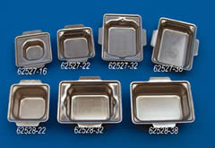
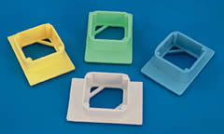
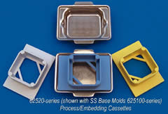
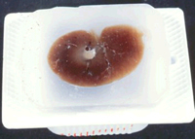
Paper chambers
- metal

Slide 21
CUTTING
Microtome – a machine with automatic regulation of section thickness: 5 – 10 μm is optimum.
sliding microtome – block is fixed in holder, knife or razor moves horizontally
rotary microtome – knife is fixed,
block holder moves vertically

Slide 22
Sliding microtome
Rotary microtome

Slide 23
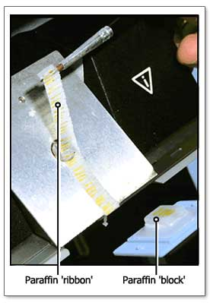
Freezing microtome (cryostat)
= rotary microtome housed in freezing box
(– 60º C)
Cutting of frozen tissue without the embedding

Slide 24
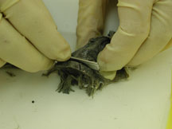
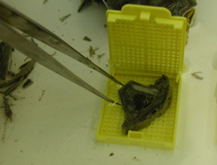
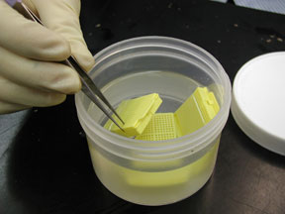
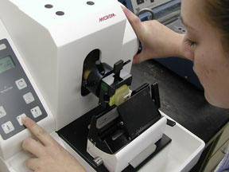
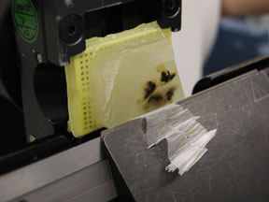
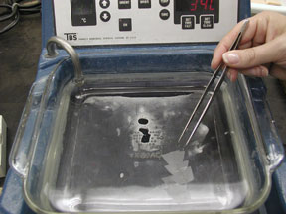
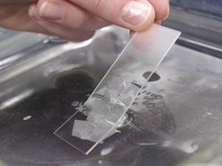
sampling
1
2
3
fixation
fixation
cutting
4
cutting
5
section affixing
6
section affixing
7

Slide 25
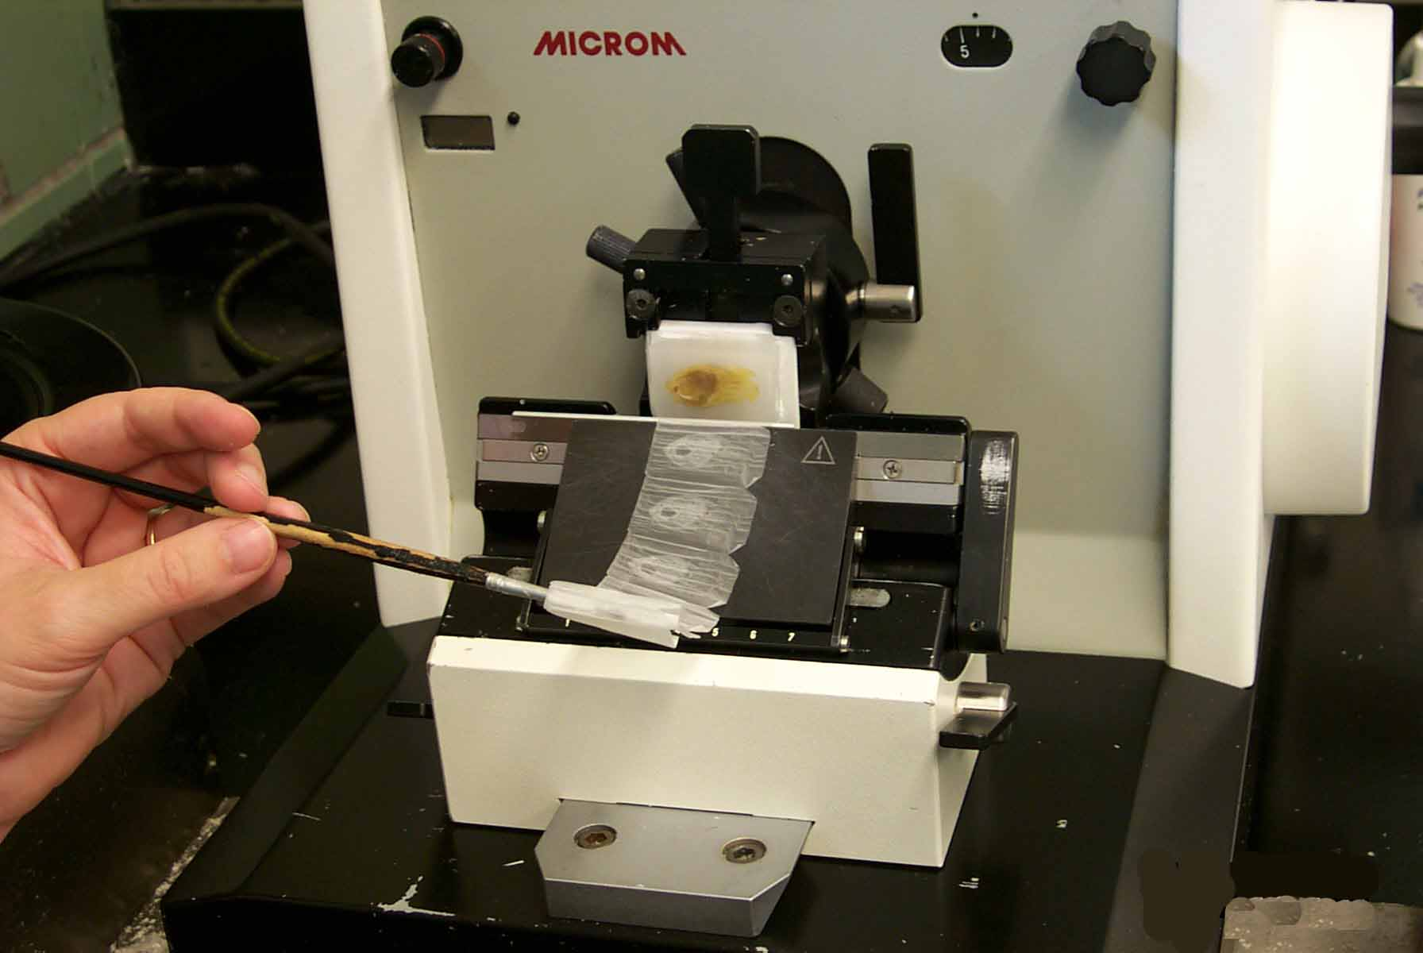

Slide 26
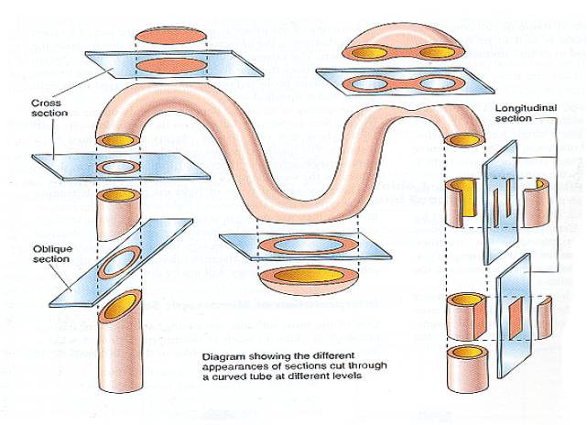
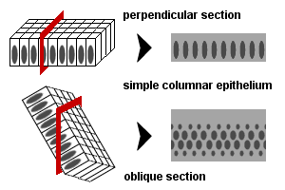

Slide 27
AFFIXING
Mixture of glycerin and egg albumin or gelatin
Section are transferred from microtome razor or knife on the level of warm water (45º C), where they are stretched; then they are put on slides coated with adhesive mixture; excess of water is drained and slides are put in incubator (thermostat, 37º C) over night to affixing of sections.

Slide 28
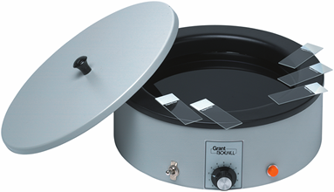
Stretching of sections on warm water
Stretching on a warm plate

Slide 29
STAINING
Different cell or tissue structures are not apparent without staining.
Cellular structures exhibit different affinity to staining dyes
alkaline dyes (basic or nuclear) – react with anionic groups of cell and tissue components
basophilia – basophilic structures in the cell
acid dyes (cytoplasmic) – react with cationic groups
acidophilia – acidophilic structures in the cell
neutrophilia – no reaction

Slide 30
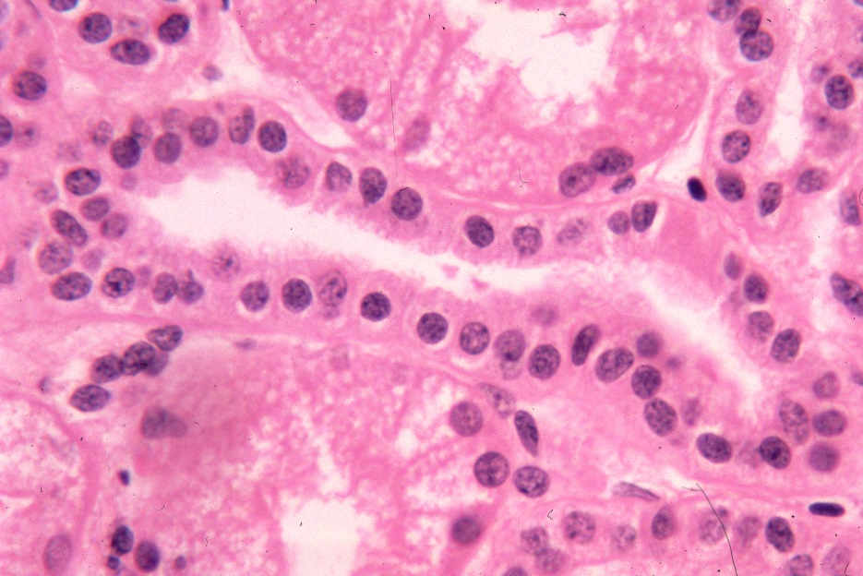
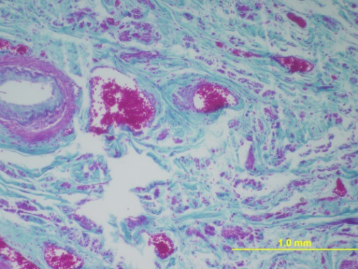
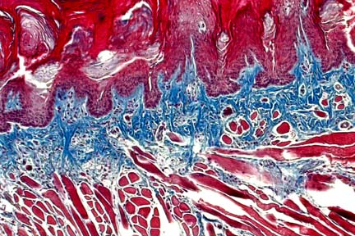
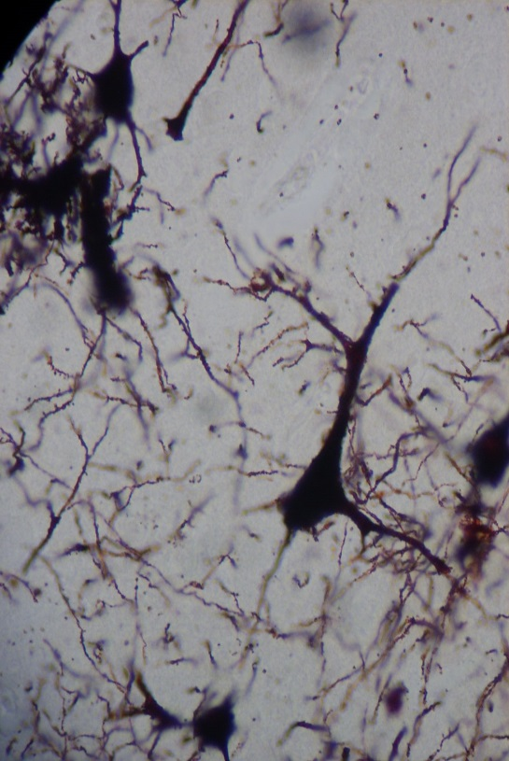
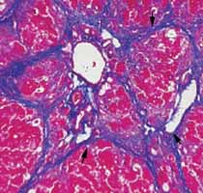
HE – the most frequent used method
Staining methods: routine – HE, AZAN
(demonstrate all components of tissue)
special
visualizes only special structures
impregnation
by silver salt for detection
of nerve or reticular fibers
Lipid droplets
detected by oil red

Slide 31
ROUTINE STAINING with HEMATOXYLINE – EOSIN (HE)
Hematoxyline – basic (nuclear) dye
Eosin – acid (cytoplasmic dye
Staining procedure:
paraffin must be removed (dissolved) by xylene
sections are rehydrated in descending series of ethanol (100% 96% 80%)
staining with hematoxyline
differentiation in acid ethanol and water (excess of dye is removed)
staining with eosin
rinsing in water (excess of dye is removed)
dehydration in graded ethanol series (80% 96% 100%)
clearing in xylene

Slide 32
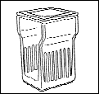
HEMATOXYLINE – EOSIN (HE)
Deparaffination Rehydration Washing Staining Differentiation
Xylen I Xylen II 100% 96% H₂O hematoxyline acidic
ethanol ethanol ethanol
Clearing Dehydration Washing Staining Washing
Xylen IV xylen III 100% 96% H₂O eosin H₂O
ethanol ethanol

Slide 33
Staining results:
HE = Hematoxyline – Eosin
nuclei – bright clear blue or dark violet
cytoplasm and collagen fibers – pink
muscle tissue – red
HES = Hematoxyline – Eosin – Safron
connective tissue – yellow
AZAN = AZocarmin – ANiline blue – orange G
nuclei – red
erythrocytes – orange
muscle – red
collagen fibers – blue

Slide 34
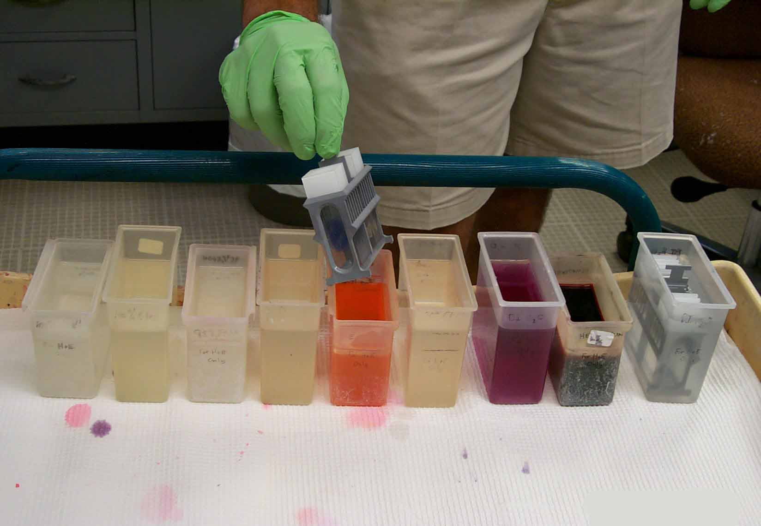
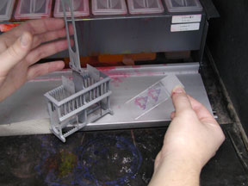
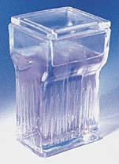
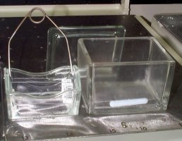
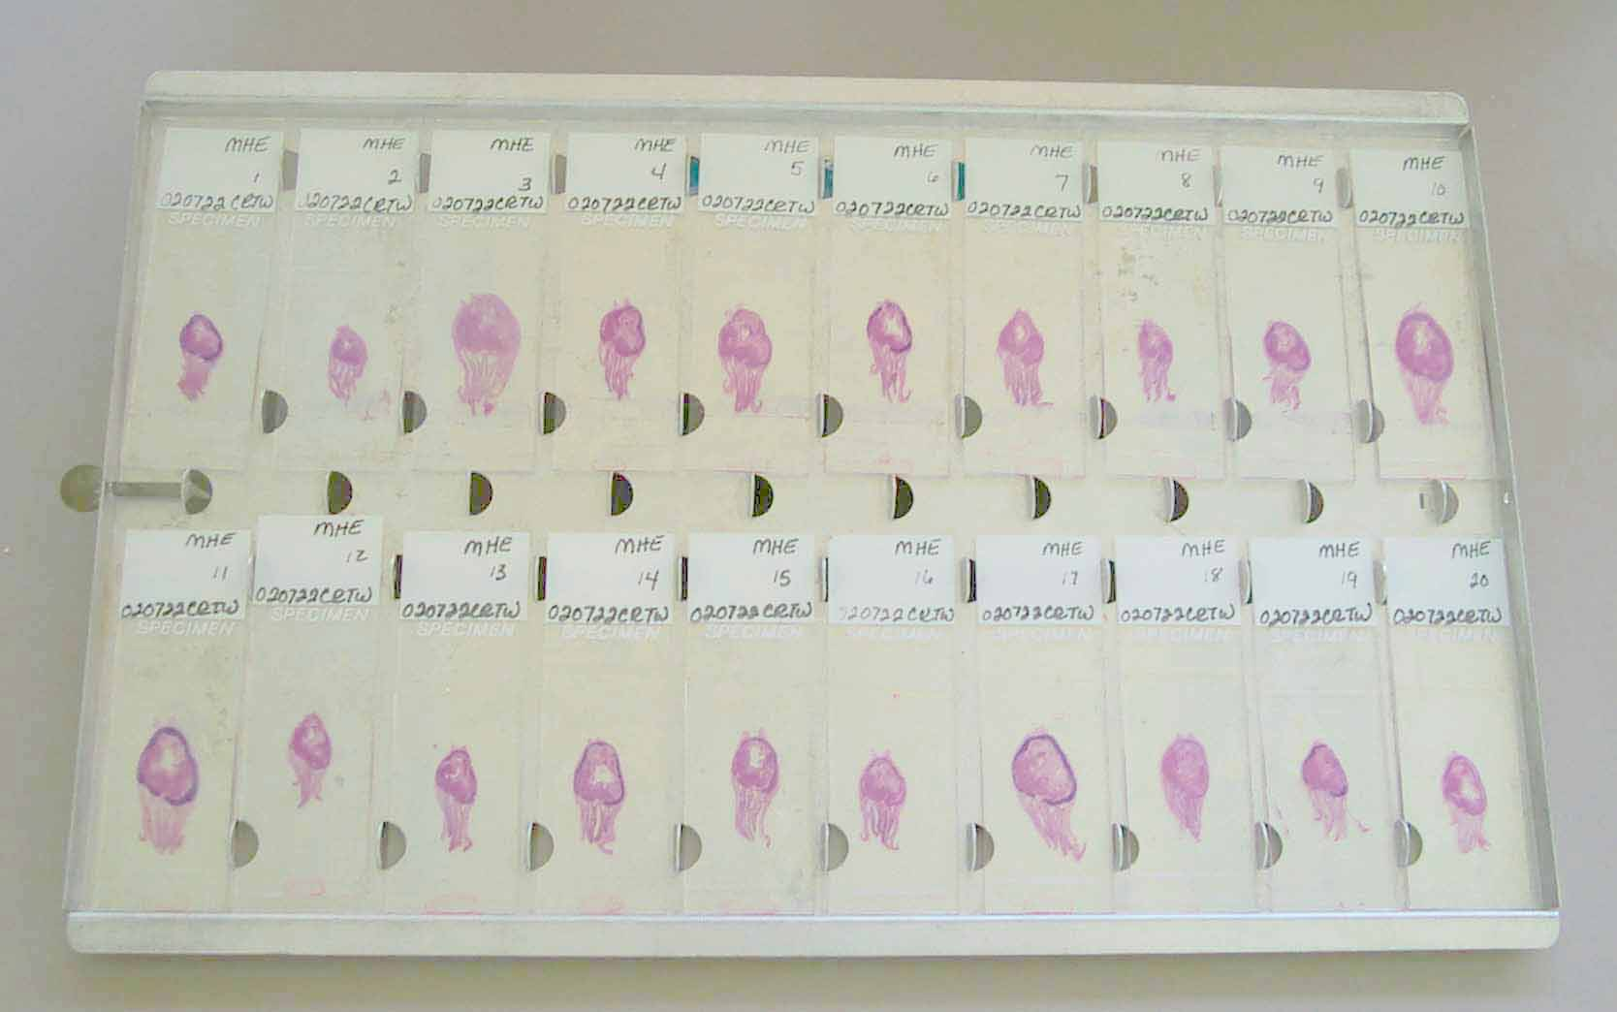
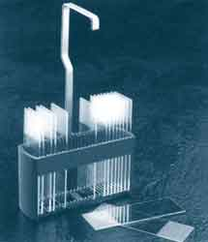
Staining tools:
cuvette
flask
slides holder
(basket)

Slide 35
Automatic slide stainer
staining set of boxes with media

Slide 36
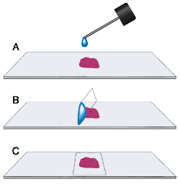
MOUNTING
Finally, preparates are closed with coverslip (coverglass) to form a permanent preparate. Small amount of mounting medium must be placed between stained section and the coverslip.
Mounting media: soluble in xylene – canada balsam soluble in water – glycerin-gelatine, arabic gum

Slide 37
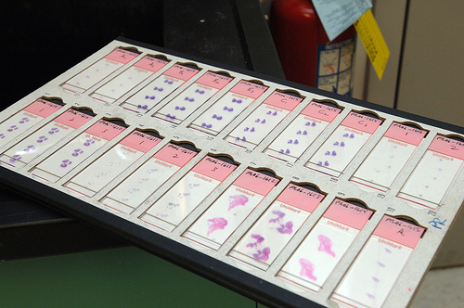
Permanent histological slides for study in the light microscope

Slide 38
Hematoxyline and eosin (HE)

Slide 39
Hematoxyline and eosin (HE)
cell cytoplasm
cell nuclei
collagenous
connective tissue

Slide 40
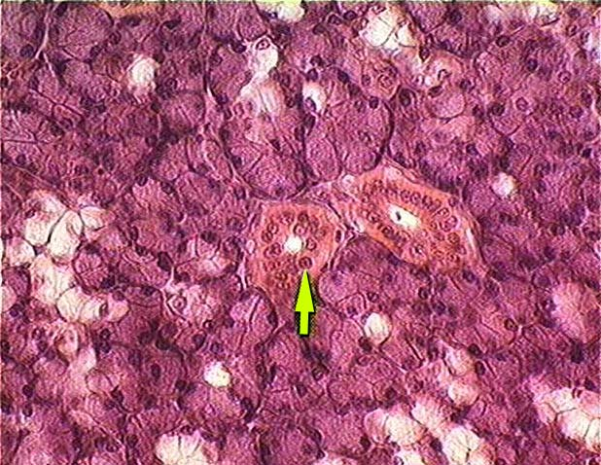
Hematoxyline and eosin (HE)
basophilic cytoplasm
of glandular cells
(contains ribosomes
with RNA)
acidophilic cytoplasm
of epithelial cells

Slide 41
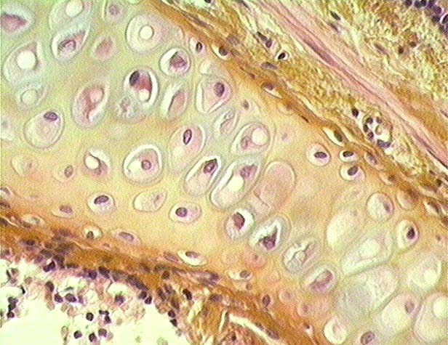
Hematoxyline, eosin and saffron (HES)
Collagenous fibers
of connective tissue
are yellow after staining
with saffron
cartillage

Slide 42
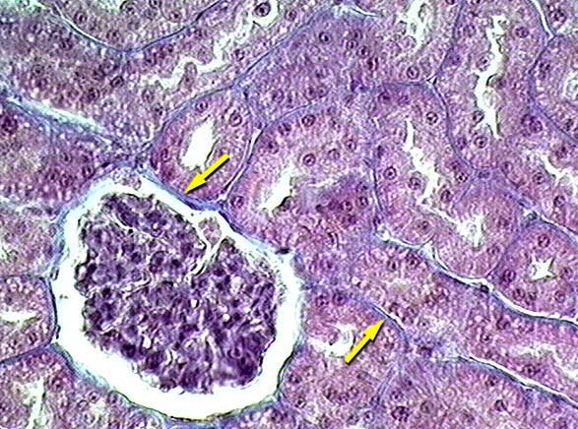
Azocarmine and aniline blue (AZAN)
Kidney – collagen connective tissue

Slide 43
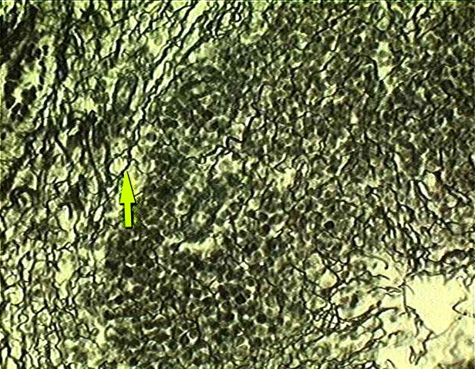
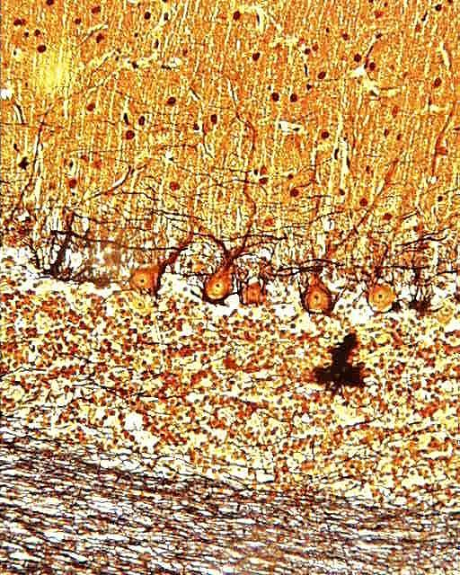
Impregnation of tissue with silver
Lien - reticular fibers
Cerebellum – nerve fibers

Slide 44
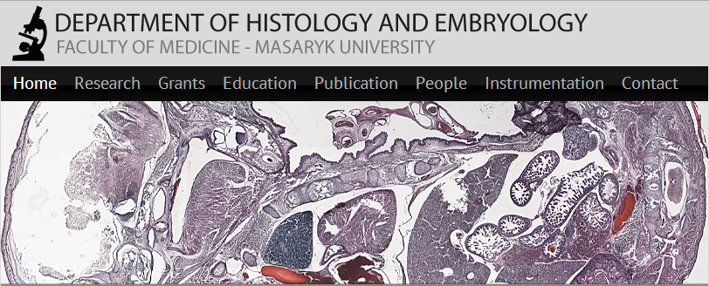
Visit us at:
http://www.med.muni.cz/histology

