Slide 1
ORGANUM VESTIBULOCOCHLEARE
Auris externa, media et interna
Auris externa
Auricula
Meatus acusticus externus
Membrana tympani
Auris media
Cavitas tympani
Ossicula auditus
Tuba auditiva
Auris interna
Labyrinthus osseus
Labyrinthus membranaceus

Slide 2
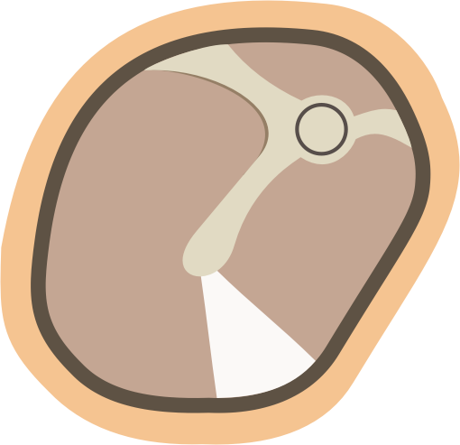
MEMBRANA TYMPANI
Middle connective tissue layer – stratum membranaceum
External layer - stratum cutaneum
Internal layer - stratum mucosum
pars flaccida membranae tympani (membrana Shrapnelli)
plica mallearis anterior et posterior
anulus fibrocartilagineus
(sulcus tympanicus)
prominentia mallearis
(processus lateralis mallei)
stria mallearis (manubrium)
umbo membranae tympani
pars tensa
Cone of light (trigonum Woodi)

Slide 3
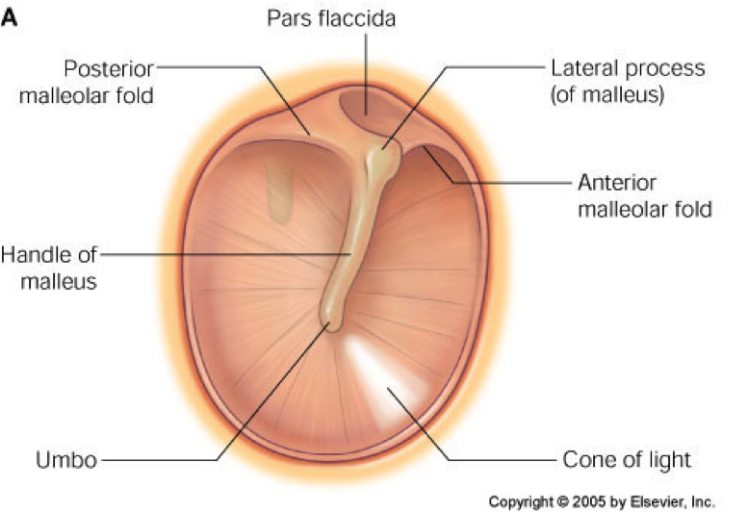

Slide 4
CAVITAS TYMPANI (eardrum)
paries membranaceus
- bubínek
paries labyrinthicus
- promontorium
- fenestra vestibuli
- fenestra cochleae
paries jugularis
- apertura externa canaliculi tympanici
paries tegmentalis
- hiatus canalis nervi petrosi minoris
paries caroticus
- canaliculi caroticotympanici
- canalis musculotubarius
semicanalis musculi tensori tympani
semicanalis tubae auditivae
paries mastoideus
- antrum mastoideum

Slide 5
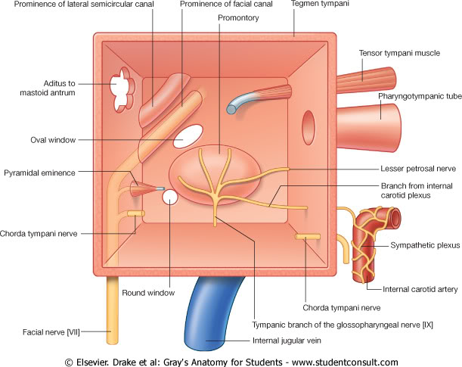
hiatus canalis
nervi petrosi minoris
CAVITAS TYMPANI
fenestra
vestibuli
fenestra
cochleae

Slide 6
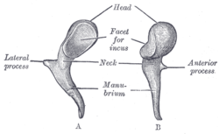
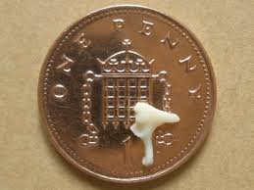
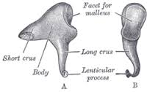
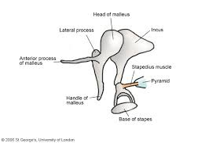
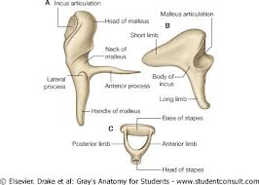
OSSICULA AUDITUS
Malleus
Caput mallei
Manubrium mallei
Processus lateralis
Processus anterior
Art. incudomallearis
Incus
Corpus incudis
Crus longum
Crus breve
Art. incudostapedialis
Stapes
Caput stapedis
Crus anterius
Crus posterius
Basis stapedis

Slide 7
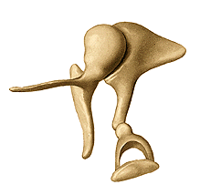
OSSICULA AUDITUS
Art. incudomallearis
Caput mallei
Crus breve
Corpus
incudis
Processus lateralis
Processus anterior
Crus longum
Art. incudostapedialis
Manubrium mallei
Caput stapedis
Crus posterius
Crus anterius
Basis stapedis
Notes:
Ossicular chain in hearing
Sound waves funneled into the external auditory canal set the tympanic membrane into vibration. The ossicular chain transmits the vibrations to the oval window, which communicates them to the fluid column of the inner ear. Sound waves in fluid meet with higher impedance; they must therefore be amplified in the middle ear. The difference in surface area between the tympanic membrane and the oval window increases the sound pressure 17-fold. A total amplification factor of 22 is achieved through the lever action of the ossicular chain. If the ossicular chain fails to transform the sound pressure between the tympanic membrane and the footplate of the stapes, the patient will experience conductive hearing loss of magnitude 20 dB.

Slide 8
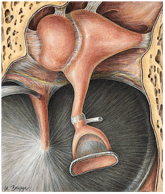
Lig. incudis sup.
Lig. mallei sup.
Lig. mallei lat.
Crus breve
Lig. incudis post.
Art. incudomallearis
M. tensor tympani, tendo
Art. incudostapedialis
M. stapedius, tendo

Slide 9
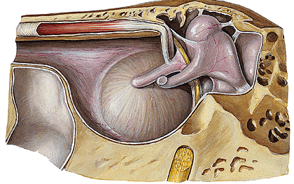
plica mallearis ant.
rec. epitympanicus
lig. mallei sup.
m. tensor tympani
caput
mallei
tuba auditoria
Incus
lig. incudis sup.
crus longum
breve
lig. incudis pos.
plica mallearis pos.
canalis caroticus

Slide 10
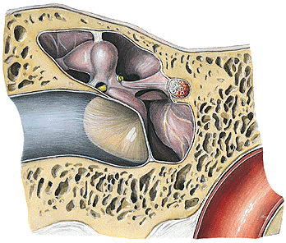
Lig. mallei sup.
Recessus epitympanicus
Incus
M. tensor tympani
Lig. mallei lat.
Prom.
Meatus acusticus externus

Slide 11
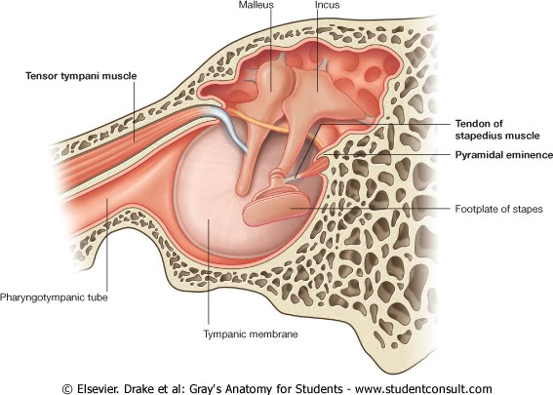
Drake et al. Gray‘s Anatomy for Students, www.studentconsult.com

Slide 12
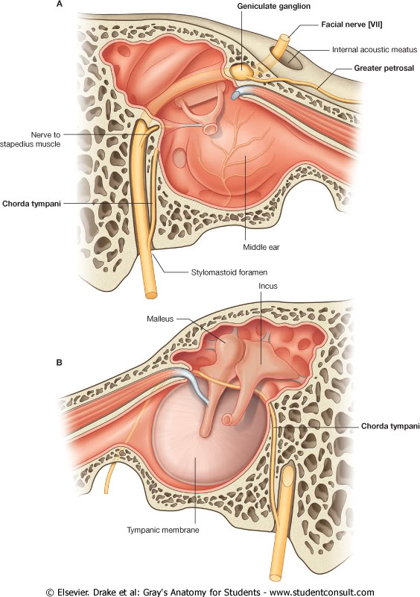

Slide 13
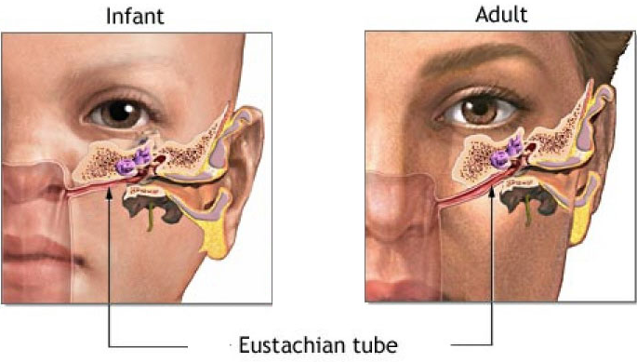
TUBA AUDITIVA, EUSTACHIAN TUBE
pars ossea tubae auditivae (10mm)
ostium tympanicum tubae auditivae
pars cartilaginea tubae auditivae (25 mm)
lamina medialis et lateralis
ostium pharyngeum tubae auditivae
torus tubarius
lymph tissue (tonsilla tubaria)

Slide 14
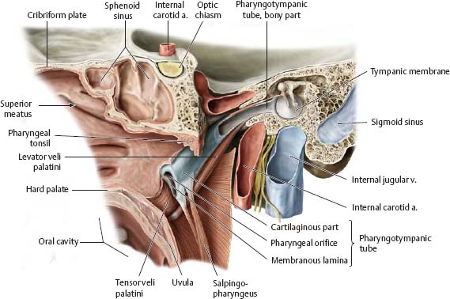
Gilroy et al. Atlas of Anatomy 2nd Edition, Thieme 2012.

Slide 15
TUBA AUDITIVA, EUSTACHIAN TUBE
1- a. carotis int.;
2-lamina lateralis et 4-medialis;
6 – m. tensor veli palatini;
7- m. salpingopharyngeus;
8-m. levator veli palatini;
9-nasopharynx;
Notes:
1- a. carotis int.; 6 – m. tensor veli palatini; 7- m. salpingopharyngeus; 8-m. levator veli palatini; 9-nasopharynx; 2-lamina lateralis et 4-medialis

Slide 16
TORUS TUBARIUS, torus levatorius, plica salpingopharyngea
2- m. tensor v.p.; 3- m.levator v.p;
6- m. salpingopharyngeus
Notes:
2- tensor; 3- levator; 6- m. salpingopharyngeus

Slide 17
Dhingra: Disease of Ear, Nose and Throat, 5th ed., Elsevier 2010.

Slide 18
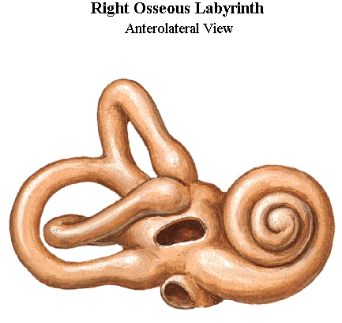
AURIS INTERNA - LABYRINTHUS OSSEUS
- vestibulum
canales semicirculares ossei
anterior
posterior
crus communae
fenestra vestibuli
ampulla ossea
lateralis
crus simplex
- cochlea
fenestra cochleae
Sinělnikov R.D. 1980. Atlas člověka.

Slide 19
COCHLEA
modiolus
lamina spiralis ossea
canalis spiralis osseus
canales longitudinales
tractus spiralis foraminosus

Slide 20
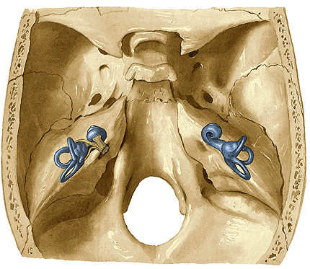
AURIS INTERNA
Sinělnikov R.D. 1980. Atlas člověka.

Slide 21
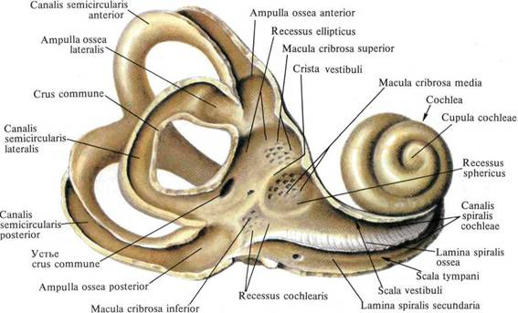
VESTIBULUM
Utriculus
n. utriculoampullaris
n. saccularis
Sacculus
Caecum
vestibulare
n. ampullaris posterior
Sinělnikov R.D. 1980. Atlas člověka.
Notes:
Caecum vestibulare ductus cochlearis

Slide 22
LABYRINTHUS MEMBRANACEUS
labyrinthus vestibularis
utriculus et sacculus
d. utriculosaccularis→d.endolymphaticus (aquaductus vestibuli)→saccus endolymph.
ductus semicirculares
macula statica utriculi et sacculi
cristae ampullares
labyrinthus cochlearis
- ductus cochlearis
lamina basilaris
membrana vestibularis Reissneri
wall of bony canal
organum spirale Corti
membrana tectoria

Slide 23
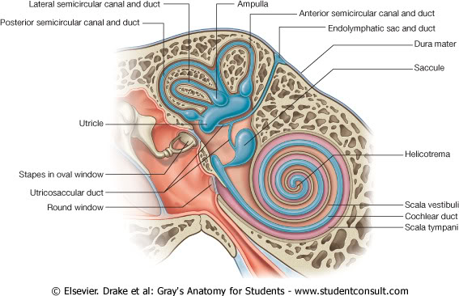
LABYRINTHUS MEMBRANACEUS
Ductus endolymphaticus
(aquaductus vestibuli)
* Ductus reuniens
*

Slide 24
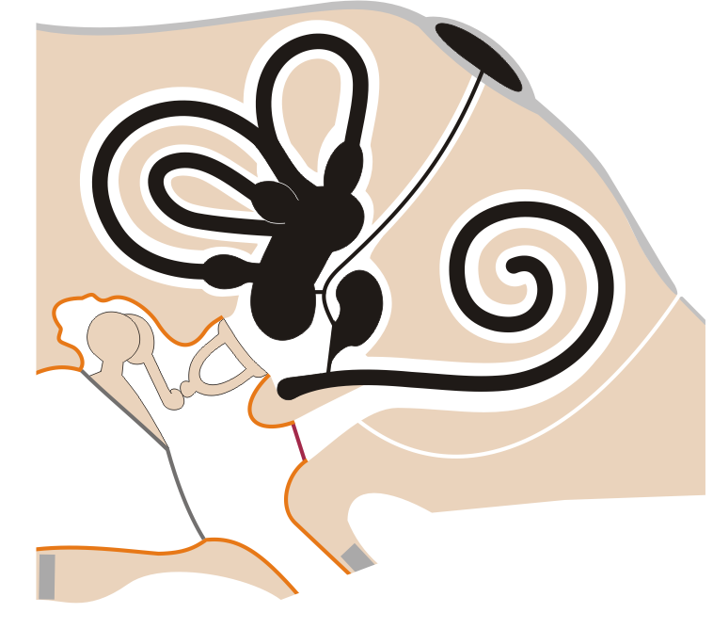
LABYRINTHUS MEMBRANACEUS
Saccus endolymphaticus (fossa subarcuata)
Ductus endolymphaticus
(aquaductus vestibuli)
ant.
Ductus semicircularis
post.
lat.
U
Ductus cochlearis
S
Ductus utriculosaccularis
Canaliculus cochleae
(apertura externa
canaliculi cochlae)
Ductus reuniens
Membrana tympani sec.
Caecum vestibulare

Slide 25
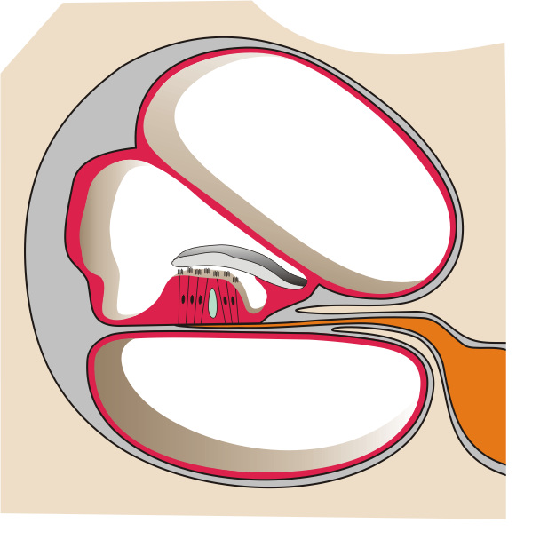
DUCTUS COCHLEARIS
Scala vestibuli
(perilymfa)
Ductus
cochlearis
(endolymfa)
membrana vestibularis Reissneri
membrana
tectoria
organum spirale Corti
membrana basilaris
Scala tympani
(perilymfa)

Slide 26
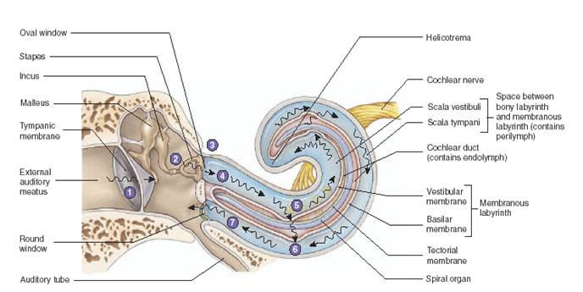

Slide 27
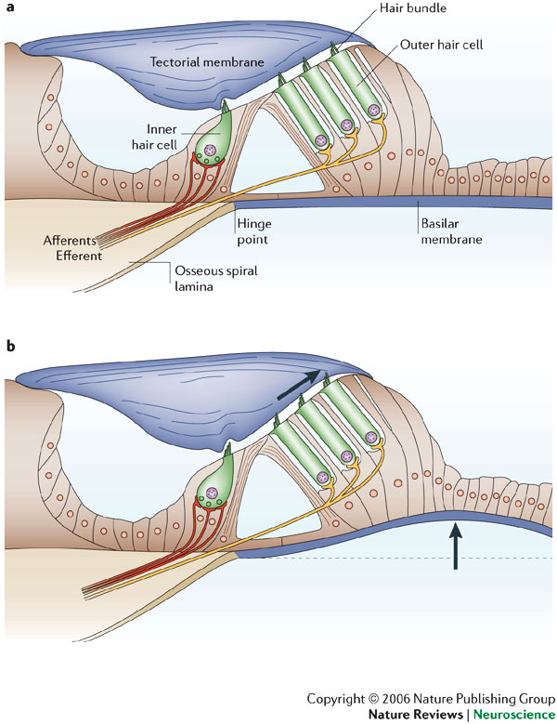

Slide 28
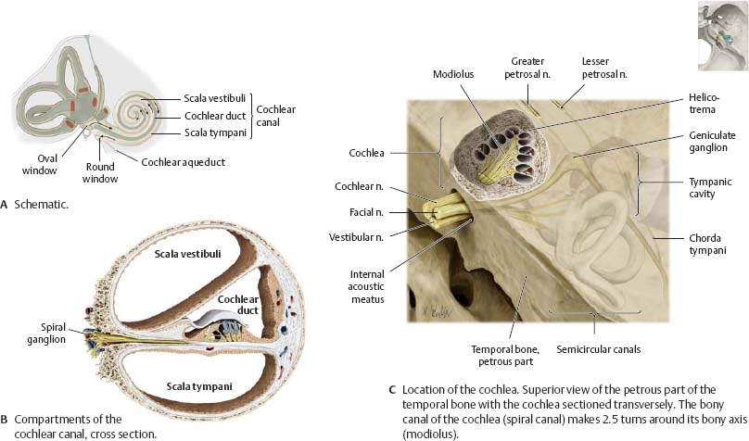
NERVUS VESTIBULOCOCHLEARIS

Slide 29
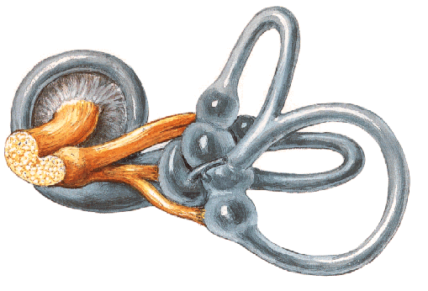
NERVUS VESTIBULOCOCHLEARIS
n. utriculoampullaris
n. cochlearis
n. vestibularis
ggl. vestibulare
superior et inferior
n. saccularis
n. ampullae posterioris
introitus canalis n. VII
area vestibularis superior
(n. utriculoampullaris)
crista transversa
tractus spiralis
foraminosus
area vestibularis inferior (n. saccularis)
+ foramen singulare (n. ampularis. post.)

Slide 30
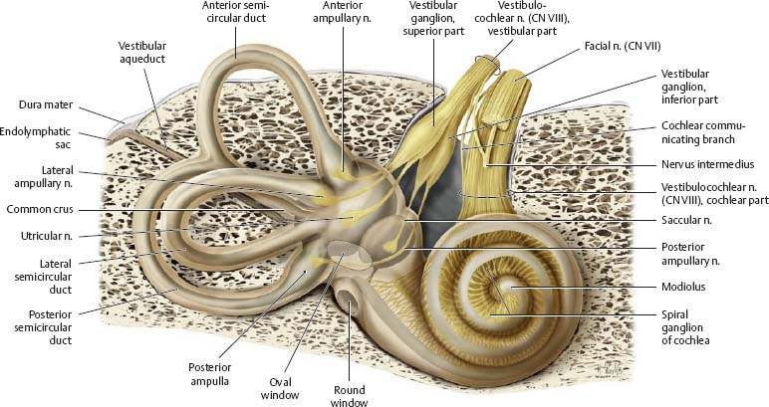
Gilroy et al. Atlas of Anatomy 2nd Edition, Thieme 2012.

Slide 31
Fundus meatus acustici interni
introitus canalis n. VII
area vestibularis superior
(n. utriculoampullaris)
crista transversa
area vestibularis inferior (n. saccularis)
+ foramen singulare (n. ampularis. post.)
tractus spiralis
foraminosus

Slide 32
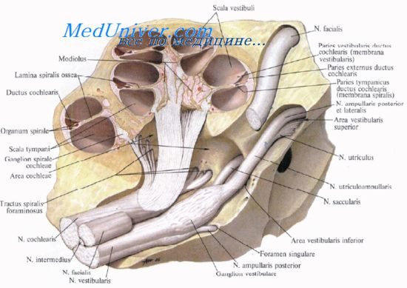
n. ampullaris ant. et lat.

