Slide 1
LYMPHATIC SYSTEM

Slide 2
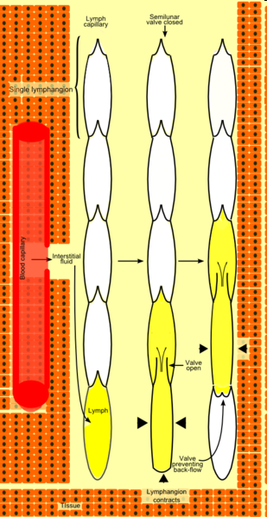
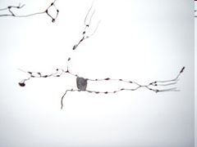
Vasa lymphocapillaria – rete lymphocapillare
Lymphoedema, metastasis
Vasa lymphatica – vas afferens, vas efferens
Trunci lymphatici
Lympha – chylus
Folliculi lymphoidei, nodi lymphoidei, tonsillae, lien,
mucosa-associated lymphoid tissue, thymus

Slide 3

CAPILLARY LYMPH PUMP

Slide 4
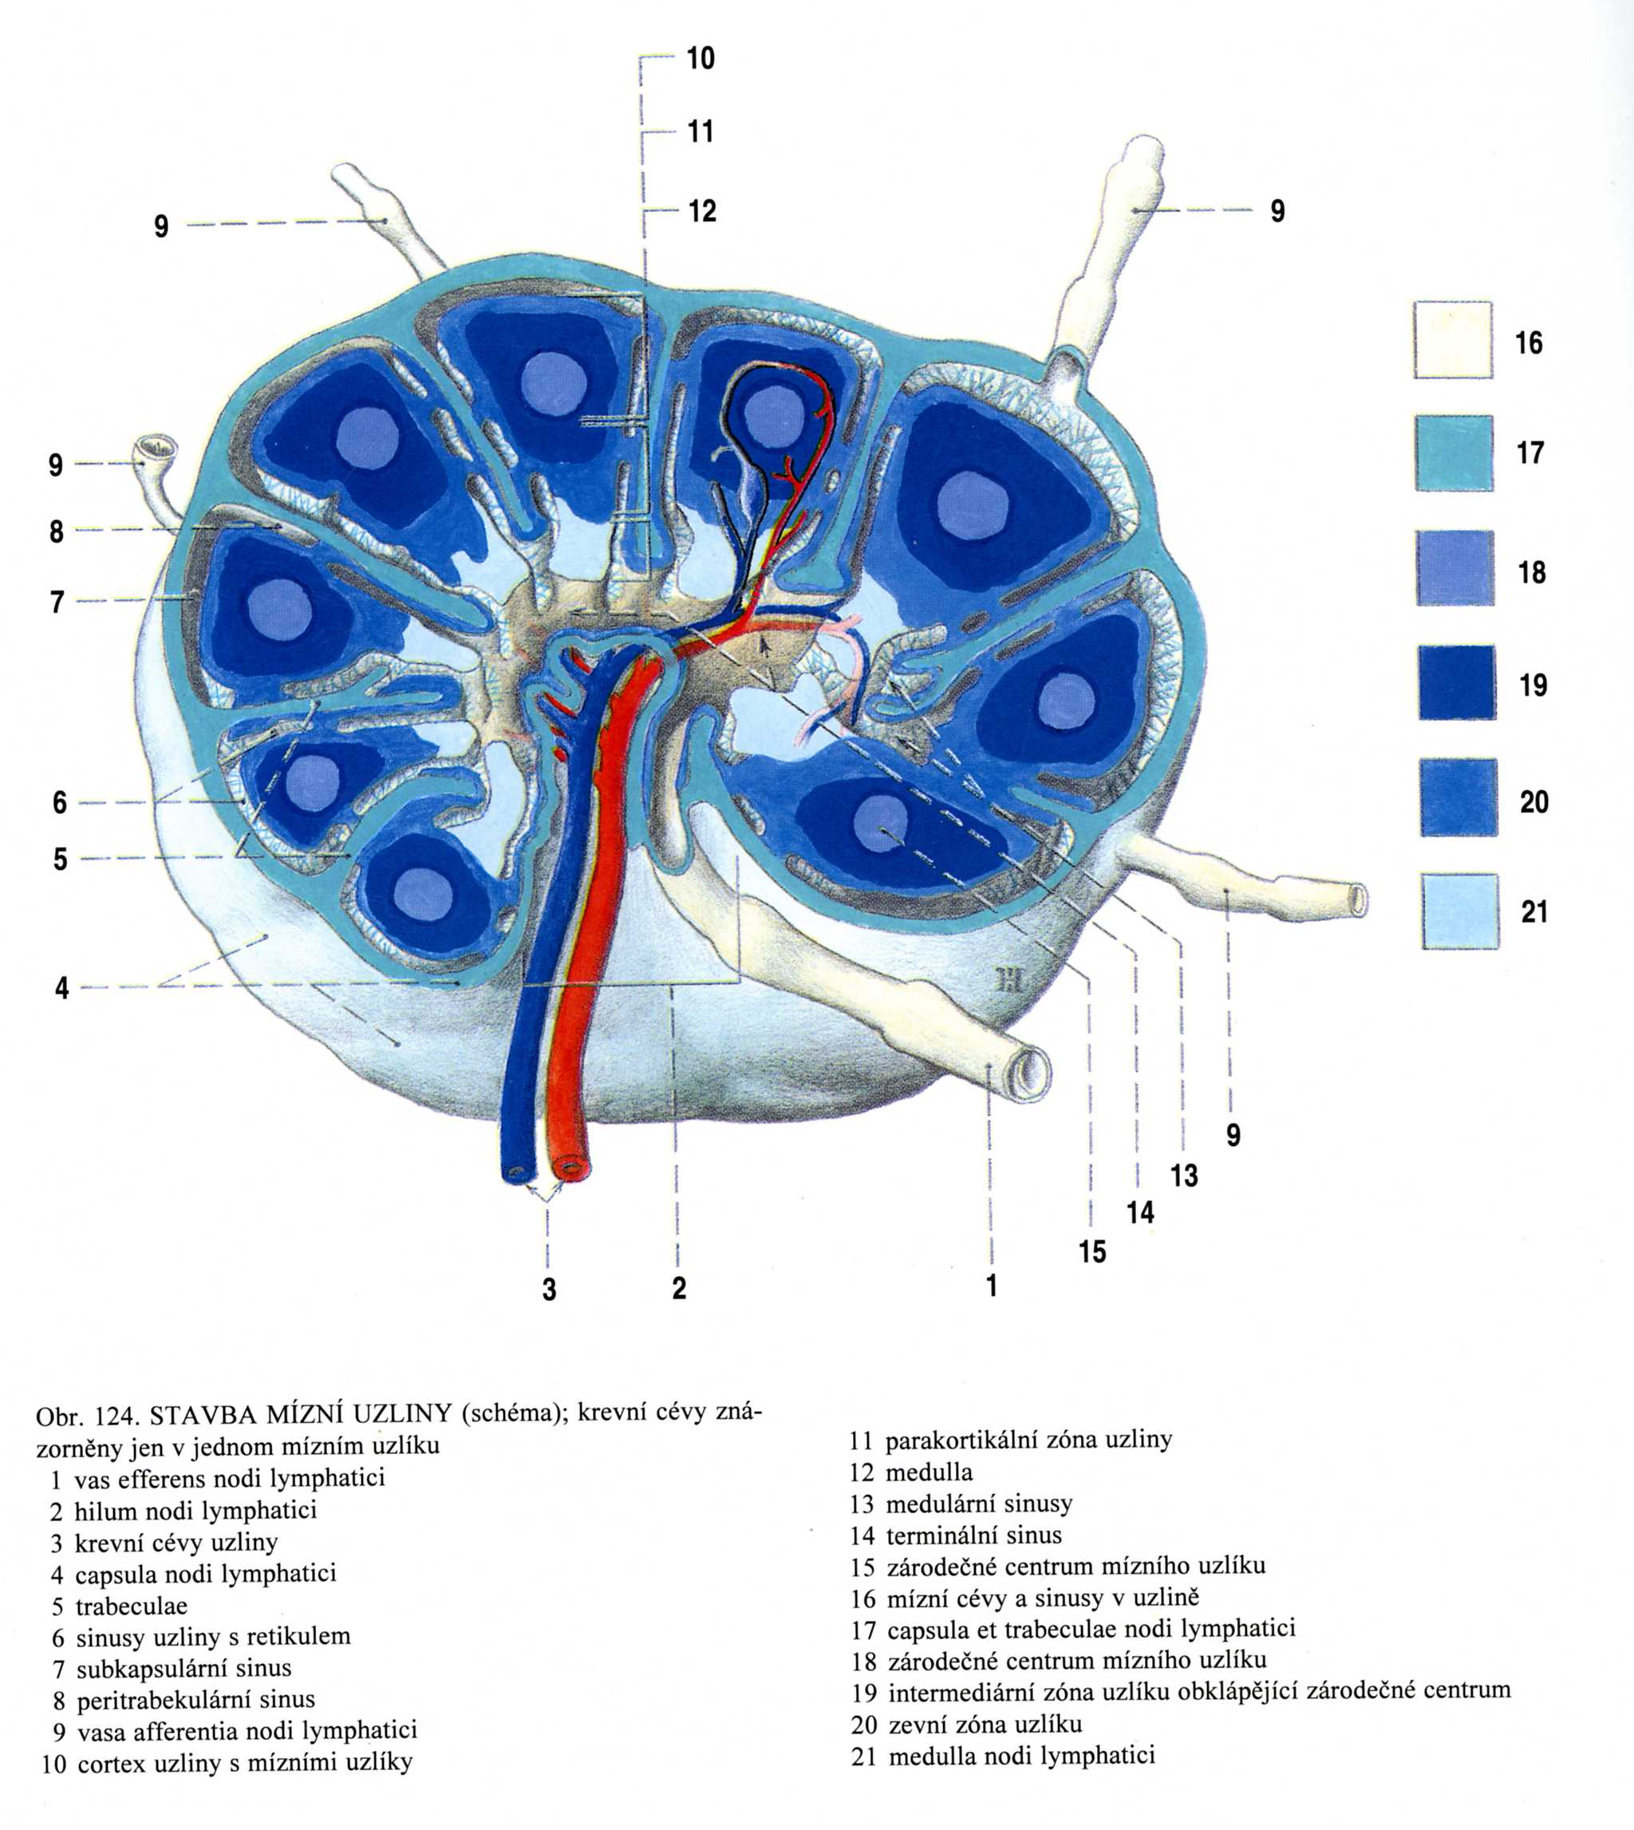
Nodus lymphoideus
- capsula
- trabeculae
- reticulum
- cortex
- medulla
- hilum
- sinus subcapsularis
- sinus corticalis
(peritrabecularis)
- sinus terminalis
(medullaris)
Tributary region
Regional lymph nodes
Sentinel lymph node

Slide 5
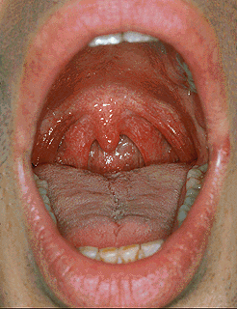
Tonsilla palatina
Notes:
Tonsilla palatina

Slide 6
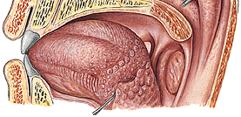
Tonsilla lingualis
Notes:
Tonsilla lingualis a palatina

Slide 7
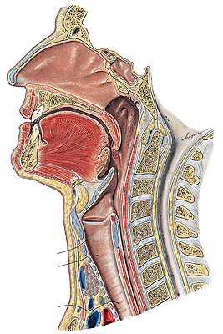
Tonsilla pharyngea
Tonsilla tubaria
Waldeyer's ring
Notes:
Tonsilla pharyngea

Slide 8
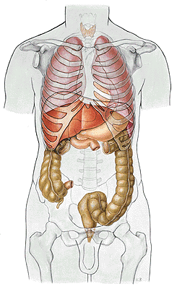
Tonsilla abdominalis –
appendix vermiformis
Notes:
Appendix, lien

Slide 9
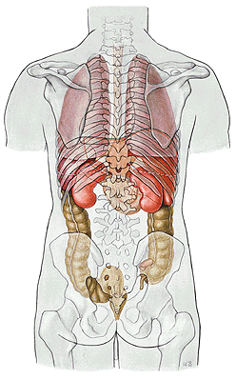
Lien, splen
Notes:
Appendix. lien

Slide 10
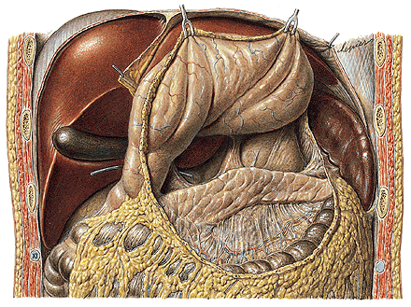
Notes:
Lien

Slide 11
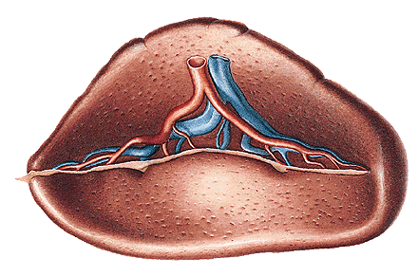
Notes:
Lien

Slide 12
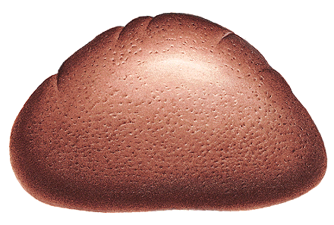
Notes:
Lien

Slide 13
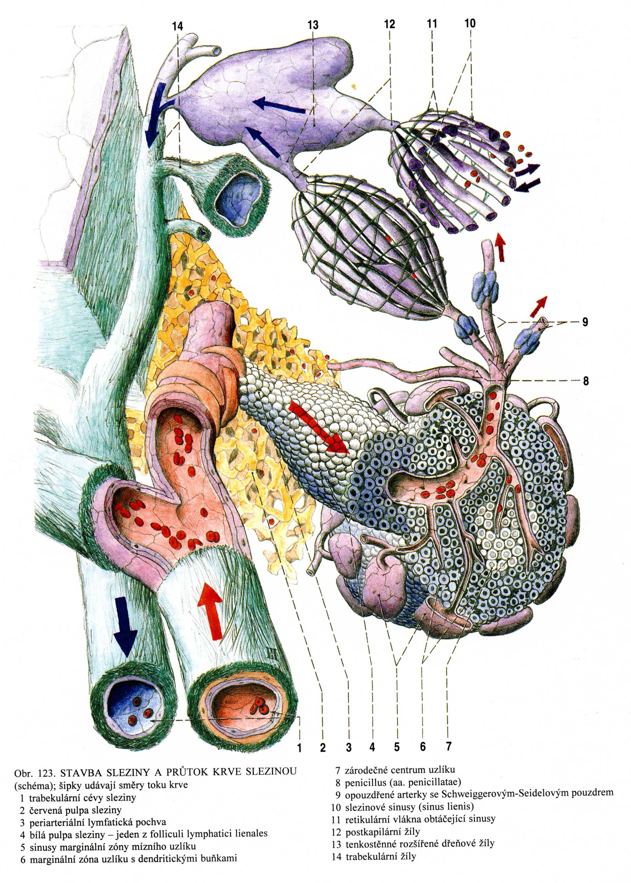
Reticulum
Pulpa rubra
Pulpa alba

Slide 14
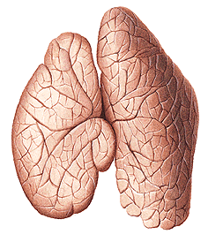
Thymus
- lobus dx. et sin.
Notes:
Thymus, of a 2 year-old child; ventral view.

Slide 15
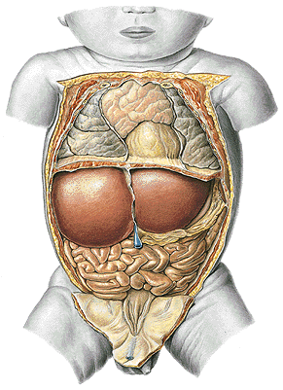
Notes:
Thymus novorozence

Slide 16
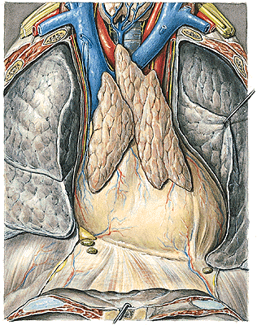
Notes:
Thymus, of an adolescent; the anterior wall of the thorax has been removed, the pleural cavity exposed and the left lung retracted laterally; ventral view.

Slide 17
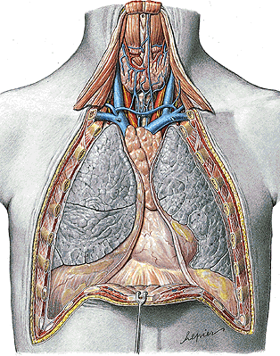
Area interpleuralis sup.
(thymica)
Notes:
Thymus, ventral view, in the young adult.

Slide 18
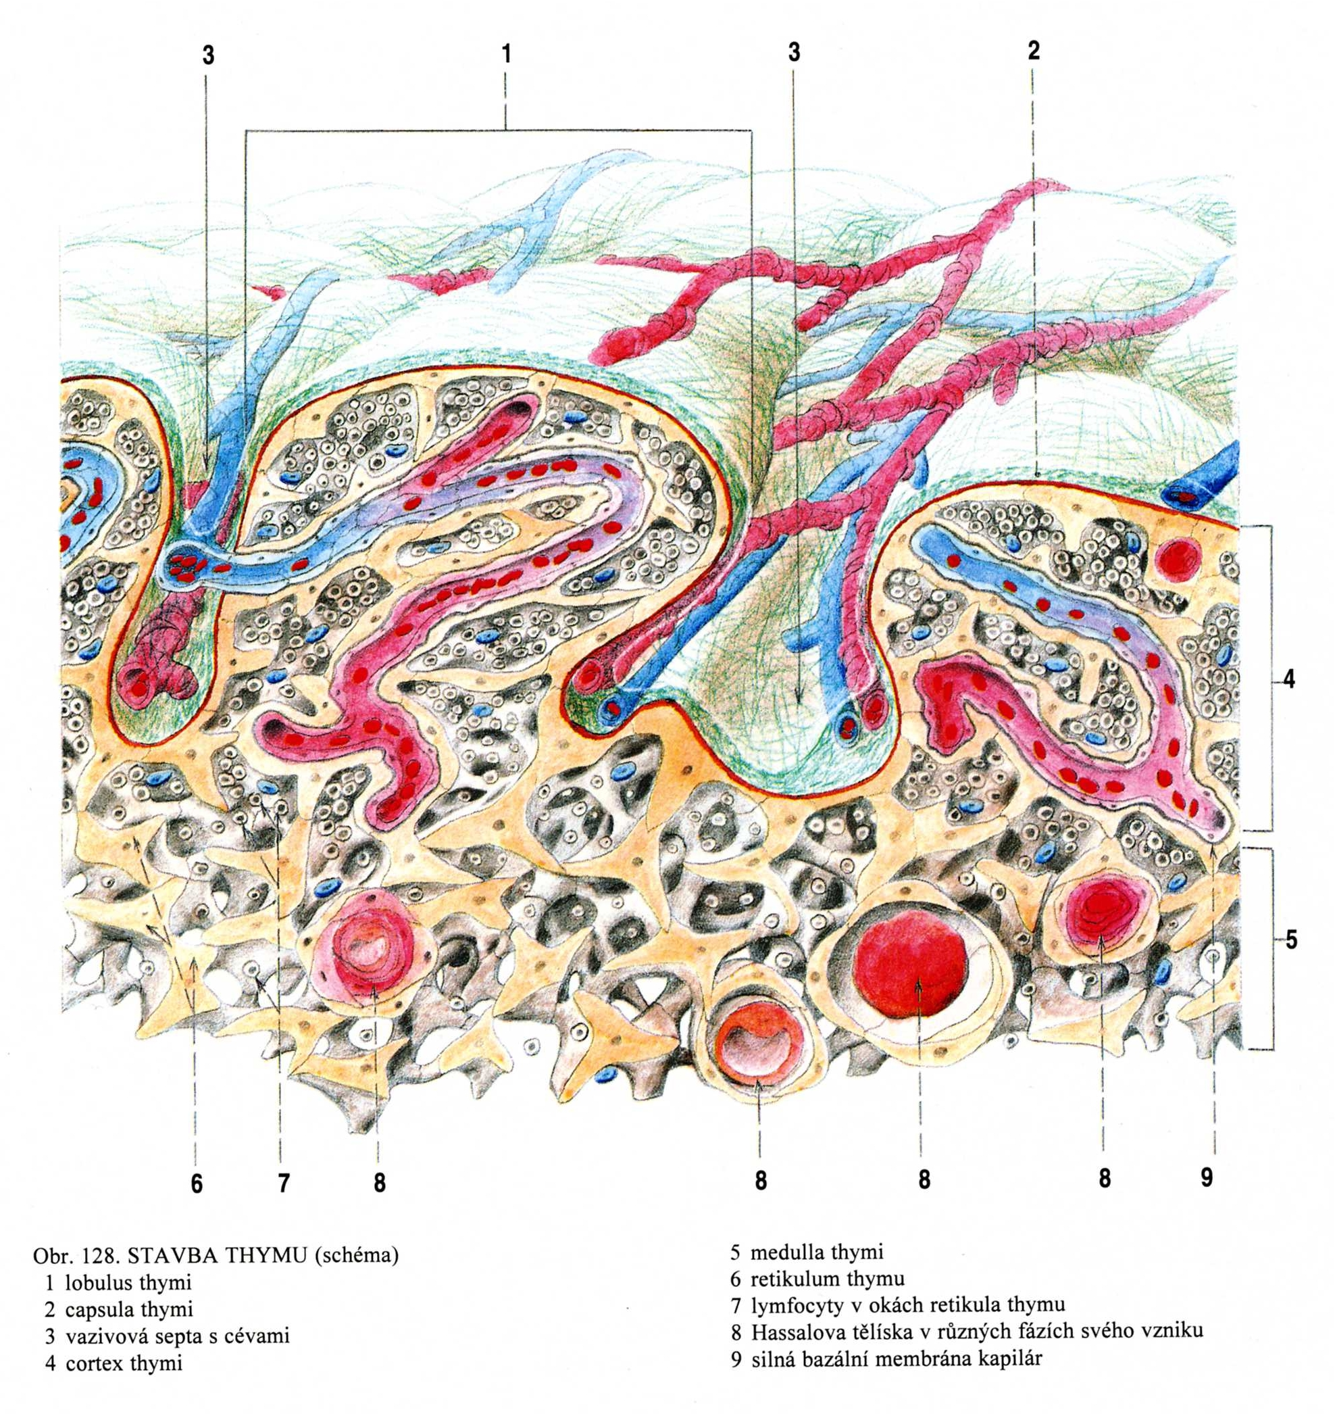
Thymus
- capsula
- reticulum
- lobuli
- cortex
- medulla

Slide 19
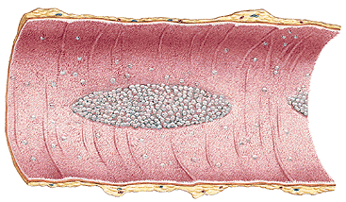
Folliculi lymphoidei solitarii
Folliculi lymphoidei aggregati
Notes:
Folliculi lymphatici aggregati

Slide 20
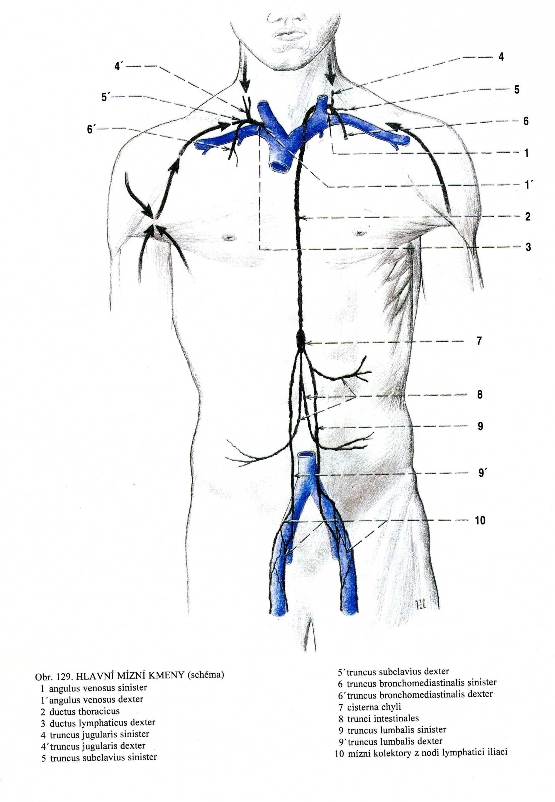
Truncus lymphaticus dexter
- tr. jugularis dexter
- tr. subclavius dx.
- tr. bronchomediastinalis dx.
Ductus thoracicus
- tr. lumbalis dx. et sin.
- tr. intestinalis
(cisterna chyli)
- tr. jugularis sin.
- tr. subclavius sin.
- tr. bronchomediastinalis sin.

Slide 21
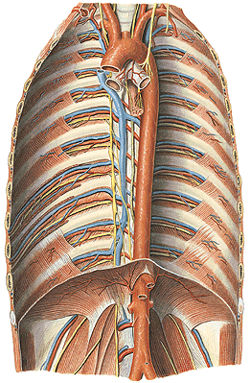
Ductus thoracicus
Notes:
Ductus thoracicus

Slide 22
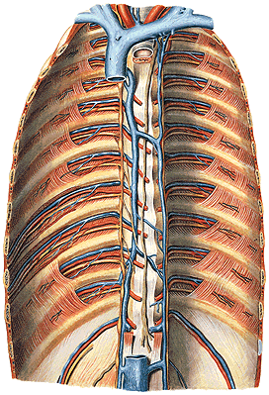
Ductus thoracicus
Notes:
Ductus thoracicus

Slide 23
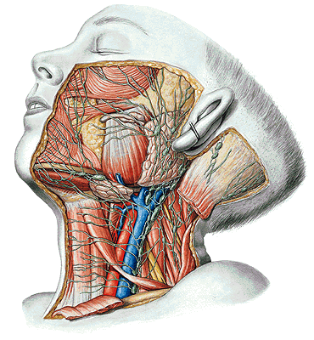
Lymphatic drainage
of the head and neck:
Nodi lymph. occipitales
Nll. mastoidei
Nll. parotidei
Nll. submandibulares
Nll. submentales
Nll. cervicales ant.spf. et prof.
Nll. cervicales lat. spf. et prof.
(nll. jugulares int.
nll. supraclaviculares - Virchow)
tr. jugularis
Notes:
Nodi lymphatici, of the head and neck of an 8 year-old male

Slide 24
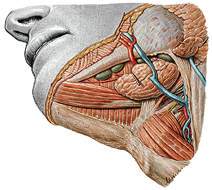
Nll. submandibulares
Notes:
Nodi lymphatici submandibulares

Slide 25
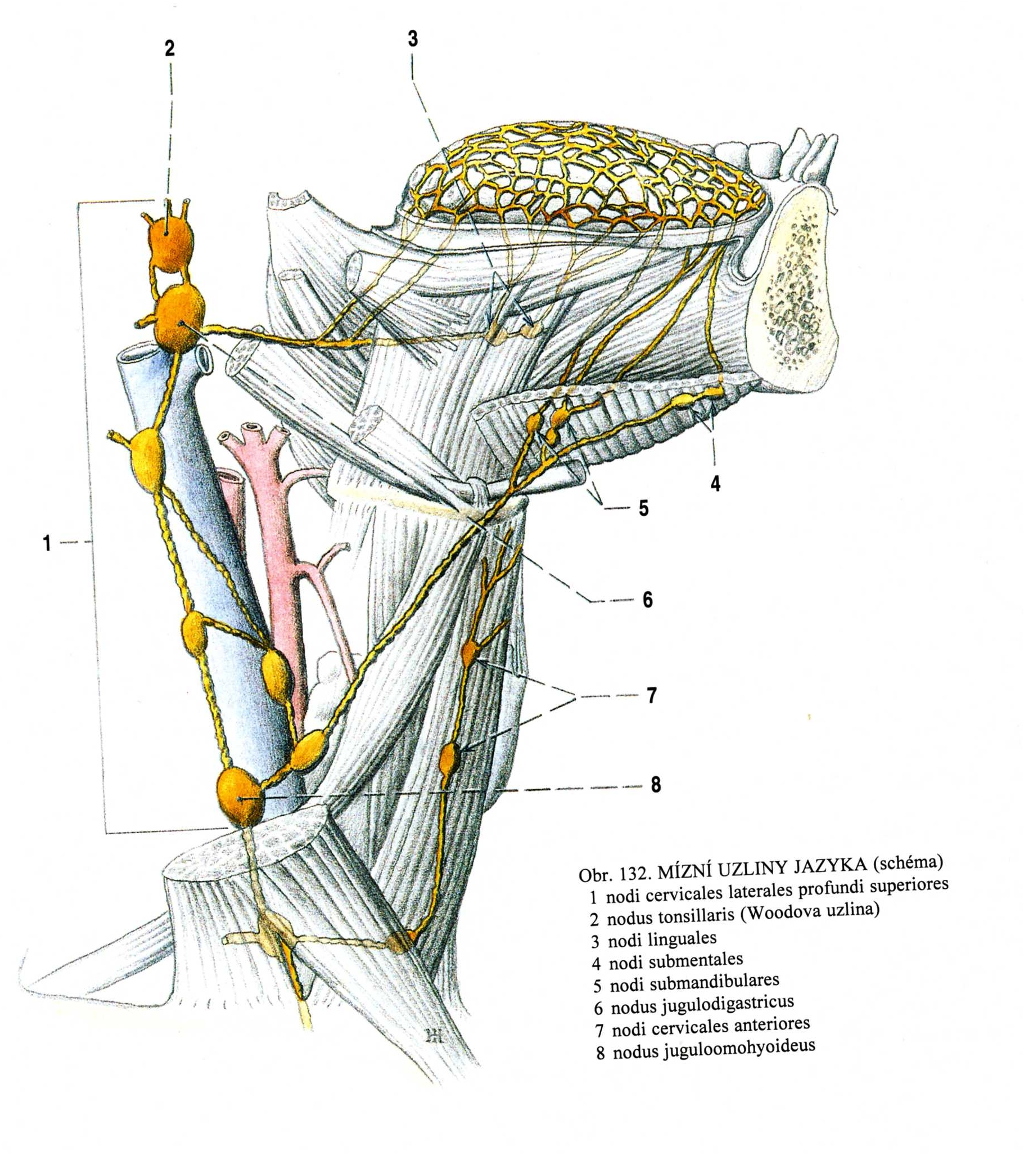
Lymphatic drainage of the tongue
Nl. tonsillaris (Wood)
Nl. jugulodigastricus
(Küttner)
Nl. juguloomohyoideus

Slide 26
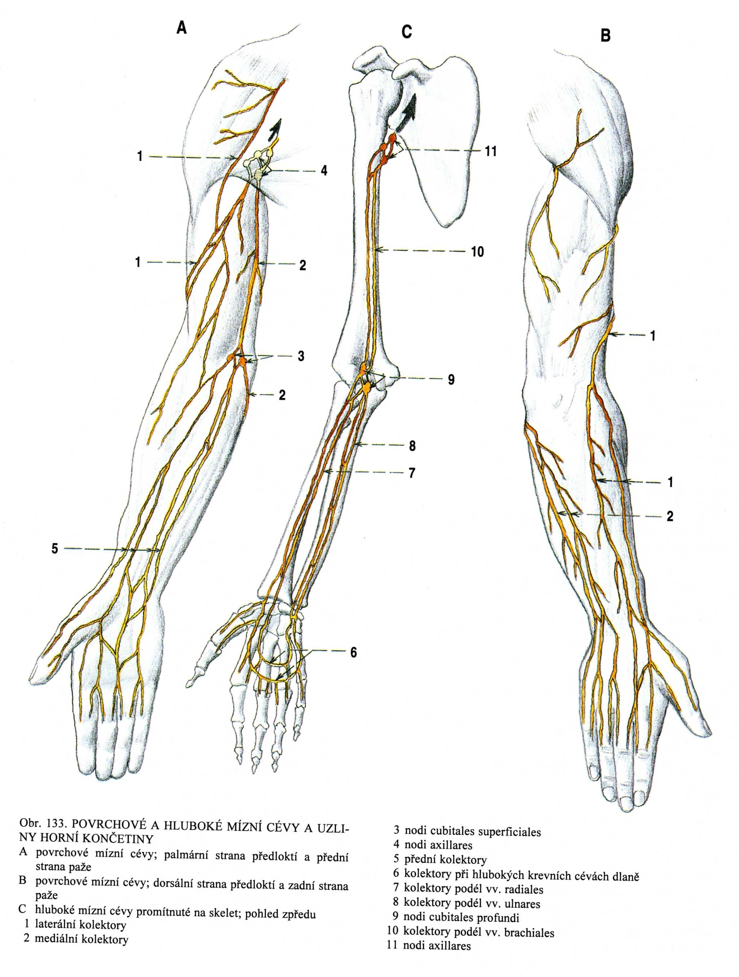
Superficial lymph vessels:
- collectores laterales
- collectores mediales
- collectores anteriores (medii)
Nll. cubitales spf. et prof.

Slide 27
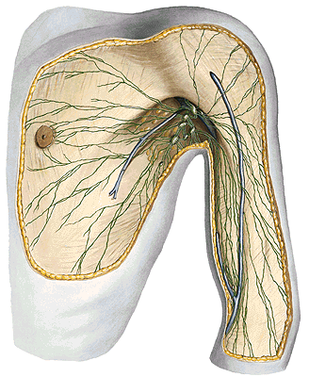
Nll. axillares

Slide 28
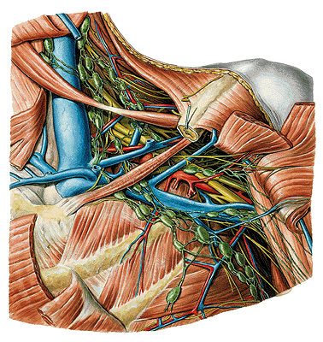
Nodi lymph.
axillares:
- humerales
- pectorales
(Sorgius)
- subscapulares
- centrales
- apicales
- infraclaviculares
tr. subclavius
Notes:
Fig. 394 Axillary fossa, Fossa axillaris; deep layer of the neck; the clavicle has been partially removed; the pectoral muscles have been sectioned; ventral view (left).

Slide 29
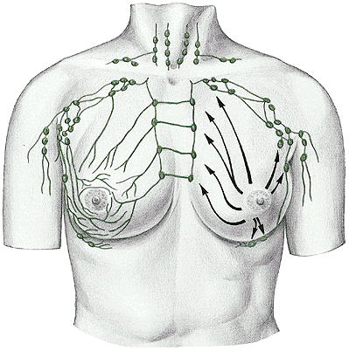
Lymphatic drainage of the breast
- nll. axillares
- nll. parasternales
- nll. supraclaviculares
- nll. intercostales
- nll. mediastinales ant.
Notes:
Fig. 789 Lymphatic drainage of the mammary gland and location of the regional lymph nodes. Note the connections between the lymphatic vessels of both sides and the lymphatic drainage into the intrathoracic lymph nodes.

Slide 30
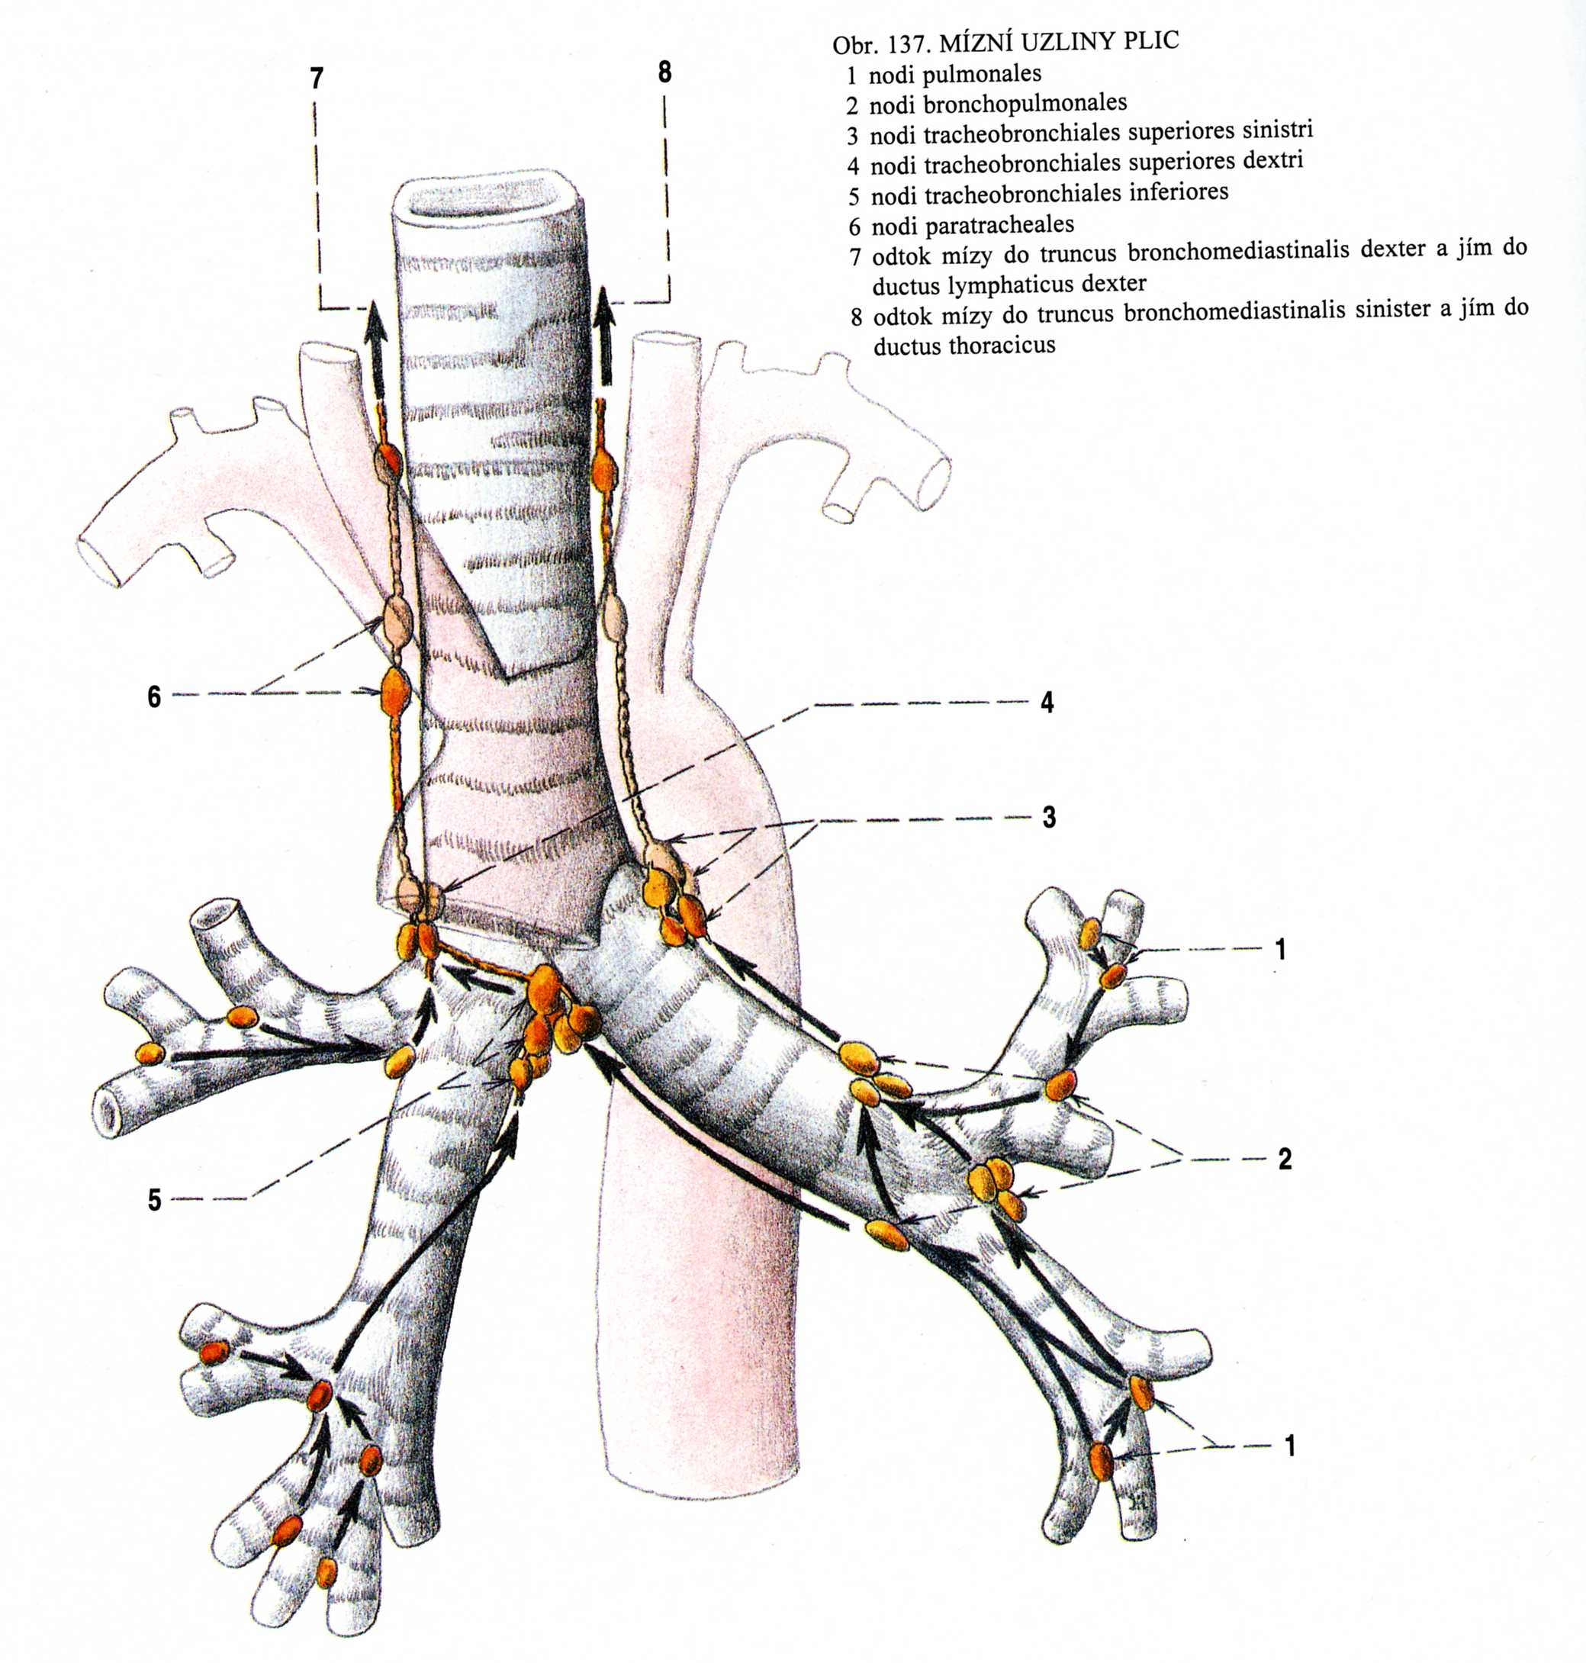
Nll. pulmonales
Nll. bronchopulmonales
Nll. tracheobronchiales
inf., sup. – dx. et sin.
Nll. paratracheales
tr. bronchomediastinalis

Slide 31
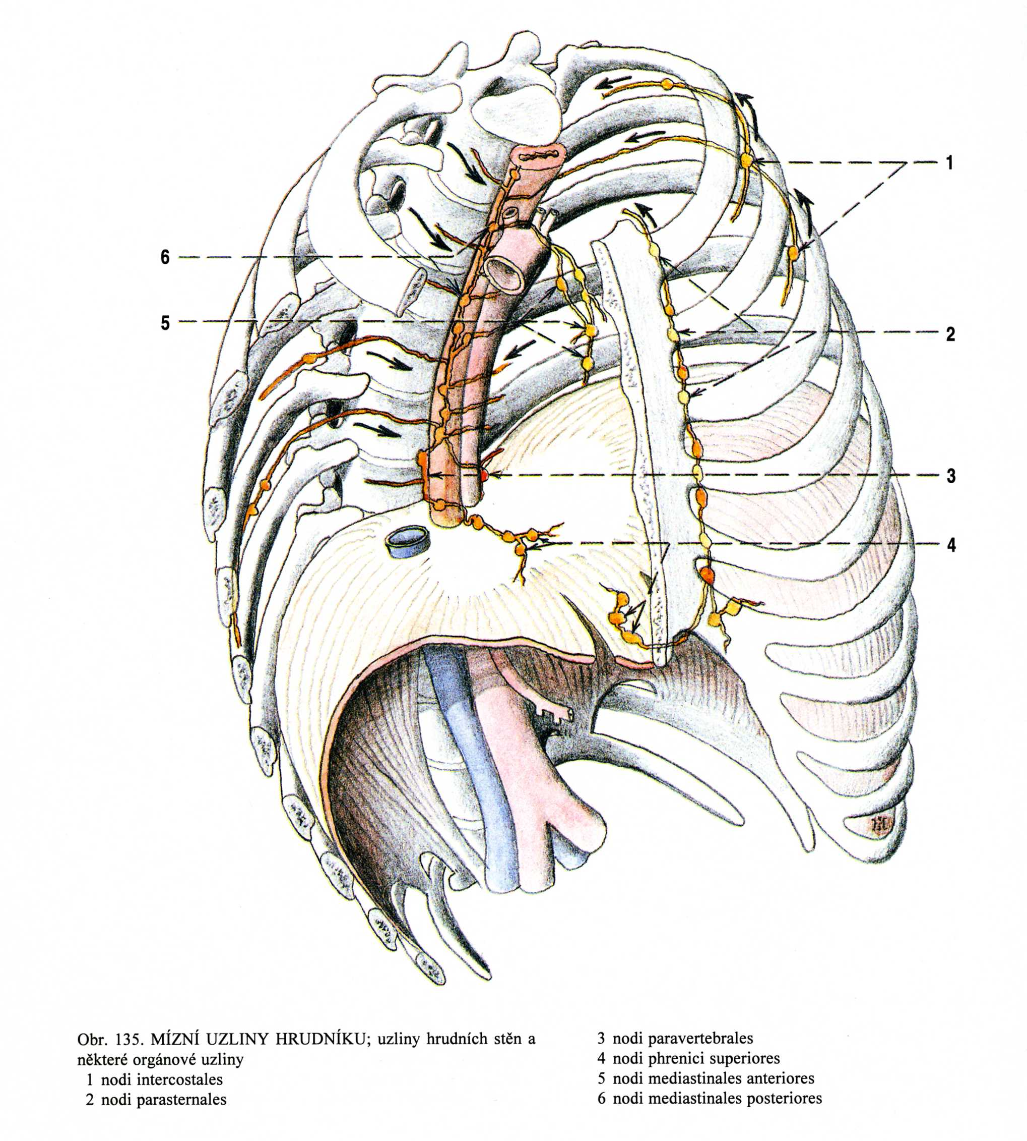
Nll. parasternales
Nll. intercostales
Nll. praevertebrales
Nll. phrenici sup.

Slide 32
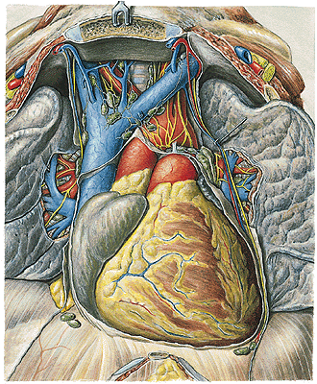
Nll. mediastinales ant.
Notes:
the mediastinal lymph nodes; ventral view.

Slide 33
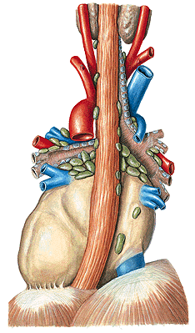
Nll. mediastinales post.
Notes:
Posterior mediastinal lymph nodes, Nodi lymphatici thoracis; the greater vessels of the mediastinum have been preserved; dorsal view. In the healthy adult the lymph nodes are usually smaller than shown here.

Slide 34
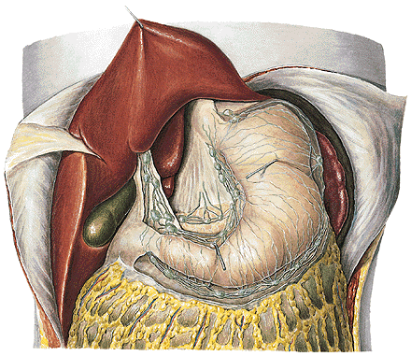
Nll. gastrici
Nll. gastroomentales
Nll. pancreaticoduodenales
Nll. lienales
Nll. coeliaci
Nll. hepatici
Nll. pancreatici
tr. intestinalis
Notes:
Nll. Gastrici, slezina

Slide 35
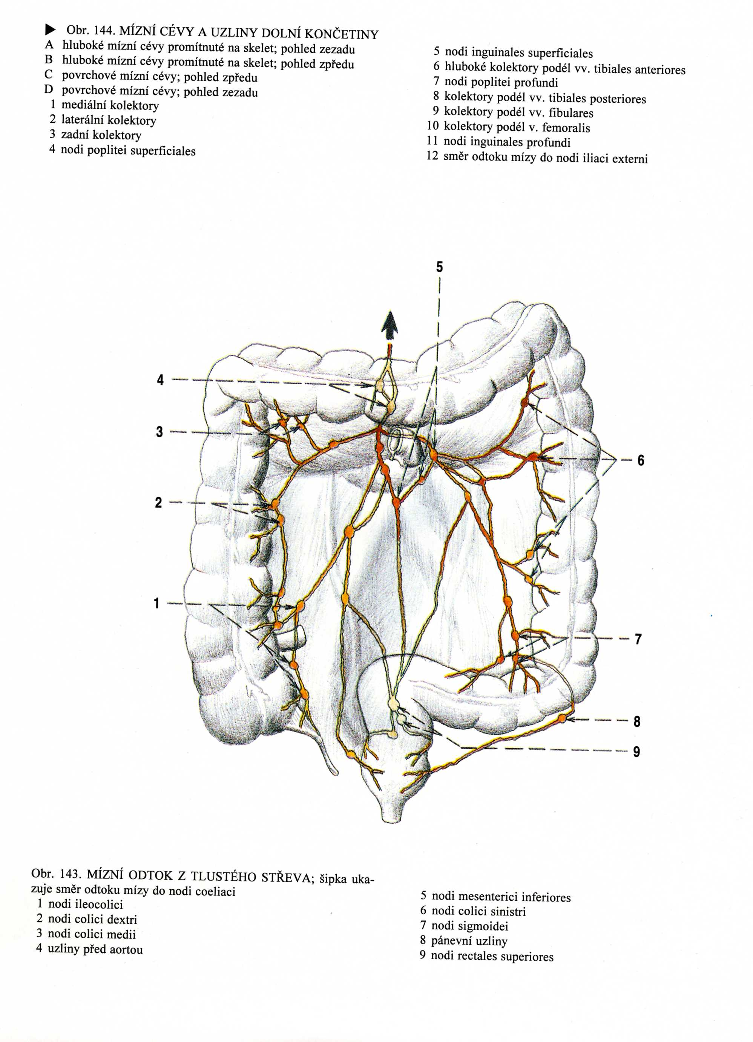
Nodi mesenterici sup.
Nodi mesenterici inf.
tr. intestinalis

Slide 36
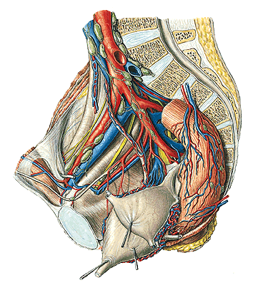
Nll. iliaci interni
- nll. paravesicales
- nll. paravaginales
- nll. parauterini
(Bayer)
- nll. pararectales
- nll. gluteales
- nll. sacrales
Nll. iliaci externi
Nll. iliaci communes
Notes:
Nll. inguinales, iliaci ext., communes, lumbales

Slide 37
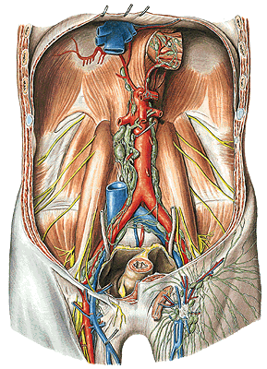
Nll. lumbales
tr. lumbalis dx. et sin.
Notes:
Lymphatic vessels, Vasa lymphatica, lymph nodes, Nodi lymphatici, of the pelvic wall in the female; the pelvis has been sectioned in the median plane; the uterus has been pulled sinistroventrally; most of the peritoneum has been removed; lateral view (right). The lymph nodes shown here are often much smaller but always present. Via the lymphatic vessels in the round ligament (Lig. teres uteri) tumor cells may spread from the uterus to the superficial inguinal lymph nodes.

Slide 38
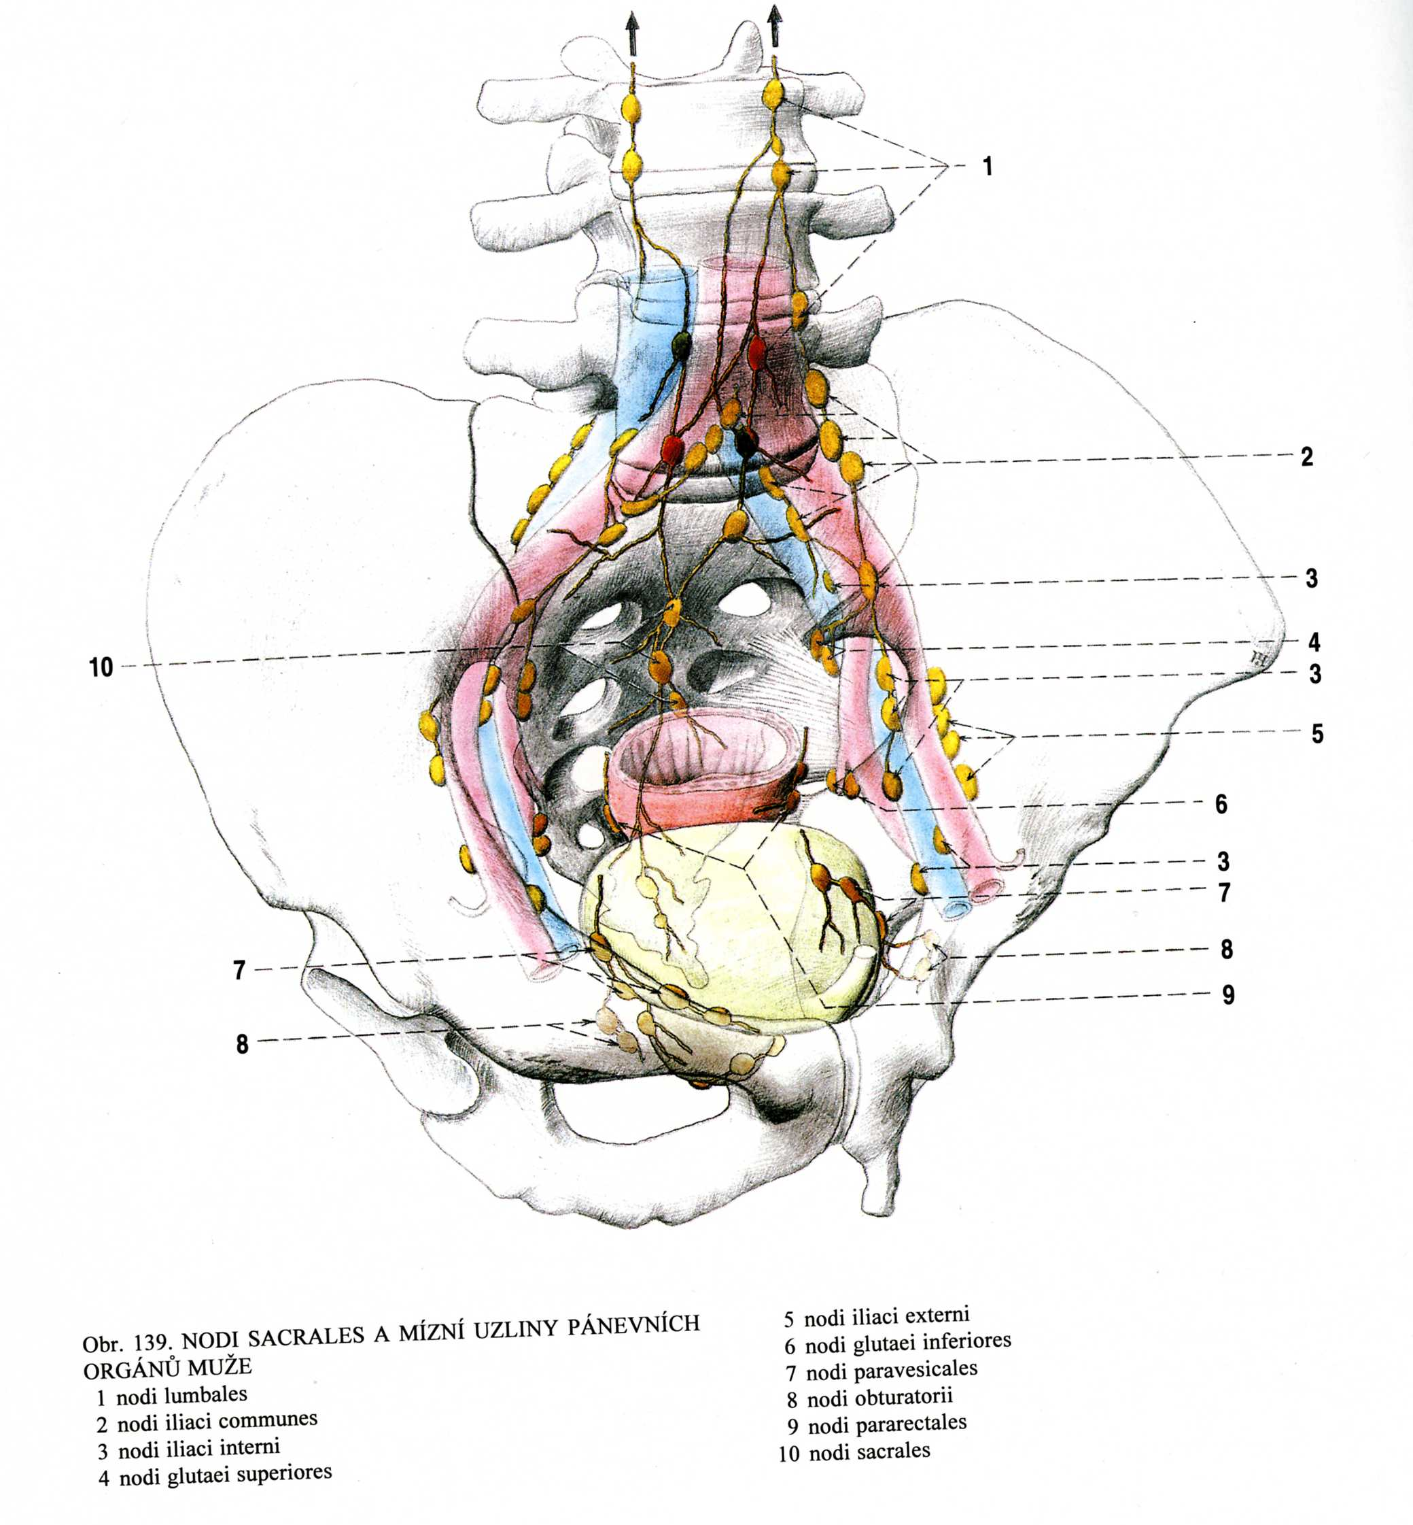
Drainage of the male pelvis

Slide 39
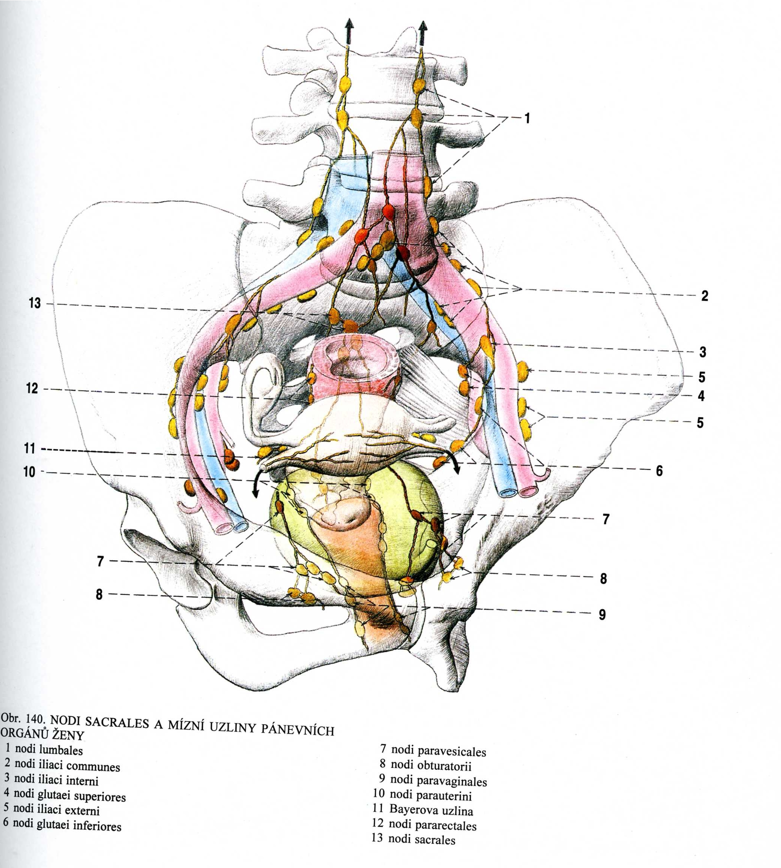
Drainage of the female pelvis
Lymph node of Bayer

Slide 40
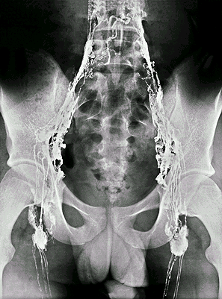
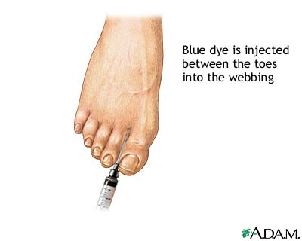
Lymphography
Notes:
AP lymfogram po injekci kontr. látky do mízních cév obou noh. Segmenty mezi chlopněmi jsou vidět jako šnůry perel.

Slide 41
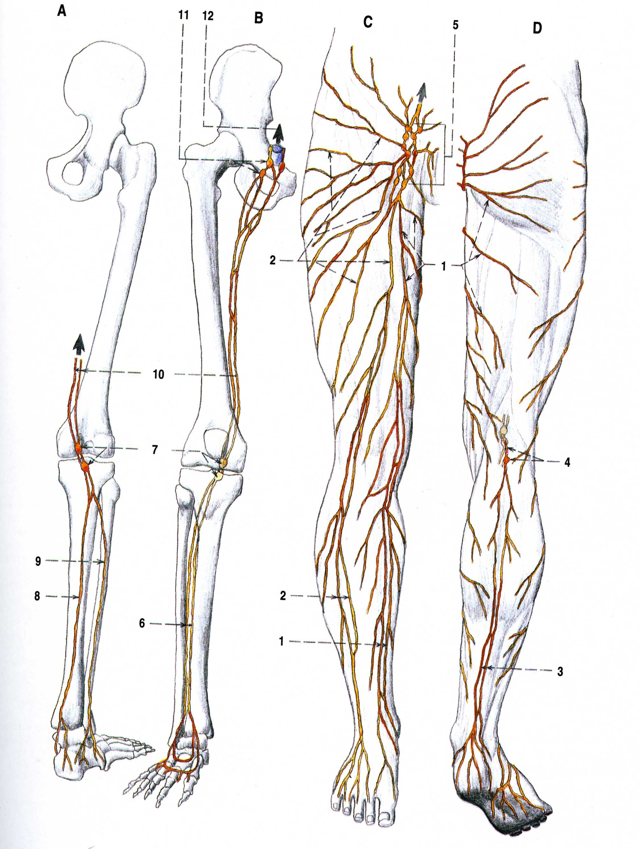
Superficial lymph vessels:
- collectores mediales
- collectores laterales
- collectores posteriores
Nll. poplitei spf. et prof.

Slide 42
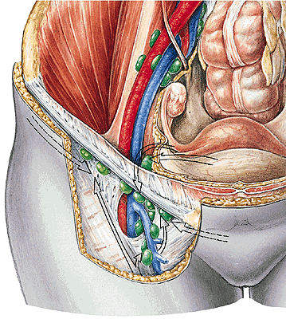
Nll. inguinales spf.
Nll. inguinales prof.
(Cloquet-Rosenmüller)
Notes:
Draining areas of the lymph nodes of the inguinal region, Regio inguinalis, in the female; ventral view (right).
* Lymph fluid drains from the medial part of the uterine tube and the uterine fundus via the round ligament (Lig. teres uteri) to the superficial lymph nodes of the inguinal region.

Slide 43
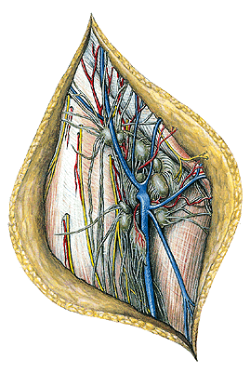
Nll. inguinales spf.
(hiatus saphenus)
Notes:
Superficial lymphatic vessels, lymph nodes and main veins of the inguinal region, Regio inguinalis; ventral view (right).

Slide 44
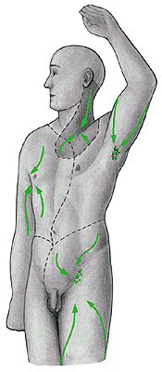
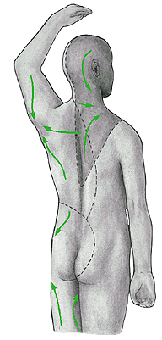

Slide 45
Illustrations were copied from:
Atlas der Anatomie des Menschen/Sobotta.
Putz,R., und Pabst,R. 20. Auflage. München:
Urban & Schwarzenberg, 1993)
Netter: Interactive Atlas of Human Anatomy.
Windows Version 2.0
Čihák R: Anatomie 3. Grada, Praha, 1997.

