Slide 1
VEINS

Slide 2
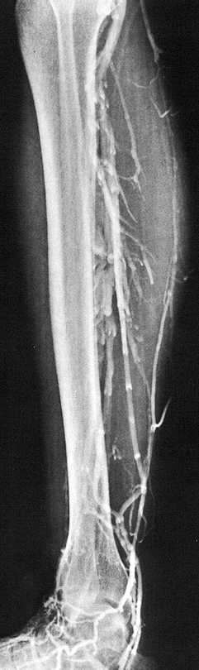
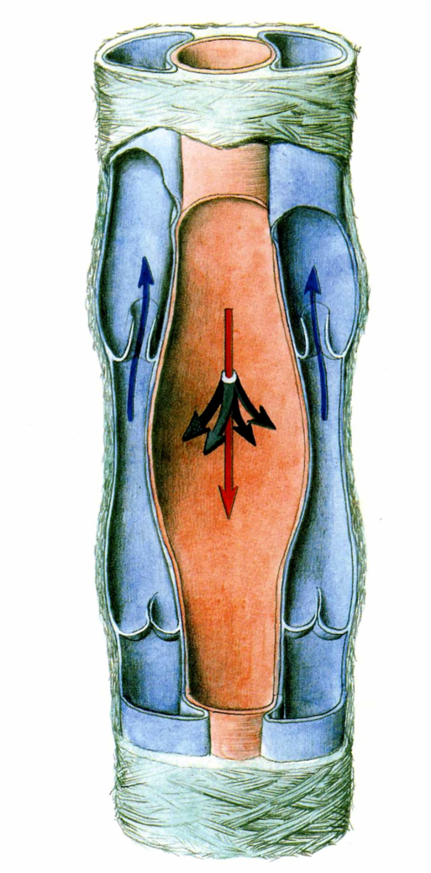
CAPILLARIES, SINUSOIDS, POSTCAPILLARY VENULES
VENULES, VEINS
TUNICA INTIMA, MEDIA, ADVENTITIA
VASA VASORUM, SYMPATHETIC AND AFFERENT NERVES
VALVES, SINUS
PHLEBOGRAPHY
VENAE COMITANTES

Slide 3
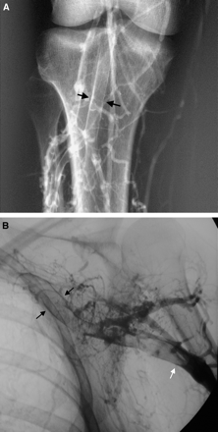
PHLEBOGRAPHY
(VENOGRAPHY)
Venous thrombosis surrounded by contrast,
the so-called ‘tram-track’ sign (arrows)

Slide 4
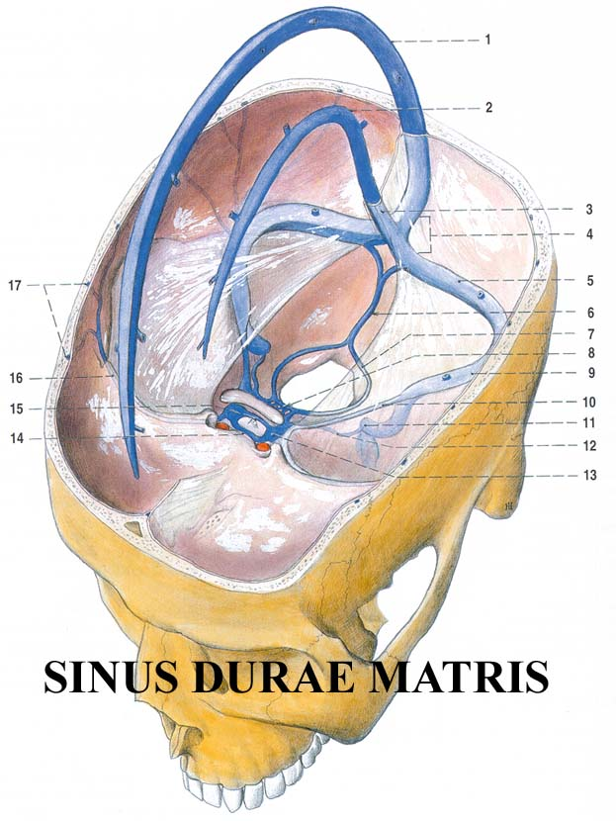
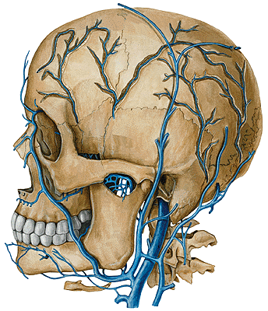
V. JUGULARIS INT.

Slide 5
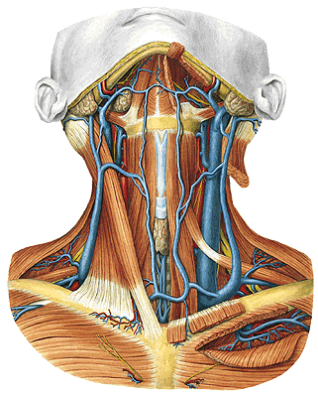
V. JUGULARIS INT.
- vv. pharyngeae
- v. facialis communis
- v. lingualis
- v. thyroidea sup.
- v. thyroidea media

Slide 6
V. RETROMANDIBULARIS
- v. temporalis spf.
- v. maxillaris
- v. temporalis media
- v. transversa faciei
V. FACIALIS
- v. angularis
- v. prof. faciei
- v. palatina ext.

Slide 7
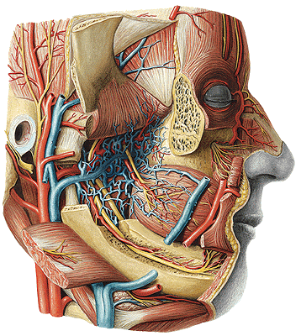
PLEXUS PTERYGOIDEUS
- v. alveolaris inf. et sup.
- v. sphenopalatina
- vv. palatinae

Slide 8
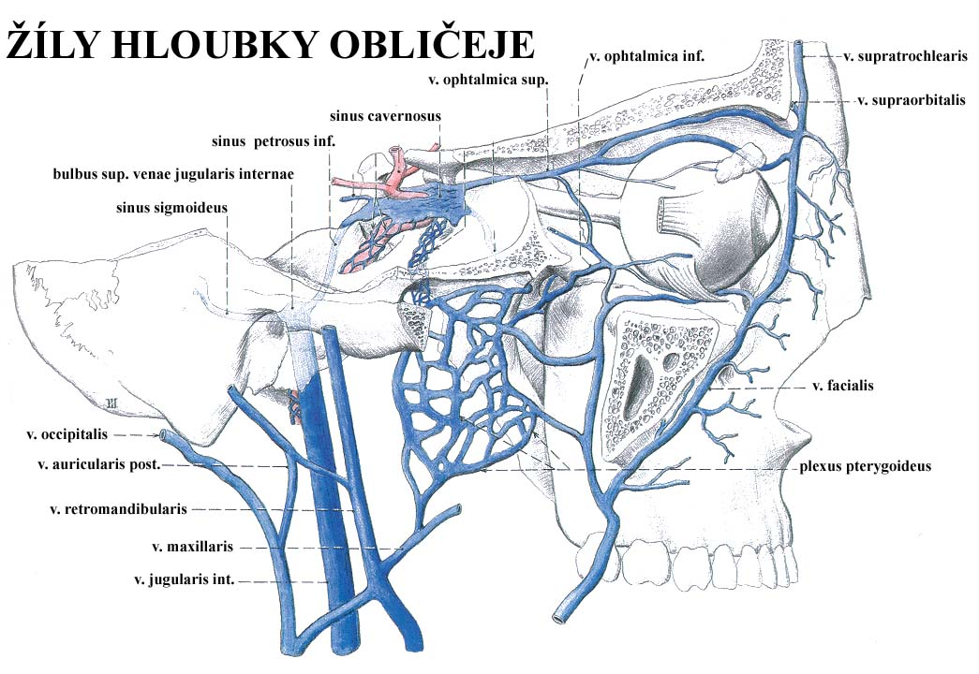

Slide 9
V. JUGULARIS EXT.
- v. retromandibularis
- v. auricularis post.
- v. occipitalis
- v. jugularis ant.
arcus venosus juguli
(- v. mediana colli)
- v. transversa colli
- v. suprascapularis

Slide 10
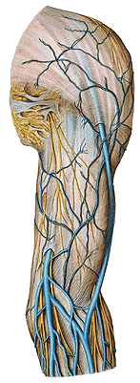
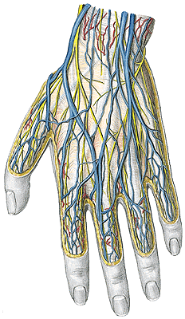
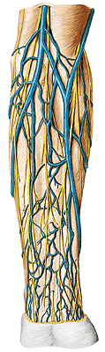
Rete digitale dorsale – vv. metacarpales dorsales – rete
venosum dorsale manus (rete venosum palmare manus –
vv. intercapitulares)
v. basilica antebrachii (hiatus basilicus) – v. basilica
v. cephalica antebrachii – v. cephalica

Slide 11
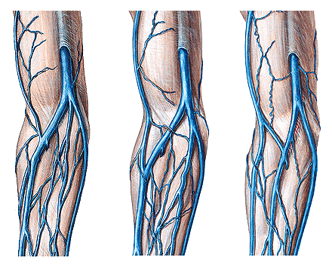
V. mediana cubiti
V. mediana antebrachii – v. mediana cephalica et basilica

Slide 12
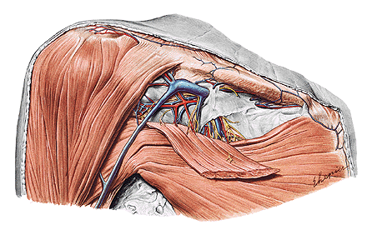
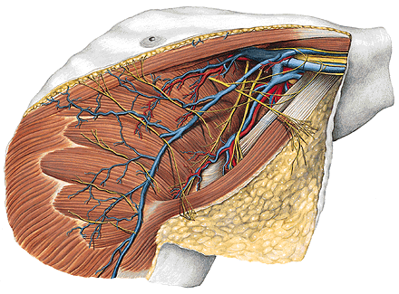
V. AXILLARIS
- v. basilica
- vv. brachiales (deep veins)
- vv. thoracoepigastricae
- v. thoracica lateralis
- v. cephalica
Trig. clavipectorale
(deltoideopectorale)

Slide 13
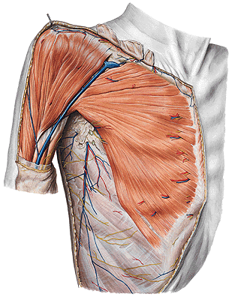
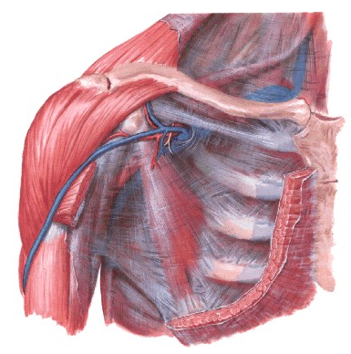
V. cephalica
Trigonum deltoideopectorale
Fascia clavipectoralis

Slide 14
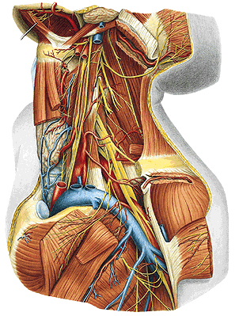
V. SUBCLAVIA
- v. axillaris
- vv. pectorales
- v. scapularis dorsalis

Slide 15
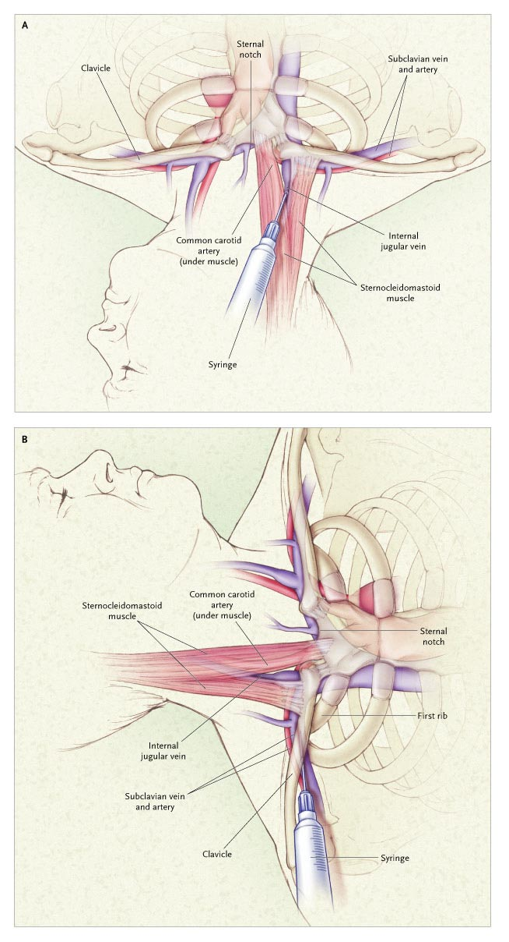
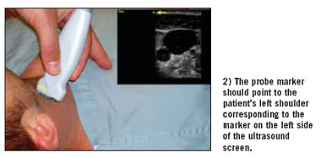
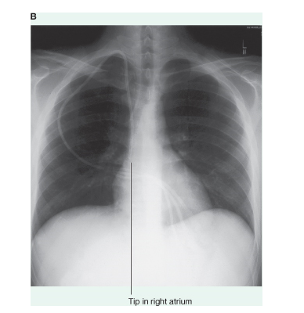

Slide 16
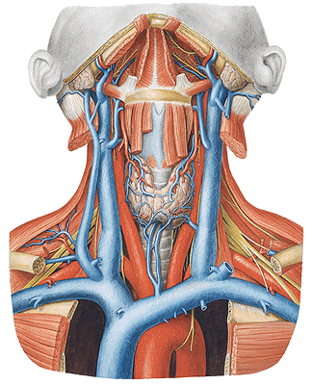
V. BRACHIOCEPHALICA
- v. jugularis int.
- v. subclavia
(angulus venosus)
- v. jugularis ext.
- vv. thyroideae inf.
- vv. thymicae
- vv. tracheales
- vv. mediastinales
- vv. bronchiales
- vv. pericardiacae
- v. vertebralis
- v. thoracica int.
- v. cervicalis prof.
- v. intercostalis sup. sin.
- 1st v. intercostalis post.

Slide 17
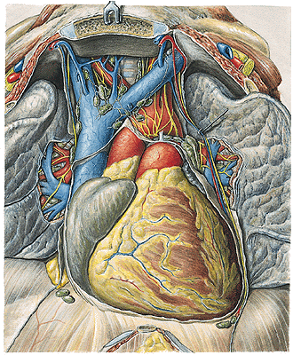
V. CAVA SUP.
- v. brachiocephalica dx. et sin.
- v. azygos

Slide 18
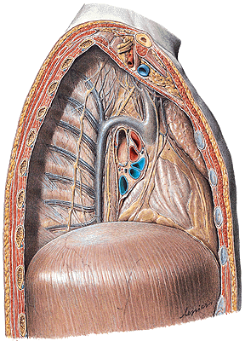
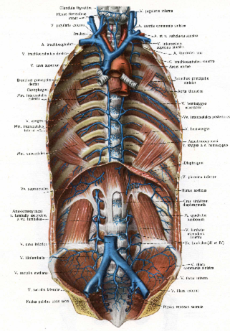
V. AZYGOS
- v. lumbalis ascendens dx. + v. subcostalis dx.
(vv. lumbales dx.)
- v. phrenica sup. dx.
- vv. intercostales post. dx. (5th – 11th)
- v. intercostalis suprema dx. (2nd – 4th)
- v. hemiazygos
- vv. oesophageales, bronchiales,
mediastinales

Slide 19
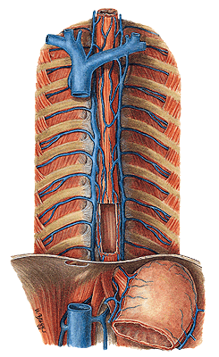
V. HEMIAZYGOS
- v. lumbalis ascendens sin. + v. subcostalis sin.
(vv. lumbales sin.)
- v. phrenica sup. sin.
- vv. intercostales post. sin.
(9th-11th)
- v. hemiazygos accessoria
(vv. intercostales post. sin.
5th – 8th)
- vv. oesophageae
- vv. bronchiales,
- vv. mediastinales

Slide 20
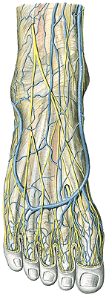
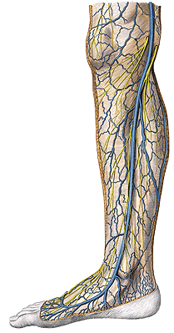
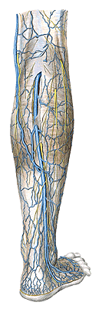
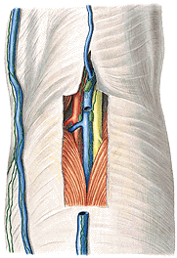
Vv. digitales dorsales – vv. metatarseae dorsales – arcus
venosus dorsalis (rete venosum dorsale pedis)
arcus venosus plantaris (rete venosum plantare pedis)
– vv. intercapitulares
v. marginalis med. – v. saphena magna
v. marginalis lat. – v. saphena parva (v. femoropoplitea)

Slide 21
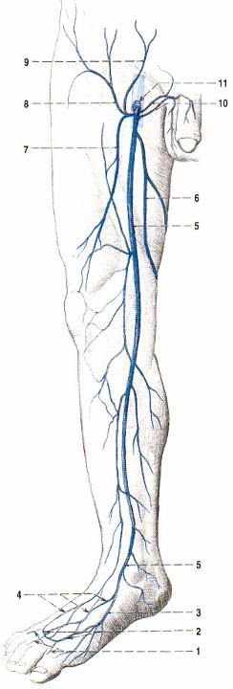
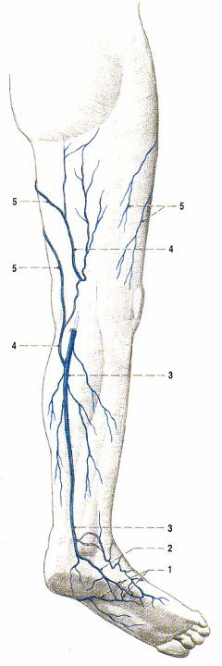

Slide 22
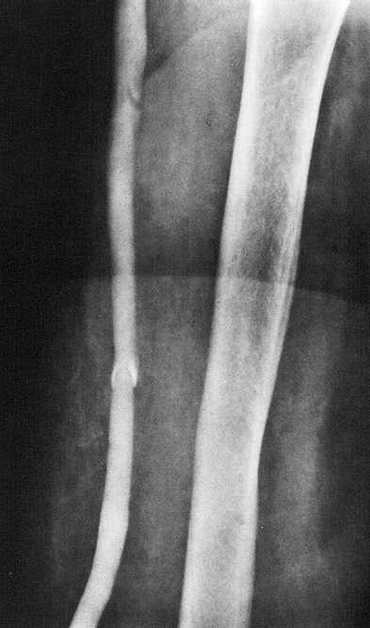
femur
v. saphena magna

Slide 23
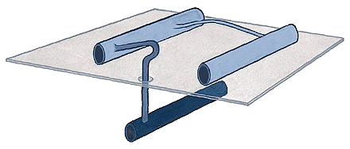
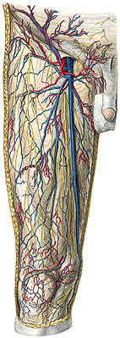
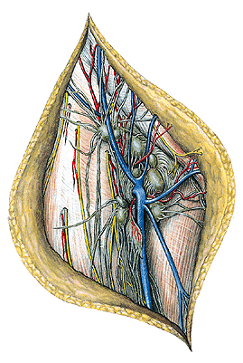
V. SAPHENA MAGNA
- v. saphena accessoria
- v. epigastrica spf.
- v. circumflexa ilium spf.
- vv. pudendae ext.
vv. perforantes

Slide 24
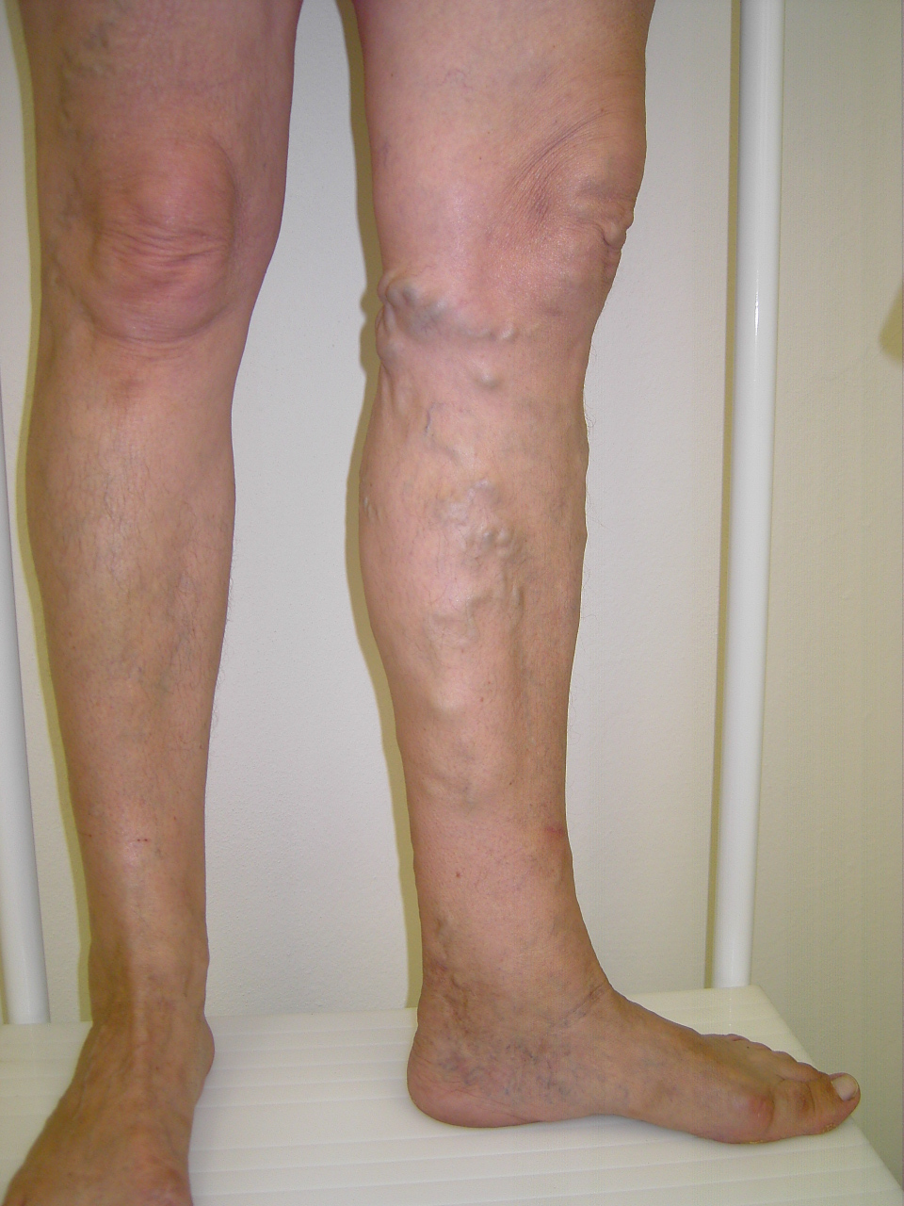
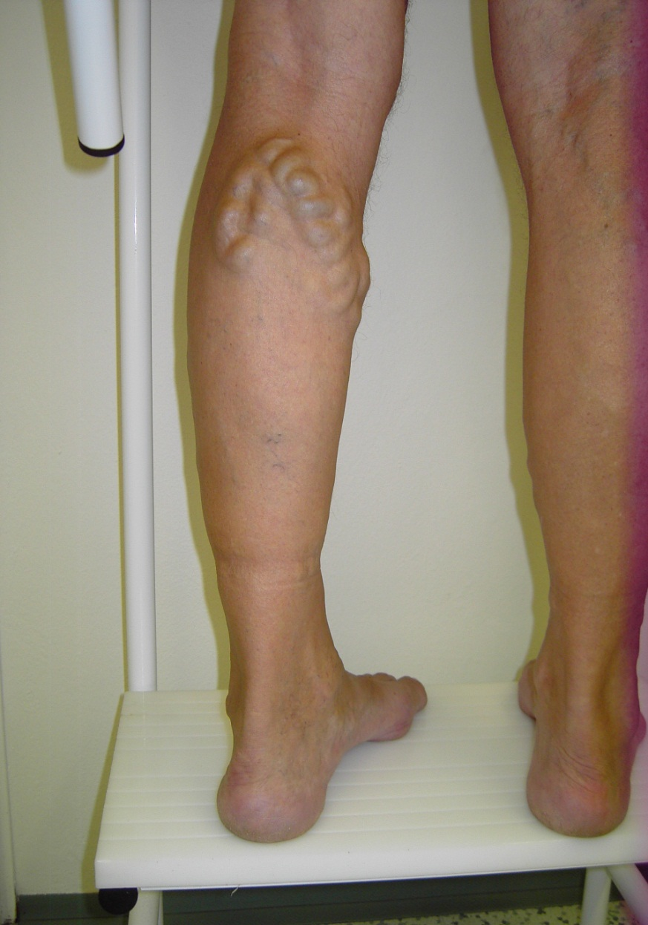
VARICOSE VEINS

Slide 25
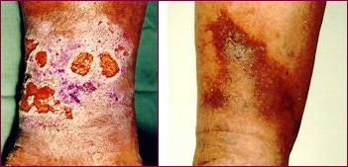
  ULCUS CRURIS

Slide 26
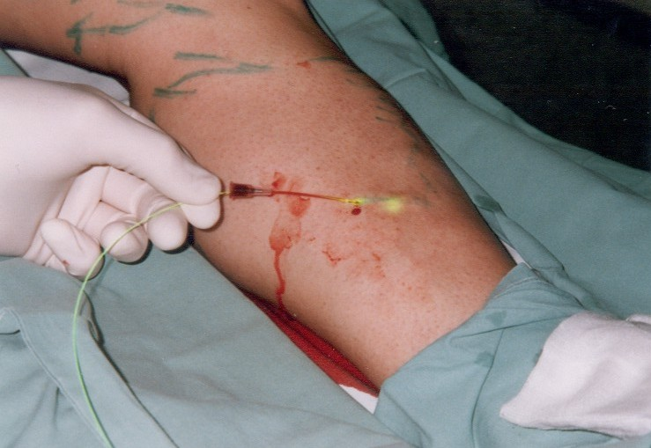

Slide 27
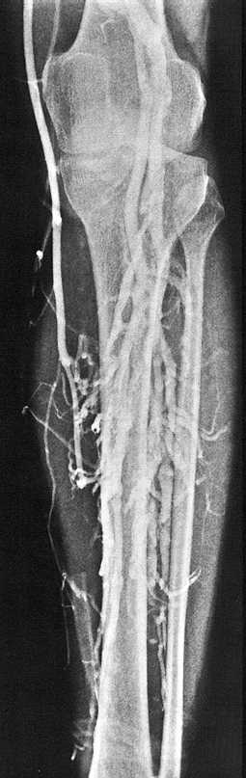
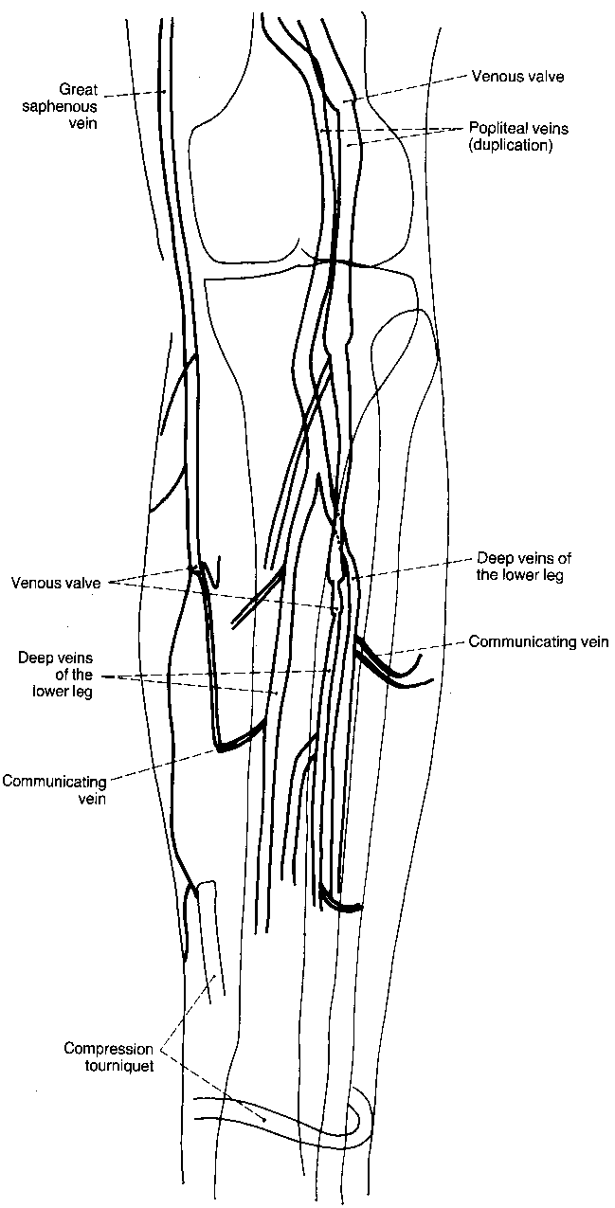

Slide 28
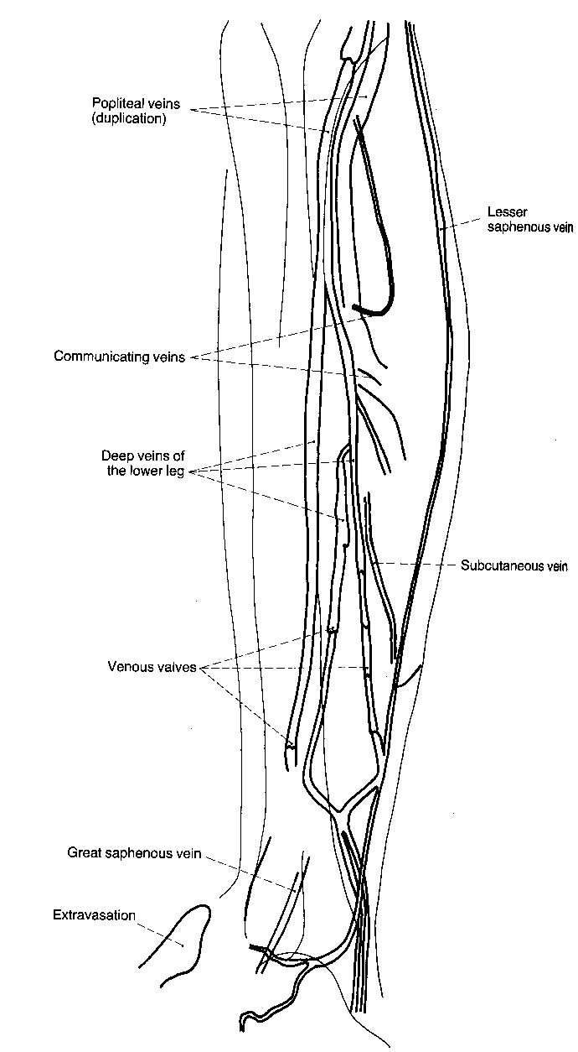

Slide 29
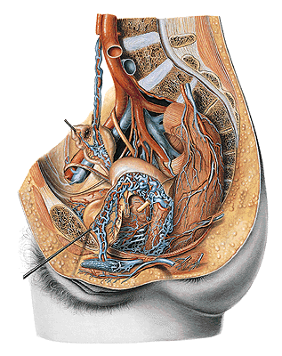
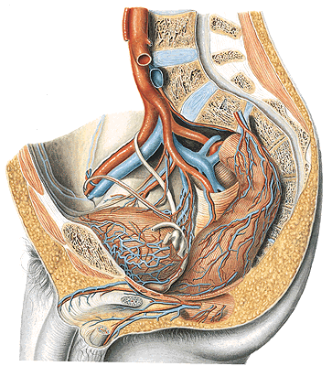
V. ILIACA INTERNA
- plexus venosus vesicalis – vv. vesicales
- plexus venosus prostaticus – v. dorsalis penis prof.
- plexus venosus vaginalis – v. dorsalis clitoridis prof.
- plexus venosus uterinus – vv. uterinae
- plexus venosus rectalis – v. rectalis sup., media, inf.
- plexus venosus sacralis – vv. sacrales lat.

Slide 30
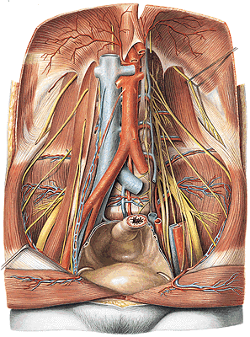
V. ILIACA COMMUNIS
- v. iliaca ext - v. femoralis
- v. epigastrica inf.
- v. circumflexa ilium prof.
- v. iliaca int.

Slide 31
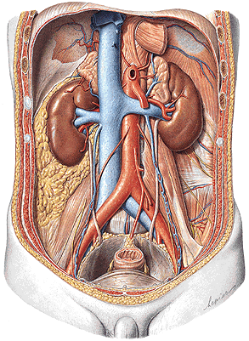
V. CAVA INF.
- v. iliaca communis dx. et sin.
- vv. lumbales
- vv. phrenicae inf.
- v. sacralis mediana
- v. testicularis dx.
(- v. ovarica dx.)
- vv. renales
- v. suprarenalis dx.
- vv. hepaticae

Slide 32
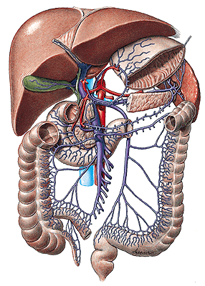
V. PORTAE
- vv. cysticae
- v. gastrica sin.
- v. gastrica dx.
- v. mesenterica sup.
- vv. pancreaticoduodenales
- vv. pancreaticae
- v. gastroomentalis dx.
- vv. jejunales et ileales
- v. ileocolica
- v. colica dx. et media
- v. splenica/lienalis
- vv. gastricae breves
- v. gastroomentalis sin.
- vv. pancreaticae
- v. mesenterica inf.
- v. colica sin., vv. sigmoideae,
v. rectalis sup.

Slide 33
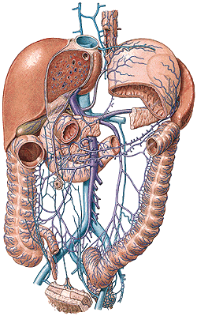
PORTAL-CAVAL / PORTAL-SYSTEMIC
ANASTOMOSES
Vv. gastricae – vv. oesophageae
Vv. paraumbilicales
(caput Medusae, Burrow’s veins)
Plexus rectalis - hemorrhoids
Retzius’ veins
Vv. hepaticae – vv. phrenicae

Slide 34
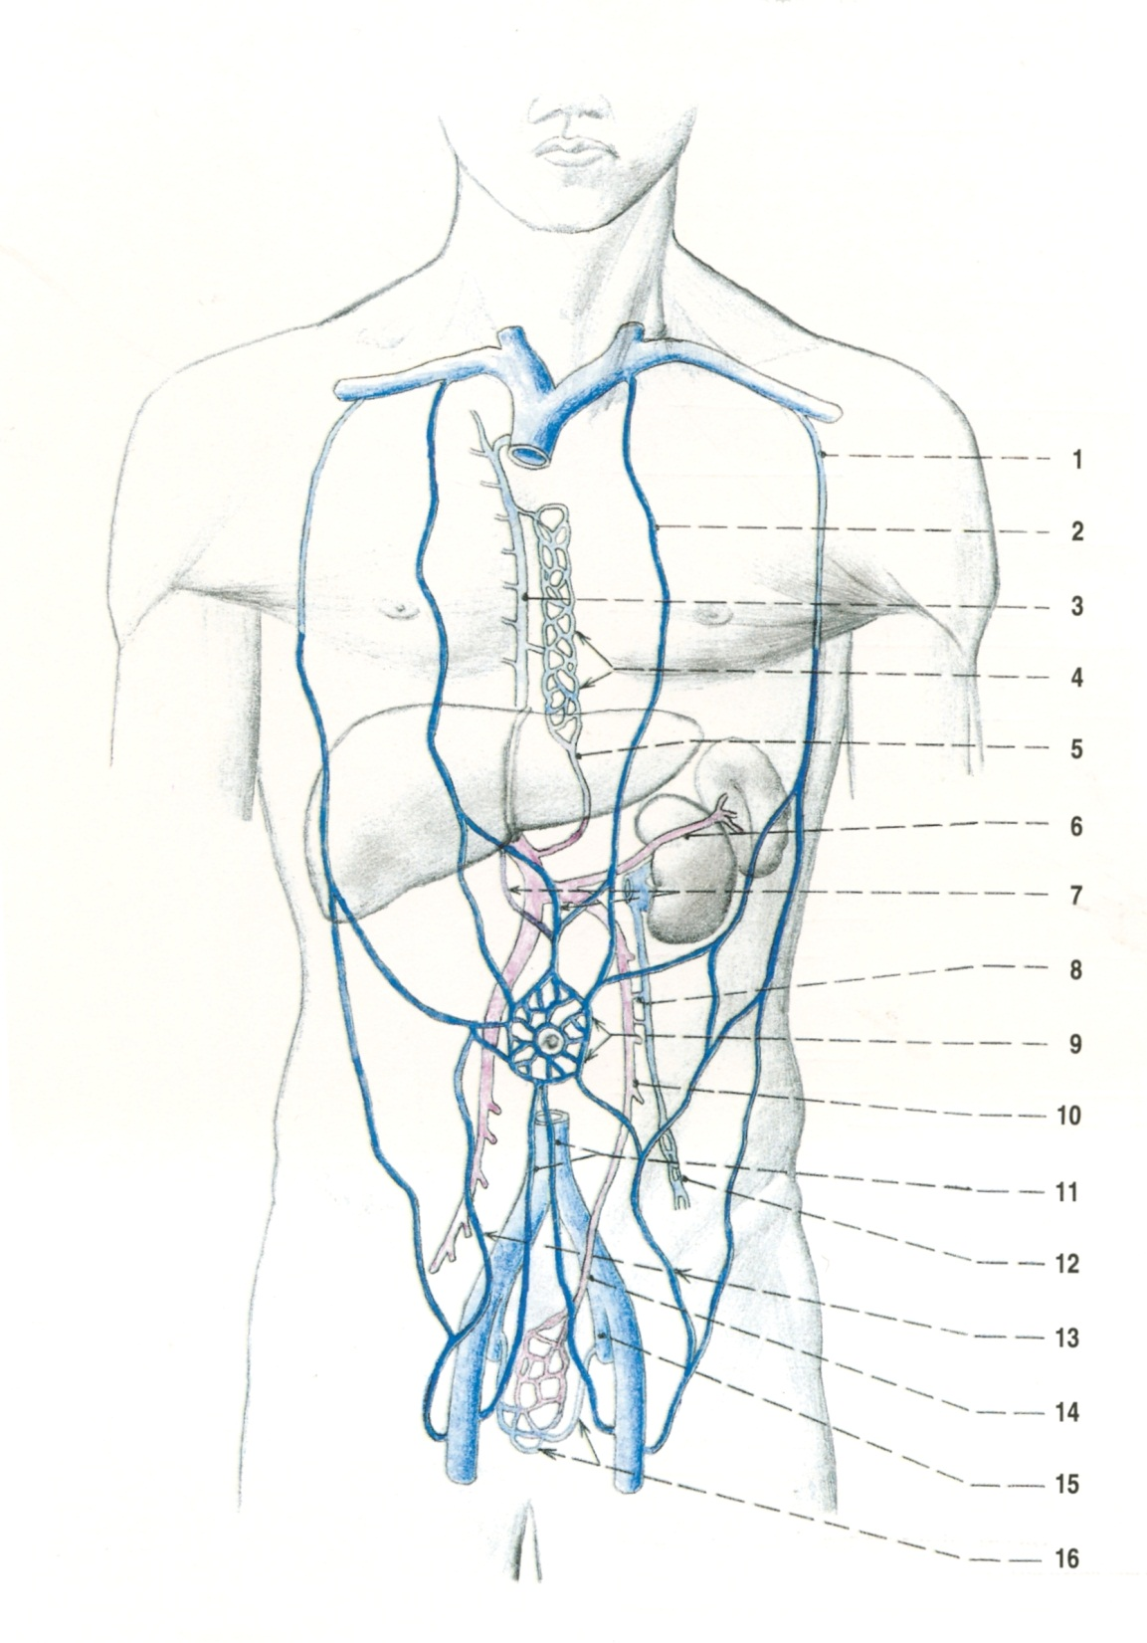
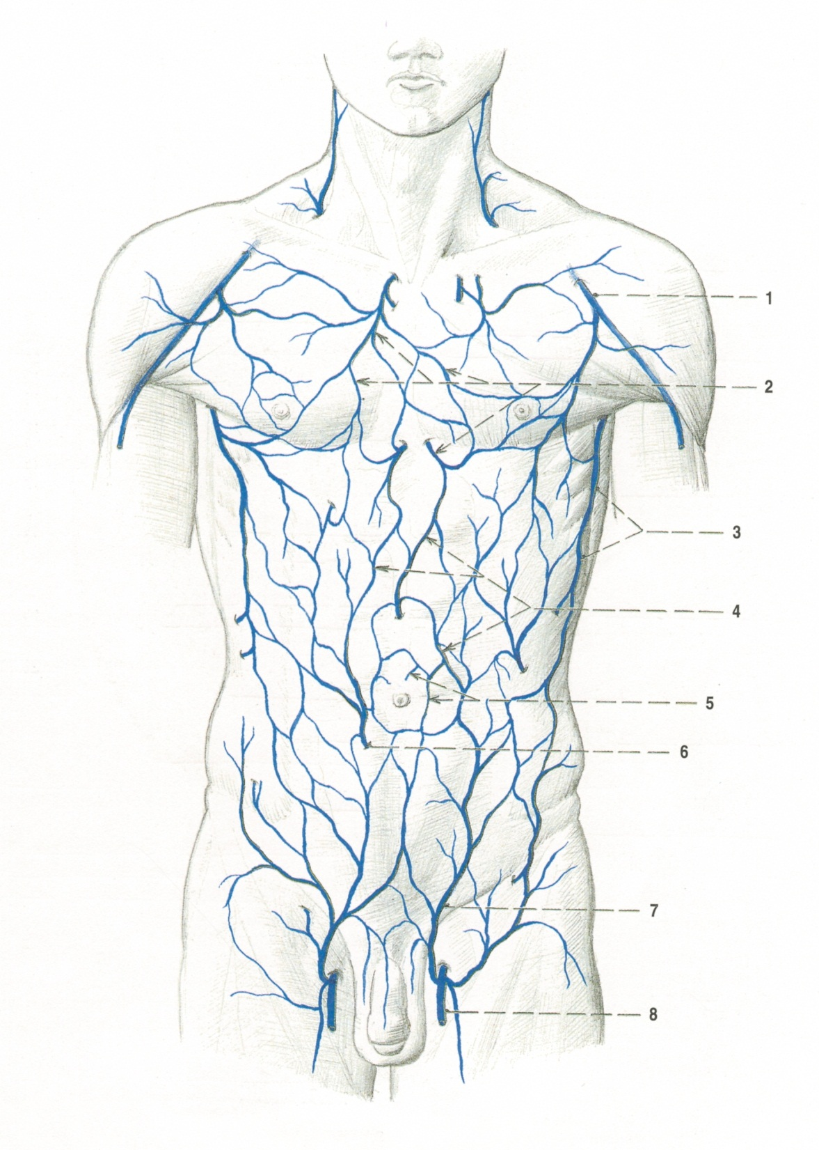

Slide 35


Caput medusae

Slide 36

FETAL CIRCULATION
- v. umbilicalis – lig. teres hepatis
- ductus venosus – lig. venosum
- foramen ovale – fossa ovalis
- ductus arteriosus – lig. arteriosum
- aa. umbilicales –chordae aa. umbilicales

Slide 37




Slide 38
Illustrations were copied from:
Atlas der Anatomie des Menschen/Sobotta.
Putz,R., und Pabst,R. 20. Auflage. München:
Urban & Schwarzenberg, 1993)
Čihák R: Anatomie 2 (Splanchnologia). Avicenum,
zdravotnické nakladatelství, Praha, 1988.

