Slide 1
Development of endocrine glands
Hypophysis
Epiphysis
Thyroid gland
Parathyroid glands
Suprarenal glands
Adenohypophysis
Neurohypophysis
ectoderm
neuroectoderm
endoderm
mesoderm
Cortex
Medulla

Slide 2
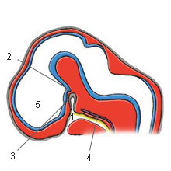
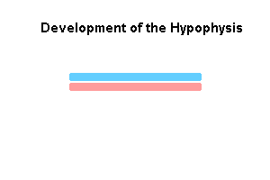
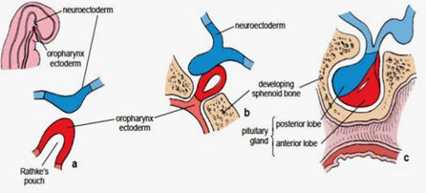

Slide 4
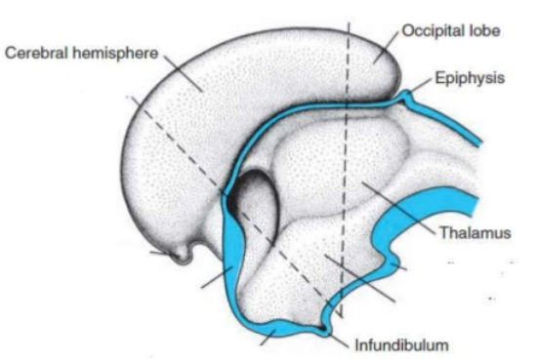

Slide 5
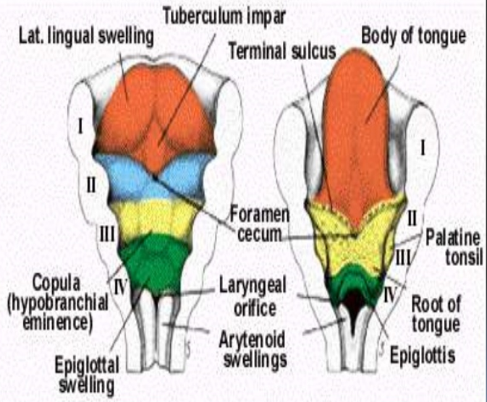

Slide 6
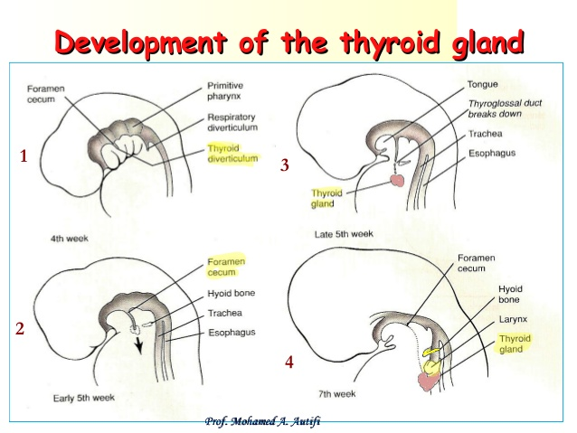

Slide 7
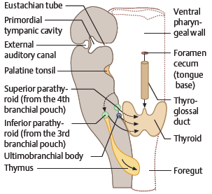

Slide 8
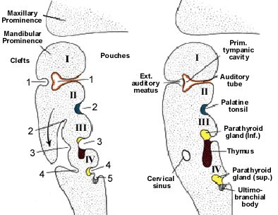

Slide 9
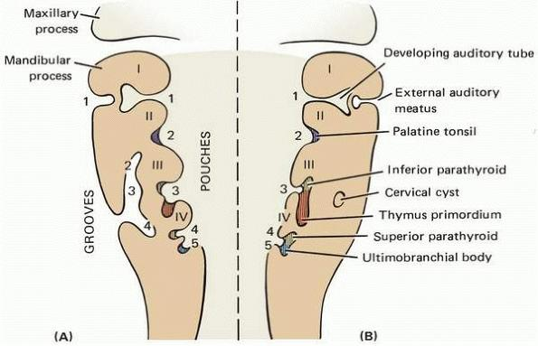

Slide 10
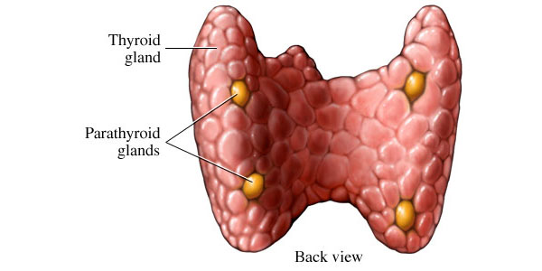

Slide 11
