Slide 1
(VII.) Electrocardiography
Physiology

Slide 2
Electrocardiography
Definition: the process of recording the electrical activity of the heart
Keywords
Specialized excitatory and conductive system of the heart
equipment for ECG recording
unipolar and bipolar leads
bipolar limb leads; unipolar limb leds; unipolar chest leads
heart vector, electrical axis of the heart

Slide 3
Specialized excitatory and conductive system of the heart
Sinoatrial node (SA)
internodal pathways
SA node
atrial muscle
Atrioventricular node (AV)
AV node
bundle of His
bundle branches
Bundle of His
Purkynje fibers
ventricular muscle
Bundle branches
Purkynje fibers

Slide 4
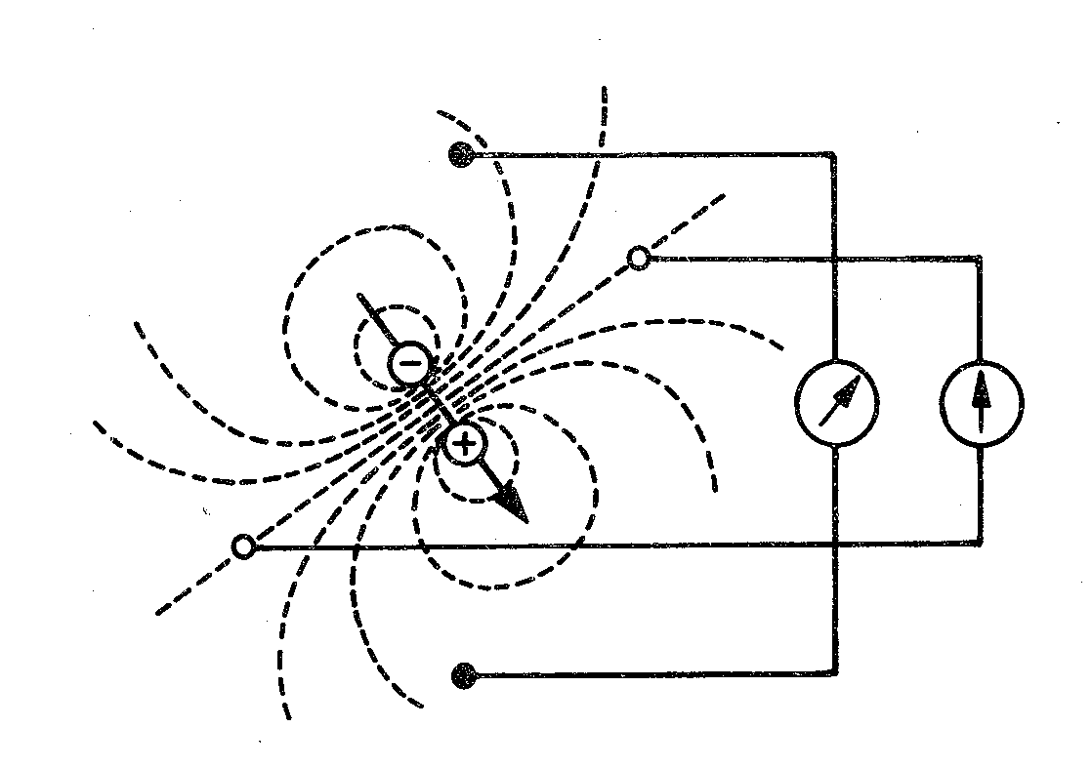
Electric dipole
Electrode: records electrical potential (Φ)
Electric lead: connection of two electrodes
Recordes voltage between electrodes
Voltage: difference between el. potentials (V= Φ1- Φ2)
electrode
Φ2
lead
Φ1

Slide 5
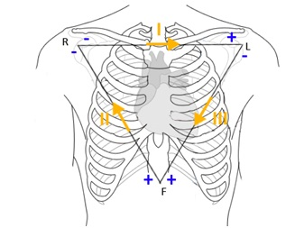
Einthoven´s triangle (standard - limb, bipolar leads)
I
R
L
II
III
Bipolar leads: both electrodes are active (variable potential en electrodes)
F

Slide 6
Augmented leads (Goldberger´s, limb unipolar leads)
R
L
avR
aVL
Unipolar leads:
one electrode is active (variable el. potential) and the second one is indifferent (constant el. potential)
Active electrode is always positive
aVF
F

Slide 7
Chest leads
Wilson´s cental terminal
R
R
R
chest electrode
Chest electrode: connection of chest electrode and Wilson´s central terminal
Unipolar leads: chest electrodes are active (positive) and Wilson´s central terminal is indifferent (el. potential 0 mV, electrically centre of the heart)
1
2
3
5
6
4

Slide 8
Leads acording to Cabrera
I
–
R
–
+
L
–
+
-
+
–
–
aVR
aVL
–
+
+
aVL
-30°
-
-
III
II
aVF
–
+
I
0°
+
+
+
–
F
–
aVR
+
30°
+
+
II
III
aVF
60°
120°
90°

Slide 9
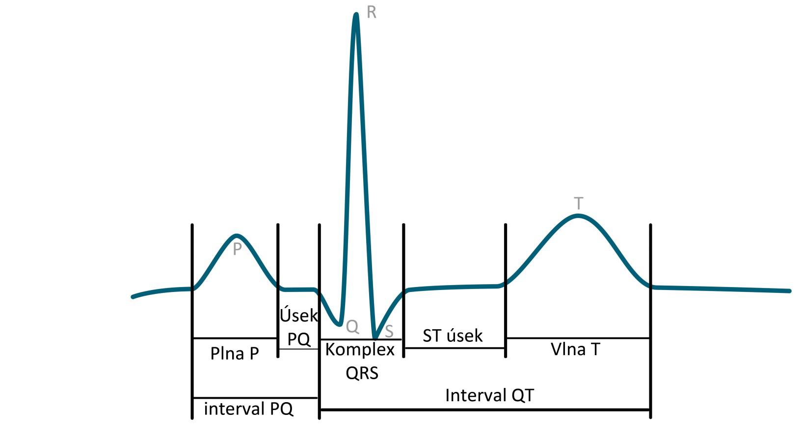
ECG description
name | Norm
P wave | 80 ms
Interval PQ (PR) | 120-200 ms
Segment PQ (PR) | 50-120 ms
Q | -
QRS | 80-100ms
R | -
S | -
segment ST | 80-120 ms
Interval QT | >= 420ms
wave T | 160 ms
R
T
P
PQ segment
ST segment
Bazett´s formula:$QTc=\frac{QT}{\sqrt{RR}}$
QT depends on RR interval – correction of QT on RR
Q
S
P wave
QRS complex
T wave
QT interval
PQ interval

Slide 10
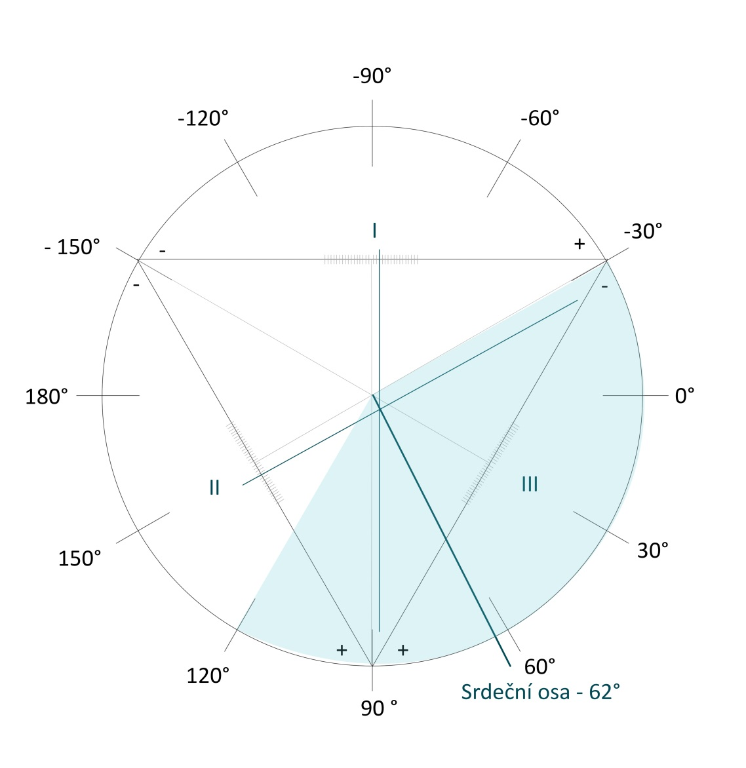
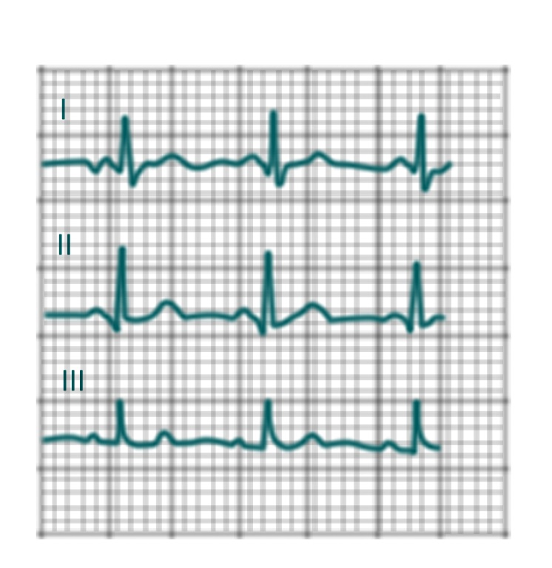
Electrical axis of heart
Average deviation of QRS complex in each lead
3. Drawing in triangle:
e.g.: combination results from I and II
2. Sumation of QRS complex
1. QRS of I,II or III leads
I | II | III
Q = -1 | Q = - 1 | Q = 0
R = 5 | R = 6 | R = 4
S = -1 | S = 0 | S = 0
3 | 5 | 4
L
R
I
–
+
–
–
3
II
5
III
Physiological interval: -30° to +110°
+
+
F

Slide 11
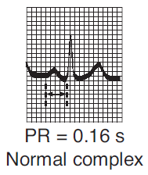
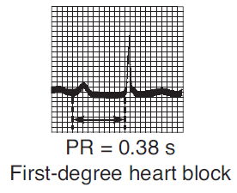
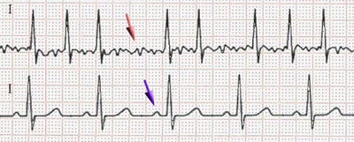
Diagnostic use of ECG
Atrioventricular block: conduction between the atria and ventricles of the heart is impaired
Arrhythmia: irregular heart beat
Fibrillation: is the rapid, irregular, and unsynchronized activity of cardiac muscle fibers
Atrial fibrillation
(absence of P, „jagged“ isolinia, irregular RR, HR 80 – 180 bpm)
AV block I. degree
Atrial fibrillation
AV block II. degree
P
P
P
P
P
P
physiology
Ventricular fibrillation
(heart cannot pump, brain damage after 3 – 5 min)
AV block III. degree
https://upload.wikimedia.org/wikipedia/commons/thumb/6/64/Afib_ecg.jpg/400px-Afib_ecg.jpg http://www.qureshiuniversity.com/Ventricular%20Fibrillation.gif
https://ekg.academy/ekgtracings/313.gif

Slide 12
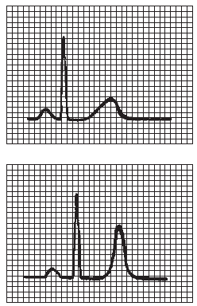
Diagnostic use of ECG
Myocardial ischemia, heart-attack
hyperkalaemia
A
B (ST elevation)

Slide 13
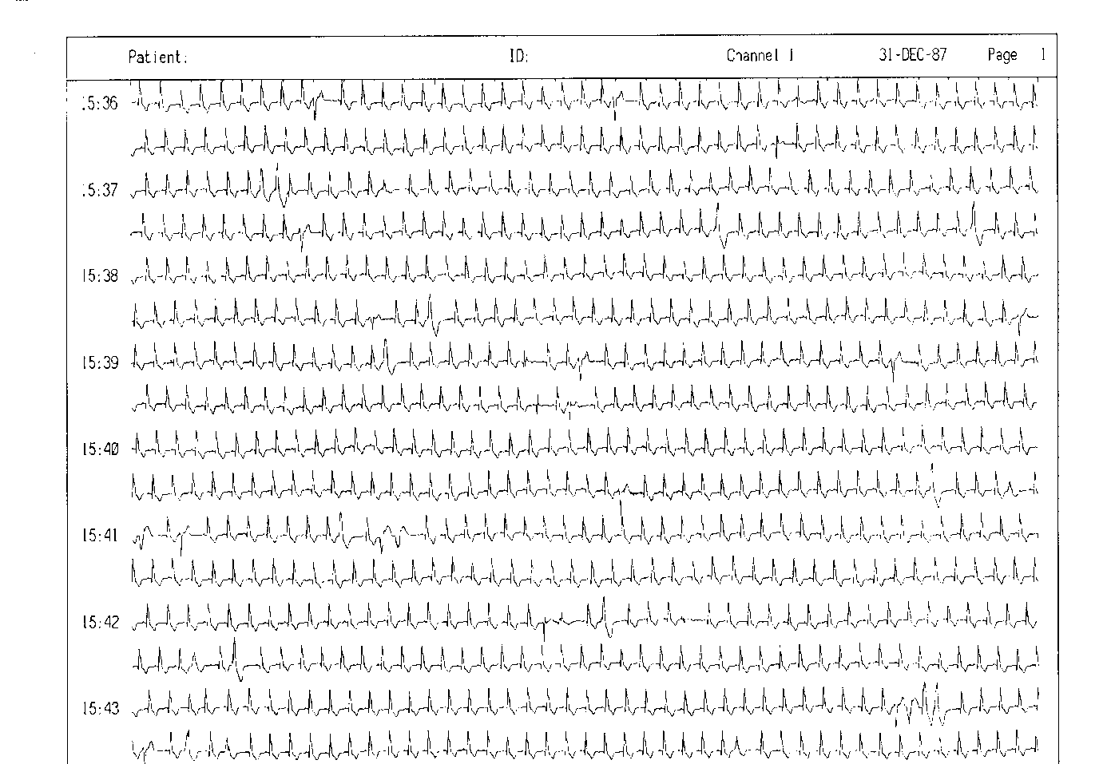
Diagnostic use of ECG
24-hour monitoring of ECG (Holter)

