Slide 1
Plethysmography - blood flow in the forearm -
© Department of Physiology, FM MU, Jan Novák, 2016

Slide 2
Blood flow measurement I
Radionuclide method
patient is injected with radioactive solution (= radiopharmaceutical) with short half-life (= fast elimination from the body = low toxicity)
higher the blood flow in the organ, higher the up-take of the radiopharmaceutical and higher is the radiation (emitted by the radiopharmaceutical) detected on the special detector
Clinical use:
Lung scintigraphy
used in the diagnostics of the pulmonary embolism (clinical condition when embolus blocks part of the pulmonary circulation and the area ahead of this obstruction shows no blood flow and is ischemic)
Myocardial scintigraphy (Cardiac-SPECT)
used in the diagnostics of ischemic heart disease if the ECG and laboratory results are unclear
After administration, radiopharmaceutical is distributed over the myocardium and areas with low radiopharmaceuticals concentration corresponds to the badly-perfused areas („hibernating myocardium“, locations after coronary artery stenosis) or to areas after myocardial infarction (myocardial scar is less perfused compared to healthy myocardium)
Normal lung Arrows = flow defect = embolism
Normal heart Arrow = flow defect = ischemia
Obrázek 1: http://web.carteret.edu/keoughp/LFreshwater/CPAP/V-Q%20Relationships/VQClassNotes_files/image006.jpg
Obrázek 2: http://img.medscapestatic.com/pi/meds/ckb/39/26839tn.jpg

Slide 3
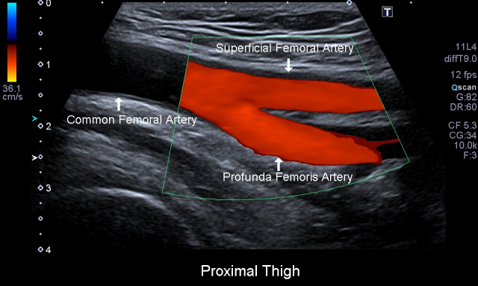
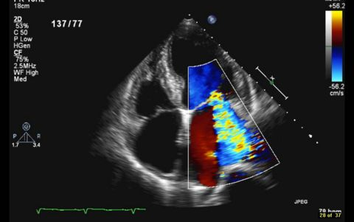
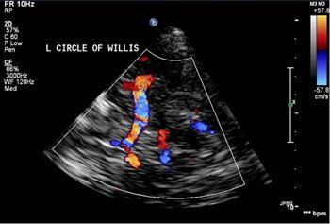
Blood flow measurement II
Doppler measurements
based on Doppler effect (changes in the frequency and wavelength of the emitted and received signal based on the mutual movement of the transmission device and receiver)
http://thequantumtunnel.com/wp-content/uploads/2013/06/Sheldon-as-Doppler-Effect.png
Clinical use:
vessel ultrasound of extremities (thrombosis, ischemia and blood flow assessment in limbs)
echocardiography (blood flow over valves, valves diseases – stenosis, regurgitations…)
Transcranial Doppler (blood flow in the brain circulation)
Obrázek tepen DKK: http://pacificvascular.com/wp-content/uploads/2014/02/PAEvaluations2.png
Obrázek echokardioagrafie: https://web.stanford.edu/group/ccm_echocardio/wikiupload/thumb/f/f9/A4C_MR_moderate.jpg/480px-A4C_MR_moderate.jpg
Obrázek TCD: http://www.swedish.org/~/media/Images/Swedish/I/Image3CircleofWillis.JPG

Slide 4
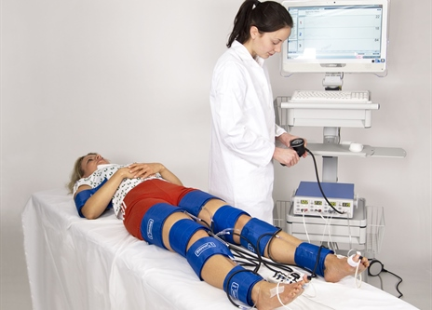
Blood flow measurement III
Plethysmography
evaluation of the volume changes in the limbs (higher the blood flow, faster the volume increase if the blood outflow from the limb is closed)
venous occlusive plethysmography uses two cuffs:
occlusive cuff (OC) is used to close (=occlude) blood outflow through veins
measuring cuff (MC) is used to detect volume changes
Clinical use:
Evaluation of endothelial function and dysfunction (within research, so called FMD = flow-mediated dilation of brachial artery reflects the function of endothelial NO-synthasis)
Evaluation of the ischemic limb disease (USA, especially in research or in clinical practice using segmental measurement of blood pressure, which informs us about the location of the arterial occlusion)
https://www.perimed-instruments.com/upl/images/377677_464_333_2_0_thumb/segmental-pressures-perimed.jpg

Slide 5
Vascular tone regulation
Various vasoactive compounds are affecting the vessel at one time including both vasodilatory (nitric oxide, adenosine, histamine, low pH = acidosis…) and vasoconstrictive compounds (angiotensin II, adrenaline through α-receptors, vasopressin, serotonin, caffeine…) = whether vasodilation or vasoconstriction occurs, depends on their ratio
Neural regulation
Vessels are innervated via sympathetic nervous system:
α-receptors causing vasoconstriction
β-receptors causing vasodilation (coronary, muscle and lung circulation)
Myogenic regulation
increased vessel wall tension causes vasoconstriction (we can image this as an „defense against too big vessel extension if the blood pressure is too high“)
myogenic regulation is mediated via stretch-receptors, that are connected to cationic channels (Na⁺, Ca²⁺) = cation influx into cell leads to depolarization and smooth muscle cells contraction
Metabolic regulation
under ischemic conditions, variety of metabolic degradation products originates (e.g. lactate, ADP, AMP) and pH decreases (acidosis), all of which results in vasodilation („the aim is to remove the degradation products from circulation“)
this is called reactive hyperemia
metabolic regulation is tightly connected with functional hyperemia that occurs during physical exercise (exercise causes the series of contractions and relaxations which affects blood flow in vessels; after every contraction blood flow increases during the relaxation period and this hyperemia lasts even after the exercise is over)

Slide 6
Endothelial function and dysfunction
Endothelial functions:
Barrier function (endothelium is a part of hematoencephalic barrier, glomerular filtration membrane, it participates on the creation of the lymph, etc.)
Blood clotting and coagulation (thrombocyte adhesion, tissue factor, tPA,…)
Immune and inflammatory reaction (endothelial selectins, VCAM, ICAM…)
Endocrine functions (e.g. nitric oxide, angiotensin-converting enzyme production, many various receptors for various hormones and signaling molecules)
Endothelial dysfunction
Endothelial dysfunction is a complex pathological phenomenon characterized by:
disruption of the vasodilation/vasoconstriction ratio (based mainly on the deficiency of nitric oxide)
pro-trombogenic state (higher risk of thrombi creation consequently causing vessel wall inflammation)
transition from quiescent to proliferative stage (disrupted endothelium produces various growth factors and cytokines leading to endothelial and vascular smooth muscle cells proliferation resulting in the vascular remodeling)
Endothelial dysfunction represents the initial stage of the atherosclerosis which in the end of the day leads to ischemic heart disease (including myocardial infarction), ischemic limb diseases (causing various ulcers and leading to limb amputations) or to brain vessels atherosclerosis (including ischemic strokes)
ENDOTHELIAL DYSFUNCTION
DEVELOPED ATHEROSCLEROTIC PLAQUE
(+ ISCHEMIA)

