Slide 1
(VII.) Examination of pulse by palpation
Physiology I - practicals

Slide 2
Pulse (pulsus)
Aortal wall stretches in forward direction
Pressure (pulse) wave
Mechanical manifestation of heart activity
Mechanical wave (pulse wave) arises after each contraction of LV and propagates along the arterial wall
Aortal valve contracts behind the pressure wave
Ejection phase of systole
(open aortal valve)
Diastole (closed aortal valve)
SBP
DBP

Slide 3
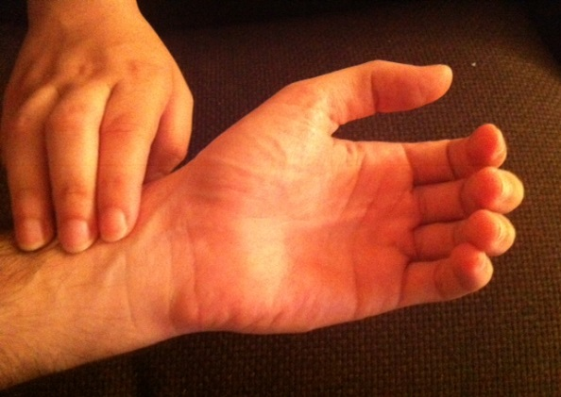
Palpation of pulse
a. carotis
a. subclavia
Where:
A. radialis
A. carotis
A. femoralis
A. brachialis
A. poplitea
A. tibialis posterior
A. dorsalis pedis
a. axillaris
aorta abdominalis
a. brachialis
a. femoralis
a. radialis
a. poplitea
How:
a. tibialis posterior
a. dorsalis pedis
http://docplayer.cz/docs-images/40/13777908/images/page_5.jpg

Slide 4
Examination of pulse
Frequency: number of pulses per one minute = pulse rate
Qualities: regularity, compressibility
According qualities, we can describe:
Pulsus regularis
Pulsus irregularis
Pulsus celer (Corrigan´s pulse: P. celer, altus, frequens)
Pulsus tardus
Pulsus durus – hardly compressible pulse – hypertension
Pulsus mollis – easily compressible pulse – hypotension
Pulsus magnus – high amplitude of pulse
Pulsus parvus – small amplitude of pulse
Pulsus filiformis – threadlike pulse – circulatory failure

Slide 5
Heart rate
Physiological values: 60 – 100 beats per minute (BPM) at rest
Tachycardia: increased heart rate (> 100 at rest)
Bradycardia: decreased heart rate (< 60 at rest)
Arrhythmia: an abnormality in the heart's rhythm, or heartbeat pattern. The heartbeat can be too slow, too fast, have extra beats, skip a beat, or otherwise beat irregularly

Slide 6
Heart rate vs. pulse frequency
Heart rate (HR) is a number of cardiac cycles per minute
computed from ECG
Pulse frequency is a number of pulse cycles per minute
Computed from sphygmography, blood pressure or by palpation of artery
Usually: heart rate = pulse frequency

Slide 7
Modulation of HR by autonomic nervous system (ANS)
ANS modulates heart automaticity by modulation of SA node activity
Parasympathetic system – vagus nerve – „nervi retardantes“
Via M2 receptors
Negative chronotropic effect
Decreased tonus of vagus nerve = increased HR
Sympathetic system – sympathetic cardiac nerves – „nervi accelerantes“
via β1 receptors
Positive chronotropic effect
Increased sympathetic activity = increased HR
Sympathetic and parasympathetic systems are active simultaneously, but in different intensity…

Slide 8
Baroreflex
Short-time control of arterial pressure
Mean arterial pressure (MAP) is detected by baroreceptors in aortic arch and sinus caroticus
stretch-receptors (mechanoreceptors)
Afferent fibres: vagus nerve (n. X.) and n. glossopharyngeus
Centre: rostral part of nucleus solitarius in medulla oblongata
Efferent pathways:
Cardiac branch: n. vagus (+ Sympathetic system) – heart rate changes
Peripheral (vascular) branch: sympathetic vascular innervation – changes of total peripheral resistance (TPR)

Slide 9
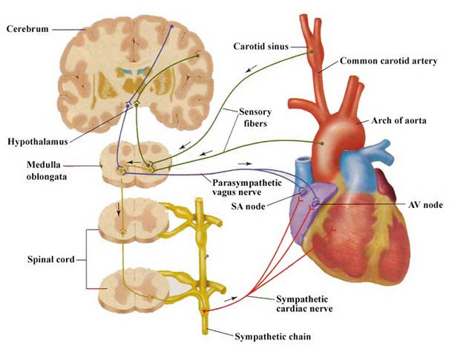
Baroreflex
Mechanism: ↓MAP ↓afferentation from baroreceptors processing
↓vagus activity and ↑sympathetic activity
↑HR and ↑TPR (MAP = HR * SV * TPR)
↑MAP
… and conversely in case of MAP increase
Vasomotoric sympathetic nerves
Vessels

Slide 10
Respiratory sinus arrhythmia (RSA)
ECG
Changes of heart rate in accordance with breathing: increase of HR during inspirium, decrease of HR during expirium
The most evident in young people, associated with vagal activity
RSA disappears with HR increase (stress, exercise, high age)
BP
respiration
time [s]
Mechanisms of RSA formation:
Baroreflex: during inspiration – ↓ intrathoracic pressure → ↑venous return (due to ↑ pressure gradient) → ↑systolic volume → ↑MAP → baroreflex (2 s lag) → ↓HR → ↑ (balance of) MAP
Central origin: irradiation of respiratory centre to cardiomotoric centre in the medulla oblongata
Bainbridge reflex: ↑venous return during inspirium – stretch of atria – activation of stretch-receptors – stimulation of n. vagus – stimulation of SA node
Local source: mechanical stretch of SA node accelerates its depolarization (weak RSA is presented in transplanted heart)
Another reflexes influencing vagal activity, chemoreflex (oscillation of pCO₂, pO₂, pH)

Slide 11
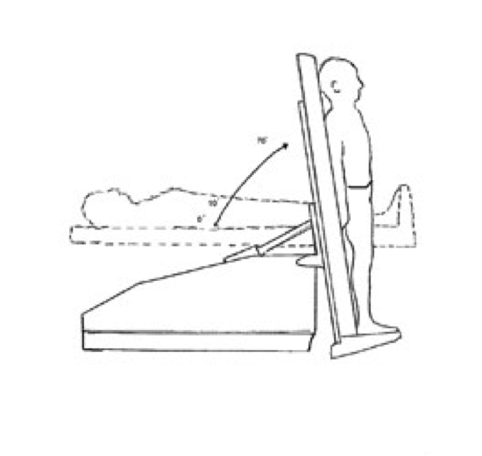
Heart rate during body posture changes
Body posture changes in gravity field cause blood pressure (BP) changes. These changes are minimized by short-term BP regulation (baroreflex).
Clinostatic reaction – change of position from standing (sitting) to lying:
↑venous return from lower part of body → ↑heart filling (preload) → ↑stroke volume(SV) → ↑BP → baroreflex causes ↓HR and ↓ total periphery resistence (TPR)
Orthostatic reaction – change of position from lying to standing (sitting): ↓ venous return from lower part of body → ↓ heart filling (preload) → ↓SV → ↓BP → baroreflex causes ↑HR and ↑TPR
Cardiac branch of baroreflex is faster but less effective in BP maintenance - HR increases within 1 s after BP decrease, this prevents to brain perfusion decrease
Peripheral branch of baroreflex is slower but more effective: TPR increases cca 6 s after BP decrease and stabilize BP → HR decreases during long lasting standing to resting value

Slide 12
Heart rate changes and physical exercise
Working muscle has higher metabolic demands – perfusion is increased (autoregulation of blood flow, metabolic vasodilatation)
Exercise increases tonus of sympaticus („ergotropic system“)
Anticipation of exercise
There is compensatory vasoconstriction in those tissues which are not metabolically active (GIT, reproduction system, excretory system, skin) – s.c. redistribution of blood.
It affects heart function:
Vasodilatation in muscles → ↓TPR → ↓BP → baroreflex → ↑HR
Sympaticus: ↑HR
Athletes' heart

Slide 13
Refferences to slides:
Slide 6 - https://www.pinterest.com/pin/144537469264742090/ [cited 31.8.2015]
Slide 6 - http://www.angiologist.com/general-medicine/pulse-palpation-and-pulse-location/ [cited 31.8.2015]
Slide 12 - http://corposcindosis.wikia.com/wiki/File:Baroreflex.jpg [cited 31.8.2015]
Slide 14 - http://www.cardiachealth.org/postural-orthostatic-tachycardia-syndrome-pots [cited 31.8.2015]

