Slide 1
GENERAL EMBRYOLOGY 2
• Development of extraembryonic structures – extra-embryonic mesoderm, extraembryonic coelom, yolk sac, fetal membranes: amnion and chorion.
• Development of the placenta.
• Anomalies of the placenta and umbilical cord.
• Multiple pregnancy – arrangement of fetal membranes.
• The length of pregnancy, calculation of delivery date.
• Fetus position in the uterus – situs, positio, presentatio and habitus. The length and weight of fetus during i.u. development. The rule of Haase.
• Mature and full-term fetus, marks of mature fetus.

Slide 2
Extraembryonic mesoderm
•Derives from cytotrophoblast
•cells fill cavity of blastocyst („sparse mesh“)
•by fusion of clefts among cells - extraembryonic coelom between 2 layers of mesoderm (visceral and parietal) arises

Slide 3
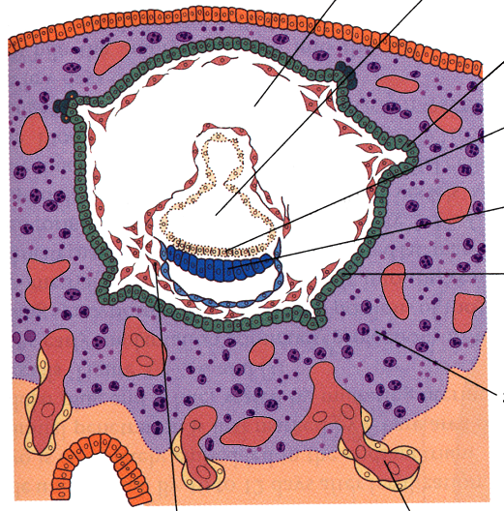
Extraembryonic mesoderm
Extraembryonic coelom
extraembryonic coelom
= chorionic cavity
žv
Parietal layer =
extraembryonic somatopleura + cytotrophoblast – chorion
+ amnionic ectoderm – amnion
Visceral layer =
extraembryonic splanchnopleura is mesoblast of yolk sac
(Heuser‘s membrane)

Slide 4
Development of chorionic villi
• chorionic villi – consist of cytotrophoblast, which is covered with syncytiotrophoblast (day 10)
• chorionic villi – with extraembryonic mesoderm ingrowing from chorionic cavity (day 12-13)
• chorionic villi – with extraembryonic blood vessels in mesoderm /vascularized mesoderm/ (day 17-18)

Slide 5
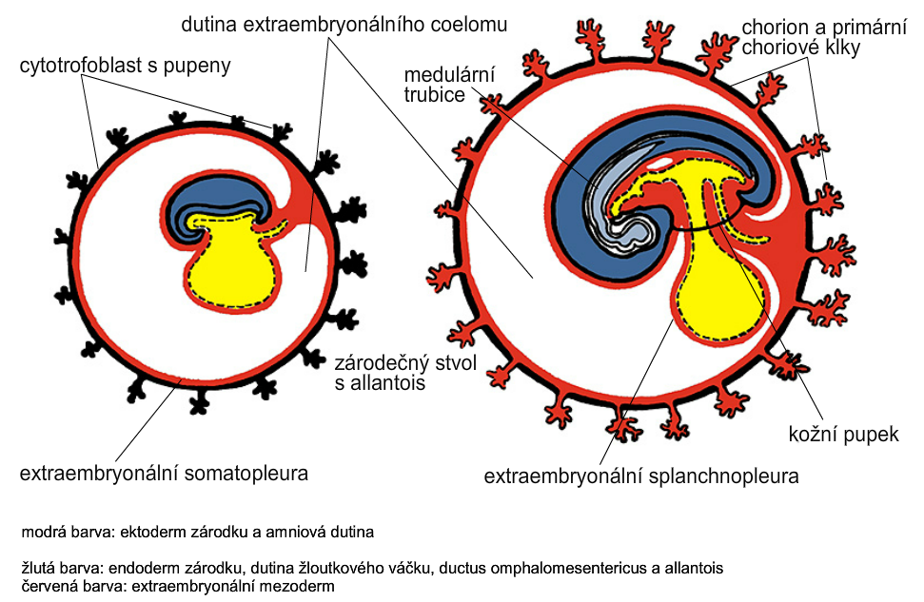
Yolk sac, amnionic sac, fetal membrane - amnion, chorion.
extraembryonic coelom
chorionic cavity
chorion and
chorionic villi
cytotrophoblastic buds
neural tube
connecting
stalk
skin navel
extraembryonic somatopleura
extraembryonic splanchnopleura

Slide 6
•Villi choriales are based over the whole surface of implanted blastocyst, resp. Its chorionic membrane
•Different growth of villi toward decidua basalis (partially decidua marginalis) and toward decidua capsularis and decidua marginalis causes division of chorion into parts:
• CHORION FRONDOSUM (toward decidua basalis
– with villi) and
CHORION LAEVE (smooth, without villi)
•Chorion frondosum and decidua basalis fuse together and creates placenta

Slide 7
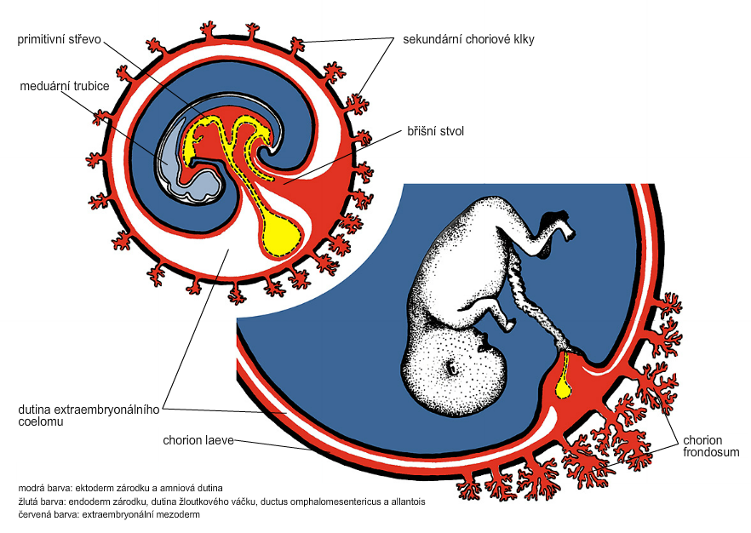
Development of fetal membranes
chorionic villi
primitive gut
neural tube
connecting stalk
amniotic cavity
chorionic cavity
chorion
frondosum
chorion
laeve

Slide 8
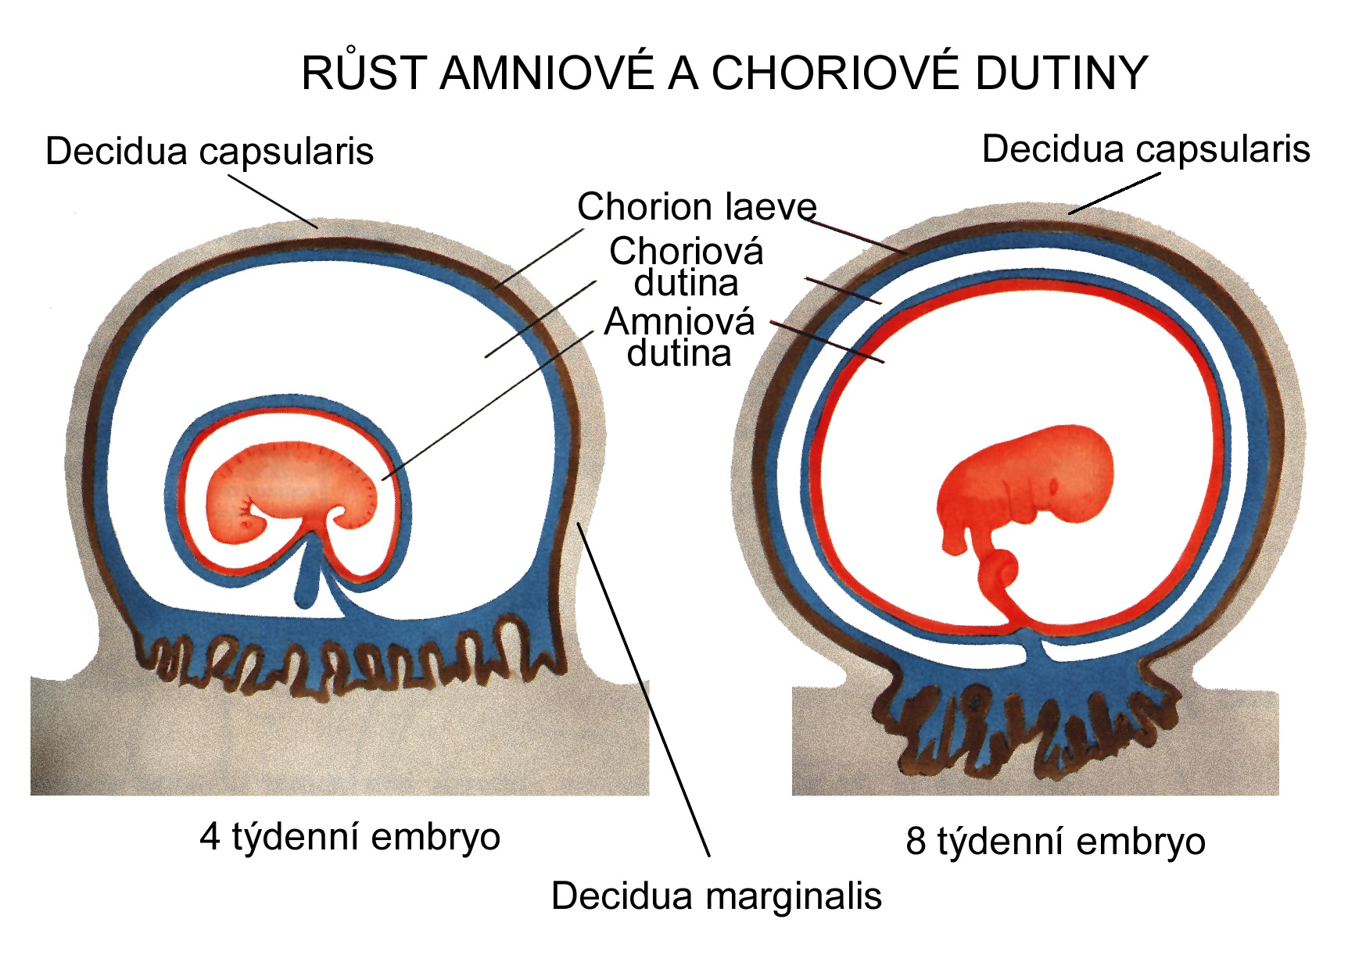
CHORION = cytotrophoblast + syncytiotrophoblast + extrembryonic
mesoderm
AMNION = extraembryonic mesoderm + ectoderm
GROWTH OF AMNIOTIC AND CHORIONIC CAVITY
Chorionic cavity
Amniotic
cavity
Chorion frondosum
Decidua basalis
Chorion frondosum
4 weeks embryo
8 weeks embryo

Slide 9
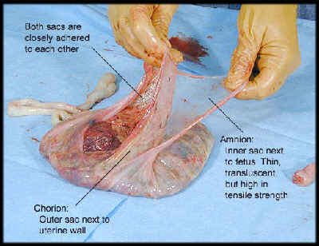
Human placenta
-discoidea
-olliformis
-hemochorialis
∅15 - 25 cm
width up 3 cm
weight 500g

Slide 10
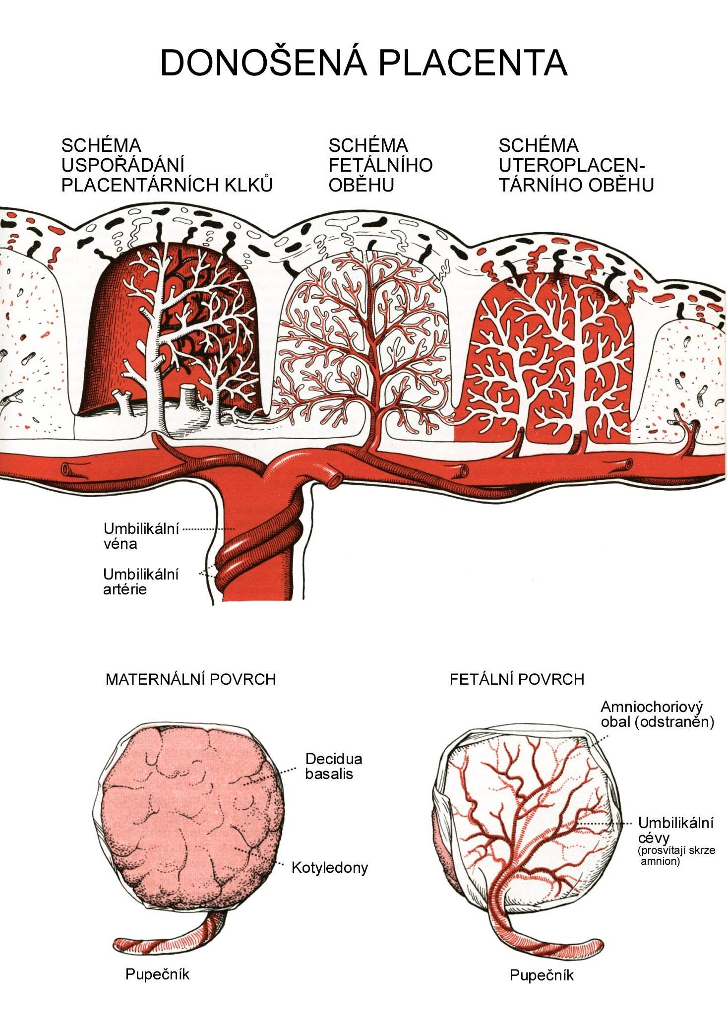
FULL TERM PLACENTA
maternal surface (with cotyledons)
umbilical
1 vein +
2 arteries
maternal surface
fetal surface
umbilical vessels
cotyledons
umbilical cord
umbilical cord

Slide 11
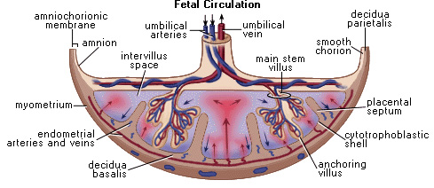
COMPARTMENTS OF PLACENTA:
 PARS FETALIS PLACENTAE – chorionic plate + chorionic
villi, intervilous space
 PARS MATERNA PLACENTAE = zona functionalis deciduae
basalis

Slide 12
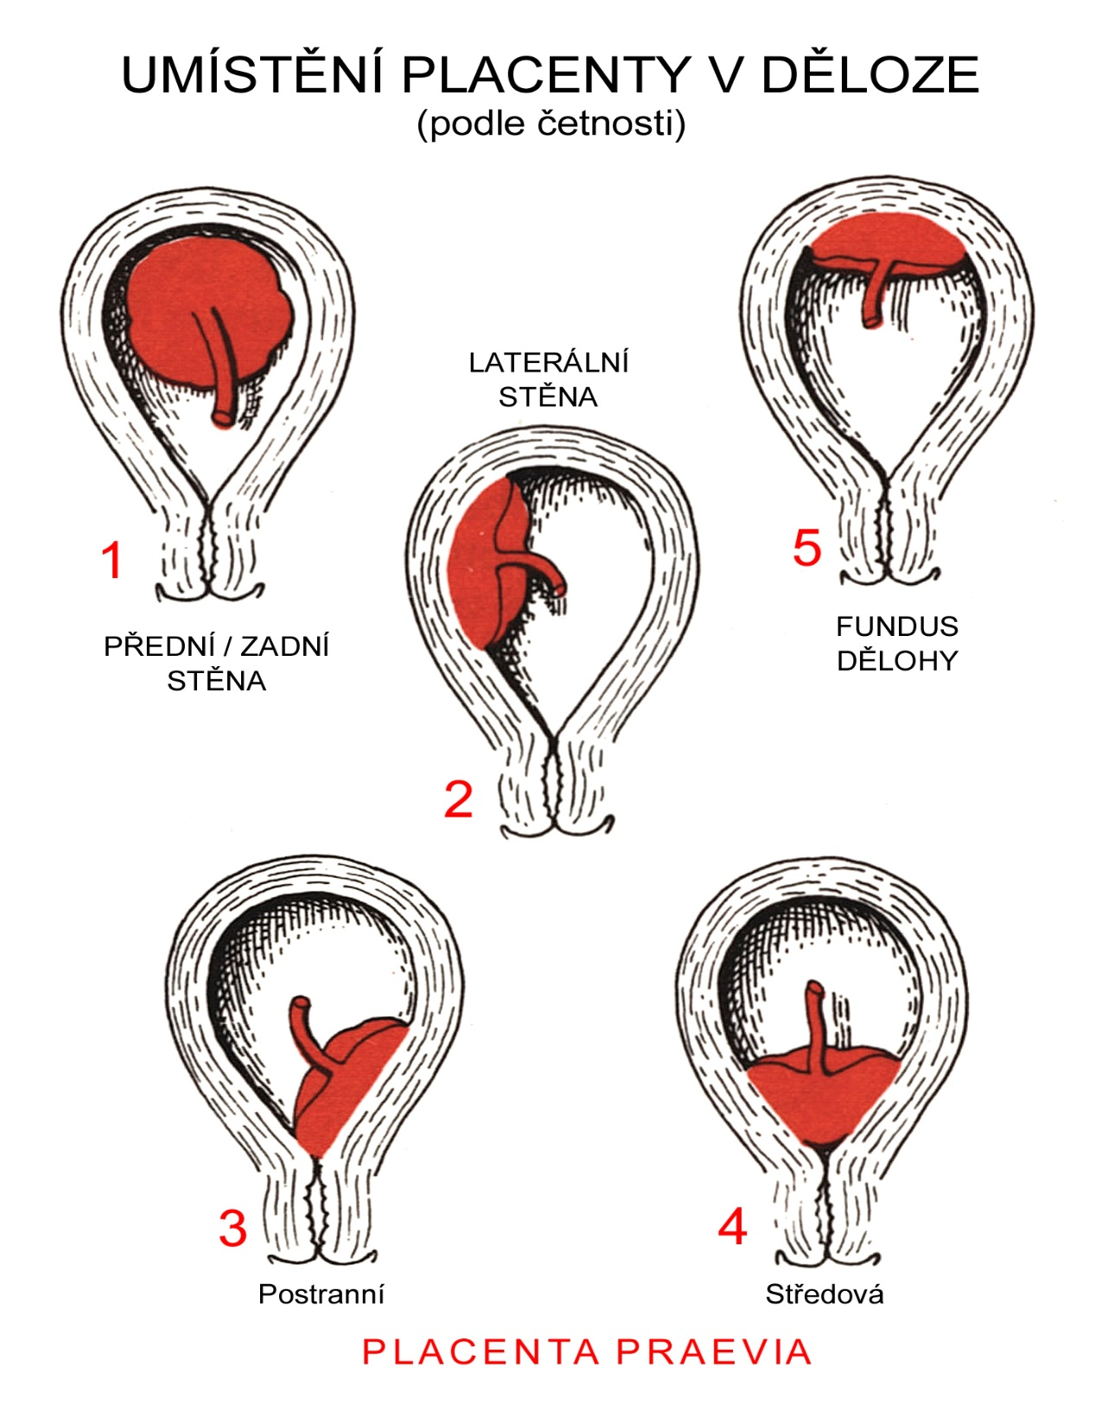
POSITION OF PLACENTA
IN UTERUS
lateral
wall
venrtal/dorsal
wall
uterine
fundus

Slide 13
Anomalies of placenta
Anomalies of chorionic villi (1 : 100 pregnancies)
 mola hydatidosa
 chorionepitheliom
Anomalies in location:
 placenta praevia (causes bleeding in week 28)
 placenta accreta (attached to myometrium)
 placenta increta (grown into myometrium)
 placenta percreta (grown through myometrium)

Slide 14
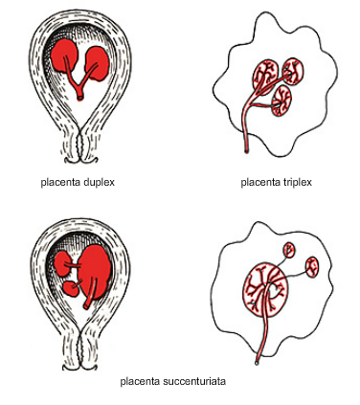
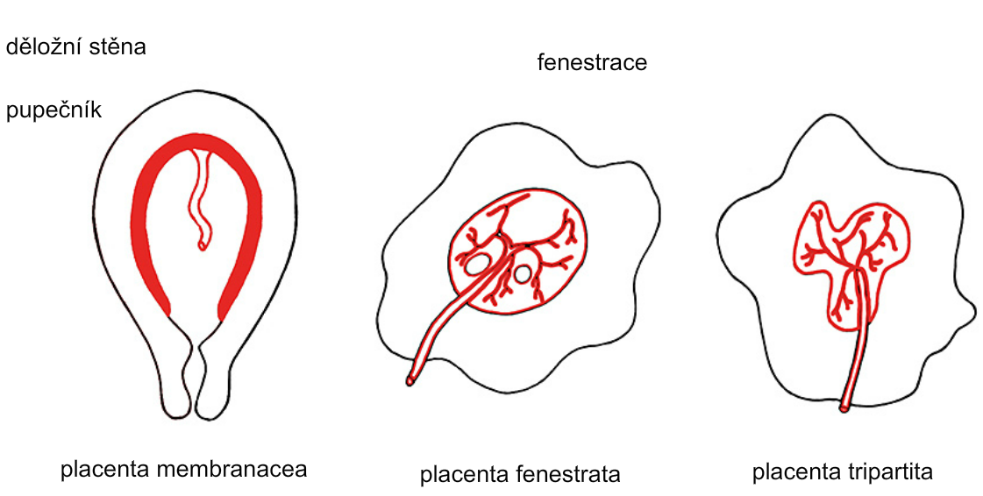
Anomalies of placenta
Anomalies of placenta
Anomálie placenty
placenta duplex
placenta triplex
(several separate pieces)
placenta placenta placenta placenta
membranacea fenestrata tripartita succenturiata
(perforated) (several portions) (1 main + several accessory placentae)
(large, thin)

Slide 15
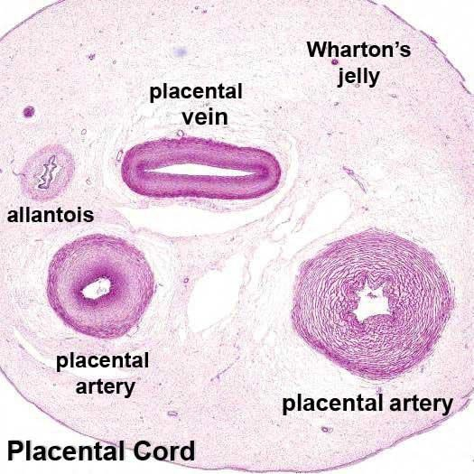
Umbilical cord of full-term fetus:
50 – 60 cm long and 1,5 – 2 cm wide
 amniotic ectoderm on the surface
 jelly-like connective tissue with umbilical vessels:
v. umbilicalis (1) + aa.umbilicales (2)
Funiculus umbilicalis

Slide 16
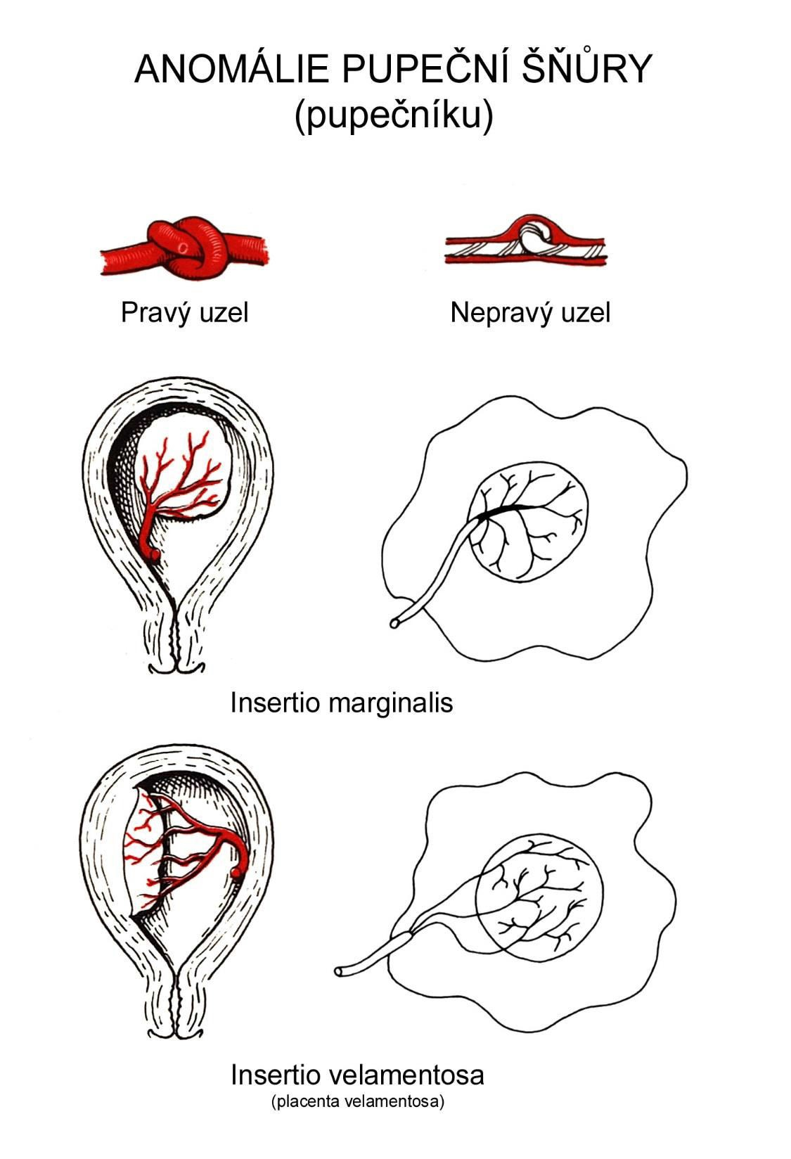
Anomalies of
umbilical cord
short (< 40 cm)
long (> 60 cm)
(danger of strangulation or formation of true knots)
true and false knots
absence of 1 umbilical
artery (hypotrophfic fetus)
True knot
False knot

Slide 17
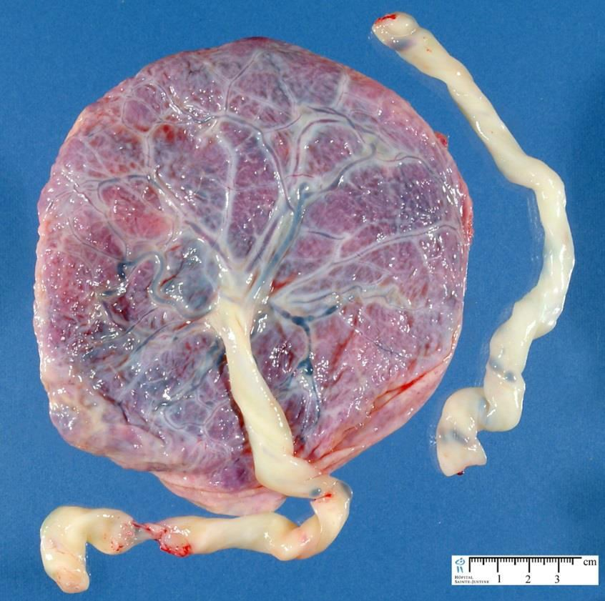
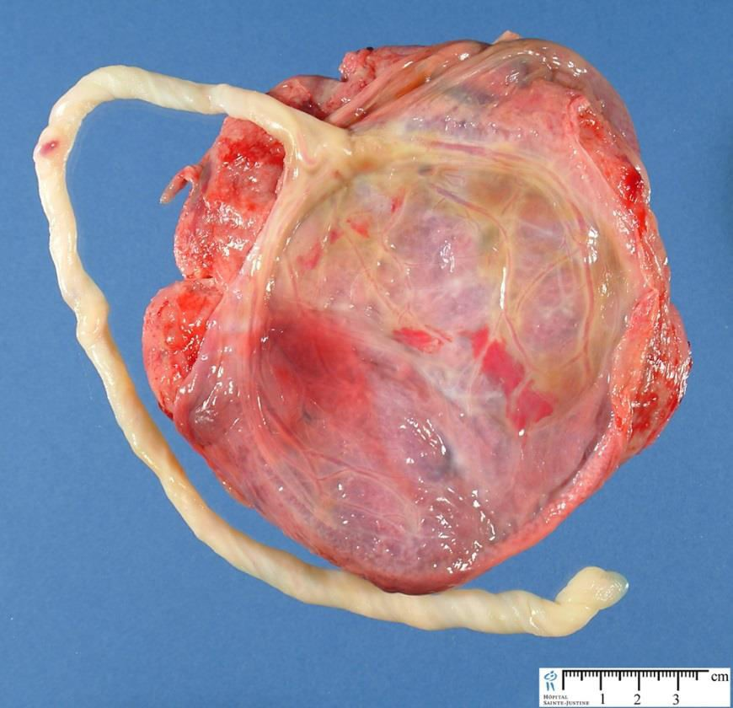
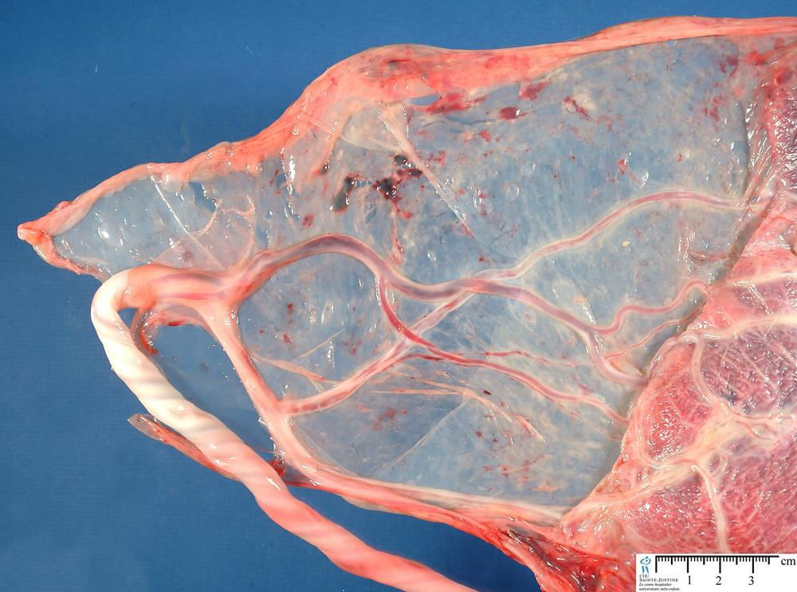
1
2
3
Umbilical cord - placenta
chorion laeve
insertion
– insertio centralis
– insertio marginalis
– insertio velamentosa

Slide 18
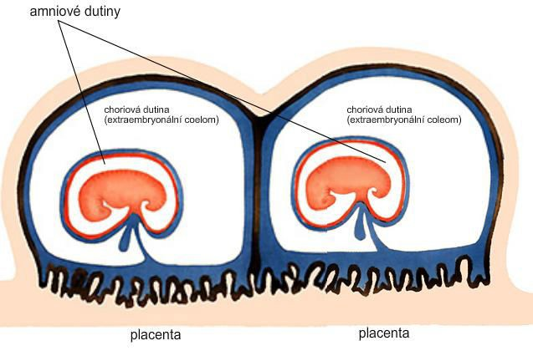
Multiple pregnanacy
twins 1:100
triplets 1:100²
quadruplets 1:100³
amniotic cavities
chorionic cavities

Slide 19
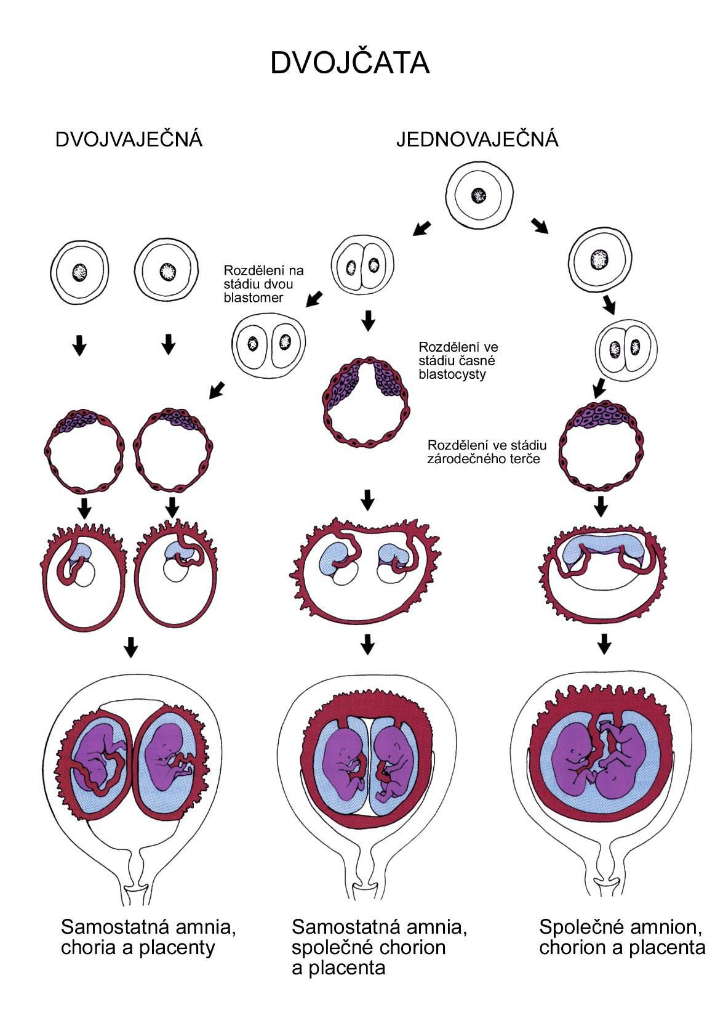
TWINS
DIZYGOTIC TWINS
2 spermatozoa fertilize
2 oocytes
each embryo develops separately
(has its own amnion,
chorion and placenta)
twins can be of different sexes
resemblance of twins is as between siblings of different age
Dizygotic
separate amnion, chorion, placenta

Slide 20
MONOZYGOTIC TWINS
1 spermatozoon fertilizes 1 oocyte
splitting of embryo occurs during the further development
arrangement of fetal membranes depends on stage on which splitting occurs
twins are always genetically identical and of same sexes
TWINS
dizygotic
monozygotic
34 % 65 %
1 %

Slide 21
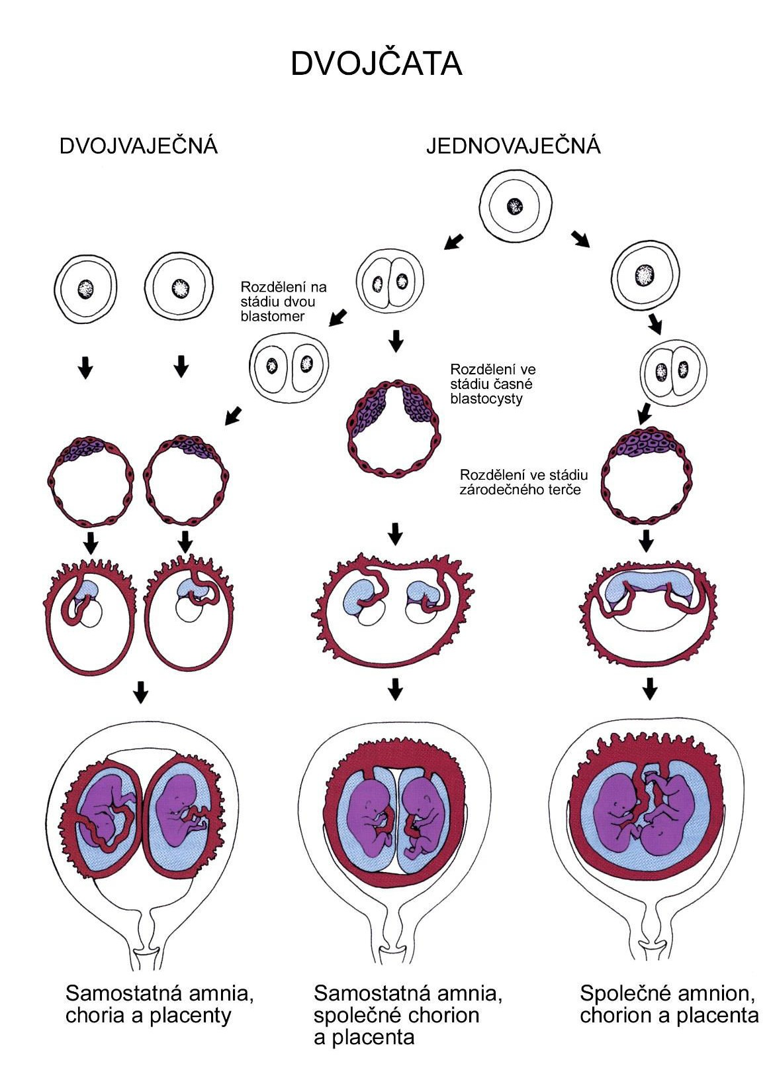
MONOZYGOTIC separated
on stage of 2 blastomeres
TWINS
dizygotic
monozygotic
each of the first 2 blasto-
meres creates 1 embryo
2 blastocysts are formed
they implantate separatly
fetal membranes as in dizygotic twins: separate amnion and chorion (diamniotic,dichorial) and own placenta
separate amnion, chorion, placenta

Slide 22
MONOZYGOTIC separated
on stage of blastocyst
TWINS
dizygotic
monozygotic
Embryoblast divided into 2 cell clusters befor creation of germ disc
trophoblast does not divide, remains common
fetal membranes: separate amnion (diamniotic), common chorion (monochorial) and common placenta
The most frequent (65 %)
separate amnion,
common chorion,
common placenta

Slide 23
MONOZYGOTIC separated on stage of bilaminar germ disc
TWINS
dizygotic
monozygotic
• creation of 2 primitive streaks
• fetal membranes are common – amnion, chorion placenta (monochorial, monoamniotic)
•conjoined „Siamese“ twins develop in case of incomplete separation
common amnion, chorion, placenta

Slide 24
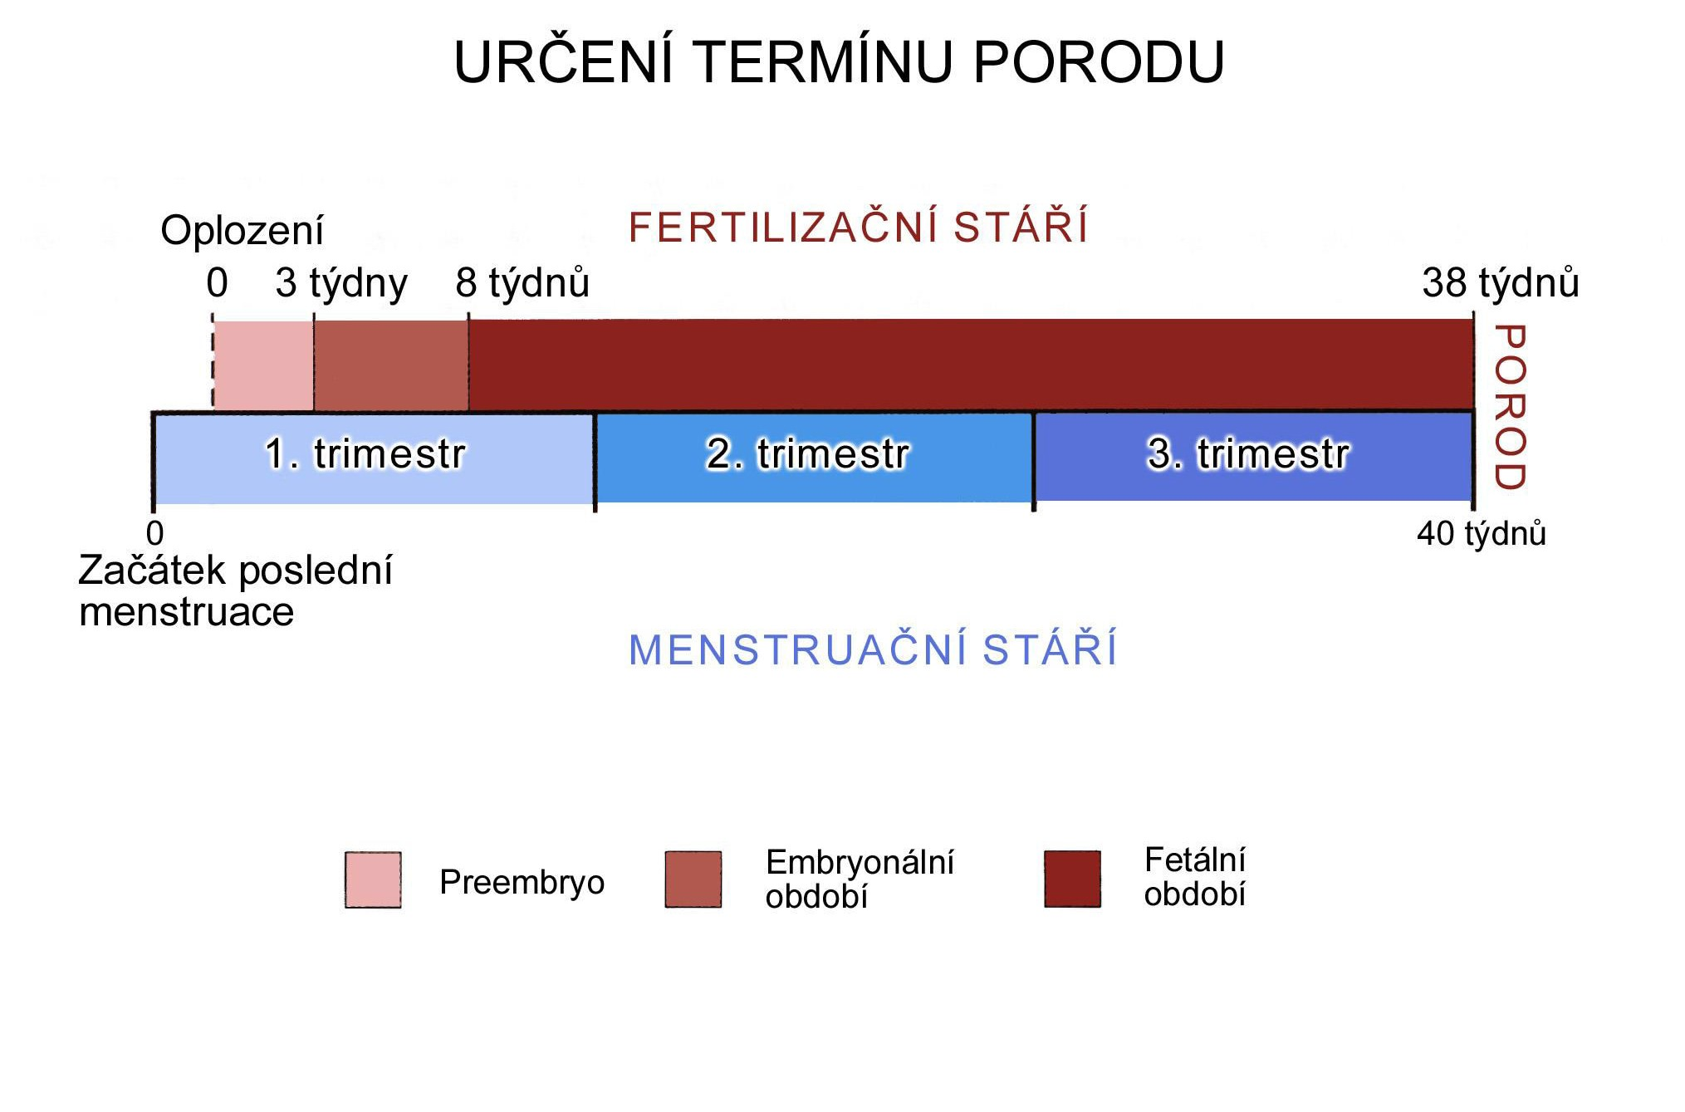
Length of pregnancy
38 týdnů = 266 dnů
Fertilization |  | CONCEPTIONAL AGE | 38 weeks = 266 days
week 0 3 | 8 |  | 38
0 |  | 40
1st day of last | MENSTRUAL AGE | 40 weeks = 280 days
menstruation |  | = 10 lunar months
preembryo
embryo
fetus
Calculation of the expected date of delivery:
Date of th 1st day of the last menstruation + 9 calendar months +7 days

Slide 25
Rule of Hasse
determine the age of fetus according its length
AGE
(l.m.)*
CRL**
(cm)
= 9 cm
• 3.
• 4.
• 5.
• 6.
• 7.
• 8.
• 9.
• 10.
₃2
₄2
₅2
6x5 (l.m. x 5)
(the second power of l.m.)
= 16 cm
= 25 cm
= 30 cm
= 35 cm
= 40 cm
= 45 cm
= 50 cm
**CRL = crown-rump length
*l.m. = lunar month

Slide 26
Fetal position in utero
During fetal development, fetus is placed in amnionic sac, which is filled with amnionic fluid. Space of this sac decreases due to growth of fetus. Therefore, fetus takes up the smallest possible volume, especially in the 3rd trimester.
Four characters of fetus arrangement in uterus are
followed up and determined before delivery:
Situs
Positio
Habitus
Presentatio

Slide 27
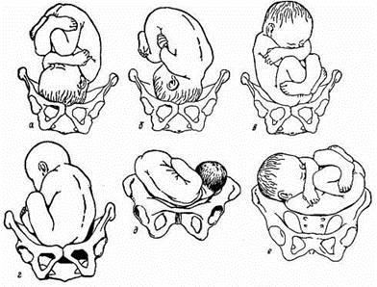
Situs
relation: long axis of fetus body – long axis of uterus
Longitudinal situs (paralel axes) - 99%, by head (kaudally) or by pelvis
Transversal situs
(perpendicular axes) - 1%
Oblique situs - unstable, moves into longitudinal or transversal situs

Slide 28
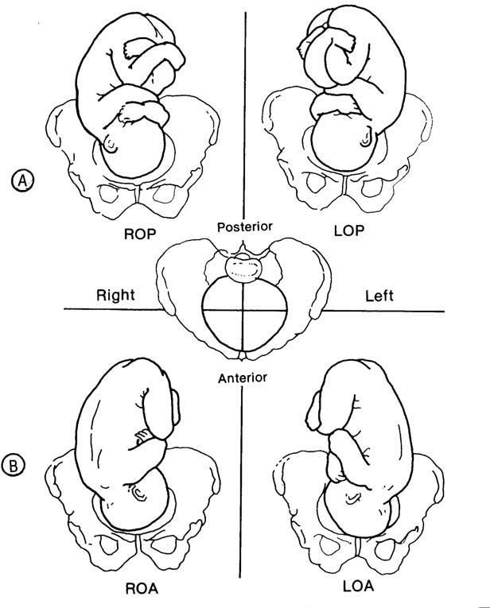
Positio
Relation: back [head] of fetus – uterine margin
Second ordinary
to the right, dorsally
First less ordinary
to the left, dorsally
2nd
1st
Second less ordinary
to the right, ventrally
First ordinary
to the left, ventrally

Slide 29
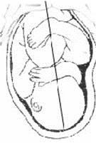
Habitus
relation: parts of fetal body to one another
regular = flexion of head, chin on chest, limbs flexed in all joints, uper limbs crossed in front the chest, lower limbs pressed to abdomen, fetus takes up the smallest possible volume
irregular = each other

Slide 30
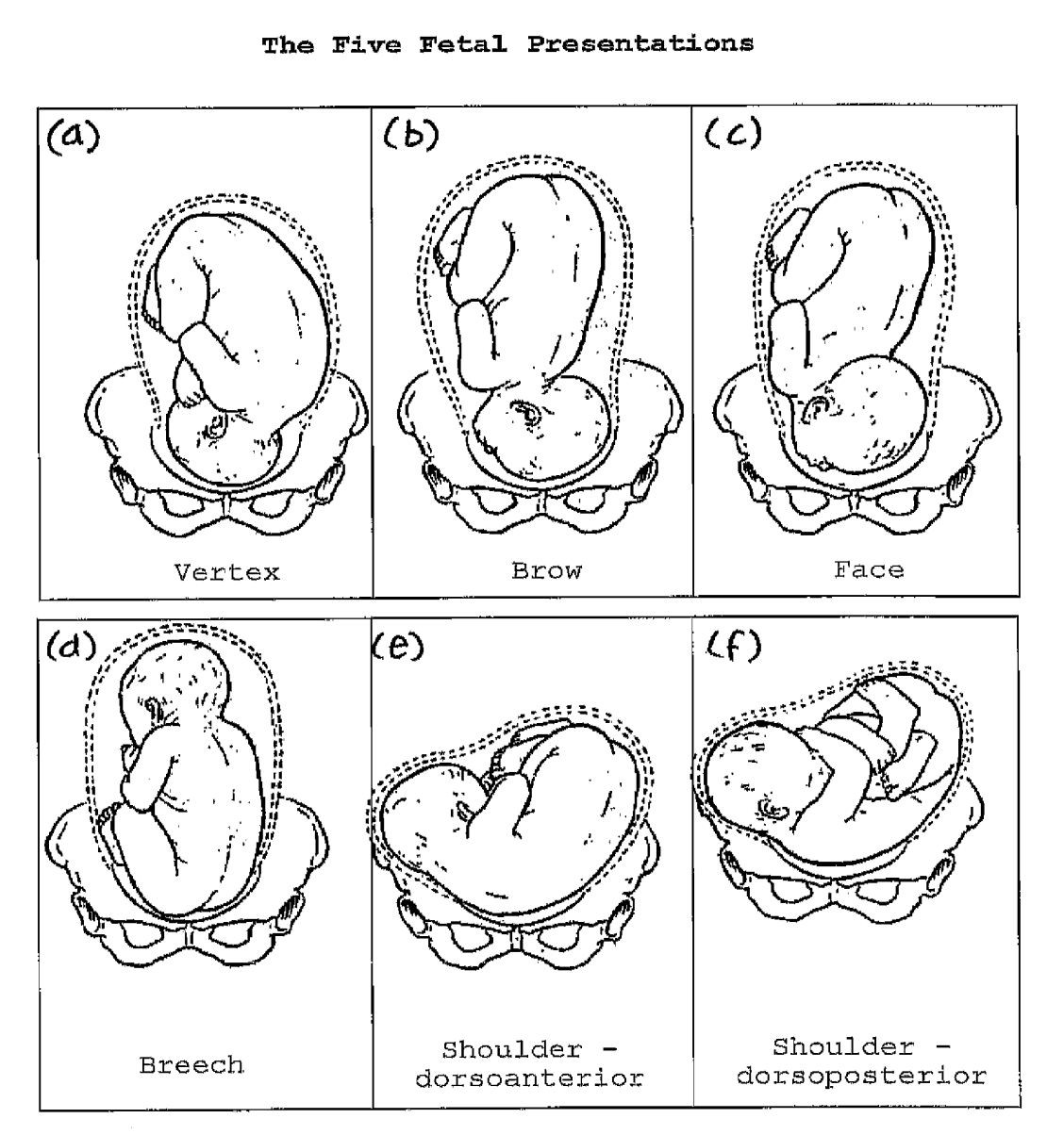
Praesentatio
relation: part of fetal body – aditus pelvis
vertex (most frequent)
forehead, face, occiput
(1 %)
pelvic end and feet
trunk, shoulder

Slide 31
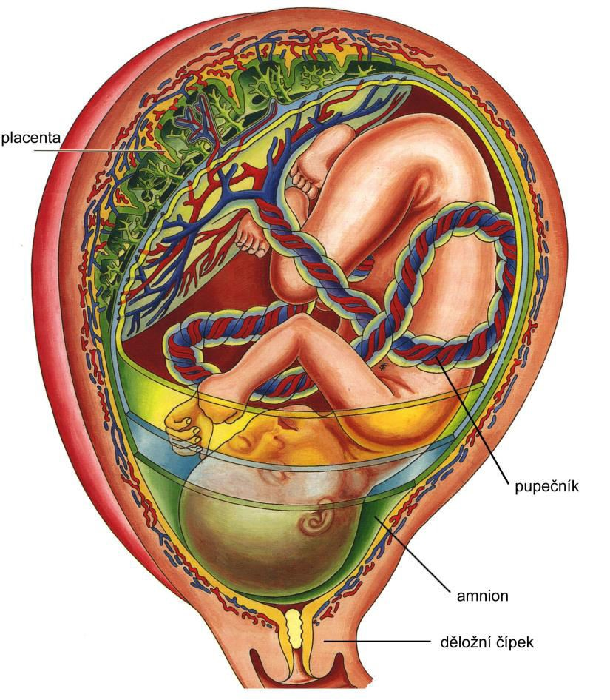
Physiological fetus position in uterus
Longitudinal situs by
head
First ordinary position
Regular habitus
Presentatio by head (vertex)

Slide 32
Mature and full-term fetus
Full-term fetus – relates to the length of pregnancy (menstrual age)
  preterm (to 37th week)
  full-term (38 – 40 week)
  after term(more then 42 week)
Mature fetus – relates to level of development:
  mature
- immature
Level of nutrition
hypotrophic
eutrophic (weight 3,000 – 3,500 g, length 50 - 51 cm)
hypertrophic

Slide 33
Marks of full-term fetus
Main characters
length (50-51 cm)
• weight (3,000-3,500 g)
diameters of the head
♂ testes are descended in scrotum,
♀ labia majora cover labia minora
Auxiliary characters
fetus is eutrophic, subcutaneous fat is well developed
skin – rests of lanugo on shoulders and back only
eyelashes, brow, hair (several cm) are developed,
nails overlap free end of fingers
skull bone are hard, major and minor fonticulus are palpable and separated from each other
newborn cries and moves

Slide 34

GENERAL EMBRYOLOGY 2
Set of embryological pictures II

Slide 35
