Slide 1
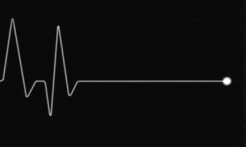
TERMS RELATED TO DEATH
Haruka Ogura
Rana Ismail

Slide 2
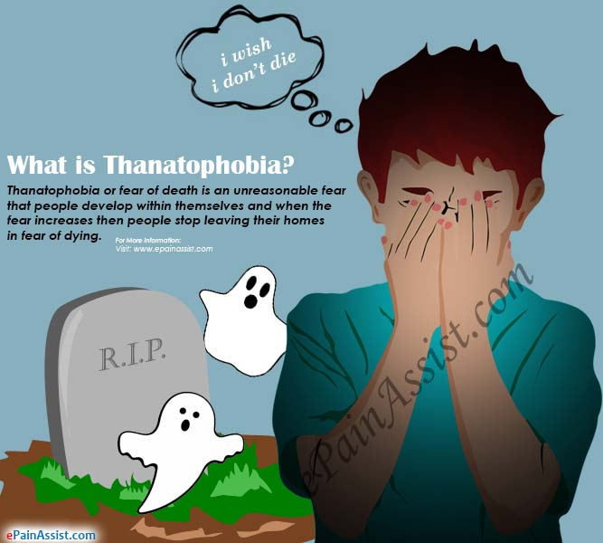
General terms
death:
​
・exitus, us m. (L); used in clinical terminology
・mors, tis, f. (L); used in pathological anatomy
(e.g.) mors thymica
=sudden death in young chidren result of infection
*finis, is, m = the end
・thanat- (G.)
(e.g.) thanatophobia= fear for death

Slide 3
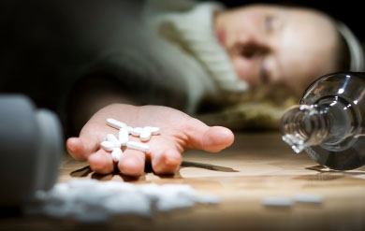
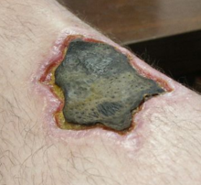
General terms
death:
・ letalis, e / mortalis, e (L) adj. = lethal
(e.g.) dosis letalis=lethal dose
*exitus letalis = natural death
・necr- (G.) = dead
(e.g.) necrosis;
necrophilia

Slide 4
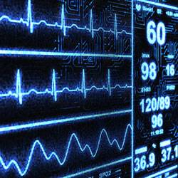
Terms using or derived from mors
・mors biologica
= a permanent cellular damage resulting from lack of oxygen, which is irreversible
・mors clinica
= a cessation of blood circulation and breathing, which is reversible by resuscitation methods

Slide 5
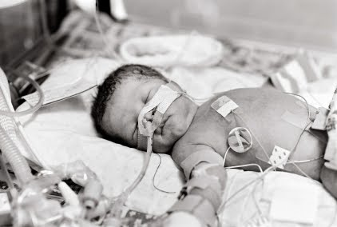
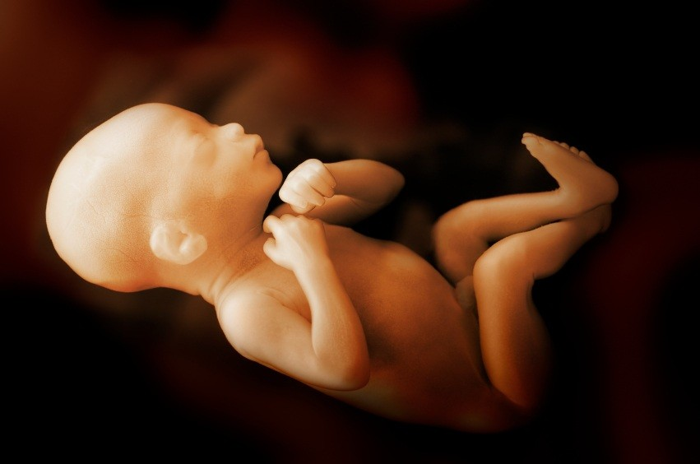
Terms using or derived from mors
・mors neonatalis
= death of a new-born
up to 10 days after birth
・mors praenatalis
= death of fetus before it starts breathing independently

Slide 6
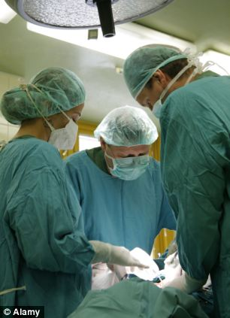
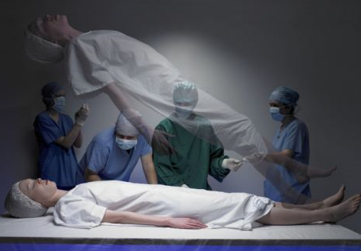
Terms using or derived from mors
・mors in tabula
= death on the operation table
・mors lentissima = very slow death
・mors subita
= sudden death
(e.g.) mors subita in tabula
=sudden death on the operation table

Slide 7
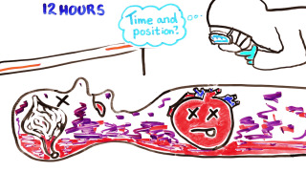
Terms using or derived from mors
・livor mortis​​​ (postmortem hypostasis)
= a settling of the blood in the lower (dependent) portion of the ​​​​body after death.Causing a purplish red discoloration of the ​​​​​skin.
One of the signs of death.
Start:1-2h patch prominent:5-6h Max:12h

Slide 8
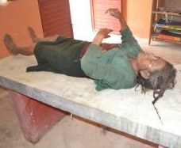
Terms using or derived from mors
・rigor mortis
​​​= post mortem stiffness caused by chemical changes in muscles.
one of the recognizable signs of death.
Start:2-3h
Subside:24h

Slide 9
Terms using or derived from mors
・in articulo mortis ​​
= in/at the moment of death
The phrase applies especially to some significant statement that a person consciously makes, such as an admission of guilt or a sudden act of contrition, just as he or she is about to enter eternity.
・moribundus, a, um ​​(Adj)
= the one who is going to die, dying man
(e.g.) gravida moribunda
・mortuus, a, um ​​(Adj)
= dead
(e.g.) digitus mortuus

Slide 10
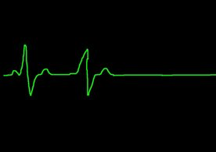
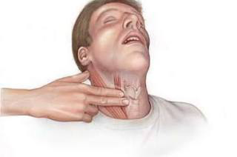
Other terms related to death
・in ultimis / in extremis​
= in the last moments of life
(e.g.) patiens in extremis
・vita minima​​​
= weak signs of life

Slide 11
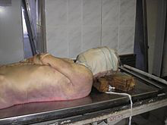
Question
１. permanent cellular damage resulting from lack of oxygen…？
→ mors biologica
2. What is mors praenatalis…？
→death of fetus before it starts breathing independently
3.
→livor mortis

Slide 12
Thank you for attention!!
10th.May.2017

