Slide 1
REVISION
Form singular / plural from given terms
cornu minus
dentes molares superiores
contra dolorem acrem
symptoma morbi latentis
segmenta anteriora bulborum
operatio post trauma gravissimum
fractura membri inferioris
amputationes digitorum minimorum
ala major
ante transfusionem necessariam
cornua minora
dens molaris superior
contra dolores acres
symptomata morborum latentium
segmentum anterius bulbi
operationes post traumata gravissima
fracturae membrorum inferiorum
amputatio digiti minimi
alae majores
ante transfusiones necessarias

Slide 2
Revision
Fill in missing endings
Ramus inferior arteri…… glutae…… superior……
Status post traum…… grav……
Infrarctus pariet…… anterior…… ventricul…… cord…… sinistr…..
In muscul…… latissim…… dors……
Pulsus frequentissim…… in febr…… acut……
Exitus post collaps…… circulation…… major…...
Laesio muscul…… longissim…… thorac……
Doses medicament…… minim……
Iniectio contra dolor…… magn……
Ulcus peptic…… chronic…… in curvatur…… minor……
ae
ae
is
a
e
is
is
i
is
i
o
o
i
us
i
a
um
is
is
i
i
is
i
ae
em
um
um
um
a
e

Slide 3
Numerals,
Latin prefixes and suffixes

Slide 4
NUMERALS - INTRODUCTION
TYPES:
CARDINAL unus, una, unum
ORDINAL secundus, a, um
MULTIPLE triplex, cis
NUMERAL ADVERBS quater

Slide 5
ORDINAL NUMERALS
1-10 | 11-12
primus, a, um | undecimus, a, um
secundus, a, um | duodecimus, a, um
tertius, a, um
quartus, a, um
quintus, a, um
sextus, a, um
septimus, a, um
octavus, a, um
nonus, a, um
decimus, a, um
denote the order in a sequence
declined like paradigms nervus, vena, septum
in the anatomical terminology, ordinals are used only up to 12
For use of numerals in anatomical terminology see handout Numerals.pdf.

Slide 6
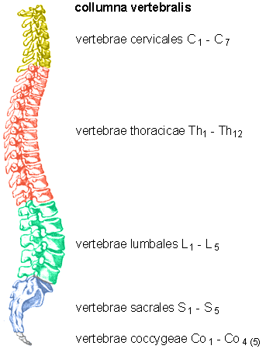
, MATCH NUMBERS AND LETTERS, FILL IN MISSING ENDINGS, READ THE NUMERALS
B
Vertebra cervical_ _ C₇
Fractura vertebra_ coccyge_ _ Co₃
Contusio vertebr_ _ _ _ lumbal_ _ _ L₁-L₂
Vertebr_ _ sacral_ _ _ S₁-S₅
Operatio vertebr_ _ thoracic_ _ Th₈-Th₉
Columna vertebr_ _ _ _
C
A
D
E
F

Slide 7
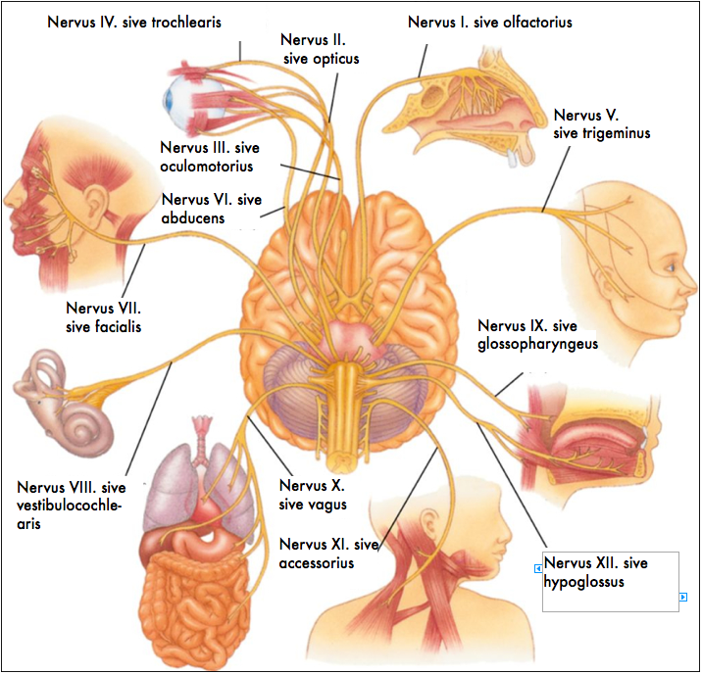

Slide 8
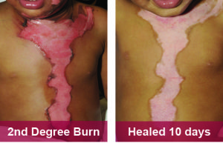
DEGREE
using ordinal numerals, a degree of any injury or disease may be expressed
  !the degree is always expressed in genitive form!
eg. second degree burn wound of chest, neck and head
  combustio thoracis, colli et capitis gradus secundi

Slide 9
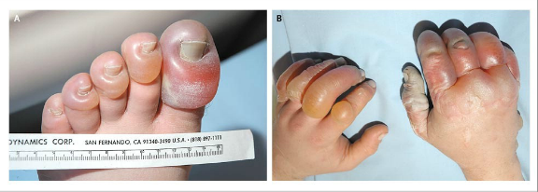
A 39-year-old man was found in a snowbank, with the ambient
Temperature 34°C. He had been reported missing the previous
evening, after and argument with his girlfriend. The emergency
services crew noticed the odor of alcohol in his breath. Large, clear blisters characteristic of severe frostbite were noted on the hands and feet. Of particular note were the left great toe and right thumb with frostbite of the third grade. Subsequently, the patient’s left great toe was amputated.
blister = bulla, ae, f.
Notes:
bullae latae manuum et pedum; congelationes hallucis sinistri et pollicis dextri gradus tertii; amputatio hallucis sinistri

Slide 10
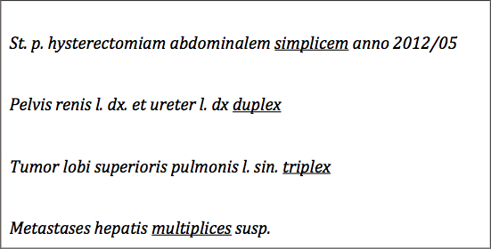
MULTIPLE 1-3 + MANY
1-3 | many
Simplex, cis | Multiplex, cis
Duplex, cis
Triplex, cis

Slide 11
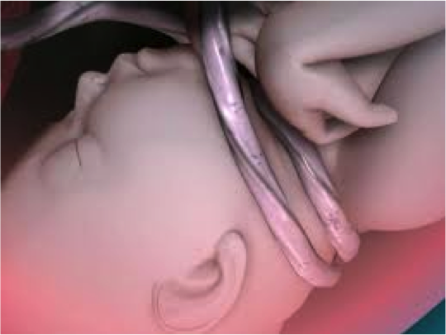
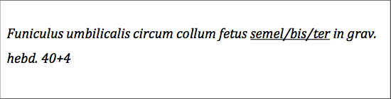
NUMERAL ADVERBS 1-4
1-4
semel
bis
ter
quater

Slide 12
COMPOUNDS WITH NUMERAL COMPONENTS
ENGLISH | LATIN | Example | GREEK | Example
one | uni- | unilateralis unigravida | mono- | monoplegia
first | primi- | primipara primigravida
two | bi- | biceps bilateralis | di- | diplegia
second | secundi- | secundigravida |  | tricephalus
three | tri- | triceps trigeminus | tri- | pars exocrina pancreatis
four | quadri- | quadriceps | tetra- | tetraplegia
half | semi- | semilunaris | hemi- | hemiplegia
few |  |  | olig-o- | oligodactylia
many | mult-(i)- | multangulus multicellularis | poly- | polydactylia polyarthritis
all, whole |  |  | pan- | panplegia pandemia

Slide 13
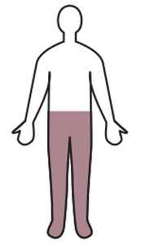
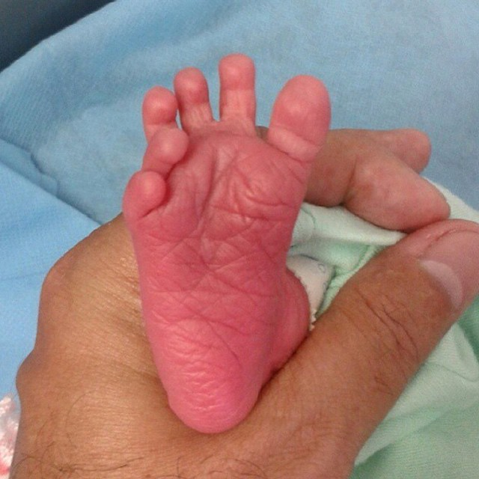
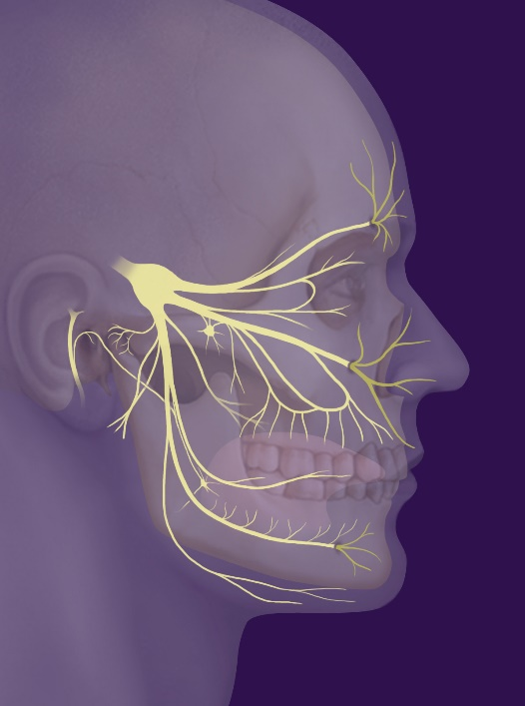
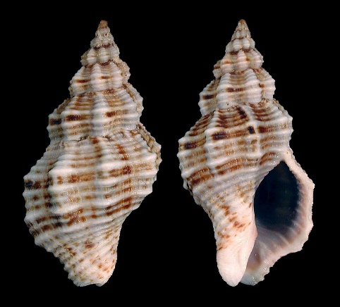
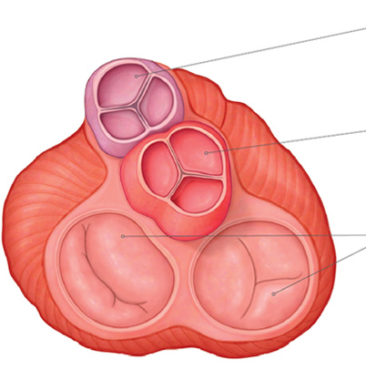
?? diplegia – multangulus – trigeminus – polydactylia – valvulae semilunares ??

Slide 14
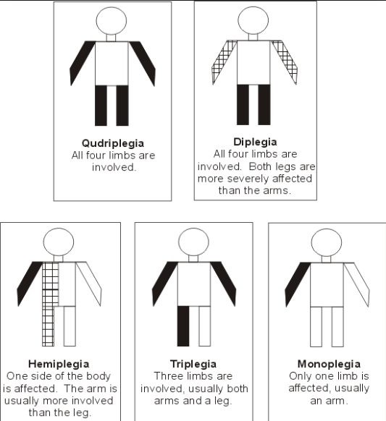
NAME WHAT KIND OF “-PLEGIA” IS ON THE PICTURE
1
2
3
4
5
MONOPLEGIA DIPLEGIA TRIPLEGIA
TETRAPLEGIA HEMIPLEGIA QUADRIPLEGIA
Notes:
Tetraplegia / quadriplegia – diplegia – hemiplegia – triplegia – monoplegia

Slide 15
BASED ON DEFINITIONS FORM TERMS
WITH GREEK ELEMENTS
-PARESIS slight, partial paralysis, muscle weakness
-PLEGIA stroke, total paralysis
Partial paralysis of a single limb or one part of the limb
Paralysis of a single extremity
Paralysis of corresponding parts on both sides of the body
Complete paralysis of the lower half of the body including both legs
A slight paralysis or weakness of both legs
Paralysis affecting only one side of the body
Paralysis of an upper and a lower extremity and of the face
Paralysis of all four limbs
Muscular weakness affecting all four extremities
Paralysis of the whole body
Weakness on one side of the body
Notes:
Monoparesis – monoplegia – diplegia – paraplegia – paraparesis –hemiplegia - triplegia – tetraplegia (=quadriplegia, quadruplegia) – tetraparesis – panplegia – hemiparesis
Tetraplegia, also known as quadriplegia, is paralysis caused by illness or injury that results in the partial or total loss of use of all four limbs and torso; paraplegia is similar but does not affect the arms. The loss is usually sensory and motor, which means that both sensation and control are lost. Tetraparesis or quadriparesis, on the other hand, means muscle weakness affecting all four limbs. It may be flaccid or spastic.

Slide 16
HOW MANY PREGNANCIES,
HOW MANY CHILDBIRTHS?
GRAVIDA - number of pregnancies, regardless of result
PARA - number of births after 20 weeks of pregnancy,
regardless of result,
stillbirth counted as 1,
multiple births /twins et. al./ counted as 1
ABORTION - miscarriage before 20 weeks of pregnancy
G₈P₅A₃
G₂P₂
G₄P₃A₁

Slide 17
-PARA AND -GRAVIDA
0
1
2
3
4
5
6
7
8
9
10
MANY
NULLI-PARA
UNI/PRIMI-PARA
SECUNDI-PARA
TERTI-PARA
QUARTI/QUADRI-PARA
QUINTI-PARA
SEXTI-PARA
SEPTI-PARA
OCTI-PARA
NONI-PARA
DECI-PARA
MULTI/PLURI-PARA
NULLI-GRAVIDA
PRIMI-GRAVIDA
SECUNDI-GRAVIDA
TERTI-GRAVIDA
QUARTI-GRAVIDA
QUINTI-GRAVIDA
SEXTI-GRAVIDA
SEPTI-GRAVIDA
OCTI-GRAVIDA
NONI-GRAVIDA
DECI-GRAVIDA
MULTI/PLURI-GRAVIDA

Slide 18
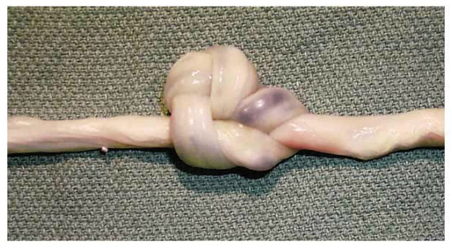
23 years old woman (gravida 1, para 0) was admitted at 40+1 weeks gestation and underwent an emergency caesarian section due to imminent hypoxia of the fetus. As revealed during the section the umbilical cord was twisted twice around the neck of the neonate, furthermore the umbilical cord was noted to have a compound knot. Compound knots, as in this case, are rare.
hypoxia, ae, f. =a diminished availability of oxygen to the body tissues
Notes:
sectio caesarea propter hypoxiam fetus imminentem, funiculus umbilicalis circum collum fetus bis, nodus compositus funiculi umbilicalis

Slide 19
LATIN AND GREEK PREFIXES
LATIN | Example | GREEK | Example
contra- | contraindicatio | ant-, anti- | antibioticum, antipyreticum
cum- (con-, com-, col-, cor) | congenitus commotio | syn-, sym- | symphysis, syndroma
de- (des-) | 1) descendens 2) desinfectio, deformatio | 1) cata- 2) Ø | catarrhus Ø
dis- (dif-, di-) | 1) dislocatio 2) dissimilis | 1) dia-, di-, ana- 2) a-, an- | diagnosis, analysis atrophia, anaesthesia
e-, ex- (ef-) | exsanguinatio | ec- | ectopia
in- (im-, il-, ir-) | immaturus | a-, an- | atrophia, anaesthesia
post- | posttraumaticus | met-, meta- | metastasis, metabolismus
re- | reinfectio | ana- | anamnesis, anabiosis

Slide 20
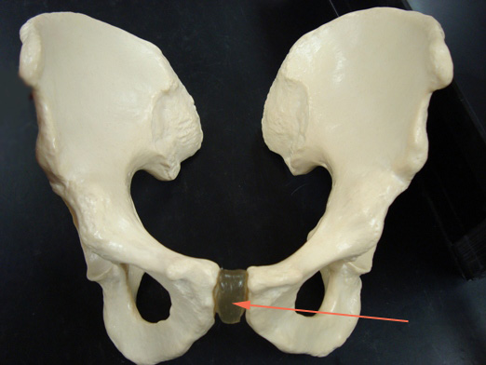
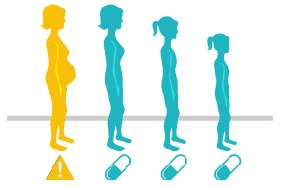
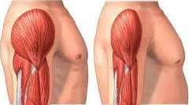
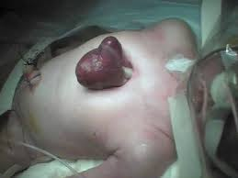


?? contraindicatio – ectopia – cattarhus – atrophia – anamnesis – symphisis ???
Notes:
anamnesis - accumulated data concerning a medical or psychiatric patient and the patient's background, including family, previous environment, experiences, and particularly, recollections, for use in analyzing his or her condition.

Slide 21
LATIN AND GREEK PREFIXES
LATIN | Example | GREEK | Example
per- | 1) peracutus, peraciditas 2) perforatus | 1) hyper- 2) dia | hypertonia, hypertrophia diencephalon, diameter
sub- (suc-, suf-, sup-, sus-) | subfebrilis, subluxatio subcutaneus | hyp-, hypo- | hypotrophia, hypotonia hypophysis, hypoglossus
Ø |  | dys- | dystrophia, dyspepsia
Ø |  | eu- | eutrophia, euthanasia

Slide 22
BASED ON DEFINITIONS MATCH GREEK PREFIXES WITH A GREEK ELEMENT
EU- HYPER- A- DYS- HYPO-
-TROPHIA
EU-
state of normal nourishment and growth
progressive changes that may result from defective nutrition of a tissue or organ
general increase in bulk of a part or organ, not due to tumor formation
progressive degeneration of an organ or tissue caused by loss of cells.
a wasting away of the body or of an organ or part, as from defective nutrition or nerve damage.
DYS-
HYPER-
HYPO-
A-

Slide 23
LATIN NOUN AND ADJECTIVE SUFFIXES
Noun ending | Meaning | Example
-io | act of, result of, process of | commotio, inflammatio, laesio, transfusio
-tor, -sor, -xor | agent | levator, extensor, flexor
-ura | act or result of an action | sutura, fisura, incisura
-itas | quality, state | obesitas, surditas, mutitas
-mentum | instrument, tool | ligamentum, medicamentum
Adjective ending | Meaning | Example
-alis, e / -aris, e / -inus, a, um / -eus, a, um / -aneus, a, um | relation | nasalis; cochlearis; uterinus; cartilagineus; cutaneus
-osus, a, um | full of | ulcerosus, venosus, periculosus
-atus, a, um | equipped with | dentatus, caudatus
- bilis, e | possibility, ability | operabilis
-ilis, e | having the quality | fragilis

Slide 24
NAME THE ACTION PERFORMED
BY THE GIVEN MUSCLE
Musculus abductor pollicis longus >> abductio, onis, f.
Adductio, onis, f.
Musculus adductor hallucis longus
Musculus compressor urethrae
Musculus constrictor pharyngis medius
Musculus depressor anguli oris
Musculus dilatator pupillae
Musculus extensor carpi
Musculus flexor digitorum profundus
Musculus levator glandulae thyr(e)oideae
Musculi rotatores thoracis
Musculus tensor fasciae latae
Compressio, onis, f.
Constrictio, onis, f.
Depressio, onis, f.
Dilatatio, onis, f.
Extensio, onis, f.
Flexio, onis, f.
Levatio, onis, f.
Rotatio, onis, f.
Tensio, onis, f.

Slide 25

NAME DEFECTS OF SENSES
surdomutitas, atis, f.
caecitas, atis, f.
surditas, atis, f.
mutitas, atis, f.

Slide 26
FILL IN THE CHART WITH TERMS
DERIVED FROM GIVEN ROOTS
BASIC WORD | DESCRIPTION | DERIVED TERM
brain | related to brain
 | small brain
 | related to the small brain
 | inflammation of the brain
liver | related to liver
 | inflammation of liver
 | cancerous tumour in liver
 | degenerative disease of liver
thorn | related to the thorn/spine
 | full of thorns
 | provided with thorns
 | found above the thorny processes
cerebralis
cerebrum, i, n.
encephalon, i, n.
cerebellum
cerebellaris
encephalitis
hepaticus
hepar, atis, n.
hepatitis
hepatoma
hepatosis
spinalis
spinosus
spina, ae, f.
spinatus
supraspinalis

Slide 27
FILL LATIN / GREEK PARALLEL PREFIXES. DERIVE LATIN TERMS USING FILLED PREFIXES
PARALLEL GREEK / LATIN PREFIX | ENGLISH DESCRIPTION | DERIVED LATIN TERM
pro- ⇨ ante- | forearm | antebrachium
endo- | inside the vein (adj. e.g. injection)
dia- | a process of transferring blood from a donor to a recipient
circum- | a double-wall sac around the heart
epi- | being on the surface, opposite of profound
peri- | located around the mouth
ecto- | outside the uterus
meta- | after the operation (e.g. state, condition)
hyper- | located above the kidney
inter- | sheet of muscle separating the thorax from the abdomen
⇨ intra-
intravenosus
⇨ trans-
transfusio
⇨ peri-
pericardium
⇨ super-
superficialis
⇨ circum-
circumoralis
⇨ extra-
extrauterinus
⇨ post-
postoperativus
⇨ supra-
suprarenalis
⇨ dia-
diaphragma

