Slide 1
3rd declension
all 3 genders
nominative form – various endings:
corpus, caput, pollex, hallux, os, femur, frons, cervix, abdomen, pes, dens, pelvis, cavitas, dolor
genitive form: -is

Slide 2
Stem = gen. sg. without -is
corpus, corporis, n. corpor-
caput, capitis, n. capit-
pollex, pollicis, m. pollic-
os, oris, n. or-
femur, femoris, n. femor-
frons, frontis, f. front-
cervix, cervicis, f. cervic-
abdomen, abdominis, n. abdomin-
pes, pedis, m. ped-
dens, dentis, m. dent-
pelvis, pelvis, f. pelv-
cavitas, cavitatis, f. cavitat-
dolor, doloris, m. dolor-
If you want to decline correctly,
it is necessary to know the genitive form.

Slide 3
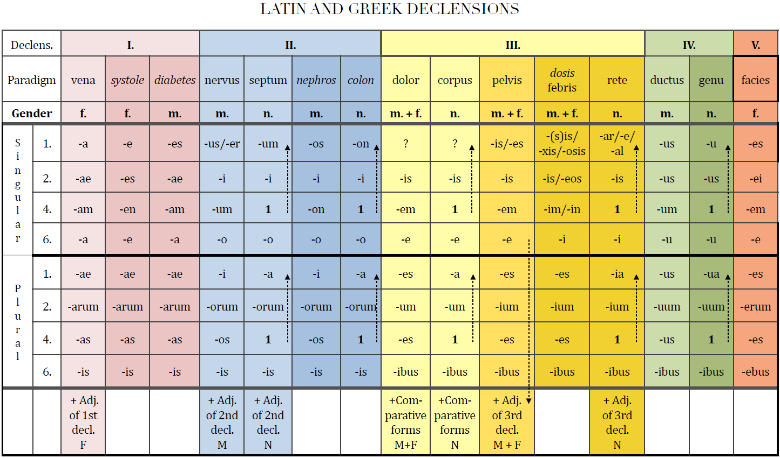

Slide 4
How do I know which paradigm to follow?
If you want to choose the right paradigm,
it is necessary to know the gender.
M+F: dolor
pelvis
dosis (febris)
N: corpus
rete

Slide 5
M+F
 | Sg. | Pl.
nom. | dolor | dolores
gen. | doloris | dolorum
ak. | dolorem | dolores
abl. | dolore | doloribus
 | Sg. | Pl.
nom. | pelvis | pelves
gen. | pelvis | pelvium
ak. | pelvem | pelves
abl. | pelve | pelvibus
only difference in gen. pl.: -um X -ium
pelvis:
1) the same nominative and genitive forms:
cutis, is, f.; canalis, is, m.; auris, is, f.; cystis, is, f.; axis, is, m.
2) genitive stem ends in two consonants
dens, ntis, m.; pars, rtis, f.; pons, ntis, m.; mens, ntis, f.; lens, ntis, f.

Slide 6
N
 | Sg. | Pl.
nom. | corpus | corpora
gen. | corporis | corporum
ak. | corpus | corpora
abl. | corpore | corporibus
 | Sg. | Pl.
nom. | rete | retia
gen. | retis | retium
ak. | rete | retia
abl. | reti | retibus
differences: abl. sg.: -e X -i
nom.+ak. pl. -a X -ia
gen. pl.: -um X -ium
rete: nom. sg. -e/-ar/-al:
animal, alis, n.; calcar, aris, n.; cochlear, aris, n.
(but not hepar, atis, n.)

Slide 7
Exceptions
os, ossis n. bone → gen. pl. -ium
vas, vasis, n. vessel
in sg. follows paradigm CORPUS vas-vasis-vas-vase
in pl. follows paradigm SEPTUM vasa-vasorum-vasa-vasis
 | sg. | pl.
nom. | os | ossa
gen. | ossis | ossium
ak. | os | ossa
abl. | osse | ossibus
 | sg. | pl.
nom. | vas | vasa
gen. | vasis | vasorum
ak. | vas | vasa
abl. | vase | vasis

Slide 8
How do I find the right paradigm?
genitive sg. ending: -ae/-es, -i, -is, -us, -ei
gender:
a) M+F:
the forms of nom. and gen. sg. is the same – pelvis
genitive stem ends in two consonants – pelvis
otherwise dolor
b) N:
nom. sg. ends -e/-ar/-al (except hepar) – rete
otherwise corpus

Slide 9
Choose the right paradigm:
caput, capitis, n. capit-
canalis, canalis, m. canal-
pollex, pollicis, m. pollic-
os, oris, n. or-
excisio, excisionis, f. excision-
femur, femoris, n. femor-
frons, frontis, f. front-
cervix, cervicis, f. cervic-
auris, auris, f. aur-
abdomen, abdominis, n. abdomin-
pes, pedis, m. ped-
dens, dentis, m. dent-
cavitas, cavitatis, f. cavitat-
regio, regionis, f. region-

Slide 10
Connection with the adjective
F M N
SG.
1. cavitas magna dolor magnus foramen magnum
2. cavitatis magnae doloris magni foraminis magni
4. cavitatem magnam dolorem magnum foramen magnum
6. cavitate magna dolore magno foramine magno
PL.
1. cavitates magnae dolores magni foramina magna
2. cavitatum magnarum dolorum magnorum foraminum magnorum
4. (in) cavitates magnas dolores magnos foramina magna
6. (in) cavitatibus magnis doloribus magnis foraminibus magnis

Slide 11
caput longum (caput, capitis, n.)
cavitas magna (cavitas, cavitatis, f.)
cochlear parvum (cochlear, cochlearis, n)
canalis palatinus (canalis, canalis, m.)

Slide 12
Change to nominative plural
musculus sphincter
foramen nutricium
dolor chronicus
vas longum
musculus adductor
femur fractum
cartilago thyreoidea
vulnus punctum

