Slide 1
Revision
4th + 5th declension
(ductus, genu, facies)

Slide 2
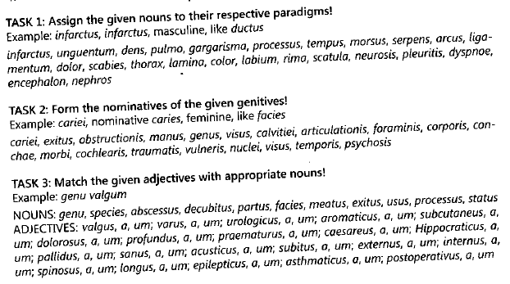

Slide 3
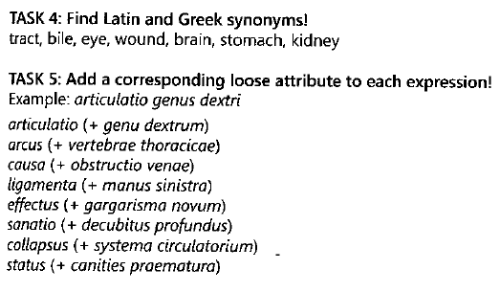

Slide 4
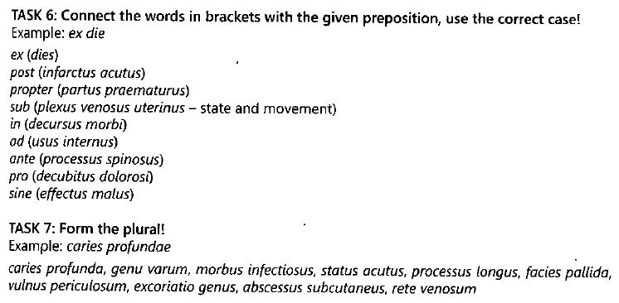

Slide 5
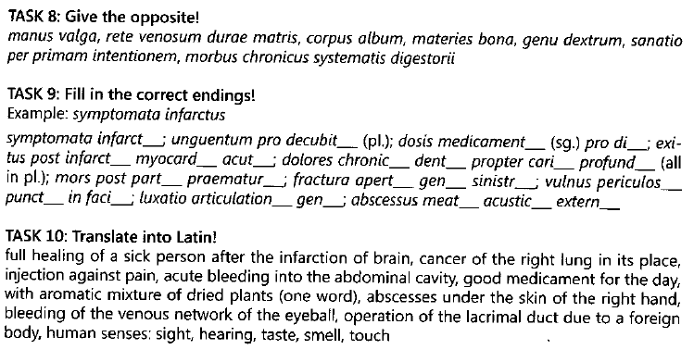

Slide 6
Adjectives of 3rd declension
3 forms ācer, ācris, ācre
(celer, celeris, celere)
2 forms brevis, breve
(nasalis, -e; capitalis, -e; frontalis, -e...)
1 form: simplex, simplicis
(permanens, -entis; adiuvans, -antis; degener, -eris...)
Remember all the forms of Nom. sg.;
Only when you learn 1-form adjectives, you need also Gen. sg.

Slide 7
Paradigms:
M+F: pelvis, ONLY Abl. sg.: -ī
N: rēte
Abl. sg. -ī
Gen. pl. -ium
Nom. + Ac. pl. -ia (neuters)
biceps, bicipitis Abl. sg.: -e
triceps, tricipitis G. pl.: -um
quadriceps, quadricipitis N.+Ak. pl. (neuters): -a

Slide 8
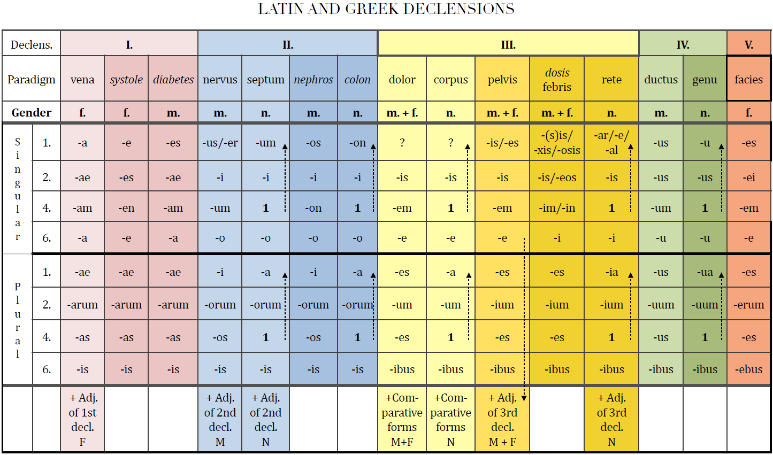

Slide 9
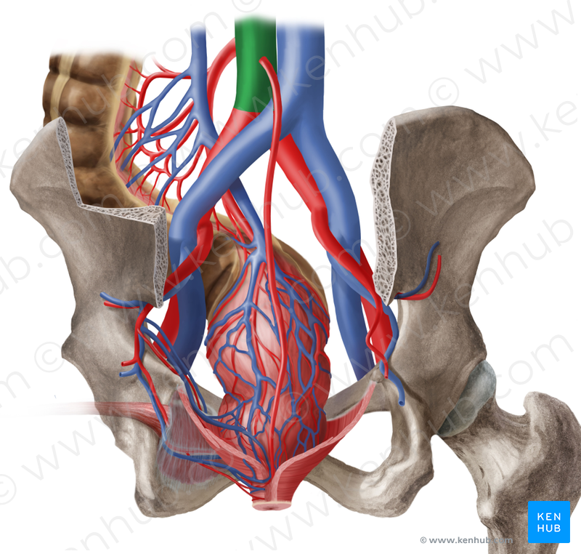
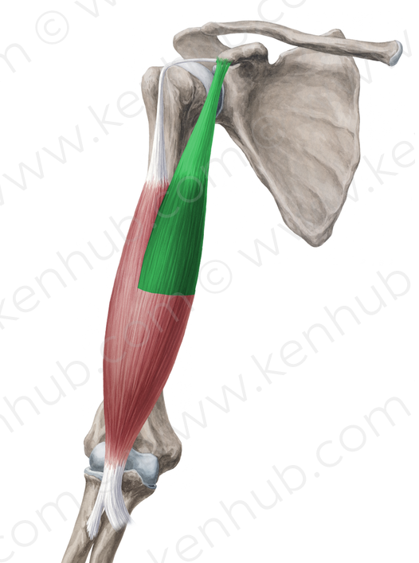
aorta abdominalis abdominalis, e
caput breve brevis, e
musculus biceps femoralis biceps, bicipitis
femoralis, e

Slide 10
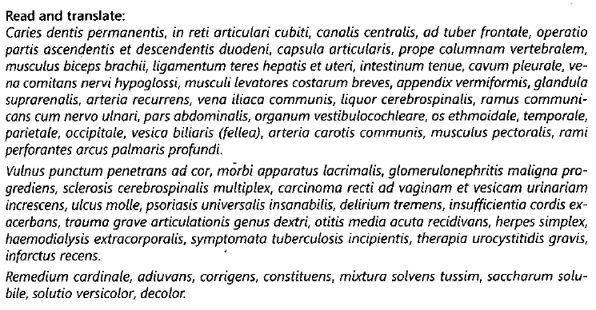

Slide 11
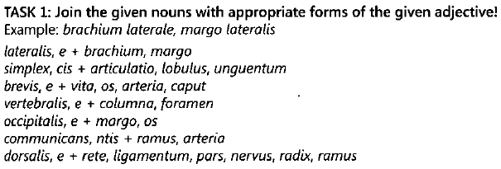

Slide 13
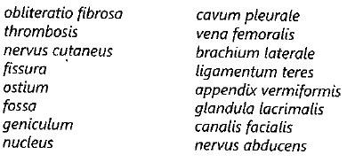

Slide 14
