Slide 1
Injuries

Slide 2
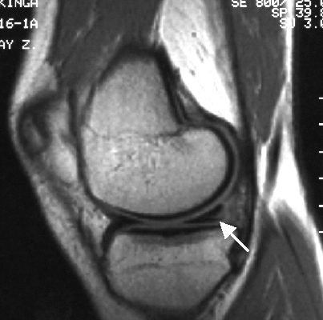
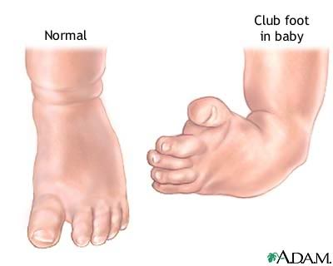
Laesio Deformitas
Any damage of an organ or tissue that leads to its damaged function
Permanent bodily malformation of the shape of and organ or part of the body
Torn meniscus

Slide 3
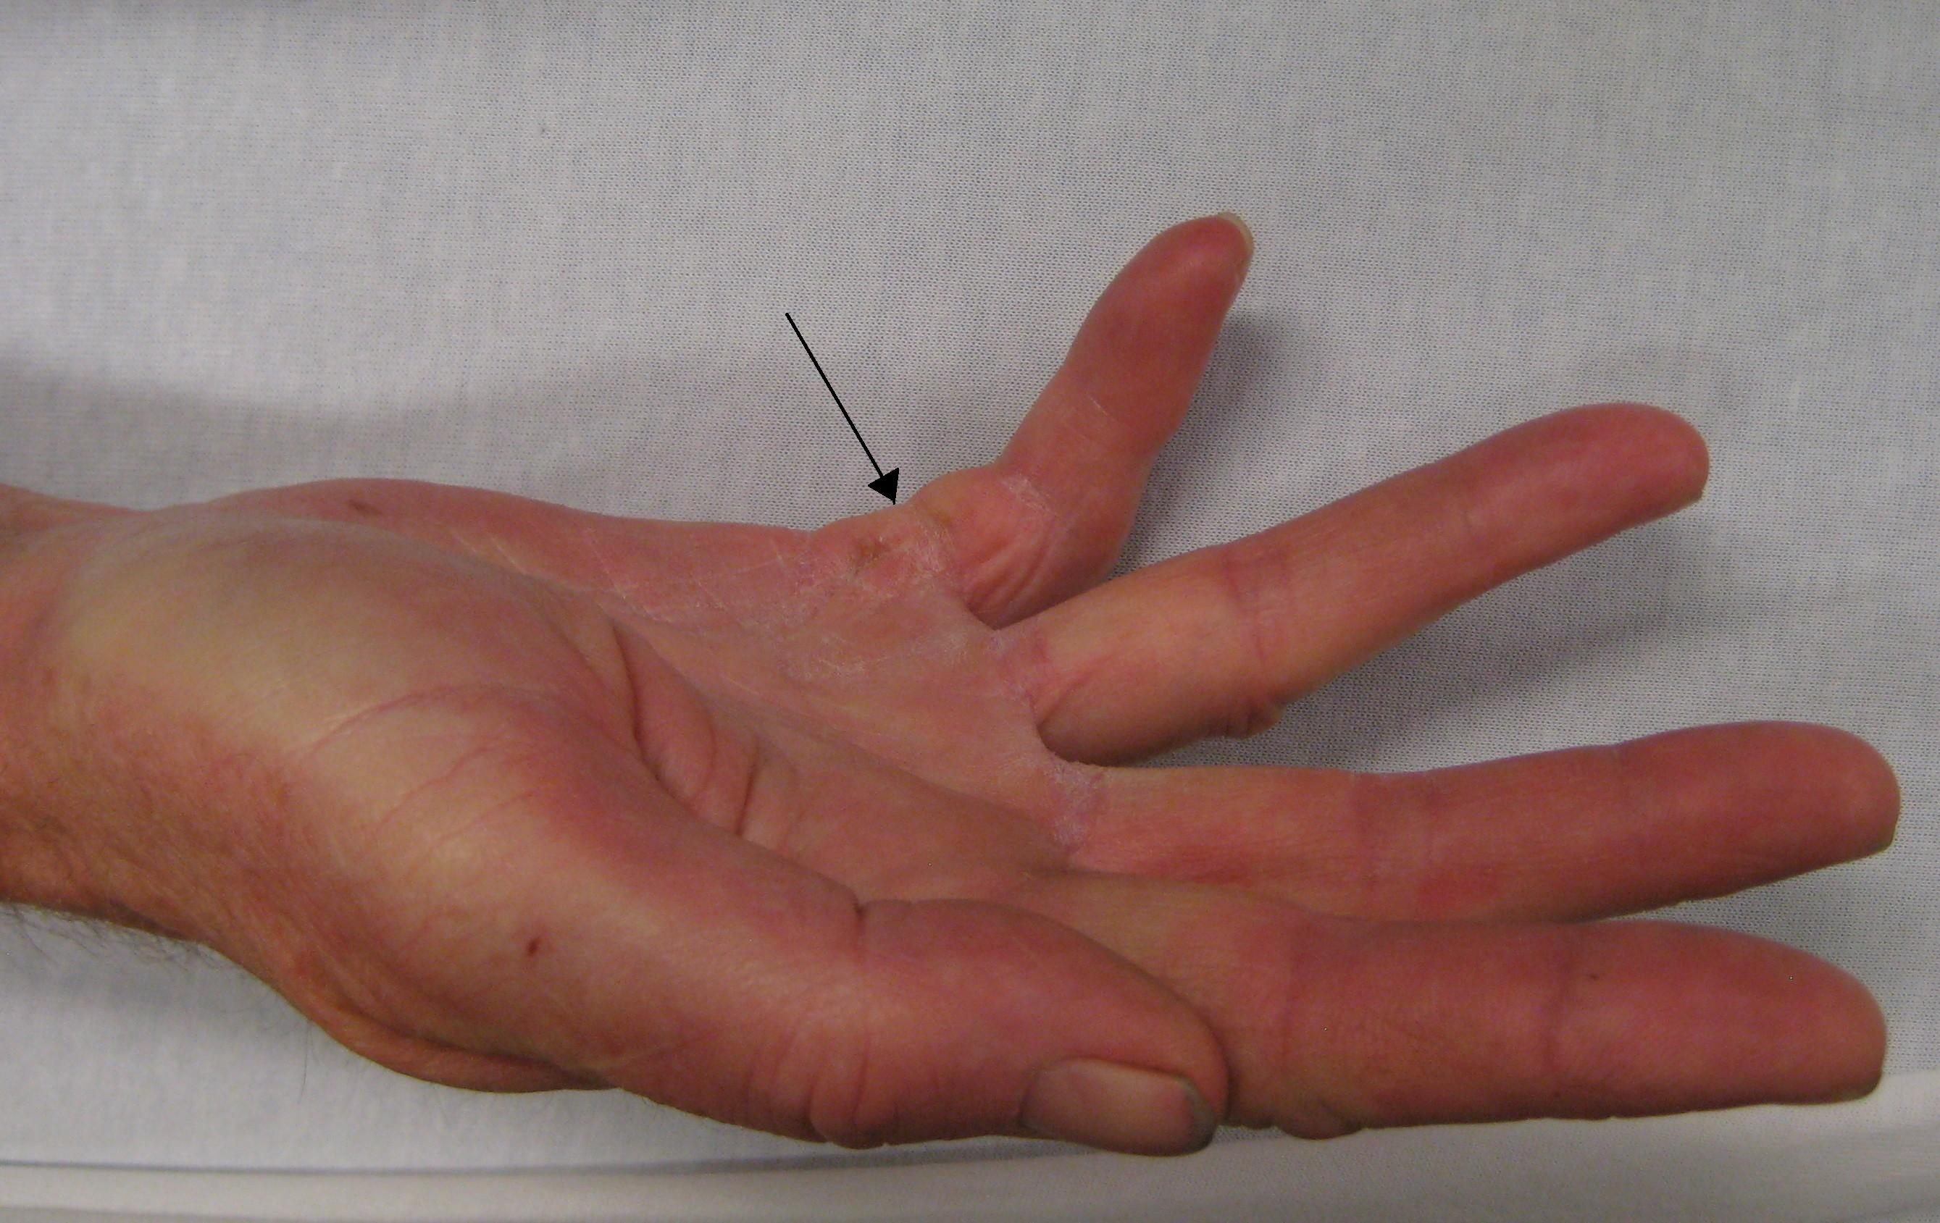
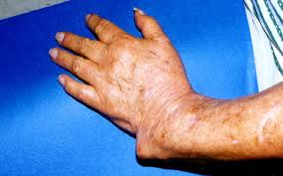
Laesio – ligamentum – musculus – flexor – digitus – quintus– manus – latus – dexter
ENDINGS?
Laesio ligamenti musculi flexoris digiti quintii manus lateris dextri
FORMULATE A DIAGNOSE:
Deformitas antebrachii l. sin.
Derformitas antebrachii lateris sinistri

Slide 4
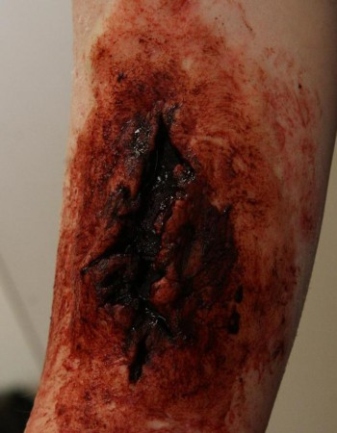
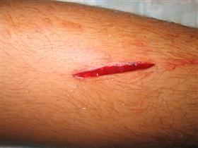
Laceratio, onis, f. = vulnus lacerum
A torn ragged wound. A wound produced by the tearing of body tissue.
External lacerations may be small or large and may be caused in many ways, such as a blow from a blunt instrument, a fall against a rough surface, or an accident with machinery.
Lacerations within the body occur when an organ is compressed or moved out of place by an external or internal force.

Slide 5
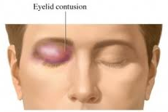
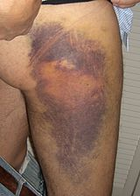
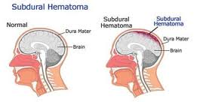
Contusio, onis, f. = vulnus contusum
Bruise wound, an injury to tissues with skin discoloration and without breakage of skin. Blood from the broken vessels accumulates in surrounding tissues, producing pain, swelling, and tenderness, and the discoloration is the result of blood seepage just under the skin.
Haematoma
=Localized swelling filled with blood

Slide 6
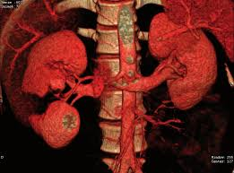
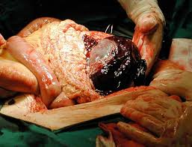
ABBREVIATIONS?
Laceratio renis l. dx.
( lateris dextri)
Contusio lienis
Mors ex __________________
contusione lienis

Slide 7
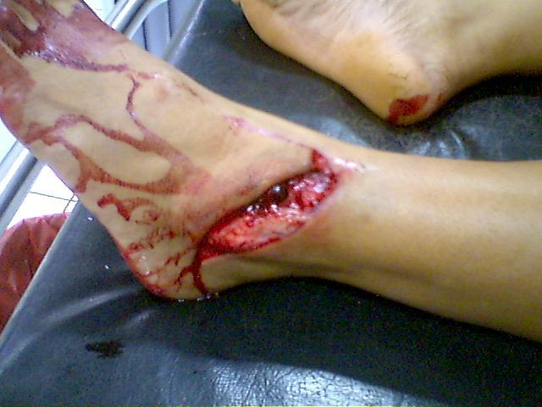
Vulnus contusolacerum

Slide 8
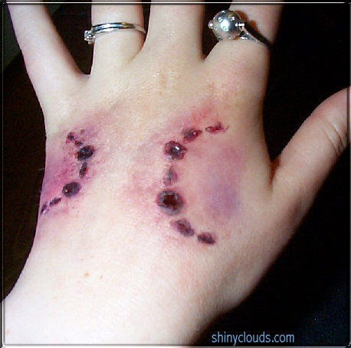
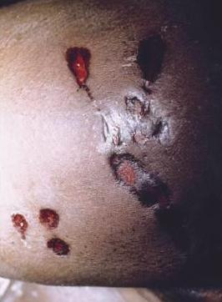
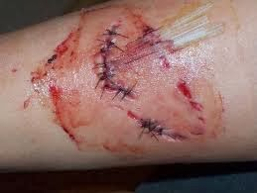
Vulnus morsum
Bite wound – this wound is usually also contusolacerum (torn and bruise)

Slide 9
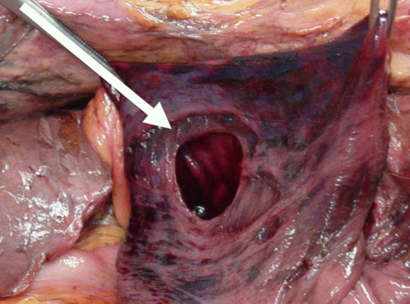
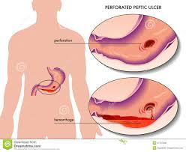
Perforatio, onis, f.
Perforation -
Hole through the whole thickness of a tissue or membrane
Perforatio fundi gastrici

Slide 10
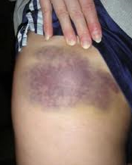
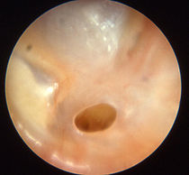
Contusio femor__ later__ dextr__ cum haematomat__
FILL IN MISSING ENDINGS
is
is
i
e
Perforatio membranae tympani
Status post _____________________
perforationem membranae tympani

Slide 11
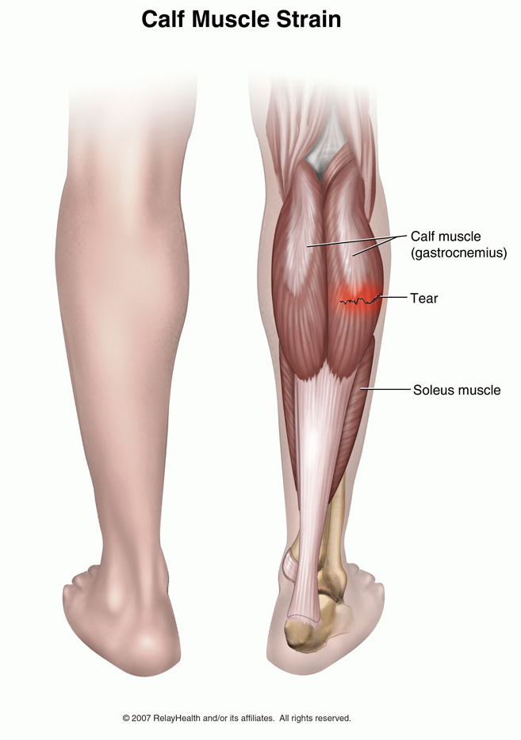
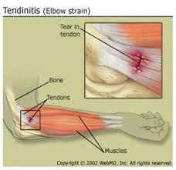
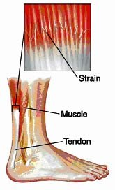
Distensio, onis, f.
strain = an injury to a muscle or tendon in which the muscle fibres tear as a result of overstretching

Slide 12
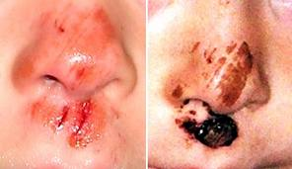
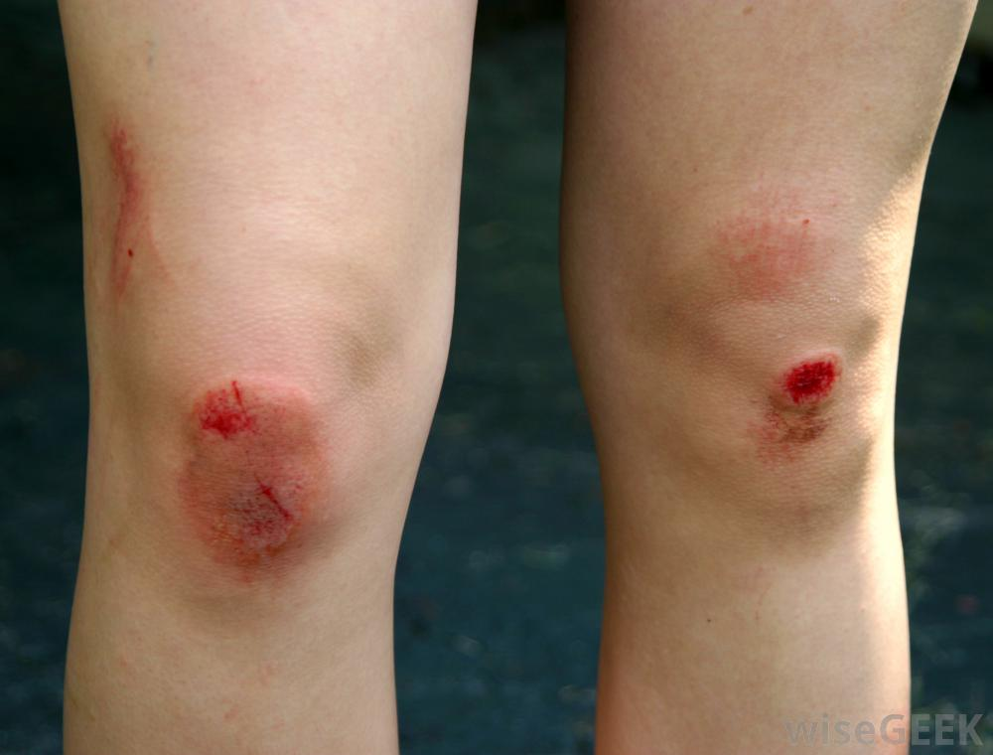
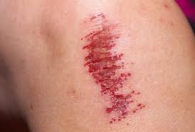
Excoriatio, onis, f.
scrape
= skin surface removed

Slide 13
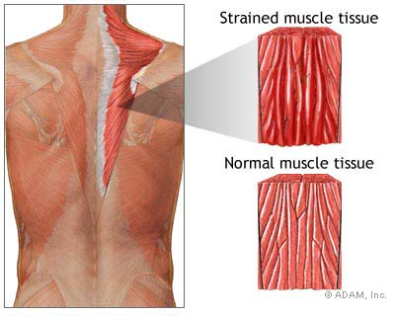
Musculus trapezius l. dx.
Distensio _________________
musculi trapezii lateris dextri
faciei
Excoriationes ________ (face), ________ (hand) l. utr. et ________ (knee)
manus
genus

Slide 14
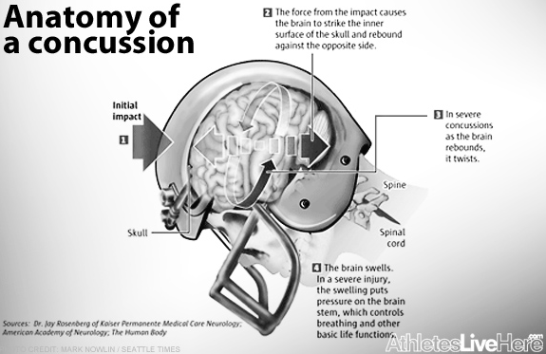
Commotio, onis, f.
concussion = a violent jarring or shaking that results in a disturbance of brain function

Slide 15
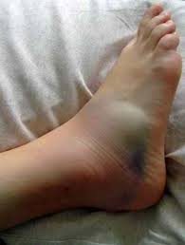
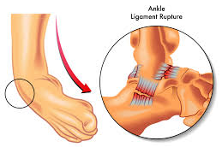
Distorsio, onis, f.
sprain, distorsion =a joint injury in which some of the fibers of a supporting ligament are ruptured but the continuity of the ligament remains intact

Slide 16
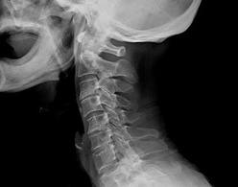
Susp. distorsionis columnae vertebralis partis cervicalis
Susp. = ?
suspicio = suspicion

Slide 17
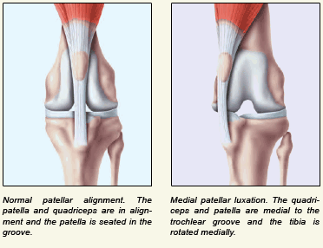
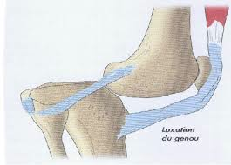
Luxatio, onis, f.
Luxation = displacement of a bone from a joint

Slide 18
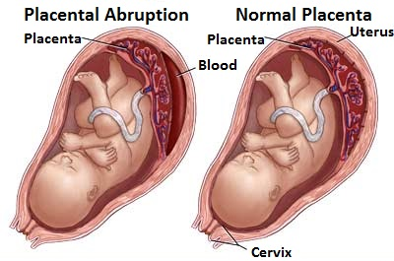
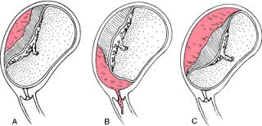
Abruptio, onis, f.
A tearing away, separation, or detachment
Placental abruption

Slide 19
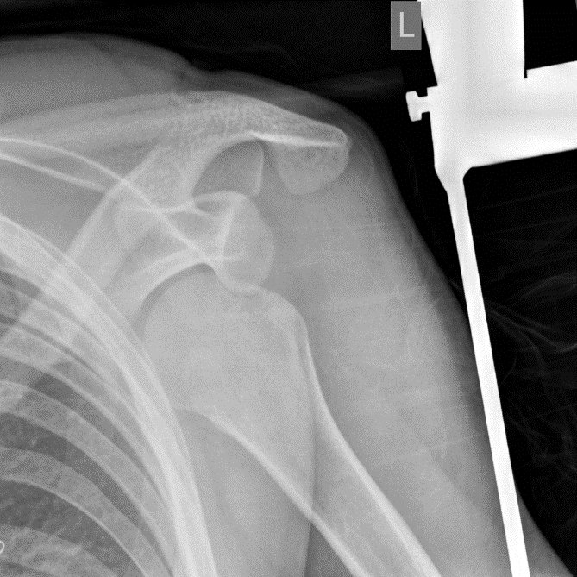
humeri | sinistri | fractura | luxatione | cum | lateris
PUT IN THE CORRECT ORDER
fractura humeri lateris sinistri cum luxatione

Slide 20
Combustio, onis, f.
burn wound

Slide 21
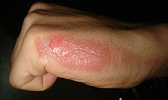
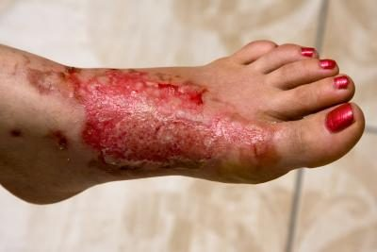
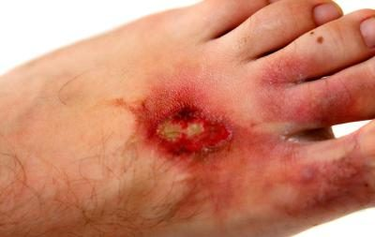
Combustio, onis, f.
2nd degree/grade burn
3rd degree/grade burn
infected burn wound
-change in the color of the skin around the burn, swelling, strange odor, the wound sinks deeper into the skin and gets larger, green or yellow pus develops, a fever

Slide 22
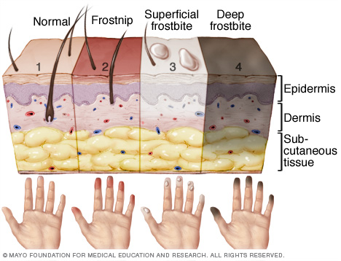
Congelatio, onis, f.
frostbite

Slide 23
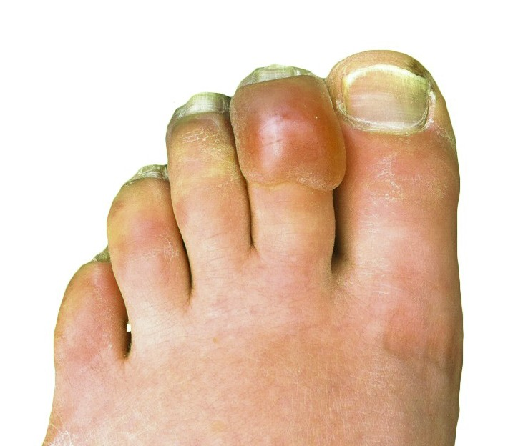
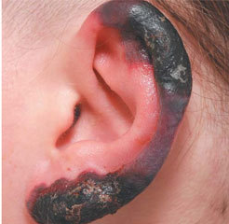
Congelatio, onis, f.

Slide 24
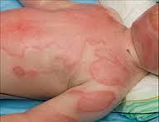
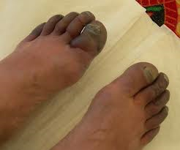
Combustio thoracis, cervicis et faciei
PLURAL?
combustiones thoracis, cervicis et faciei
Congelationes extremitatum inferiorum gr. IV.
WHAT DOES „GR. IV.“ MEAN?

