Slide 1
Tutorial in Basic Medical Terminology

Slide 2
Study materials
Teachers’ own materials (e.g. hand-outs, presentations, activity cards) which are going to be periodically uploaded on the IS in Study materials of your subject.
Prucklová, R. – Severová, M.: Introduction to Latin and Greek Terminology in Medicine. Praha: KLP, 2012 (Unit 1-7)
"Drill" on the IS (https://is.muni.cz/auth/dril/?lang=en )

Slide 3
Testing
Vocabulary tests at the beginning of each lesson
Two partial exams
each successfully written partial test (over 70 %) means that you get bonus 5 % for your final exam)
Credit test
70% required if you were not successful in any of the partial tests
65% required if you were successful in ONE of the partial tests
60% required if you were successful in BOTH partial tests

Slide 4
Testing
Students can sit the credit test in the 15th week (May 29-June 4, 2017), there are no exceptions to this whatsoever.
Resits of the credit test will take place only during the exam period, i.e. June 5 – July 9, 2017, or during the extended exam period, i.e. August 28 – September 10, 2017.
The number of possible credit test resits is two.
The dates and number of resits set by the teacher before the exam period is final, it means no other dates will be added during the exam period or later.

Slide 5
Testing
Results of the tests will be available to students in the Notebook on the IS.
The student’s results will be given in percentage together with the pass mark.
The student will have the access to his/her tests during guarantee’s office hours only.

Slide 6
Attendance
Absences are going to be electronically registered in the IS. In order to be sure you have been registered as present in the class, be punctual, the attendance is always checked immediately after the beginning of the class.
We can tolerate TWO unexcused absences only; all further absences have to be properly excused by the Study Department.
Unexcused absences are regularly recorded in the Notebook on the IS, and students having these records cannot sit the credit test.

Slide 7
Course objectives
The course will focus on basic latin grammar to help the studensts understand medical terminology
After passing final exam, the students will:
understand rules of creating Latin terms and to understand meaning of particular terms
create correct Latin terms (both from anatomical and clinical terminology)
master the vocabulary in a systematic way
understand the system in the terminology of anatomical structures ( = easier memorizing of the terms)

Slide 8
Latin pronunciation

Slide 9
Vowels
A | Ā | B | C | D | E | Ē | F | G | H | I | Ī | K | L | M | N
O | Ō | P | Q | R | S | T | U | Ū | V | X | Y | Y | Z
Vowels
Long Short
Ā (father) frāctūra A (cut) lingua
Ē (sad) artēria E (met) vertebra
Ī (intrigue) spīna I (intrigue) digitus
I (yes) > J
Ō (door) sensōrius O (on) skeleton
Ū (boom) ruptūra U (put) uterus
Y (analysis) hypophysis Y (lady) tympanum
Diphtongs
AE=Ē (care) anaemia
OE=Ē (care) lagoena
Greek words
OE (o-e) dyspnoe
EU (e-u) euthanasia

Slide 10
Read aloud
hypnosis
ala
olla
eupnoe
ileus
mucus
haematoma
iliacus
ossa
diploe
cubitus
venae
diameter
sacralis
ulcus
iris
sutura
sigmoideus
depressor
area
oesophagus
melior
meatus
leucocytus

Slide 11
Consonants
A | Ā | B | C | D | E | Ē | F | G | H | I | Ī | K | L | M | N
O | Ō | P | Q | R | S | T | U | Ū | V | X | Y | Ŷ | Z
Consonant/group of consonants | Pronunciation | Example
1: c + a, o, u, consonants c + ae, oe, e, i, y | [k] medical [ts] tsar | camera, costa, cultivatio, cranium caecus, coeliacia, centrum, circulatio, cynismus
2: ch | [x] loch | chirurgia, cholera

Slide 12
Consonants II
Consonant/group of consonants | Pronunciation | Example
3: g gu + vowel | [g] ground [gv] | gramma, gastritis lingua, sanguis
4: h | [h] house | herba, haematologia
5: j + vowel | [y] yes | iniectio/injectio, maior/major
6: p p + h | [p] present [f] physiology | pneumonia, pulmo phantasia, pharmacia
7: qu+ vowel | [kv] | aqua, quadriceps
8: r r+h | [r] rupture [r] | vertebra, ruptura rheuma, rhinitis

Slide 13
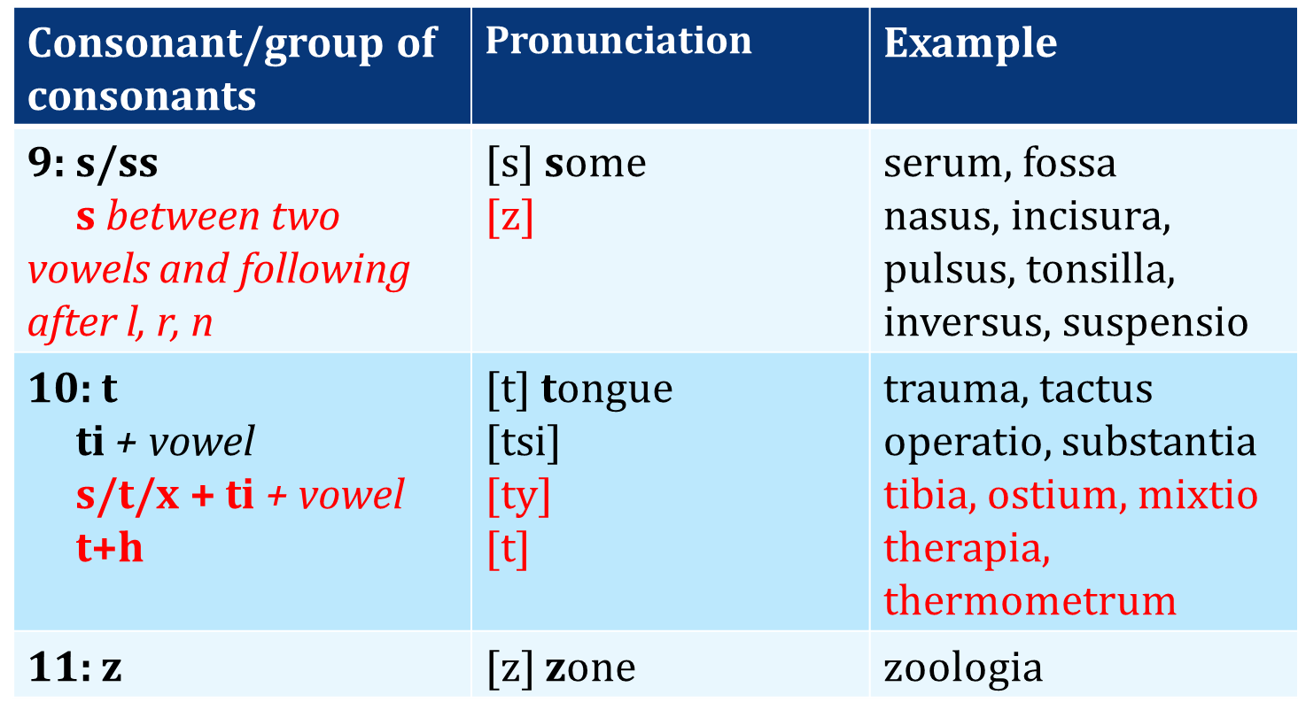
Consonants III

Slide 14
Read aloud
lingua, unguis, diameter obliqua, liquor cerebrospinalis, lobus quadratus hepatis
os nasale, medulla ossium, dorsum, ossa cranii, intestinum crassum, junctura fibrosa, membrana interossea antebrachii, musculus masseter, musculus risorius
aorta descendens, arteria comitans nervi ischiadici, articulatio sacrococcygea, intestinum caecum, tunica mucosa vesicae urinariae, fossa sacci lacrimalis, pectus, occiput
phalanx media, diaphragma, diaphysis, encephalon, os sphenoidale, hemispherium, kyphosis, sphincter, nephros, symphysis pubica
antebrachium, facies, atrium cordis dextrum, brachium sinistrum, endometrium, frenulum labii inferioris, impressio cardiaca, os hyoideum, promontorium
tonsillae palatinae, areae gastricae, arteria nutricia ulnae, cartilago tubae auditivae, meatus nasopharyngeus, membrana vitrea, musculus tensor fasciae latae, plicae palatinae transversae, sulcus glutealis, tunica mucosa tracheae

Slide 15
Grammatical categories

Slide 16
What will you find in the dictionary?
English words are presented in one single form
!!!Latin words are presented in three forms!!!
E.g.:
MUSCULUS, I, M. = MUSCLE
OS, OSSIS, N. = BONE
English translation
Main form
(full nominative)
Genitive ending/or even full Genitive form
Gender abbreviation
!CAUTION! ALL THREE FORMS are EQUALLY important for the future ability to use the noun in the context.

Slide 17
Gender
ENGLISH has 3 genders:
HE – refers to male humans and animals
SHE – refers to female humans and animals
IT – inanimate objects or animals
LATIN has 3 genders:
not only humans and animals, but also other objects are thought of as being:
masculine -> discipulus (he-student), musculus (muscle)
feminine -> discipula (she-student), vena (vein)
neutral -> corpus (body)
THERE IS NOTHING, WHICH COULD INDICATE THE GENDER TO YOU
YOU HAVE TO LEARN IT BY HEART
In Latin, adjectives change their form depending on the noun to which they refer
Without knowing noun’s gender you CANNOT attach a correct form of an adjective to it.

Slide 18
Genitive ending => Declension
Declensions are groups of nouns (or adjectives) using the same set of suffixes (=endings)
There are 5 declensions in Latin
Genitive ending is the only part of the word, which will indicate you its declension

Slide 19
Decide on the number of declension
0. corpus, oris, n.
cutis, is, f.
1. caput, itis, n.
2. capilli, orum, m.
3. facies, ei, f.
4. os, oris, n.
lingua, ae, f.
5. mentum, i, n.
6. axilla, ae, f.
7. brachium, ii, n.
8. cubitus, i, m.
9. antebrachium, ii, n.
10. carpus, i, m.
11. pollex, icis, m.
12. palma, ae, f.
13.,18. digitus, i, m.
14. sulcus, i, m.
15.,28. penis, is m.
16. femur, oris, n.
17. genu, us, n.
19. frons, frontis, f.
20. oculus, i, m.
21. nasus, i, m.
22. auris, is, f.
23. bucca, ae, f.
24. collum, i, n.
cervix, icis, f.
25. pectus, oris, n.
26. abdomen, inis, n.
27. hypogastrium, ii, n.
29. truncus, i, m.
30. manus, us, f.
31. crus, cruris, n.
32. tarsus, i, m.
talus, i, m.
33. pes, pedis, m.
34. hallux, ucis, m.
3
3
3
2
5
3
1
2
1
2
2
2
2
3
1
2
2
3
3
4
3
2
2
3
1
2
3
3
3
2
2
4
3
2
2
3
3

Slide 20
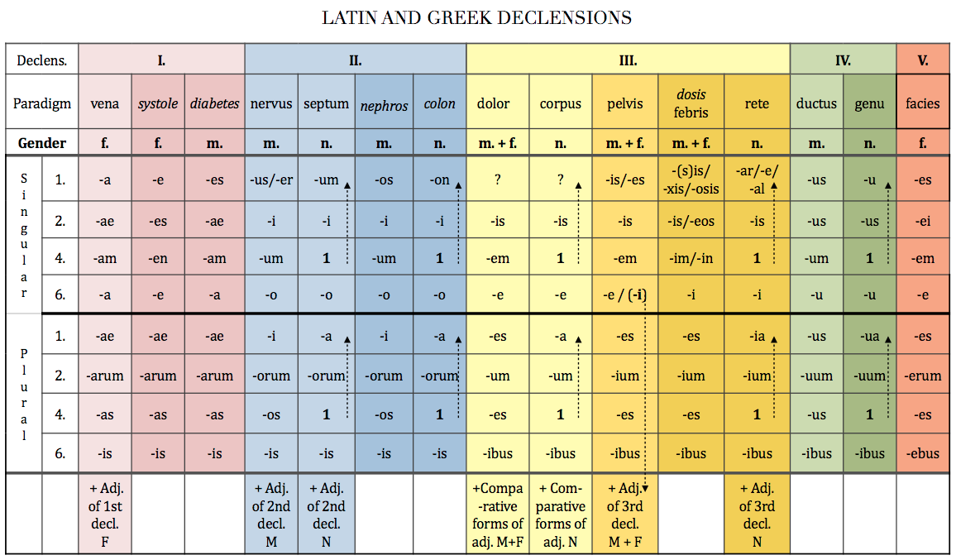

Slide 21
Genitive ending ⇒ stem of a word
A stem is a form to which endings can be attached
In some declensions (1st, 4th, 5th, and in majority of cases also 2nd) the nominative and genitive forms of the word have identical stem
In some declensions (3rd, partially 2nd) word’s stem can greatly different
WE NEED TO REMOVE THE GENITIVE ENDING IN ORDER TO GAIN THE GENITIVE STEM
ven-a
ven-ae
humer-us
humer-i
diamet-er
diametr-i
dol-or
dolor-is
corp-us
corpor-is
de-ns
dent-is
arc-us
arc-us
gen-u
gen-us
faci-es
faci-ei

Slide 22
Decide what is the stem of the noun
ex: caput, capit-is
skeleton, skeleti
os, ossis
cranium, cranii
orbita, orbitae
collum, colli
cervix, cervicis
thorax, thoracis
costa, costae
discus, disci
processus, processus
vertebra, vertebrae
pelvis, pelvis
coxa, coxae
ilia, ilium
coccyx, coccygis
ischium, ischii
pubes, pubis
symphysis, symphysis
nasus, nasi
dens, dentis
mandibula, mandibulae
clavicula, claviculae
scapula, scapulae
sternum, sterni
humerus, humeri
arcus, arcus
radius, radii
ulna, ulnae
metacarpus, metacarpi
carpus, carpi
phalanx, phalangis
femur, femoris
patella, patellae
tibia, tibiae
fibula, fibulae
metatarsus, metatarsi

Slide 23
Latin – inflectional language
In many languages, Latin and Greek among them, nouns inflect (change their form) for number and for case.
Inflection for number involves singular (sg.) : plural (pl.) forms (eg. forearm : forearms, antebrachium : antebrachia) and is present in English as well.
Inflection for case involves changing the form of the noun according to its syntactic function/meaning. Latin has extensive case system in which a special form is used for every specific meaning. In medical terminology we use 4 out of 6 Latin cases to express the following meanings:

Slide 24
Cases and their meanings
LATIN
system of specific case endings + prepositions
1. NOMINATIVE – subject (ending)
2. GENITIVE – dependency of two nouns, possession (ending)
4. ACCUSATIVE – object, movement (preposition + ending)
6. ABLATIVE – place, location, instrument, cause (preposition + ending)
ENGLISH
prepositions or word order
subject of the sentence
of
object of the sentence
by, with, to, because of...
In medical terminology ACCUSATIVE and ABLATIVE cases are used ONLY AFTER the PREPOSITION.
NOMINATIVE and GENITIVE NEVER appear AFTER a PREPOSITION

Slide 25
ONLY ACCUSATIVE (4TH CASE) AND ABLATIVE (6TH CASE)APPEAR AFTER A PREPOSITION

Slide 26
Introduction to syntax NOUN IN APPOSITION I.
noun + noun < GENITIVE
Translated: using of
Meaning: state of dependency, possession
EX: Fractura costae //fractura costarum
Fracture of rib Fracture of ribs
! = rib fracture = rib fractures

Slide 27
Connect two nouns
ex: caput + costa > caput costae head of rib
caput + femur ->
caput + fibula ->
caput + humerus ->
caput + phalanx ->
caput + radius ->
caput + talus ->
caput + ulna ->
caput femoris
caput fibulae
caput humeri
caput phalangis
caput radii
caput tali
caput ulnae

Slide 28
Adjectives of the 1st and 2nd declension, dictionary entry
Magnus, a, um
Magnus magna magnum
m. f. n.
coxa cervix
oculus sulcus
crus arcus
bucca metatarsus
fibula hallux
Dexter, a, um
Dexter dextra dextrum
m. f. n.
coxa cervix
oculus sulcus
crus arcus
bucca metatarsus
fibula hallux

Slide 29
Find all the adjectives
vena, ae, f.
periculum, i, n.
fractura, ae, f.
suspicio, onis, f.
thorax, cis, m.
fractus, a, um
dies, ei, m.
pulsus, us, m.
hepaticus, a, um
arcus, us, m.
thoracicus, a, um
hepar, tis, n.
rete, is, n.
planus, a, um
caesareus, a, um
diameter, tri, f.
caries, ei, f.
ruptus, a, um
flexor, oris, m.
bonus, a, um

Slide 30
Find all the adjectives
vena, ae, f.
periculum, i, n.
fractura, ae, f.
suspicio, onis, f.
thorax, cis, m.
fractus, a, um
dies, ei, m.
pulsus, us, m.
hepaticus, a, um
arcus, us, m.
thoracicus, a, um
hepar, tis, n.
rete, is, n.
planus, a, um
caesareus, a, um
diameter, tri, f.
caries, ei, f.
ruptus, a, um
flexor, oris, m.
bonus, a, um

Slide 31
Agreed-attribute What is the correct adjective for the noun in the triangle?
dextra
dextrum
dexter
dextrum
genu
orbita
pes
dexter
dextrum
dextra
dextra
dexter

Slide 32
Structure of multi-word medical terms
two-word terms:
noun + adjective in nominative singular:
costa vera (true rib); fibula fracta (broken calf-bone)
noun in nominative + noun in genitive (second noun is usually translated into english using „of“)
spina scapulae (spine of shoulderblade); fractura fibulae (fracture of calf bone)
noun in nominative + noun following a preposition
ACC: medicamentum contra dolorem (remedy against pain)
ABL: medicamentum pro adultis (remedy for adults)
multi-word terms combining these types in various ways
status post fracturam colli femoris sinistri cum dislocatione
state after a fracture of the neck of the left femur with a dislocation
extractio dentis canini propter cariem profundam cum anaesthesia locali
extraction of canine tooth because of deep dental decay with local anesthesia

Slide 33
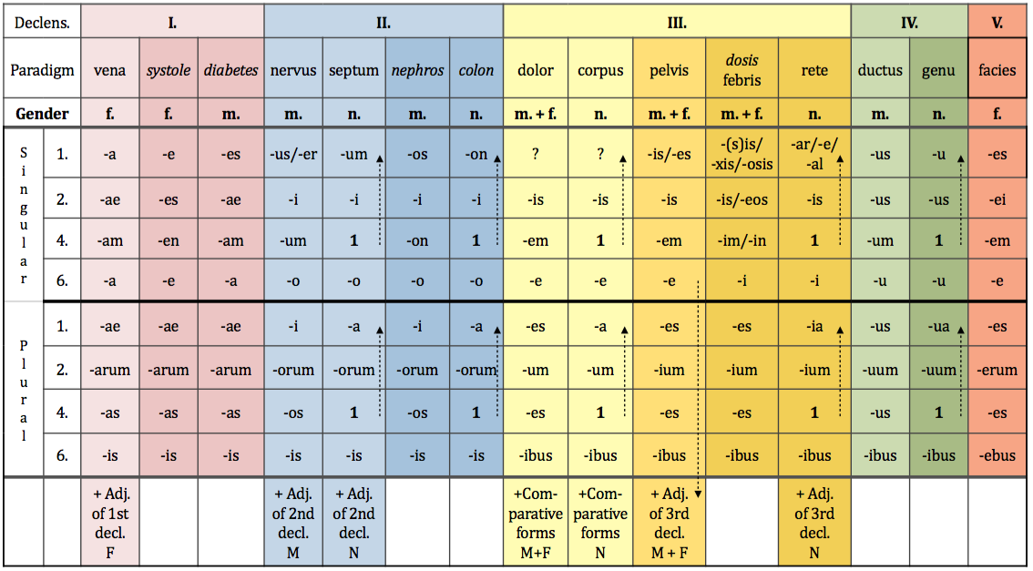
1st Latin declension

Slide 34
1st Latin declension
Example word: vēna, ae, f.
case | singular | plural
nom. | vēna | vēnae
gen. | vēnae | vēnarum
ak. | vēnam | vēnas
abl. | vēnā | vēnis

Slide 35
1st Greek declension
In the first declension we decline nouns that have:
Genitive sg. ending | -ES | -AE
Nominative sg. ending | -E | -ES
Gender | F | M

Slide 36
1st Greek declension

Slide 37
1st Greek declension
 | systole, es, f | diabetes, ae, m.
nom. sg. | systole | diabetes
gen. sg. | systoles | diabetae
ak. sg. | systolen | diabetam
abl. sg. | systole | diabeta
All nouns infleced like systole, es, f. are of feminine gender.
All nouns inflectted like diabetes, ae, m. are of masculine gender.
Paradigms vena, systole and diabetes have identical endings in plural.

Slide 38
1st Greek declension

Slide 39
Feminine form of adjectives ending in US, A, UM / ER, A, UM

Slide 40
Homework
learn 1st declension by heart
revise/learn terms for grammatical categories
revise/learn vocabulary from handouts 1.1, 2 and 3
revise prepositions – see pdf file PREPOSITIONS
translate into Latin following slide:

Slide 41
Translate
complicated fracture of right shinbone
rupture of coronary artery
congenital anomaly of vertebral column (literally: column of vertebrae)
after angina
cause of acute dyspnea
mucous membrane of gall bladder
fracture of the fourth coccygeal vertebra
congenital insufficiency of eustachian tube
treatment of chronic allergy

