Slide 1
Latin nouns of the 4th and 5th declension
-U- and -E- stems

Slide 2
4th declension
genitive singular ending -ūs
mostly of masculine gender: -us/-ūs
paradigm word: ductus = duct
There are 2 nouns that have ablative plural ending -ubus:
arcus, us, m. = bow
artus, us, m. = member, joint
 | singular | plural
nom. | duct-us | duct-ūs
gen. | duct-ūs | duct-uum
ak. | duct-um | duct-ūs
abl. | duct-ū | duct-ibus
There are only few exceptions of feminine gender:
manus, ūs, f. -hand
acus, ūs, f. -needle
names of trees

Slide 3
Decide on the declension of the nouns
tractus, us, m.
musculus, i, m.
corpus, corporis, n.
ulcus, eris, n.
manus, us, f.
visus, us, m.
nervus, i, m.
methodus, i, f.
crus, cruris, n.

Slide 4
4th declension - neuters
genitive singular ending -ūs
paradigm word: genū = knee
In the 4th declension there are only two neuters:
genu, us, n = knee
cornu, us, n. = horn
 | singular | plural
nom. | gen-ū | gen-ua
gen. | gen-ūs | gen-uum
ak. | gen-ū | gen-ua
abl. | gen-ū | gen-ibus

Slide 5
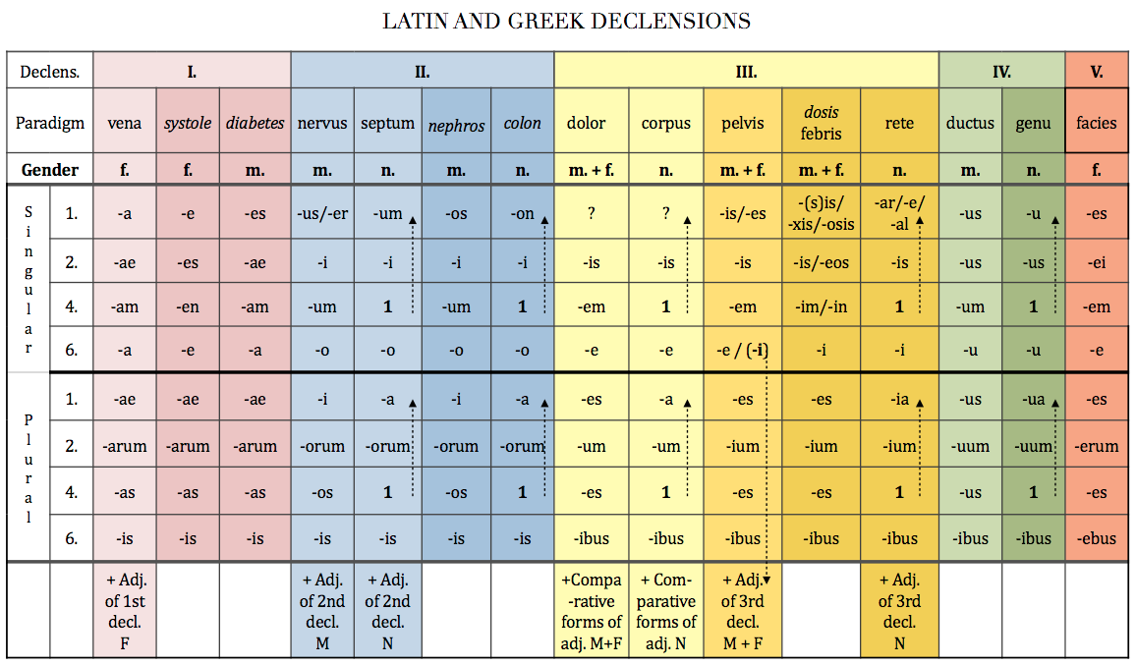

Slide 6
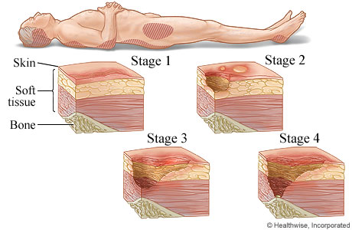
decubitus profundus

Slide 7
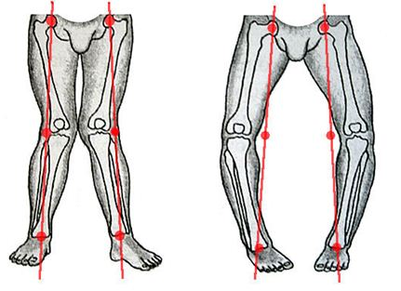
genua valga genua vara

Slide 8
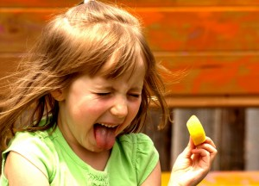
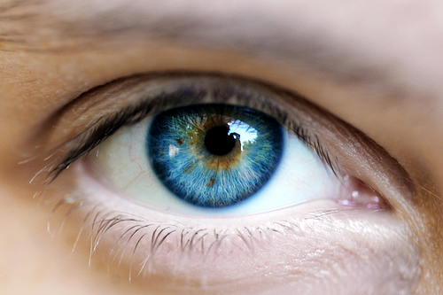
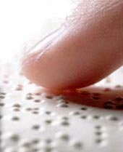
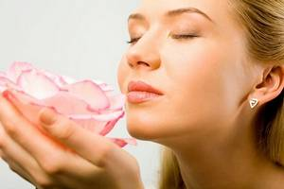
Sensus humani:
gustus ~ visus ~ tactus ~ auditus ~ olfactus
1
2
3
5
4

Slide 9
5th declension
genitive singular ending -ei
paradigm word: faciēs = face, front part
all the nouns of the 5th declension are of feminine gender
 | singular | plural
nom. | faci-ēs | faci-ēs
gen. | faci-ēī | faci-ērum
ak. | faci-em | faci-ēs
abl. | faci-ē | faci-ēbus
SG: speciēs, speciēī f. =species X PL: speciēs urologicae =mixture of dried plants

Slide 11
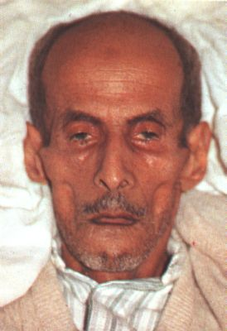
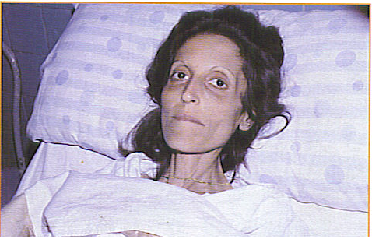
The facial expression produced in the by impending death or long illness (accompanied by pain), excessive evacuations, excessive hunger, and the like, e.g.by peritonitis (inflammation of peritoneum) or cholera. Its synonym is facies abdominalis.
The nose is sharp, the eyes sunken, the temples fallen in, the ears cold and drawn in and their lobes distorted, the skin of the face hard, stretched and dry, and the colour of the face pale or dusky.
facies Hippocratica / facies abdominalis

Slide 12
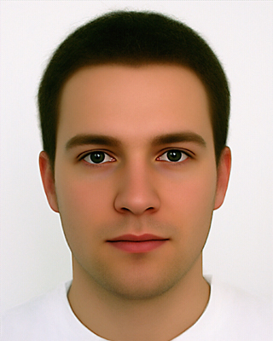
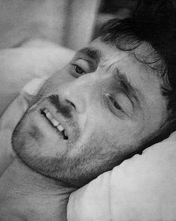
facies composita – normal, calm facial expression of healthy person
facies dolorosa – facial expression showing signs of pain

Slide 13
Connect the nouns with adjectives
infarctus spinosus, a, um
partus dolorosus, a, um
plexus valgus, a, um
processus venosus, a, um
usus praematurus, a, um
decubitus Hippocraticus, a, um
genu acutus, a, um
facies externus, a, um

Slide 14
Form corresponding loose atributes
articulatio (genu + dexter, tra, trum)
Articulatio genus dextri
arcus (vertebrae + thoracici, ae, a)
Arcus vertebrarum thoracicarum
causa (obstructio venae)
Causa obstructionis venae
ligamenta (manus + sinister, tra, trum)
Ligamenta manus sinistrae
effectus (gargarisma + novus, a, um)
Effectus gargarismatis novi
sanatio (decubitus + profundus, a, um)
Sanatio decubitus profundi
collapsus (systema + circulatorius, a, um)
Collapsus systematis circulatorii
status (canities + praematurus, a, um)
Status canitiei praematurae
Unit 6, task 5

Slide 15
Connect the phrases with the preposition
post + infarctus acutus
Post infarctum acutum
propter + partus praematurus
propter partum praematurum
sub +plexus venosus uterinus
Sub plexu venoso uterino / sub plexum venosum uterinum
in + decursus morbi
In decursu morbi
ad + usus internus
Ad usum internum
ante + processus spinosus
Ante processum spinosum
sine + effectus malus
Sine effectu malo
Unit 6, task 6

