Slide 1


XXII. Measurement of basal metabolic expenditure (BME) using indirect calorimetry
XXIII. Calculation of energy expenditure
© Department of Physiology
Faculty of Medicine
Masaryk University
2016
M. Bébarová

Slide 2


direct and indirect calorimetry
metabolic expenditure: basal vs. resting
basal conditions
catabolism/anabolism
energy balance
nitrogen balance
energetic equivalent of oxygen

Slide 3
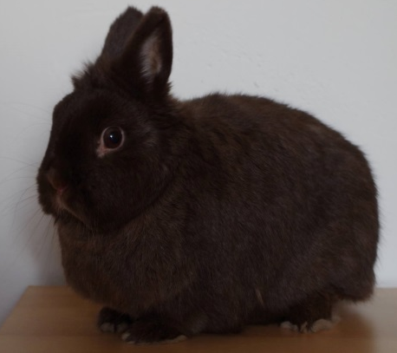
Direct calorimetry
Works on presumption that all metabolic actions are accompanied by heat production
Technically demanding
In practice,
often not used
Air in
Air out
Water
Heat insulation

Slide 4
Indirect calorimetry
Works on presumption that consumption of oxygen, CO₂ production and nitrate metabolites waste correspond to the energetic output
Open or closed cycle setup
In practicals: closed system setup using Krogh respirometer (CO₂ is absorbed by filter)

Slide 5
Caloric (energetic) equivalent of oxygen (EE)
= amount of energy released during consumption of 1 L of oxygen:
For mixed diet:
EE = 20.19 kJ/L O₂
EE of nutrients:
Glucose 21,4 kJ / litr O₂
Proteins 18,8 kJ / litr O₂
Lipids 19,6 kJ / litr O₂

Slide 6
Combustion heat
Total energy released as heat when a 1 g of substance undergoes complete combustion with oxygen
physical combustion heat - energy is produced by burning the substrate
physiological combustion heat - energy produced by the oxidation of the substrate by a living organism
carbohydrates and lipids: physiological = physical combustion heat
proteins: physical > physiological combustion heat
(burning of proteins products nitrogen oxides, the metabolism of proteins products urea, which contains rezidual amount of chemical energy)
carbohydrates 17,1 kJ/g
lipids 38,9 kJ/g
physical combustion heat of proteins 23 kJ/g
physiological combustion heat of proteins 17,1 kJ/g

Slide 7
Metabolism
set of life-sustaining chemical transformations within the cells of living organisms
catabolism: set of metabolic pathways that breaks down molecules into smaller units that are either oxidized to release energy, or used in other anabolic reactions
anabolism: set of metabolic pathways that construct molecules from smaller units, theese reactions require energy

Slide 8
Nitrogen balance
= nitrogen intake (proteins, aminoacides) –
nitrogen loss (urine)
positive (nitrogen intake > nitrogen loss)
  growth, pregnancy, tissue repair
negative (nitrogen loss > nitrogen intake)
  burns, serious tissue injuries, fevers, hyperthyroidism, wasting diseases, and during long periods of fasting

Slide 9
Basal metabolism
Energetic expenditure of organism established in defined (basal) conditions:
Thermoneutral environment
12-18 hours after the last meal containing proteins
Psychological and social well-being, optimally in the morning before leaving the bed
Despite the preserving of the conditions, the obtained value of basal energetic expenditure is only an estimate of the real energy associated with basal metabolism

Slide 10
Actual energy expenditure (AEE)
at rest
at standing
after workload
estimate the oxygen consumption (l/s)
correct the measured values to 0 °C and 101,325 kPa (for the formula see Physiology and Neuroscience Practicals, 2013 – page 87)
calculate AEE (kJ/s, kJ/day)
explain differences in AEE observed in different conditions

Slide 11
Calculation of energy expenditure
basal energy expenditure (BEE)
according to Harris-Benedict formula (Physiology and Neuroscience Practicals, 2013 – page 89)
kcal/day - transform to kJ/day (1 kcal = 4.18 kJ)
actual energy expenditure (AEE)
may be calculated based on:
BEE
AF (activity factor)
TF (temperature factor)
IF (injury factor)

